Slide 1
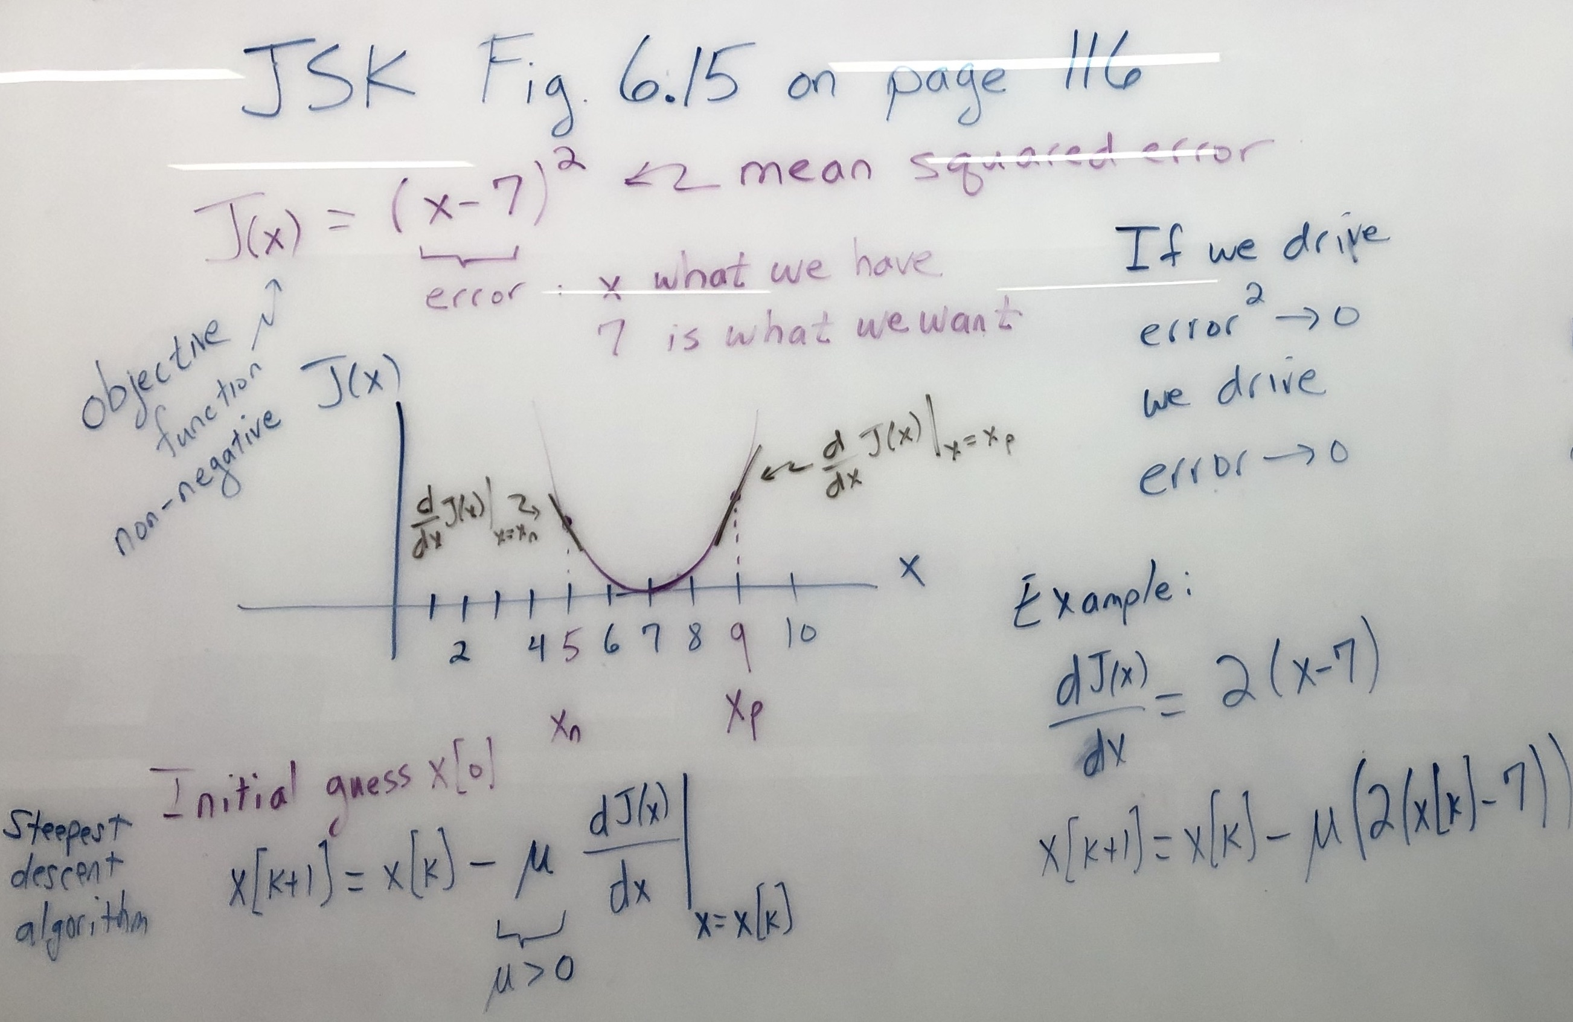
In-Lecture #3 Assignment
Steepest Descent Derivation

Slide 2
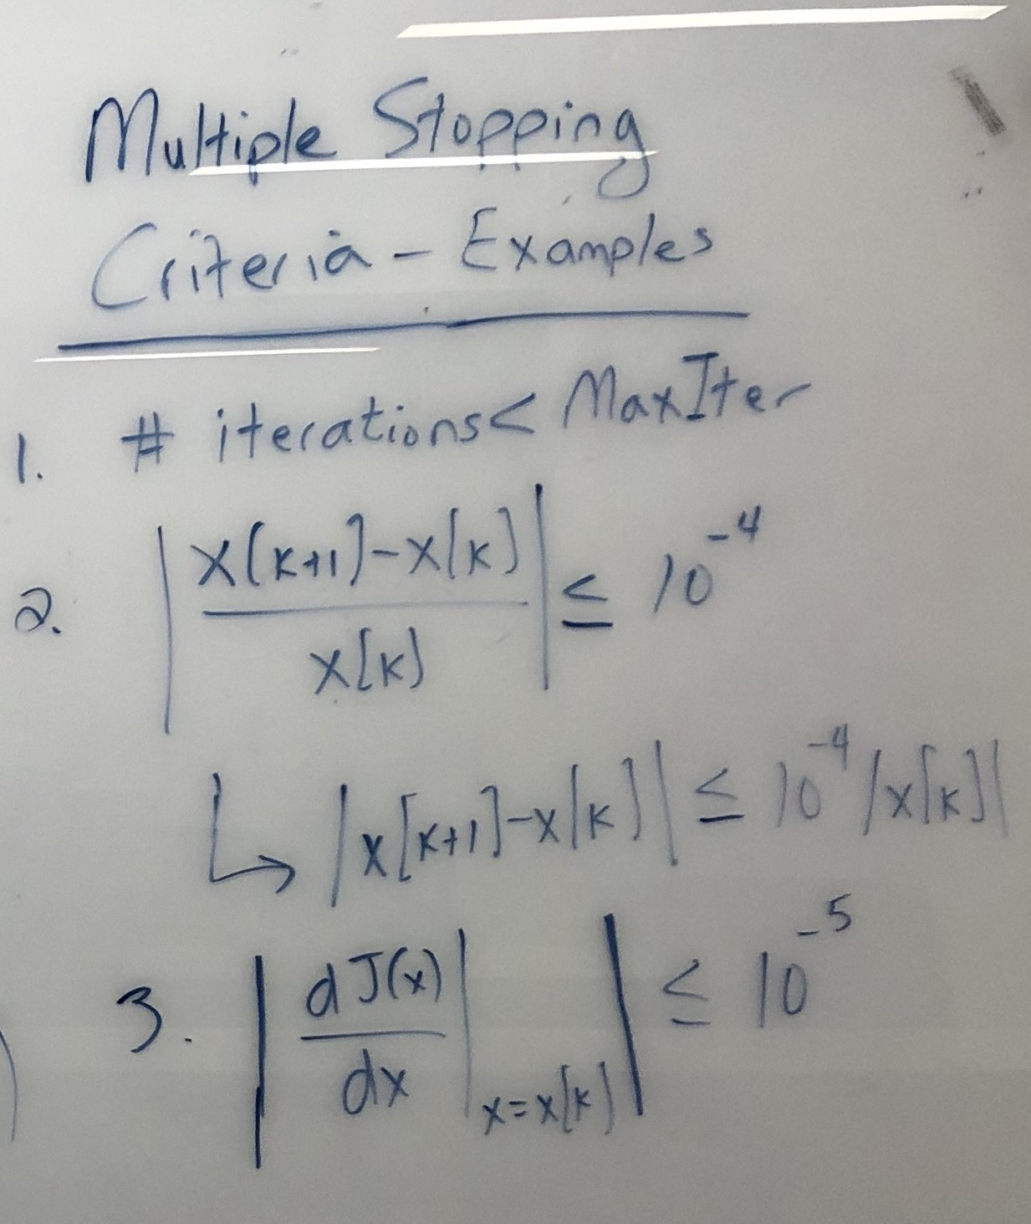
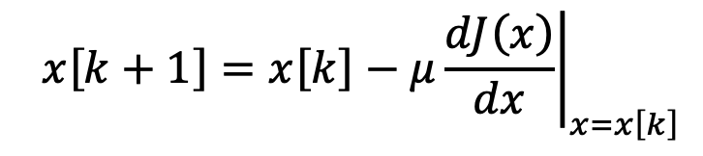
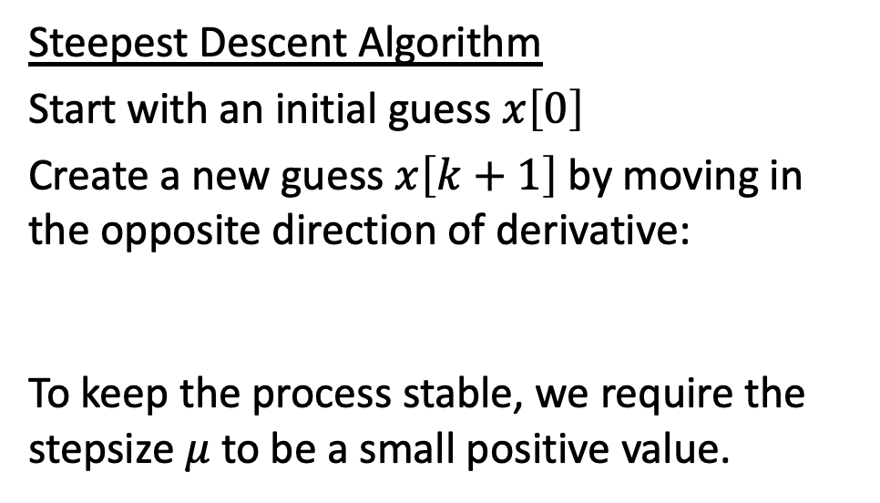
Steepest Descent Algorithm
Start with an initial guess $x\left[0\right]$
Create a new guess $x\left[k+1\right]$ by moving in the opposite direction of derivative:
To keep the process stable, we require the stepsize $μ$ to be a small positive value.
For J(x) = (x – 7)², the first derivative is
J’(x) = 2(x – 7), and the update becomes
This is a first-order IIR filter with output x[k+1] and input 14μ u[k].
Real-valued pole location at 1-2μ. For BIBO stability, -1 < 1-2μ < 1 which is 0 < μ < 1.
UT Austin EE 445S Real-Time DSP Lab Prof. Brian L. Evans Spring 2021

