Slide 1
Interpolation and Pulse Shaping

Slide 2
Outline
Discrete-to-continuous conversion
Interpolation
Pulse shapes
Rectangular
Triangular
Sinc
Raised cosine
Sampling and interpolation demonstration
Conclusion

Slide 3
Data Conversion
Analog-to-Digital Conversion
Lowpass filter has stopband frequency less than ½ f_{s} to reduce aliasing due to sampling (enforce sampling theorem)
Digital-to-Analog Conversion
Discrete-to-continuous conversion could be as simple as sample and hold
Lowpass filter has stopband frequency less than ½ f_{s} to reduce artificial high frequencies
Lecture 4
Lecture 8
Analog Lowpass Filter
Quantizer
Sampler at sampling rate of f_{s}
Lecture 7
Discrete to Continuous Conversion
Analog Lowpass Filter
f_{s}

Slide 4
Discrete-to-Continuous Conversion
Input: sequence of samples y[n]
Output: smooth continuous-time function obtained through interpolation (by “connecting the dots”)
If f₀ < ½ f_{s} , then would be converted to
Otherwise, aliasing has occurred, and the converter would reconstruct a cosine wave whose frequency is equal to the aliased positive frequency that is less than ½ f_{s}
3
4
5
6
7
n
1
2

Slide 5
Discrete-to-Continuous Conversion
General form of interpolation is sum of weighted pulses
Sequence y[n] converted into continuous-time signal that is an approximation of y(t)
Pulse function p(t) could be rectangular, triangular, parabolic, sinc, truncated sinc, raised cosine, etc.
Pulses overlap in time domain when pulse duration is greater than or equal to sampling period T_{s}
Pulses generally have unit amplitude and/or unit area
Above formula is related to discrete-time convolution

Slide 6
Interpolation From Tables
Using mathematical tables of numeric values of functions to compute a value of the function
Estimate f(1.5) from table
Zero-order hold: take value to be f(1) to make f(1.5) = 1.0 (“stairsteps”)
Linear interpolation: average values of nearest two neighbors to get f(1.5) = 2.5
Curve fitting: fit four points in table to polynomal a₀ + a₁ x + a₂ x² + a₃ x³ which gives f(1.5) = x² = 2.25
x | f(x)
0 | 0.0
1 | 1.0
2 | 4.0
3 | 9.0
9
4
1
x
0
1
2
3

Slide 7
Rectangular Pulse
Zero-order hold
Easy to implement in hardware or software
The Fourier transform is
In time domain, no overlap between p(t) and adjacent pulses p(t - T_{s}) and p(t + T_{s})
In frequency domain, sinc has infinite two-sided extent; hence, the spectrum is not bandlimited
p(t)
1
-½ T_{s}
½ T_{s}
t

Slide 8
Sinc Function
Even function (symmetric at origin)
Zero crossings at
Amplitude decreases proportionally to 1/x
sinc(x)
1
x
−3π
−2π
−π
0
π
2π
3π

Slide 9
Triangular Pulse
Linear interpolation
It is relatively easy to implement in hardware or software, although not as easy as zero-order hold
Overlap between p(t) and its adjacent pulses p(t - T_{s}) and p(t + T_{s}) but with no others
Fourier transform is
How to compute this? Hint: Triangular pulse is equal to 1 / T_{s} times the convolution of rectangular pulse with itself
In frequency domain, sinc²(f T_{s}) has infinite two-sided extent; hence, the spectrum is not bandlimited
p(t)
1
-T_{s}
T_{s}
t

Slide 10
Sinc Pulse
Ideal bandlimited interpolation
In time domain, infinite overlap between other pulses
Fourier transform has extent f ∈ [-W, W], where
P(f) is ideal lowpass frequency response with bandwidth W
In frequency domain, sinc pulse is bandlimited
Interpolate with infinite extent pulse in time?
Truncate sinc pulse by multiplying it by rectangular pulse
Causes smearing in frequency domain (multiplication in time domain is convolution in frequency domain)

Slide 11
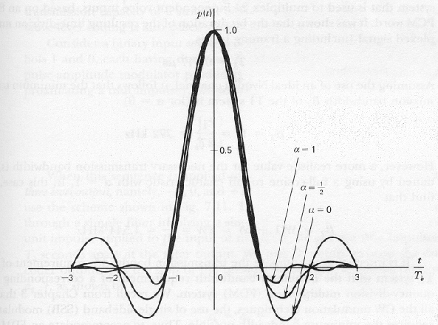
Raised Cosine Pulse: Time Domain
Pulse shaping used in communication systems
W is bandwidth of an ideal lowpass response
α ∈ [0, 1] rolloff factor
Zero crossings at t = ± T_{s} , ± 2 T_{s} , …
See handout G in reader on raised cosine pulse
ideal lowpass filter impulse response
Attenuation by 1/t² for large t to reduce tail

Slide 12
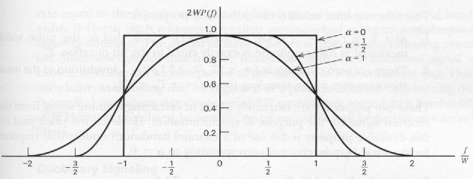
Raised Cosine Pulse Spectra
Pulse shaping used in communication systems
Bandwidth increased by factor of (1 + α): (1 + α) W = 2 W – f₁
f₁ marks transition from passband to stopband
Bandwidth generally scarce in communication systems

Slide 13
Sampling and Interpolation Demo
DSP First, Ch. 4, Sampling and interpolation, http://www.ece.gatech.edu/research/DSP/DSPFirstCD/
Sample sinusoid y(t) to form y[n]
Reconstruct sinusoid using rectangular, triangular, or truncated sinc pulse p(t)
Which pulse gives the best reconstruction?
Sinc pulse is truncated to be four sampling periods long. Why is the sinc pulse truncated?
What happens as the sampling rate is increased?

Slide 14
Conclusion
Discrete-to-continuous time conversion involves interpolating between known discrete-time samples y[n] using pulse shape p(t)
Common pulse shapes
Rectangular for same-and-hold interpolation
Triangular for linear interpolation
Sinc for optimal bandlimited linear interpolation but impractical
Truncated raised cosine for practical bandlimited interpolation
Truncation causes smearing in frequency domain
3
4
5
6
7
n
1
2

