Slide 1
EE 445S Real-Time Digital Signal Processing Lab Fall 2013
Lab #3.1 Digital Filters
Chao Jia
Notes:
1

Slide 2
Outline
Discrete-Time Convolution
FIR Filter Design
Convolution Using Circular Buffer
FIR Filter Implementation
2
Notes:
2

Slide 3
Discrete-Time Convolution
Represented by the following equation
Filter implementations will use the second version (hold h[n] in place and flip-and-slide x[n] about h[n])
Z-transform of convolution
for z є ROC(X) ∩ ROC(H)
3
Notes:
3

Slide 4
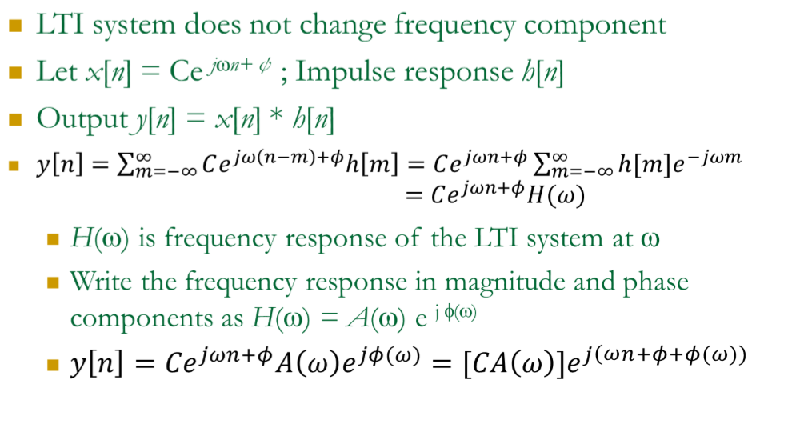
DT Convolution Sinusoidal Response
4
Notes:
4

Slide 5
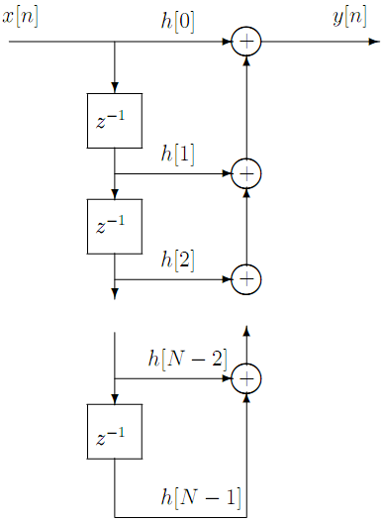
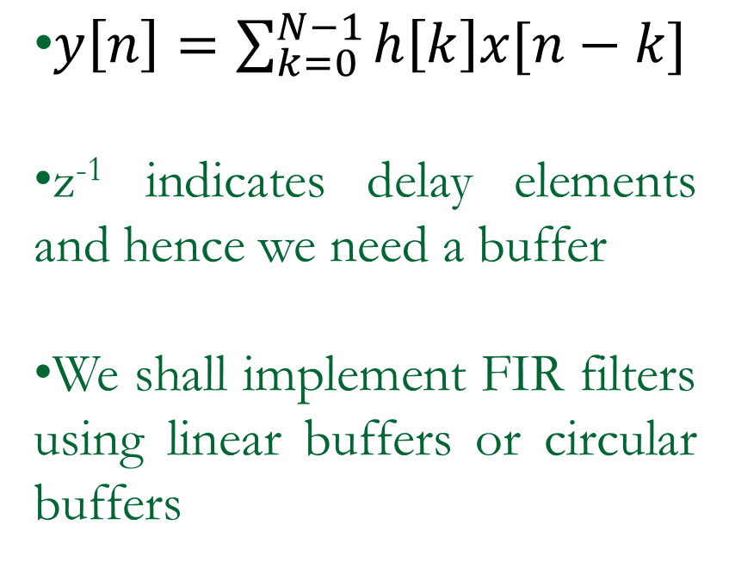
FIR Filters Design & Implementation
An FIR filter does discrete-time convolution
5
Notes:
5

Slide 6
FIR Filters Design & Implementation
Design
Use the Filter Design & Analysis Tool (fdatool) to obtain the filter co-efficients
Specifications given in the task list
Write convolution function to implement FIR filter given coefficients from fdatool
6
Notes:
6

Slide 7
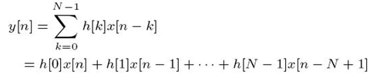
Linear buffer
How to get output
If we want to calculate the output y[n]
Now x[n+1] is entered and we want y[n+1]
Store the newest sample at the beginning, shift all the elements in the array to right and discard the oldest one
h[0] | h[1] | h[2] | …… | h[N-3] | h[N-2] | h[N-1]
x[n] | x[n-1] | x[n-2] | …… | x[n-N+3] | x[n-N+2] | x[n-N+1]
h[0] | h[1] | h[2] | …… | h[N-3] | h[N-2] | h[N-1]
x[n+1] | x[n] | x[n-1] | …… | x[n-N+4] | x[n-N+3] | x[n-N+2]

Slide 8
Circular buffer
If we want to calculate the output y[n]
Now x[n+1] is entered and we want y[n+1]
Only need an index to point where the newest sample is
Modify the index modulo L (L is the length of the sample buffer) when new sample is entered.
x[n-N+1] | x[n] | x[n-1] | …… | x[n-N+4] | x[n-N+3] | x[n-N+2]
oldest | newest | Newest +1
x[n+1] | x[n] | x[n-1] | …… | x[n-N+4] | x[n-N+3] | x[n-N+2]
newest | Newest +1 | Newest +2 |  |  |  | oldest

Slide 9
Circular buffer
In this way, samples are written into the array in a circular fashion
For the length of circular buffer L:
Always choose it to be larger than N.
Make sure that L is a power of 2 (for hardware circular buffering)
(C6748 DSP requires the size of the circular buffer to be a power of 2)

Slide 10
Convolution Using Circular Buffer
main()
{
int x_index = 0;
float y, xcirc[N];
---
---
/*--------------------------------------------*/
/* circularly increment newest (No %)*/
++newest;
if(newest == N) newest = 0;
/*-------------------------------------------*/
/* Put new sample in delay line. */
xcirc[newest] = newsample;
/*-------------------------------------------*/
/* Do convolution sum */
Go on to the next column →
→ y = 0;
x_index = newest
for (k = 0; k < No_of_coeff; k++)
{
y += h[k]*xcirc[x_index];
/*-------------------------------------*/
/* circularly decrement x_index */
--x_index;
if(x_index == -1) x_index = N-1;
/*-------------------------------------*/
}
...
}
10
Notes:
10

Slide 11
Task List
1. Run winDSK and applications “Graphic Equalizer” and “Notch Filter”
2. Design FIR filters with fdatool in Matlab
3. Implement convolution with linear buffer
4. Implement convolution with circular buffer
5. Compare the theoretical and experimental magnitude response
11
Notes:
11

