Slide 1
EE 445S Real-Time Digital Signal Processing Lab Fall 2013
Lab 3 IIR Filters
Chao Jia
Debarati Kundu
Andrew Mark
Notes:
1

Slide 2
Outline
IIR Filters DF-I and Implementation
IIR Filter DF-II and Implementation
IIR Filter SOS and Implementation
2
Notes:
2

Slide 3
IIR Filters
IIR Filters can be represented as
Its time domain equivalent is
This is called “Direct Form” since the multiplier coefficients in the difference equation are precisely the coefficients of the transfer function.
3
Notes:
3

Slide 4
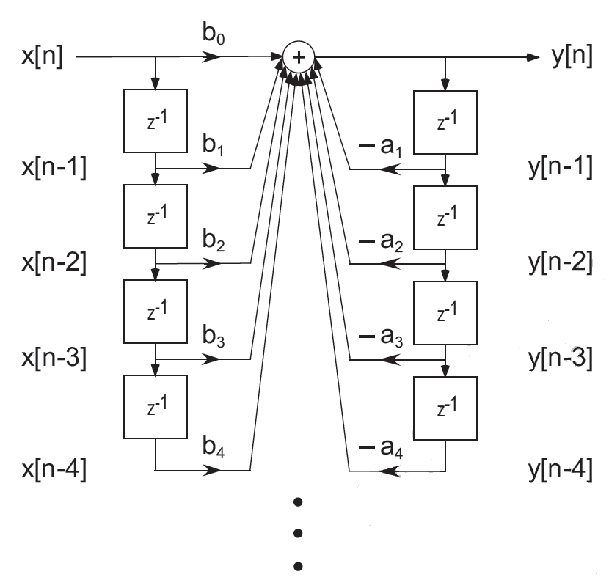
IIR Filters DF-I Implementation
Compute y[n]
Update state variables
4
Notes:
4

Slide 5
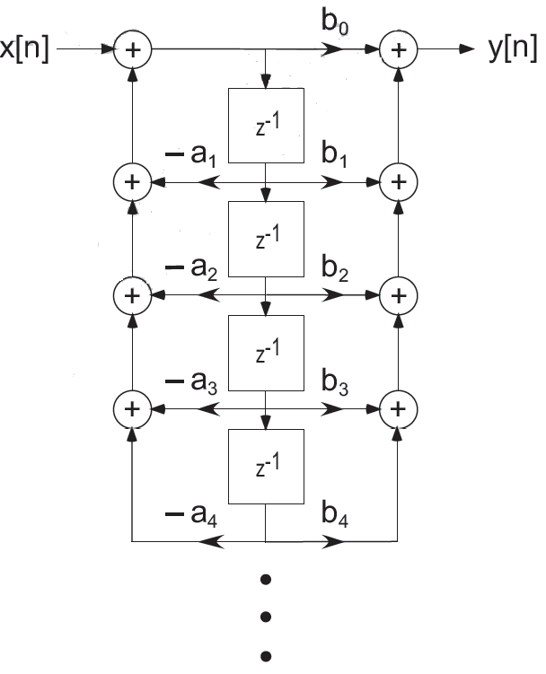
IIR Filters DF-II Implementation
Compute v[n]
Compute y[n]
Update state variables
5
Notes:
5

Slide 6
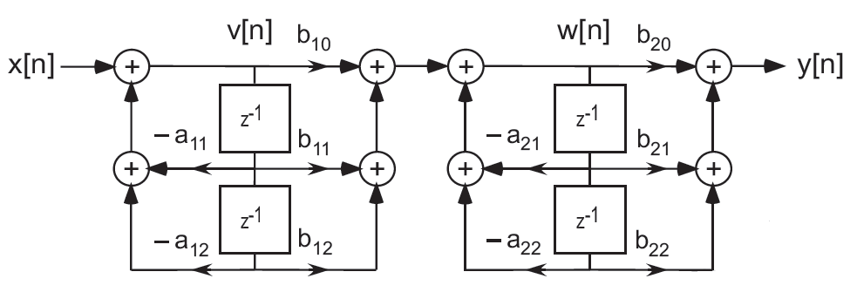
IIR Filters SOS Implementation
A cascade of second order sections (SOS).
Each section is just a second order IIR filter, also called as biquad.
6
Notes:
6

Slide 7
Discrete-Time IIR Biquad
For poles at , where is the pole radius (r < 1 for stability), with y = –2 a:
Real poles:
Q = ½
h[n] = C₀ a^{n} u[n] + C₁ n a ^{n} u[n]
Poles on unit circle:
(oscillatory response)
Example: To maintain stability (given a 16-bit fixed-point digital signal processor with 40-bit accumulators), Q_{max} ~ 40
6 - 7
Filter design programs often use r as approximation of quality factor

Slide 8
IIR Filter Implementation
Classical IIR filter designs
Filter of order n will have n/2 conjugate poles if n is even or one real pole and (n-1)/2 conjugate poles if n is odd
Response is very sensitive to perturbations in pole locations
Rule-of-thumb for implementing IIR filter
Decompose IIR filter into second-order sections (biquads)
Cascade biquads from input to output in order of ascending quality factors
6 - 8

Slide 9
IIR Filters SOS Implementation
The fdatool in Matlab automatically breaks the IIR filter into biquads. Same coefficients are used as DF-I and DF-II.
For M biquads, you also get M+1 scaling factors. Typically scale_{M+1} = 1
Implementation is like
Use either DF-I or DF-II to implement each biquad.
Each biquad has its own state variables. DO NOT MIX THE STATE VARIABLES OF BIQUADS.
Scale₁
Biquad₁
Scale₂
Biquad₂
…
Scale_{M}
Biquad_{M}
Scale_{M+1}
9
Notes:
9

