Slide 1
EE 445S Real-Time Digital Signal Processing Lab Fall 2013
Lab 4
Generation of PN sequences
Debarati Kundu and Andrew Mark
Notes:
1

Slide 2
Outline
Pseudo Noise Sequences and Applications.
Generation of Pseudo Noise Sequences.
Scrambling and Descrambling.
Autocorrolation Function.
2
Notes:
2

Slide 3
Pseudo Noise Sequences
Special class of periodic sequence, composed of 1’s and 0’s, which looks like random noise
But a PN sequence is deterministic
Used widely in data scramblers, noise generators, calibration
By convention, PN sequence is composed of chips, duration of which is much shorter than bit duration
Hence, the bandwidth of PN sequence is much higher than that of the data
3
Notes:
3

Slide 4
Spread Spectrum(SS) Communications and other uses
PN sequence modulates the data, thus “spreading” the spectrum greatly.
Due to this spreading, SS signals are hard to detect.
Only authorized receivers knowing the correct PN sequence can recover the SS signal from noise.
More robust to jamming, interference, and multipath effects.
Allows CDMA, where multiple users share the same frequency band, by appropriately choosing PN sequences having low cross correlation
Enables precise timing measurement, and robust synchronization of data in noisy environments
4
Notes:
4

Slide 5
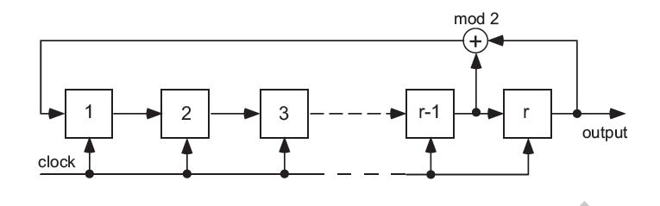
Simple Shift Register Generator
An r-stage simple feedback shift register with one feedback tap
Also called Fibonacci implementation.
Each stage stores one bit (0 or 1), called chirp.
At each clock tick, contents at stage n shifts “to the right” to stage n+1.
Additions are mod-2 additions (EX-OR)
One or more intermediate stages are fed back in mod-2 addition, but final stage always fed back.
Proper selection of “feedback taps” yield “maximal length” PN sequences (m-sequences) of length
5
Notes:
5

Slide 6
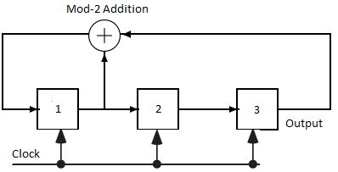
SSRG example
([3,1]s)]
n | y(n) | y(n-1) | y(n-2) | y(n-3)
0 | 1 | 1 | 0 | 0
1 | 1 | 1 | 1 | 0
2 | 0 | 1 | 1 | 1
3 | 1 | 0 | 1 | 1
4 | 0 | 1 | 0 | 1
5 | 0 | 0 | 1 | 0
6 | 1 | 0 | 0 | 1
7 | 1 | 1 | 0 | 0
6
Notes:
6

Slide 7
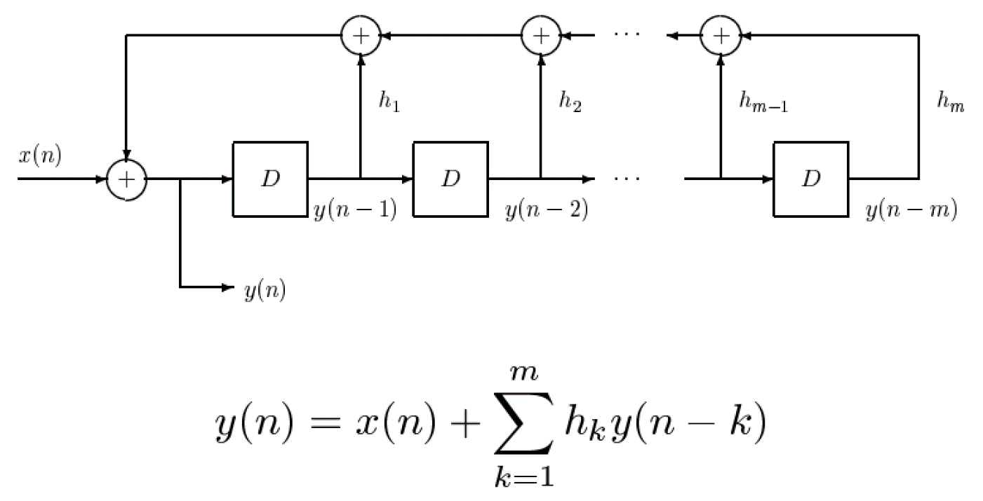
PN Sequences for Data Scrambling
Long strings of 1s or 0s in the input sequence must be randomized before transmission through a communication system.
Otherwise, carrier recovery, equalization, and symbol clock tracking won’t work properly.
Use a self-synchronizing data scrambler, where h_{k} defines the scrambler connections.
Modulo arithmetic!

Slide 8
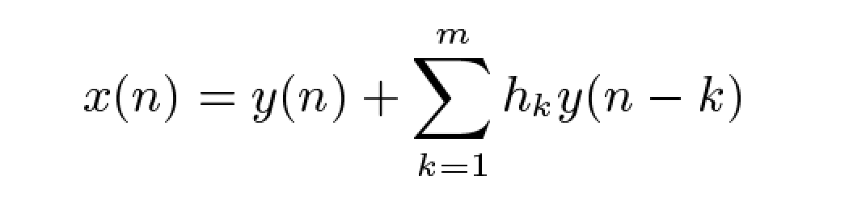
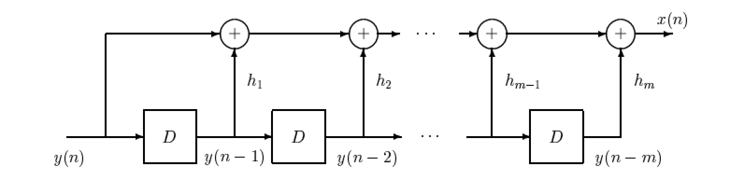
Descrambler
To descramble the data, we invert the scrambling process.
This is simply an FIR filter with m+1 taps that uses modulo arithmetic.
Note that errors in y(n) caused by the channel will cause errors in the recovered sequence.

Slide 9
Autocorrelation Function
Let y(n) be a periodic sequence with period N. The transformed sequence is:
The periodic autocorrelation function is:
This sum is performed by normal addition.
For maximal length sequences with period
9
Notes:
9

Slide 10
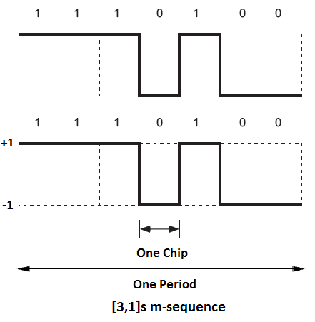
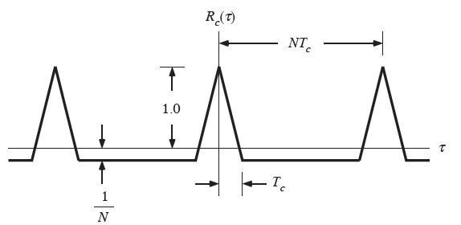
An example:
Waveform generated:
Autocorrelation:
10
Notes:
10

Slide 11
Skipped content
Modular Shift Register Generator method for generating PN sequences
Details on cross-correlation of PN sequences
Please go through the book for the theory
11
Notes:
11

