Slide 1
Common Signals in MATLAB
Prof. Brian L. Evans
Dept. of Electrical and Computer Engineering
The University of Texas at Austin
Fall 2024

Slide 2
Outline
MATLAB
Mathematical Representations of Signals
Continuous-Time Signals
Sinusoids
Exponentials
Infinite and finite length
Sinc pulse
Chirps
Spectrograms
Discrete-Time Signals

Slide 3
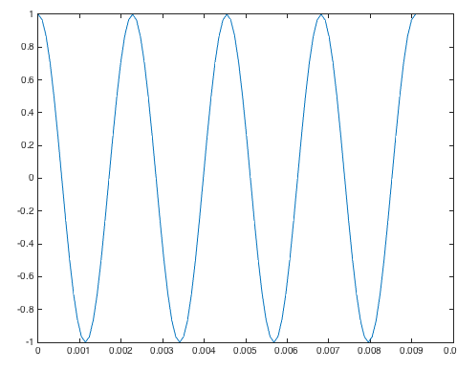
MATLAB
MATLAB
Matrix Laboratory (MATLAB)
Released in 1984 to universities
First toolboxes in control systems and signal processing (1987)
Semicolon prevents printing result
Scalar variables
Generating vectors
start : inc : end generate values from start to end at increments of inc
1 : 0.5 : 3 gives vector [1.0 1.5 2.0 2.5 3.0]
Plot vector x vs. vector t
% Scalar variables
f0 = 440;
fs = 24*f0;
Ts = 1/fs;
% Generate four periods % of time samples
t = 0 : Ts : 4/f0;
% Apply cosine to every
% element of 2 pi f0 t
x = cos(2*pi*f0*t);
plot(t, x);

Slide 4
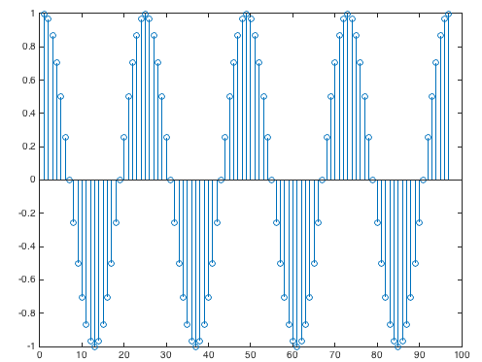
MATLAB
MATLAB
Plot individual samples as stems
Sound card on platform
Supports specific sampling rates, such as
8000 Hz for speech and audio
44100 Hz for CD audio
Playing sound in MATLAB
sound(vector, rate) will play values of vector at sampling rate and clip values lying outside [-1, 1]
soundsc(vector, rate) will scale values of vector to be in range [-1, 1] and play scaled values at sampling rate
stem(x);
f0 = 440;
fs = 8000; % rate
Ts = 1/fs;
t = 0 : Ts : 3; % 3 sec
x = cos(2*pi*f0*t);
sound(x, fs);

Slide 5
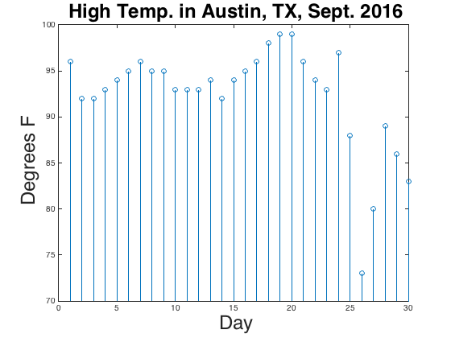
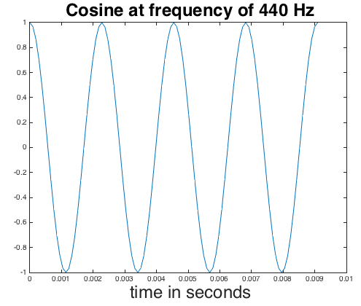
Signals As Functions
Mathematical Representations of Signals
Function of independent variable
High temperature vs. day
Audio signal vs. time
Continuous-time signals
x(t) where t can take any real value
x(t) may be 0 for range of values of t
sep2016hightemp = [ 96, 92, 92, 93, 94, 95, 96, 95, 95, 93, 93, 93, 94, 92, 94, 95, 96, 98, 99, 99, 96, 94, 93, 97, 88, 73, 80, 89, 86, 83 ];
stem(sep2016hightemp);
title('High Temp. in Austin, TX, Sept. 2016');
xlabel('Day');
ylabel('Degrees F');
ylim( [70 100] );
Discrete-time signals
x[n] where n ∈ {...-3,-2,-1,0,1,2,3...}
Unitless sample index n (e.g. day)
Amplitude value may be real or complex
f0 = 440;
fs = 24*f0;
Ts = 1/fs;
t = 0 : Ts : 4/f0;
x = cos(2*pi*f0*t); plot(t, x);

Slide 6
Signals As Functions
Mathematical Representations of Signals
Analog amplitude
Deterministic amplitudes
Mathematically described, e.g. x(t) = cos(2 π f₀ t)
Random amplitudes
Cannot be predicted exactly or described by a formula
Distribution of amplitude values can be defined
Example: Flipping coin 10x
Digital amplitude
From a discrete set of values
1
-1
flipnumber = 1:10;
y = sign(randn(10,1));
stem(flipnumber, y);
Trial #2
Trial #1
1
1
flip
flip
-1
-1

Slide 7
Sinusoidal Signal
Continuous-Time Signals
Mathematical form: A cos(ω₀ t + φ)
A is amplitude/magnitude
ω₀ is frequency in rad/s where ω₀ = 2 π f₀ and f₀ is in cycles/s or Hz
φ is phase shift in radians
Smallest period: T = 1 / f₀
Signal x(t) has period T if x(t+T) = x(t) for all t
Using property cos(x + 2π) = cos(x),
cos(2π f₀ (t + T)) = cos(2π f₀ t + 2π f₀ T) = cos(2π f₀ t)
when 2π f₀ T = 2π or when f₀ T = 1 or when T = 1 / f₀
When f₀ = 440 Hz, T = 2.27 ms
Play As Audio
f0 = 440;
fs = 8000;
Ts = 1/fs;
t = 0 : Ts : 3;
x = cos(2*pi*f0*t);
sound(x, fs);

Slide 8
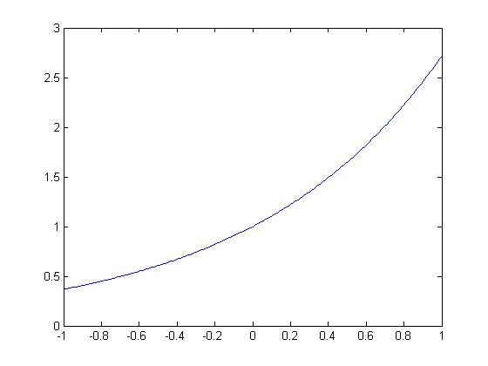
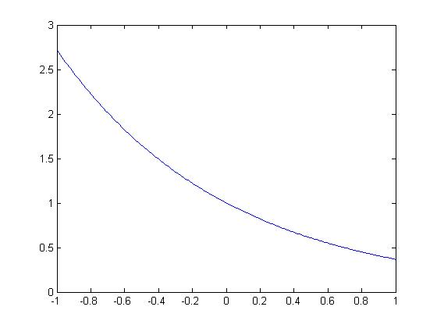
Exponential Signals
Continuous-Time Signals
Real-valued exponential signals
Amplitude values are always non-negative
Might decay or not as t goes to infinity
e^{-t}
e^{t}
t
t
t = -1 : 0.01 : 1;
e1 = exp(t);
plot(t, e1)
t = -1 : 0.01 : 1;
e2 = exp(-t);
plot(t, e2)

Slide 9
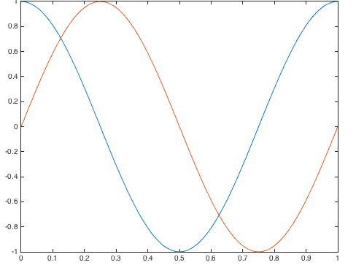
Exponential Signals
Continuous-Time Signals
Complex numbers
Cartesian form x + j y for real x and y
Polar form r e ^{jθ} = r cos(θ) + j r sin(θ)
Polar-to-Cartesian: x = r cos(θ) and y = r sin(θ)
Cartesian-to-Polar: and
Complex sinusoid: Euler’s formula
Complex sinusoidal signal
“inverse” Euler formula
t = 0 : 1/100 : 1;
plot(t, cos(2*pi*t));
hold;
plot(t, sin(2*pi*t));
t

Slide 10
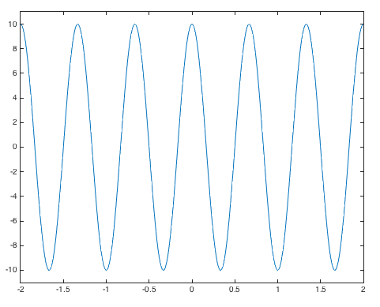
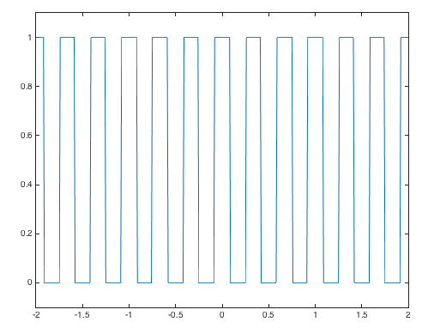
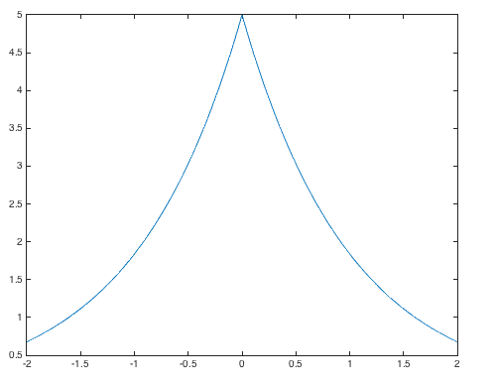
Two-Sided Signals
Continuous-Time Signals
Square wave f₀ = 3 Hz
t
t
t
t = -2 : 0.01 : 2;
% Cosine
w0 = 3*pi;
x1 = 10*cos(w0*t);
figure;
plot(t, x1);
ylim( [-11 11] );
t = -2 : 0.01 : 2;
% Square Wave
f0 = 3;
v = cos(2*pi*f0*t);
x2 = 0.5*sign(v) + 0.5;
figure;
plot(t, x2);
ylim( [-0.1, 1.1] );
t = -2 : 0.01 : 2;
% Two-Sided Exponential
x3 = 5*exp(-abs(t));
figure;
plot(t, x3);

Slide 11
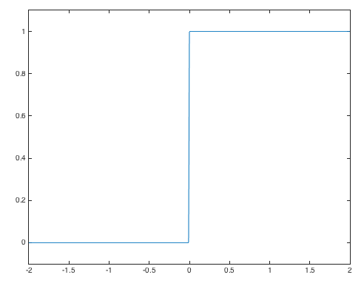
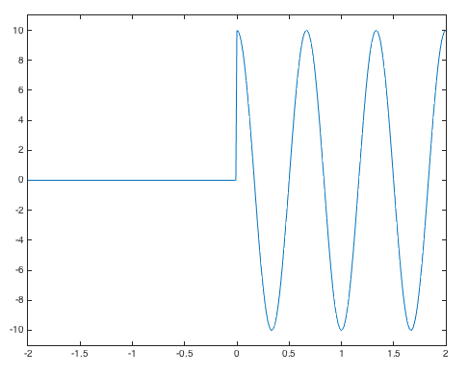
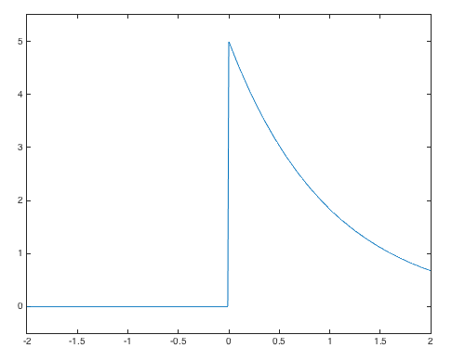
One-Sided Infinite-Length Signals
Continuous-Time Signals
t
t
t
t = -2 : 0.01 : 2;
% Unit Step
x1 = stepfun(t, 0);
figure;
plot(t, x1);
ylim( [-0.1 1.1] );
t = -2 : 0.01 : 2;
% Cosine
w0 = 3*pi;
x1 = 10*cos(w0*t).*stepfun(t,0);
figure;
plot(t, x1);
ylim( [-11 11] );
t = -2 : 0.01 : 2;
% Two-Sided Exponential
x3 = 5*exp(-t).*stepfun(t,0);
figure;
plot(t, x3);
ylim( [-0.5, 5.5] );
Pointwise multiplication: vector1 .* vector2
stepfun(t, 0) can also be implemented as ( t >= 0 )

Slide 12
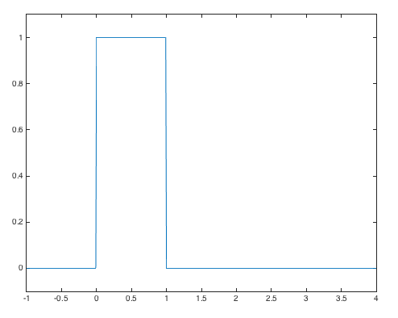
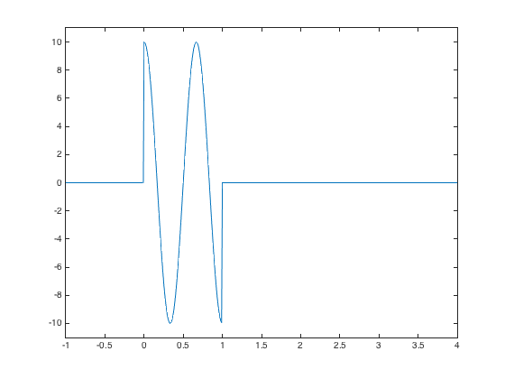
Finite-Length Signals
Continuous-Time Signals
Rectangular pulse
Sinusoidal signal
t = -1 : 0.01 : 4;
rp = rectpuls(t-1/2);
w0 = 3*pi;
x4 = 10*cos(w0*t).*rp;
plot(t, x4);
ylim( [-11 11] );
t = -1 : 0.01 : 4;
rp = rectpuls(t-1/2);
plot(t, rp);
ylim( [-0.1 1.1] );
Value of p(0)?
p(1)?
p(0.5)?

Slide 13
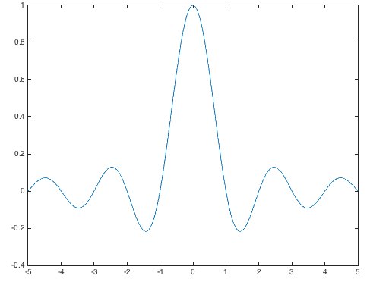
Sinc Pulse
Continuous-Time Signals
Sinc pulse
In time, infinite overlap with other sinc pulses
Plot of pulse p(t)
Ts = 1;
t = -5 : 0.01 : 5;
p = sinc(t/Ts);
plot(t, p)
Finite-length version
Truncate sinc pulse by multiplying it by rectangular pulse
Symmetry about origin?
Where are the zero crossings?
Amplitude decrease vs. time?
Why is sinc(0) = 1?

Slide 14
Chirp Signals
Continuous-Time Signals
Sinusoid with rising or falling frequency vs. time
Change in frequency occurs continuously
Linear sweep over range of frequencies (e.g. audio test signal)
Revisit sinusoidal signal model
Assumes constant amplitude, frequency and phase over time
Angle in right term ψ(t) = 2 π f₀ t + φ varies linearly with time
Derivative of ψ(t) w/r to t is constant frequency 2 π f₀ in rad/s

Slide 15
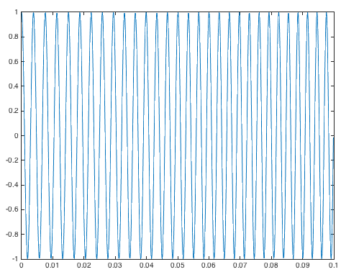

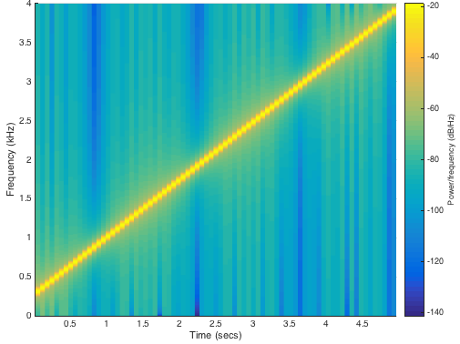
Chirp Signals
Continuous-Time Signals
Linear sweep 261-3951 Hz
Chirp x(t) = A cos(ψ(t))
where
Instantaneous freq. (Hz)
Scaled slope of angle ψ(t)
For x(t) over 0 ≤ t ≤ t_{max}, instantaneous frequency from f₀ to f₀ + 2 μ t_{max}
Linear frequency sweep
For 0 ≤ t ≤ t_{max}, sweep f₁ to f₂
f₀ = f₁ and μ = (f₂ – f₁) / (2 t_{max})
x(t)
t
Spectrogram

Slide 16
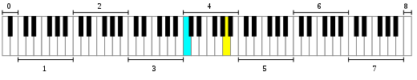







Music – Western Scale – Intro
Time-Frequency Spectrum – SPFirst Sec. 3-7
Octave
https://en.wikipedia.org/wiki/File:Piano_Frequencies.svg
Piano with 88 keys
Key frequencies increase from left to right (27.5 to 4186 Hz)
Middle C at 262 Hz (C4) in cyan & A at 440 Hz (A4) in yellow
Octave has 12 keys and doubles frequencies of previous octave
Octave
C D E F G A B
Sheet music
Music Note Graphics by Vecteezy
F
♯
D
4
B
Frequency
4
E
G
Lyrics
A
B
C
eas - y
as
1
2
3
ah
sim-ple
as
Time
How fast notes are played depends on time signature and beats per minute (bpm)

Slide 17

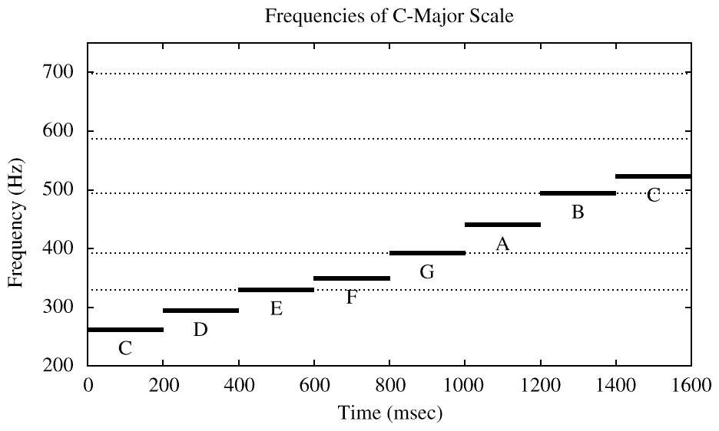
Music – Western Scale – Intro
Time-Frequency Spectrum – SPFirst Sec. 3-7
C major scale
Stepped frequencies
Constant frequency for each note
C4 = 261.626;
D4 = 293.665;
E4 = 329.628;
F4 = 349.228;
G4 = 391.995;
A4 = 440.000;
B4 = 493.883;
C5 = 523.251;
bpm = 60; % 300
beattime = 60/bpm;
fs = 48000;
Ts = 1/fs;
N = beattime/Ts;
t = Ts : Ts : N*Ts;
f = [C4,D4,E4,F4,G4,A4,B4,C5];
vec = zeros(1, length(f)*N);
for i = 1:length(f)
note = cos(2*pi*f(i)*t);
vec((i-1)*N+1 : i*N) = note;
end
sound(vec, fs);
60 bpm
300 bpm
300 bpm
Ideal Analysis

Slide 18
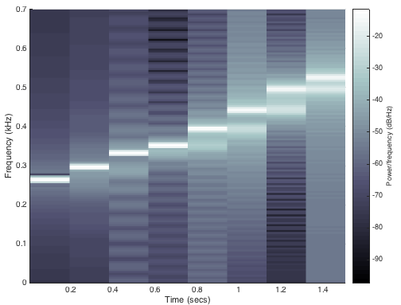
Music – Western Scale – Intro
Time-Frequency Spectrum – SPFirst Sec. 3-7
Analysis of audio clip for C major scale
300 bpm
Artifacts at transitions in notes (more on slide 4-9)
N = beattime * fs; % number of samples in one note
spectrogram(vec, N, 100, N, fs, 'yaxis');
ylim( [0 0.7] ); % focus on 0 to 700 Hz
colormap bone % grayscale mapping
Grayscale map

Slide 19
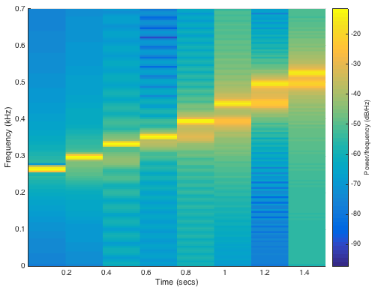
Music – Western Scale – Intro
Time-Frequency Spectrum – SPFirst Sec. 3-7
Analysis of audio clip for C major scale (repeated)
300 bpm
Artifacts at transitions in notes (more on slide 4-9)
N = beattime * fs; % number of samples in one note
spectrogram(vec, N, 100, N, fs, 'yaxis');
ylim( [0 0.7] ); % focus on 0 to 700 Hz
Default map

Slide 20
Spectrogram: Time-Frequency Plot
Time-Frequency Spectrum – SPFirst Sec. 3-7
Breaks signal x(t) into segments of N samples
Computes Fourier series for each segment using FFT
Time-Domain Plot
Spectrogram
x(t)
f
Shift start of segment
Shift start of segment
FFT Segment 1
FFT Segment 2
FFT Segment 3
Segment 1
Segment 2
Segment 3
t
t
Fourier series fundamental period T₀ = N T_{s} is time resolution
Fourier series fundamental frequency $f_{0}=\frac{1}{T_{0}}=\frac{1}{N T_{s}}=\frac{f_{s}}{N}$ is frequency resolution
N Fourier series frequencies $−\frac{1}{2}f_{s}<f<$ $\frac{1}{2}f_{s}$ due to sampling $f_{s}>2 f_{max}$
MATLAB: spectrogram(x, N, overlap, N, fs, ‘yaxis’)

Slide 21
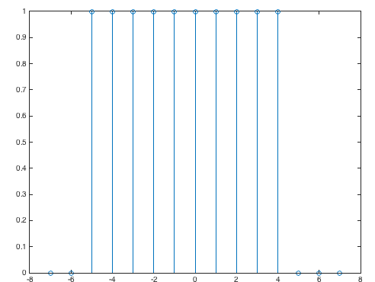
Discrete-Time Signals & Systems
Discrete-Time Signals
Discrete-time signals (see slide 2-9)
Formula: x[n] = cos((π/2) n) useful in analysis
Samples: xvec = [1 0 -1 0 1 0 -1 0] useful in simulation
Properties: even symmetric useful in reasoning
Piecewise: v[n] = rectpuls(n/10)
Discrete-time systems
Produce output signal from input signal
Squaring: y[n] = x²[n]
Averaging: y[n] = ½ x[n] + ½ x[n-1]
x[n]
T{•}
y[n]
n = -7 : 7;
v = rectpuls(n/10);
stem(n, v);
Width is 10 samples

Slide 22
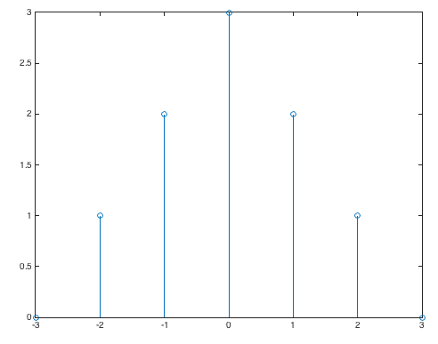
Unit Impulse Response
Discrete-Time Signals
Discrete-time unit impulse signal δ[n]
δ[n]
δ[n-2]
1
1
n
n
-3
-2
-1
0
1
2
3
-3
-2
-1
0
1
2
3
Expressing finite-length signals using unit impulses
3 δ[n]
x[n]
3
n = -3 : 3;
x = [0 1 2 3 2 1 0];
stem(n, x);
2 δ[n+1]
2
2 δ[n-1]
δ[n+2]
1
δ[n-2]
- OR -
n
n = -3 : 3;
x = 3*tripuls(n/6);
stem(n, x);
-3
-2
-1
0
1
2
3
No MATLAB function for δ[n]
Could use rectpuls(n) but awkward

Slide 23
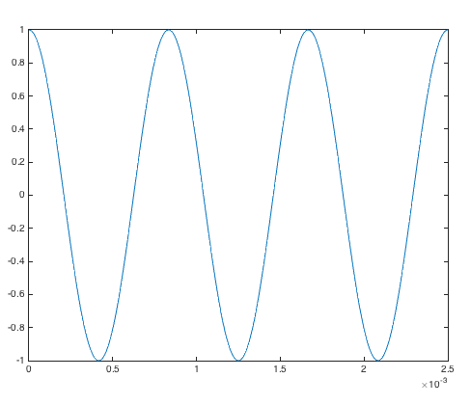
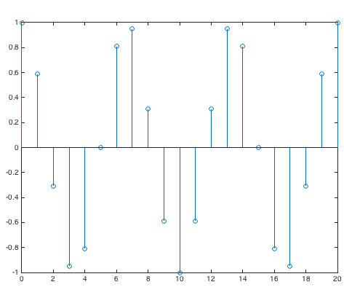
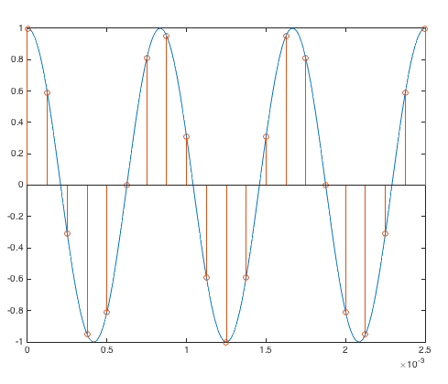
Periodicity of Discrete-Time Sinusoids
Discrete-Time Signals
Key idea
Continuous-time period may not align w/ discrete-time grid
Example
f₀ = 1200 Hz and f_{s} = 8000 Hz
Three continuous-time periods
Discrete-time period of 20 samples

Slide 24
Periodicity of Discrete-Time Sinusoids
Discrete-Time Signals
Continuous-time
Continuous-time period T₀ = 1 / f₀
f0 = 1200;
fs = 8000;
% w0 = 2 pi (3 / 20)
N = 3;
L = 20;
% Time extent
Ts = 1/fs;
nmax = L;
tmax = nmax*Ts;
% x(t) = cos(2 pi f0 t)
fp = fs*24;
Tp = 1 / fp;
t = 0 : Tp : tmax;
xt = cos(2*pi*f0*t);
% x[n] = cos(w0 n)
w0 = 2*pi*N/L;
n = 0 : nmax;
xn = cos(w0*n);
tn = 0 : Ts : tmax;
% Plots
plot(t, xt);
figure; stem(n, xn);
figure; plot(t, xt);
hold; stem(tn, xn);
Discrete-time cosine
Sample x(t) at rate f_{s} by substituting t = n T_{s} :
Discrete-time frequency
Remove common factors between integers N & L
cos(2 π (N / L) n) has discrete-time period of L samples that contains N continuous-time periods
See handout on Discrete-Time Periodicity

