Slide 1
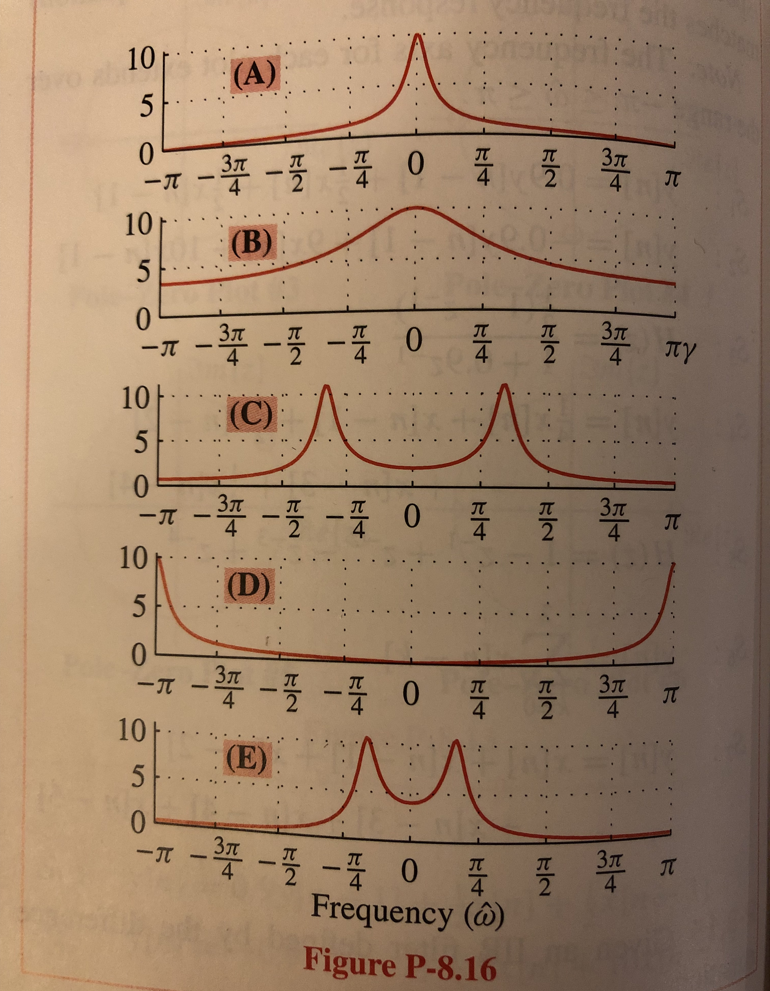
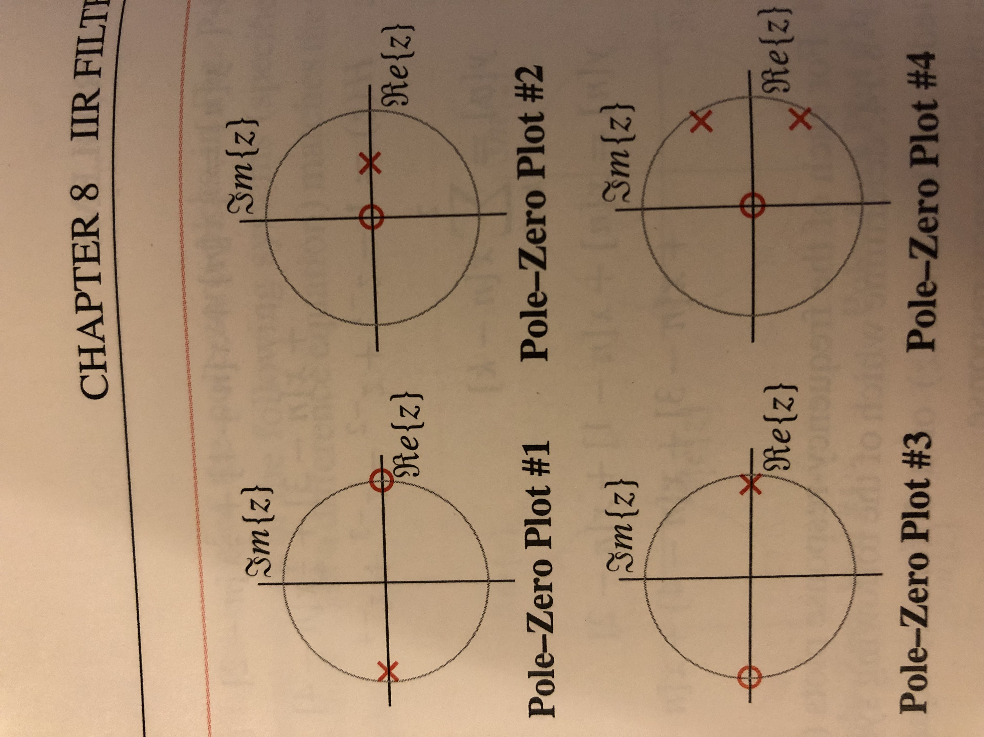
Homework Problem 7.2. In Fig. P-8.16 in Signal Processing First, match each pole-zero plot (PZ 1-4) with the correct one of five possible frequency responses (A-E). In the pole-zero plots, poles are denoted by X and zeros by O.
In addition, for each of the four filters,
i. give a formula for the transfer function in the z-domain including the region of convergence,
ii. give a formula for the frequency response from the transfer function in the z-domain in part i. Why can convert
iii. plot the magnitude response in the frequency domain
iv. indicate the frequency selectivity as lowpass, highpass, bandpass, or bandstop.

