Slide 1
Introduction & Sinusoids
EE 313 Linear Systems and Signals Fall 2025
Prof. Brian L. Evans
Dept. of Electrical and Computer Engineering
The University of Texas at Austin
Textbook: McClellan, Schafer & Yoder, Signal Processing First, 2003
Lecture 1 http://www.ece.utexas.edu/~bevans/courses/signals

Slide 2

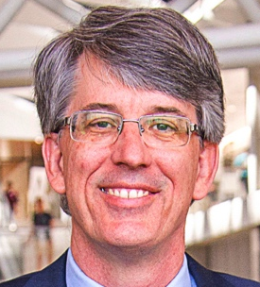
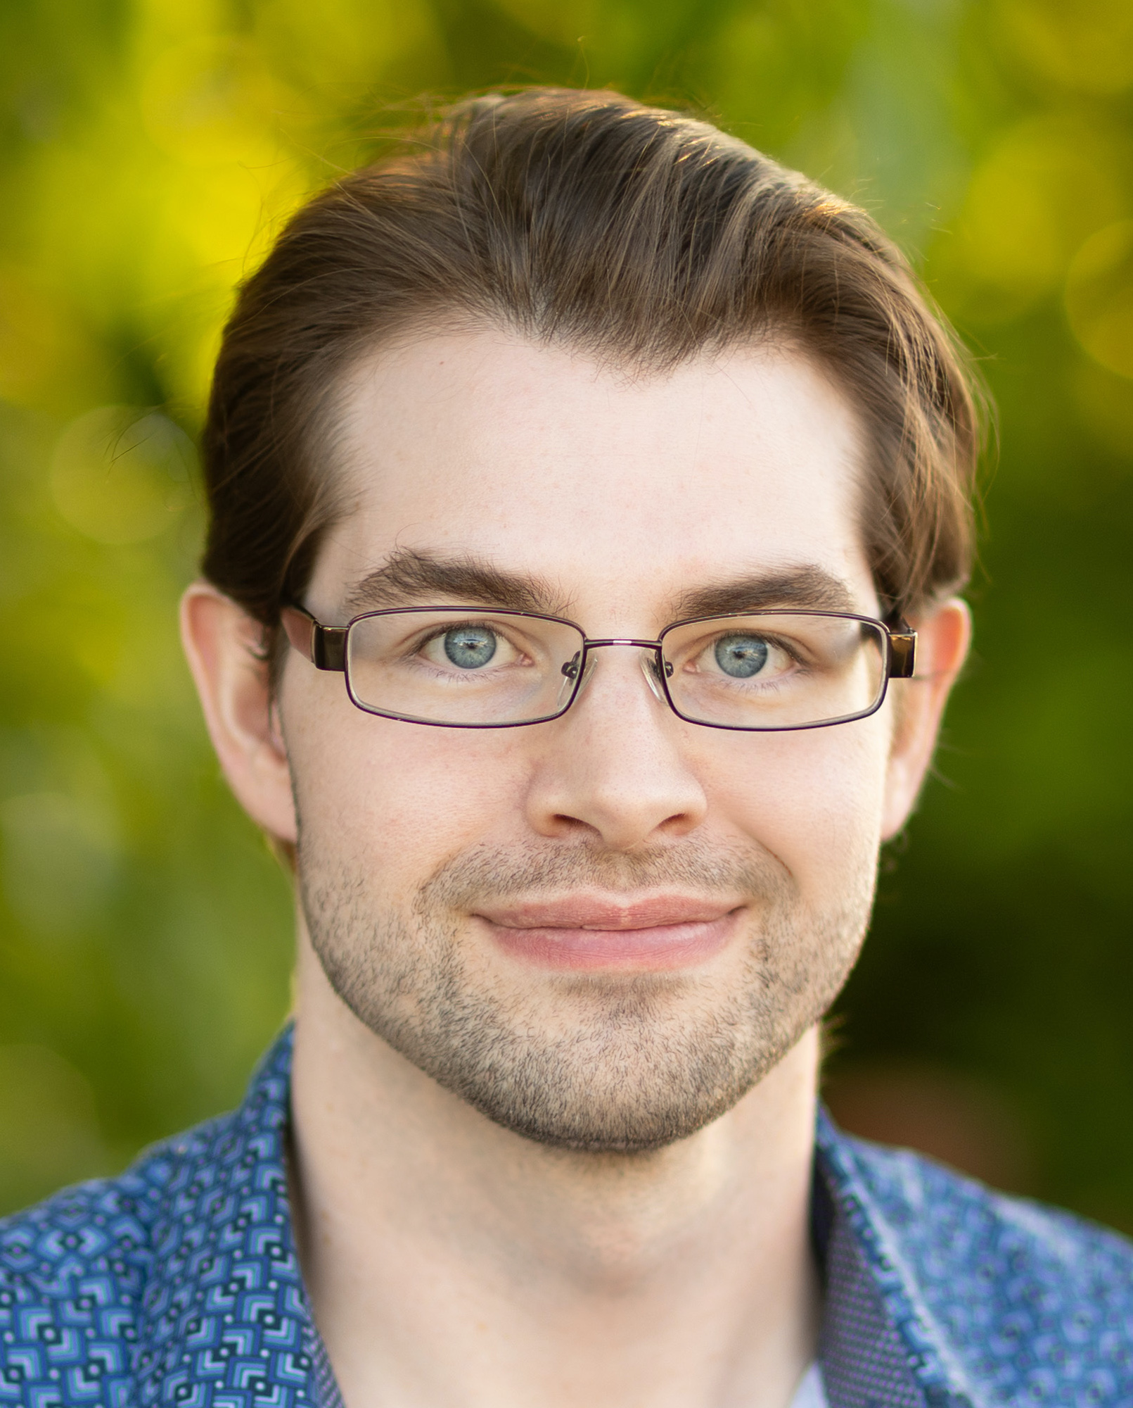
Instructional Staff
Welcome
Support learning & growth to reach goals
Lecture discussions and assignments
Friday 12-2pm coffee/advising hours EER O’s cafe
In-class and Canvas announcements
Prof. Evans’ Office hours
M 2:00-3:30pm and W 3:30-5:00pm, EER 6.882
Immediately after TTH 11:00am-12:30pm lecture
Mr. Dan Jacobellis, Teaching Assistant
Office hours: TBA

Slide 3
Destress Course to Improve Learning
Welcome
Review pre-requisite course info first two weeks
Predictable weekly schedule and workload
Balanced workload week-to-week (one major deliverable)
In-lecture assignments to help you on that week’s assignment
Drop lowest homework and in-lecture assignment to help in balancing course workload with other commitments
Feedback on assignments by next class meeting
Always know equivalent letter grade: 90+ A, 86.67-89.99 A-, 83.34-86.66 B+, 80.00-83.33 B, 76.67-79.99 B-, etc.
No relative grading – each student is in their own lane
Access to previous homework & midterm solutions

Slide 4
Getting the Most Out of This Course
Welcome
Student advice (during Friday coffee/advising hours)
Remove distractions that prevent you from being efficient in your work and in your play
Write down questions in a journal when they arise & ask them
Find mutually beneficial study group of 2-3 persons
Professor advice
When choosing courses, check workload ratings (see slide 1-12)
Attend instructor and TA office hours as you can
Attend/view lectures: it will save you time & give new insights
Start assignments when assigned and make progress each day: having more calendar time will allow you to learn info better **
** D. Brewer-Deluce, "3 ways to study better, according to cognitive research", The Conversation, Aug. 2020

Slide 5
Prof. Evans’ Research Projects
Course Overview
33 PhD, 13 MS and 215 BS alumni
System | Contribution | SW release | Prototype | Funding
Cellular (LTE) | full duplex commun. | Matlab |  | 6G@UT
 | satellite commun. | Python |  | AT&T Labs
 | reconfigurable surface | Matlab+Py |  | Tektronix
Smart grid commun. | interference reduction real-time testbeds | Matlab | Freescale & TI modems | IBM, NXP, TI
Wi-Fi | interference reduction | Matlab | NI FPGA | Intel, NI
Underwater | large receive array | Matlab | Lake testbed | ARL:UT
Camera | image acquisition | Matlab | DSP/C | Intel,Ricoh
 | video acquisition | Matlab | Android | TI
Display | image halftoning | Matlab | C | HP, Xerox
 | video halftoning | Matlab | C | Qualcomm
Design tools | distributed computing | Linux/C++ | Navy sonar | Navy, NI
DSP Digital Signal Processor FPGA Field Programmable Gate Array

Slide 6
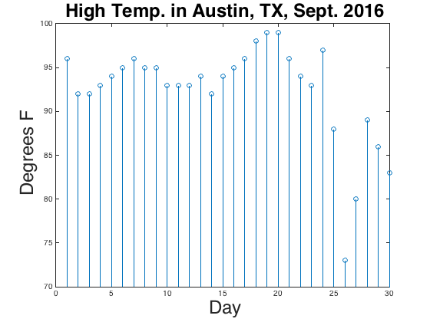
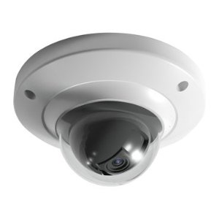
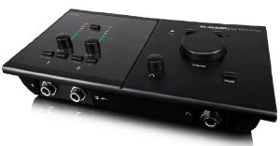
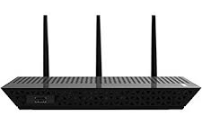
Linear Systems & Signals
Course Overview – SPFirst Ch. 1 Intro
Signal
Carries information
Patterns of variations in physical quantity
Signal processing signalprocessingsociety.org
Generation, transformation and extraction of information
Algorithms with associated architectures and implementations
Applications related to processing information
System
Manipulates, changes, records or transmits signals
Converts a signal into another
Audio mixing board
IP camera
Wi-Fi access point

Slide 7
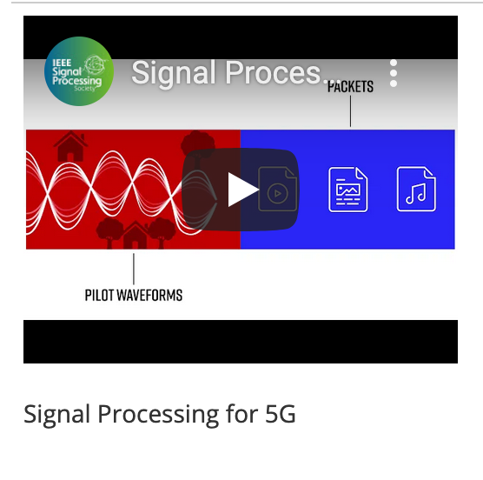
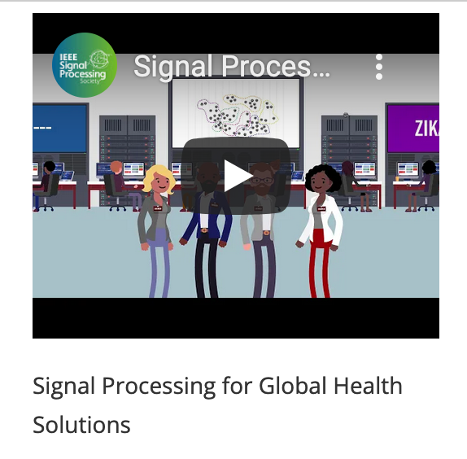
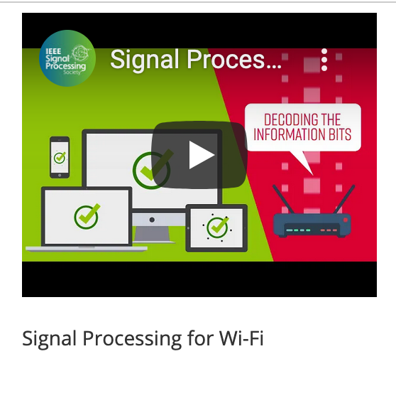
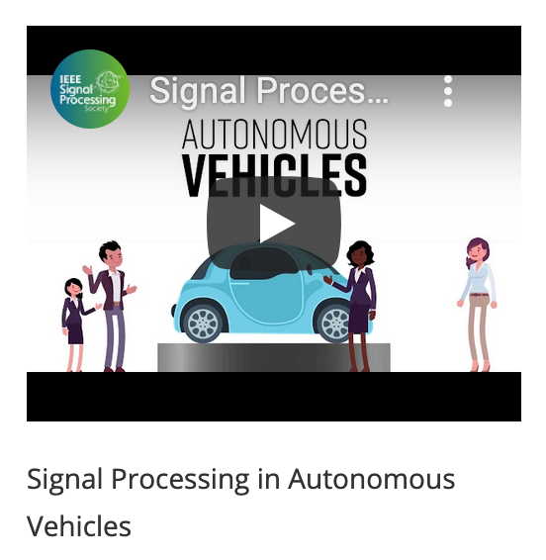
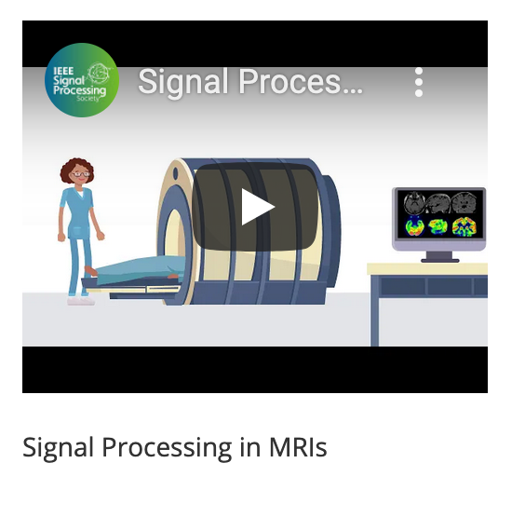
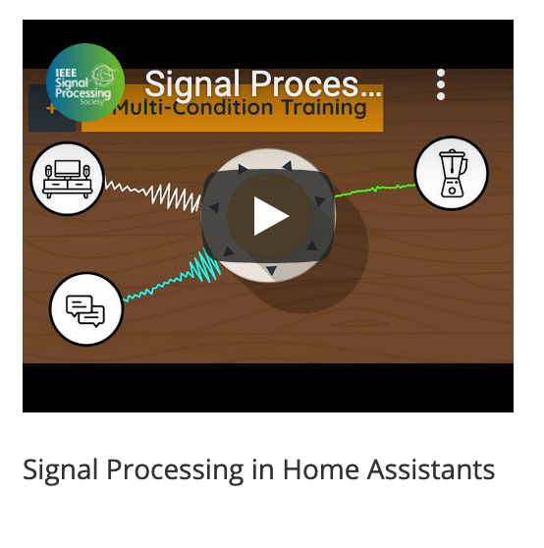
IEEE Signal Processing Society Videos
Course Overview

Slide 8
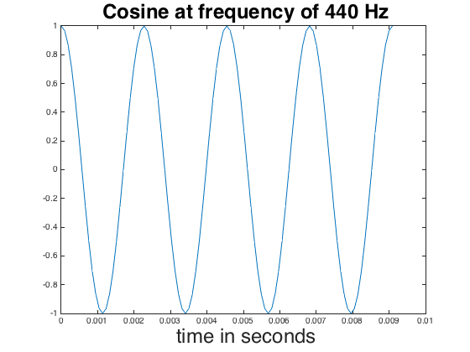
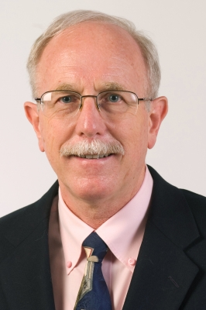
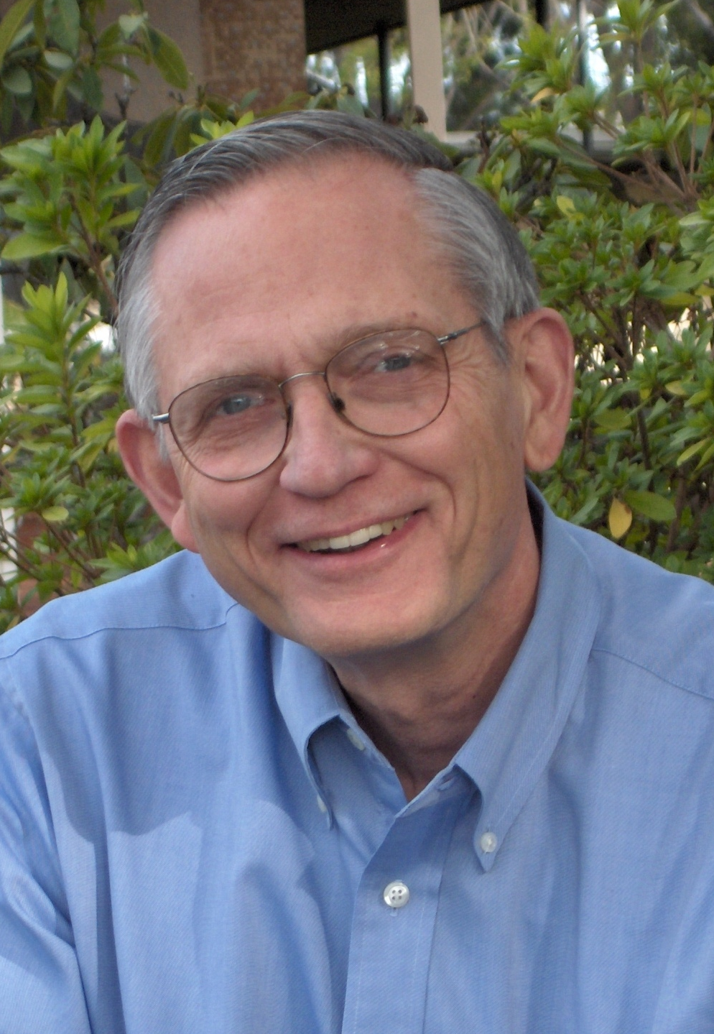
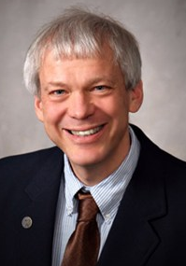
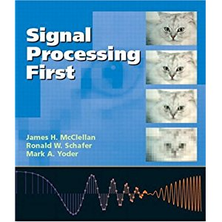
Course Overview
Course Overview
Objectives
Understand mathematical descriptions of signal processing algorithms
Express those algorithms as software implementations in MATLAB
x(t) = cos(2 π (440 Hz) t)
f0 = 440;
fs = 24*f0;
Ts = 1/fs;
t = 0 : Ts : 4/f0;
x = cos(2*pi*f0*t); plot(t, x);
Your objectives?
Required textbook
James McClellan (Georgia Tech)
Ronald Schafer (Georgia Tech)
Mark Yoder (Rose-Hulman Inst. of Tech.)
dspfirst.gatech.edu

Slide 9
Grading
Course Overview
Cutoffs 90.00 A 86.67 A- 83.34 B+ 80.00 B 76.67 B- 73.34 C+ 70.00 C etc.
Calculation of numeric grades
17% midterm #1 exam
17% midterm #2 exam
26% final exam
20% homework (drop lowest grade of 9)
10% tune-up Tuesdays (drop lowest grade of 9)
10% mini-projects
Midterm and final exams (in person)
Based on in-lecture discussions and assignments
Open books, notes & computer (but no networking or AI tools)
Dozens of old exams on course site (most with solutions)
Dates are October 2, November 13, and December 12

Slide 10


Grading
Course Overview
Homework (drop lowest of 9)
Model signals/systems using mathematics
Translate mathematics into Matlab simulations
Submit your own independent solutions
Submitted on Fridays by 11:59pm on Canvas
from www.studentum.no
Tune-up Tuesdays (drop lowest of 7)
Hands-on work in lecture, submitted by 6pm
Related to that week’s homework assignment
Keeping up-to-date reduces Thursday night panic
By Beth Hayden
Two mini-projects
Deeper dive into material from Signal Processing First online

Slide 11
Pre-requisite for 15 ECE Courses
ECE 313 Linear Systems and Signals at The University of Texas at Austin
Communications, Networks, Signal Processing, Systems
Computer Architecture & Embedded Systems
ECE 445S Real-Time Dig. Sig. Proc. Lab ECE 351M Digital Signal Processing ECE 360K Digital Communications
ECE 460J Data Science Laboratory
ECE 461P Data Science Principles
ECE 361E Machine Learning / Data
Analytics / Edge AI
ECE 362K Intro to Automatic Control
ECE 371R Digital Image Processing ECE 471C Wireless Communications Lab
ECE 372N Telecommunication Networks
ECE 379K Computer Vision
ECE 445L Embedded Systems Design Lab ECE 445S Real-Time Dig. Sig. Proc. Lab
Data Science & Machine Learning
Energy Systems and Renewable Energy
ECE 341 Electric Drives and Motors
ECE 362R Renewable Energy
Clouds represent ECE specializations (tech cores/components)
Courses in blue fulfill a requirement for one or more technical cores/components

Slide 12
Course Workloads
Course Overview
Undergrad ECE courses with highest workload ratings?
4.70 460N Computer Arch F21
4.47 445L Emb Sys Des Lab Sp22
4.13 445L Emb Sys Des Lab F21
4.05 461S Operating Systems F21
3.88 460N Computer Arch Sp22
3.88 461S Operating Systems Sp22
3.80 325 Electromagnetic Eng. Sp22
3.78 422C SW Des & Impl II ** F21
3.77 460R Intro to VLSI Design F21
Workload rating
(1-5 with 5 highest)
** Averaged across all sections that semester. **

Slide 13
Signals As Functions
Mathematical Representations of Signals – SPFirst Sec. 1-1
Function of independent variable
High temperature vs. day
Audio signal vs. time
Continuous-time signals
x(t) where t can take any real value
x(t) may be 0 for range of values of t
sep2016hightemp = [ 96, 92, 92, 93, 94, 95, 96, 95, 95, 93, 93, 93, 94, 92, 94, 95, 96, 98, 99, 99, 96, 94, 93, 97, 88, 73, 80, 89, 86, 83 ];
stem(sep2016hightemp);
title('High Temp. in Austin, TX, Sept. 2016');
xlabel('Day');
ylabel('Degrees F');
ylim( [70 100] );
Discrete-time signals
x[n] where n ∈ {...-3,-2,-1,0,1,2,3...}
Unitless sample index n (e.g. day)
Amplitude value may be real or complex
f0 = 440;
fs = 24*f0;
Ts = 1/fs;
t = 0 : Ts : 4/f0;
x = cos(2*pi*f0*t); plot(t, x);

Slide 14
Signals As Functions
Mathematical Representations of Signals – SPFirst Sec. 1-1
Analog amplitude
Deterministic amplitudes
Mathematically described, e.g. x(t) = cos(2 π f₀ t)
Random amplitudes
Cannot be predicted exactly or described by a formula
Distribution of amplitude values can be defined
Example: Flipping coin 10x
Digital amplitude
From a discrete set of values
1
-1
flipnumber = 1:10;
y = sign(randn(10,1));
stem(flipnumber, y);
Trial #2
Trial #1
1
1
flip
flip
-1
-1

Slide 15
Sinusoidal Signal
Sinusoids – SPFirst Ch. 2 Intro & Sec. 2-3
Mathematical form: A cos(ω₀ t + φ)
A is amplitude/magnitude
ω₀ is frequency in rad/s where ω₀ = 2 π f₀ and f₀ is in cycles/s or Hz
φ is phase shift in radians
Smallest period: T = 1 / f₀
Signal x(t) has period T if x(t+T) = x(t) for all t
Using property cos(x + 2π) = cos(x),
cos(2π f₀ (t + T)) = cos(2π f₀ t + 2π f₀ T) = cos(2π f₀ t)
when 2π f₀ T = 2π or when f₀ T = 1 or when T = 1 / f₀
When f₀ = 440 Hz, T = 2.27 ms
Play As Audio
f0 = 440;
fs = 8000;
Ts = 1/fs;
t = 0 : Ts : 3;
x = cos(2*pi*f0*t);
sound(x, fs);

Slide 16
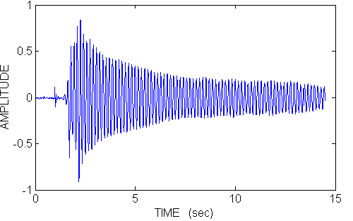
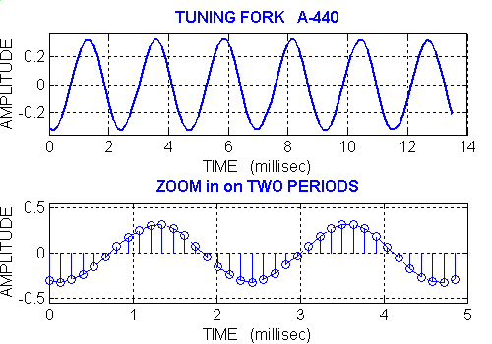
Tuning Fork Example A-440 Hz
Sinusoids – SPFirst Sec 2-1
Estimate Period
Middle plot below gives T ≈ 8.15ms – 5.85ms = 2.3ms
Bottom plot below gives
T ≈ (2 + 2/7) ms = 2.28ms
Estimate Frequency
f₀ = 1 / T = 1 / (2.3ms) = 435 Hz
f₀ = 1 / T = 1 / (2.28ms) = 438 Hz
©2003-2016, JH McClellan & RW Schafer

Slide 17
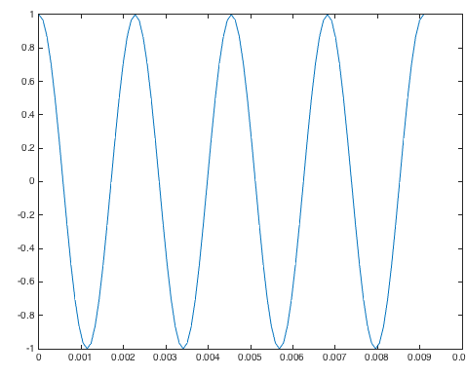
MATLAB Interlude
Sinusoids – SPFirst Sec. 2-4
Matrix Laboratory (MATLAB)
Released in 1984 to universities
First toolboxes in control systems and signal processing (1987)
Semicolon prevents printing result
Scalar variables
Generating vectors
start : inc : end generate values from start to end at increments of inc
1 : 0.5 : 3 gives vector [1.0 1.5 2.0 2.5 3.0]
Plot vector x vs. vector t
% Scalar variables
f0 = 440;
fs = 24*f0;
Ts = 1/fs;
% Generate four periods % of time samples
t = 0 : Ts : 4/f0;
% Apply cosine to every
% element of 2 pi f0 t
x = cos(2*pi*f0*t);
plot(t, x);

Slide 18
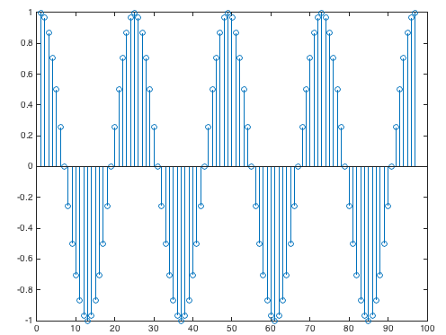
MATLAB Interlude
Sinusoids – SPFirst Sec. 2-4
Plot individual samples as stems
Sound playback on platform
Supports specific sampling rates, such as
8000 Hz for speech and audio
44100 Hz for CD audio
Playing sound in MATLAB
sound(vector, rate) will play values of vector at sampling rate and clip values lying outside [-1, 1]
soundsc(vector, rate) will scale values of vector to be in range [-1, 1] and play scaled values at sampling rate
stem(x);
f0 = 440;
fs = 8000; % rate
Ts = 1/fs;
t = 0 : Ts : 3; % 3 sec
x = cos(2*pi*f0*t);
sound(x, fs);

Slide 19
Systems
Mathematical Representations of Systems – SPFirst Sec. 1-2 & 1-3
Systems operate on signals to produce new signals or new signal representations
Continuous-time system examples
y(t) = ½ x(t) + ½ x(t-1)
y(t) = x²(t)
Discrete-time system examples
y[n] = ½ x[n] + ½ x[n-1]
y[n] = x²[n]
x(t)
T{•}
y(t)
x[n]
T{•}
y[n]
Audio, image and communication applications for squaring block
Average of current input and delayed input is a simple filter

Slide 20
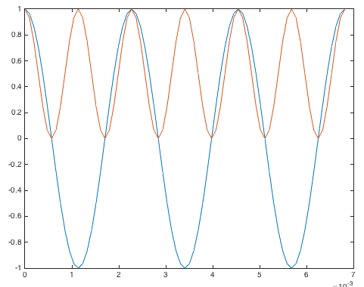
Squaring Block
Mathematical Representations of Systems – SPFirst Sec. 1-2, 1-3 & 2-2
Applications
AM radio receiver
Displayed pixels on screen undergo (•)^{2.2} nonlinearity
Increase musical note by one octave on Western scale
Input ‘A’ note at 440 Hz
x(t) = cos(2 π 440 t)
y(t) = cos²(2 π 440 t) = ½ (1 + cos(2 (2 π 440 t)) ) = ½ + ½ cos(2 π 880 t)
x(t)
(•)²
y(t)
Play As Audio
f0 = 440;
fs = 8000;
Ts = 1/fs;
tmax = 3;
t = 0 : Ts : tmax;
x = cos(2*pi*f0*t);
sound(x, fs);
pause(tmax+1);
y = x .^ 2;
sound(y, fs);
What frequency does a constant value have?
What frequency does the second term have?
Uses trig identity cos²(θ) = ½ + ½ cos(2θ)

Slide 21
License Info for SPFirst Slides
McClellan, Schafer &Yoder have released their work under a Creative Commons License with the following terms:
Attribution
The licensor permits others to copy, distribute, display, and perform the work. In return, licensees must give the original authors credit.
Non-Commercial
The licensor permits others to copy, distribute, display, and perform the work. In return, licensees may not use the work for commercial purposes—unless they get the licensor's permission.
Share Alike
The licensor permits others to distribute derivative works only under a license identical to the one that governs the licensor's work.
Full Text of the License
This (hidden) page should be kept with the presentation
©2003-2016, JH McClellan & RW Schafer
1-21

