Slide 1
Periodic Signals
EE 313 Linear Systems and Signals Fall 2025
Prof. Brian L. Evans
Dept. of Electrical and Computer Engineering
The University of Texas at Austin
Textbook: McClellan, Schafer & Yoder, Signal Processing First, 2003
Lecture 2 http://www.ece.utexas.edu/~bevans/courses/signals

Slide 2
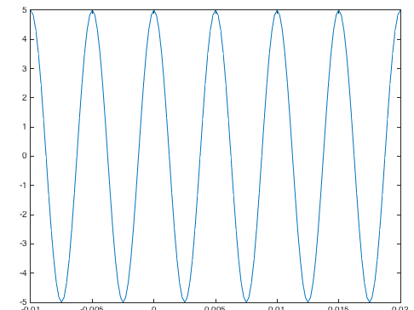
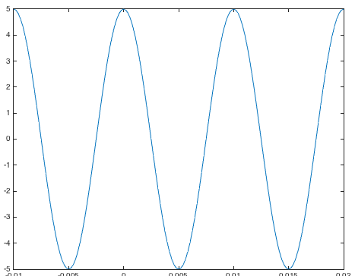
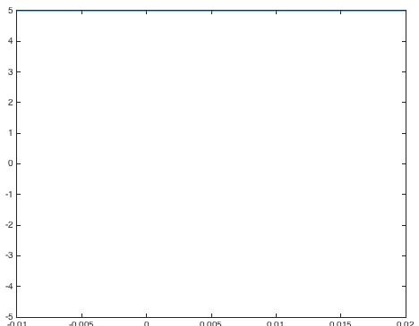
Periodic Signals
Periodic Signals – SPFirst Sec. 2-3.1
A signal has period T if x(t + T) = x(t) for all t
Also periodic with periods 2T, 3T, etc., and –T, –2T, etc.
Smallest positive period is called the fundamental period
Signal cos(2 π f₀ t + φ) has period T₀ = 1 / f₀
Using cosine property cos(x + 2π) = cos(x),
cos(2π f₀ (t + T₀) + φ) = cos(2π f₀ t + 2π f₀ T₀ + φ) = cos(2π f₀ t + φ)
when 2π f₀ T₀ = 2π or when f₀ T₀ = 1 or when T₀ = 1 / f₀
5 cos(2π f₀ t)
ms
ms
ms
-10
-5
0
5
10
15
20
-10
-5
0
5
10
15
20
-10
-5
0
5
10
15
20
f₀ = 200 Hz
f₀ = 100 Hz
f₀ = 0 Hz

Slide 3
Time Shift
Periodic Signals – SPFirst Sec. 2-3.2
Unit area rectangular pulse
Symmetric about origin
Matlab command rectpuls(t)
rect(t)
Shift to the right
rect(t-1)
1
1
t
t
-1
-1/2
0
1/2
1
3/2
-1
-1/2
0
1/2
1
3/2
Ts = 1/100;
t = -1.5 : Ts : 2.5;
x = rectpuls(t-1);
plot(t, x);
ylim( [-0.5 1.5] );
rect(t+1/2)
Shift to the left
1
t
-1
-1/2
0
1/2
1
3/2

Slide 4
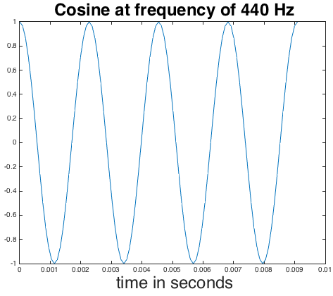
Phase Shift
Periodic Signals – SPFirst Sec. 2-3.2
For sinusoidal signals, time shift causes phase shift
x₀(t) = A cos(2 π f₀ t)
x₀(t - t₁) = A cos(2 π f₀ (t – t₁)) = A cos(2 π f₀ t – 2 π f₀ t₁)
Time shift of t₁ causes phase shift of φ = –2 π f₀ t₁
Initial interpretation of this phase shift
Positive time shift causes negative phase shift
Negative time shift causes positive phase shift
Phase shift: ambiguity of multiples of 2π
Due to cosine property cos(x + 2π) = cos(x)
Each multiple of 2π corresponds to picking different peak
cos(2π 440 t + 2π)
= cos(2π 440 t)
f0 = 440;
fs = 24*f0;
Ts = 1/fs;
t = 0 : Ts : 4/f0;
x = cos(2*pi*f0*t); plot(t, x);

Slide 5
Sampling
Sampling Sinusoids – SPFirst Sec. 2-4
Many signals originate as continuous-time signals, e.g. voice or conventional music
Sample continuous-time signal at equally-spaced points in time to obtain discrete-time signal
y[n] = y(n T_{s})
n ∈ {…, -2, -1, 0, 1, 2,…}
T_{s} is sampling period
Sinusoidal signal
T_{s}
3
4
5
6
7
n
1
2
y(t)

Slide 6
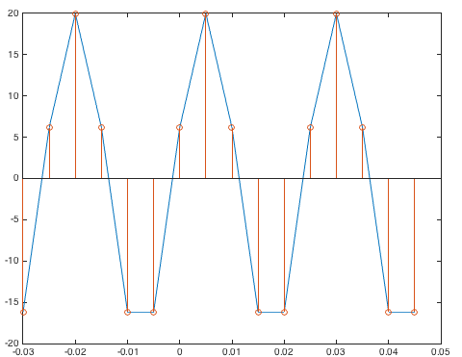
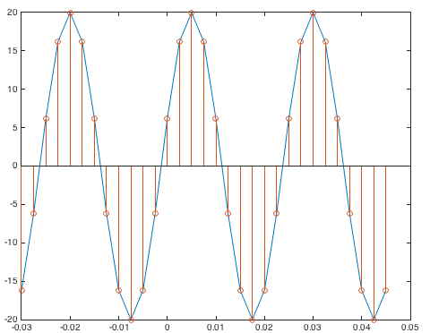
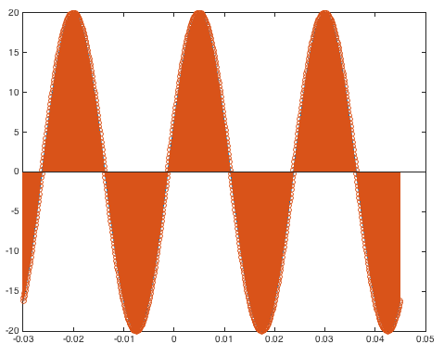
Plotting Signals
Sampling Sinusoids – SPFirst Sec. 2-4
T_{s} = 0.0050s f_{s} = 200Hz = 5f₀
5 samples/cycle
Sample signals before plotting them in Matlab
x(t) = 20 cos(2π 40 t – 0.4π)
Uniformly sample at points in continuous time t = n T_{s} :
x(nT_{s}) = 20 cos(80π nT_{s} – 0.4π)
How small does T_{s} have to be to produce an accurate plot?
T_{s} = 0.0025s
f_{s} = 400Hz = 10f₀
10 samples/cycle
T_{s} = 0.0001s
f_{s} = 10kHz = 250f₀ 250 samples/cycle
f0 = 40; Ts = 0.0001;
t = -0.03 : Ts : 0.045;
x = 20*cos(2*pi*f0*t - 0.4*pi);
figure; plot(t, x);
hold; stem(t, x);

Slide 7
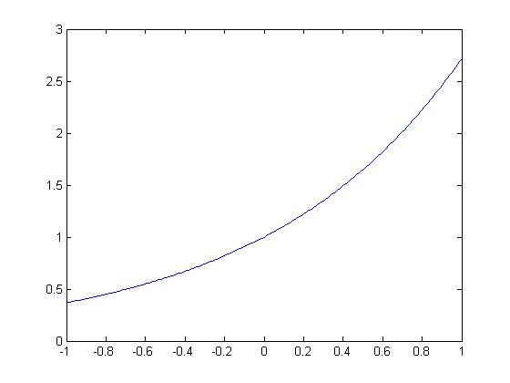
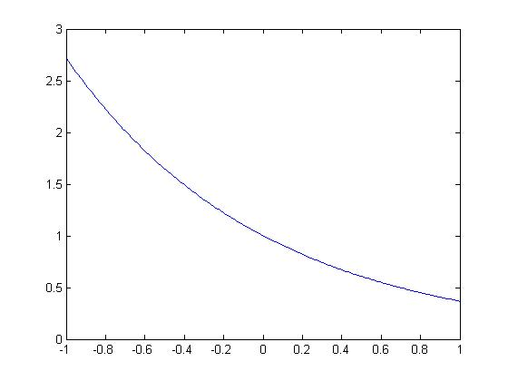
Exponential Signals
Complex Exponentials– SPFirst Sec. 2-5
Real-valued exponential signals
Amplitude values are always non-negative
Might decay or not as t goes to infinity
e^{-t}
e^{t}
t
t
t = -1 : 0.01 : 1;
e1 = exp(t);
plot(t, e1)
t = -1 : 0.01 : 1;
e2 = exp(-t);
plot(t, e2)

Slide 8
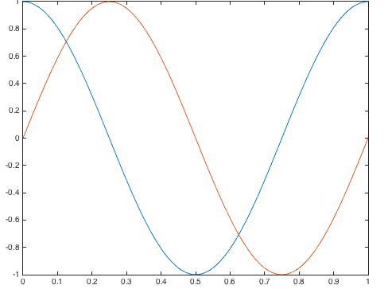
Exponential Signals
Complex Exponentials– SPFirst Sec. 2-5.1
SPFirst Fig. 2.4
Complex numbers
Cartesian form x + j y for real x and y
Polar form r e ^{jθ} = r cos(θ) + j r sin(θ)
Polar-to-Cartesian: x = r cos(θ) and y = r sin(θ)
Cartesian-to-Polar: and
y
r
θ
x
Complex sinusoid: Euler’s formula
Complex sinusoidal signal
“inverse” Euler formula
t = 0 : 1/100 : 1;
plot(t, cos(2*pi*t));
hold;
plot(t, sin(2*pi*t));
t

Slide 9
Many Faces of Signals
Complex Exponentials– SPFirst Sec. 2-8
Function, e.g. cos(t) in continuous time or cos(π n) in discrete time, useful in analysis
Sequence of numbers, e.g. {1,2,3,2,1} or a sampled triangle function, useful in simulation
1
Set of properties, e.g. even symmetric, useful in reasoning about behavior
t
-1/2
0
1/2
A piecewise representation, e.g. rect(t) below, useful in analysis
rect(t)
1
Above mathematical models can be used to approximate measured/observed signals
t
-1/2
0
1/2

Slide 10
Spectrum Representation
Spectrum Representation – SPFirst Ch. 3 Intro
Sinusoidal waveforms
Spectrum is collection of amplitude, phase and frequency info to express more complicated signals
where A₀ is real-valued and
Example (slide 1-16)
y(t) = x²(t) = cos²(2 π 440 t) = ½ (1 + cos(2 (2 π 440 t)) ) = ½ + ½ cos(2 π 880 t)
A₀
A₁ |  | A₂
f₁ | 440 Hz | f₂ | 880 Hz
φ₁ |  | φ₂

Slide 11
Two-Sided Spectrum
Spectrum Representation – SPFirst Sec. 3-1
Expanding cosine terms with inverse Euler formula
where
Two-sided spectrum
2N+1 frequencies and 2N+1 complex amplitudes
{ (0, X₀), (f₁, ½ X₁), (-f₁, ½ X₁*), …, (f_{k}, ½ X_{k}), (-f_{k}, ½ X_{k}*), … }
Frequency-domain representation of signal x(t)

Slide 12
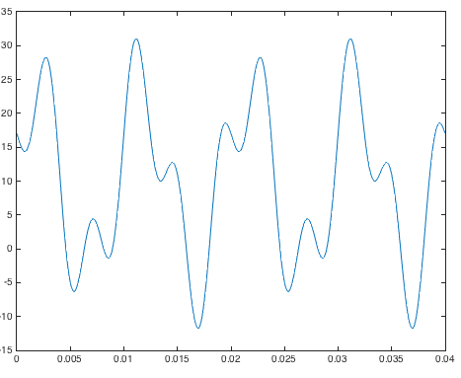
Two-Sided Spectrum Example
Spectrum Representation – SPFirst Sec. 3-1
x(t) = 10 + 14 cos(200π t – π/3) + 8 cos(500π t + π/2)
Expanding cosine terms using (inverse) Euler formula
Constant term has zero frequency: 10 e ^{j 0 t} = 10
Spectrum plot
Two periods of x(t)
Complex amplitude
t
–250
–100
0
100
250
Spectral line
f (in Hz)
©2003-2016, JH McClellan & RW Schafer

Slide 13
License Info for SPFirst Slides
McClellan, Schafer &Yoder have released their work under a Creative Commons License with the following terms:
Attribution
The licensor permits others to copy, distribute, display, and perform the work. In return, licensees must give the original authors credit.
Non-Commercial
The licensor permits others to copy, distribute, display, and perform the work. In return, licensees may not use the work for commercial purposes—unless they get the licensor's permission.
Share Alike
The licensor permits others to distribute derivative works only under a license identical to the one that governs the licensor's work.
Full Text of the License
This (hidden) page should be kept with the presentation
©2003-2016, JH McClellan & RW Schafer
2-13

