Slide 1
Fourier Series
EE 313 Linear Systems and Signals Fall 2024
Prof. Brian L. Evans
Dept. of Electrical and Computer Engineering
The University of Texas at Austin
Textbook: McClellan, Schafer & Yoder, Signal Processing First, 2003
Lecture 3 http://www.ece.utexas.edu/~bevans/courses/signals

Slide 2
Beat Notes
Periodic Signals – SPFirst Sec. 3-2
Occurs when multiplying two sinusoidal signals
Audio: singing when holding a note, some musical instruments
Communications: amplitude modulation (AM radio, Wi-Fi)
Example:
Spectrum
Rewrite x(t) as sum of complex sinusoids
f

Slide 3
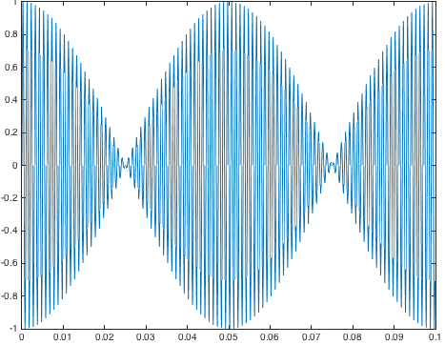
Beat Notes
Periodic Signals – SPFirst Sec. 3-2
Example:
Equal to:
f0 = 10; f1 = 1000;
fs = 8000; Ts = 1/fs;
t = 0 : Ts : 3;
x0 = cos(2*pi*f0*t);
x1 = sin(2*pi*f1*t);
x = x0 .* x1; sound(x, fs);
% plot one period
T0 = 1/f0;
n = T0 / Ts;
plot( t(1:n), x(1:n) );
f2 = 1010; f3 = 990;
fs = 8000; Ts = 1/fs;
t = 0 : Ts : 3;
x2 = cos(2*pi*f2*t - pi/2);
x3 = cos(2*pi*f3*t - pi/2);
x = 0.5*x2 + 0.5*x3;
sound(x, fs);
% plot one period
f0 = gcd(f2, f3); T0 = 1/f0;
n = T0 / Ts;
plot( t(1:n), x(1:n) );

Slide 4
Periodic Waveforms
Periodic Signals – SPFirst Sec. 3-3
A signal has period T if x(t + T) = x(t) for all t
Also periodic with periods 2T, 3T, etc., and –T, –2T ...
Smallest positive period T₀ is called the fundamental period
Fundamental frequency f₀ is computed as 1 / T₀
Synthesize periodic signals
Add two or more cosine waves with harmonic frequencies
Finding fundamental frequency
Largest f₀ such that f_{k} = k f₀ , i.e. f₀ = gcd{ f_{k} }
Consider notes A 440 Hz, E 660 Hz and F♯ 740 Hz. f₀ = __

Slide 5
Notation and Speech Example
Periodic Signals – SPFirst Sec. 3-3.1
Alternate periodic signal synthesis formula
Expand cosines into sum of two exponentials (Euler’s formula)
Explicitly represents positive and negative frequencies:
where
Synthesis of “ah” vowel from SPFirst (page 45)
http://dspfirst.gatech.edu/chapters/03spect/demos/vowel
Matlab command: vowel
Comment out lines that start with capture and imwrite
Combines components at 200, 400, 500, 1600 and 1700 Hz

Slide 6
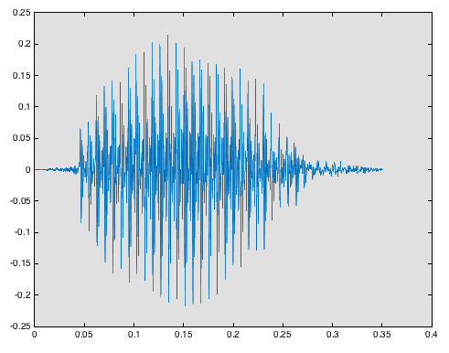
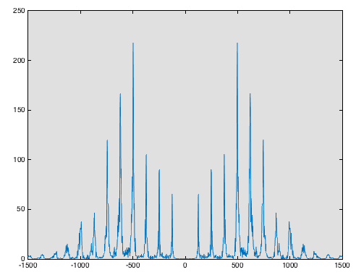

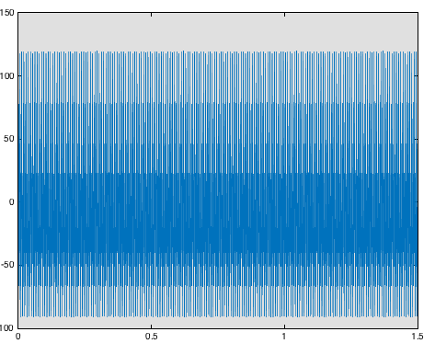
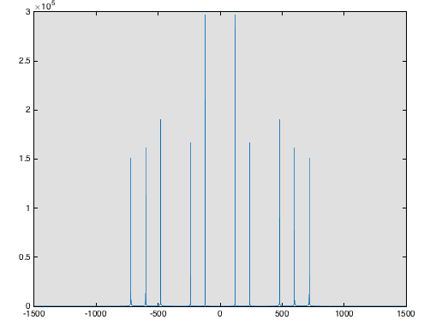
Speech Example Revisited
Periodic Signals – SPFirst Sec. 3-3.1
A recording of the “ah” vowel being spoken
How close did synthesized vowel sound like “ah”?
Magnitude of Spectrum
Time domain
“ah” recording
t
f
Magnitude of Spectrum
Time domain
synthesized sound
t
f

Slide 7
Fourier Series
Periodic Signals – SPFirst Sec. 3-4
Any periodic signal can be synthesized
With a sum of harmonically related sinusoids
Mathematical theory realized by Fourier series
T₀ fundamental period
f₀ fundamental frequency (f₀ = 1 / T₀)
kth complex exponential in summation has frequency f_{k} = k f₀
Special case
Conjugate symmetric amplitudes:
Leads to real-valued x(t):

Slide 8
Fourier Series
Periodic Signals – SPFirst Sec. 3-4
Analysis: start with x(t) and compute { a_{k} }
Integrate x(t) over fundamental period T₀
Calculation of a₀ simplifies to average value of x(t)
Can often “eyeball” a₀ without performing integration
Example #1: With x(t) = cos(2 π f₀ t), what is a₀ ?
Example #2: With x(t) = cos²(2 π f₁ t), what is a₀ ?
Synthesis: start with { a_{k} } and compute x(t)
General case:

Slide 9
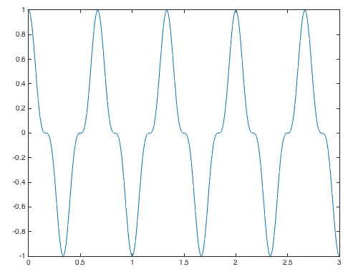
Spectrum of the Fourier Series
Periodic Signals – SPFirst Sec. 3-5
Find Fourier series coefficients for x(t) = cos³(3πt)
Approach #1: Fourier analysis formulas
Plot x(t) to find T₀ = 3 s / 4.5 = 2/3 s and “eyeball” a₀ = 0 and then
t
Approach #2: Expand into complex exponentials
Spectrum
Resulting spectrum
ω₀ = gcd(3π, 9π) = 3π
f₀ = 1.5 Hz
f
-3 f₀
-f₀
f₀
3 f₀

Slide 10
Fourier Analysis of a Square Wave
Periodic Signals – SPFirst Sec. 3-6.1
Periodic square wave with 50% duty cycle
Defined for one period as
x(t)
1
t
Fourier coefficients
a₀ = ½ because x(t) is 1 half the time and 0 half the time
Then,
For k ≠ 0

Slide 11
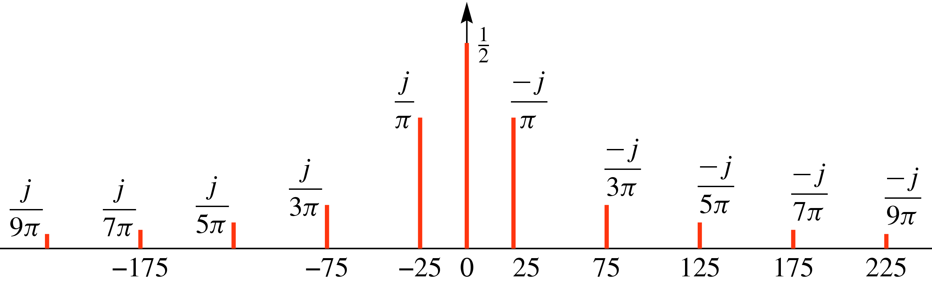
Spectrum for a Square Wave
Periodic Signals – SPFirst Sec. 3-6.2
Fourier coefficients
Independent of T₀
Example
T₀ = 0.04 s → f₀ = 25 Hz
x(t)
1
1
t
0
.01
.02
0.04
©2003-2016, JH McClellan & RW Schafer

Slide 12
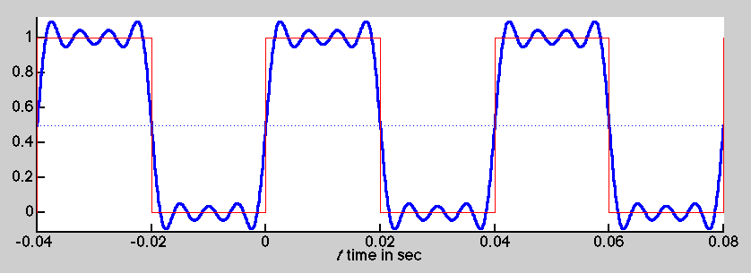

Fourier Synthesis of a Square Wave
Periodic Signals – SPFirst Sec. 3-6.3
Synthesis using up to 7th harmonic
demo
©2003-2016, JH McClellan & RW Schafer

Slide 13
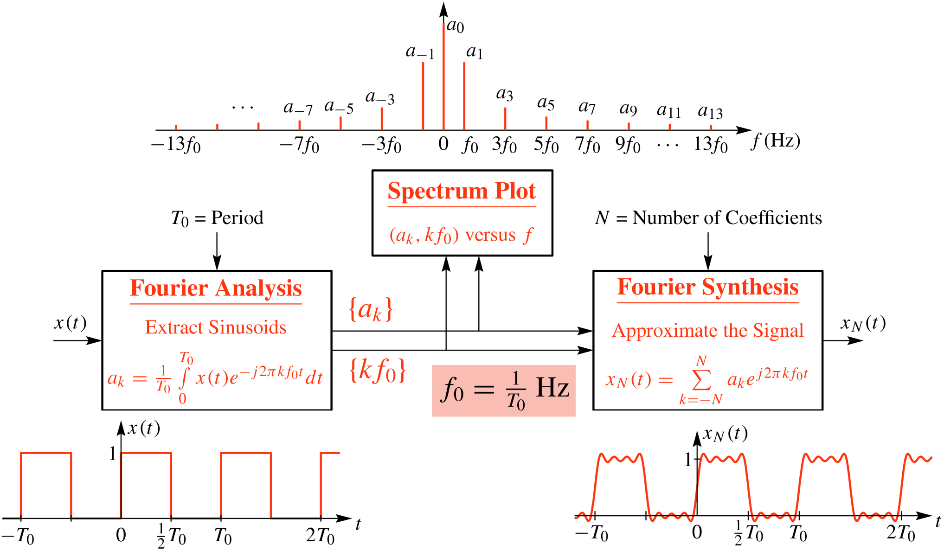
Spectrum & Fourier Series
Periodic Signals – SPFirst Sec. 3-6
©2003-2016, JH McClellan & RW Schafer

Slide 14
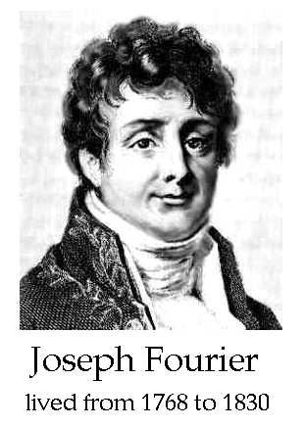
Fourier Synthesis vs. Analysis
Periodic Signals – SPFirst Sec. 3-6
Fourier Synthesis
Given (f_{k}, A_{k}, φ_{k}) values, create x(t)
Implementing synthesis formula is somewhat straightforward
Achieving high perceptual quality in x(t) is difficult, e.g. synthesized speech or music
Fourier Analysis
Very difficult task, esp. for physical signals
Given x(t), extract (f_{k}, A_{k}, φ_{k}) values. How many?
Using (f_{k}, A_{k}, φ_{k}), how close is model to signal?
Need mathematical algorithms for computer

Slide 15
License Info for SPFirst Slides
McClellan, Schafer &Yoder have released their work under a Creative Commons License with the following terms:
Attribution
The licensor permits others to copy, distribute, display, and perform the work. In return, licensees must give the original authors credit.
Non-Commercial
The licensor permits others to copy, distribute, display, and perform the work. In return, licensees may not use the work for commercial purposes—unless they get the licensor's permission.
Share Alike
The licensor permits others to distribute derivative works only under a license identical to the one that governs the licensor's work.
Full Text of the License
This (hidden) page should be kept with the presentation
©2003-2016, JH McClellan & RW Schafer
3-15

