Slide 1
Time-Frequency Spectrum
EE 313 Linear Systems and Signals Fall 2024
Prof. Brian L. Evans
Dept. of Electrical and Computer Engineering
The University of Texas at Austin
Textbook: McClellan, Schafer & Yoder, Signal Processing First, 2003
Lecture 4 http://www.ece.utexas.edu/~bevans/courses/signals

Slide 2
Waveform Synthesis
Time-Frequency Spectrum – SPFirst Sec. 3-7
Synthesize many kinds of waveforms using
Constant, cosine and general periodic signals when f_{k} = k f₀
Non-periodic signals, e.g.
©2003-2016, JH McClellan & RW Schafer

Slide 3
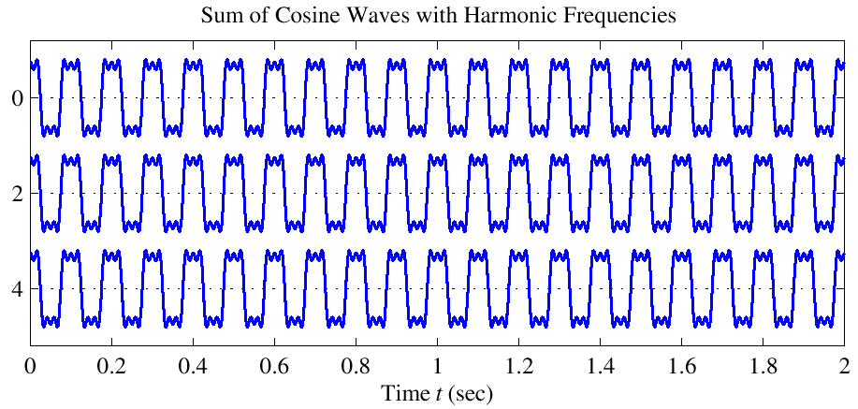
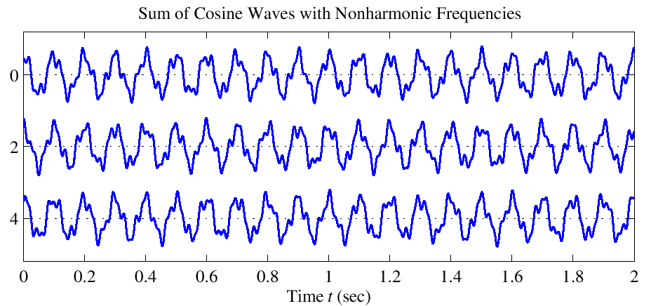
Waveform Synthesis
Time-Frequency Spectrum – SPFirst Sec. 3-7
Figure 3-10: Sum of three cosine waves of harmonic frequencies. Fundamental frequency of x_{h}(t) is 10 Hz.
Figure 3-11: Sum of three cosine waves with nonharmonic frequencies, x₂(t). No exact repetition appears in this signal.
We’ve been assuming spectrum (set of amplitudes, frequencies, and phases) does not change with time
©2003-2016, JH McClellan & RW Schafer

Slide 4
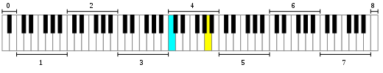







Music – Western Scale – Intro
Time-Frequency Spectrum – SPFirst Sec. 3-7
Octave
https://en.wikipedia.org/wiki/File:Piano_Frequencies.svg
Piano with 88 keys
Key frequencies increase from left to right (27.5 to 4186 Hz)
Middle C at 262 Hz (C4) in cyan & A at 440 Hz (A4) in yellow
Octave has 12 keys and doubles frequencies of previous octave
Octave
C D E F G A B
Sheet music
Music Note Graphics by Vecteezy
F
♯
D
4
B
Frequency
4
E
G
Lyrics
A
B
C
eas - y
as
1
2
3
ah
sim-ple
as
Time
How fast notes are played depends on time signature and beats per minute (bpm)

Slide 5

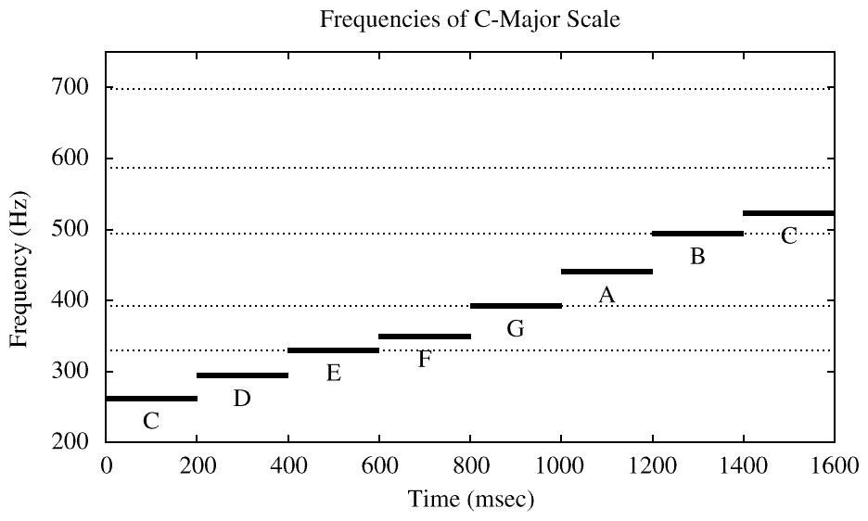
Music – Western Scale – Intro
Time-Frequency Spectrum – SPFirst Sec. 3-7
C major scale
Stepped frequencies
Constant frequency for each note
C4 = 261.626;
D4 = 293.665;
E4 = 329.628;
F4 = 349.228;
G4 = 391.995;
A4 = 440.000;
B4 = 493.883;
C5 = 523.251;
bpm = 60; % 300
beattime = 60/bpm;
fs = 8000;
Ts = 1/fs;
N = beattime/Ts;
t = Ts : Ts : N*Ts;
f = [C4,D4,E4,F4,G4,A4,B4,C5];
vec = zeros(1, length(f)*N);
for i = 1:length(f)
note = cos(2*pi*f(i)*t);
vec((i-1)*N+1 : i*N) = note;
end
sound(vec, fs);
60 bpm
300 bpm
300 bpm
Ideal Analysis

Slide 6
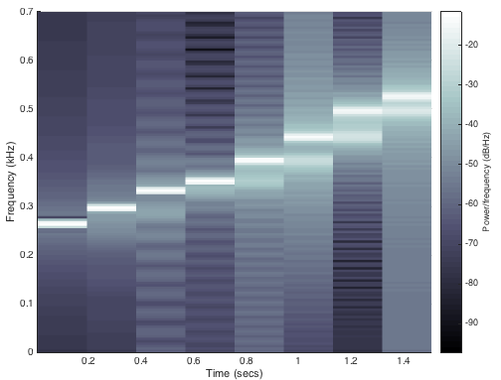
Music – Western Scale – Intro
Time-Frequency Spectrum – SPFirst Sec. 3-7
Analysis of audio clip for C major scale
300 bpm
Artifacts at transitions in notes (more on slide 4-9)
N = beattime * fs; % number of samples in one note
spectrogram(vec, N, 100, N, fs, 'yaxis');
ylim( [0 0.7] ); % focus on 0 to 700 Hz
colormap bone % grayscale mapping
Grayscale map

Slide 7
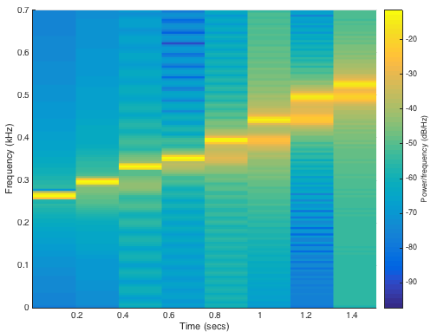

Music – Western Scale – Intro
Time-Frequency Spectrum – SPFirst Sec. 3-7
Analysis of audio clip for C major scale (repeated)
300 bpm
Artifacts at transitions in notes (more on slide 4-9)
N = beattime * fs; % number of samples in one note
spectrogram(vec, N, 100, N, fs, 'yaxis');
ylim( [0 0.7] ); % focus on 0 to 700 Hz
Default map

Slide 8
Spectrogram: Time-Frequency Plot
Time-Frequency Spectrum – SPFirst Sec. 3-7
Breaks signal x(t) into segments of N samples
Computes Fourier series for each segment using FFT
Time-Domain Plot
Spectrogram
x(t)
f
Shift start of segment
Shift start of segment
FFT Segment 1
FFT Segment 2
FFT Segment 3
Segment 1
Segment 2
Segment 3
t
t
Fourier series fundamental period T₀ = N T_{s} is time resolution
Fourier series fundamental frequency $f_{0}=\frac{1}{T_{0}}=\frac{1}{N T_{s}}=\frac{f_{s}}{N}$ is frequency resolution
N Fourier series frequencies $−\frac{1}{2}f_{s}<f<$ $\frac{1}{2}f_{s}$ due to sampling $f_{s}>2 f_{max}$
MATLAB: spectrogram(x, N, overlap, N, fs, ‘yaxis’)

Slide 9
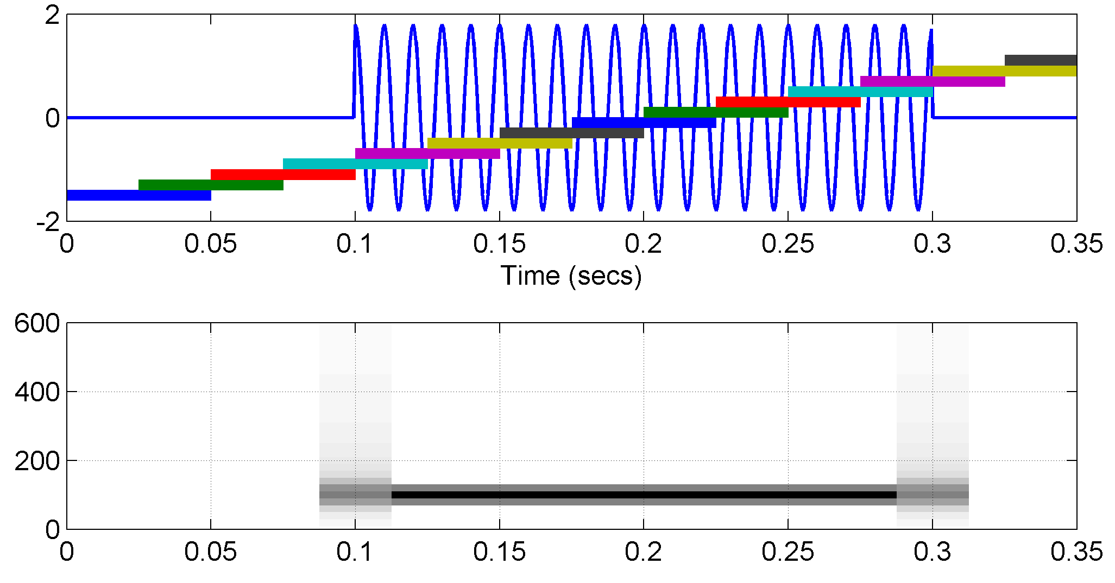
Spectrogram
Time-Frequency Spectrum – SPFirst Sec. 3-7
50% overlap between adjacent segments common
Consider “edge” effects in analyzing short sinusoid
SECTION
LOCATIONS
MIDDLE of SECTION
is REFERENCE TIME
SPFirst adds plotspec (above) and spectgr functions
©2003-2016, JH McClellan & RW Schafer

Slide 10
Chirp Signals
Time-Frequency Spectrum – SPFirst Sec. 3-8
Sinusoid with rising or falling frequency vs. time
Change in frequency occurs continuously
Linear sweep over range of frequencies (e.g. audio test signal)
Revisit sinusoidal signal model
Assumes constant amplitude, frequency and phase over time
Angle in right term ψ(t) = 2 π f₀ t + φ varies linearly with time
Derivative of ψ(t) w/r to t is constant frequency 2 π f₀ in rad/s

Slide 11
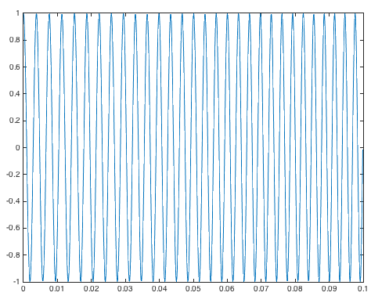
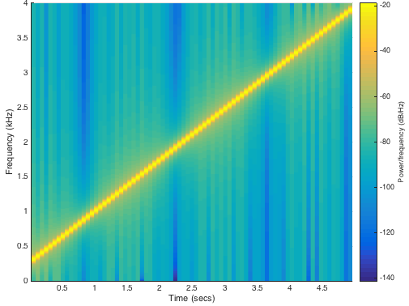
Chirp Signals
Time-Frequency Spectrum – SPFirst Sec. 3-8
Linear sweep 261-3951 Hz
Chirp x(t) = A cos(ψ(t))
where
x(t)
Instantaneous freq. (Hz)
Scaled slope of angle ψ(t)
For x(t) over 0 ≤ t ≤ t_{max}, instantaneous frequency from f₀ to f₀ + 2 μ t_{max}
t
Linear frequency sweep
For 0 ≤ t ≤ t_{max}, sweep f₁ to f₂
f₀ = f₁ and μ = (f₂ – f₁) / (2 t_{max})
Spectrogram

Slide 12
Chirp Signals
MATLAB code for previous slide
fs = 8000;
Ts = 1 / fs;
tmax = 5;
t = 0 : Ts : tmax;
f1 = 261; % note C4
f2 = 3951; % note B7
f0 = f1;
mu = (f2 - f1) / (2*tmax);
phi = 0;
angle = 2*pi*mu*t.^2 + 2*pi*f0*t + phi;
x = cos(angle);
sound(x, fs);
figure;
plot(t(1:800), x(1:800));
figure;
spectrogram(x, 1024, 512, 1024, fs, 'yaxis');

Slide 13
License Info for SPFirst Slides
McClellan, Schafer &Yoder have released their work under a Creative Commons License with the following terms:
Attribution
The licensor permits others to copy, distribute, display, and perform the work. In return, licensees must give the original authors credit.
Non-Commercial
The licensor permits others to copy, distribute, display, and perform the work. In return, licensees may not use the work for commercial purposes—unless they get the licensor's permission.
Share Alike
The licensor permits others to distribute derivative works only under a license identical to the one that governs the licensor's work.
Full Text of the License
This (hidden) page should be kept with the presentation
©2003-2016, JH McClellan & RW Schafer
4-13

