Slide 1
Sampling and Aliasing
EE 313 Linear Systems and Signals Fall 2024
Prof. Brian L. Evans
Dept. of Electrical and Computer Engineering
The University of Texas at Austin
Textbook: McClellan, Schafer & Yoder, Signal Processing First, 2003
Lecture 5 http://www.ece.utexas.edu/~bevans/courses/signals

Slide 2
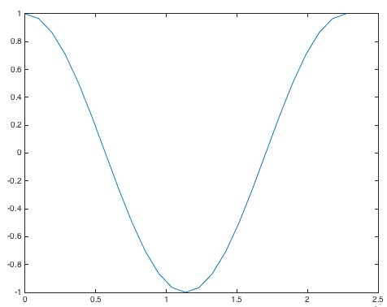
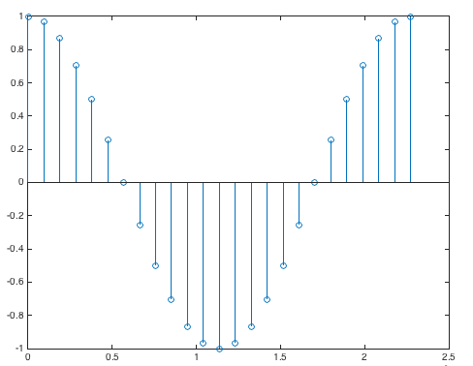
Introduction
Sampling and Reconstruction– SPFirst Ch. 4 Intro
Conversion of signals
Sampling: Continuous-Time to Discrete-Time
Reconstruction: Discrete-Time to Continuous-Time
f0 = 440;
fs = 24*f0;
Ts = 1/fs;
tmax = 1/f0;
t = 0 : Ts : tmax;
x = cos(2*pi*f0*t);
plot(t, x);
figure;
stem(t, x);
sampling
reconstruction
t
cosine at 440 Hz
sampling rate: 10560 Hz sampling period: 94.7 μs

Slide 3
Sampling and Reconstruction
Sampling and Reconstruction– SPFirst Ch. 4 Intro and Sec. 4-1.4
Sampling Theorem
Continuous-time signal x(t) with frequencies no higher than f_{max} can be reconstructed exactly from its samples x(n T_{s}) if samples taken at sampling rate of f_{s} > 2 f_{max}
Sampling audio CD signals
Normal human hearing is from about 20 Hz to 20 kHz
Filter analog continuous-time signal to pass frequencies up to 20 kHz and reject frequencies above 22 kHz
Sample filtered signal at sampling rate of 44100 Hz
Reconstruction fills in missing values between sampling times (e.g. interpolation)

Slide 4
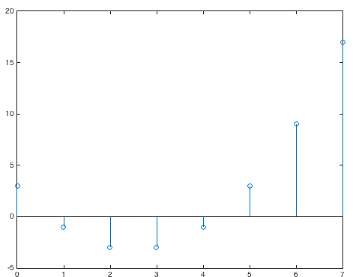
Discrete-Time Signals
Sampling– SPFirst Sec. 4-1
Many signals originate in continuous time
Example: Talking on smart phone or playing live music
Sample continuous-time signal at equally-spaced points in time to obtain a sequence of numbers
s[n] = s(n T_{s}) for n ∈ {…, -1, 0, 1, …}
How to choose sampling period T_{s} ?
Sampled analog waveform
s(t)
T_{s}
t
T_{s}
Using a formula
x[n] = n² – 5n + 3
How does it look in continuous time?
x[n]
See also SPFirst Fig. 4-2
n = 0 : 7;
x = n.^2 - 5*n + 3;
stem(n, x);
n

Slide 5
Sampling Sinusoidal Signals
Sampling– SPFirst Sec. 4-1.1
Analog continuous-time signals
Sinusoids model physical quantities such as musical tones
Sums of sinusoids can represent general continuous-time signals
Sampling sinusoidal signal x(t) = A cos(ω t + φ)
where the normalized radian frequency is
Discrete time n abstracts away continuous time information
Discrete-time frequency abstracts away continuous-time frequency information

Slide 6

Discrete-Time Frequency
Sampling– SPFirst Sec. 4-1.1
Examples
Application | Sampling Rate | Continuous-Time Frequency | Discrete-Time Frequency
Speech | 8000 Hz | 220 Hz | 2 π 11/400 = 0.1728
Audio | 44100 Hz | 441 Hz | 2 π 1/100 = 0.0628
Audio | 48000 Hz | 1320 Hz | 2 π 11/400 = 0.1728
Comparing first and third rows
Same gives same discrete-time signal x[n]
Different tone when x[n] is played at sampling rate 8000 Hz vs. 48000 Hz
n = 1 : 48000;
wHat = 0.1728;
x = cos(wHat*n);
sound(x, 8000);
pause(3);
sound(x, 48000);

Slide 7
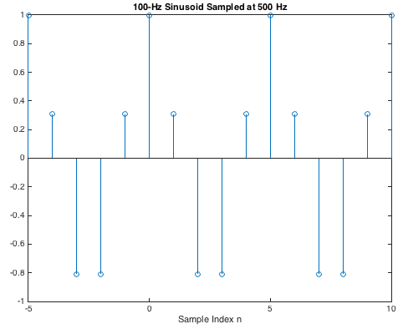
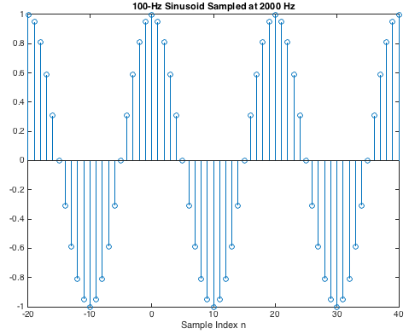
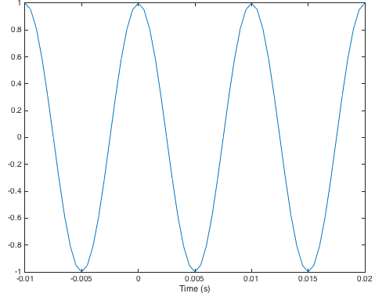
How to Pick a Sampling Rate?
Sampling– SPFirst Sec. 4-1.1
Sampling theorem
Sampling rate f_{s} > 2 f_{max}
Larger f_{s} tracks waveform shape better in time
f_{s} = 5 f_{max} = 2.5 (2 f_{max}) is 2.5 times oversampling
f_{s} =500 Hz
2.5x oversampling
f_{s} =2000 Hz
Cosine at f₀ =100 Hz
10x oversampling
Used 10x oversampling to generate continuous-time plot
See also SPFirst Fig. 4-3

Slide 8
How to Pick a Sampling Rate?
Sampling– SPFirst Sec. 4-1.1
f0 = 100;
tmin = -0.01; tmax = 0.02;
fs = 5*f0; Ts = 1/fs;
wHat = 2*pi*f0/fs;
nmin = round(tmin / Ts);
nmax = round(tmax / Ts);
n = nmin : nmax;
x2 = cos(wHat*n);
figure; stem(n, x2);
xlabel('Sample Index n');
title('100-Hz Sinusoid Sampled at 500 Hz');
MATLAB code
For previous slide
f_{s} =500 Hz
2.5x oversampling
f_{s} =2000 Hz
10x oversampling
f0 = 100;
tmin = -0.01; tmax = 0.02;
fs = 20*f0; Ts = 1/fs;
wHat = 2*pi*f0/fs;
nmin = round(tmin / Ts);
nmax = round(tmax / Ts);
n = nmin : nmax;
x1 = cos(wHat*n);
figure; stem(n, x1);
xlabel('Sample Index n');
title('100-Hz Sinusoid Sampled at 2000 Hz');
Cosine at f₀ =100 Hz
f0 = 100;
tmin = -0.01; tmax = 0.02;
fs = 20*f0; Ts = 1/fs;
t = tmin : Ts : tmax;
x = cos(2*pi*f0*t);
figure;
plot(t, x);
xlabel('Time (s)');
title('Continuous-Time Sinusoid at 100 Hz');
Used 10x oversampling to generate continuous-time plot

Slide 9
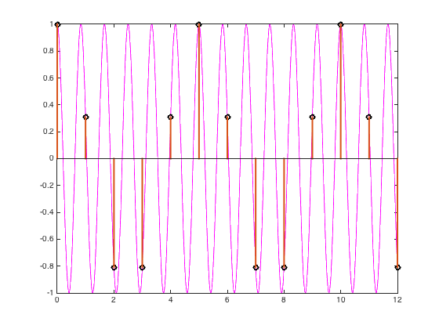
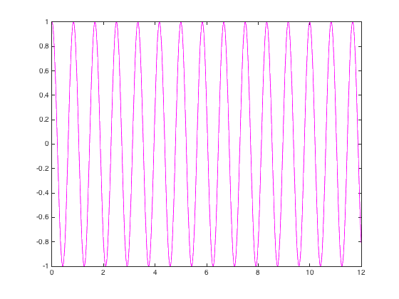
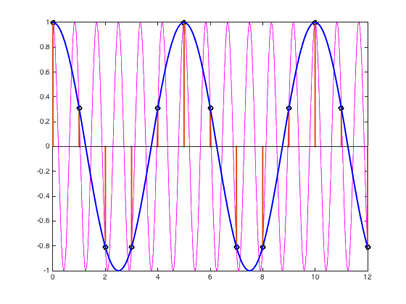
Aliasing
Sampling– SPFirst Sec. 4-1.2
Definition for “alias” [dictionary.com]
“a false name used to conceal one's identity; an assumed name”
Is x₂[n]=cos(2.4πn) an alias for x₁[n]=cos(0.4πn)?
x₂[n] = cos(2.4πn) = cos(0.4πn + 2πn) = cos(0.4πn) = x₁[n]
f₂ = 1.2 Hz
Sample at f_{s} = 1 Hz
f₁ = 0.2 Hz
See also SPFirst Fig. 4-4

Slide 10
Aliasing
Sampling– SPFirst Sec. 4-1.2
MATLAB code from previous slide
%% Part 1: Define Signals
wHat = 0.4*pi;
nmax = 12;
n = 0:nmax;
x1 = cos(wHat*n);
x2 = cos(2.4*pi*n);
fs = 1;
f1 = 0.2;
w1Hat = 2*pi*f1/fs;
period = round(fs/f1);
f2 = 1.2;
w2Hat = 2*pi*f2/fs;
Ts = 1/fs;
tmax = (nmax/period)*(1/f1);
t = 0 : (Ts/100) : tmax;
x1cont = cos(2*pi*f1*t);
x2cont = cos(2*pi*f2*t);
%% Part 2: Generate Plots
figure;
plot(t, x2cont, 'm-', 'LineWidth', 1);
figure;
plot(t, x2cont, 'm-', 'LineWidth', 1);
hold;
stem(n, x1, 'Linewidth', 2, 'MarkerEdgeColor', 'black');
stem(n, x2, 'Linewidth', 2, 'MarkerEdgeColor', 'black');
figure;
plot(t, x2cont, 'm-', 'LineWidth', 1);
hold;
stem(n, x1, 'Linewidth', 2, 'MarkerEdgeColor', 'black');
stem(n, x2, 'Linewidth', 2, 'MarkerEdgeColor', 'black');
plot(t, x1cont, 'b-', 'LineWidth', 2);

Slide 11
Aliasing
Sampling– SPFirst Sec. 4-1.2
Continuous-time sinusoid
x(t) = A cos(2π f₀ t + φ)
Sample at T_{s} = 1/f_{s}
x[n] = x(T_{s}n) = A cos(2π f₀ T_{s} n + φ)
Keeping the sampling period same, sample
y(t) = A cos(2π (f₀ + l f_{s}) t + φ)
where l is an integer
y[n] = y(T_{s}n) = A cos(2π(f₀ + lf_{s})T_{s}n + φ) = A cos(2πf₀T_{s}n + 2πlf_{s}T_{s}n + φ) = A cos(2πf₀T_{s}n + 2πln + φ) = A cos(2πf₀T_{s}n + φ) = x[n]
Here, f_{s}T_{s} = 1
Since l is an integer, cos(x + 2 π l) = cos(x)
y[n] indistinguishable from x[n]

Slide 12
Another Kind of Aliasing (Folding)
Sampling– SPFirst Sec. 4-1.2
Continuous-time sinusoid
x(t) = A cos(-2π f₀ t + φ)
Sample at T_{s} = 1/f_{s}
x[n] = x(T_{s}n) = A cos(-2π f₀ T_{s} n + φ)
Keeping the sampling period same, sample
y(t) = A cos(2π (-f₀ + l f_{s}) t + φ)
where l is an integer
y[n] = y(T_{s}n) = A cos(2π(-f₀ + lf_{s})T_{s}n + φ) = A cos(-2πf₀T_{s}n + 2πlf_{s}T_{s}n + φ) = A cos(-2πf₀T_{s}n + 2πln + φ) = A cos(-2πf₀T_{s}n + φ) = x[n]
Here, f_{s}T_{s} = 1
Since l is an integer, cos(x + 2 π l) = cos(x)
y[n] indistinguishable from x[n]

Slide 13
Spectrum of a Discrete-Time Signal
Sampling– SPFirst Sec. 4-1.3
Spectrum of a sinusoidal signal
½
Frequency components at and
Example: Two of the aliases for x₁[n] = cos(0.4πn)
x₂[n] = cos(2.4πn) = cos(0.4πn + 2πn) = cos(0.4πn) = x₁[n]
x₃[n] = cos(-1.6πn) = cos(0.4πn − 2πn) = cos(0.4πn) = x₁[n]
Only need to add principal frequency components for synthesis
½
−2.4π
−1.6π
−0.4π
0.4π
1.6π
2.4π
Aliases
Principal Components
Aliases

Slide 14
Ideal Reconstruction
Sampling– SPFirst Sec. 4-1.5
Sampling theorem
Possible to reconstruct continuous-time signal from samples
Does not say how to do it
Reconstruction: Ideal case
Need a formula for signal of one or more sinusoids
Consider y[n] = A cos(2 π f₀ n T_{s} + φ) where f_{s} > 2 f₀
Practical?
Reconstruction: Practical case
Interpolation fills in values between samples
There are other approaches to “undo” sampling process

Slide 15
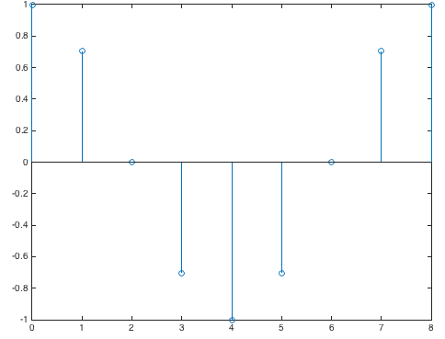
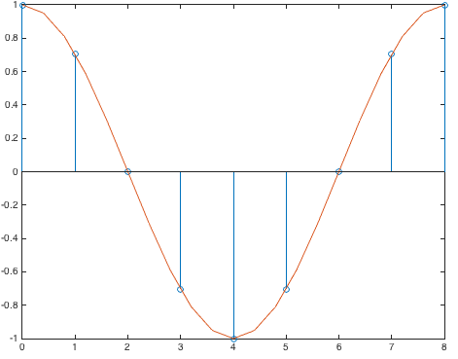
Discrete-to-Continuous Conversion
Sampling– SPFirst Sec. 4-1.5
Input: sequence of samples y[n]
Output: continuous-time signal y(t) via interpolation (“connecting the dots”)
Example: Cosine of frequency f₀
From sampling theorem, f_{s} > 2 f₀ or f₀ < ½ f_{s}
%% y[n] is sinusoid w/
%% period of 8 samples
f0 = 0.125;
fs = 1;
wHat = 2*pi*f0/fs;
n = 0 : 8;
yofn = cos(wHat*n);
fs = 20*f0;
Ts = 1/fs;
t = 0 : Ts : (1/f0);
yoft = cos(2*pi*f0*t);
figure;
stem(n, yofn);
figure;
stem(n, yofn);
hold
plot(t, yoft);

Slide 16
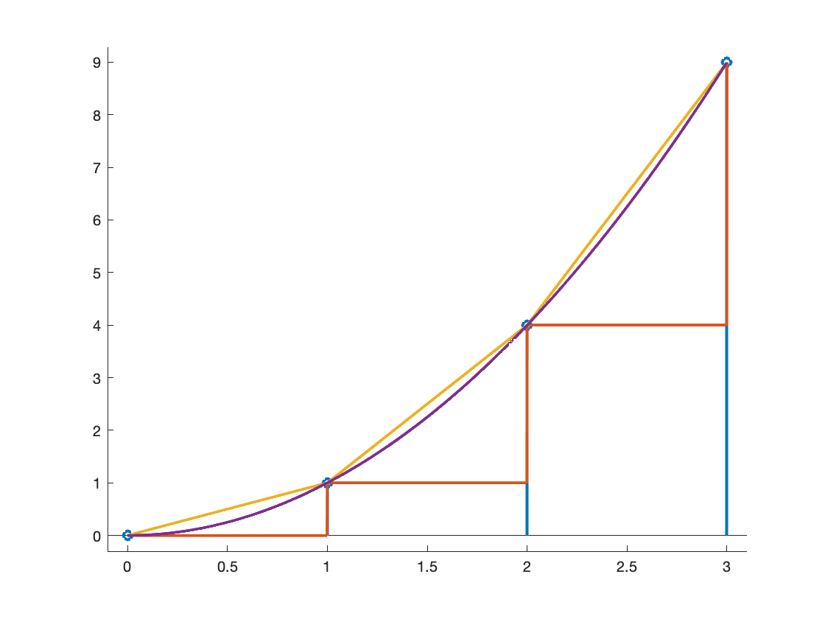
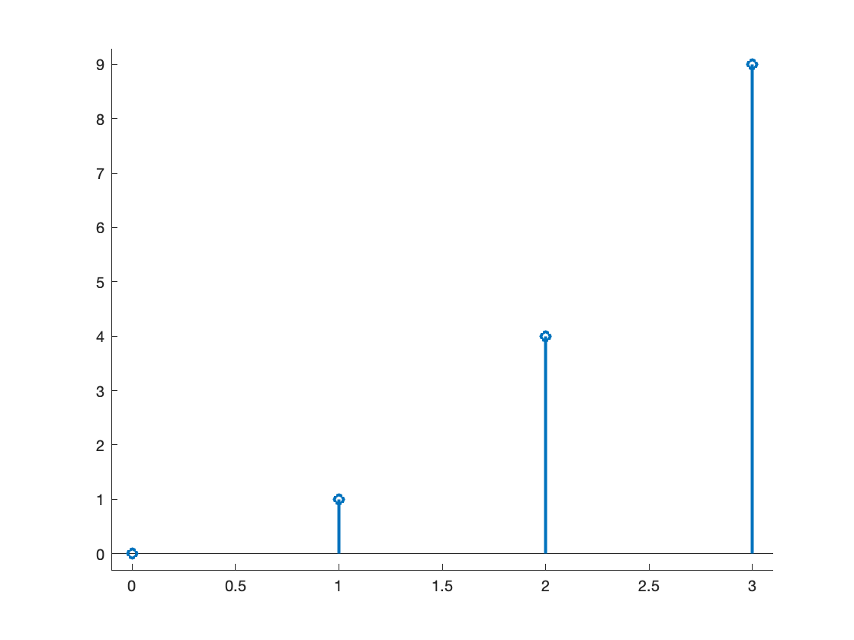
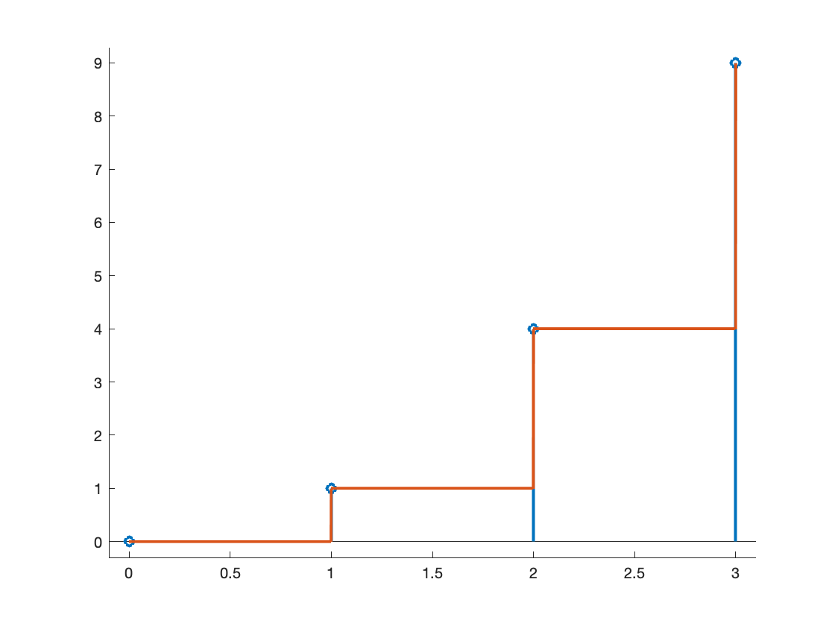
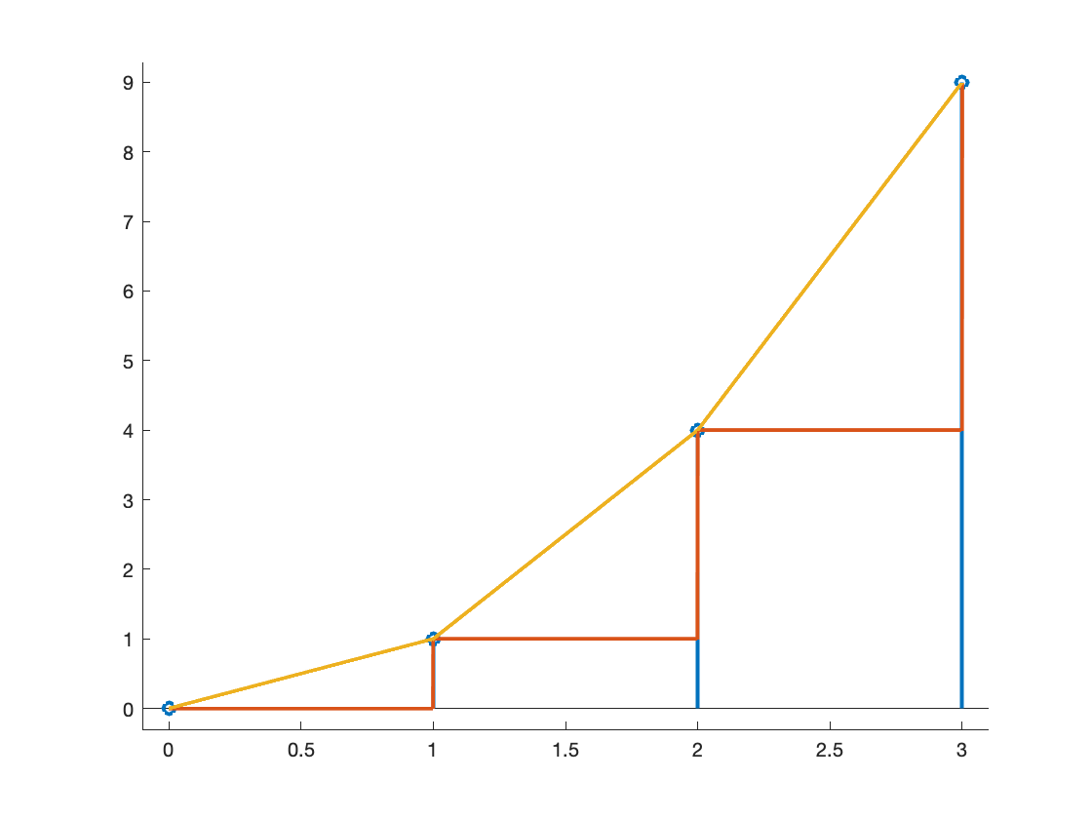
Interpolation From Tables
Sampling– SPFirst Sec. 4-1.5
Using mathematical tables to estimate a function value
x | f(x)
0 | 0.0
1 | 1.0
2 | 4.0
3 | 9.0
Estimate f(1.5) from table
Zero-order hold: take value to be f(1) to make f(1.5) = 1.0 (“stairsteps”) No multiplications or additions
Linear interpolation: average values of nearest two neighbors: f(1.5) = 2.5 2 multiplications and 3 additions per value
f(x)
Curve fitting: fit four points to cubic polynomial: f(1.5) = x² = 2.25 43 multiplications to find polynomial coefficients + 1 multiplication per value
x
Notes:
xmin = 0;
xmax = 3;
xoffset = 0.1;
yoffset = 0.3;
%%% Samples
xsamples = xmin : xmax;
ysamples = xsamples .^ 2;
figure;
hold on;
stem(xsamples, ysamples, 'LineWidth', 2);
xlim( [xmin-xoffset xmax+xoffset] );
ymax = max(ysamples);
ylim( [-yoffset ymax+yoffset] );
pause;
%%% Interpolation
N = 1000;
xstep = 1/N;
x = [ xmin : xstep : xmax ];
yzoh = floor(x) .^ 2;
plot(x, yzoh, 'LineWidth', 2);
pause;
y1 = x;
y2 = 3*x - 2;
y3 = 5*x - 6;
ylinear = [ y1(1:N) y2(N+1:2*N) y3(2*N+1:3*N+1) ];
plot(x, ylinear, 'LineWidth', 2);
pause;
yspline = x .^ 2;
plot(x, yspline, 'LineWidth', 2);
hold off;

Slide 17
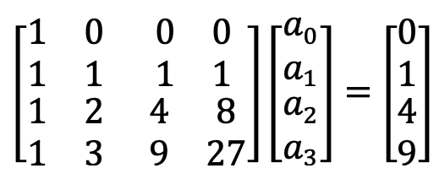



Curve Fitting
Sampling– SPFirst Sec. 4-1.5
Interpolate over 1 < x < 2 using cubic polynomial
f(x) = a₀ + a₁ x + a₂ x² + a₃ x³
f(0) = 0 = a₀
f(1) = 1 = a₀ + a₁ + a₂ + a₃
f(2) = 4 = a₀ + 2 a₁ + 4 a₂ + 8 a₃
f(3) = 9 = a₀ + 3 a₁ + 9 a₂ + 27 a₃
Matlab code to solve for
A
(2/3)n³ operations to solve system of n equations
A = [ 1 0 0 0; 1 1 1 1; 1 2 4 8; 1 3 9 27 ]; b = [ 0; 1; 4; 9 ]; a = A \ b;
a₂ = 1 and a₀ = a₁ = a₃ = 0 to give f(x) = x²

Slide 18
License Info for SPFirst Slides
McClellan, Schafer &Yoder have released their work under a Creative Commons License with the following terms:
Attribution
The licensor permits others to copy, distribute, display, and perform the work. In return, licensees must give the original authors credit.
Non-Commercial
The licensor permits others to copy, distribute, display, and perform the work. In return, licensees may not use the work for commercial purposes—unless they get the licensor's permission.
Share Alike
The licensor permits others to distribute derivative works only under a license identical to the one that governs the licensor's work.
Full Text of the License
This (hidden) page should be kept with the presentation
©2003-2016, JH McClellan & RW Schafer
5-18

