Slide 1
Sampling Theorem
EE 313 Linear Systems and Signals Fall 2024
Prof. Brian L. Evans
Dept. of Electrical and Computer Engineering
The University of Texas at Austin
Textbook: McClellan, Schafer & Yoder, Signal Processing First, 2003
Lecture 6 http://www.ece.utexas.edu/~bevans/courses/signals

Slide 2
Linear Systems and Signals Topics
Sampling Theorem – SPFirst Ch. 4
Domain | Topic | Discrete Time | Continuous Time
Time | Signals | SPFirst Ch. 4 | SPFirst Ch. 2
 | Systems | SPFirst Ch. 5 | SPFirst Ch. 9
 | Convolution | SPFirst Ch. 5 | SPFirst Ch. 9
Frequency | Fourier series | ** | SPFirst Ch. 3
 | Fourier transforms | SPFirst Ch. 6 | SPFirst Ch. 11
 | Frequency response | SPFirst Ch. 6 | SPFirst Ch. 10
Generalized Frequency | z / Laplace Transforms | SPFirst Ch. 7-8 | Supplemental Text
 | Transfer Functions | SPFirst Ch. 7-8 | Supplemental Text
 | System Stability | SPFirst Ch. 8 | SPFirst Ch. 9
Mixed Signal | Sampling | SPFirst Ch. 4 | SPFirst Ch. 12
✔
✔
✔
✔
➔
** Spectrograms (Ch. 3) for time-frequency spectrums (plots) computed the discrete-time Fourier series for each window of samples.

Slide 3
Sampling Theorem
Sampling Theorem – SPFirst Sec.4-1.4 and 4.2 Intro
Continuous-time signal x(t) with frequencies no higher than f_{max} can be reconstructed from its samples x(n T_{s}) if samples taken at rate f_{s} > 2 f_{max}
Nyquist rate = 2 f_{max}
Nyquist frequency = f_{s} / 2
What happens if f_{s} = 2 f_{max}?
SPFirst sampling and interpolation demo
Distance between two zero crossings: one half period
How to compute sinusoidal frequency from zero crossings?
Is frequency content of sinusoid preserved after sampling?
What is the quality of sampled vs. original signal in time domain as sampling rate increases above Nyquist rate?
link

Slide 4
Spectrum of Discrete-Time Signal
Spectrum Due to Sampling – SPFirst Sec.4-1.5 and 4-2.1
Sampling a sinusoidal signal x(t) = A cos(ω₀ t + φ)
Frequency of discrete-time signal is
Including aliased frequencies
Has two spectral lines at
Also contains all aliases due to periodicity of exp(j θ):

Slide 5
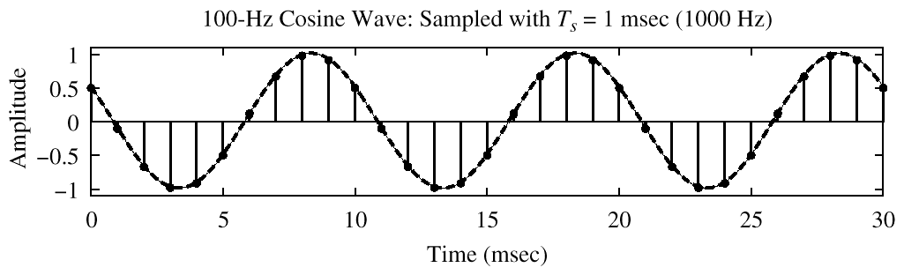
Case #1: Oversampling
Oversampling – SPFirst Sec. 4-2.2
Sampling rate f_{s} > 2 f_{max} to avoid aliasing & folding
Example: f₀ = 100 Hz and f_{s} = 1000 Hz
where
–1.8π
–0.2π
0.2π
1.8π
See also SPFirst Fig. 4-8
©2003-2016, JH McClellan & RW Schafer

Slide 6
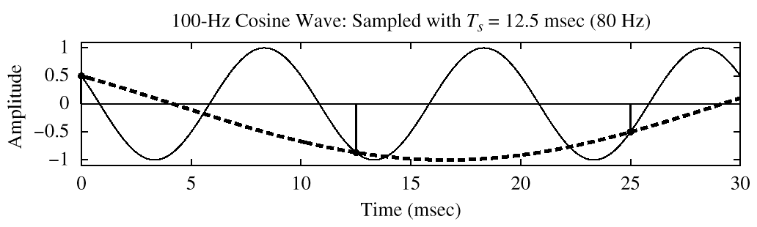
Case #2: Aliasing by Undersampling
Aliasing – SPFirst Sec. 4-2.3
Sampling rate f_{s} ≤ 2 f_{max}
Example: f₀ = 100 Hz and f_{s} = 80 Hz
where
–2.5π
–1.5π
–0.5π
0.5π
1.5π
2.5π
See also SPFirst Fig. 4-9
©2003-2016, JH McClellan & RW Schafer

Slide 7
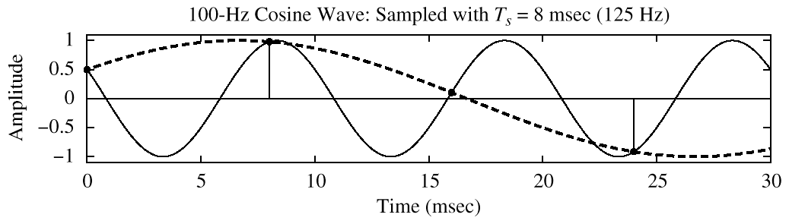
Case #3: Folding by Undersampling
Folding – SPFirst Sec. 4-2.4
Sampling rate f_{max} < f_{s} ≤ 2 f_{max} as special case of #2
Example: f₀ = 100 Hz and f_{s} = 125 Hz
where
–1.6π
–0.4π
0.4π
1.6π
See also SPFirst Fig. 4-11
©2003-2016, JH McClellan & RW Schafer

Slide 8
Folding Due to Undersampling
Folding – SPFirst Sec. 4-2.4
Sinusoid sin(2 π f_{input} t) sampled at f_{s} = 2000 samples/s with f_{input} varied
f_{s} = 2000 samples/s
1000
Apparent frequency (Hz)
See also SPFirst Fig. 4-12
1000
2000
3000
4000
Input frequency, f_{input} (Hz)
Mirror image effect about f_{input} = ½ f_{s} gives rise to name of folding (see next slide)

Slide 9
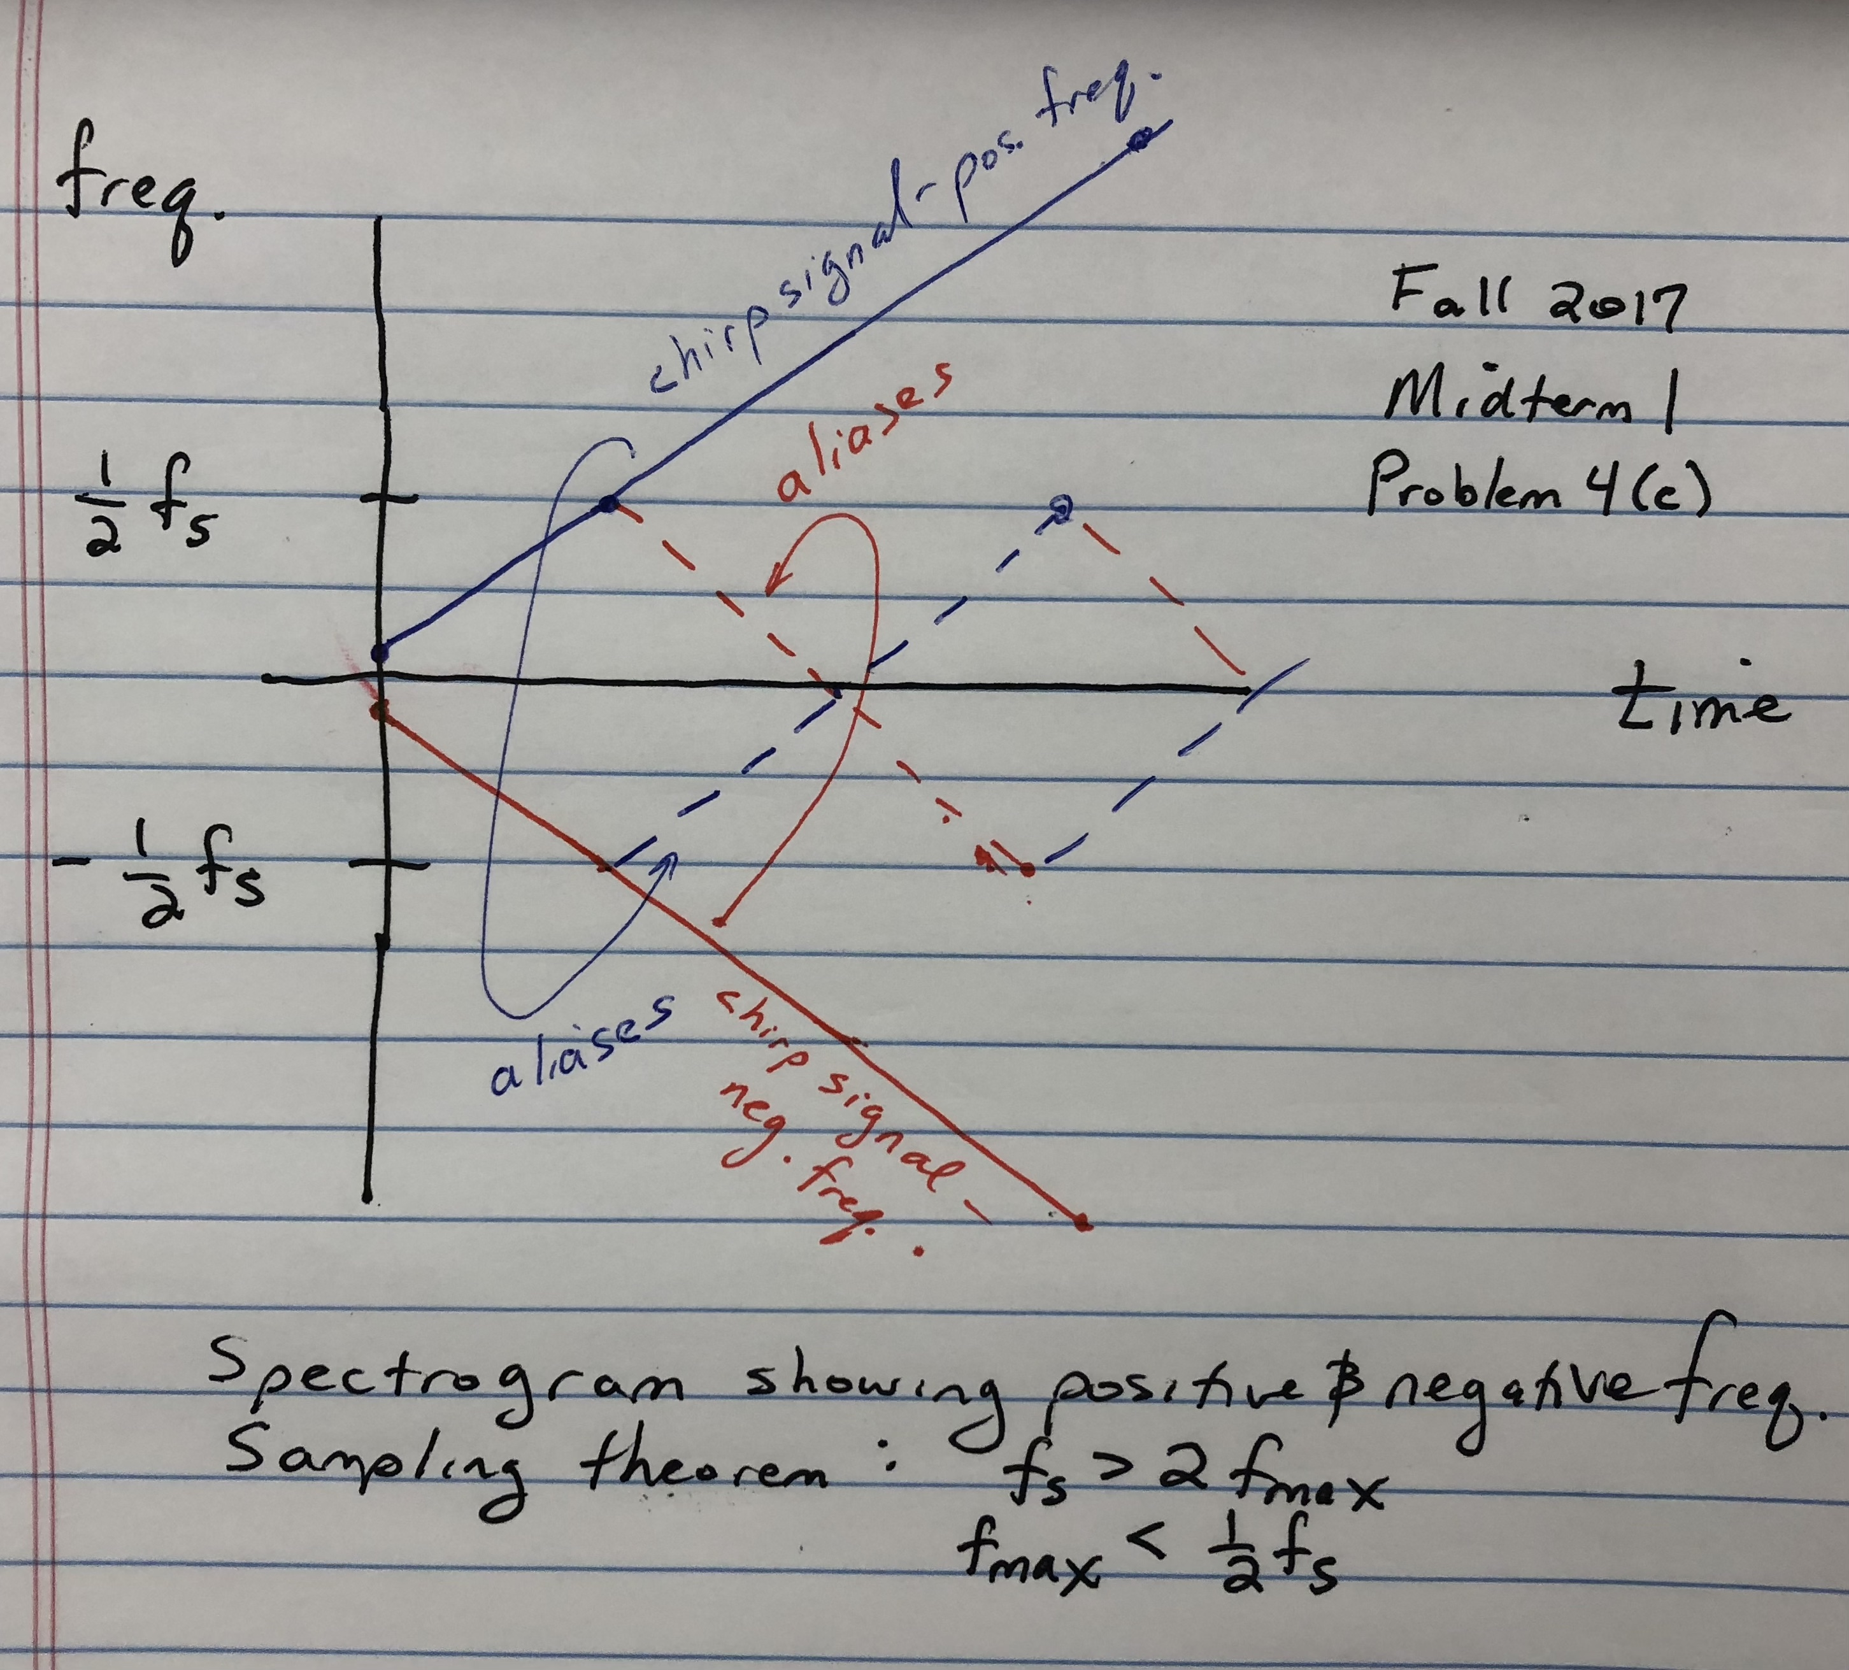
Folding Due to Undersampling

Slide 10
Aliasing & Folding Demonstrations
Sampling Theorem – SPFirst Sec. 4-2
Case #1 Oversampling
Third demo: f₀ = 600 Hz and f_{s} = 2000 Hz
Case #2 Aliasing
First demo: f₀ = 600 Hz and f_{s} = 500 Hz
Case #3 Folding
Second demo: f₀ = 600 Hz and f_{s} = 750 Hz
Reconstructed signal
Has frequencies between –½ f_{s} and ½ f_{s}
link
http://dspfirst.gatech.edu/chapters/04samplin/demos/aliasing/index.html

Slide 11
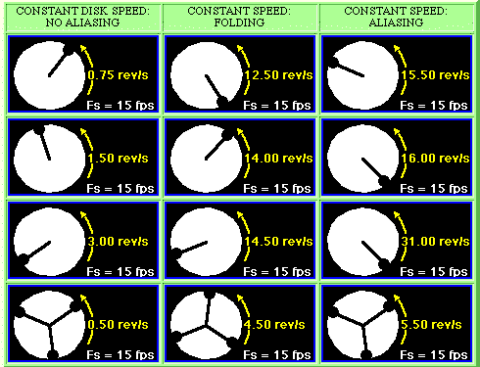
Strobe Demonstrations
Strobe Demonstrations – SPFirst Sec. 4-3
link
©2003-2016, JH McClellan & RW Schafer

Slide 12
Discrete-to-Continuous Conversion
Sampling & Reconstruction – SPFirst Sec. 4-4.1
General form of interpolation is sum of weighted pulses
Input: discrete-time sequence y[n]
Output: continuous-time signal that is an approximation of y(t)
Pulse function p(t)
Unit amplitude and/or unit area
Rectangular, triangular, sinc, truncated sinc, etc.
Overlaps in time with other pulses when duration > T_{s}

Slide 13
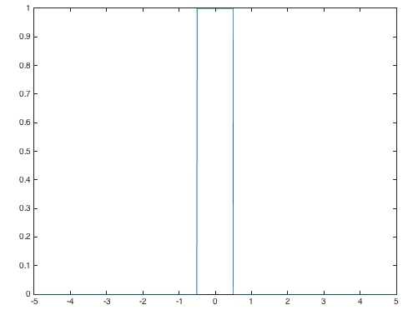
Zero-Order Hold
D-to-C Conversion– SPFirst Sec. 4-4.2
Rectangular pulse
Easy to implement in hardware or software
In time, no overlap between p(t) and adjacent pulses p(t - T_{s}) and p(t + T_{s})
Plot of pulse p(t)
Ts = 1;
t = -5 : 0.01 : 5;
p = rectpuls(t/Ts);
plot(t, p)
Symmetry about origin?
Value of p(0)?
Value of p(-0.5*T_{s})?
Value of p(0.5*T_{s})?

Slide 14
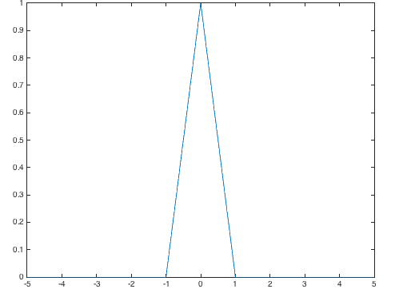
Linear Interpolation
D-to-C Conversion– SPFirst Sec. 4-4.3
Triangular pulse
Easy to implement in hardware or software
Zero-order hold even easier
Overlap between p(t) and its adjacent pulses p(t - T_{s}) and p(t + T_{s})
No overlap with others
Plot of pulse p(t)
Ts = 1;
t = -5 : 0.01 : 5;
p = tripuls(t/(2*Ts));
plot(t, p)
Symmetry about origin?
Value of p(0)?
Value of p(-T_{s})?
Value of p(T_{s})?

Slide 15
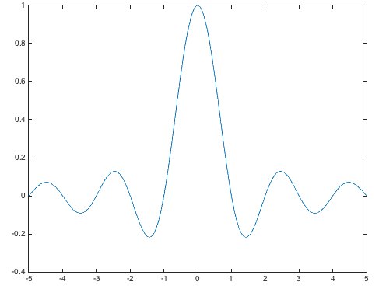
Ideal Bandlimited Interpolation
D-to-C Conversion– SPFirst Sec. 4-4.6 and 11-4.2
Sinc pulse
In time, infinite overlap with other sinc pulses
Plot of pulse p(t)
Ts = 1;
t = -5 : 0.01 : 5;
p = sinc(t/Ts);
plot(t, p)
Interpolate in time w/ infinite extent pulse?
Make it finite in extent
Truncate sinc pulse by multiplying it by rectangular pulse
Symmetry about origin?
Where are the zero crossings?
Amplitude decrease vs. time?
Why is sinc(0) = 1?

Slide 16
Sampling and Interpolation Demo
D-to-C Conversion– SPFirst Sec. 4-4.6
Sampling and interpolation demo (revisited) http://dspfirst.gatech.edu/chapters/04samplin/demos/recon/index.html/
Sampling
Continuous to Discrete Time Conv.
Discrete to Continuous Time Conv.
Reconstruction
f_{s}
f_{s}
Does the rectangular, triangular, or truncated sinc pulse shape give the best reconstruction?
Sinc pulse is truncated to be four sampling periods long. Why is the sinc pulse truncated?
What happens as the sampling rate is increased?

Slide 17
Sampling & Reconstruction
Sampling Theorem– SPFirst Sec. 4-5
Continuous-time signal x(t) with frequencies no higher than f_{max} can be reconstructed from its samples x(n T_{s}) if samples taken at rate f_{s} > 2 f_{max}
x(t) bandlimited: limited to band of frequencies -f_{max} ≤ f ≤ f_{max}
Represent
Can represent periodic & non-periodic signals (slides 4-2/4-3)
Sampling
Reconstruction

Slide 18
License Info for SPFirst Slides
McClellan, Schafer &Yoder have released their work under a Creative Commons License with the following terms:
Attribution
The licensor permits others to copy, distribute, display, and perform the work. In return, licensees must give the original authors credit.
Non-Commercial
The licensor permits others to copy, distribute, display, and perform the work. In return, licensees may not use the work for commercial purposes—unless they get the licensor's permission.
Share Alike
The licensor permits others to distribute derivative works only under a license identical to the one that governs the licensor's work.
Full Text of the License
This (hidden) page should be kept with the presentation
©2003-2016, JH McClellan & RW Schafer
6-18

