Slide 1
Discrete-Time Systems
EE 313 Linear Systems and Signals Fall 2024
Prof. Brian L. Evans
Dept. of Electrical and Computer Engineering
The University of Texas at Austin
Textbook: McClellan, Schafer & Yoder, Signal Processing First, 2003
Lecture 7 http://www.ece.utexas.edu/~bevans/courses/signals

Slide 2
Linear Systems and Signals Topics
Discrete-Time Systems – SPFirst Sections 5-1 to 5-4
Domain | Topic | Discrete Time | Continuous Time
Time | Signals | SPFirst Ch. 4 | SPFirst Ch. 2
 | Systems | SPFirst Ch. 5 | SPFirst Ch. 9
 | Convolution | SPFirst Ch. 5 | SPFirst Ch. 9
Frequency | Fourier series | ** | SPFirst Ch. 3
 | Fourier transforms | SPFirst Ch. 6 | SPFirst Ch. 11
 | Frequency response | SPFirst Ch. 6 | SPFirst Ch. 10
Generalized Frequency | z / Laplace Transforms | SPFirst Ch. 7-8 | Supplemental Text
 | Transfer Functions | SPFirst Ch. 7-8 | Supplemental Text
 | System Stability | SPFirst Ch. 8 | SPFirst Ch. 9
Mixed Signal | Sampling | SPFirst Ch. 4 | SPFirst Ch. 12
✔
✔
➔
✔
✔
✔
** Spectrograms (Ch. 3) for time-frequency spectrums (plots) computed the discrete-time Fourier series for each window of samples.

Slide 3
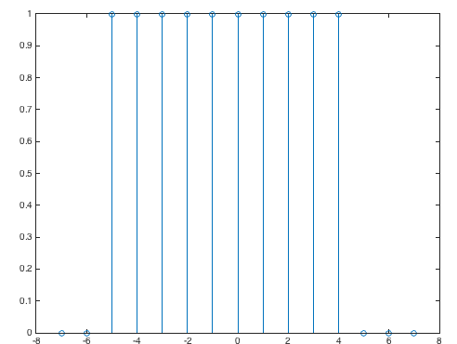
Discrete-Time Signals & Systems
Discrete-Time Systems – SPFirst Ch. 5 Intro & Sec. 5-1
Discrete-time signals (see slide 2-9)
  Formula: x[n] = cos((π/2) n) useful in analysis
  Samples: xvec = [1 0 -1 0 1 0 -1 0] useful in simulation
  Properties: even symmetric useful in reasoning
  Piecewise: v[n] = rectpuls(n/10)
Discrete-time systems
  Produce output signal from input signal
  Squaring: y[n] = x²[n]
  Averaging: y[n] = ½ x[n] + ½ x[n-1]
x[n]
T{•}
y[n]
see slide 1-18
n = -7 : 7;
v = rectpuls(n/10);
stem(n, v);
Width is 10 samples

Slide 4

Running-Average Filter
The Running Average Filter – SPFirst Sec. 5-2
Filter alters input
  Removes component or modifies characteristic
coffee filter
[Wikipedia]
Finite impulse response (FIR) filter
  Each output sample is finite sum of weighted input samples
Running-average (a.k.a. moving average) filter
  Each output sample is average of finite number of input samples
  Example: y[n] = ( x[n] + x[n+1] + x[n+2] ) / 3
See also
SPFirst Figs.
5-2 & 5-3
sliding window
x[n]
y[n]
6
6
4
4
2
-3
-2
-1
0
1
2
3
4
5
6
7
n
-3
-2
-1
0
1
2
3
4
5
6
7
n

Slide 5
Running-Average Filter
The Running Average Filter – SPFirst Sec. 5-2
Noncausal filter
  Uses future input values (as in example on previous slide)
  Buffer input signal before computing nth output sample
Causal filter
  Only uses present and past input values
  Compute nth output sample when nth input sample arrives
  Example: y[n] = ( x[n] + x[n-1] + x[n-2] ) / 3
sliding window
x[n]
y[n]
6
6
4
4
2
-3
-2
-1
0
1
2
3
4
5
6
7
n
-3
-2
-1
0
1
2
3
4
5
6
7
n

Slide 6
General FIR Filter
The Running Average Filter – SPFirst Sec. 5-3
Causal FIR filter
  Sliding window of M+1 samples
  M+1 filter coefficients b₀, b₁, …, b_{M}
  Vector dot product of [b₀ b₁ … b_{M}] and [x[n] x[n-1] … x[n-M]]
Averaging filter
  Three terms: filter order M = 2 and b_{k} = 1/3 for k = 0, 1, 2
  General case: b_{k} = 1/(M+1) for k = 0, 1, …, M
Coefficients completely define filter
  Example: { b_{k} } = { 1, -1 } gives y[n] = x[n] – x[n-1]
  Example: { b_{k} } = { 1, 0, -1 } gives y[n] = x[n] – x[n-2]

Slide 7
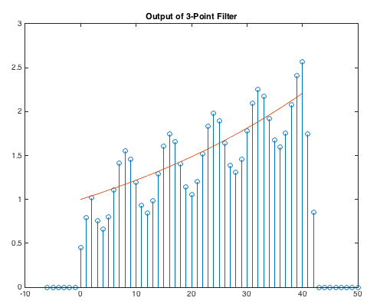
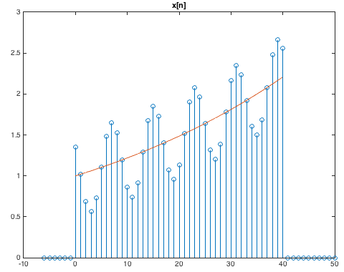
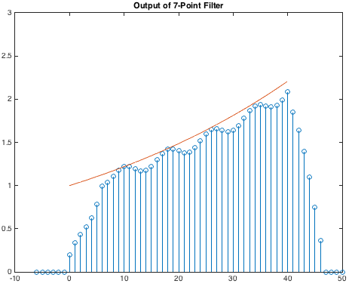
FIR Filtering
The Running Average Filter – SPFirst Sec. 5-3.1
Signal is sum of increasing exponential & sinusoid
  x[n] = (1.02)^{n} + ½ cos((2 π / 8) n + π / 4) for 0 ≤ n ≤ 40
Apply causal 3-point and 7-point averaging filters
  b = { b_{k} } = { 1/3, 1/3, 1/3 } where M = 2
  b = { b_{k} } = { 1/7, 1/7, 1/7, 1/7, 1/7, 1/7, 1/7 } where M = 6
n
n
n
See also SPFirst Fig. 5-6

Slide 8
FIR Filtering (MATLAB Code)
The Running Average Filter – SPFirst Sec. 5-3.1
% Define x[n] for 0<=n<=40
n = 0 : 40;
x1 = (1.02).^n;
x2 = 0.5*cos((2*pi/8)*n + pi/4);
x = x1 + x2;
% Save n and x1 for plotting trend
t = n;
x1t = x1;
% Define x[n] for -6<=n<=50
n0 = 6;
n = [ (-n0:-1) n (41:50) ];
x = [ zeros(1,n0) x zeros(1,10) ];
x1 = [ zeros(1,n0) x1 zeros(1,10) ];
% Define filter coefficients
b3coeff = (1/3)*ones(1,3);
b7coeff = (1/7)*ones(1,7);
% Filter data
y3 = filter(b3coeff, 1, x);
y7 = filter(b7coeff, 1, x);
% Plot results
figure;
stem(n, x);
title('x[n]'); ylim([0 3]);
hold on; plot(t, x1t); hold off;
figure;
stem(n, y3);
title('Output of 3-Point Filter'); ylim([0 3]);
hold on; plot(t, x1t); hold off;
figure;
stem(n, y7);
title('Output of 7-Point Filter'); ylim([0 3]);
hold on; plot(t, x1t); hold off;
Note: filter(b, 1, x) command
Filter coefficients
Input signal

Slide 9

Audio Example
The Running Average Filter – SPFirst Sec. 5-3.1
Signal is sum of three ‘B’ notes on Western scale
  Where f_{B3} = 246.9416 Hz, f_{B4} = 493.8833 Hz, f_{B5} = 987.7666 Hz
  With sampling rate f_{s} = 8000 Hz and
  Note: f_{B4} = 2 f_{B3} and f_{B5} = 4 f_{B3} due to octave spacing
Filter signal with 4-point averaging filter
  b = { b_{k} } = { 1/4, 1/4, 1/4, 1/4 } where M = 3
Filter signal with 16-point averaging filter
  b = { b_{k} } = { 1/16, 1/16, 1/16, …, 1/16 } where M = 15
What differences do you hear?

Slide 10
Audio Example (MATLAB code)
The Running Average Filter – SPFirst Sec. 5-3.1
% Set sampling rate and duration
fs = 8000;
tmax = 3;
nmax = round(fs * tmax);
n = 1 : nmax;
% B note in three different octaves
B1 = 61.73541; % Hz
B3 = 4*B1
B4 = 2*B3;
B5 = 2*B4;
f = [ B3 B4 B5 ];
wHat = 2*pi*f/fs;
a = [ 1 1 1 ];
x = zeros(1, length(n));
for i = 1 : length(wHat)
x = x + a(i)*cos(wHat(i)*n);
end
% Scale amplitude to be in [-1, 1]
x = x / max(abs(x));
% Filter signal of 3 notes
average4 = (1/4)*ones(1,4);
y4 = filter(average4, 1, x);
average16 = (1/16)*ones(1,16);
y16 = filter(average16, 1, x);
% Play sounds to keep same volume level
sound(x, fs);
pause(tmax+1);
sound(y4, fs);
pause(tmax+1);
sound(y16, fs);
Note: filter(b, 1, x) command
Filter coefficients
Input signal

Slide 11
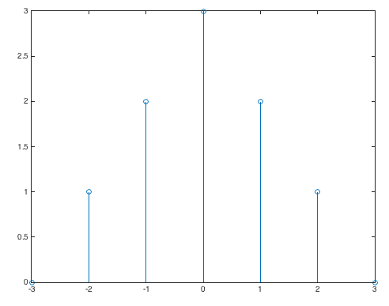
Unit Impulse Response
The Running Average Filter – SPFirst Sec. 5-3.2
Discrete-time unit impulse signal δ[n]
δ[n]
δ[n-2]
1
1
n
n
-3
-2
-1
0
1
2
3
-3
-2
-1
0
1
2
3
Expressing finite-length signals using unit impulses
3 δ[n]
x[n]
3
n = -3 : 3;
x = [0 1 2 3 2 1 0];
stem(n, x);
2 δ[n+1]
2
2 δ[n-1]
δ[n+2]
1
δ[n-2]
- OR -
n
n = -3 : 3;
x = 3*tripuls(n/6);
stem(n, x);
-3
-2
-1
0
1
2
3
No MATLAB function for δ[n]
Could use rectpuls(n) but awkward

Slide 12
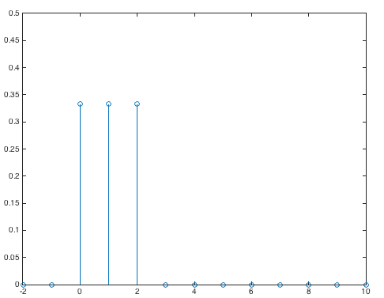
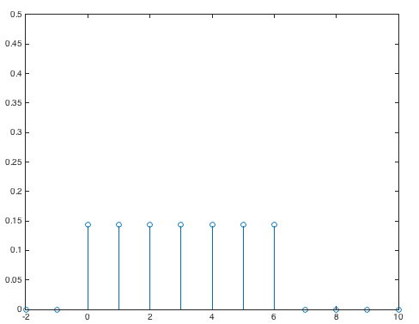
Unit Impulse Response
The Running Average Filter – SPFirst Sec. 5-3.2
Output of system when unit impulse δ[n] is input
δ[n]
T{•}
h[n]
  When system is a finite impulse response filter, let x[n] = δ[n],
  Impulse responses for 3-point and 7-point averaging filters
M = 2;
n = -2 : 10;
h = rectpuls((n-1) / 3);
h = h / (M+1);
stem(n, h);
ylim( [0, 0.5] );
M = 6;
n = -2 : 10;
h = rectpuls((n-M/2) / (M+1));
h = h / (M+1);
stem(n, h);
ylim( [0, 0.5] );
n
n

Slide 13
Convolution and FIR Filters
The Running Average Filter – SPFirst Sec. 5-3.3
FIR filters of order M
  Input-output relationship (slide 7-6):
  Impulse response h[n] = b_{n} for 0 ≤ n ≤ M
  (see slide 7-11)
  Called a finite convolution sum
  Output y[n] obtained by convolving x[n] and h[n]
Convolution
  Input-output algorithm for large class of filters including FIR
  Applies to infinite-length signals
  More on general case later

Slide 14
Computing Finite Convolution Sums
The Running Average Filter – SPFirst Sec. 5-3.3
Expand finite convolution sum
x[n]
3
h[n]
2
1
1
-3
-2
-1
0
1
2
3
4
5
n
-1
2
3
4
n
y[n]
is one sample longer than x[n]
n | -1 | 0 | 1 | 2 | 3 | 4
x[n] | 0 | 1 | 2 | 3 | 0 | 0
h[n] | 0 | 1 | -1 | 0 | 0 | 0
h[0] x[n] | 0 | 1 | 2 | 3 | 0 | 0
h[1] x[n-1] | 0 | 0 | -1 | -2 | -3 | 0
y[n] | 0 | 1 | 1 | 1 | -3 | 0
x = [1 2 3];
h = [1 -1];
y = conv(x, h);
- OR -
x = [1 2 3 0];
h = [1 -1];
y = filter(h, 1, x);

Slide 15
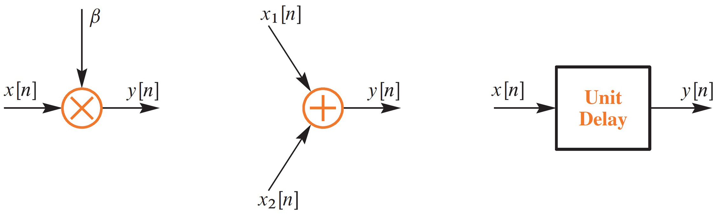
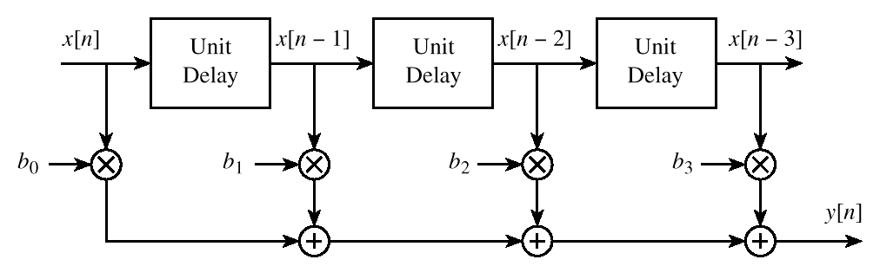
Block Diagram Representations
The Running Average Filter – SPFirst Sec. 5-4
©2003-2016, JH McClellan & RW Schafer

Slide 16
License Info for SPFirst Slides
McClellan, Schafer &Yoder have released their work under a Creative Commons License with the following terms:
Attribution
    The licensor permits others to copy, distribute, display, and perform the work. In return, licensees must give the original authors credit.
Non-Commercial
    The licensor permits others to copy, distribute, display, and perform the work. In return, licensees may not use the work for commercial purposes—unless they get the licensor's permission.
Share Alike
    The licensor permits others to distribute derivative works only under a license identical to the one that governs the licensor's work.
Full Text of the License
This (hidden) page should be kept with the presentation
©2003-2016, JH McClellan & RW Schafer
7-16

