Slide 1
Discrete-Time Convolution
EE 313 Linear Systems and Signals Fall 2024
Prof. Brian L. Evans
Dept. of Electrical and Computer Engineering
The University of Texas at Austin
Textbook: McClellan, Schafer & Yoder, Signal Processing First, 2003
Lecture 8 http://www.ece.utexas.edu/~bevans/courses/signals

Slide 2
Linear Systems and Signals Topics
Discrete-Time Convolution – SPFirst Sec. 5-4 to 5-7
Domain | Topic | Discrete Time | Continuous Time
Time | Signals | SPFirst Ch. 4 | SPFirst Ch. 2
 | Systems | SPFirst Ch. 5 | SPFirst Ch. 9
 | Convolution | SPFirst Ch. 5 | SPFirst Ch. 9
Frequency | Fourier series | ** | SPFirst Ch. 3
 | Fourier transforms | SPFirst Ch. 6 | SPFirst Ch. 11
 | Frequency response | SPFirst Ch. 6 | SPFirst Ch. 10
Generalized Frequency | z / Laplace Transforms | SPFirst Ch. 7-8 | Supplemental Text
 | Transfer Functions | SPFirst Ch. 7-8 | Supplemental Text
 | System Stability | SPFirst Ch. 8 | SPFirst Ch. 9
Mixed Signal | Sampling | SPFirst Ch. 4 | SPFirst Ch. 12
✔
✔
✔
➔
✔
✔
✔
** Spectrograms (Ch. 3) for time-frequency spectrums (plots) computed the discrete-time Fourier series for each window of samples.

Slide 3
Linear Time Invariant Systems
Discrete-Time Convolution – SPFirst Sec. 5-5 Intro & Sec. 5-5.1
Have rich set of mathematical tools for analysis
Characterize properties of system as a closed box
x[n]
T{•}
y[n]
Time-Invariance
  When input delayed by n₀, output delayed by same amount
x[n-n₀]
T{•}
y_{shifted}[n]
  Try input x[n-n₀] and see if response y_{shifted}[n] = y[n-n₀]
  For y[n] = x²[n],
  y_{shifted}[n] = (x[n-n₀])²
  = x²[n-n₀]
  = y[n-n₀]
  YES
  For y[n] = n x[n],
  y_{shifted}[n] = n x[n-n₀]
  NO

Slide 4
Linear Time Invariant Systems
Discrete-Time Convolution – SPFirst Sec. 5-5.2
Consider a system
x₁[n]
T{•}
y₁[n]
x₂[n]
T{•}
y₂[n]
Additivity
  Input x₁[n] + x₂[n] gives additive output y₁[n] + y₂[n]
Homogeneity
    Input α x₁[n] gives scaled output α y₁[n] for all constant α
Linearity means additivity and homogeneity hold
  For y[n] = x²[n],
  y_{scaled}[n] = (α x[n])²
  = α² x² [n].
  Is it α y[n]?
  NO
  For y[n] = n x[n],
  y_{scaled}[n] = n (α x[n])
  = α (n x[n])
  = α y[n]
  YES
  y_{additive}[n] = n (x₁[n] + x₂[n])
  = n x₁[n] + n x₂[n]
  = y₁[n] + y₂[n]
  YES

Slide 5
Role of Initial Conditions
Discrete-Time Convolution – SPFirst Sec. 5-4.1 & 5-5.3 & 8-2
Unit delay system
  Observe system with y[n] = x[n-1] for time n ≥ 0
  First input value is x[0] and first output value is y[0]
  What is the value of y[0]?
  For input α x[n], what is the output y_{scaled}[n]?
  For input x₁[n] + x₂[n], what is the output y_{additive}[n]?
  For input x[n-n₀], what is the output y_{shifted}[n]?
Linearity and time-invariance system properties
  System must be “at rest” (i.e. initial conditions are zero)
  Necessary but not sufficient condition

Slide 6
FIR Filters
Discrete-Time Convolution – SPFirst Sec. 5-5.3
Time-invariance for input x[n-n₀], is output y[n-n₀]?
Additivity for input x₁[n]+x₂[n], is output y₁[n]+y₂[n]?
Homogeneity: for input α x[n], is output α y[n]?
  YES
  YES
  YES

Slide 7
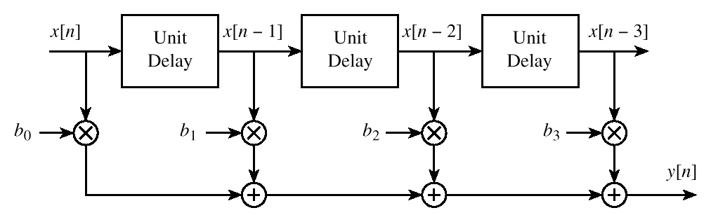
FIR Filters
Discrete-Time Convolution – SPFirst Sec. 5-4 & 5-5.3
What happens when observing FIR filter for n ≥ 0?
  First input value is x[0] and first output value is y[0]
  What is the value of y[0]?
  What are the initial conditions?
FIR filter block diagram
  Where are the initial conditions?
h[0]
h[1]
h[2]
h[3]

Slide 8
Convolution and LTI Systems
Discrete-Time Convolution – SPFirst Sec. 5-6.1
Output y[n] for input x[n]
Decompose x[n] into weighted sum of delayed impulses
Apply additivity
Apply homogeneity
Apply time-invariance
Apply change of variables

Slide 9
FIR Convolution
Discrete-Time Convolution – SPFirst Sec. 5-6.1
Impulse response h[n] has extent 0 ≤ n ≤ M
Example: Two-point averaging filter M = 1
h[n]
Averaging filter impulse response
y[n] = h[0] x[n] + h[1] x[n-1]
= ( x[n] + x[n-1] ) / 2
n
h = [1/2 1/2];
x = [0 1 2 3 2 1 0];
y = conv(h, x);
0
1
2
3
Discrete-time convolution demos
  http://dspfirst.gatech.edu/matlab/#dconvdemo
  http://pages.jh.edu/~signals/discreteconv2/index.html

Slide 10
Convolution Properties
Discrete-Time Convolution – SPFirst Sec. 5-6.2
Convolution with impulse
Commutative property
  Showed earlier on slide 8-8
Associative property
Non-zero when m = n – n₀

Slide 11
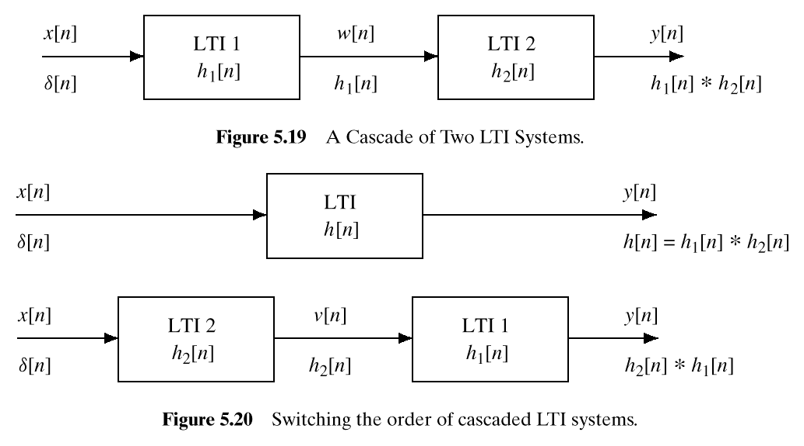
Cascaded LTI Systems
Discrete-Time Convolution – SPFirst Sec. 5-7
Switching the order of cascaded LTI systems
  Application of associative property of convolution
©2003-2016, JH McClellan & RW Schafer

Slide 12
License Info for SPFirst Slides
McClellan, Schafer &Yoder have released their work under a Creative Commons License with the following terms:
Attribution
    The licensor permits others to copy, distribute, display, and perform the work. In return, licensees must give the original authors credit.
Non-Commercial
    The licensor permits others to copy, distribute, display, and perform the work. In return, licensees may not use the work for commercial purposes—unless they get the licensor's permission.
Share Alike
    The licensor permits others to distribute derivative works only under a license identical to the one that governs the licensor's work.
Full Text of the License
This (hidden) page should be kept with the presentation
©2003-2016, JH McClellan & RW Schafer
8-12

