Slide 1
Frequency Response of FIR Filters
EE 313 Linear Systems and Signals Fall 2024
Prof. Brian L. Evans
Dept. of Electrical and Computer Engineering
The University of Texas at Austin
Textbook: McClellan, Schafer & Yoder, Signal Processing First, 2003
Lecture 9 http://www.ece.utexas.edu/~bevans/courses/signals

Slide 2
Linear Systems and Signals Topics
Frequency Response of FIR Filters – SPFirst Sec. 6-1 to 6-7
Domain | Topic | Discrete Time | Continuous Time
Time | Signals | SPFirst Ch. 4 | SPFirst Ch. 2
 | Systems | SPFirst Ch. 5 | SPFirst Ch. 9
 | Convolution | SPFirst Ch. 5 | SPFirst Ch. 9
Frequency | Fourier series | ** | SPFirst Ch. 3
 | Fourier transforms | SPFirst Ch. 6 | SPFirst Ch. 11
 | Frequency response | SPFirst Ch. 6 | SPFirst Ch. 10
Generalized Frequency | z / Laplace Transforms | SPFirst Ch. 7-8 | Supplemental Text
 | Transfer Functions | SPFirst Ch. 7-8 | Supplemental Text
 | System Stability | SPFirst Ch. 8 | SPFirst Ch. 9
Mixed Signal | Sampling | SPFirst Ch. 4 | SPFirst Ch. 12
✔
✔
✔
✔
✔
✔
➔
➔
✔
** Spectrograms (Ch. 3) for time-frequency spectrums (plots) computed the discrete-time Fourier series for each window of samples.

Slide 3
Linear Time Invariant System
Frequency Response of FIR Filters – SPFirst Ch. 6 Intro
Uniquely defined by its impulse response h[n]
x[n]
h[n]
y[n]
Sinusoidal response
  When input is sinusoid, output is sinusoid of same frequency
  The output sinusoid may have different magnitude/phase
Frequency response
  Indicates how input frequencies are transferred to output
  Directly connected to impulse response (next slide)
Output frequencies are only those present in input

Slide 4
Sinusoidal Response of FIR Filters
Frequency Response of FIR Filters – SPFirst Sec. 6-1
Input complex-valued sinusoid
x[n]
h[n]
y[n]
Output is due to convolution
Frequency response
  Directly related to impulse response
  Response to complex sinusoid signal of any frequency
  Describes how frequencies are transferred from input to output

Slide 5
Sinusoidal Response of FIR Filters
Frequency Response of FIR Filters – SPFirst Sec. 6-1
Frequency response
  Powers of :
  Polar form (magnitude-phase form):
Response to complex-valued sinusoid revisited
Change in magnitude (gain)
Change in phase (phase shift)

Slide 6
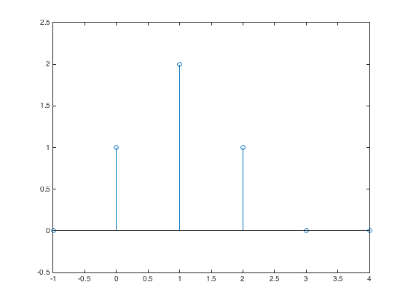
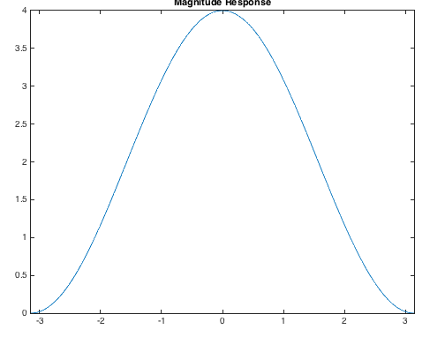
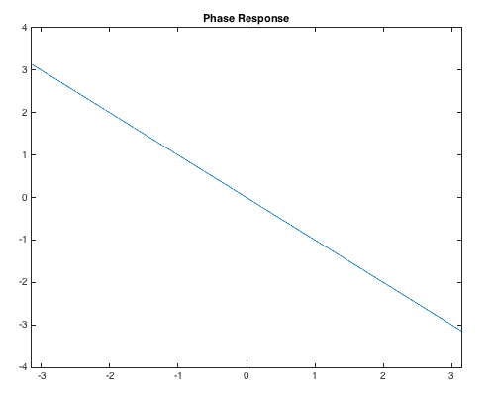
Sinusoidal Response of FIR Filters
Frequency Response of FIR Filters – SPFirst Sec. 6-1 & 6-5
2
h[n]
Example
h = [ 0 1 2 1 0 0];
n = [-1 0 1 2 3 4];
stem(n, h);
ylim( [-0.5 2.5] );
1
0
Lowpass filter
n
wHat = -pi : 0.01 : pi;
Hmag = 2 + 2*cos(wHat);
Hphase = -wHat;
figure;
plot(wHat, Hmag);
title('Magnitude Response');
xlim( [-pi pi] );
figure;
plot(wHat, Hphase);
title('Phase Response');
xlim( [-pi pi] );
gain of 3
magnitude
phase
Sinusoidal Response
phase shift
-π/3

Slide 7
Sinusoidal Response of FIR Filters
Frequency Response of FIR Filters – SPFirst Sec. 6-2 & 6-4.3
Frequencies in output are only those in input
Derivation
Input:
Output:
For real-valued h[n]

Slide 8
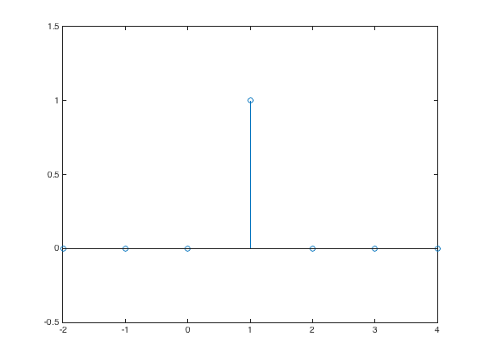
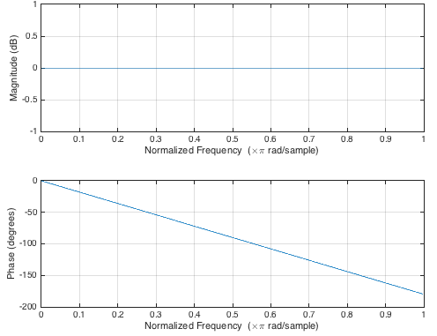
Ideal Delay
Frequency Response of FIR Filters – SPFirst Sec. 6-5.1
h = [ 0 0 0 1 0 0 0];
n = [-2 -1 0 1 2 3 4];
stem(n, h);
ylim( [-0.5 1.5] );
Delay by 1 Sample
h[n]
x[n]
y[n]
Zero Initial
Condition
n
  Impulse response
Allpass Filter
  Frequency response
Linear Phase
freqz( [ 0 1 ] );

Slide 9
Two-Point Averaging Filter
Frequency Response of FIR Filters
Input-output relationship
h[n]
Two-tap averaging filter
½
Impulse response
n
1
2
3
Frequency response
x[n-1]
x[n]
Delay
h[0]
h[1]
Σ
y[n]
magnitude
phase (linear)

Slide 10
First-Order Difference
Frequency Response of FIR Filters – SPFirst Sec. 6-5.2
Input-output relationship
h[n]
First-order difference
½
Impulse response
n
2
3
- ½
Frequency response
Generalized
Linear Phase
amplitude
phase

Slide 11
Cascading FIR Filters Demo
Frequency Response of FIR Filters – SPFirst Sec. 6-6
DSP First, 2nd ed, ch. 6, cascading FIR Filters
  http://dspfirst.gatech.edu/chapters/06firfreq/demos/blockd/index.html
From lowpass filter to highpass filter
  original image → blurred image → sharpened/blurred image
From highpass to lowpass filter
  original image → sharpened image → blurred/sharpened image
Frequencies that are zeroed out can never be recovered (e.g. DC is zeroed out by highpass filter)
Two LTI systems in cascade
  Order can be switched and cascade output would remain same
  Assumes computations are performed in exact precision

Slide 12
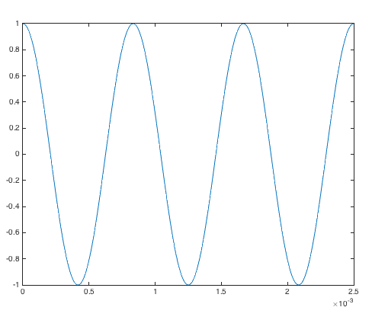
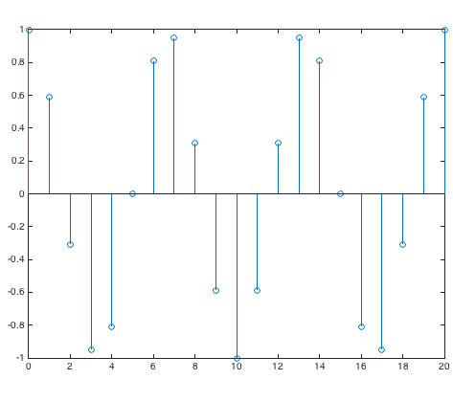
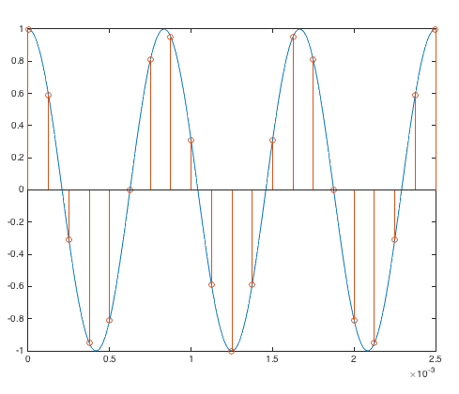
Periodicity of Discrete-Time Sinusoids
Frequency Response of FIR Filters – Not in SPFirst
Key idea
  Continuous-time period may not align w/ discrete-time grid
  Example
  f₀ = 1200 Hz and f_{s} = 8000 Hz
Three continuous-time periods
Discrete-time period of 20 samples

Slide 13
Periodicity of Discrete-Time Sinusoids
Frequency Response of FIR Filters – Not in SPFirst
Continuous-time
  Continuous-time period T₀ = 1 / f₀
f0 = 1200;
fs = 8000;
% w0 = 2 pi (3 / 20)
N = 3;
L = 20;
% Time extent
Ts = 1/fs;
nmax = L;
tmax = nmax*Ts;
% x(t) = cos(2 pi f0 t)
fp = fs*24;
Tp = 1 / fp;
t = 0 : Tp : tmax;
xt = cos(2*pi*f0*t);
% x[n] = cos(w0 n)
w0 = 2*pi*N/L;
n = 0 : nmax;
xn = cos(w0*n);
tn = 0 : Ts : tmax;
% Plots
plot(t, xt);
figure; stem(n, xn);
figure; plot(t, xt);
hold; stem(tn, xn);
Discrete-time cosine
  Sample x(t) at rate f_{s} by substituting t = n T_{s} :
Discrete-time frequency
  Remove common factors between integers N & L
  cos(2 π (N / L) n) has discrete-time period of L samples that contains N continuous-time periods
  See handout on Discrete-Time Periodicity

Slide 14
License Info for SPFirst Slides
McClellan, Schafer &Yoder have released their work under a Creative Commons License with the following terms:
Attribution
    The licensor permits others to copy, distribute, display, and perform the work. In return, licensees must give the original authors credit.
Non-Commercial
    The licensor permits others to copy, distribute, display, and perform the work. In return, licensees may not use the work for commercial purposes—unless they get the licensor's permission.
Share Alike
    The licensor permits others to distribute derivative works only under a license identical to the one that governs the licensor's work.
Full Text of the License
This (hidden) page should be kept with the presentation
©2003-2016, JH McClellan & RW Schafer
9-14

