Slide 1
Z-Transforms
EE 313 Linear Systems and Signals Fall 2023
Prof. Brian L. Evans
Dept. of Electrical and Computer Engineering
The University of Texas at Austin
Textbook: McClellan, Schafer & Yoder, Signal Processing First, 2003
Lecture 10 http://www.ece.utexas.edu/~bevans/courses/signals

Slide 2
Linear Systems and Signals Topics
Z-Transforms – SPFirst Ch. 7 Intro
Domain | Topic | Discrete Time | Continuous Time
Time | Signals | SPFirst Ch. 4 | SPFirst Ch. 2
 | Systems | SPFirst Ch. 5 | SPFirst Ch. 9
 | Convolution | SPFirst Ch. 5 | SPFirst Ch. 9
Frequency | Fourier series | ** | SPFirst Ch. 3
 | Fourier transforms | SPFirst Ch. 6 | SPFirst Ch. 11
 | Frequency response | SPFirst Ch. 6 | SPFirst Ch. 10
Generalized Frequency | z / Laplace Transforms | SPFirst Ch. 7-8 | Supplemental Text
 | Transfer Functions | SPFirst Ch. 7-8 | Supplemental Text
 | System Stability | SPFirst Ch. 8 | SPFirst Ch. 9
Mixed Signal | Sampling | SPFirst Ch. 4 | SPFirst Ch. 12
✔
✔
✔
✔
✔
✔
✔
✔
➔
➔
✔
** Spectrograms (Ch. 3) for time-frequency spectrums (plots) computed the discrete-time Fourier series for each window of samples.

Slide 3
Z-Transforms
Z-Transforms – SPFirst Ch. 7 Intro & Sec. 7-1
Analysis tool for discrete-time signals and systems
Converts convolution & difference equations into polynomials
Describes LTI system transfer of input to output frequencies
Adds third domain to time and frequency domains
Hopefully pick domain in which analysis is the easiest
General definition: z is complex variable
z
time domain
z-domain
Simplified definition for finite-length signal x[n]
z

Slide 4
Z-Transform Pairs
Z-Transforms – SPFirst Sec. 7-1
Z-transform for finite length signal x[n]
z
Unit impulse
z
Delayed unit impulse
valid for all z
z
valid for all z ≠ 0
Two-point impulse response
z
valid for all z ≠ 0
polynomial in z ⁻¹

Slide 5
Z-Transform Pairs
Z-Transforms – SPFirst Sec. 7-2
Review
FIR filter of Mth order
Impulse response h[n]
Let x[n] = z^{n} for –∞ < n < ∞
x[n] | X(z) | Valid
 |  | all z
 |  | z ≠ 0
 |  | z ≠ 0
h[n]
H(z) is system function, a.k.a. transfer function in z-domain
H(z) is z-transform of impulse response h[n]
z
polynomial in z ⁻¹
If H(z) = 1 + 2z⁻¹ + z⁻², what is h[n]?

Slide 6
Z-Transform Properties
Z-Transforms – SPFirst Sec. 7-3 & 7-4
Superposition property
z
When viewed as system, z-transform has linearity
Time-delay property
z⁻¹ in z-domain corresponds to time shift of 1 sample
z
x[n]
y[n]
z⁻¹
if x[-1] = 0 system is LTI
initial condition

Slide 7
Convolution and the z-Transform
Z-Transforms – SPFirst Sec. 7-5
Review
Unit delay
y[n] | Y(z) | Valid
 |  | all z
 |  | z ≠ 0
 |  | z ≠ 0
 |  | z ≠ 0
 |  | **
 |  | z ≠ 0
h[n] = δ[n-1]
y[n] = x[n] * δ[n-1] = x[n-1]
Y(z) = z⁻¹ X(z) = H(z) X(z)
x[n]
y[n]
z⁻¹
if x[-1] = 0 system is LTI
Convolution property
z
Assuming causal x[n] i.e. x[n] = 0 for n < 0

Slide 8
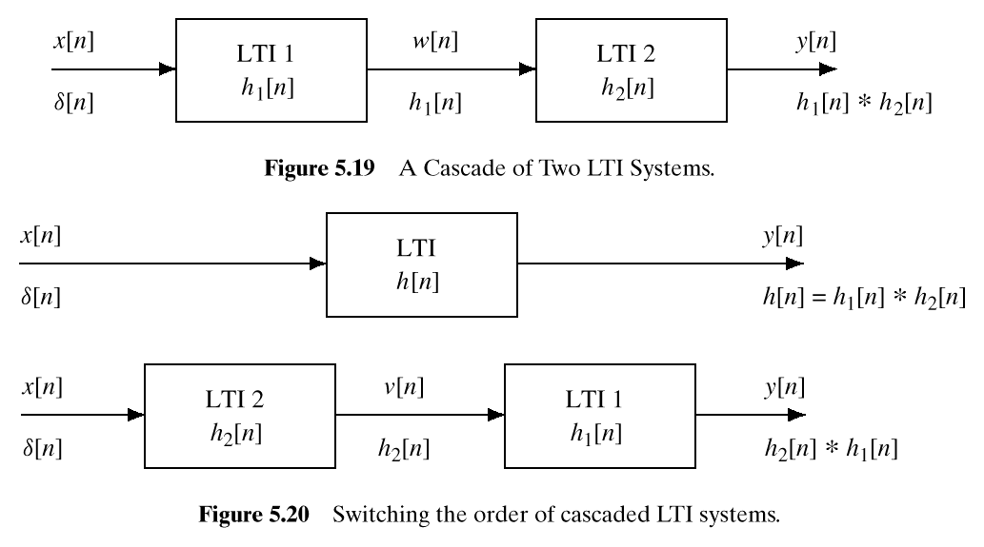
Cascading LTI Systems
Z-Transforms – SPFirst Sec. 7-5.1
Based on convolution property
X(z)
W(z)
Y(z)
W(z) = H₁(z) X(z)
Y(z) = H₂(z) W(z) = H₂(z) H₁(z) X(z)
X(z)
Y(z)
H(z) = H₂(z) H₁(z) = H₁(z) H₂(z)

Slide 9
z-Domain and Frequency Domain
Z-Transforms – SPFirst Sec. 7-6
Make connection directly from their definitions
Basis for freqz(h) command
How does look in z-domain?
Circle of radius 1 (a.k.a. unit circle)

Slide 10
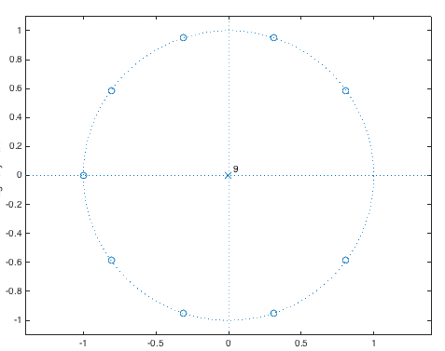
L-Point Averaging Filter
Z-Transforms – SPFirst Sec. 7-6 & 7.7
Impulse response:
h[n]
Z-transform
n
-1
0
1
2
L-1
L
L=10
Roots of numerator (zeros):
Roots of denominator (poles):
Zero at z = 1 cancels pole at z = 1
h = (1/10)*ones(1,10);
zplane(h);

Slide 11
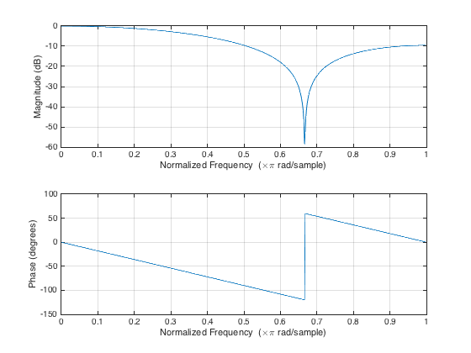
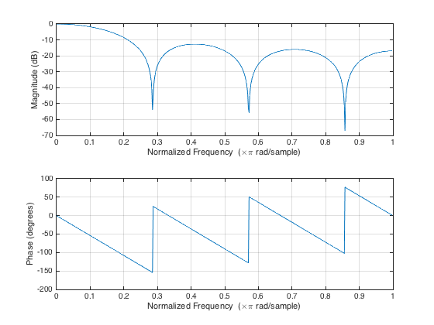
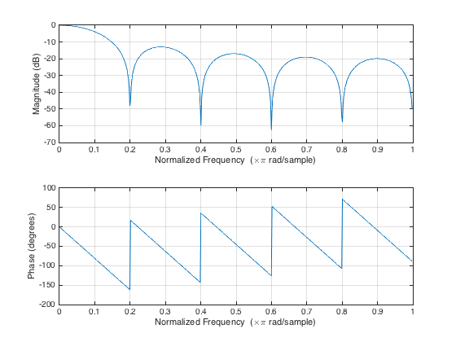
L-Point Averaging Filter
Z-Transforms – SPFirst Sec. 7-6 & 7.7
Zeros in magnitude response at
L = 3
L = 7
L = 11
h = (1/3)*ones(1,3);
freqz(h);
h = (1/7)*ones(1,7);
freqz(h);
h = (1/10)*ones(1,10);
freqz(h);

Slide 12
License Info for SPFirst Slides
McClellan, Schafer &Yoder have released their work under a Creative Commons License with the following terms:
Attribution
The licensor permits others to copy, distribute, display, and perform the work. In return, licensees must give the original authors credit.
Non-Commercial
The licensor permits others to copy, distribute, display, and perform the work. In return, licensees may not use the work for commercial purposes—unless they get the licensor's permission.
Share Alike
The licensor permits others to distribute derivative works only under a license identical to the one that governs the licensor's work.
Full Text of the License
This (hidden) page should be kept with the presentation
©2003-2016, JH McClellan & RW Schafer
10-12

