Slide 1
Infinite Impulse Response Filters
EE 313 Linear Systems and Signals Fall 2024
Prof. Brian L. Evans
Dept. of Electrical and Computer Engineering
The University of Texas at Austin
Textbook: McClellan, Schafer & Yoder, Signal Processing First, 2003
Lecture 11 http://www.ece.utexas.edu/~bevans/courses/signals

Slide 2
Linear Systems and Signals Topics
Infinite Impulse Response (IIR) Filters– SPFirst Ch. 8 Intro
Domain | Topic | Discrete Time | Continuous Time
Time | Signals | SPFirst Ch. 4 | SPFirst Ch. 2
 | Systems | SPFirst Ch. 5 | SPFirst Ch. 9
 | Convolution | SPFirst Ch. 5 | SPFirst Ch. 9
Frequency | Fourier series | ** | SPFirst Ch. 3
 | Fourier transforms | SPFirst Ch. 6 | SPFirst Ch. 11
 | Frequency response | SPFirst Ch. 6 | SPFirst Ch. 10
Generalized Frequency | z / Laplace Transforms | SPFirst Ch. 7-8 | Supplemental Text
 | Transfer Functions | SPFirst Ch. 7-8 | Supplemental Text
 | System Stability | SPFirst Ch. 8 | SPFirst Ch. 9
Mixed Signal | Sampling | SPFirst Ch. 4 | SPFirst Ch. 12
✔
✔
✔
✔
✔
✔
✔
✔
➔
➔
➔
✔
** Spectrograms (Ch. 3) for time-frequency spectrums (plots) computed the discrete-time Fourier series for each window of samples.

Slide 3
Infinite Impulse Response (IIR) Filter
Infinite Impulse Response (IIR) Filters– SPFirst Sec. 8-2
IIR Filter
  Depends on current/previous input values (like an FIR filter)
  Depends on previous output values (unlike an FIR filter)
Infinitely long impulse response
  Consists of modes of form a^{n} u[n] where u[n] is unit step
  Amplitude decays or remains bounded or explodes as n ➔ ∞
First-order example #1:
  Compute first output value:
  Initial condition y[-1]. What value to use? Why? p. 198/201
  Given y[-1] and x[n], we can compute y[n] iteratively
etc.

Slide 4
Infinite Impulse Response (IIR) Filter
Infinite Impulse Response (IIR) Filters– SPFirst Sec. 8-2
First-order example #2:
Closed-form impulse response using time domain
LTI #2
n | -1 | 0 | 1 | 2 | 3 | …
δ[n]
h[n-1]
h[n] | 0
First-order example #3:
  Input
  into LTI #2 to get impulse response
  Using LTI properties,

Slide 5
Three Common Z-Transform Pairs
Infinite Impulse Response (IIR) Filters– SPFirst Sec. 8-3.3
h[n] = δ[n]
h[n] = a^{n} u[n]
  Region of convergence: entire z-plane
h[n] = δ[n-1]
  Region of convergence for summation: |z| > |a|
  Region of convergence: entire z-plane except z = 0
  |z| > |a| is the complement of a disk in z-domain
  h[n-1] ⇔ z⁻¹ H(z)

Slide 6
First-Order LTI IIR Filter
Infinite Impulse Response (IIR) Filters– SPFirst Sec. 8-3.1
Find impulse response h[n] in z-domain
Take z-transform of both sides of difference equation
Take inverse z-transform of transfer function H(z)
z
pole at z = a

Slide 7
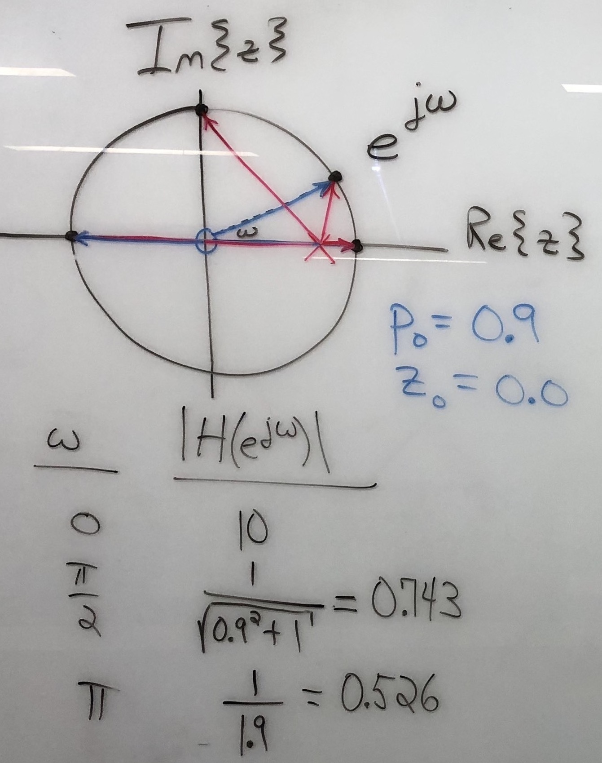
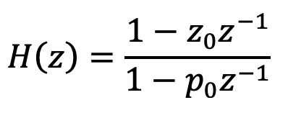
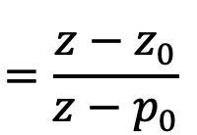

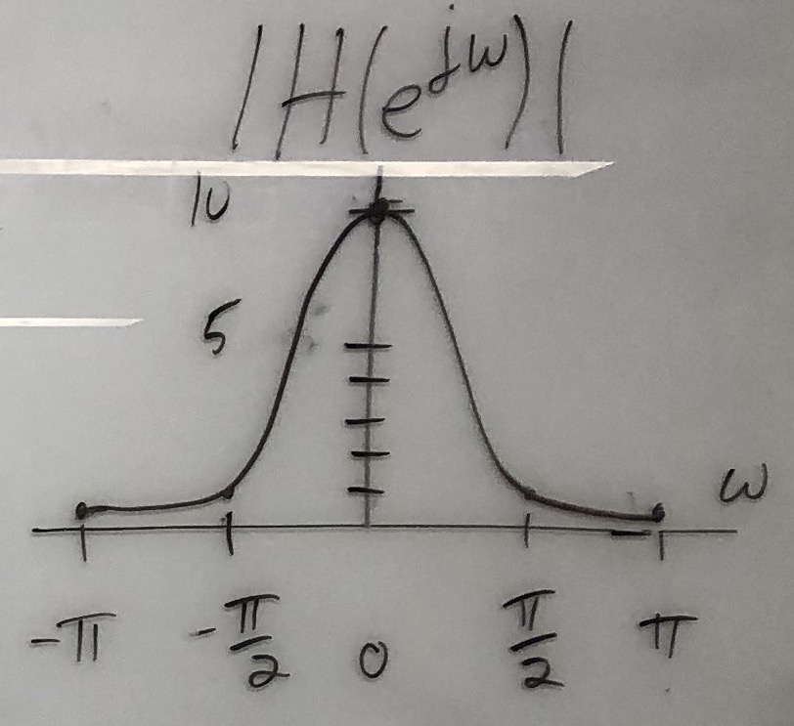



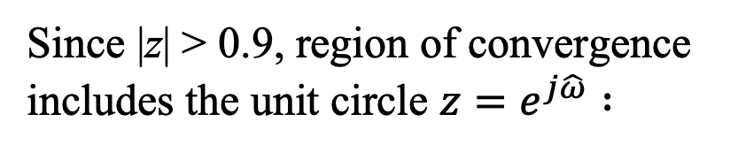
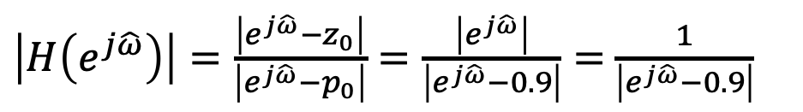


First-Order LTI IIR Filter Freq. Resp.
Infinite Impulse Response (IIR) Filters– SPFirst Sec. 8-5 & 8-9
Pole p₀ = 0.9 and zero z₀ = 0
$$e^{j\hat{ω}}$$
Since |z| > 0.9, region of convergence includes the unit circle $z=e^{j\hat{ω}} :$
$$\hat{ω}$$
${|H(e}^{j\hat{ω}}$)|
$\left|H\left(e^{j\hat{ω}}\right)\right|=\frac{\left|e^{j\hat{ω}}−z_{0}\right|}{\left|e^{j\hat{ω}}−p_{0}\right|}=\frac{\left|e^{j\hat{ω}}\right|}{\left|e^{j\hat{ω}}−0.9\right|}=$ $\frac{1}{\left|e^{j\hat{ω}}−0.9\right|}$
  Angle of pole near unit circle indicates frequency at which peak occurs in magnitude response
${|H(e}^{j\hat{ω}}$)|
  Angle of zero on or near unit circle indicates frequency at which valley occurs in magnitude response
$$\hat{ω}$$

Slide 8
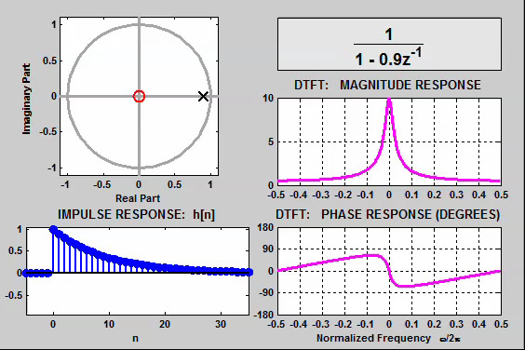
Demonstrations
Infinite Impulse Response (IIR) Filters– SPFirst Sec. 8-6
Time/frequency/z domain movies for IIR Filters
  http://dspfirst.gatech.edu/chapters/08feedbac/demos/3_domain/index.html
IIR filter with one pole and a zero at the origin
link

Slide 9
Second-Order LTI IIR Filter
Infinite Impulse Response (IIR) Filters– SPFirst Sec. 8-4 & 8-9
Input-output relationship in time domain
  MATLAB : filter([b0 b1 b2], [1 -a1 -a2], x);
Transfer function in z-domain
Factor transfer function in z-domain
Valid z values
|z| > |p₀| and |z| > |p₁|
Zeros z₀ and z₁
Poles p₀ and p₁

Slide 10
Magnitude Response
Infinite Impulse Response (IIR) Filters– SPFirst Sec. 8-5 & 8-9
  Zeros z₀ & z₁ and poles p₀ & p₁
  Poles inside unit circle:
  is valid
  |a – b| is distance between
  complex numbers a and b
  is distance from point
  on unit circle and pole p₀
% zero locations on unit circle
zeroAngle = 15*pi/16;
z0 = exp(j*zeroAngle);
z1 = exp(-j*zeroAngle);
numer = [1 -(z0+z1) z0*z1];
% pole locations inside unit circle
r = 0.9; poleAngle = pi/16;
p0 = r * exp(j*poleAngle);
p1 = r * exp(-j*poleAngle);
denom = [1 -(p0+p1) p0*p1];
% Set DC response at H(1) to be 1
C = (denom * [1 1 1]') / (numer * [1 1 1]');
freqz(C*numer, denom);
lowpass
highpass bandpass bandstop allpass notch?
Im(z)
O
X
Re(z)
O
X
Zeros are on the unit circle

Slide 11
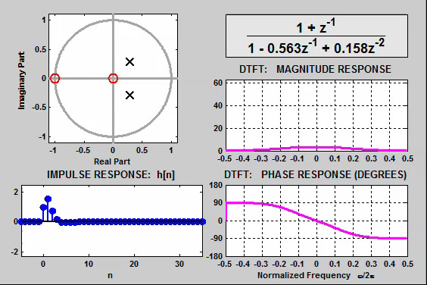
Demonstrations
Infinite Impulse Response (IIR) Filters– SPFirst Sec. 8-6
Time/frequency/z domain movies for IIR Filters
  http://dspfirst.gatech.edu/chapters/08feedbac/demos/3_domain/index.html
IIR filter with two poles and two zeros with poles moving towards unit circle
link

Slide 12
Stability
Infinite Impulse Response (IIR) Filters– SPFirst Sec. 8-8
A discrete-time LTI system is bounded-input bounded-output (BIBO) stable if for any bounded input x[n] such that | x[n] | ≤ B₁ < ∞, then the filter response y[n] is also bounded | y[n] | ≤ B₂ < ∞
Proposition: A discrete-time filter with an impulse response of h[n] is BIBO stable if and only if
  Every finite impulse response LTI system (even after implementation) is BIBO stable
  A causal infinite impulse response LTI system is BIBO stable if and only if its poles lie inside the unit circle
  http://users.ece.utexas.edu/~bevans/courses/signals/handouts/Appendix%20H%20BIBO%20Stability.pdf

Slide 13
BIBO Stability
Infinite Impulse Response (IIR) Filters– SPFirst Sec. 8-8
Rule #1: For a causal sequence, poles are inside the unit circle (applies to z-transform functions that are ratios of two polynomials) OR
Rule #2: Unit circle is in region of convergence
Example:
pole at z=a
  Stable if |a| < 1 by rule #1 or equivalently
  Stable if |a| < 1 by rule #2 because |z|>|a| and |a|<1

Slide 14
Block Diagram for IIR Filter
Infinite Impulse Response (IIR) Filters– SPFirst Sec. 8-3.2
Convert difference equation to visual representation
  Start with input x[n] and output y[n]
  Generate x[n-1] and y[n-1] terms using unit delay blocks
  Add blocks for multiplication by constants a₁, b₀ and b₁
  Add blocks for addition
b₀
How many initial conditions?
x[n]
y[n]
×
+
+
z⁻¹
b₁
a₁
z⁻¹
x[n-1]
y[n-1]
×
×

Slide 15
Block Diagram for IIR Filter
Infinite Impulse Response (IIR) Filters– SPFirst Sec. 8-3.2 & 8-9
Convert difference equation to visual representation
b₀
How many initial conditions?
x[n]
y[n]
×
+
+
z⁻¹
b₁
a₁
z⁻¹
x[n-1]
y[n-1]
×
+
+
×
z⁻¹
b₂
z⁻¹
a₂
x[n-2]
y[n-2]
What happens if a₂=0 and b₂=0?
×
×

Slide 16
License Info for SPFirst Slides
McClellan, Schafer &Yoder have released their work under a Creative Commons License with the following terms:
Attribution
    The licensor permits others to copy, distribute, display, and perform the work. In return, licensees must give the original authors credit.
Non-Commercial
    The licensor permits others to copy, distribute, display, and perform the work. In return, licensees may not use the work for commercial purposes—unless they get the licensor's permission.
Share Alike
    The licensor permits others to distribute derivative works only under a license identical to the one that governs the licensor's work.
Full Text of the License
This (hidden) page should be kept with the presentation
©2003-2016, JH McClellan & RW Schafer
11-16

