Slide 1
Continuous-Time Signals and LTI Systems
EE 313 Linear Systems and Signals Fall 2024
Prof. Brian L. Evans
Dept. of Electrical and Computer Engineering
The University of Texas at Austin
Textbook: McClellan, Schafer & Yoder, Signal Processing First, 2003
Lecture 12 http://www.ece.utexas.edu/~bevans/courses/signals

Slide 2
Linear Systems and Signals Topics
Continuous-Time Signals and LTI Systems – SPFirst Ch. 9 Intro
Domain | Topic | Discrete Time | Continuous Time
Time | Signals | SPFirst Ch. 4 | SPFirst Ch. 2
 | Systems | SPFirst Ch. 5 | SPFirst Ch. 9
 | Convolution | SPFirst Ch. 5 | SPFirst Ch. 9
Frequency | Fourier series | ** | SPFirst Ch. 3
 | Fourier transforms | SPFirst Ch. 6 | SPFirst Ch. 11
 | Frequency response | SPFirst Ch. 6 | SPFirst Ch. 10
Generalized Frequency | z / Laplace Transforms | SPFirst Ch. 7-8 | Supplemental Text
 | Transfer Functions | SPFirst Ch. 7-8 | Supplemental Text
 | System Stability | SPFirst Ch. 8 | SPFirst Ch. 9
Mixed Signal | Sampling | SPFirst Ch. 4 | SPFirst Ch. 12
✔
✔
✔
➔
✔
✔
✔
✔
✔
✔
✔
✔
✔
** Spectrograms (Ch. 3) for time-frequency spectrums (plots) computed the discrete-time Fourier series for each window of samples.

Slide 3
Many Faces of Signals
Continuous-Time Signals and LTI Systems – SPFirst Sec. 9-1
Function, e.g. A cos(ω₀ t + φ) in continuous time or in discrete time, useful in analysis
Sequence of numbers, e.g. {1,2,3,2,1} or a sampled triangle function, useful in simulation
Set of properties, e.g. even and causal, useful in reasoning about behavior
A piecewise representation, e.g. useful in analysis
A generalized function, e.g. the Dirac delta δ(t), useful in analysis

Slide 4
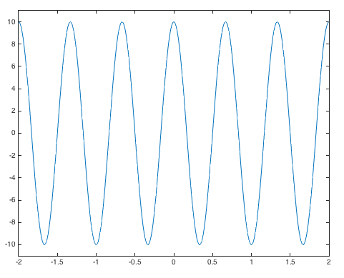
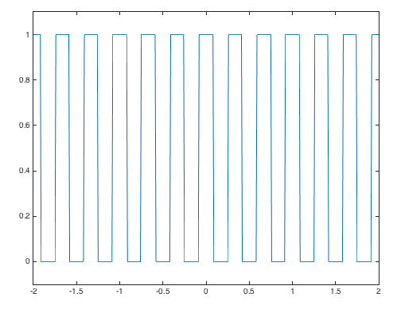
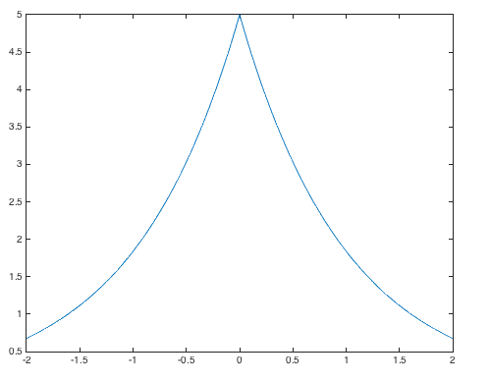
Two-Sided Signals
Continuous-Time Signals and LTI Systems – SPFirst Sec. 9-1
Square wave f₀ = 3 Hz
t
t
t
t = -2 : 0.01 : 2;
% Cosine
w0 = 3*pi;
x1 = 10*cos(w0*t);
figure;
plot(t, x1);
ylim( [-11 11] );
t = -2 : 0.01 : 2;
% Square Wave
f0 = 3;
v = cos(2*pi*f0*t);
x2 = 0.5*sign(v) + 0.5;
figure;
plot(t, x2);
ylim( [-0.1, 1.1] );
t = -2 : 0.01 : 2;
% Two-Sided Exponential
x3 = 5*exp(-abs(t));
figure;
plot(t, x3);

Slide 5
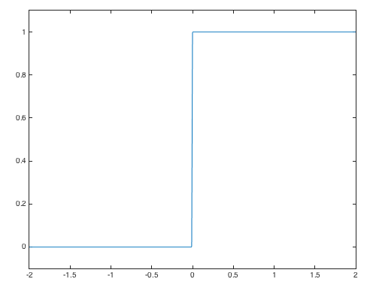
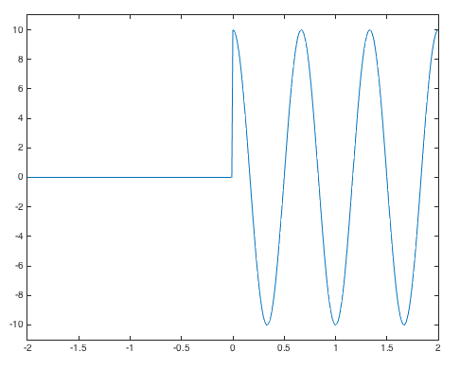
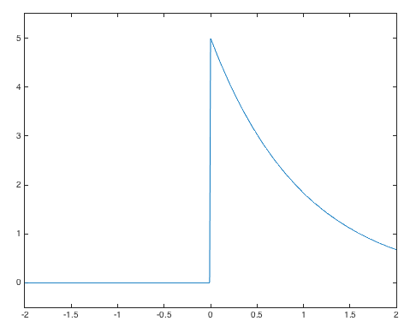
One-Sided Signals
Continuous-Time Signals and LTI Systems – SPFirst Sec. 9-1
t
t
t
t = -2 : 0.01 : 2;
% Unit Step
unitstep = (t >= 0);
x1 = unitstep;
figure;
plot(t, x1);
ylim( [-0.1 1.1] );
t = -2 : 0.01 : 2;
% Cosine
w0 = 3*pi;
unitstep = (t >= 0);
x1 = 10*cos(w0*t).*unitstep;
figure;
plot(t, x1);
ylim( [-11 11] );
t = -2 : 0.01 : 2;
% Two-Sided Exponential
unitstep = (t >= 0);
x3 = 5*exp(-t).*unitstep;
figure;
plot(t, x3);
ylim( [-0.5, 5.5] );

Slide 6
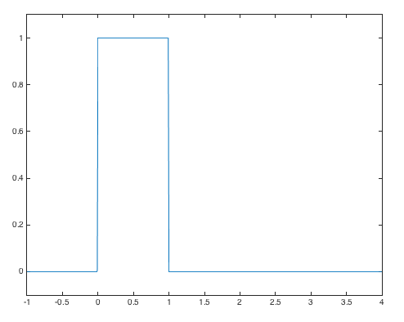
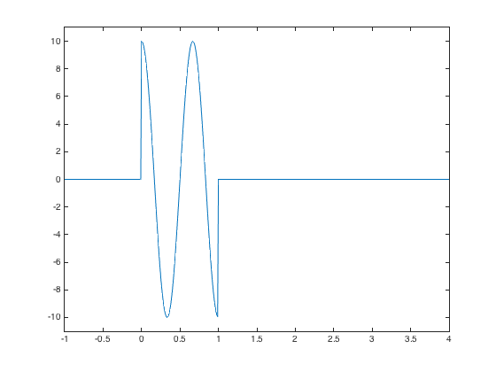
Finite-Length Signals
Continuous-Time Signals and LTI Systems – SPFirst Sec. 9-1
Rectangular pulse
Sinusoidal signal
t = -1 : 0.01 : 4;
rp = rectpuls(t-1/2);
w0 = 3*pi;
x4 = 10*cos(w0*t).*rp;
plot(t, x4);
ylim( [-11 11] );
t = -1 : 0.01 : 4;
rp = rectpuls(t-1/2);
plot(t, rp);
ylim( [-0.1 1.1] );
Value of p(0)?
p(1)?
p(0.5)?

Slide 7
Unit Impulse (Dirac Delta)
Continuous-Time Signals and LTI Systems – SPFirst Sec. 9-2
Mathematical idealism for an instantaneous event
Dirac delta as generalized function (a.k.a. functional)
−ε
ε
t
Unit area:
Sifting
provided g(t) is defined at t = 0
Scaling:
Unit Area
−ε
ε
t
Note that δ(0) is undefined
Unit Area

Slide 8
Unit Impulse (Dirac Delta)
Continuous-Time Signals and LTI Systems – SPFirst Sec. 9-2
Generalized sifting, assuming that a > 0
By convention, plot Dirac delta as arrow at origin
Undefined amplitude at origin
(1)
Denote area at origin as (area)
Unit Area
Height of arrow is irrelevant
0
t
Direction of arrow indicates sign of area

Slide 9
Unit Impulse (Dirac Delta)
Continuous-Time Signals and LTI Systems – SPFirst Sec. 9-2
We can simplify δ(t) under integration
Other examples
What about?
Answer: 0
What about at origin?
What about?
By substitution of variables,
u(0) can take any value
Common values: 0, ½, 1
L. B. Jackson, “A correction to impulse invariance,” IEEE Sig. Proc. Letters, Oct. 2000.

Slide 10
Systems
Continuous-Time Signals and LTI Systems – SPFirst Sec. 9-3
Systems operate on signals to produce new signals or new signal representations
x(t)
T{•}
y(t)
Continuous-time system examples
y(t) = ½ x(t) + ½ x(t-1)
y(t) = x²(t)
x(t)
(•)²
y(t)
Squaring block
x(t) = cos(2 π 440 t)
y(t) = cos²(2 π 440 t) = ½ (1 + cos(2 (2 π 440 t)) ) = ½ + ½ cos(2 π 880 t)
AM radio receiver
Screen maps pixels by (•)^{2.2}
Increase musical note by one octave
See lecture slides 1-15 and 1-16

Slide 11
Continuous-Time System Properties
Continuous-Time Signals and LTI Systems – SPFirst Sec. 9-4
Let x(t), x₁(t), and x₂(t) be inputs to a continuous-time linear system and let y(t), y₁(t), and y₂(t) be their corresponding outputs
A linear system satisfies
Additivity: x₁(t) + x₂(t) ⇒ y₁(t) + y₂(t)
Homogeneity: a x(t) ⇒ a y(t) for any real/complex constant a
Quick test to identify some nonlinear systems?
For time-invariant system, shift of input signal by any real-valued τ causes same shift in output signal, i.e. x(t - τ) ⇒ y(t - τ), for all τ
Example: Squaring block
x(t)
(•)²
y(t)
See lecture slides 8-2 and 8-3

Slide 12
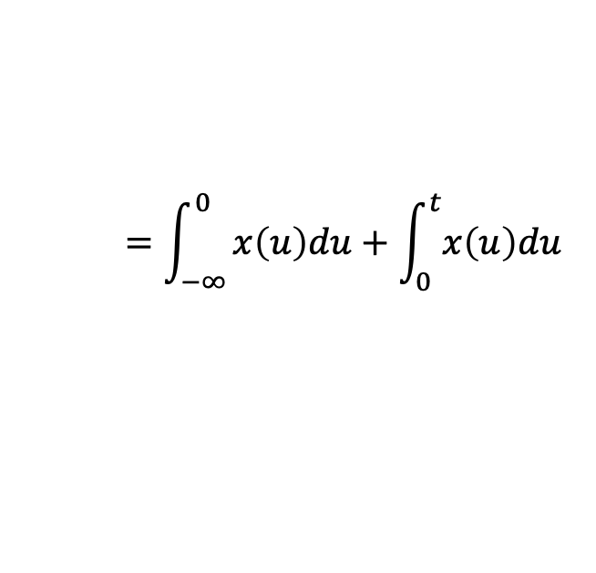
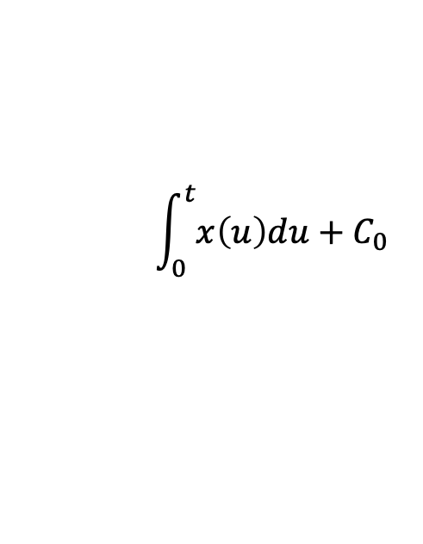
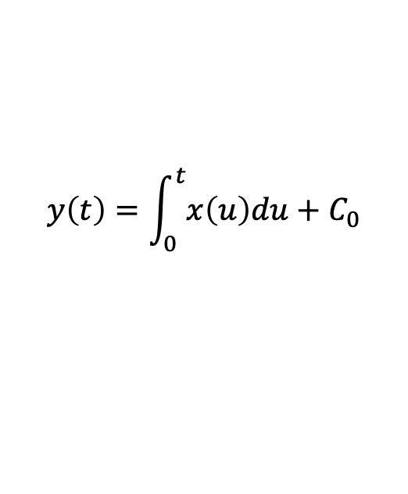
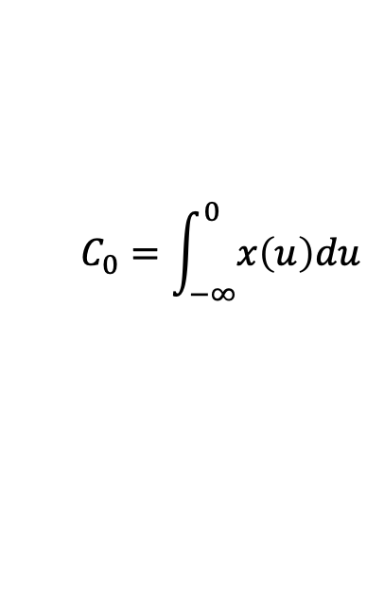
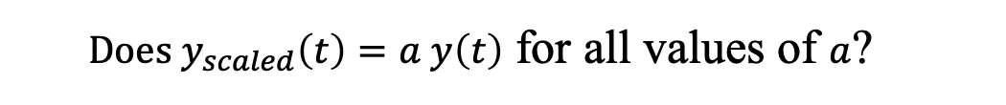
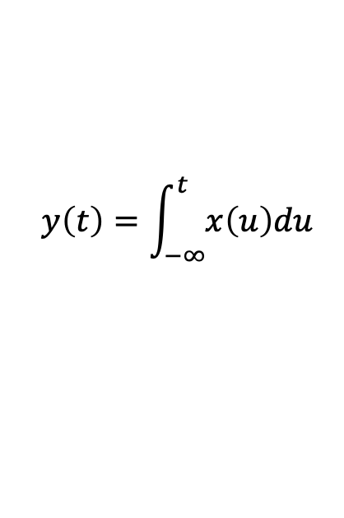
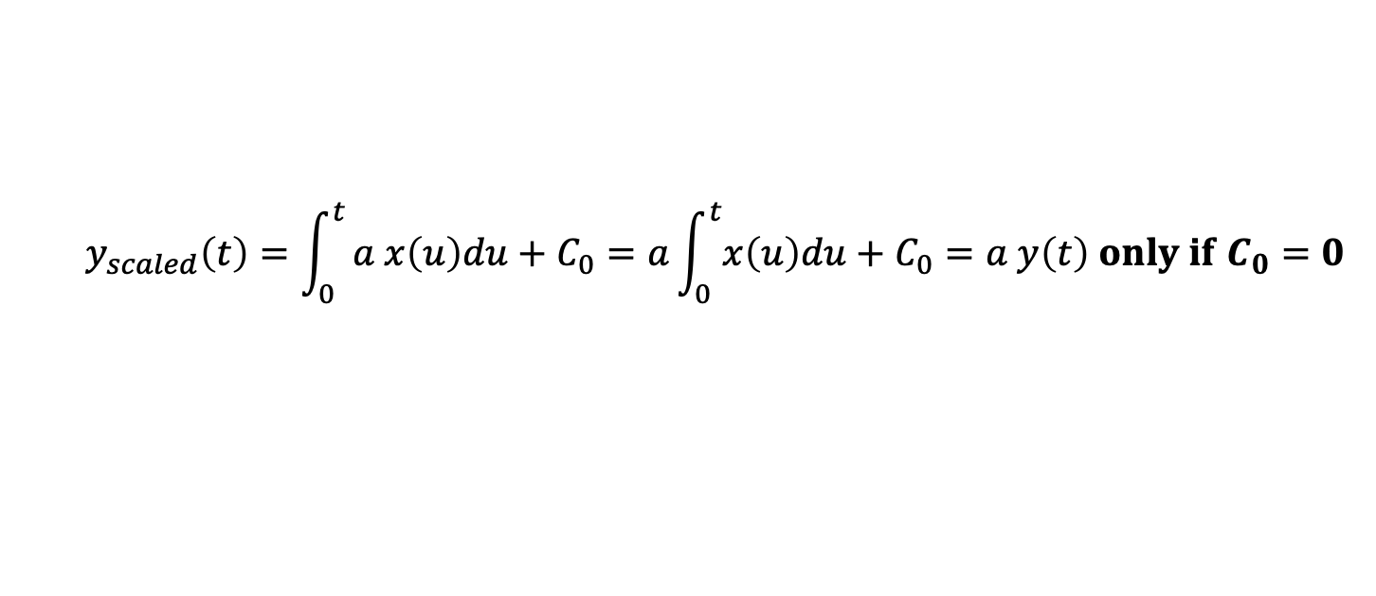
Initial Conditions for Linear Systems
Observe signals and systems starting at time t = 0
Example: Integrator
x(t)
y(t)
$$y\left(t\right)=\int_{−∞}^{t}{x\left(u\right)du}$$
$$=\int_{−∞}^{0}{x\left(u\right)du+\int_{0}^{t}{x\left(u\right)du}}$$
Observe integrator for t ≥ 0
C₀ is the initial condition w/r to observation
x(t)
$$\int_{0}^{t}{x\left(u\right)du+C_{0}}$$
y(t)
$$C_{0}=\int_{−∞}^{0}{x\left(u\right)du}$$
Homogeneity: input $a x\left(t\right)$for output $y_{scaled}\left(t\right)$
$$y\left(t\right)=\int_{0}^{t}{x\left(u\right)du+C_{0}}$$
$Does y_{scaled}\left(t\right)=a y\left(t\right)$ for all values of $a$?
$$y_{scaled}\left(t\right)=\int_{0}^{t}{a x\left(u\right)du+C_{0}=a\int_{0}^{t}{x\left(u\right)du+C_{0}=a y\left(t\right) only if C_{0}=0 }}$$
System “at rest” is a necessary condition for linearity

Slide 13
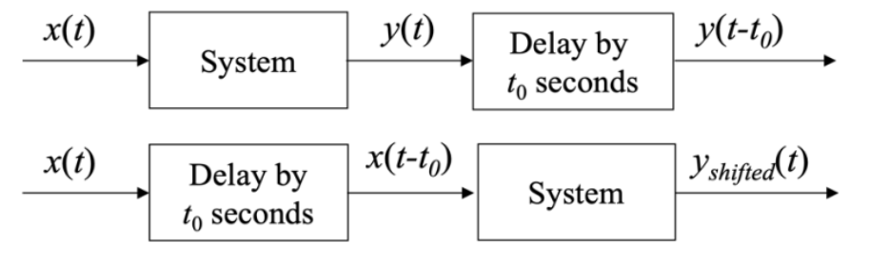
Init. Cond. for Time-Invariant Systems?
Observe system for t ≥ 0⁻
Notation means to include any Dirac delta signals at origin
Does y_{shifted}(t) = y(t-t₀) for all real-valued t₀ for $t≥0^{−}$ ?
Handouts for example systems
Time-Invariance for a (Shift) System Under Observation
link
Time-Invariance for an Integrator
link

Slide 14
Continuous-Time System Properties
Continuous-Time Signals and LTI Systems – SPFirst Sec. 9-4
Ideal delay by T seconds
x(t)
y(t)
Role of initial conditions?
Linear? Time-invariant?
Scale by a constant (a.k.a. gain block)
Two different ways to express it in a block diagram
x(t)
y(t)
x(t)
y(t)
Linear? Time-invariant?
See lecture slide 8-4

Slide 15
Continuous-Time System Properties
Continuous-Time Signals and LTI Systems – SPFirst Sec. 9-4
Tapped delay line
M-1 delay blocks:
…
Coefficients (or taps) are a₀, a₁, …a_{M-1}
…
Impulse response lasts for (M-1) T seconds:
Σ
Role of initial conditions?
Linear? Time-invariant?
See lecture slides 8-5 and 8-6

Slide 16
Continuous-Time System Properties
Continuous-Time Signals and LTI Systems – SPFirst Sec. 9-4
Amplitude Modulation (AM)
y(t) = A x(t) cos(2π f_{c} t)
f_{c} is the carrier frequency (frequency of radio station)
A is a constant
Linear? Time-invariant?
AM radio transmitter if x(t) = 1 + k_{a} m(t)
m(t) is audio signal to be broadcast
| k_{a} m(t) | < 1
x(t)
A
y(t)
cos(2 π f_{c} t)

Slide 17
License Info for SPFirst Slides
McClellan, Schafer &Yoder have released their work under a Creative Commons License with the following terms:
Attribution
The licensor permits others to copy, distribute, display, and perform the work. In return, licensees must give the original authors credit.
Non-Commercial
The licensor permits others to copy, distribute, display, and perform the work. In return, licensees may not use the work for commercial purposes—unless they get the licensor's permission.
Share Alike
The licensor permits others to distribute derivative works only under a license identical to the one that governs the licensor's work.
Full Text of the License
This (hidden) page should be kept with the presentation
©2003-2016, JH McClellan & RW Schafer
12-17

