Slide 1
Frequency Response
EE 313 Linear Systems and Signals Fall 2024
Prof. Brian L. Evans
Dept. of Electrical and Computer Engineering
The University of Texas at Austin
Textbook: McClellan, Schafer & Yoder, Signal Processing First, 2003
Lecture 14 http://www.ece.utexas.edu/~bevans/courses/signals

Slide 2
Linear Time Invariant System
Frequency Response – SPFirst Ch. 10 Intro & Sec. 10-1
Uniquely defined by its impulse response h(t)
x(t)
h(t)
y(t)
Sinusoidal response
  When input is sinusoid, output is sinusoid of same frequency
  The output sinusoid may have different magnitude/phase
Frequency response
  Indicates how input frequencies are transferred to output
  Directly connected to impulse response (next slide)
Output frequencies are only those present in input
See lecture slide 9-2 for discrete-time version

Slide 3
Sinusoidal Response of LTI Systems
Frequency Response – SPFirst Sec. 10-1
Input complex-valued sinusoid
x(t)
h(t)
y(t)
Output is due to convolution
Frequency response
  Directly related to impulse response
  Response to complex sinusoid signal of any frequency ω
  Describes how frequencies are transferred from input to output
See lecture slide 9-3 for discrete-time analogy

Slide 4
Sinusoidal Response of LTI Systems
Frequency Response – SPFirst Sec. 10-1
Frequency response
  Polar form (magnitude-phase form):
Response to complex-valued sinusoid revisited
Change in magnitude (gain)
Change in phase (phase shift)
See lecture slide 9-4 for discrete-time analogy

Slide 5
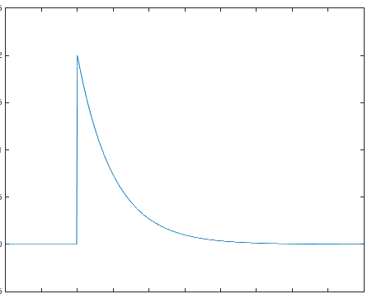
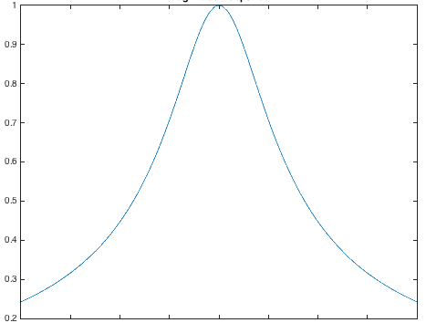
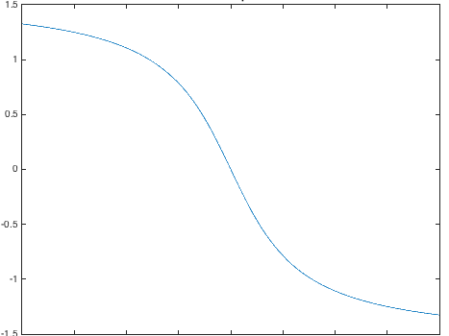
Sinusoidal Response of LTI Systems
Frequency Response – SPFirst Sec. 10-1
2
h(t)
t = -1 : 0.01 : 4;
unitstep = ( t >= 0 );
h = 2*exp(-2*t).* unitstep;
plot(t, h);
ylim( [-0.5 2.5] );
Example:
1
0
t
Lowpass filter
0 1 2 3
w = -8 : 0.01 : 8;
H = 2 ./ (2 + j*w);
Hmag = abs(H);
Hphase = phase(H);
figure;
plot(w, Hmag);
title('Magnitude Response');
figure;
plot(w, Hphase);
title('Phase Response');
gain
Sinusoidal Response
-8 -6 -4 -2 0 2 4 6 8
phase shift
-π/4
See lecture slide 9-5 for discrete-time analogy

Slide 6
Sinusoidal Response of LTI Systems
Frequency Response – SPFirst Sec. 10-2
Frequencies in output are only those in input
Derivation
Input:
Output:
For real-valued h(t)
See lecture slide 9-6 for discrete-time analogy

Slide 7
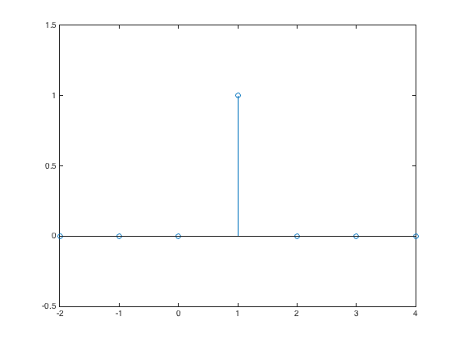
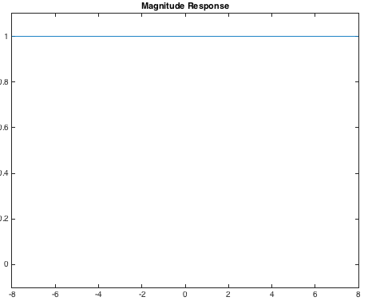
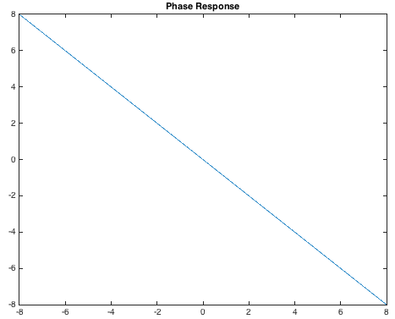
Ideal Delay
Frequency Response – SPFirst Sec. 10-3.1
Delay by T seconds
h(t)
(1)
T = 1
x(t)
y(t)
Zero Initial
T
t
Conditions
  Impulse response
w = -8 : 0.01 : 8;
H = exp(-j*w);
Hmag = abs(H);
Hphase = -w;
figure;
plot(w, Hmag);
ylim([-0.1, 1.1]);
title('Magnitude Response');
figure;
plot(w, Hphase);
title('Phase Response');
  Frequency response
Allpass Filter
Linear Phase
See lecture slide 9-7 for discrete-time analogy

Slide 8
LTI Response to Sum of Sinusoids
Frequency Response – SPFirst Sec. 10-2.3 & 10-2.4
Input as sum of sinusoids
x(t)
h(t)
y(t)
  Any values of
  LTI System
Output for kth sinusoid
Output for sum of sinusoids
  Apply linearity property
When x(t) is periodic, is y(t) periodic or not?

Slide 9
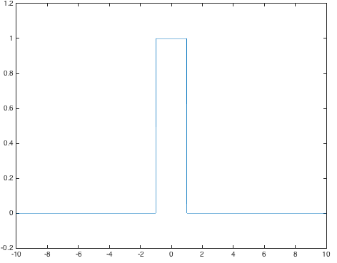
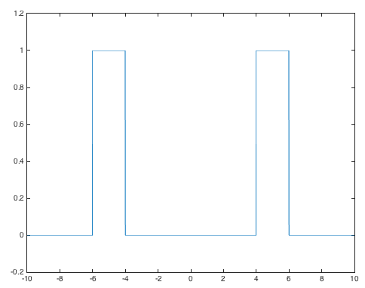
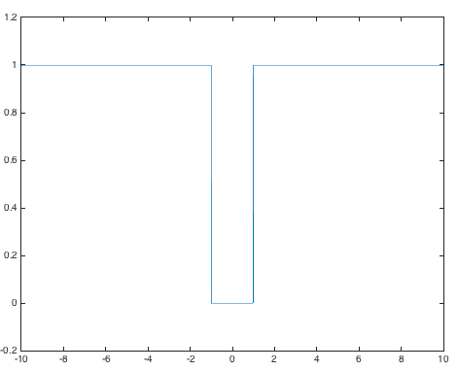
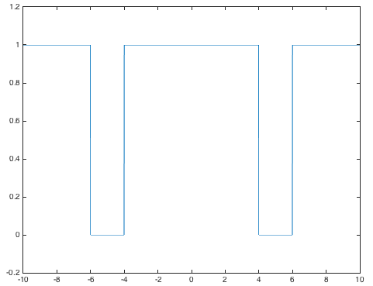
Ideal Filters
Frequency Response – SPFirst Sec. 10-3
w = -10 : 0.01 : 10;
W = 2;
% Lowpass
Hlp = rectpuls(w/W);
figure;
plot(w, Hlp);
ylim( [-0.2 1.2] );
% Highpass
Hhp = 1 - Hlp;
figure;
plot(w, Hhp);
ylim( [-0.2 1.2] );
% For bandpass/bandstop
wc = 5; % Center freq.
% Bandpass
Hbp = rectpuls((w-wc)/W) + rectpuls((w+wc)/W);
figure;
plot(w, Hbp);
ylim( [-0.2 1.2] );
% Bandstop
Hbs = 1 - Hbp;
figure;
plot(w, Hbs);
ylim( [-0.2 1.2] );
Lowpass
Bandpass
-5
0
5
ω
-5
0
5
ω
Highpass
Bandstop
-5
0
5
ω
-5
0
5
ω

Slide 10
Applying Ideal Filters
Frequency Response – SPFirst Sec. 10-4
  x(t) = 10 + 14 cos(5t – π/3) + 8 cos(10t + π/2)
X(jω)
x(t)
y(t)
h(t)
  LTI System
ω
H(jω)
–10
–5
0
5
10
Lowpass Filter
Y(jω) = H(jω) X(jω)
ω
-5
0
5
ω
–10
–5
0
5
10
See lecture slide 2-12 for spectral representation of x(t)

Slide 11
Applying Ideal Filters
Frequency Response – SPFirst Sec. 10-4
  x(t) = 10 + 14 cos(5t – π/3) + 8 cos(10t + π/2)
X(jω)
x(t)
y(t)
h(t)
  LTI System
ω
H(jω)
–10
–5
0
5
10
Highpass Filter
Y(jω) = H(jω) X(jω)
ω
-5
0
5
ω
–10
–5
0
5
10
See lecture slide 2-12 for spectral representation of x(t)

Slide 12
Applying Ideal Filters
Frequency Response – SPFirst Sec. 10-4
  x(t) = 10 + 14 cos(5t – π/3) + 8 cos(10t + π/2)
X(jω)
x(t)
y(t)
h(t)
  LTI System
ω
H(jω)
–10
–5
0
5
10
Bandpass Filter
Y(jω) = H(jω) X(jω)
ω
-5
0
5
ω
–10
–5
0
5
10
See lecture slide 2-12 for spectral representation of x(t)

Slide 13
Applying Ideal Filters
Frequency Response – SPFirst Sec. 10-4
  x(t) = 10 + 14 cos(5t – π/3) + 8 cos(10t + π/2)
X(jω)
x(t)
y(t)
h(t)
  LTI System
ω
H(jω)
–10
–5
0
5
10
Bandstop Filter
Y(jω) = H(jω) X(jω)
ω
-5
0
5
ω
–10
–5
0
5
10
See lecture slide 2-12 for spectral representation of x(t)

Slide 14
License Info for SPFirst Slides
McClellan, Schafer &Yoder have released their work under a Creative Commons License with the following terms:
Attribution
    The licensor permits others to copy, distribute, display, and perform the work. In return, licensees must give the original authors credit.
Non-Commercial
    The licensor permits others to copy, distribute, display, and perform the work. In return, licensees may not use the work for commercial purposes—unless they get the licensor's permission.
Share Alike
    The licensor permits others to distribute derivative works only under a license identical to the one that governs the licensor's work.
Full Text of the License
This (hidden) page should be kept with the presentation
©2003-2016, JH McClellan & RW Schafer
14-14

