Slide 1
Transfer Functions
EE 313 Linear Systems and Signals Fall 2024
Prof. Brian L. Evans
Dept. of Electrical and Computer Engineering
The University of Texas at Austin
Textbook: McClellan, Schafer & Yoder, Signal Processing First, 2003
Lecture 18 http://www.ece.utexas.edu/~bevans/courses/signals

Slide 2
Linear Systems and Signals Topics
The Laplace Transform – SPFirst Ch. 16 Intro
Domain | Topic | Discrete Time | Continuous Time
Time | Signals | SPFirst Ch. 4 | SPFirst Ch. 2
 | Systems | SPFirst Ch. 5 | SPFirst Ch. 9
 | Convolution | SPFirst Ch. 5 | SPFirst Ch. 9
Frequency | Fourier series | ** | SPFirst Ch. 3
 | Fourier transforms | SPFirst Ch. 6 | SPFirst Ch. 11
 | Frequency response | SPFirst Ch. 6 | SPFirst Ch. 10
Generalized Frequency | z / Laplace Transforms | SPFirst Ch. 7-8 | Supplemental Text
 | Transfer Functions | SPFirst Ch. 7-8 | Supplemental Text
 | System Stability | SPFirst Ch. 8 | SPFirst Ch. 9
Mixed Signal | Sampling | SPFirst Ch. 4 | SPFirst Ch. 12
✔
✔
✔
✔
✔
✔
✔
✔
✔
✔
✔
✔
✔
✔
✔
➔
✔
✔
✔
✔
** Spectrograms (Ch. 3) for time-frequency spectrums (plots) computed the discrete-time Fourier series for each window of samples.

Slide 3
Transforms
The Laplace Transform – SPFirst Ch. 16 Intro
Provide alternate signal & system representations
  Simplifies analysis in some cases
  Reveals new properties (e.g. bandwidth)
Algebra: Poles and Zeros
Diff. Equ.
{a_{k}, b_{k}}
Diff. Equ.
{a_{k}, b_{k}}
Input-Output Physical Model
Passbands and Stopbands
Input-Output Physical Model
Passbands and Stopbands
SPFirst Fig. 16-1
SPFirst Fig. 8-13

Slide 4
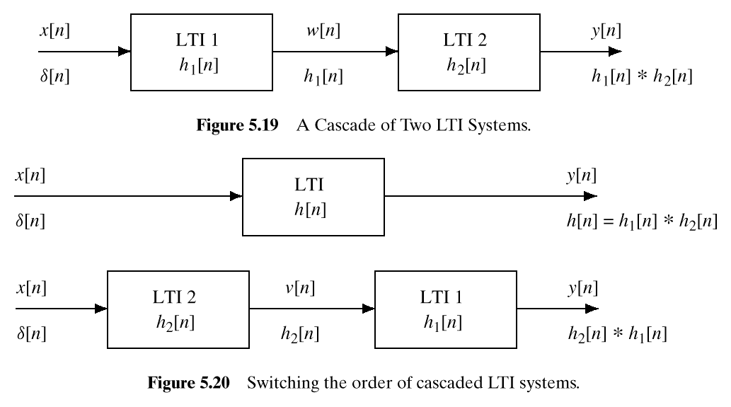
Transfer Function
Laplace transform of impulse response h(t) of linear time-invariant (LTI) system
Convolution in time property:
x(t)
w(t)
y(t)
X(s)
h₁(t)
W(s)
h₂(t)
Y(s)
W(s) = H₁(s) X(s)
Y(s) = H₂(s) W(s) = H₂(s) H₁(s) X(s)
x(t)
y(t)
X(s)
h(t)
Y(s)
See lecture slide 10-8 for discrete-time analogy
H(s) = H₂(s) H₁(s) = H₁(s) H₂(s)

Slide 5
Transfer Function Examples
Ideal delay by T seconds
  Initial conditions (initial voltages in delay buffer) are zero
x(t)
y(t)
Scale by a constant (a.k.a. gain block)
x(t)
y(t)
See lecture slide 12-13

Slide 6
Transfer Function Examples
Tapped delay line
  Initial conditions (initial voltages in delay buffers) are zero
M-1 delay blocks:
…
…
Impulse response lasts for (M-1) T seconds:
Σ
See lecture slide 12-14

Slide 7
Transfer Function Examples
Ideal integrator with y(0⁻) = 0 for LTI to hold
Ideal differentiator with x(0⁻) = 0 for LTI to hold
x(t)
y(t)
x(t)
y(t)
0
0
See lecture slide 12-12

Slide 8
Transfer Function for Diff. Equation
Example: y”(t) + 5 y’(t) + 6 y(t) = x’(t) + x(t)
  For LTI, initial conditions must be zero:
x(t)
y(t)
  y(0⁻) = 0, y’(0⁻) =0 and x’(0⁻) =0
Take Laplace transform of both sides of equation
Apply partial fractions decomposition

Slide 9
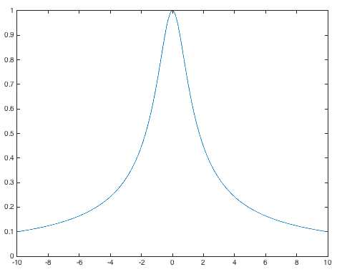
First-Order LTI System
Im{s}
One pole at s = p₀
X
Re{s}
Frequency response
Re{s} > Re{p₀}
  If ROC includes imaginary axis, i.e. when Re{p₀} < 0,
p0 = -1;
w = -10 : 0.01 : 10;
plot(w, abs(1 ./ (j*w - p0)));
  is distance from point
  on imaginary axis jω to pole p₀
ω
Lowpass Filter

Slide 10
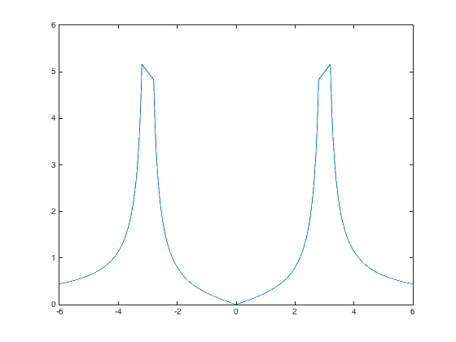
Second-Order LTI Oscillator
Im{s}
Poles at s = ±jω₀ & zero at s = 0
jω₀
X
O
Re{s}
−jω₀
X
SPFirst Table 16-1
Frequency response
Re{s} > 0
  Since ROC does not include imaginary axis, we cannot go directly from Laplace to Continuous-time Fourier transform
  Compute continuous-time Fourier transform of h(t)
(π)
(π)
ω
See lecture slide 17-11
−ω₀
ω₀

Slide 11
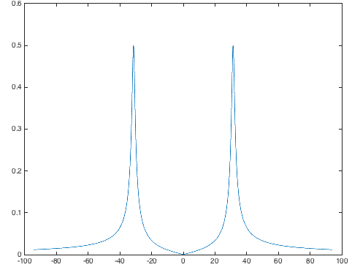
Second-Order LTI Bandpass Filter
Im{s}
Poles at s = -a±jω₀ & zero at s = -a
X
jω₀
O
-a
Re{s}
X
−jω₀
SPFirst Table 16-1
Frequency response
Re{s} > -a
  Since ROC includes imaginary axis, i.e. when a > 0,
a = 1
ω₀ = 10π
ω

Slide 12
LTI Systems in Cascade and Parallel
Cascade
X(s)
H₁(s)
H₂(s)
Y(s)
⇔
X(s)
H₂(s)
H₁(s)
Y(s)
  W(s) = H₁(s) X(s) Y(s) = H₂(s)W(s)
  Y(s) = H₁(s) H₂(s) X(s) ⇒ Y(s)/X(s) = H₁(s)H₂(s) = H(s)
  One can switch order of the cascade of two LTI systems if both LTI systems represent amplitudes in exact precision
Parallel combination
Use partial fractions to decompose a transfer function H(s) = G₁(s) + G₂(s)
  Y(s) = G₁(s)X(s) + G₂(s)X(s)
  Y(s)/X(s) = G₁(s) + G₂(s)
G₁(s)
X(s)
Σ
Y(s)
⇔
X(s)
G₁(s) + G₂(s)
Y(s)
G₂(s)
Advantages of parallel vs. cascade combination?

Slide 13
Feedback Connection of LTI Systems
E(s)
F(s)
Y(s)
F(s)
Σ
G(s)
Y(s)
⇔
-
H(s)
Governing equations
What happens if H(s) is a constant K?
  Choice of K controls all poles in transfer function
Combining equations
  Common LTI system in EE362K Introduction to Automatic Control and
  EE445L Microcontroller Applications/Organization

Slide 14
Solving a Differential Equation
The Laplace Transform – SPFirst Sec. 16-8
Example: y”(t) +5 y’(t) + 6 y(t) = x’(t) + x(t)
  With y(0⁻) = 2, y’(0⁻) =1, and f(t) = e^{- 4 t} u(t)
  So x’(t) = -4 e^{-4 t} u(t) + e^{-4 t} δ(t), x ’(0⁻) = 0 and x ’(0⁺) = 1
  See Course Handout S

Slide 15
License Info for SPFirst Slides
McClellan, Schafer &Yoder have released their work under a Creative Commons License with the following terms:
Attribution
    The licensor permits others to copy, distribute, display, and perform the work. In return, licensees must give the original authors credit.
Non-Commercial
    The licensor permits others to copy, distribute, display, and perform the work. In return, licensees may not use the work for commercial purposes—unless they get the licensor's permission.
Share Alike
    The licensor permits others to distribute derivative works only under a license identical to the one that governs the licensor's work.
Full Text of the License
This (hidden) page should be kept with the presentation
©2003-2016, JH McClellan & RW Schafer
18-15

