Slide 1



Cyclic Spectral Analysis of Power Line Noise in the 3-200 kHz Band
Karl Nieman†, Jing Lin†, Marcel Nassar†, Khurram Waheed‡, Brian L. Evans†
†Department of Electrical and Computer Engineering, The University of Texas, Austin, TX USA
‡Freescale Semiconductor, Inc., Austin, TX USA
March 27, 2013

Slide 2
Outline
Background | Measurement Campaigns | Cyclic Bit Loading | Conclusion
Background
  Cyclostationary noise in PLC
  Cyclic spectral analysis
  Measurement setup
Measurement Campaigns
  Characterization of “cyclostationarity” of noise
Cyclic Bit Loading for G3-PLC
  Demonstrate 2x throughput increase

Slide 3
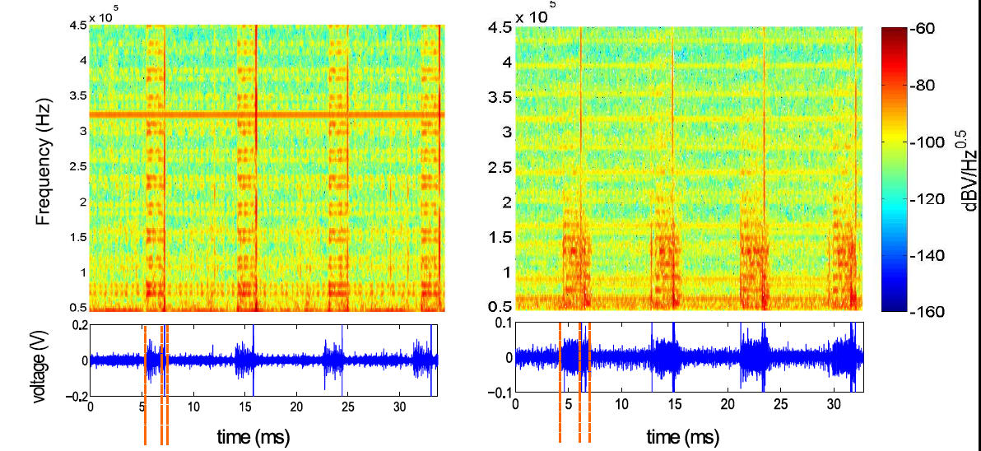
Cyclostationary Noise in Outdoor PLC
Background | Measurement Campaigns | Cyclic Bit Loading | Conclusion
Medium Voltage Site
Low Voltage Site
Data collected jointly with Aclara and
Texas Instruments near St. Louis, MO, USA.
fundamental period ≈ ½ AC cycle
lines separate statistically-similar regions
Both sites reveal time and frequency-periodic statistical properties
Example cyclic noise sources [Güzelgöz2010]
  motors, fluorescent bulbs, light dimmers, rectifying circuits, etc.

Slide 4
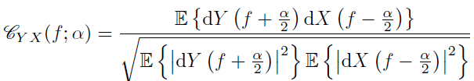

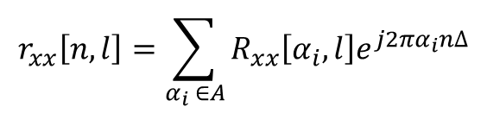

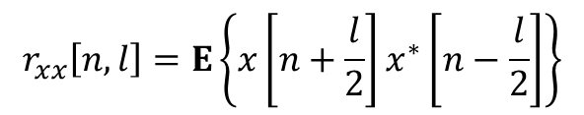
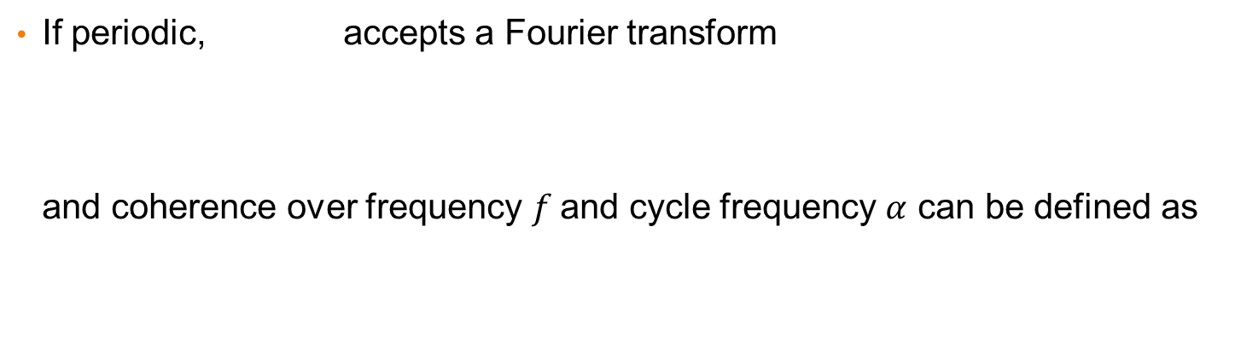
Cyclic Spectral Analysis [Gardner1986, Antoni2007]
Background | Measurement Campaigns | Cyclic Bit Loading | Conclusion
Instantaneous auto-correlation function
is periodic w/ period if:
$$r_{xx}\left[n,l\right]=E\left\{x\left[n+\frac{l}{2}\right]x^{∗}\left[n−\frac{l}{2}\right]\right\}$$
$$r_{xx}\left[n,l\right]=r_{xx}\left[n+kN,l\right], ∀k∈ℤ$$
If periodic, accepts a Fourier transform
and coherence over frequency $f$and cycle frequency $α$ can be defined as
$$r_{xx}\left[n,l\right]$$
$$r_{xx}\left[n,l\right]=\sum_{α_{i} ∈A}{R_{xx}\left[α_{i},l\right]e^{j2πα_{i}n∆}}$$
cycle frequencies $α_{i}$
“cyclic spectral coherence”

Slide 5
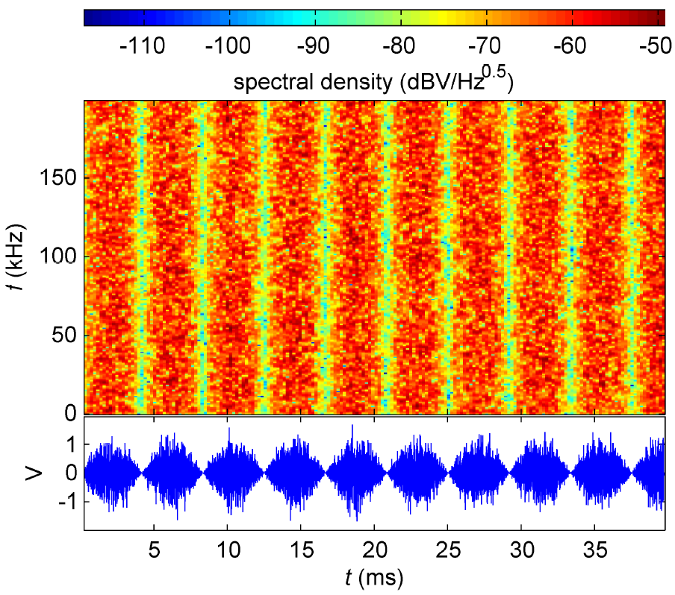
Example: 120 Hz AM White Noise
Background | Measurement Campaigns | Cyclic Bit Loading | Conclusion
repeating statistical properties every
half cycle = 240 Hz

Slide 6
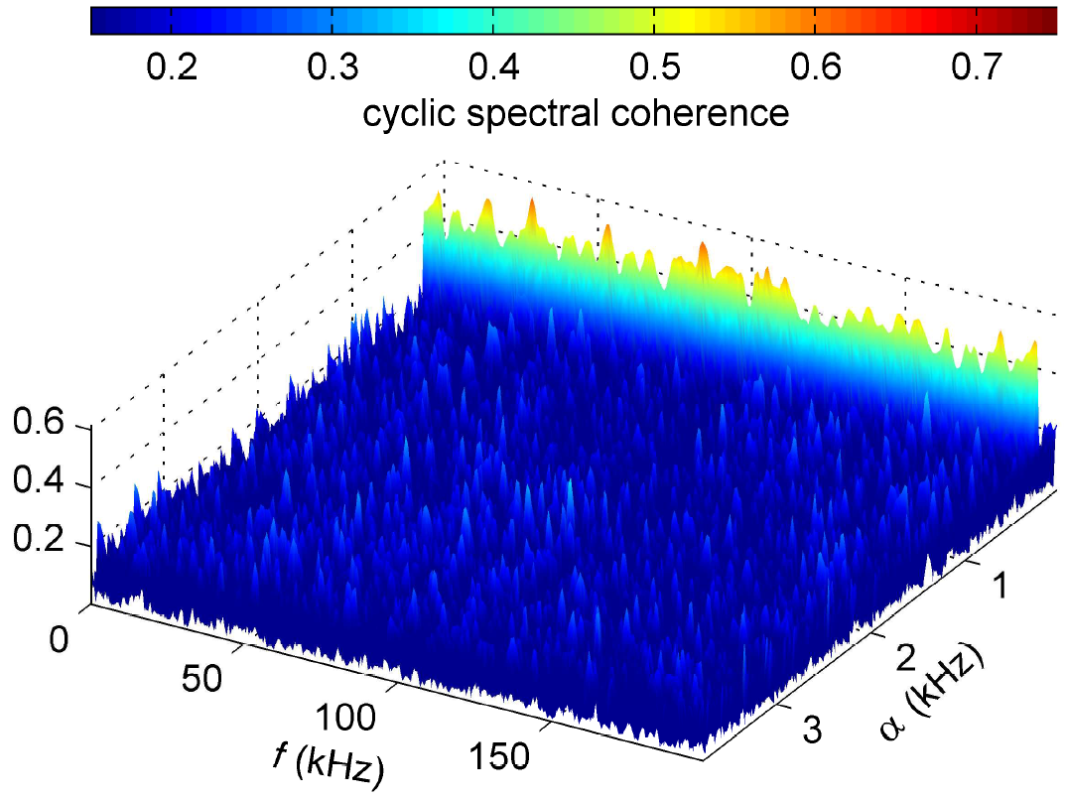
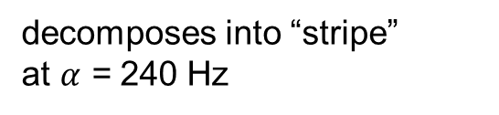
Example: 120 Hz AM White Noise
Background | Measurement Campaigns | Cyclic Bit Loading | Conclusion
decomposes into “stripe”
at $α$ = 240 Hz

Slide 7
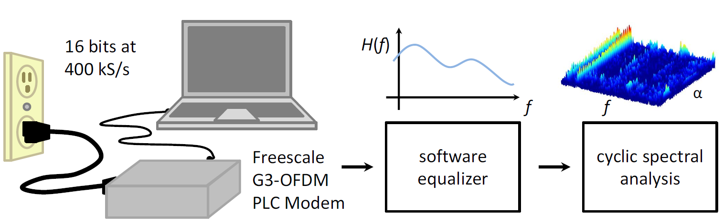
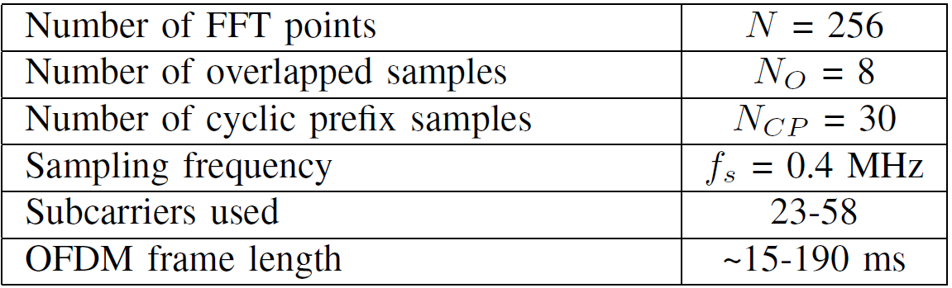
Measurement Setup
Background | Measurement Campaigns | Cyclic Bit Loading | Conclusion
Used to collect noise samples at low-voltage sites
System configuration (G3-PLC CENELEC-A, 3-95 kHz):
Note: frames can span many AC cycles!

Slide 8
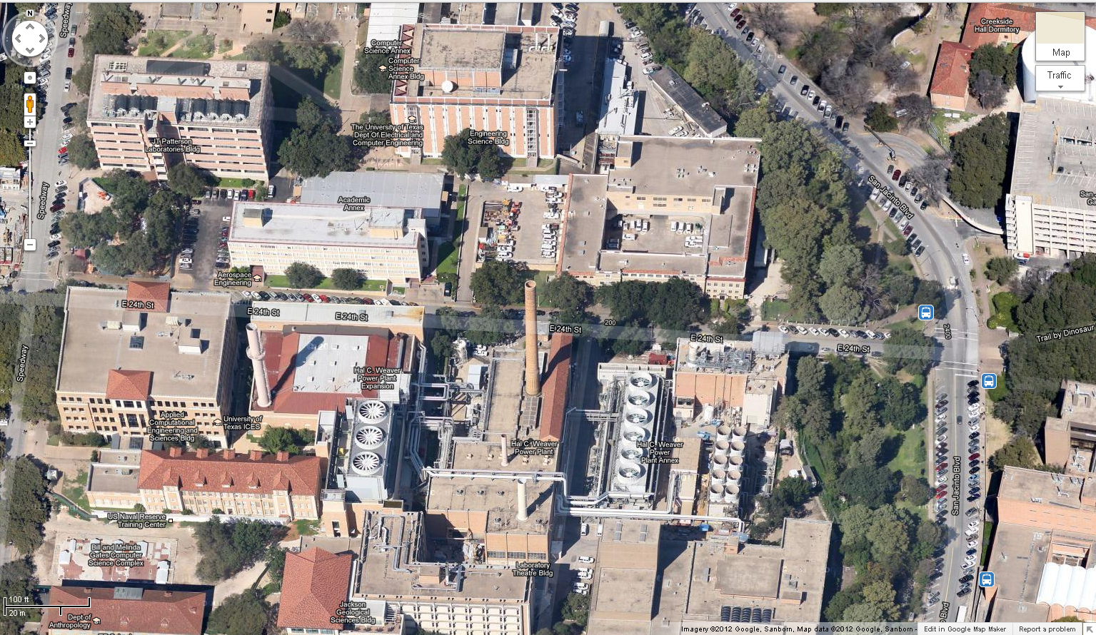
Measurement Sites in Austin, TX USA
Background | Measurement Campaigns | Cyclic Bit Loading | Conclusion
Office
Engineering Sciences Building room 414
Residential Apartment complex ~2 mi North
San Jacinto
E 24th St
Industrial
Hal C. Weever Power Plant Expansion

Slide 9
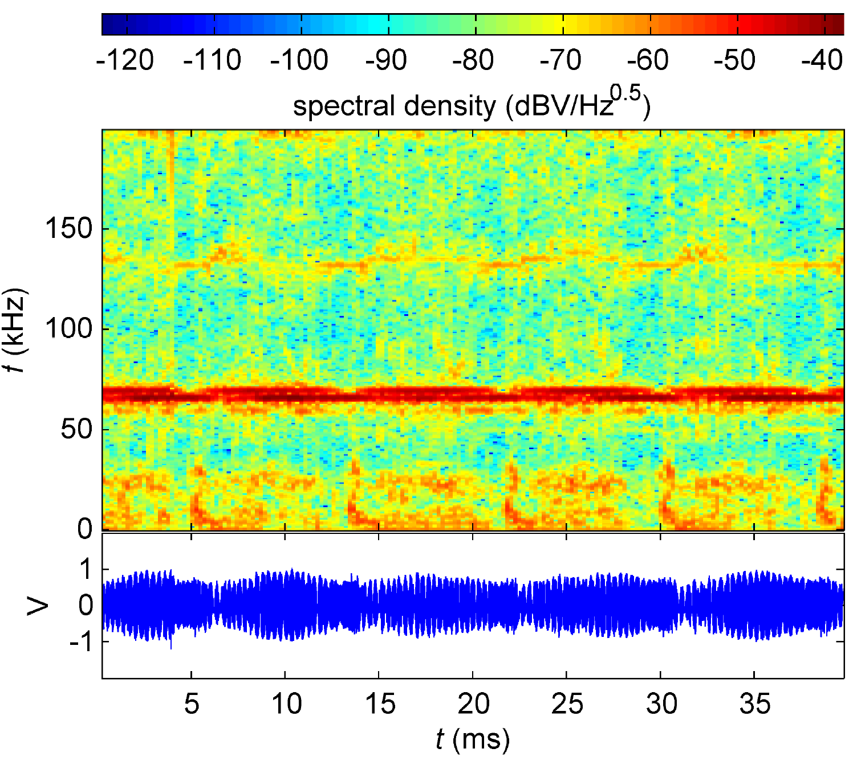
Measurement Site 1: Office
Background | Measurement Campaigns | Cyclic Bit Loading | Conclusion
weak narrowband f = 140 kHz
strong narrowband f = 60, 65 kHz
broadband impulse
DC-30 kHz

Slide 10
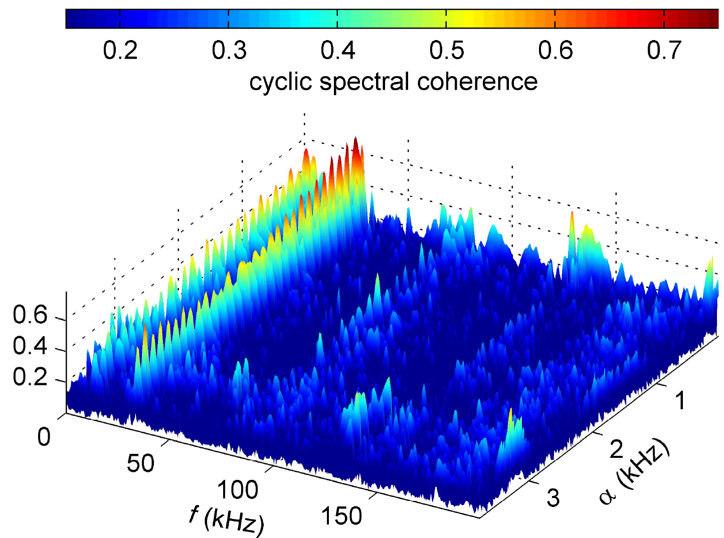
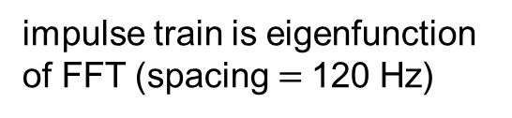
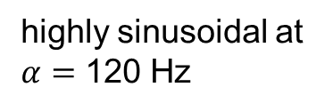
Case Study 1: Office
Background | Measurement Campaigns | Cyclic Bit Loading | Conclusion
impulse train is eigenfunction of FFT (spacing $=$120 Hz)
Higher power, but less coherent at f = 60,65 kHz
highly sinusoidal at $α=$ 120 Hz

Slide 11
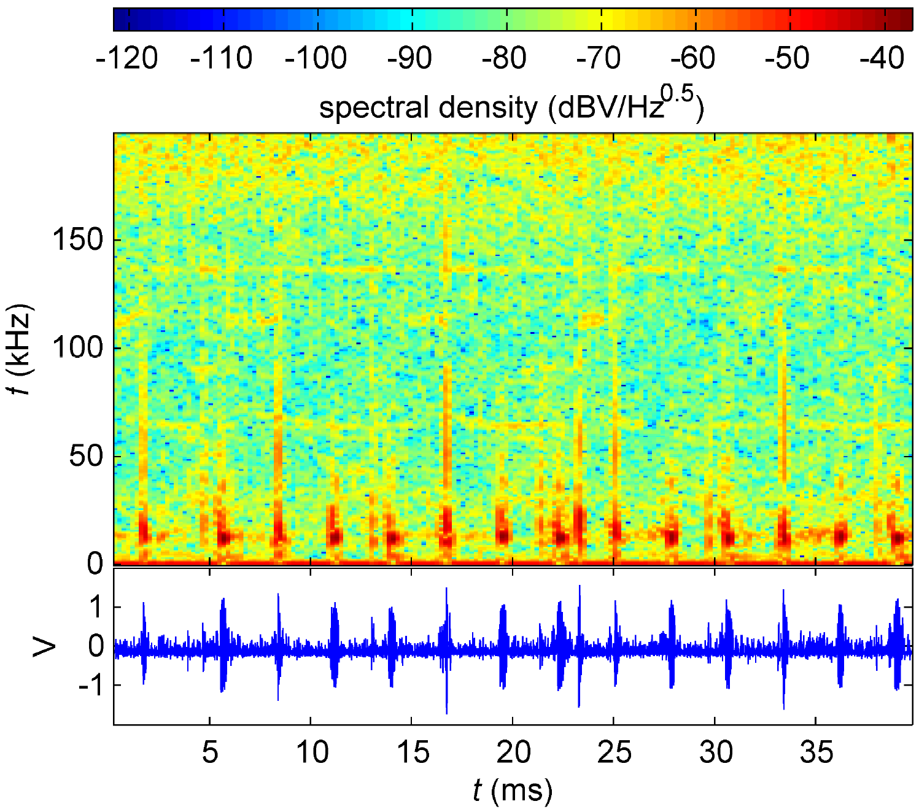
Measurement Site 2: Industrial
Background | Measurement Campaigns | Cyclic Bit Loading | Conclusion
broadband impulses
f = 30-120 kHz
narrow impulses
f = 10 kHz

Slide 12
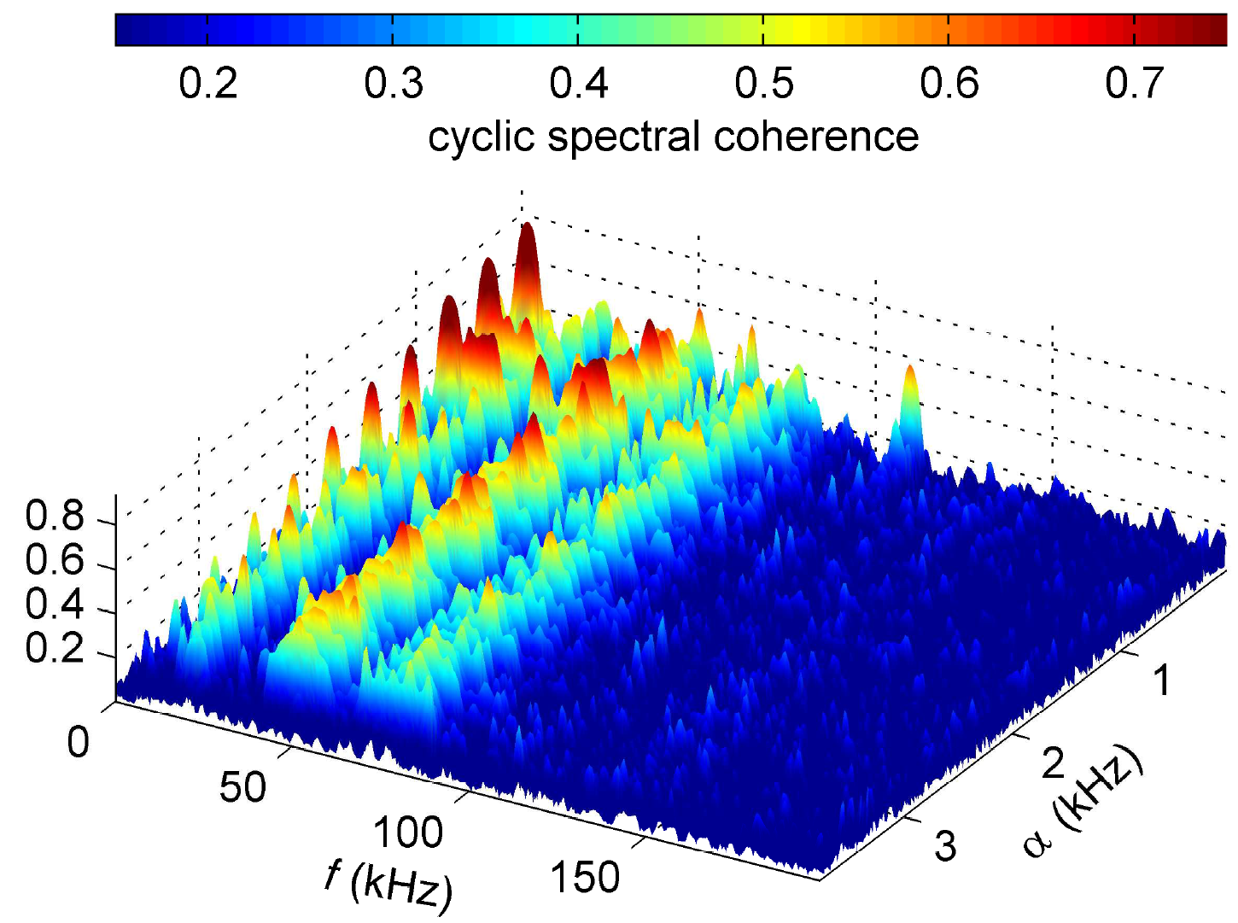
Measurement Site 2: Industrial
Background | Measurement Campaigns | Cyclic Bit Loading | Conclusion
highly stationary
360 Hz impulses
less stationary
120 Hz structures

Slide 13
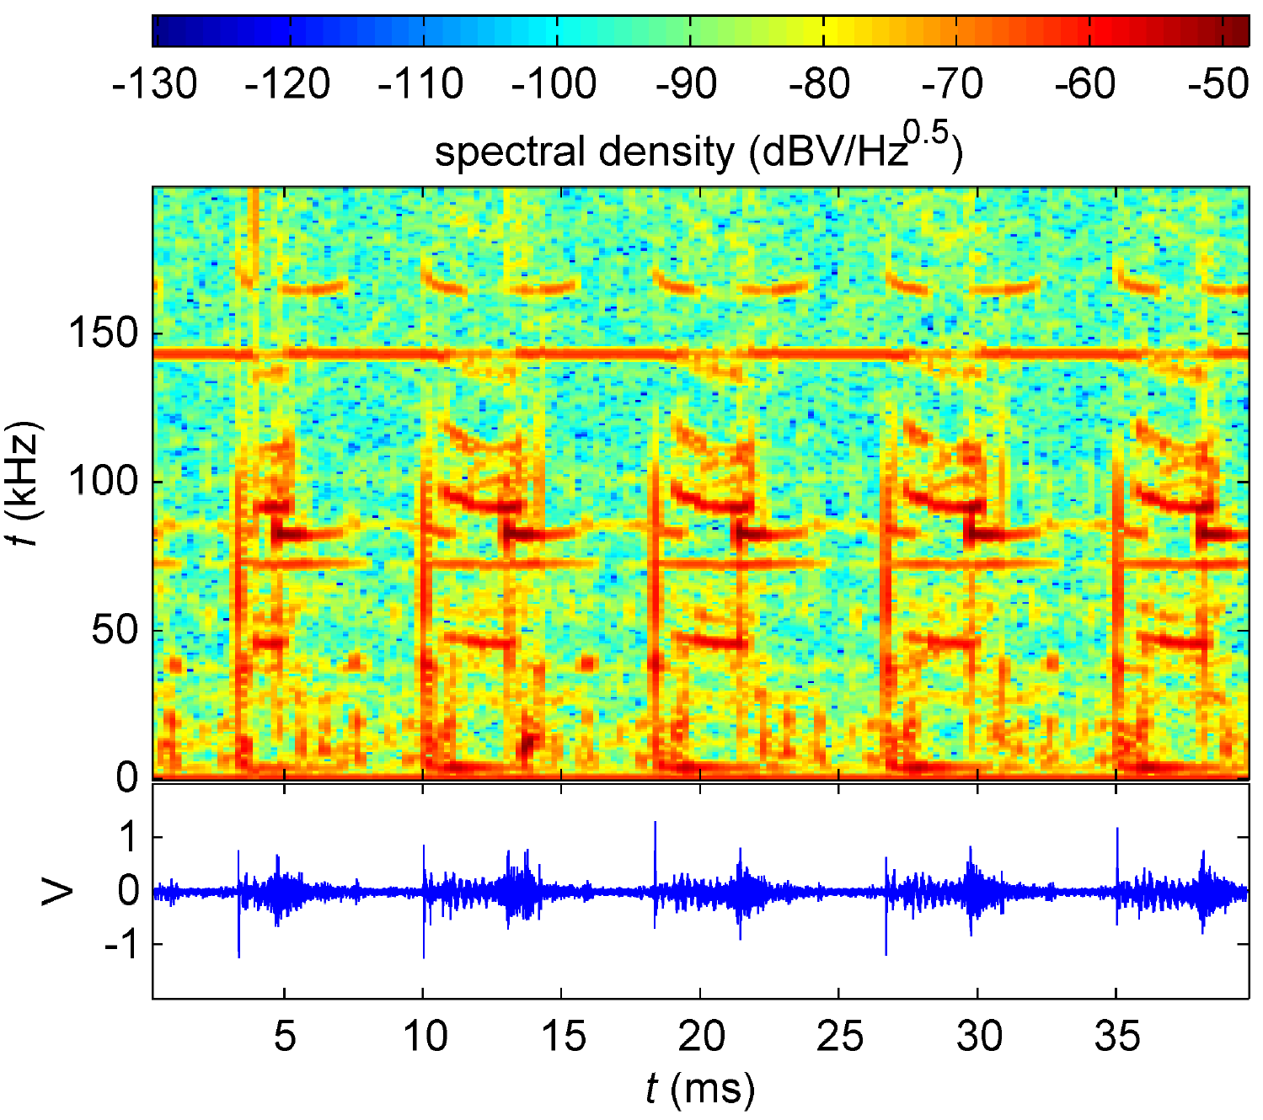
Measurement Site 3: Residential
Background | Measurement Campaigns | Cyclic Bit Loading | Conclusion
frequency sweep
f = 170 kHz
narrowband
f = 140 kHz
complex spectrum
f = 30-120 kHz

Slide 14
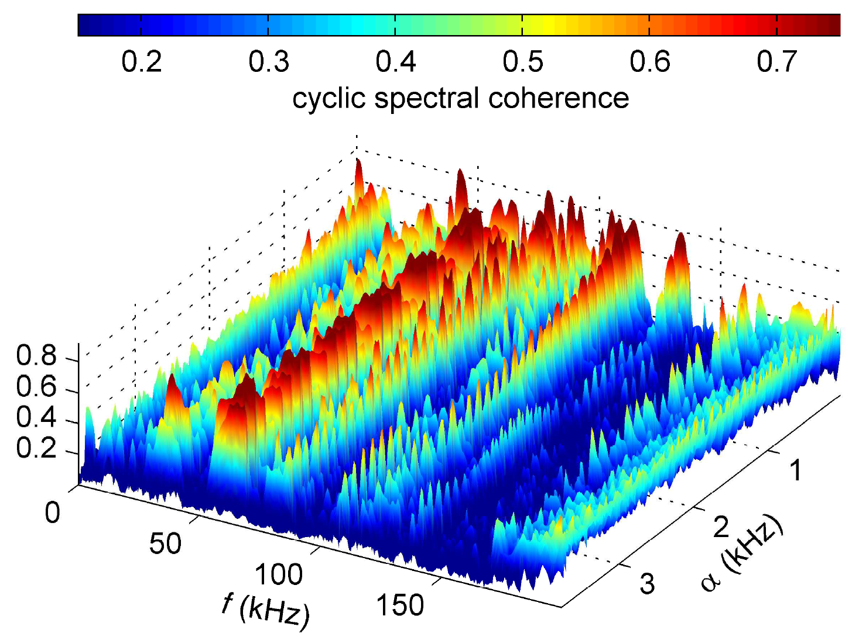
Measurement Site 3: Residential
Background | Measurement Campaigns | Cyclic Bit Loading | Conclusion
though spectrally complex, many components have strong stationarity at 120 Hz

Slide 15
Cyclic Bit Loading for G3-PLC
Background | Measurement Campaigns | Cyclic Bit Loading | Conclusion
12 G3-PLC symbols ≈ 8.34 ms
Exploit highly-colored yet cyclic noise to increase system throughput
RX measures SNR-per-subcarrier over ½ AC cycle
“Enhanced” tone map request is used to give TX 2-D bit allocation map

Slide 16
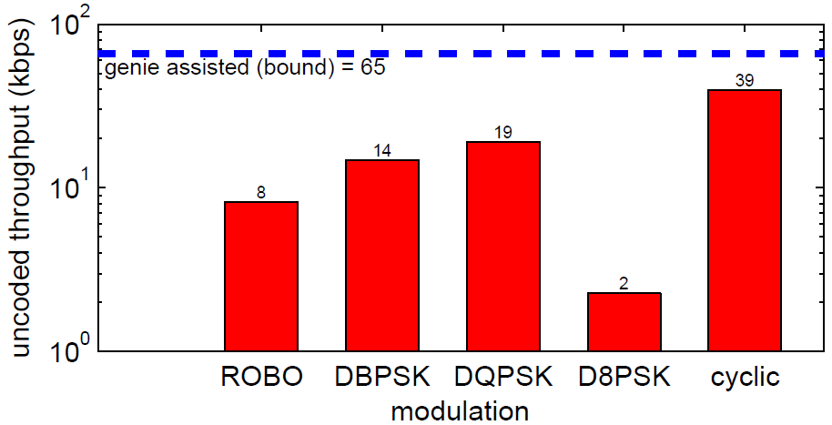
Link Throughput for Target BER = 10⁻²
Background | Measurement Campaigns | Cyclic Bit Loading | Conclusion
2x increase!
Throughput increased by 2x in measured noise data
Further gains possible using larger modulation/rate codebook

Slide 17
Conclusions
Background | Measurement Campaigns | Cyclic Bit Loading | Conclusion
Demonstrated utility of cyclic spectral analysis for PLC
Confirmed cyclostationarity of meaured noise components
Achieved 2x throughput increase using cyclic bit loading
Data and Matlab tools are available for download here:
http://users.ece.utexas.edu/~bevans/papers/2013/PLCcyclic/index.html

Slide 18
References
Background | Measurement Campaigns | Cyclic Bit Loading | Conclusion
  M. Nassar, J. Lin, Y. Mortazavi, A. Dabak, I. H. Kim, and B. L. Evans, “Local Utility Powerline Communications in the 3-500 kHz Band: Channel Impairments, Noise, and Standards”, IEEE Signal Processing Magazine, Special Issue on Signal Processing Techniques for Smart Grid, Sep. 2012.
  S. Güzelgöz, H. B. Celebi, T. Guzel, H. Arslan, M. C. Mihcak, “Time Frequency Analysis of Noise Generated by Loads in PLC”, Proc. IEEE International Conference on Telecommunications, 2010.
  J. Antoni, “Cyclic Spectral Analysis in Practice,” Mechanical Systems and Signal Processing, 2007.
  M. Nassar, A. Dabak, I. H. Kim, T. Pande, and B. L. Evans, “Cyclostationary Noise Modeling in Narrowband Powerline Communication for Smart Grid Applications,” Proc. IEEE International Conference on Acoustics, Speech, and Signal Processing, 2012.
  W. Gardner, “The Spectral Correlation Theory of Cyclostationary Time-Series,” Signal Processing, 1986.
  S. Katar, B. Mashbum, K. Afkhamie, H. Latchman, and R. Newman, “Channel adaptation based on cyclo-stationary noise characteristics in PLC systems,” IEEE Intl. Symp. on Power Line Commun. and Its
  Appl.(ISPLC), pp. 16–21, 2006.

Slide 19
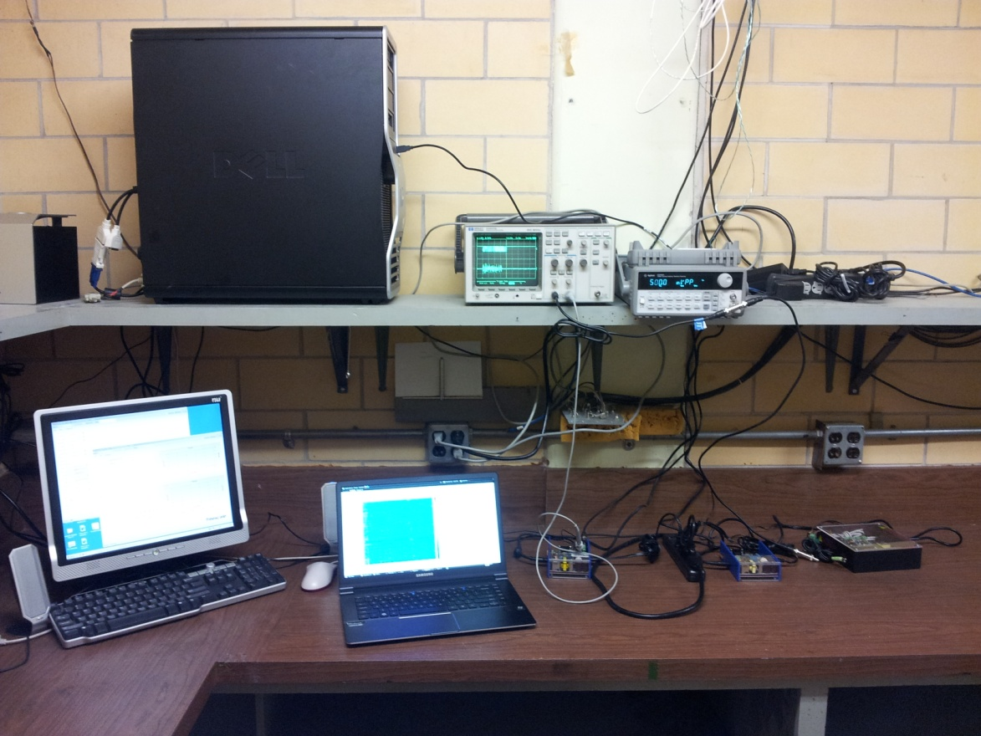
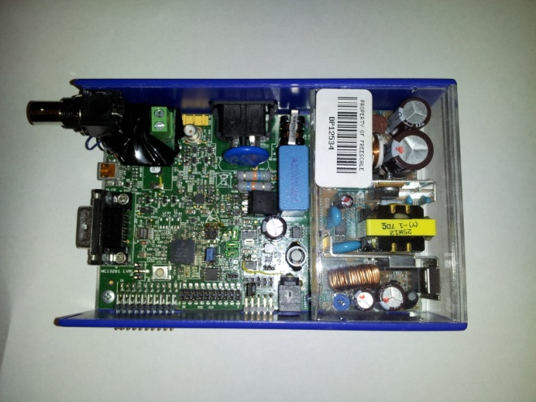

Noise Playback Testbed
Backup
G3 link using two Freescale PLC G3-OFDM modems
Software tools provided by Freescale allow frame-by-fame analysis
Test setup allows synchronous noise injection into power line
Freescale PLC G3-OFDM Modem
One modem was used to sample power line noise data in field
Collected 16k 16-bit 400 kS/s samples at each location
ESPL Freescale PLC Testbed in ENS 607

