Slide 1
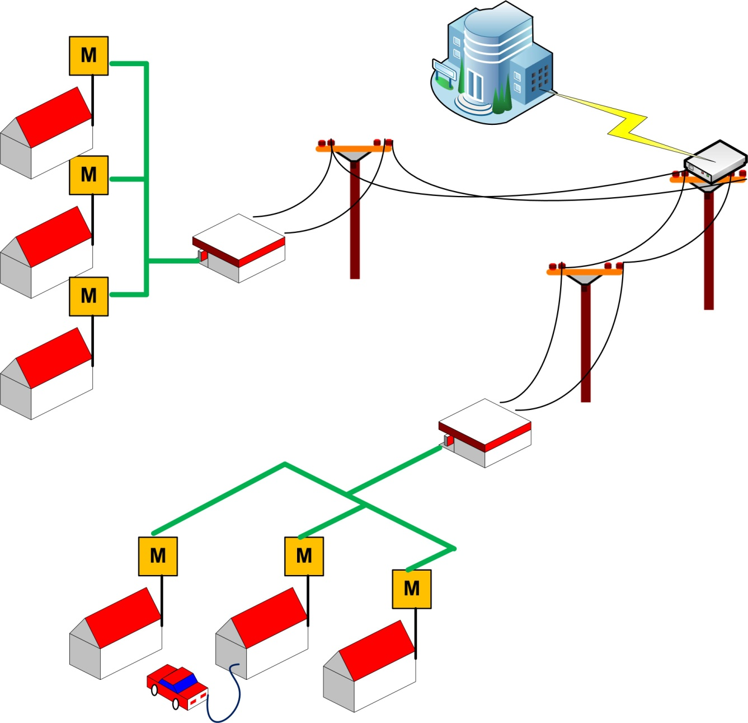
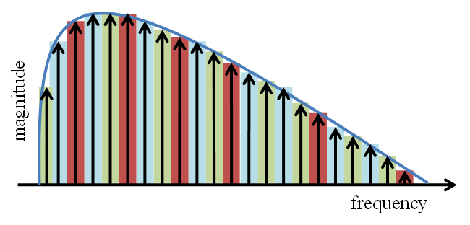
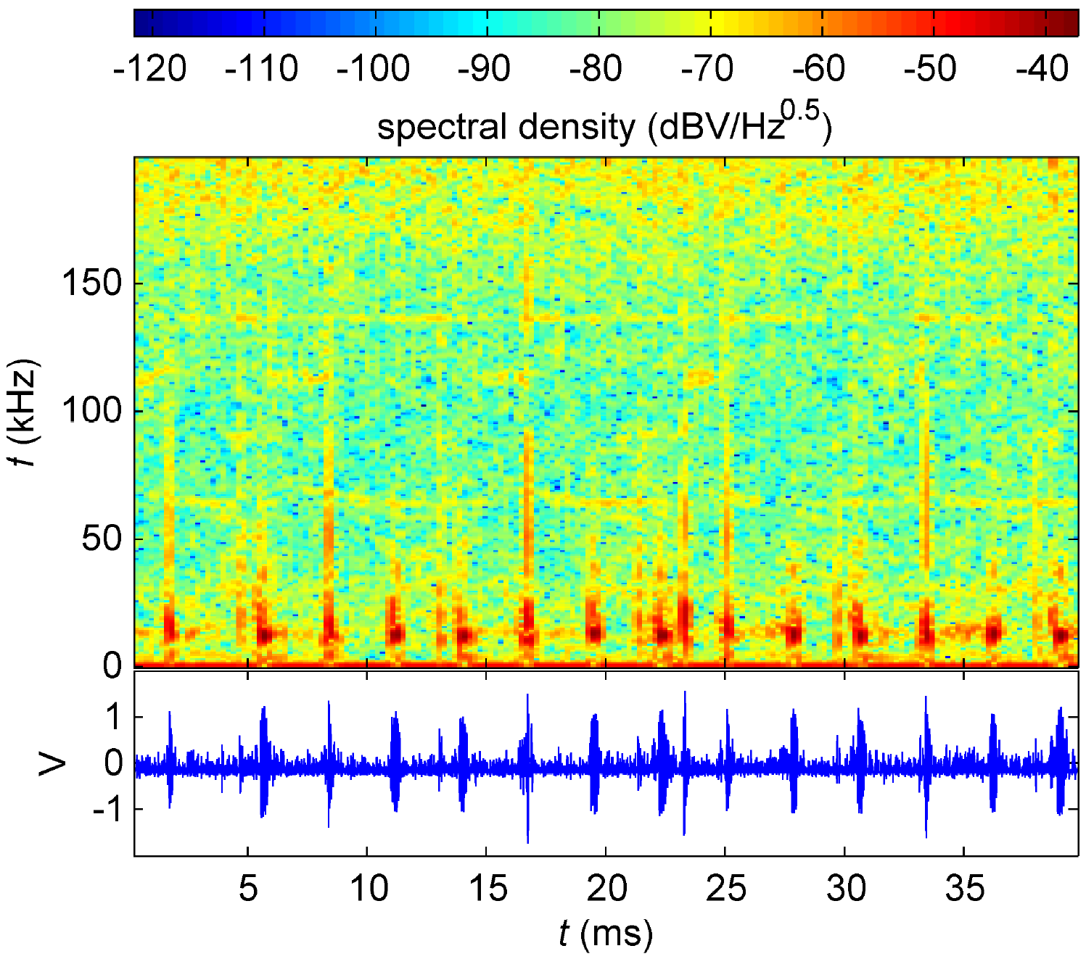
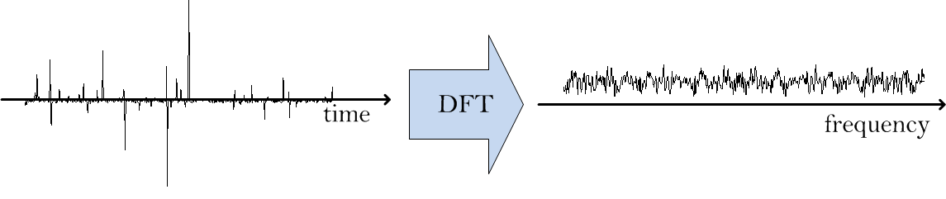
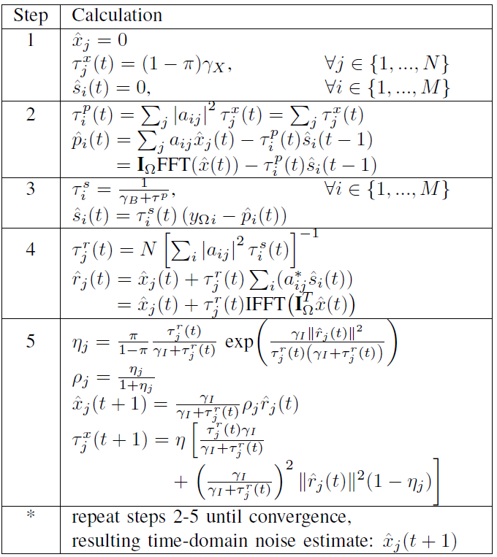
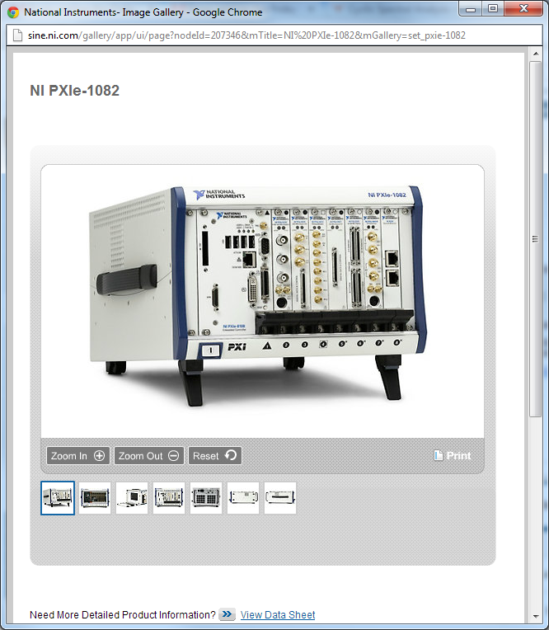
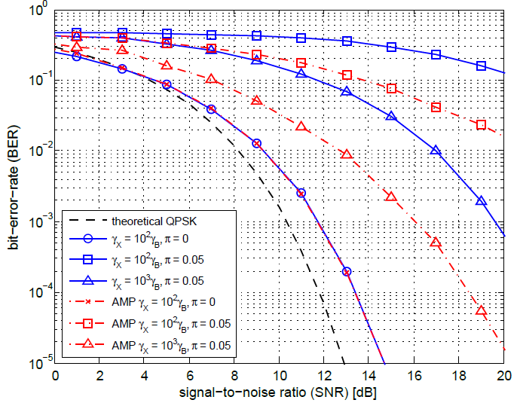
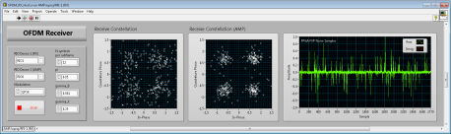
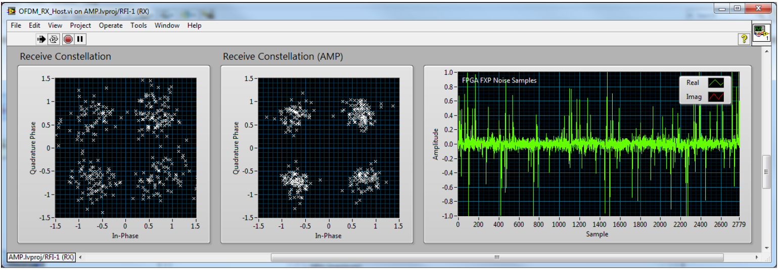
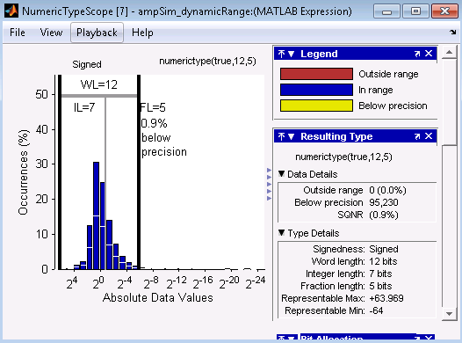
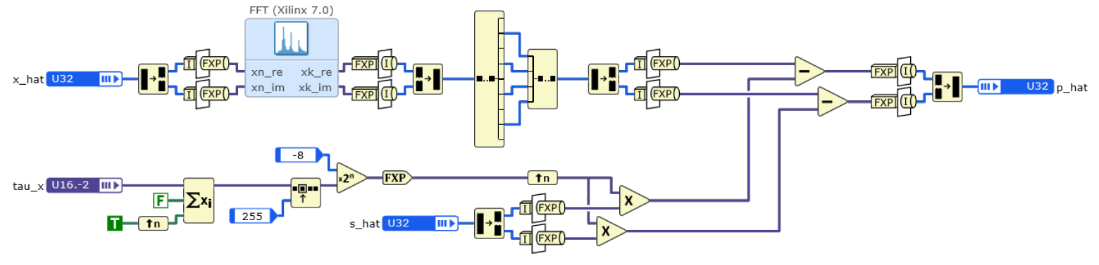



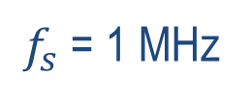
FPGA Implementation of a Message-Passing OFDM Receiver for Impulsive Noise Channels
Prof. Brian L. Evans, Wireless Networking and Communications Group, The University of Texas at Austin
Students: Mr. Karl Nieman, Mr. Marcel Nassar and Ms. Jing Lin
Objective: Implement real-time OFDM receiver with impulsive noise mitigation for use in power line communications (PLC).
Impulsive Noise in PLC
OFDM
Outdoor medium-voltage line (St. Louis, MO)
Indoor low-voltage line (UT Campus)
OFDM transmits data over multiple independent subcarriers (tones)
Local utility
$f_{s}$ = 1 MHz
Interleave
x
IFFT
Filter
Receiver
+
FFT
y
Equalizer and detector
+
+
Vector of symbol amplitudes (complex)
Gaussian (w) +
Impulsive Noise (e)
Impulsive noise estimation
-
Data concentrator
Channel
Conventional OFDM system
Added in our system
Smart meters
MV-LV transformer
FFT spreads out impulsive noise across all subcarriers
Communication in a Smart Grid
Cyclostationary noise becomes
impulsive after interleaving
Approximate Message Passing (AMP)
AMP PLC Test System Powered by NI Products
TX Chassis
RX Chassis
BER Results
Iterative algorithm (4 iterations used)
In-band noise inferred from out-of-band guard tones
LabVIEW DSP Design Module (a high-level graphical synthesis tool) was used to map processing to FPGA
Mapped to fixed-point using MATLAB toolbox
1 × PXIe-1082
1 × PXIe-8133
1 × PXIe-7965R
1 × NI-5781 FAM
1 × PXIe-1082
1 × PXIe-8133
2 × PXIe-7965R
1 × NI-5781 FAM
LabVIEW DSP Design Module
differential MCX pair (quadrature component = 0)
testbench control/data visualization
LabVIEW DSP Design Module
LabVIEW
16-bit DAC
256 IFFT w/ 22 CP insertion
zero padding (null tones)
43.2 kSps
data symbol generation
NI 5781
sample rate conversion
generate complex conjugate pair
RT controller
FlexRIO FPGA Module 1 (G3TX)
Host Computer
10 MSps
400 kSps
368.3 kSps
103.6 kSps
data and reference symbol interleave
LabVIEW RT
51.8 kSps
8.6 kSps
reference symbol LUT
differential MCX pair
LabVIEW DSP Design Module
14-bit ADC
51.8 kSps
8.6 kSps
BER/SNR calculation w/ and w/o AMP
NI 5781
256 FFT w/ 22 CP removal, noise injection
FlexRIO FPGA Module 2 (G3RX)
FlexRIO FPGA Module 3 (AMPEQ)
RT controller
sample rate conversion
time and frequency offset correction
null tone and active tone separation
Subtract noise estimate from active tones
data and reference symbol de- interleave
channel estimation/ ZF equalization
LabVIEW RT
10 MSps
400 kSps
400 kSps
368.3 kSps
184.2 kSps
AMP noise estimate
368.3 kSps
256 FFT, tone select
51.8 kSps
51.8 kSps
43.1 kSps
43.1 kSps
LabVIEW Front Panel
BER analyzed over typical PLC operating range
Up to 8 dB SNR recovered using AMP algorithm
FPGA Resource Usage
Utilization | TX | RX | AMP+EQ
FPGA | 1 | 2 | 3
total slices | 32.6% | 64.0% | 94.2%
slice reg. | 15.8% | 39.3% | 59.0%
slice LUTs | 17.6% | 42.4% | 71.4%
DSP48s | 2.0% | 7.3% | 27.3%
blockRAMs | 7.8% | 18.4% | 29.1%
conventional
with AMP
input impulsive noise
DSP Design Diagram (step 2 of algorithm)
Project website: http://users.ece.utexas.edu/~bevans/projects/plc/
Project supported by NI, Freescale, IBM, and TI

