Slide 1


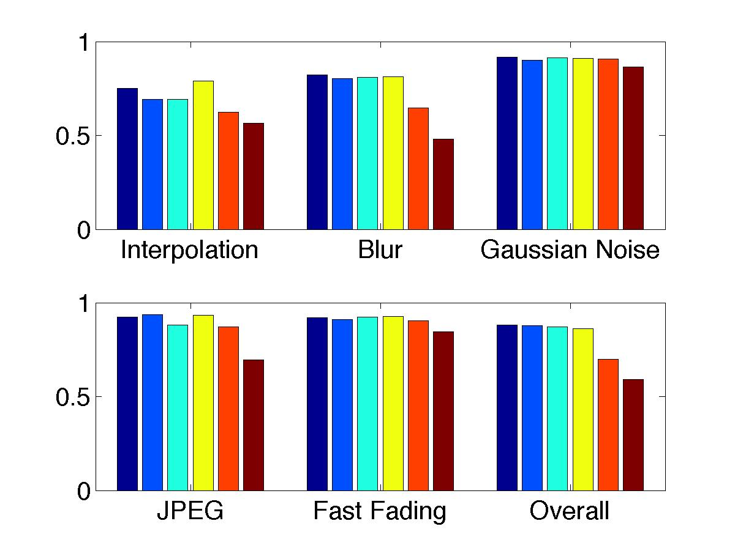
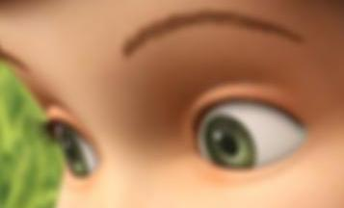
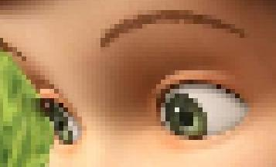
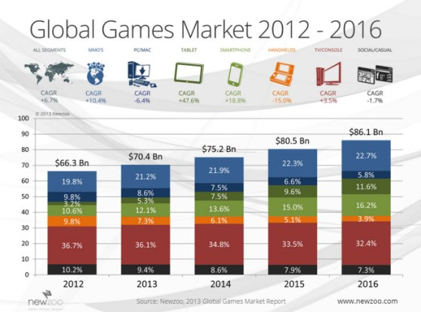

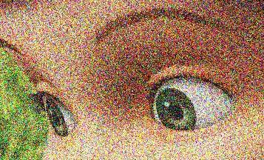
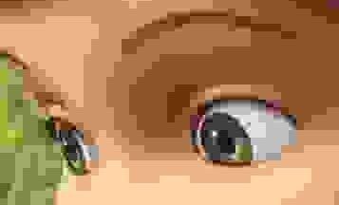
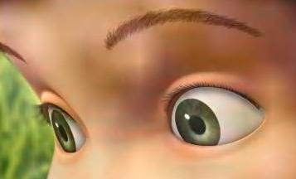
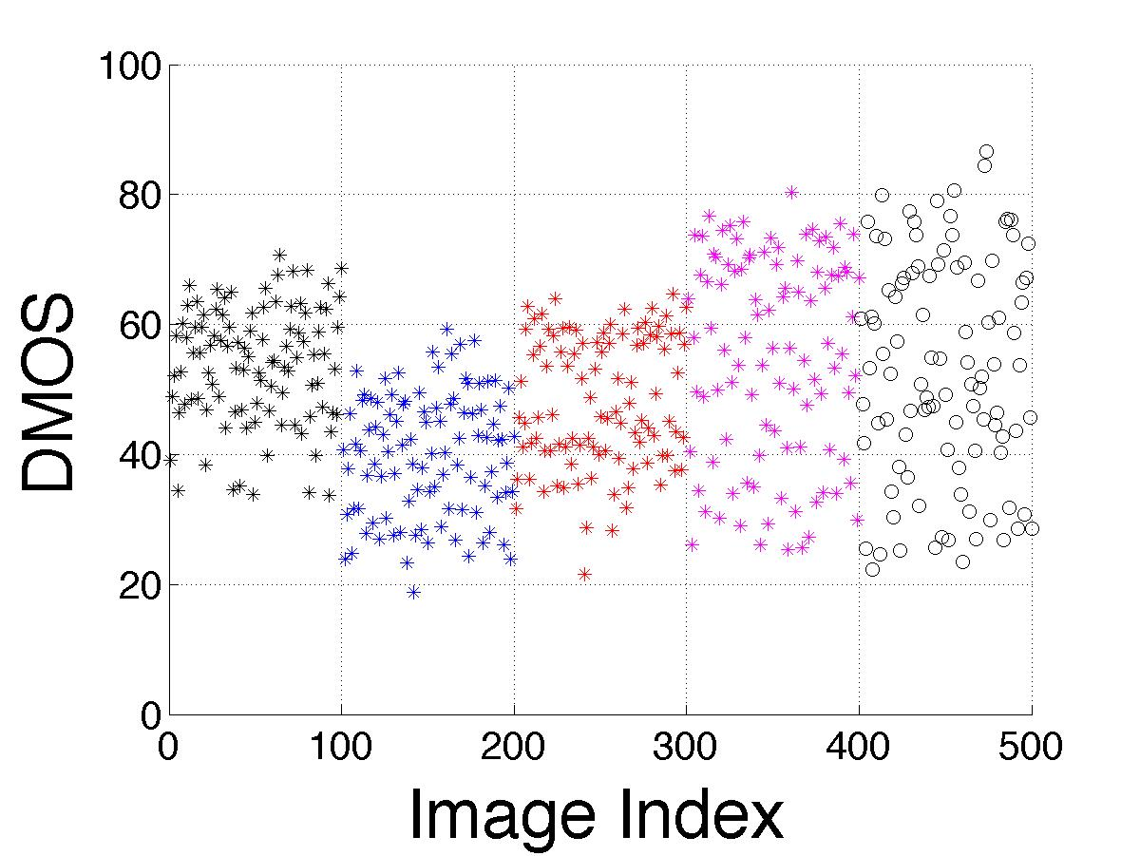
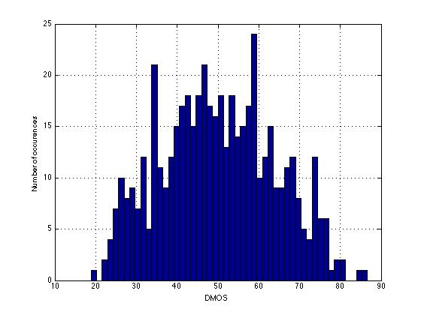


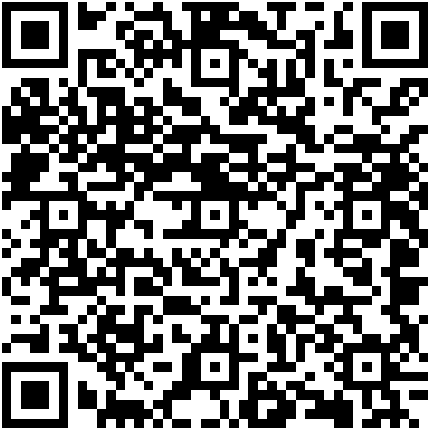
Full-Reference Visual Quality Assessment for Synthetic Images: A Subjective Study
Ms. Debarati Kundu and Prof. Brian L. Evans
Embedded Signal Processing Laboratory (ESPL)
debarati@utexas.edu, bevans@ece.utexas.edu
Motivation
ESPL Synthetic Image Database
Performance of Full-Reference Algorithms
Problem: Automate Image Quality Assessment (IQA) for synthetic scenes
Approach: Evaluate IQA algorithms for high-resolution synthetic scenes
25 pristine reference images
Used less severe distortions than natural images
500 distorted images
Evaluate 23 image quality assessment algorithms
  Give designers of video games and animated films immediate feedback for rendering artifacts
  Give video game designers immediate feedback on transmission artifacts in cloud gaming
  5 distortion types
  4 distortion levels for each image and each distortion type
  Develop public database of pristine and distorted synthetic images
  Conduct subjective testing for visual quality assessment
  Correlate IQA algorithms with subjective test results
Blur
Interpolation
Spearman’s Rank Ordered Correlation Coefficient between leading full-reference metrics and subjective opinion scores
Original
Gaussian Noise
Spectral Residual Based Similarity (SR-SIM) | Feature Similarity Index (Color) (FSIMc)
Visual Saliency Induced Index (VSI) | Most Apparent Distortion (MAD)
Multiscale Structural Similarity Index (MS-SSIM) | Peak Signal-to-Noise Ratio (PSNR)
Synthetic Scenes
Conclusion
JPEG Compression
Fast Fading
Processing Artifacts
Transmission Artifacts
Overall: SR-SIM ✓
Saliency-inspired pooling strategies perform well
PSNR does reasonably well for additive noise & fast fading
Interpolation and Blur
  Interpolation: MAD ✓
  Blur and Gaussian Noise: SR-SIM ✓
Synthetic Scenes
Subjective Study Methodology
Sources of graphics data
Artifacts
Multiple artifacts may occur at same time
Evaluated on Dell U2412M 24-inch displays
64 subjects evaluated every image over three sessions
Single Stimulus Continuous Evaluation on a scale of [0,100]
Reference and distorted images evaluated in same session
Differential Mean Opinion Score obtained for each image
  JPEG Compression : FSIMc ✓
  Fast Fading: MAD ✓
  Animation studios
  Kinect, video games
  Interpolation, banding, ringing, noise, blur
  JPEG and wireless distortions
  Less severe distortions in the database
  Result in near-threshold artifacts
Future Work
Conduct subjective tests for larger number of graphics artifacts
Evaluate no-reference image quality measures on database
Applicability of natural video statistics in animation sequences
Scatter plot of DMOS scores
Histogram of DMOS scores
http://users.ece.utexas.edu/~bevans/papers/2015/imagequality/

