Slide 1


May 24, 2018
Real-time testbed for diversity in powerline and wireless smart grid communications
Junmo Sung and Brian L. Evans
Wireless Networking and Communications Group and
Dept. of Electrical and Computer Engineering
The University of Texas at Austin

Slide 2
Motivation
Exploit existing heterogeneous smart grid communication technologies
Diversity of powerline and wireless communication channels
More reliable communication possible with diversity
Testbed for test and evaluation of various combining schemes

Slide 3
Heterogeneous Link Diversity
Noise Estimator Options
Maximal Ratio Combiner (MRC)
Average | Overhead | Complexity
Instantaneous | High | High
✓ Time | Medium | Medium
Time & Freq. | Low | Low
Good performance-complexity tradeoff
Log-likelihood ratio (LLR) combining
nth OFDM symbol; kth subcarrier; σ² Gaussian noise variance

Slide 4
Powerline/Wireless Diversity System
Smart Meter (Transmitter)
Data Concentrator (Receiver)
Diversity over heterogeneous links
Combiner at receiver
Common OFDM baseband system for both subsystems

Slide 5
Testbed Overview: Hardware
Hardware Setup
National Instruments
Two chasses
Plug-in modules
Two subsystems
  Powerline Tx/Rx chassis
  Wireless Tx/Rx chassis
Laptop
  Command center
  Visualization
Ethernet router
Powerline
Wireless

Slide 6
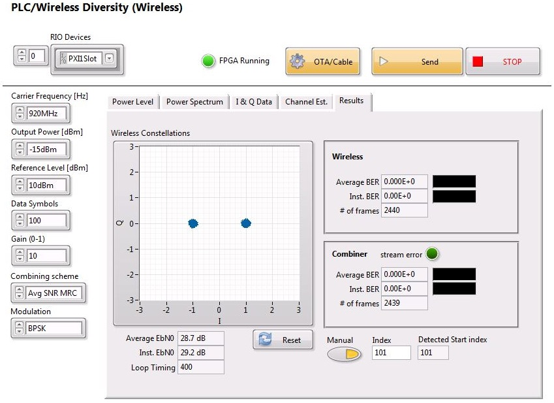
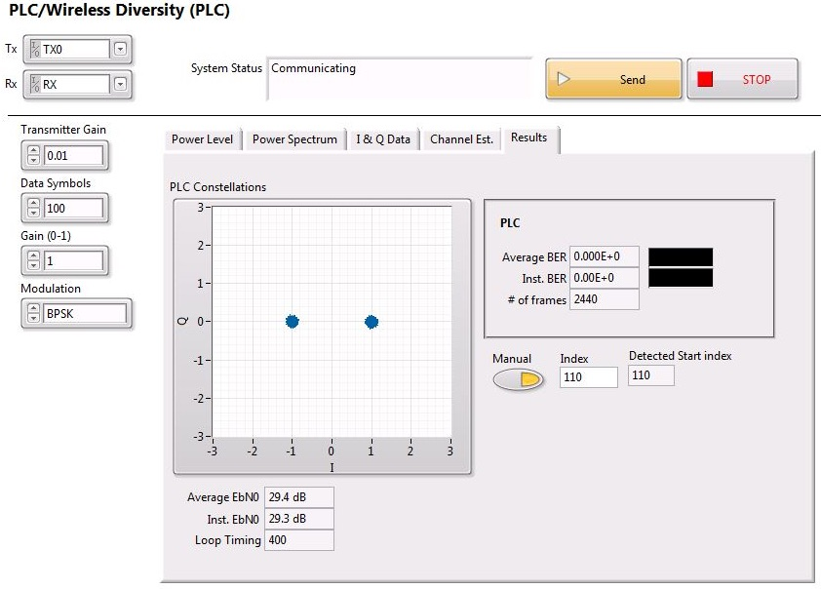
Testbed Overview: Software
Wireless Transceiver
Powerline Transceiver
3 parallel threads (PLC, wireless communications, LLR combiner)
2 processors running a real-time operating system
Displays instantaneous and average BER/SNR and constellations

Slide 7
Baseband Parameters
Parameter | Value
Sample rate | 400 kHz
DFT/IDFT size | 256 samples
CP length | 64 samples
Frame duration | variable
Frame rate | 2.5 frames/s
Active subcarriers | 36
Modulation Schemes | BPSK / Differential BPSK
Frame Structure: preamble of 9 training symbols for channel estimation, noise estimation and timing synch. plus up to 491 data symbols
DBPSK: This version applies differential encoding across adjacent subcarriers in the same OFDM symbol
Coding: Convolutional encoder plus Viterbi decoder
IEEE P1901.2-like baseband system
Wireless carrier frequency: 920 MHz
PLC Transmission Band: CENELEC-A band from 35.9375 to 90.6250 kHz

Slide 8
Implementation Challenges
Channel and noise power estimation
  For channel: least-squares estimation and zero-forcing equalization
  For noise power: exploitation of repeated symbols in preamble
Sample timing detection
  Cross-correlation of received and known preambles
Sampling and carrier frequency offset
  Sample synchronization using PXI chassis reference clock
  Wireless system uses same local oscillator for up/downconversion
  Transmitter sends start triggers to receiver
Frame transmission synchronization
  Determinism of real-time operating system

Slide 9
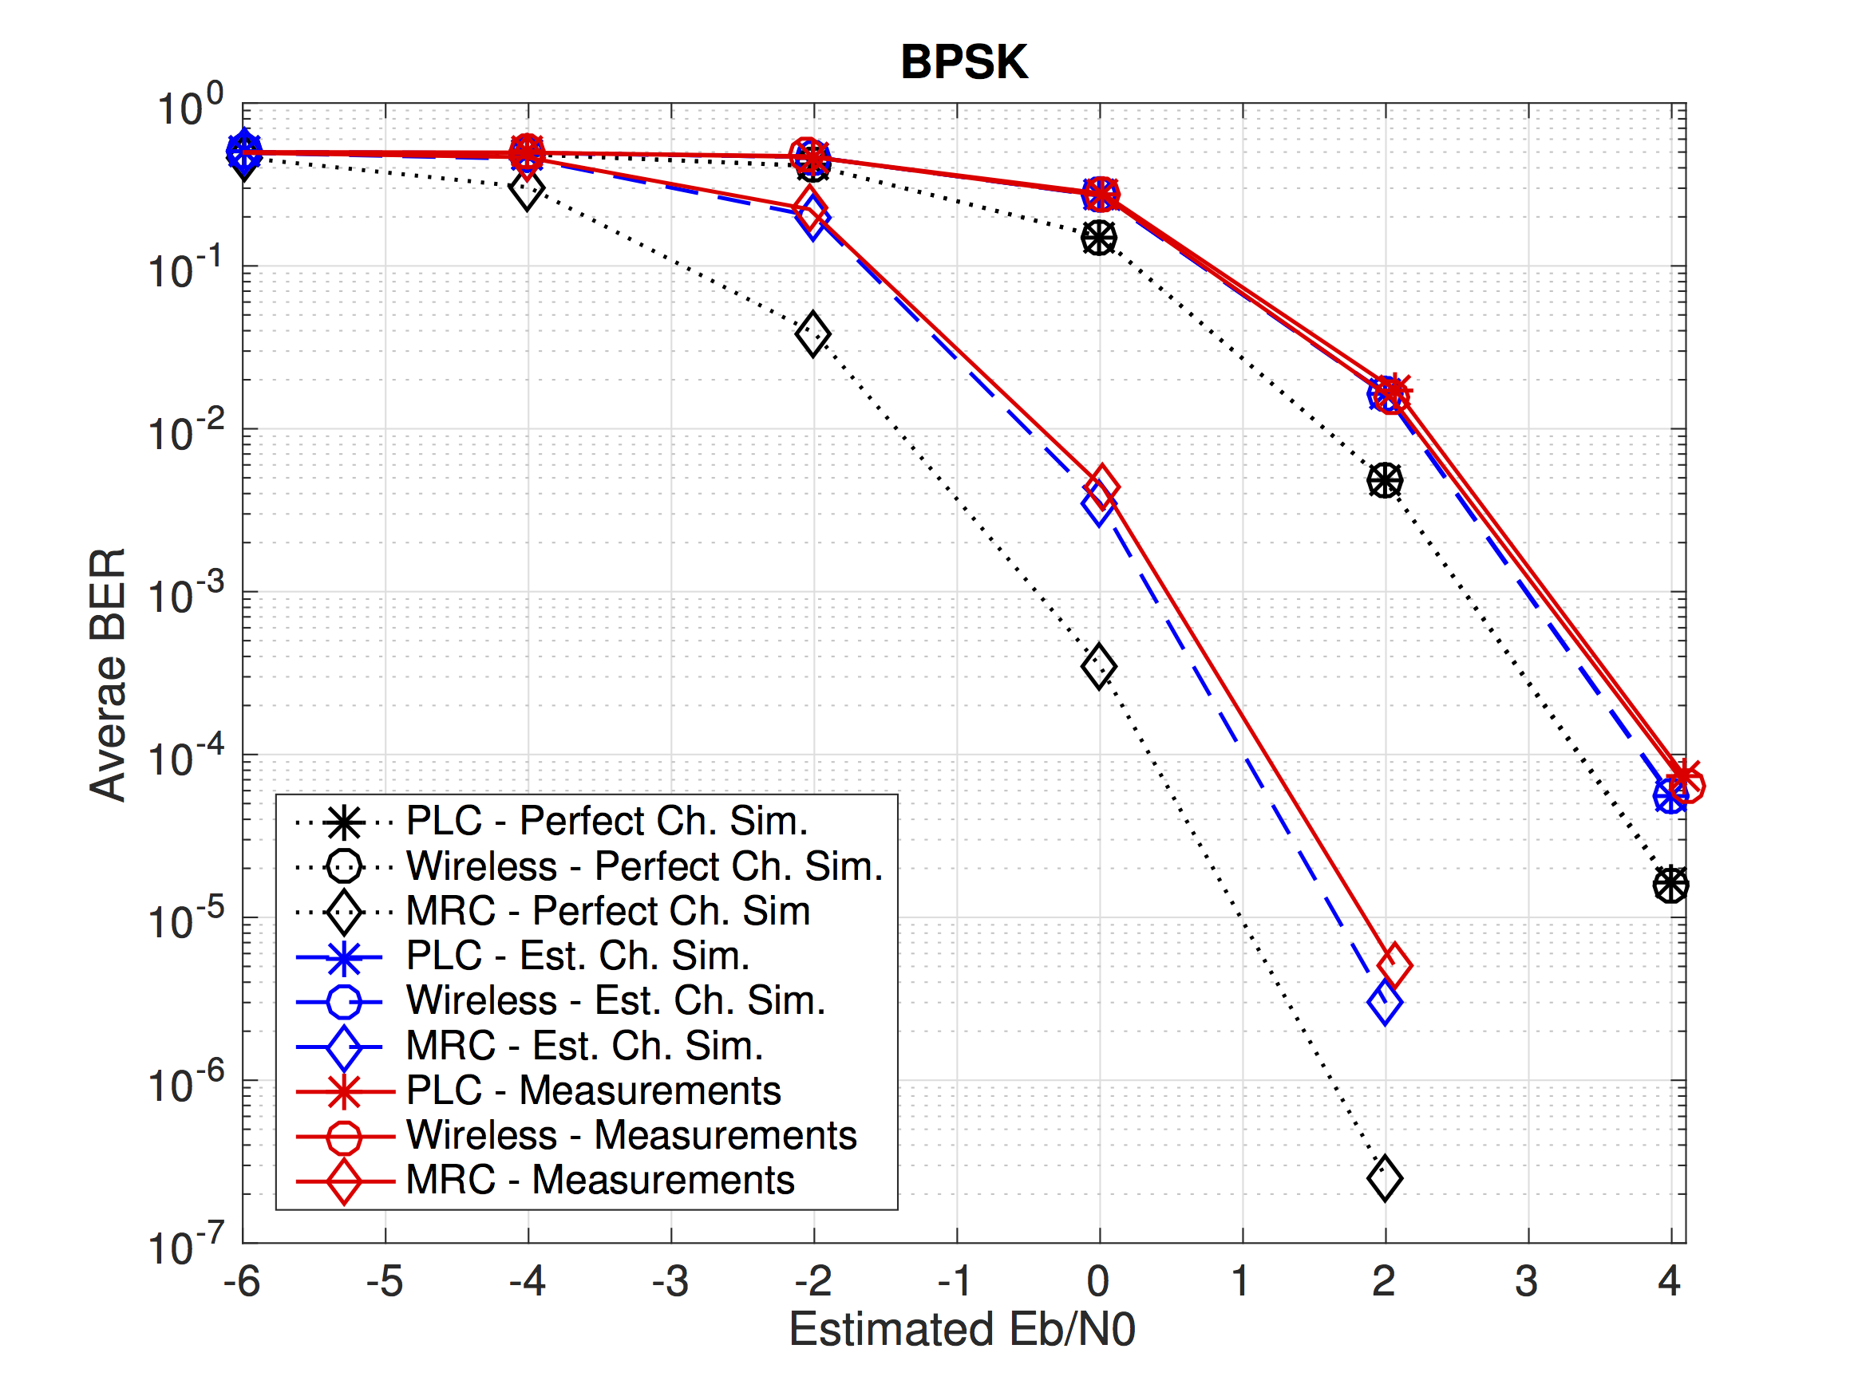
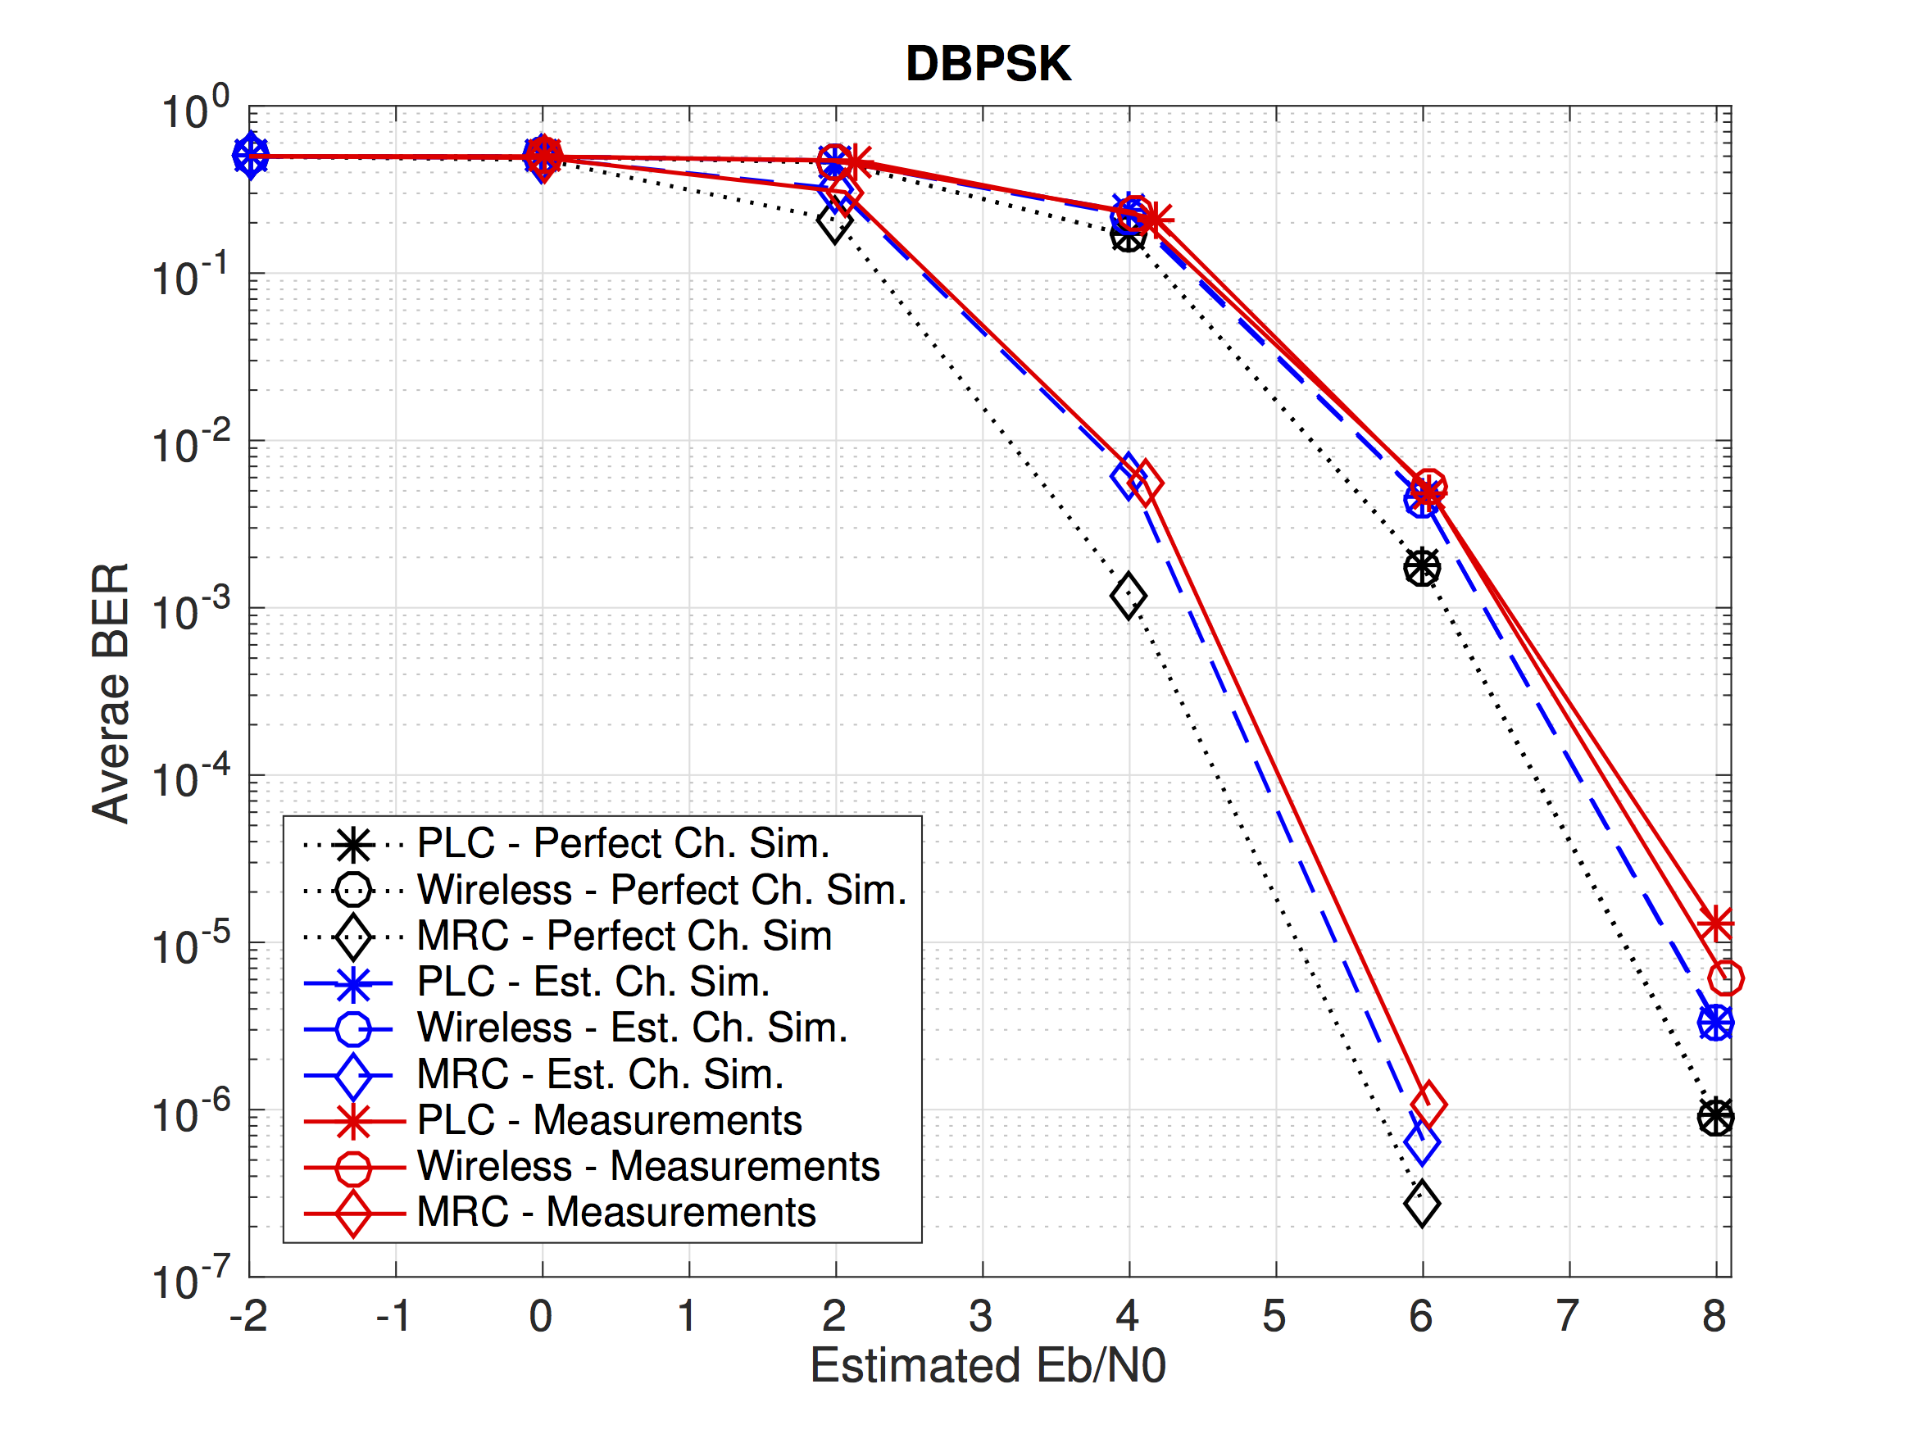
Initial Results
Case 1: Both communications experience a similar E_{b}/N₀
BPSK and MRC
Differential BPSK and MRC
separate
separate
combined
combined
With MRC and Differential BPSK
Both communications experience a similar E_{b}/N₀

Slide 10
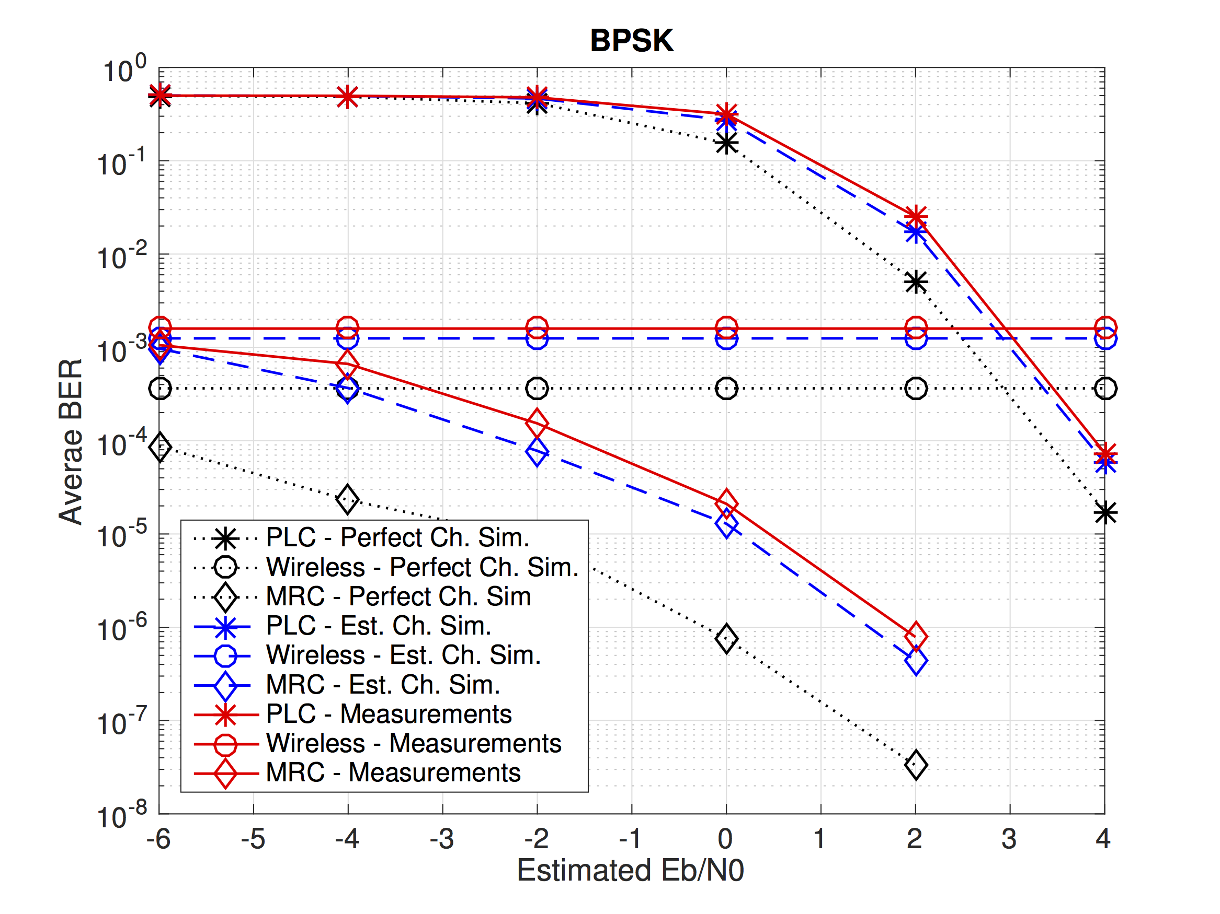
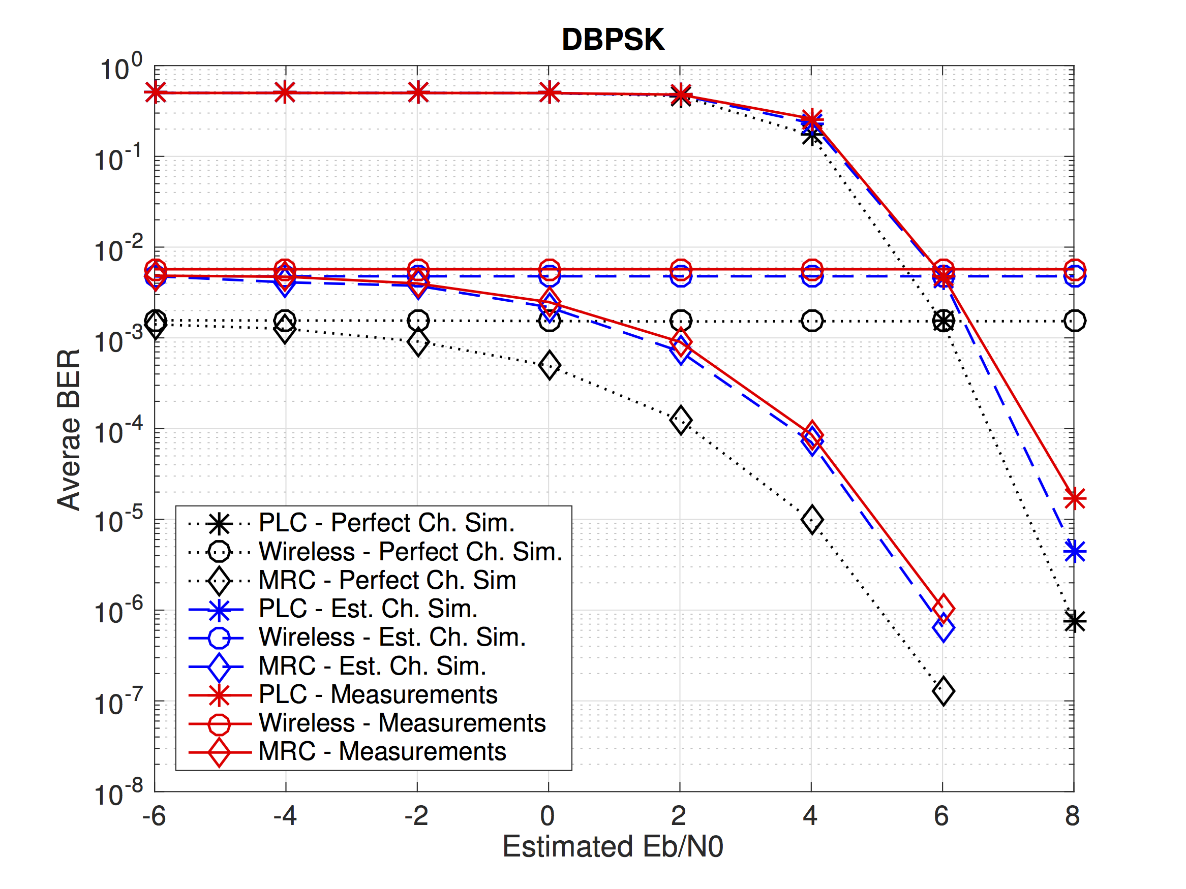
Initial Results
Case 2: SNR is fixed for wireless and is swept for powerline
BPSK and MRC
Differential BPSK and MRC
With MRC and BPSK
SNR is fixed for wireless and variable for powerline
powerline
powerline
combined
combined

Slide 11
Conclusion
Testbed for evaluation of diversity combining schemes
  Flexible and real-time testbed
  Powerline and wireless communication subsystems implemented
Source code and implementation details released
  http://users.ece.utexas.edu/∼bevans/projects/plc/software/testbed/
Demonstration with a simple scheme
  Similar performance to simulation achieved on testbed

