Slide 1



Modeling and Mitigation of Interference in Wireless Receivers with Multiple Antennae
Aditya Chopra
PhD Committee:
Prof. Jeffrey Andrews
Prof. Brian L. Evans (Supervisor)
Prof. Robert W. Heath, Jr.
Prof. Elmira Popova
Prof. Haris Vikalo
November 18, 2011

Slide 2

The demand for wireless Internet data is predicted to increase 1000$×$ over the next decade
2x increase per year!
Source: Cisco Visual Networking Index Forecast
Introduction | Modeling (CoLo) | Modeling (Dist) | Outage Performance | Receiver Design

Slide 3
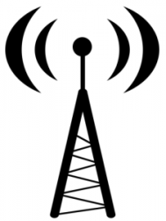

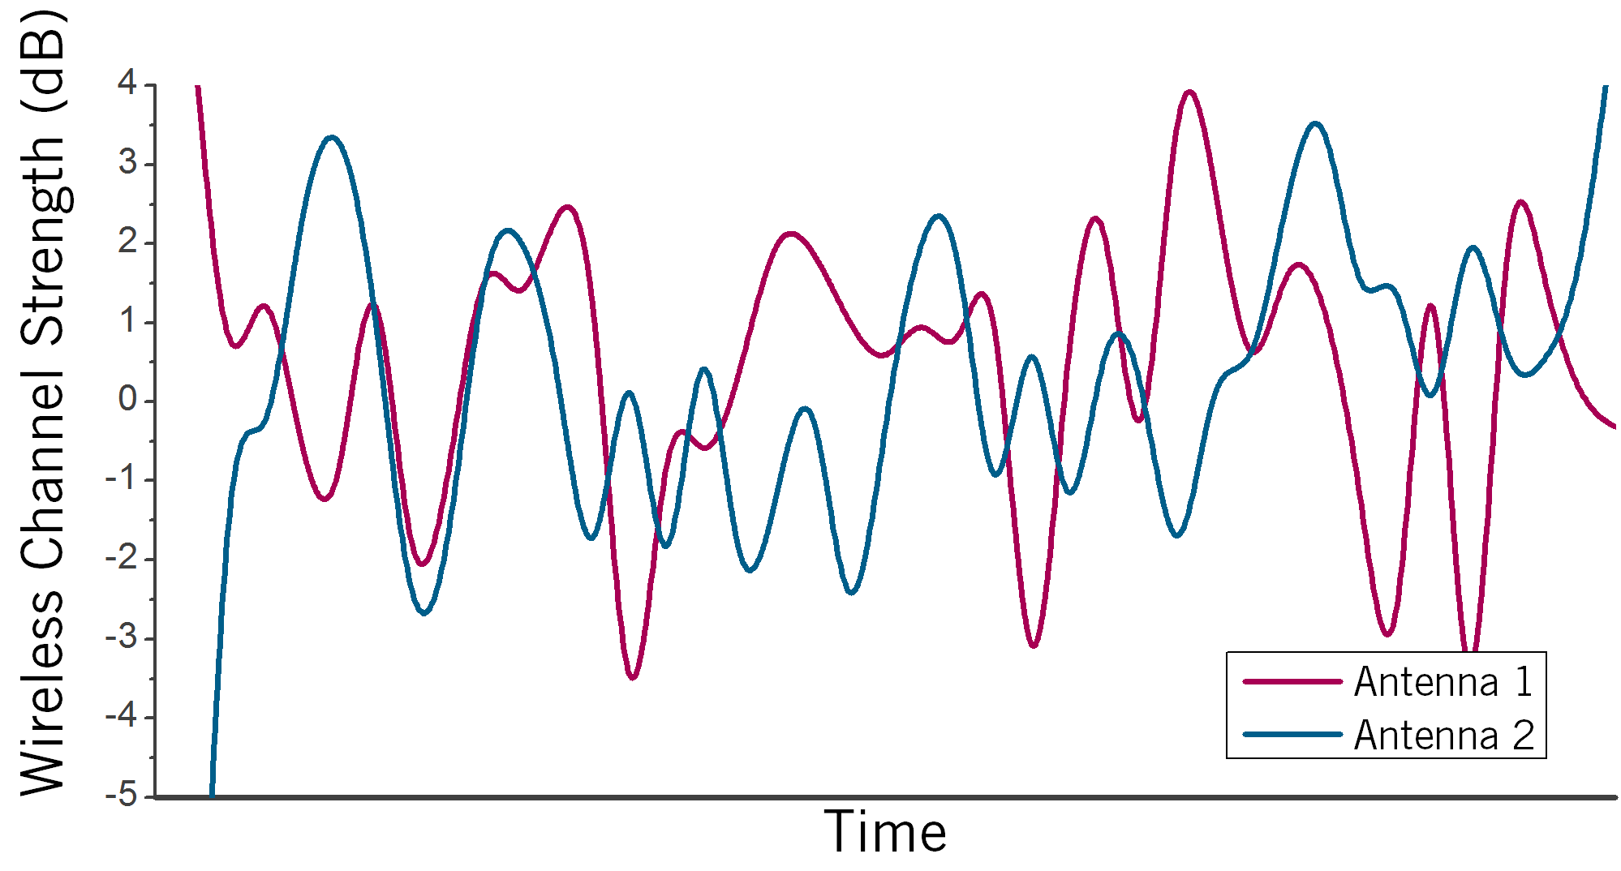
Wireless communication systems are increasingly using multiple antennae to meet demand
Benefits
Wireless Channel
Transmit Antennae
Receive Antennae
Multiplexing | Diversity
Multiple data streams are transmitted simultaneously to increase data rate | Antennae with strong channels compensate for antennae with weak channels to increase reliability
11
101110
10
10
Introduction | Modeling (CoLo) | Modeling (Dist) | Outage Performance | Receiver Design

Slide 4
A growing mobile user population with increasing wireless data demand leads to interference
Cell Boundary
Adj. Channel Interference
Base Station
or
Access Point
Link
Co-channel Interference
Out-of-cell Interference

Slide 5
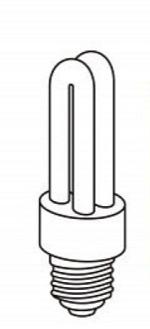
Interference is also caused by non-communicating source emissions …
… and impairs wireless communication performance
Non-communicating devices
Microwave ovens Fluorescent bulbs
Computational Platform
Clocks, amplifiers, busses
Impact of platform interference from a laptop LCD on wireless throughput (IEEE 802.11g) [Slattery06]
Introduction | Modeling (CoLo) | Modeling (Dist) | Outage Performance | Receiver Design

Slide 6
Interference mitigation has been an active area of research over the past decade
Cell Boundary
Co-existence[Rao2002]
Base Station
Interference Cancellation [Andrews2005]
Interference Alignment [Jafar2008]
Resource Allocation[Andrews2009]
Base Station Coordination[Heath2009]

Slide 7
I employ a statistical approach to the interference modeling and mitigation problem
Thesis statement
Accurate statistical modeling of interference observed by multi-antenna wireless receivers facilitates design of wireless systems with significant improvement in communication performance in interference-limited networks.
Proposed solution
Model statistics of interference in multi-antenna receivers
Analyze performance of conventional multi-antenna receivers
Develop multi-antenna receiver algorithms using statistical models of interference
Introduction | Modeling (CoLo) | Modeling (Dist) | Outage Performance | Receiver Design
Notes:
Remove problem and approach… expand solution

Slide 8

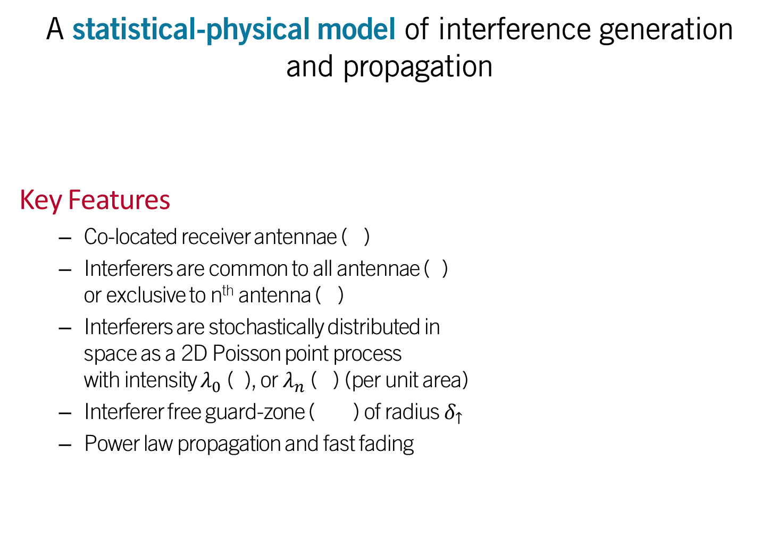
A statistical-physical model of interference generation and propagation
Key Features
Co-located receiver antennae ( )
Interferers are common to all antennae ( ) or exclusive to n^{th} antenna ( )
Interferers are stochastically distributed in space as a 2D Poisson point process with intensity $λ_{0}$ ( ), or $λ_{n}$ ( ) (per unit area)
Interferer free guard-zone ( ) of radius $δ_{↑}$
Power law propagation and fast fading
A 3-antenna receiver within a Poisson field of interferers
2
1
3
3
n
2
$$δ_{↓}$$
1
n
1
3
2
1
Introduction | Modeling (CoLo) | Modeling (Dist) | Outage Performance | Receiver Design

Slide 9
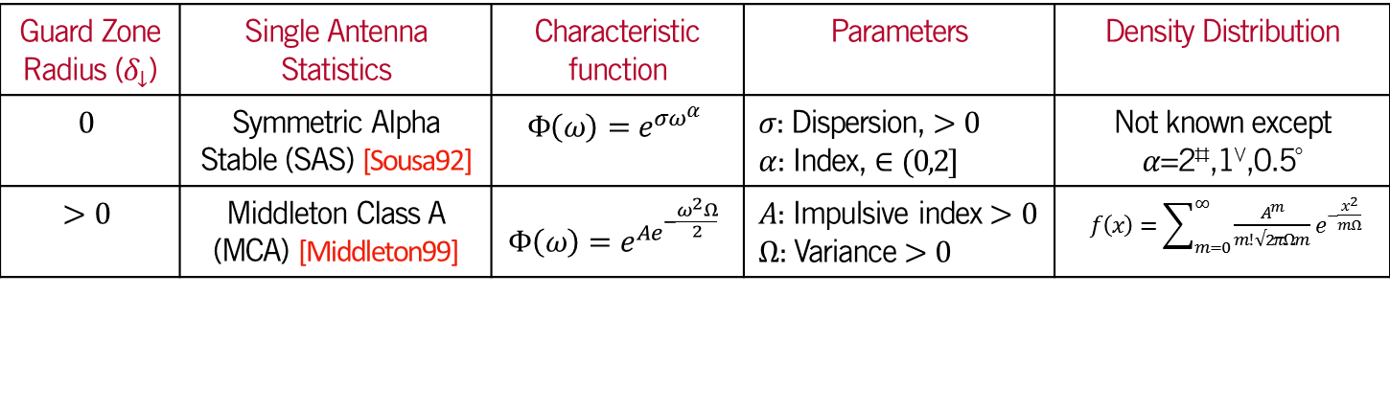
Non-Gaussian distributions have been used in prior work to model single antenna interference statistics
I derive joint statistics of interference observed by multi-antenna receivers
Wireless networks with guard zones (Centralized Networks)
Wireless networks without guard zones (De-centralized Networks)
Guard Zone Radius ($δ_{↓}$) | Single Antenna Statistics | Characteristic function | Parameters | Density Distribution
$$0$$ | Symmetric Alpha Stable (SAS) [Sousa92] | $$Φ\left(ω\right)=e^{σω^{α}}$$ | $σ$: Dispersion, $>0$ $α$: Index, $∈(0,2]$ | Not known except $α$=2⇨,1,0.5
$$>0$$ | Middleton Class A (MCA) [Middleton99] | $$Φ\left(ω\right)=e^{Ae^{−\frac{ω^{2}Ω}{2}}}$$ | $A$: Impulsive index $>0$ $Ω$: Variance $>0$ | $f\left(x\right)=\sum_{m=0}^{∞}{\frac{A^{m}}{m! √2πΩm}}e^{−\frac{x^{2}}{mΩ}}$
⇨ | Gaussian distribution
 | Cauchy distribution
 | Levy distribution
Introduction | Modeling (CoLo) | Modeling (Dist) | Outage Performance | Receiver Design

Slide 10
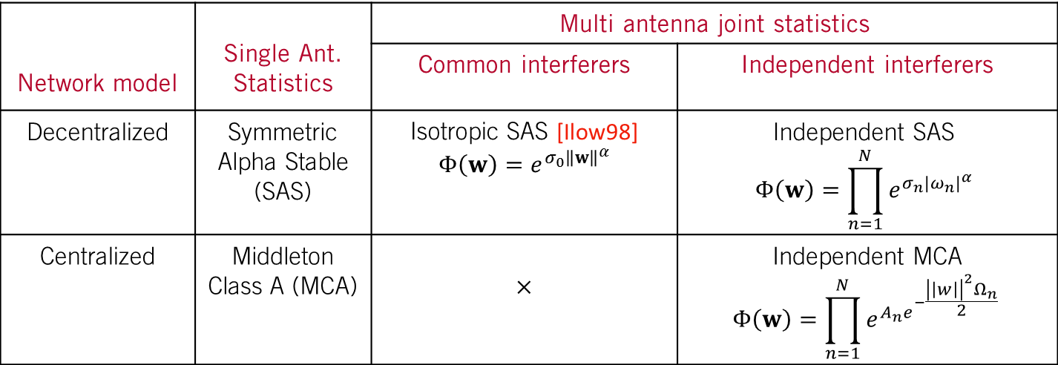

Using the system model, the sum interference at the n^{th} antenna is expressed as
$$Z_{n}=\sum_{i_{0}∈ 𝒮_{0}}{A_{i_{0}}e^{jφ_{i_{0}}}H_{i_{0},n}e^{jθ_{i_{0},n}}{\left\|r_{i_{0}}\right\|}^{−\frac{γ}{2}}}+\sum_{i_{n}∈ 𝒮_{n}}{A_{i_{n}}e^{jφ_{i_{n}}}H_{i_{n} }e^{jθ_{i_{n}}}{\left\|r_{i_{n}}\right\|}^{−\frac{γ}{2}}}$$
SOURCE EMISSION
FADING CHANNEL
PATHLOSS
COMMON INTERFERERS
EXCLUSIVE INTERFERERS
Network model | Single Ant. Statistics | Multi antenna joint statistics
 |  | Common interferers | Independent interferers
Decentralized | Symmetric Alpha Stable (SAS) | Isotropic SAS [Ilow98] $Φ\left(w\right)=e^{σ_{0}{\left\|w\right\|}^{α}}$ | Independent SAS $$Φ\left(w\right)=\prod_{n=1}^{N}{e^{σ_{n}{|ω_{n}^{}|}^{α}}}$$
Centralized | Middleton Class A (MCA) | $$×$$ | Independent MCA $$Φ\left(w\right)=\prod_{n=1}^{N}{e^{A_{n}e^{−\frac{{\left|\left|w\right|\right|}^{2}Ω_{n}}{2} }}}$$
Introduction | Modeling (CoLo) | Modeling (Dist) | Outage Performance | Receiver Design

Slide 11
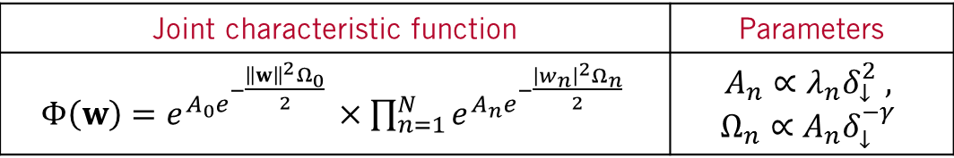
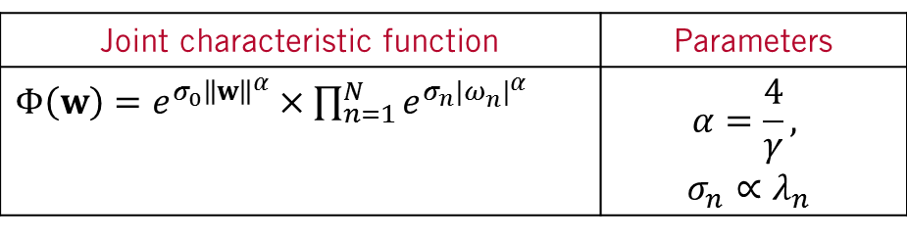
In networks with guard zones, interference from common interferers exhibits isotropic Middleton Class A statistics
Interference in decentralized networks
Interference in centralized networks
A 3-antenna receiver within a Poisson field of interferers
Joint characteristic function | Parameters
$Φ\left(w\right)=e^{σ_{0}{\left\|w\right\|}^{α}}×\prod_{n=1}^{N}{e^{σ_{n}{|ω_{n}^{}|}^{α}}}$ | $$α=\frac{4}{γ},$$ $$σ_{n}∝λ_{n}$$
2
1
3
3
2
$$δ_{↓}$$
1
2
1
1
3
Joint characteristic function | Parameters
$Φ\left(w\right)=e^{A_{0}e^{−\frac{{\left\|w\right\|}^{2}Ω_{0}}{2} }}×\prod_{n=1}^{N}{e^{A_{n}e^{−\frac{{\left|w_{n}\right|}^{2}Ω_{n}}{2} }}}$ | $$A_{n}∝λ_{n}δ_{↓}^{2} ,$$ $$Ω_{n}∝A_{n}δ_{↓}^{−γ}$$
Introduction | Modeling (CoLo) | Modeling (Dist) | Outage Performance | Receiver Design

Slide 12
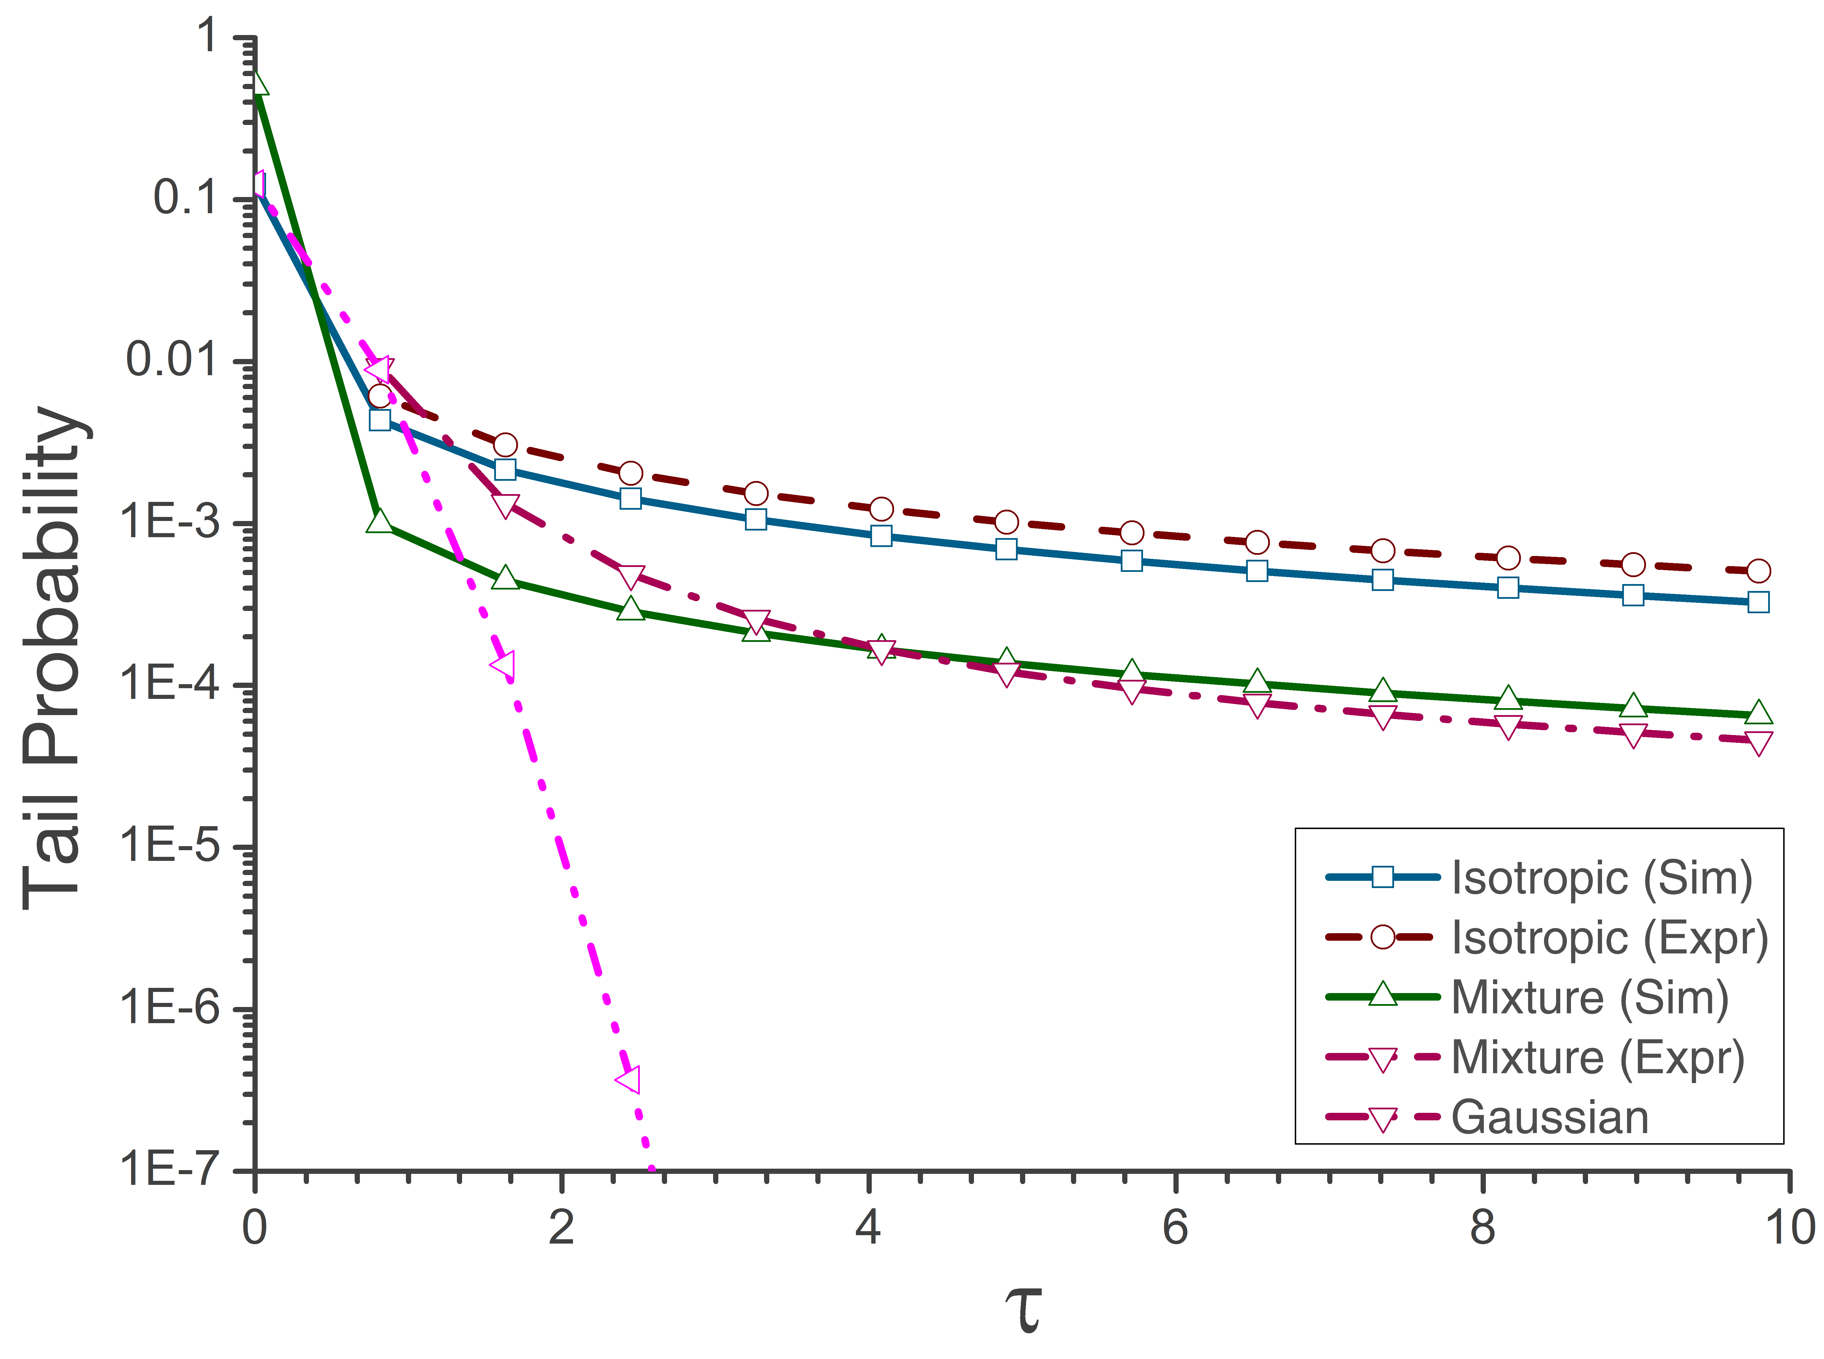
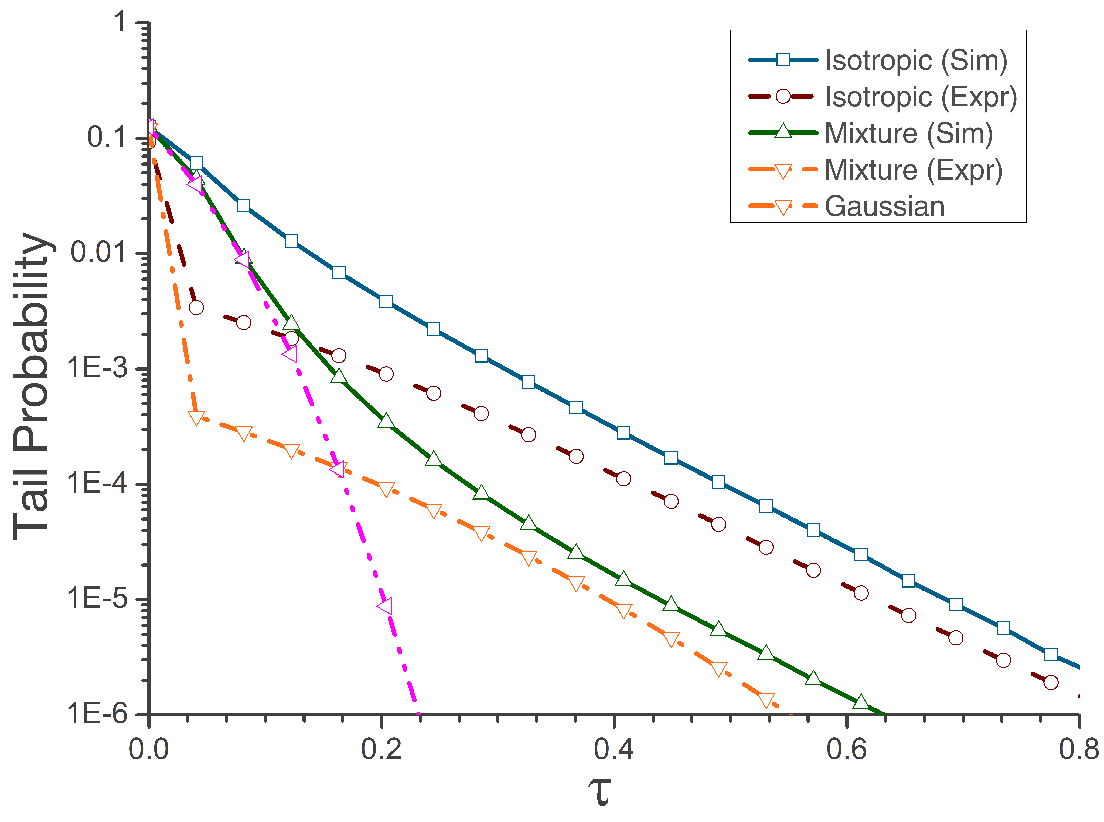
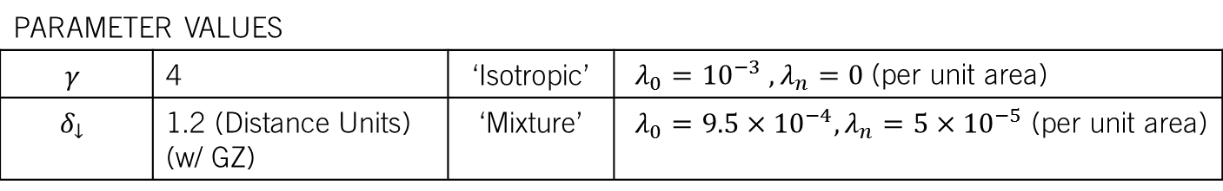
Simulation results indicate a close match between proposed statistical models and simulated interference
Tail probability of simulated interference in networks without guard zones
Tail probability of simulated interference in networks with guard zones
Tail Probability: $ℙ\left\{ \left|Z_{1}\right|>τ, \left|Z_{2}\right|>τ …\left|Z_{n}\right|>τ\right\}$
PARAMETER VALUES
$$γ$$ | 4 | ‘Isotropic’ | $λ_{0}={10}^{−3}$ $, λ_{n}=0$ (per unit area)
$$δ_{↓}$$ | 1.2 (Distance Units) (w/ GZ) | ‘Mixture’ | $λ_{0}=9.5×{10}^{−4},λ_{n}=5×{10}^{−5}$ (per unit area)
Introduction | Modeling (CoLo) | Modeling (Dist) | Outage Performance | Receiver Design

Slide 13
My framework for multi-antenna interference across co-located antennae results in joint statistics that are
Spatially isotropic (common interferers)
Spatially independent (exclusive interferers)
In a continuum between isotropic and independent (mixture)
for two impulsive distributions
Middleton Class A (networks with guard zones)
Symmetric alpha stable (networks without guard zones)
Introduction | Modeling (CoLo) | Modeling (Dist) | Outage Performance | Receiver Design

Slide 14
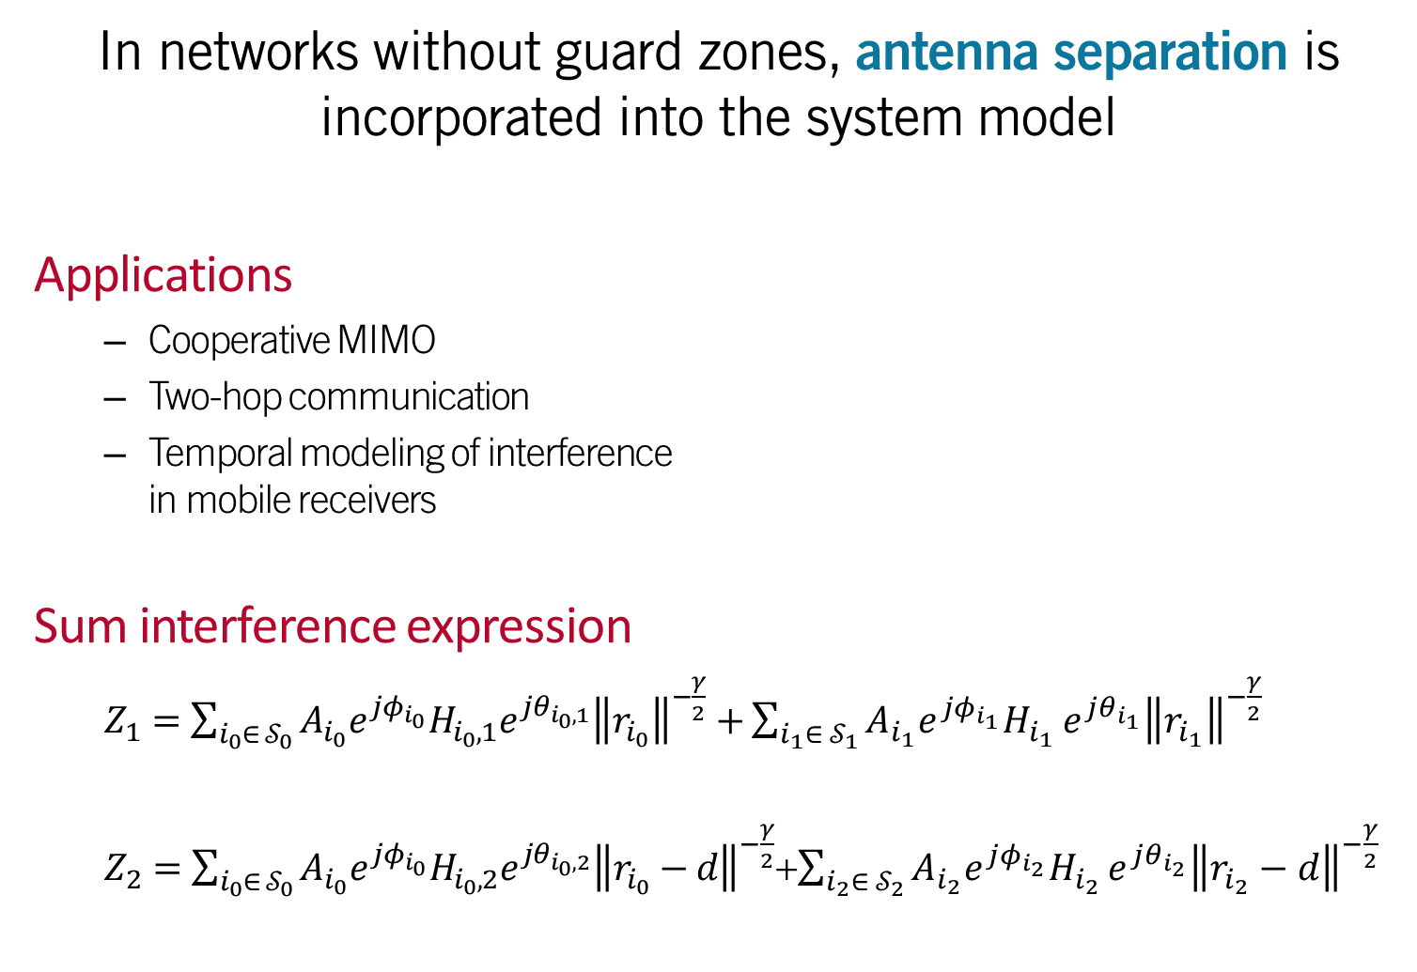

In networks without guard zones, antenna separation is incorporated into the system model
Applications
Cooperative MIMO
Two-hop communication
Temporal modeling of interference in mobile receivers
Sum interference expression
$Z_{1}=\sum_{i_{0}∈ 𝒮_{0}}{A_{i_{0}}e^{jφ_{i_{0}}}H_{i_{0},1}e^{jθ_{i_{0},1}}{\left\|r_{i_{0}}\right\|}^{−\frac{γ}{2}}}$ $+\sum_{i_{1}∈ 𝒮_{1}}{A_{i_{1}}e^{jφ_{i_{1}}}H_{i_{1} }e^{jθ_{i_{1}}}{\left\|r_{i_{1}}\right\|}^{−\frac{γ}{2}}}$
$Z_{2}=\sum_{i_{0}∈ 𝒮_{0}}{A_{i_{0}}e^{jφ_{i_{0}}}H_{i_{0},2}e^{jθ_{i_{0},2}}{\left\|r_{i_{0}}−d\right\|}^{−\frac{γ}{2}}}$+$\sum_{i_{2}∈ 𝒮_{2}}{A_{i_{2}}e^{jφ_{i_{2}}}H_{i_{2} }e^{jθ_{i_{2}}}{\left\|r_{i_{2}}−d\right\|}^{−\frac{γ}{2}}}$
Two antennae ( ) and interferers ( ) in a decentralized network
2
1
2
1
2
1
1
$$d$$
2
2
1
Introduction | Modeling (CoLo) | Modeling (Dist) | Outage Performance | Receiver Design

Slide 15



The extreme scenarios of antenna colocation ($d=0$) and antenna isolation ($d→∞$) are readily resolved
Interference statistics move in a continuum from spatially isotropy to spatial independence as antenna separation increases!
Colocated antennae ($d=0$)
Characteristic function of interference:
$$Φ\left(ω_{1},ω_{2}\right)=e^{σ{\left(ω_{1}^{2}+ω_{2}^{2}\right)}^{\frac{α}{2}}}$$
Interference exhibits spatial isotropy
Remote antennae ($d→∞$)
Characteristic function of interference:
$$Φ\left(ω_{1},ω_{2}\right)=e^{σ{\left(ω_{1}^{α}+ω_{2}^{α}\right)}^{}}$$
Interference exhibits spatial independence
Introduction | Modeling (CoLo) | Modeling (Dist) | Outage Performance | Receiver Design

Slide 16
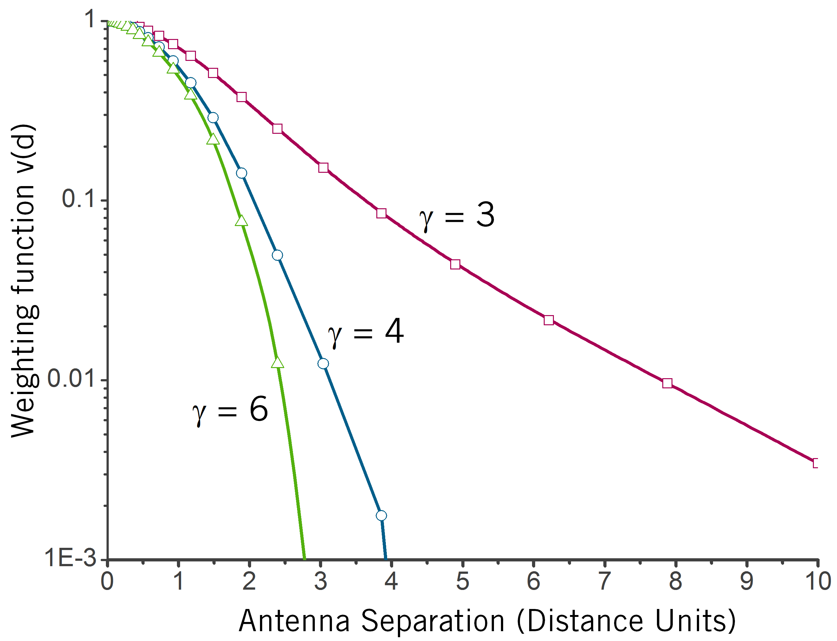
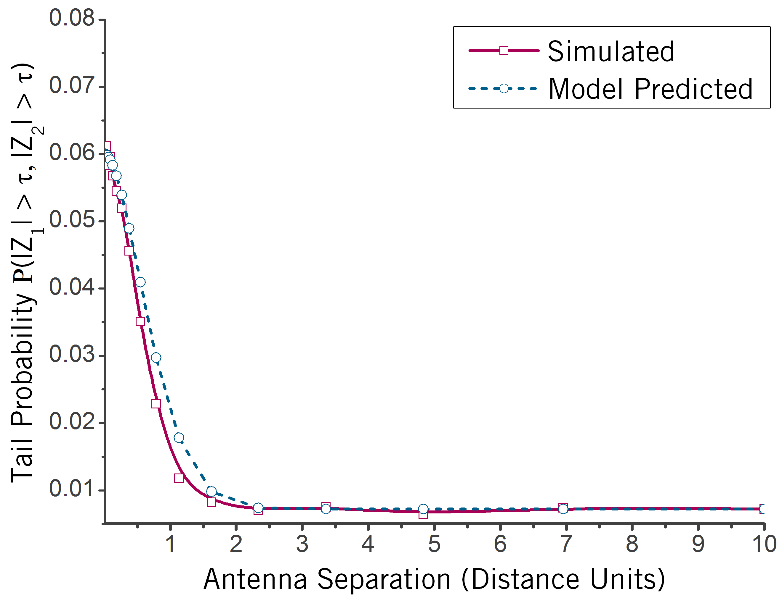
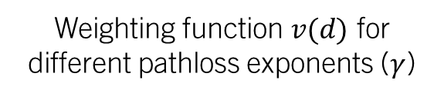

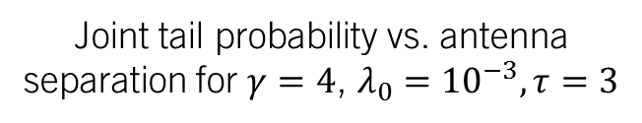
Interference statistics are approximated using the isotropic-independent statistical mixture framework
$$Φ\left(ω_{1},ω_{2}\right)≈e^{ν\left(d\right)σ{\left(ω_{1}^{2}+ω_{2}^{2}\right)}^{\frac{α}{2}}+\left(1−ν\left(d\right)\right)σ{\left(ω_{1}^{α}+ω_{2}^{α}\right)}^{}}$$
Weighting function $v(d)$ for different pathloss exponents ($γ$)
Joint tail probability vs. antenna separation for $γ=4$, $λ_{0}={10}^{−3},τ=3$
Introduction | Modeling (CoLo) | Modeling (Dist) | Outage Performance | Receiver Design

Slide 17


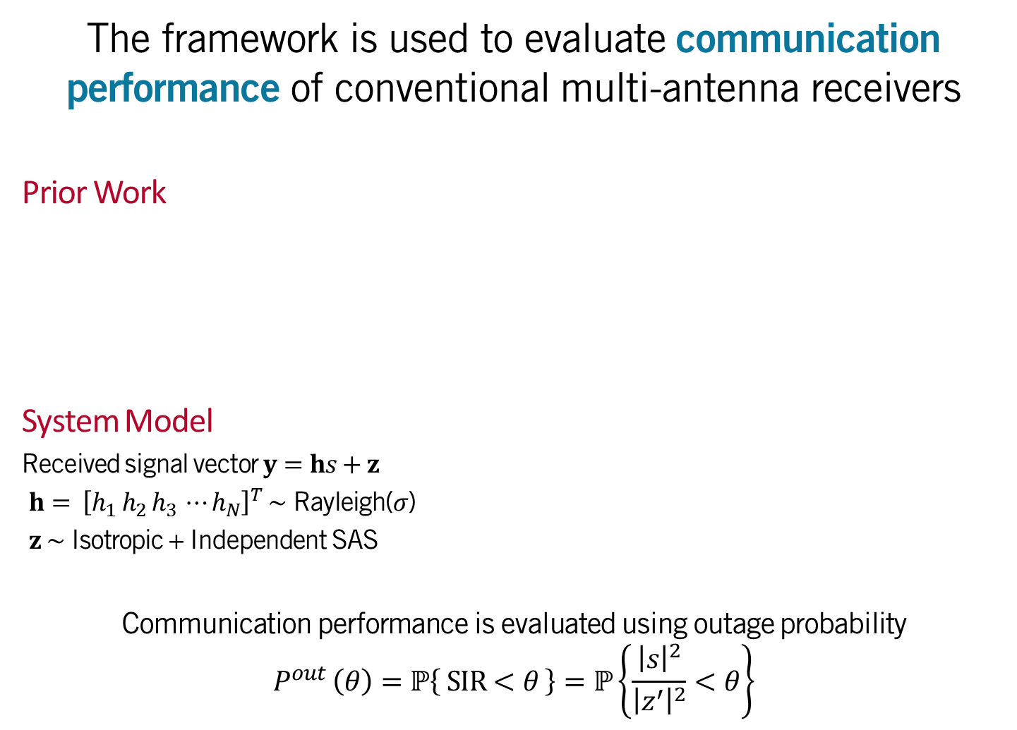



The framework is used to evaluate communication performance of conventional multi-antenna receivers
Prior Work
System Model
Received signal vector $y=hs+z$
$h= {\left[h_{1} h_{2} h_{3} ⋯h_{N}\right]}^{T} \sim$ Rayleigh($σ$)
$z \sim$ Isotropic + Independent SAS
Communication performance is evaluated using outage probability
$$P^{out} \left(θ\right)=ℙ\left\{ SIR<θ \right\}=ℙ\left\{\frac{{\left|s\right|}^{2}}{{\left|z^{′}\right|}^{2}}<θ\right\}$$
Article | Wireless System | Interference | Joint Statistics | Performance Metric
[Rajan2011] | SIMO | SAS | Independent | Bit Error Rate (BPSK)
[Gao2005] | SIMO | MCA | Indp. / Isotropic | Bit Error Rate (BPSK)
[Gao2007] | MIMO | MCA | Independent | Bit Error Rate (BPSK)
$$h_{1}$$
$$s$$
$$h_{2}$$
$$\hat{s}=s+z′$$
$$h_{N}$$
Single Transmit Antenna
Multiple Receive Antennae
SIR: Signal-to-Interference Ratio
Introduction | Modeling (CoLo) | Modeling (Dist) |Outage Performance | Receiver Design

Slide 18





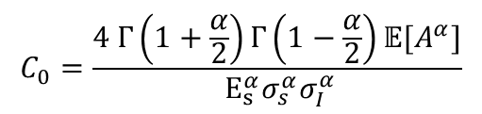




Outage probability of linear combiners
$$w_{1}$$
$$×$$
+
$$⋮$$
$$y=hs+n$$
$$w^{T}y$$
$$SIR=\frac{{\left|w^{T}h\right|}^{2}{\left|s\right|}^{2}}{{\left|w^{T}z\right|}^{2}}$$
$$w_{N}$$
$$×$$
SIR: Signal-to-Interference Ratio
Receiver algorithm | Weight vector | Outage probability $\left.\left(ℙ\left\{SIR<θ\right\}\right.\right)$
Equal Gain Combiner | $$w_{n}=\frac{h_{n}^{∗}}{\left|h_{n}\right|}$$ | $${C_{0}θ}^{\frac{α}{2}}𝔼_{h}\left.\left[\frac{λ_{n}{\left\|h\right\|}_{α}^{α}}{{\left\|h\right\|}_{1}^{α}}+ \frac{λ_{0}}{{\left\|h\right\|}_{1}^{2α}}\right.\right]$$
Maximum Ratio Combiner | $$w_{n}=h_{n}^{∗}$$ | ${C_{0}θ}^{\frac{α}{2}}𝔼_{h}\left.\left[\frac{λ_{n}{\left\|h\right\|}_{α}^{α}}{{\left\|h\right\|}_{2}^{α}}+ \frac{λ_{0}}{{\left\|h\right\|}_{2}^{2α}}\right.\right]$
Selection Combiner | $$w_{n }=ℐ_{h_{n}=max\{h\} }$$ | $$C_{0}(λ_{0}+λ_{n})θ^{\frac{α}{2}}\sum_{n=1}^{N}{{\left(−1\right)}^{n+1}}\frac{\left({N \atop n}\right)}{n!}$$
$$C_{0}=\frac{4 Γ\left(1+\frac{α}{2}\right)Γ\left(1−\frac{α}{2}\right)𝔼[A^{α}]}{ E_{s}^{α}σ_{s}^{α}σ_{I}^{α}}$$
Introduction | Modeling (CoLo) | Modeling (Dist) |Outage Performance | Receiver Design

Slide 19


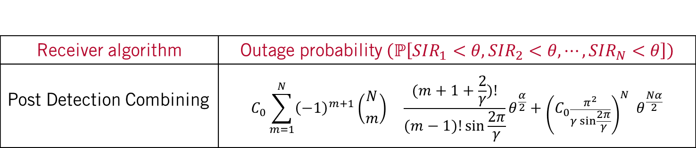
Outage probability of a genie-aided non-linear combiner
SELECT BEST
Select antenna stream with best detection SIR
Receiver assumes knowledge of SIR at each antenna
$${SIR}_{n}=\frac{{\left|h_{n}\right|}^{2}{\left|s\right|}^{2}}{{\left|z_{n}\right|}^{2}}$$
$$⋮$$
Receiver algorithm | Outage probability $\left.\left(ℙ\left.\left[SIR_{1}<θ,SIR_{2}<θ\right.,⋯,SIR_{N}<θ\right]\right.\right)$
Post Detection Combining | $$C_{0}\sum_{m=1}^{N}{{\left(−1\right)}^{m+1}\left({N \atop m}\right) {}_{}^{}{\frac{(m+1+\frac{2}{γ})!}{(m−1)!\sin{\frac{2π}{γ}}}}}θ^{\frac{α}{2}}+{\left(C_{0}\frac{π^{2}}{γ sin\frac{2π}{γ}}\right)}^{N} { θ}^{\frac{Nα}{2}}$$
Introduction | Modeling (CoLo) | Modeling (Dist) |Outage Performance | Receiver Design

Slide 20
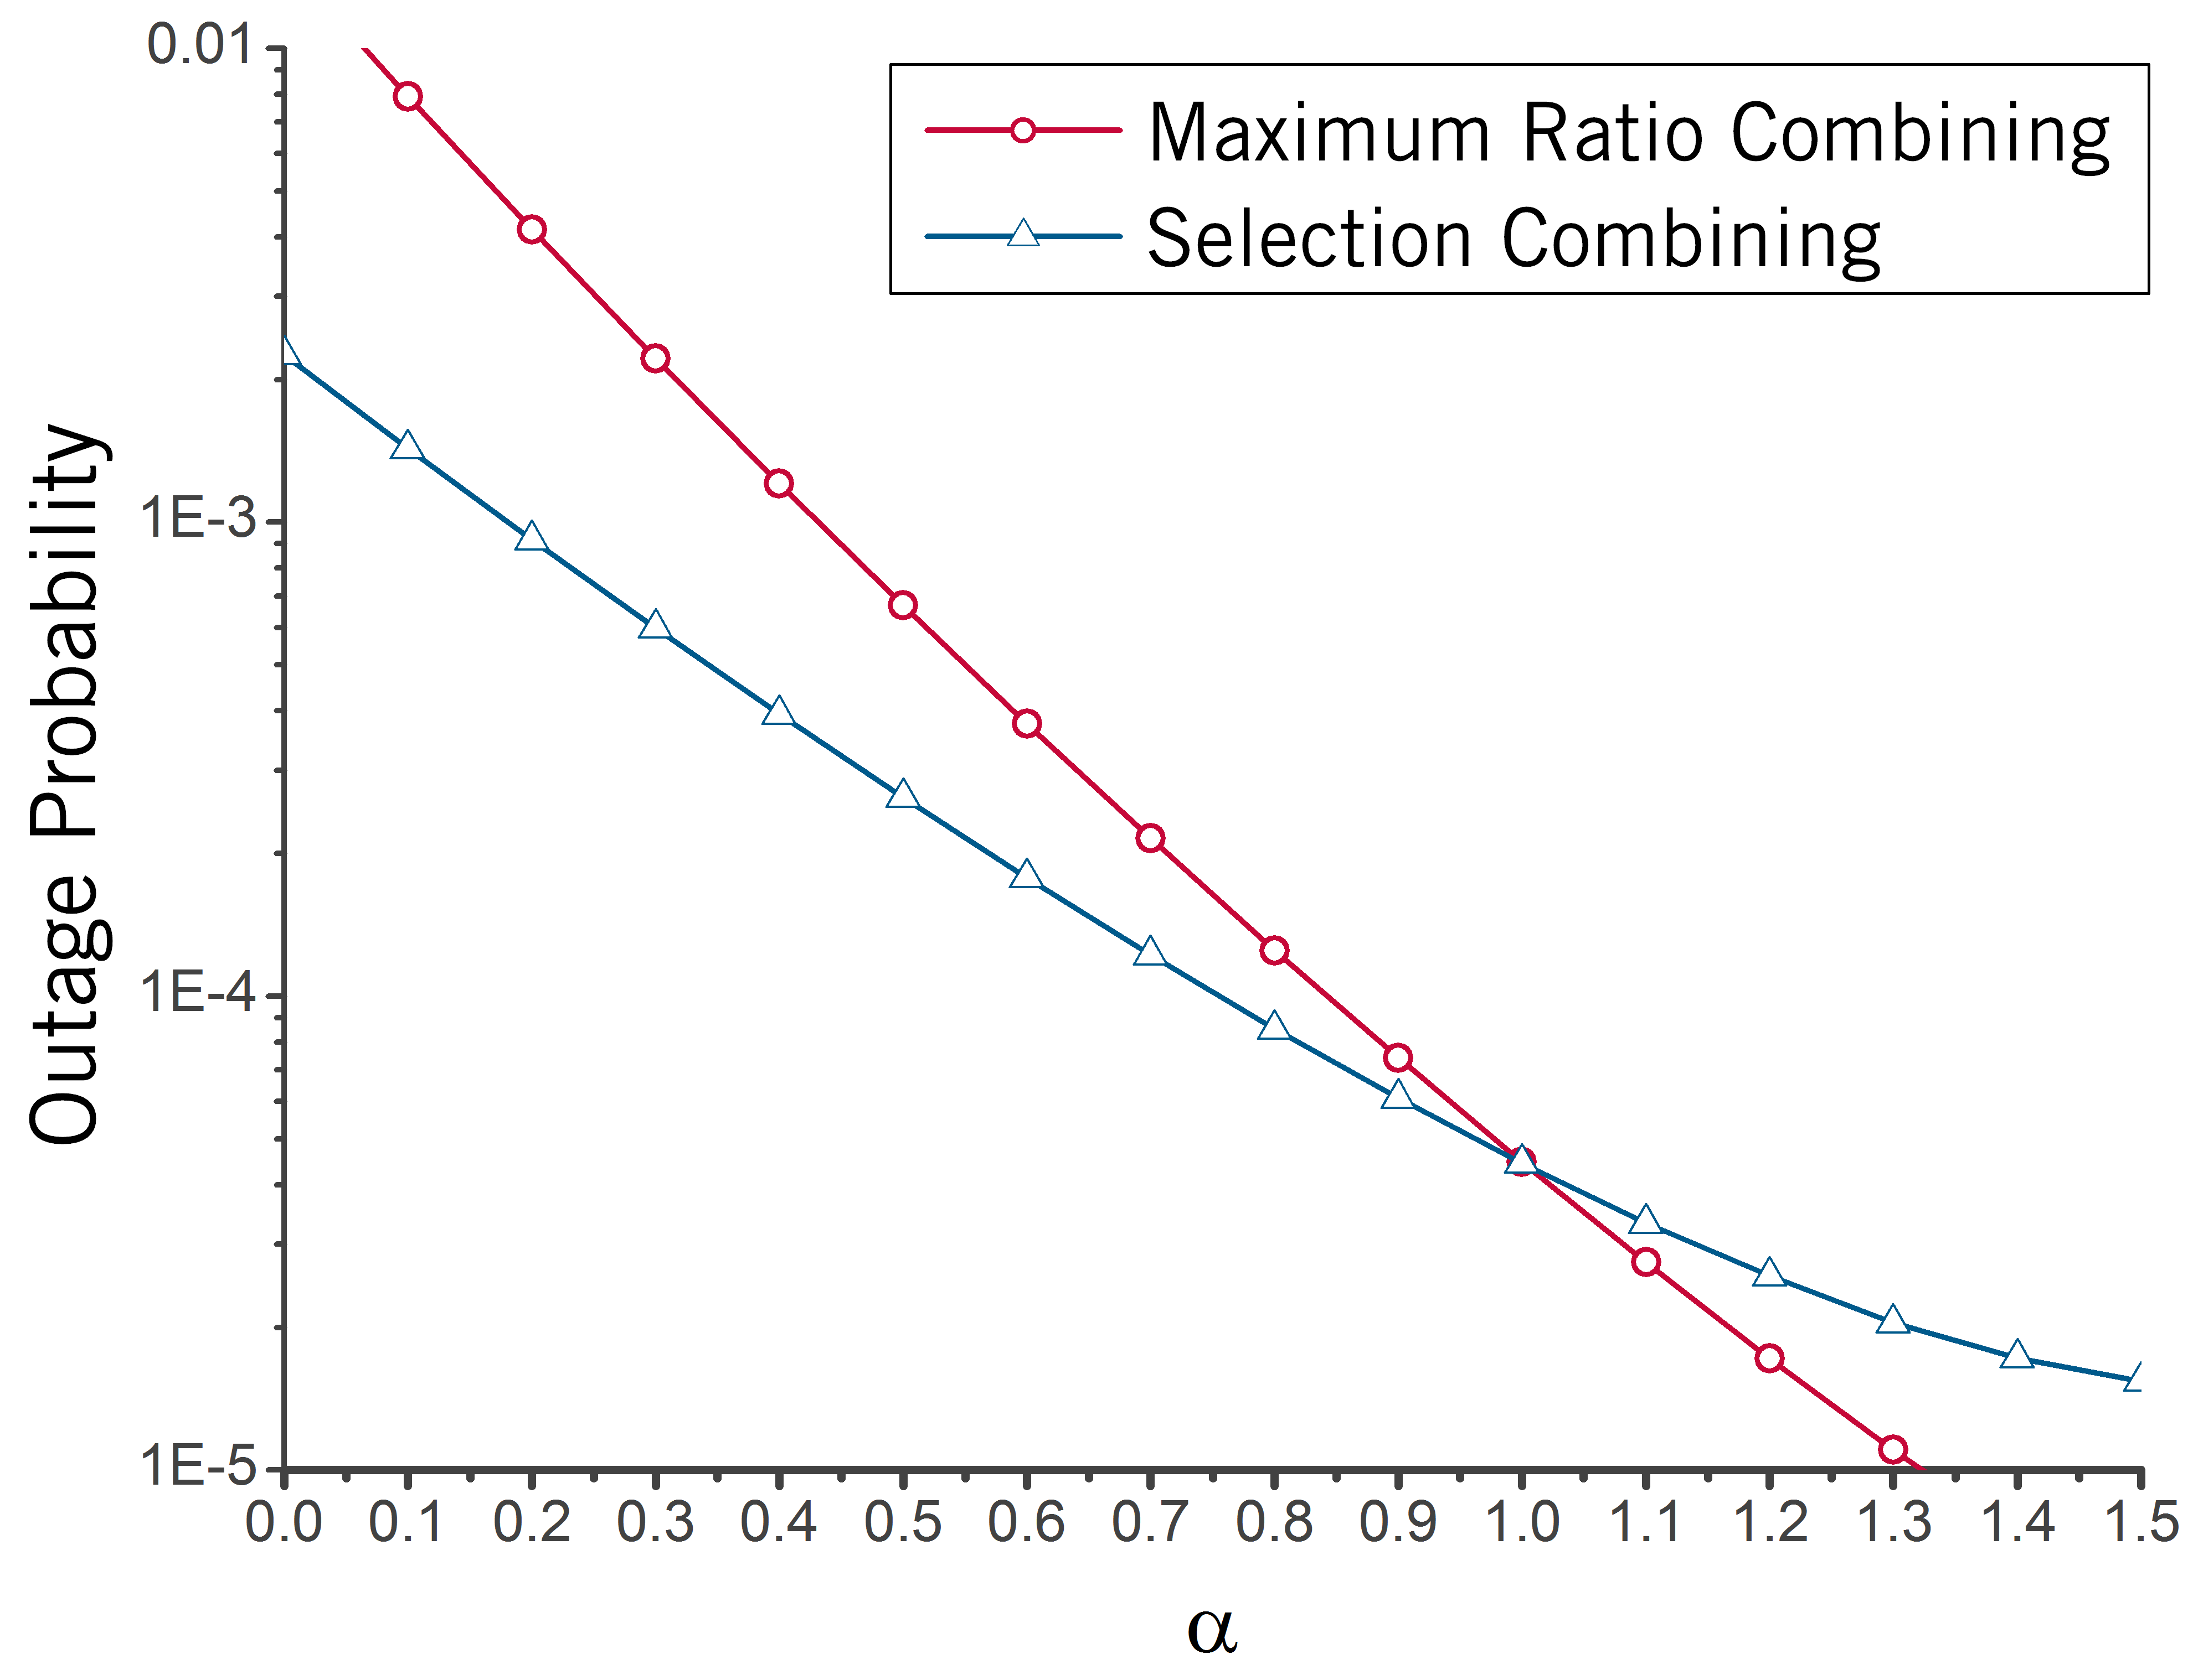
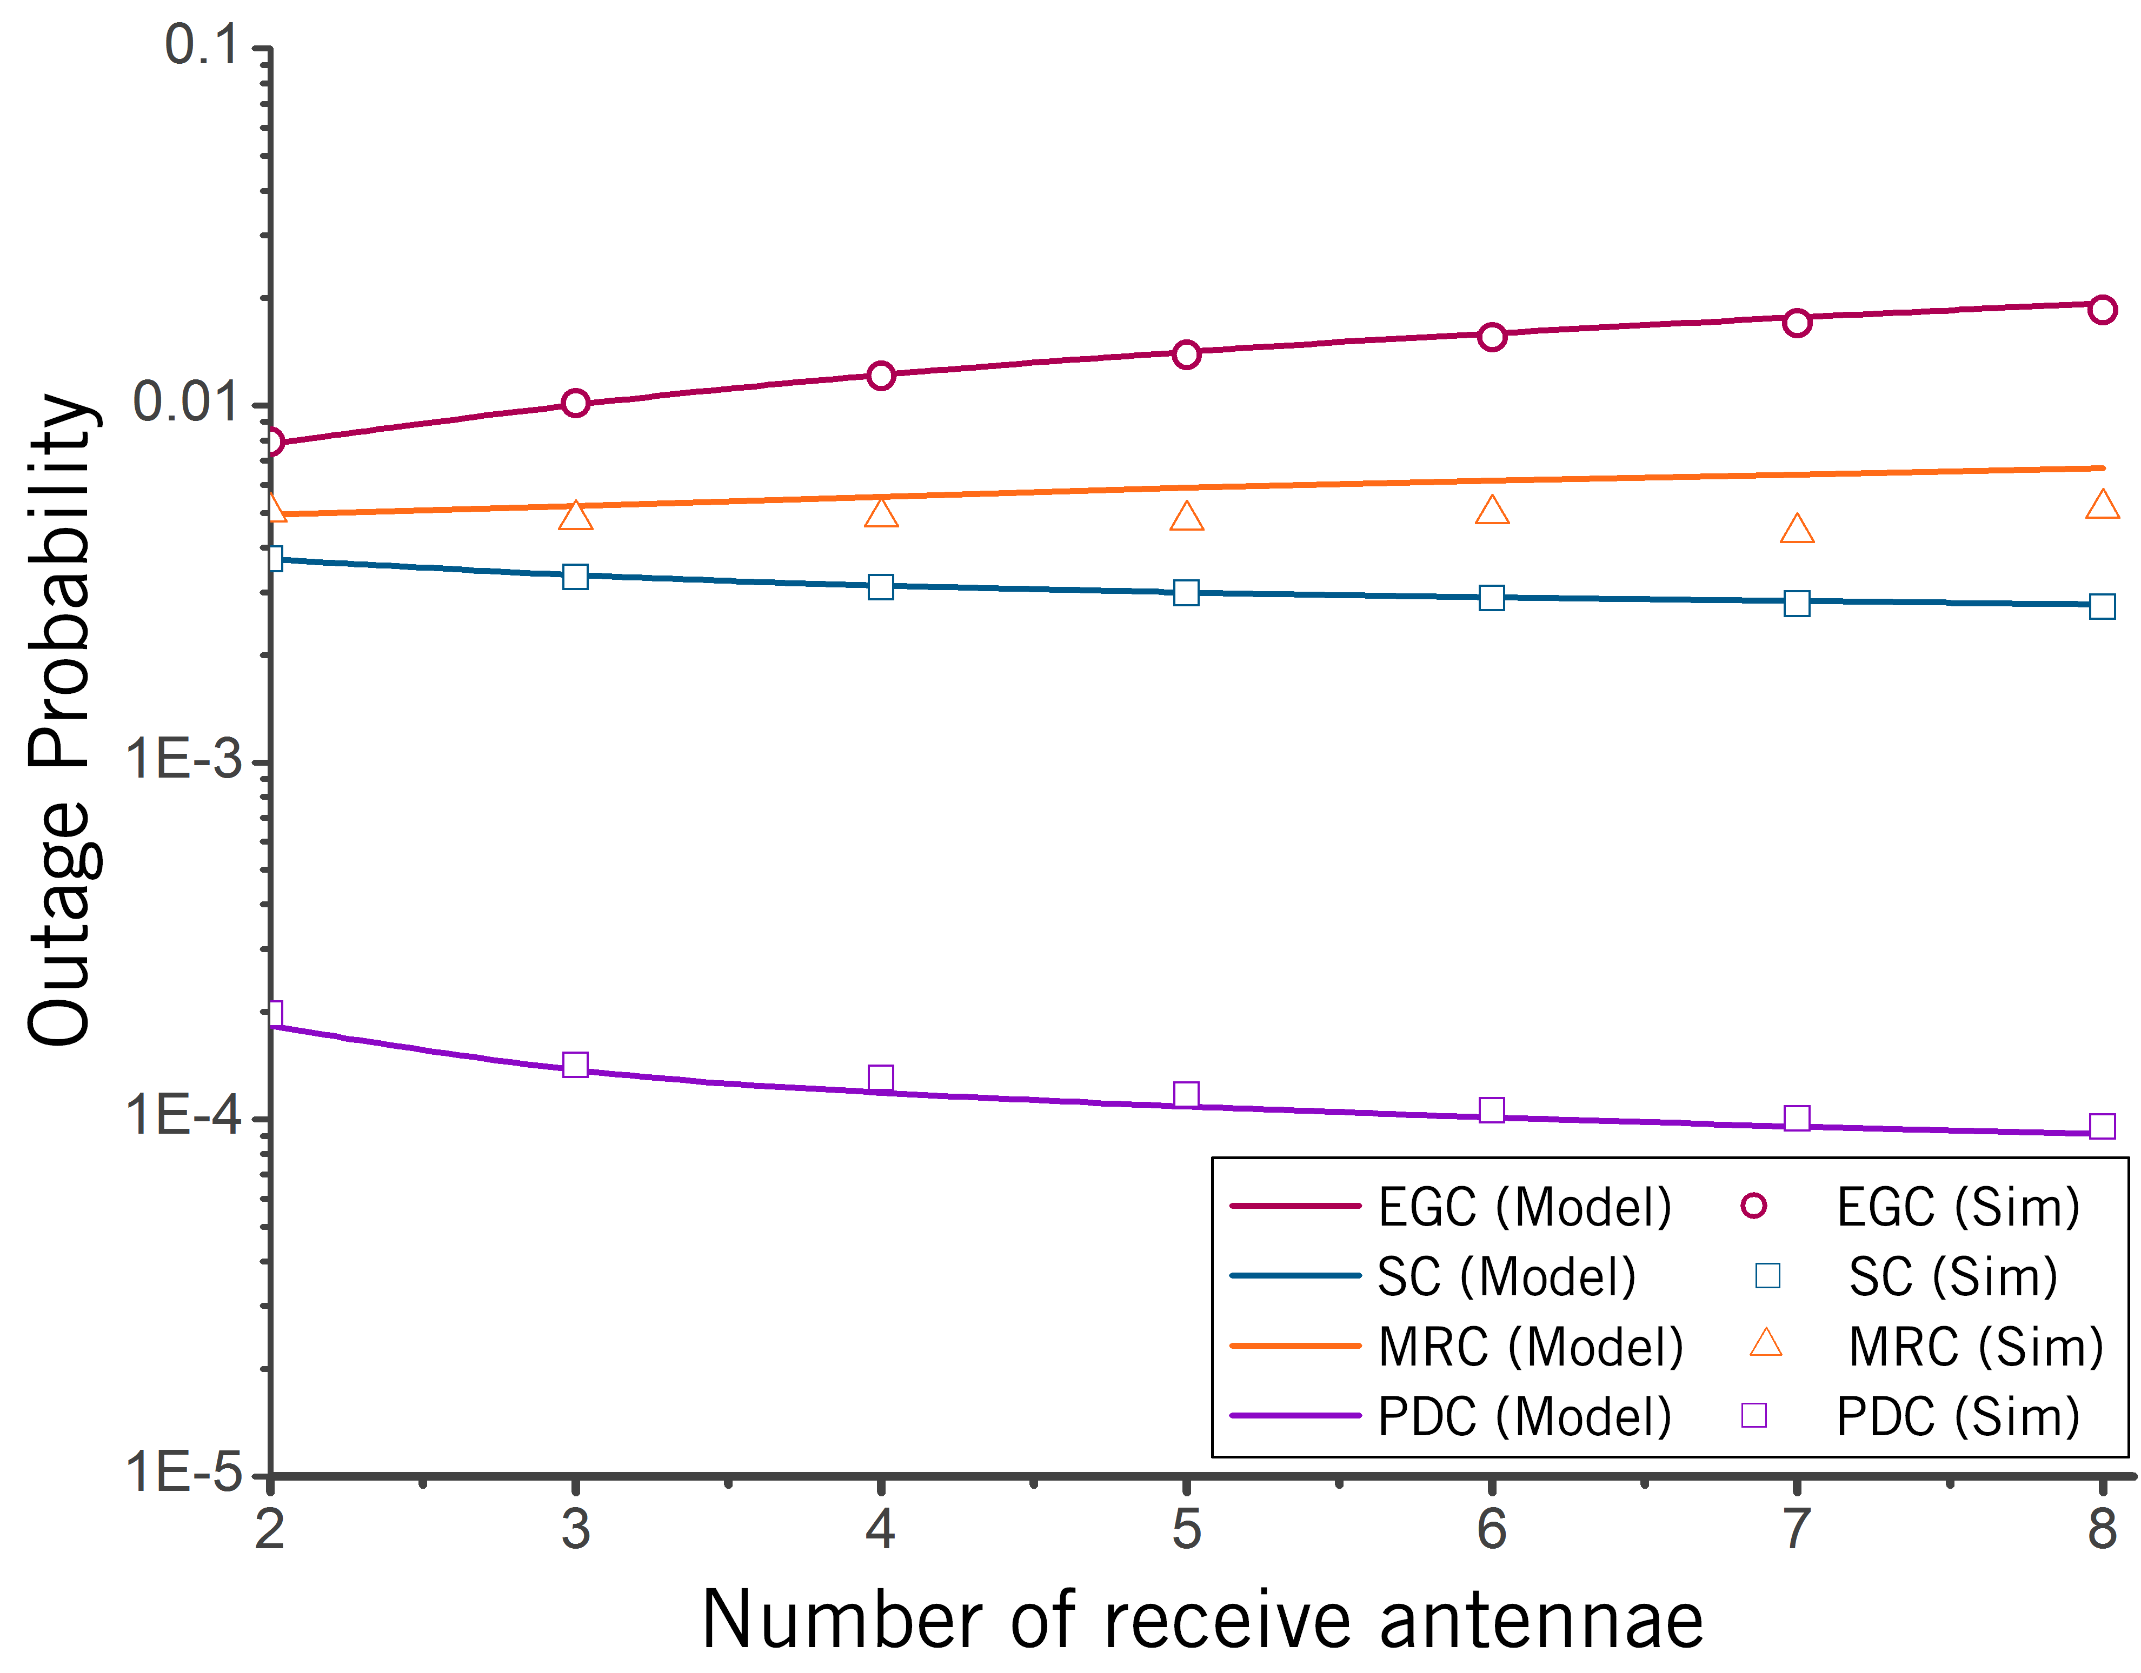
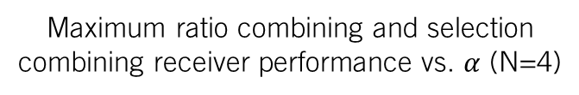
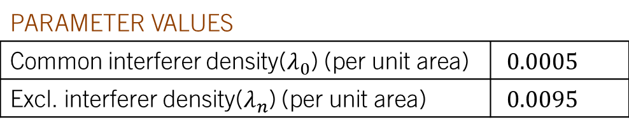
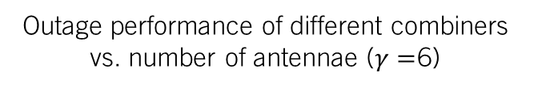
Derived expressions (‘Model’) match simulated outage (‘Sim’) for a variety of spatial dependence scenarios
Maximum ratio combining and selection combining receiver performance vs. $α$ (N=4)
Outage performance of different combiners vs. number of antennae ($γ=$6)
(N)
PARAMETER VALUES
Common interferer density($λ_{0}$) (per unit area) | $0.0005$
Excl. interferer density($λ_{n}$) (per unit area) | $0.0095$
Introduction | Modeling (CoLo) | Modeling (Dist) |Outage Performance | Receiver Design

Slide 21
Using communication performance analysis, I design algorithms that outperform conventional receivers
Prior Work
Proposed Receiver Structures
Receiver Type | Interference Model | Joint Statistics | Fading Channel
Filtering | Symmetric alpha stable [Gonzales98][Ambike94] | Independent | No
Sequence detection, Decision feedback | Gaussian Mixture [Blum00][Bhatia94] | Independent | No
Detection | Symmetric alpha stable[Rajan10] | Independent | Yes
Receiver Type | Interference Model | Joint Statistics | Fading Channel
Linear filtering | SAS | Independent/Isotropic | Yes
Non-linear filtering | SAS | Independent/Isotropic | Yes
Introduction | Modeling (CoLo) | Modeling (Dist) | Outage Performance | Receiver Design

Slide 22
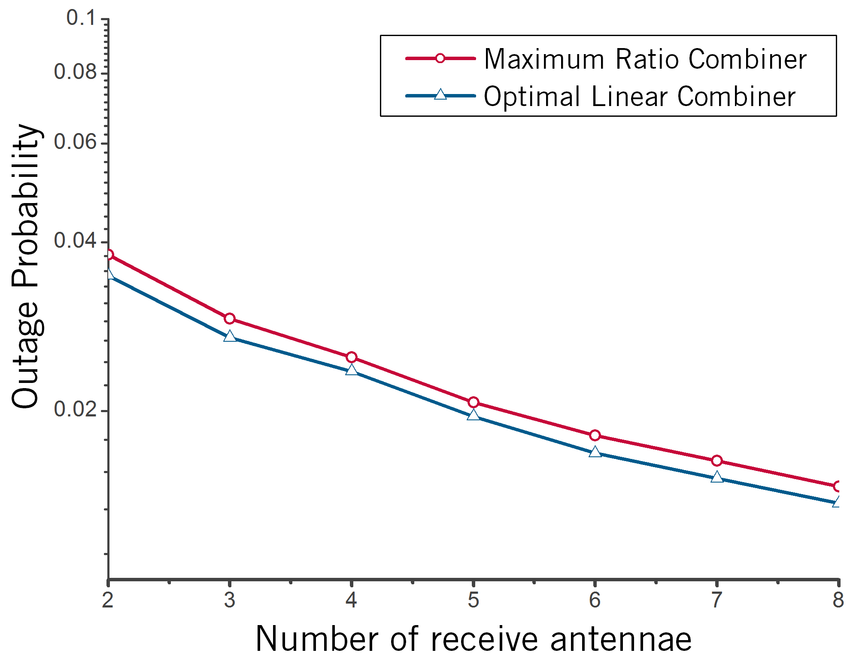
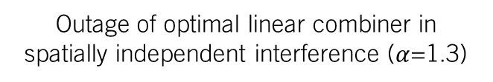
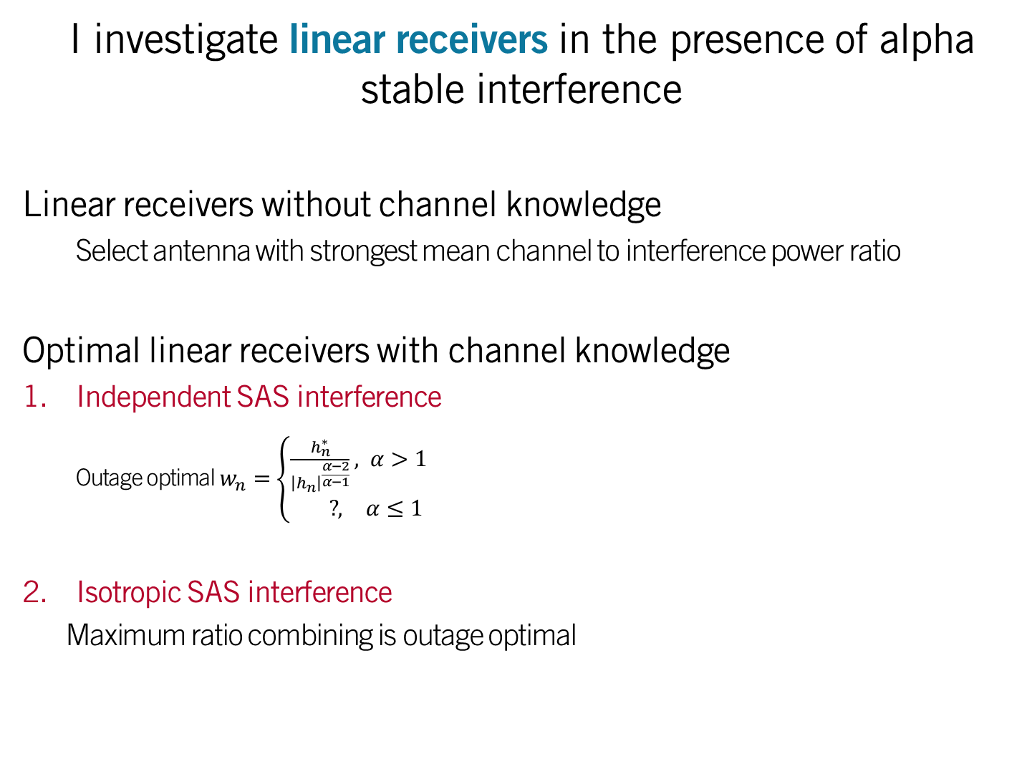
I investigate linear receivers in the presence of alpha stable interference
Linear receivers without channel knowledge
Select antenna with strongest mean channel to interference power ratio
Optimal linear receivers with channel knowledge
Independent SAS interference
Outage optimal $w_{n}=\left\{\begin{aligned}\frac{h_{n}^{∗}}{{\left|h_{n}\right|}^{\frac{α−2}{α−1}}}, α>1 \\ & ?, α≤1\end{aligned}\right.$
Isotropic SAS interference
Maximum ratio combining is outage optimal
Outage of optimal linear combiner in spatially independent interference ($α$=1.3)
(N)
Introduction | Modeling (CoLo) | Modeling (Dist) | Outage Performance | Receiver Design

Slide 23
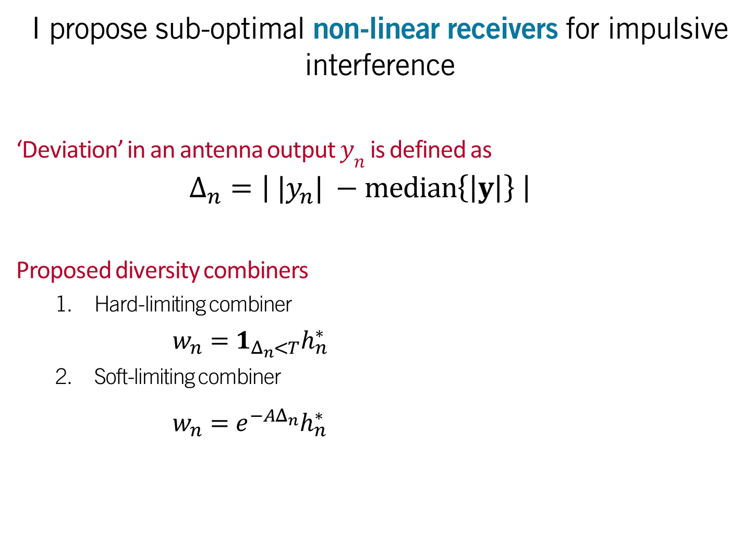
I propose sub-optimal non-linear receivers for impulsive interference
‘Deviation’ in an antenna output $y_{n}$ is defined as
$$Δ_{n}=\left| |y_{n}| −median\left.\left\{\left|y\right|\right.\right\} \right|$$
Proposed diversity combiners
Hard-limiting combiner
$w_{n}=1_{Δ_{n}<T}h_{n}^{∗}$
Soft-limiting combiner
$w_{n}=e^{−AΔ_{n}}h_{n}^{∗}$
Introduction | Modeling (CoLo) | Modeling (Dist) | Outage Performance | Receiver Design

Slide 24
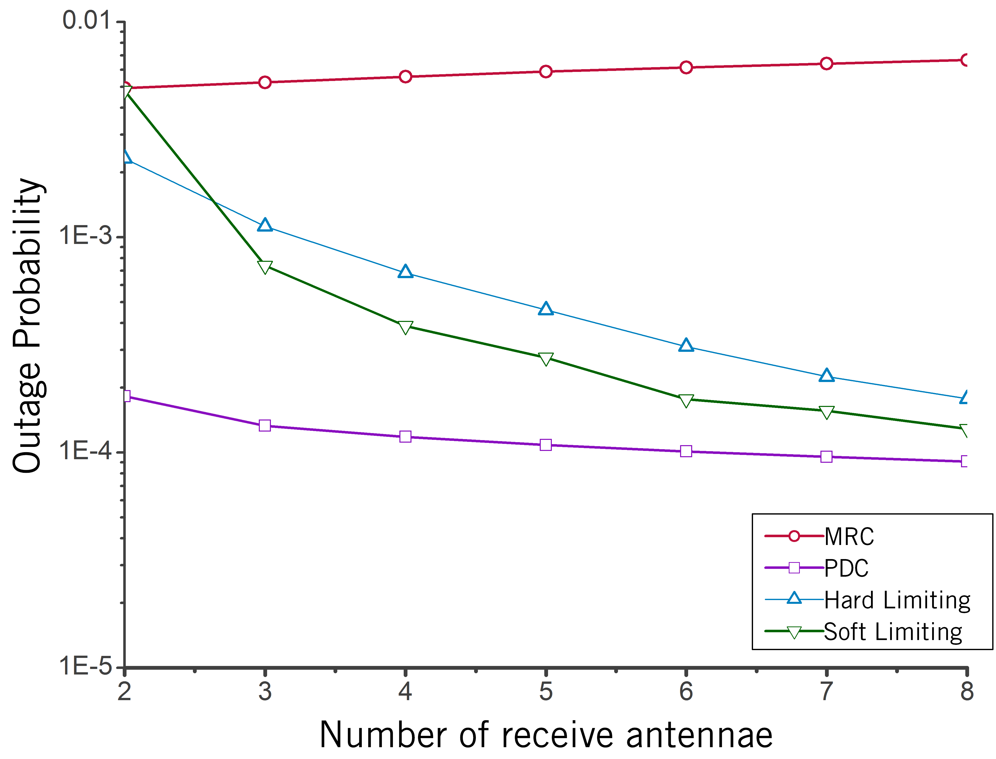
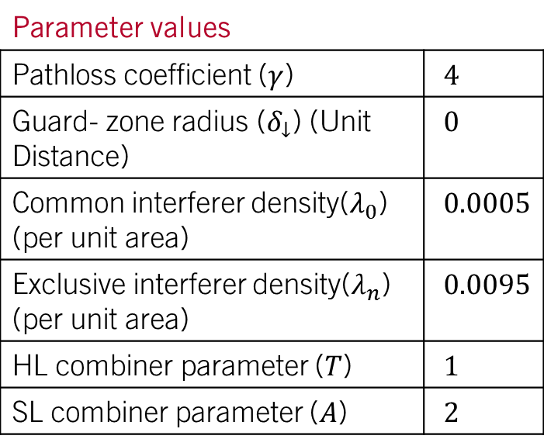
Proposed diversity combiners exhibit better outage performance compared to conventional combiners
Parameter values
Pathloss coefficient ($γ$) | $4$
Guard- zone radius ($δ_{↓}$) (Unit Distance) | $0$
Common interferer density($λ_{0}$) (per unit area) | $0.0005$
Exclusive interferer density($λ_{n}$) (per unit area) | $0.0095$
HL combiner parameter ($T$) | $1$
SL combiner parameter ($A$) | $2$
10x improvement in
outage probability
Introduction | Modeling (CoLo) | Modeling (Dist) | Outage Performance | Receiver Design

Slide 25


Joint interference statistics across separate antennae can also improve cooperative reception strategies
System Model Performance-Cost tradeoff
A distant base-station transmits a signal to the destination receiver ( ) surrounded by interferers ( ) and cooperative receivers ( )
Which cooperative receiver should be selected to assist in signal reception?
Power Cost
Outage Probability
$$0$$
Antenna Separation (Distance Units)
$$∞$$
Introduction | Modeling (CoLo) | Modeling (Dist) | Outage Performance | Receiver Design

Slide 26
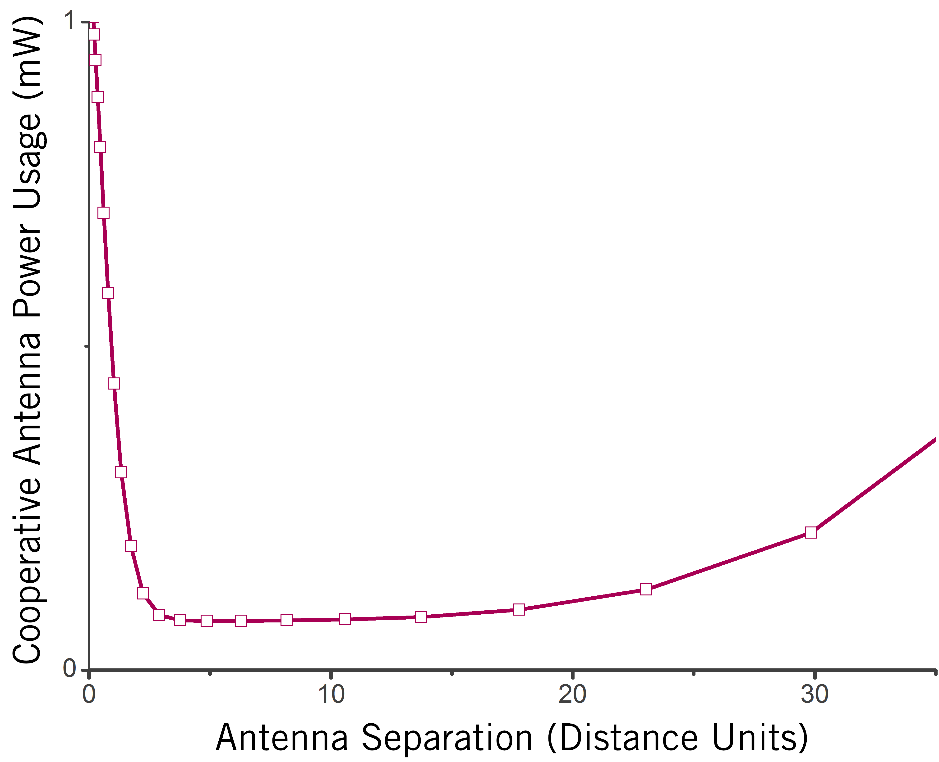
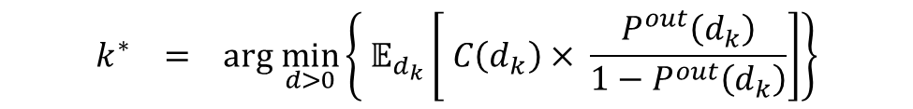
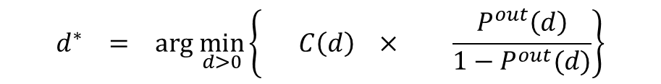

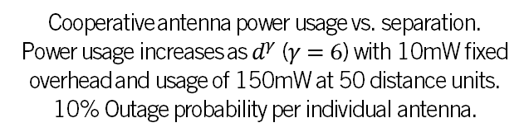
Total cost is evaluated using a re-transmission based model
Optimal Antenna Separation
$k^{th}$-Nearest Neighbor Selection
$d_{k}\sim D_{k}$ is the random variable describing
the location of the k-th nearest neighbor
$$d^{∗} = arg \min_{d>0}\left\{ C\left(d\right) × \frac{P^{out}\left(d\right)}{1−P^{out}(d)}\right\}$$
Cooperative antenna power usage vs. separation. Power usage increases as $d^{γ}$ ($γ=6$) with 10mW fixed overhead and usage of 150mW at 50 distance units.
10% Outage probability per individual antenna.
Optimal cooperative antenna location
Cost per re-transmission
Expected re-transmissions
$$k^{∗} = arg \min_{d>0}\left\{ 𝔼_{d_{k}}\left[ C\left(d_{k}\right)× \frac{P^{out}\left(d_{k}\right)}{1−P^{out}\left(d_{k}\right)}\right]\right\}$$
Optimal k-th nearest neighbor
Expected Cost of k-th re-transmission

Slide 27
In conclusion, the contributions of my dissertation are
A framework for modeling multi-antenna interference
Interference statistics are mix of spatial isotropy and spatial independence
Statistical modeling of multi-antenna interference
Co-located antennae in networks without guard zones
Two geographically separate antennae in networks with guard zones
Outage performance analysis of conventional receivers in networks without guard zones
Accurate outage probability expressions inform receiver design
Design of receiver algorithms with improved performance in impulsive interference
Order of magnitude reduction in outage probability compared to linear receivers
80% reduction in power by using physically separate antennae

Slide 28
Future work
Statistical Modeling
Non-Poisson distribution of interferer locations
>2 physically separate antennae in a field of interferers
Physically separate antennae in a centralized network
Temporal modeling of interference statistics with correlated fields of randomly distributed interferers
Performance Analysis
Performance analysis of multi-antenna wireless networks
Receiver Design
Closed form expressions and bounds on performance of non-linear receivers
Incorporate interference modeling into conventional relaying strategies

Slide 29
Journal Papers
A. Chopra and B. L. Evans, ``Outage Probability for Diversity Combining in Interference-Limited Channels'', IEEE Transactions on Wireless Communications, submitted Sep. 14, 2011
A. Chopra and B. L. Evans, ``Joint Statistics of Radio Frequency Interference in Multi-Antenna Receivers'', IEEE Transactions on Signal Processing, accepted with minor mandatory changes.
A. Chopra and B. L. Evans, ``Design of Sparse Filters for Channel Shortening'', Journal of Signal Processing Systems, May 2011, 14 pages, DOI 10.1007/s11265-011-0591-0
Conference Papers
A. Chopra and B. L. Evans, ``Design of Sparse Filters for Channel Shortening'', Proc. IEEE Int. Conf. on Acoustics, Speech, and Signal Proc., Mar. 14-19, 2010, Dallas, Texas USA.
A. Chopra, K. Gulati, B. L. Evans, K. R. Tinsley, and C. Sreerama, ``Performance Bounds of MIMO Receivers in the Presence of Radio Frequency Interference'', Proc. IEEE Int. Conf. on Acoustics, Speech, and Signal Proc., Apr. 19-24, 2009, Taipei, Taiwan.
K. Gulati, A. Chopra, B. L. Evans, and K. R. Tinsley, ``Statistical Modeling of Co-Channel Interference'', Proc. IEEE Int. Global Communications Conf., Nov. 30-Dec. 4, 2009, Honolulu, Hawaii.
K. Gulati, A. Chopra, R. W. Heath, Jr., B. L. Evans, K. R. Tinsley, and X. E. Lin, ``MIMO Receiver Design in the Presence of Radio Frequency Interference'', Proc. IEEE Int. Global Communications Conf., Nov. 30-Dec. 4th, 2008, New Orleans, LA USA.
A. G. Olson, A. Chopra, Y. Mortazavi, I. C. Wong, and B. L. Evans, ``Real-Time MIMO Discrete Multitone Transceiver Testbed'', Proc. Asilomar Conf. on Signals, Systems, and Computers, Nov. 4-7, 2007, Pacific Grove, CA USA.
In preparation
A. Chopra and B. L. Evans, ``Joint Statistics of Interference Across Two Separate Antennae''

Slide 30
References
RFI Modeling
D. Middleton, “Non-Gaussian noise models in signal processing for telecommunications: New methods and results for Class A and Class B noise models”, IEEE Trans. Info. Theory, vol. 45, no. 4, pp. 1129-1149, May 1999.
J. Ilow and D . Hatzinakos, “Analytic alpha-stable noise modeling in a Poisson field of interferers or scatterers”, IEEE Trans. on Signal Proc., vol. 46, no. 6, pp. 1601-1611, Jun. 1998.
E. S. Sousa, “Performance of a spread spectrum packet radio network link in a Poisson field of interferers,” IEEE Trans. on Info. Theory, vol. 38, no. 6, pp. 1743–1754, Nov. 1992.
X. Yang and A. Petropulu, “Co-channel interference modeling and analysis in a Poisson field of interferers in wireless communications,” IEEE Trans. on Signal Proc., vol. 51, no. 1, pp. 64–76, Jan. 2003.
Cisco visual networking index: Global mobile data traffic forecast update, 2010 - 2015. Technical report, Feb. 2011.
John P. Nolan. Multivariate stable densities and distribution functions: general and elliptical case. Deutsche Bundesbank’s Annual Fall Conference, 2005.

Slide 31
Performance Analysis
Ping Gao and C. Tepedelenlioglu. Space-time coding over fading channels with impulsive noise. IEEE Transactions on Wireless Communications, 6(1):220–229, Jan. 2007.
A. Rajan and C. Tepedelenlioglu. Diversity combining over Rayleigh fading channels with symmetric alpha-stable noise. IEEE Transactions on Wireless Communications, 9(9):2968–2976, 2010.
S. Niranjayan and N. C. Beaulieu. The BER optimal linear rake receiver for signal detection in symmetric alpha-stable noise. IEEE Transactions on Communications, 57(12):3585–3588, 2009.
C. Tepedelenlioglu and Ping Gao. On diversity reception over fading channels with impulsive noise. IEEE Transactions on Vehicular Technology, 54(6):2037–2047, Nov. 2005.
G. A. Tsihrintzis and C. L. Nikias. Performance of optimum and suboptimum receivers in the presence of impulsive noise modeled as an alpha stable process. IEEE Transactions on Communications, 43(234):904–914, 1995.

Slide 32
Receiver Design
A. Spaulding and D. Middleton, “Optimum Reception in an Impulsive Interference Environment-Part I: Coherent Detection”, IEEE Trans. Comm., vol. 25, no. 9, Sep. 1977
J.G. Gonzalez and G.R. Arce, “Optimality of the Myriad Filter in Practical Impulsive-Noise Environments”, IEEE Trans. on Signal Proc., vol. 49, no. 2, Feb 2001
S. Ambike, J. Ilow, and D. Hatzinakos, “Detection for binary transmission in a mixture of Gaussian noise and impulsive noise modelled as an alpha-stable process,” IEEE Signal Proc. Letters, vol. 1, pp. 55–57, Mar. 1994.
O. B. S. Ali, C. Cardinal, and F. Gagnon. Performance of optimum combining in a Poisson field of interferers and Rayleigh fading channels. IEEE Transactions on Wireless Communications, 9(8):2461–2467, 2010.
Andres Altieri, Leonardo Rey Vega, Cecilia G. Galarza, and Pablo Piantanida. Cooperative strategies for interference-limited wireless networks. In Proc. IEEE International Symposium on Information Theory, pages 1623–1627, 2011.
Y. Chen and R. S. Blum. Efficient algorithms for sequence detection in non-Gaussian noise with intersymbol interference. IEEE Transactions on Communications, 48(8):1249–1252, Aug. 2000.

Slide 33
about me
Member of the Wireless Networking and Communications Group at The University of Texas at Austin since 2006.
Completed projects
Currently active projects
ADSL testbed (Oil & Gas) | 2 x 2 wired multicarrier communications testbed using PXI hardware, x86 processor, real-time operating system and LabVIEW
Spur modeling/mitigation (NI) | Detect and classify spurious signals; fixed and floating-point algorithms to mitigate spurs
Interference modeling and mitigation (Intel) | Statistical models of interference; receiver algorithms to mitigate interference; MATLAB toolbox
Impulsive noise mitigation in OFDM (NI) | Non-parametric interference mitigiation for wireless OFDM receivers using PXI hardware, FPGAs, and LabVIEW
Powerline communications (TI, Freescale, SRC) | Modeling and mitigating impulsive noise; building multichannel multicarrier communications testbed using PXI hardware, x86 processor, real-time operating system, LabVIEW

Slide 34
Interference mitigation has been an active area of research over the past decade
INTERFERENCE MITIGATION STRATEGY | LIMITATIONS
Hardware design Receiver shielding | Does not mitigate interference from devices using same spectrum
Network planning Resource allocation Basestation coordination Partial frequency re-use | Requires user coordination Slow updates
Receiver algorithms Interference cancellation Interference alignment Statistical interference mitigation | Require user coordination and channel state information Statistical methods require accurate interference models
Introduction | Modeling (CoLo) | Modeling (Dist) | Outage Performance | Receiver Design
Notes:
Base station coord. , statistical receiver methods..

Slide 35
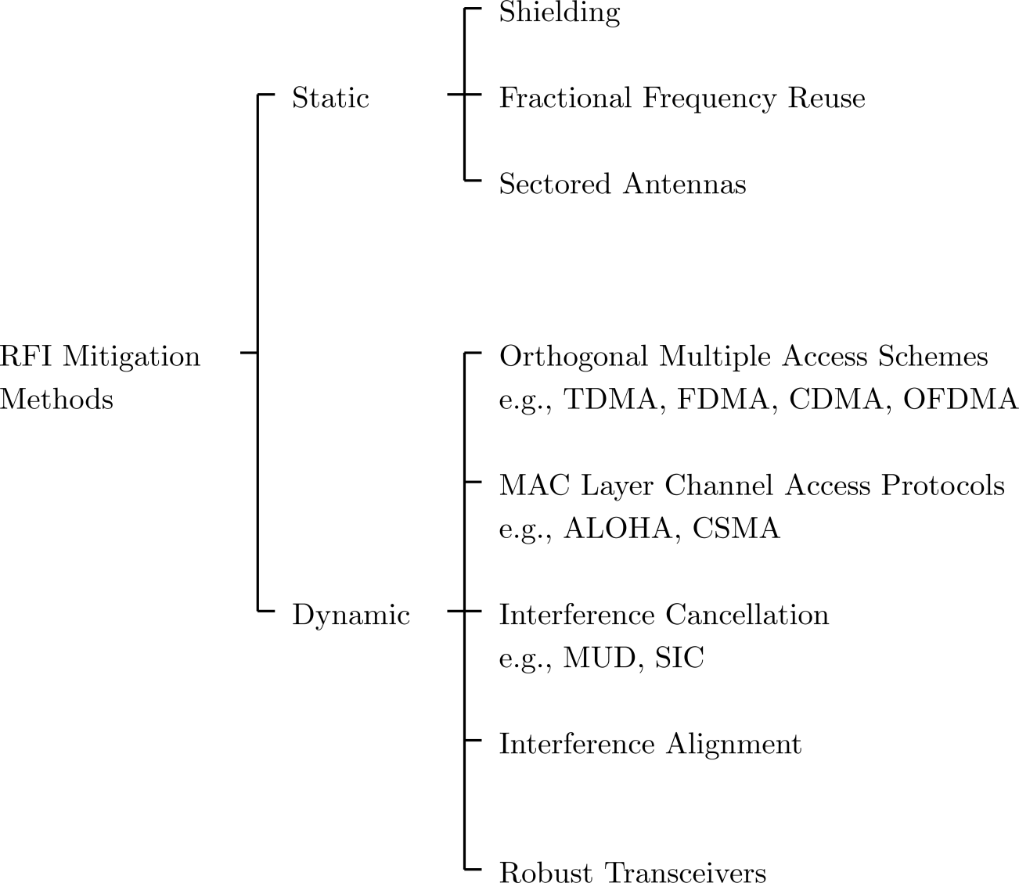
Interference Mitigation Techniques

Slide 36
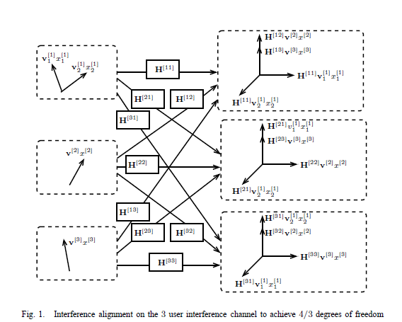
Interference alignment

Slide 37
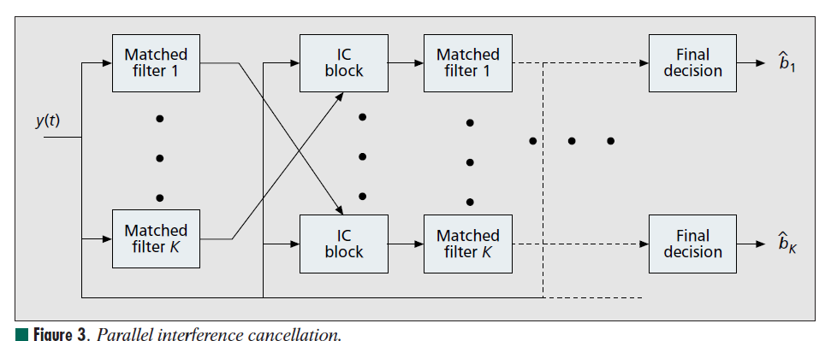
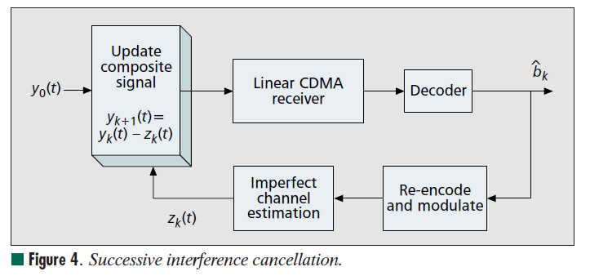
Interference cancellation
J. G. Andrews, ”Interference Cancellation for Cellular Systems: A Contemporary Overview”, IEEE Wireless Communications Magazine, Vol. 12, No. 2, pp. 19-29, April 2005

Slide 38
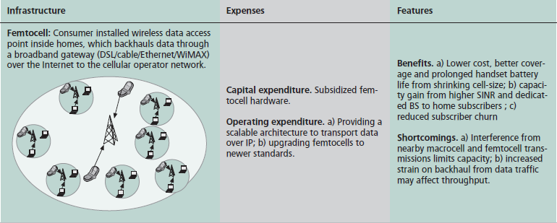
Femtocell Networks
V. Chandrasekhar, J. G. Andrews and A. Gatherer, "Femtocell Networks: a Survey", IEEE Communications Magazine, Vol. 46, No. 9, pp. 59-67, September 2008

Slide 39
Spectrum Occupied by Typical Standards
39
Standard | Carrier (GHz) | Wireless Networking | Interfering Clocks and Busses
Bluetooth | 2.4 | Personal Area Network | Gigabit Ethernet, PCI Express Bus, LCD clock harmonics
IEEE 802. 11 b/g/n | 2.4 | Wireless LAN (Wi-Fi) | Gigabit Ethernet, PCI Express Bus, LCD clock harmonics
IEEE 802.16e | 2.5–2.69 3.3–3.8 5.725–5.85 | Mobile Broadband (Wi-Max) | PCI Express Bus, LCD clock harmonics
IEEE 802.11a | 5.2 | Wireless LAN (Wi-Fi) | PCI Express Bus, LCD clock harmonics

Slide 40
Impact of LCD on 802.11g
Pixel clock 65 MHz
LCD Interferers and 802.11g center frequencies
40
LCD Interferers | 802.11g Channel | Center Frequency | Difference of Interference from Center Frequencies | Impact
2.410 GHz | Channel 1 | 2.412 GHz | ~2 MHz | Significant
2.442 GHz | Channel 7 | 2.442 GHz | ~0 MHz | Severe
2.475 GHz | Channel 11 | 2.462 GHz | ~13 MHz | Just outside Ch. 11. Impact minor

Slide 41
Measured Data
25 radiated computer platform RFI data sets from Intel each with 50,000 samples taken at 100 MSPS

Slide 42
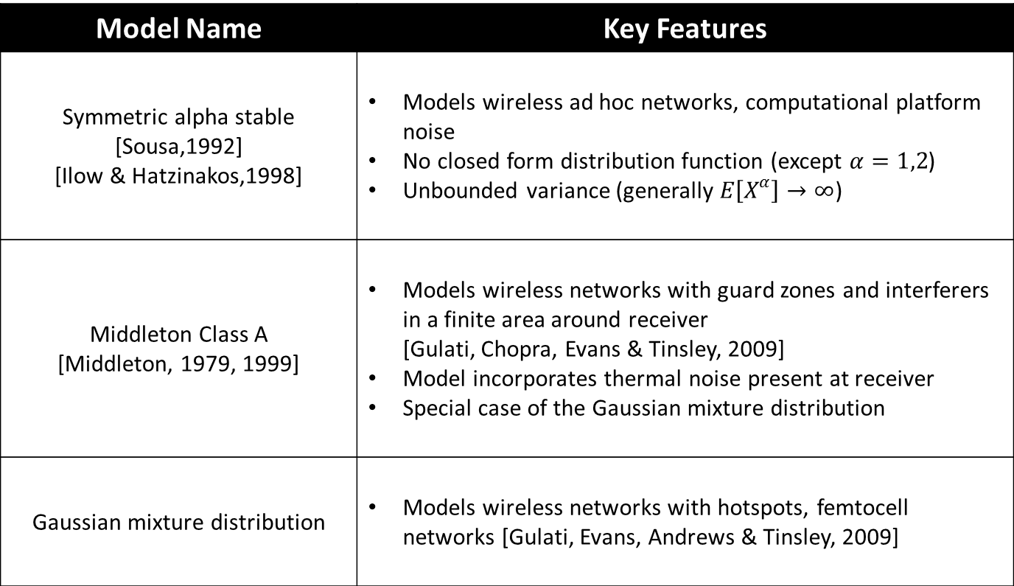
Single Antenna RFI Models
Model Name | Key Features
Symmetric alpha stable [Sousa,1992] [Ilow & Hatzinakos,1998] | Models wireless ad hoc networks, computational platform noise No closed form distribution function (except $α=1,2$) Unbounded variance (generally $E\left[X^{α}\right]→∞$)
Middleton Class A [Middleton, 1979, 1999] | Models wireless networks with guard zones and interferers in a finite area around receiver [Gulati, Chopra, Evans & Tinsley, 2009] Model incorporates thermal noise present at receiver Special case of the Gaussian mixture distribution
Gaussian mixture distribution | Models wireless networks with hotspots, femtocell networks [Gulati, Evans, Andrews & Tinsley, 2009]
Introduction |RFI Modeling | Performance Analysis | Receiver Design | Summary

Slide 43
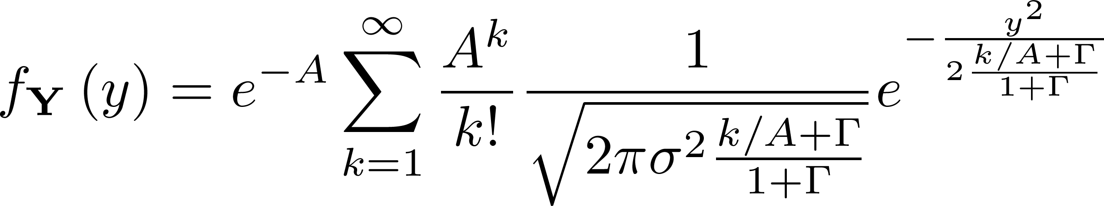





Single Antenna RFI Models
Symmetric alpha stable distribution [Sousa,1992]
Characteristic function:
$$Φ\left(ω\right)=e^{−σ|ω|^{α}}$$
Middleton Class A distribution [Middleton, 1977, 1999] Amplitude distribution:
Gaussian mixture distribution
Amplitude distribution:
Parameter | Range
$$α$$ | $$[0,2]$$
$$σ$$ | $$(0,∞)$$
Parameter | Range
$$A$$ | $$[0,2]$$
$$Γ$$ | $$(0,∞)$$
$$σ$$ | $$(0,∞)$$
Parameter | Range
$$p_{1},p_{2},⋯$$ | $$[0,1]$$
$$σ_{1},σ_{2}, ⋯$$ | $$(0,∞)$$
Introduction |RFI Modeling | Performance Analysis | Receiver Design | Summary

Slide 44

Two-Antenna RFI Generation Model
INTERFERER TO ANTENNA 1
COMMON INTERFERER
INTERFERER TO ANTENNA 2
Key model characteristics
Correlated interferer field observed by receive antennas
Inter-antenna distances insignificant compared to antenna-interferer distances
Sum interference in two-antenna receiver
$$Y_{1}=\sum_{i∈Π_{0}}{B_{i}e^{jθ_{i}}r_{i}^{−γ/2}h_{i}e^{jφ_{i}}}+\sum_{i^{′}∈Π_{1}}{B_{i^{′}}e^{jθ_{i^{′}}}r_{i^{′}}^{−γ/2}h_{i^{′}}e^{jφ_{i^{′}}}}$$
$$Y_{2}=\sum_{i∈Π_{0}}{B_{i}e^{jθ_{i}}r_{i}^{−γ/2}h_{i}e^{jφ_{i}}}+\sum_{i^{′}∈Π_{2}}{B_{i^{′}}e^{jθ_{i^{′}}}r_{i^{′}}^{−γ/2}h_{i^{′}}e^{jφ_{i^{′}}}}$$
$Π_{0}$ denotes set of interferers observed by both antennas (intensity $λ_{0})$
$Π_{1},$ $Π_{2}$ denote interferers observed at antenna $1$and $2$ respectively (intensity $λ_{1},λ_{2})$
Introduction |RFI Modeling | Performance Analysis | Receiver Design | Summary

Slide 45

Multi-Antenna RFI Generation Model
Spatially correlated interferer fields in $N_{R}$-antenna receiver
$2^{N_{R}}– 1$ i.i.d. interferer sets
Sum interference from $2^{N_{R}−1}$ sets at each antenna
Proposed model extension to $N_{R}$-antenna receiver
Two categories of interferers
Sum interference from $2$ sets at each antenna
Sum interference in $N_{R}$-antenna receiver
$$Y_{k}=\sum_{i∈Π_{0}}{B_{i}e^{jθ_{i}}r_{i}^{−γ/2}h_{i}e^{jφ_{i}}}+\sum_{i^{′}∈Π_{k}}{B_{i^{′}}e^{jθ_{i^{′}}}r_{i^{′}}^{−γ/2}h_{i^{′}}e^{jφ_{i^{′}}}}$$
$Π_{0}$ is set of interferers common to all receive antennas (intensity $λ_{0}$)
$Π_{k}$ is set of interferers observed by receive antenna $k$ (intensity $λ_{k}$)
Emissions lead to RFI in all antennas | Emissions lead to RFI in one antenna
Introduction |RFI Modeling | Performance Analysis | Receiver Design | Summary

Slide 46

Existing Models of Multi-Antenna RFI
Model Name | Key Features
Symmetric alpha stable (isotropic) [Ilow & Hatzinakos,1998] | Models spatially dependent RFI generated from single set of interferers observed by all receive antennas No closed form distribution function (except $α=1,2$) Unbounded variance (generally $E\left[X^{α}\right]→∞$)
Multidimensional Class A Models $I − III$ [Delaney, 1995] | Multidimensional extension of Middleton class A distribution, no statistical derivation Different statistical distributions required to reflect spatial dependence/independence in RFI
Bivariate class A distribution [McDonald & Blum, 1997] | Approximate distribution based on statistical-physical derivation Models RFI observed at two receive antennas only Spatially dependent RFI
Temporal second-order alpha stable model [Yang & Petropulu, 2003] | Models second-order temporal statistics of co-channel interference Assumes temporal correlation in interferer fields
Introduction |RFI Modeling | Performance Analysis | Receiver Design | Summary

Slide 47



Statistical Models for Multi-Antenna RFI
Multidimensional symmetric alpha stable distribution [Ilow & Hatzinakos, 1998]
Multidimensional Class A distribution [Delaney, 1995]
Extension type | Characteristic function
Spatially independent | $$Φ\left(ω\right)=e^{−\sum_{n=1}^{N_{R}}{σ_{n}|ω_{n}|^{α}} }$$
Isotropic | $$Φ\left(ω\right)=e^{−σ||w{||}^{α}}$$
Extension type | Amplitude distribution
Spatially independent
Isotropic
Introduction |RFI Modeling | Performance Analysis | Receiver Design | Summary

Slide 48


Statistical Models for Multi Antenna RFI
Physical model of RFI for 2 antenna systems
Amplitude distribution [McDonald & Blum, 1997]
Parameter | Range
$$A$$ | $$[0,2]$$
$$Γ_{1},Γ_{2}$$ | $$(0,∞)$$
$$κ$$ | $$[0,1]$$
Introduction |RFI Modeling | Performance Analysis | Receiver Design | Summary

Slide 49
KL divergence

Slide 50


Interference in separate antennae

Slide 51

Homogeneous Spatial Poisson Point Process

Slide 52
Poisson Field of Interferers
Applied to wireless ad hoc networks, cellular networks
Closed Form Amplitude Distribution
Model | Interference | Region | Key Prior Work
Symmetric Alpha Stable | Spatial | Entire plane | [Sousa, 1992] [Ilow & Hatzinakos, 1998] [Yang & Petropulu, 2003]
Middleton Class A | Spatio-temporal | Finite area | [Middleton, 1977, 1999]
Other Interference Statistics – closed form amplitude distribution not derived
Statistics | Interference | Region | Key Prior Work
Moments | Spatial | Finite area | [Salbaroli & Zanella, 2009]
Characteristic Function | Spatial | Finite area | [Win, Pinto & Shepp,2009]
Notes:
Actions:
Should mention Shot-Noise related work.
Questions:

Slide 53
Isotropic SAS

Slide 54
Independent SAS

Slide 55
Mixture SAS

Slide 56


Threshold selection with $α=\frac{2}{3}$

Slide 57


Threshold selection with $α=\frac{4}{3}$

Slide 58

Parameter Estimators for Alpha Stable
58
Return

Slide 59
Gaussian Mixture vs. Alpha Stable
Gaussian Mixture vs. Symmetric Alpha Stable
 | Gaussian Mixture | Symmetric Alpha Stable
Modeling | Interferers distributed with Guard zone around receiver (actual or virtual due to PL) | Interferers distributed over entire plane
Pathloss Function | With GZ: singular / non-singular Entire plane: non-singular | Singular form
Thermal Noise | Easily extended (sum is Gaussian mixture) | Not easily extended (sum is Middleton Class B)
Outliers | Easily extended to include outliers | Difficult to include outliers

Slide 60
RFI Mitigation in SISO Systems
60
Return
Mitigation of computational platform noise in single carrier, single antenna systems [Nassar, Gulati, DeYoung, Evans & Tinsley, ICASSP 2008, JSPS 2009]
Computer Platform Noise Modelling | Evaluate fit of measured RFI data to noise models Middleton Class A model Symmetric Alpha Stable
Parameter Estimation | Evaluate estimation accuracy vs complexity tradeoffs
Filtering / Detection | Evaluate communication performance vs complexity tradeoffs Middleton Class A: Correlation receiver, Wiener filtering, and Bayesian detector Symmetric Alpha Stable: Myriad filtering, hole punching, and Bayesian detector

Slide 61
Filtering and Detection
Assumption
Multiple samples of the received signal are available
N Path Diversity [Miller, 1972]
Oversampling by N [Middleton, 1977]
61
Impulsive Noise
Pulse
Shaping
Pre-Filtering
Matched Filter
Detection Rule
Return
Middleton Class A noise
Symmetric Alpha Stable noise
Filtering
Wiener Filtering (Linear)
Detection
Correlation Receiver (Linear)
Bayesian Detector [Spaulding & Middleton, 1977]
Small Signal Approximation to Bayesian detector [Spaulding & Middleton, 1977]
Filtering
Myriad Filtering
Optimal Myriad [Gonzalez & Arce, 2001]
Selection Myriad
Hole Punching [Ambike et al., 1994]
Detection
Correlation Receiver (Linear)
MAP approximation [Kuruoglu, 1998]

Slide 62
Results: Class A Detection
62
Communication Performance
Binary Phase Shift Keying
Pulse shape Raised cosine 10 samples per symbol 10 symbols per pulse | Channel A = 0.35 Γ = 0.5 × 10⁻³ Memoryless
Method | Comp. Complexity | Detection Perform.
Correl. | Low | Low
Wiener | Medium | Low
Bayesian S.S. Approx. | Medium | High
Bayesian | High | High

Slide 63
Results: Alpha Stable Detection
63
Communication Performance
Return
Same transmitter settings as previous slide
Method | Comp. Complexity | Detection Perform.
Hole Punching | Low | Medium
Selection Myriad | Low | Medium
MAP Approx. | Medium | High
Optimal Myriad | High | Medium
Use dispersion parameter γ in place of noise variance to generalize SNR

Slide 64
RFI Mitigation in 2x2 MIMO Systems
64
2 x 2 MIMO receiver design in the presence of RFI [Gulati, Chopra, Heath, Evans, Tinsley & Lin, Globecom 2008]
Return
RFI Modeling | Evaluated fit of measured RFI data to the bivariate Middleton Class A model [McDonald & Blum, 1997] Includes noise correlation between two antennas
Parameter Estimation | Derived parameter estimation algorithm based on the method of moments (sixth order moments)
Performance Analysis | Demonstrated communication performance degradation of conventional receivers in presence of RFI Bounds on communication performance [Chopra , Gulati, Evans, Tinsley, and Sreerama, ICASSP 2009]
Receiver Design | Derived Maximum Likelihood (ML) receiver Derived two sub-optimal ML receivers with reduced complexity

Slide 65







Bivariate Middleton Class A Model
Joint spatial distribution
Return
Parameter | Description | Typical Range
 | Overlap Index. Product of average number of emissions per second and mean duration of typical emission
 | Ratio of Gaussian to non-Gaussian component intensity at each of the two antennas
 | Correlation coefficient between antenna observations

Slide 67
Results on Measured RFI Data
50,000 baseband noise samples represent broadband interference
Estimated Parameters
Bivariate Middleton Class A
Overlap Index (A) | 0.313 | 2D- KL Divergence 1.004
Gaussian Factor (Γ₁) | 0.105
Gaussian Factor (Γ₂) | 0.101
Correlation (κ) | -0.085
Bivariate Gaussian
Mean (µ) | 0 | 2D- KL Divergence 1.6682
Variance (σ₁) | 1
Variance (σ₂) | 1
Correlation (κ) | -0.085
Marginal PDFs of measured data compared with estimated model densities

Slide 68




System Model
Return
2 x 2 MIMO System
Maximum Likelihood (ML) receiver
Log-likelihood function
Sub-optimal ML Receivers
approximate

Slide 69





Sub-Optimal ML Receivers
69
Two-piece linear approximation
Four-piece linear approximation
Return
Approximation of
chosen to minimize

Slide 70
Results: Performance Degradation
Performance degradation in receivers designed assuming additive Gaussian noise in the presence of RFI
Return
Simulation Parameters
4-QAM for Spatial Multiplexing (SM) transmission mode
16-QAM for Alamouti transmission strategy
Noise Parameters: A = 0.1, Γ₁= 0.01, Γ₂= 0.1, κ = 0.4
Severe degradation in communication performance in high-SNR regimes

Slide 71
Results: RFI Mitigation in 2 x 2 MIMO
71
Return
Improvement in communication performance over conventional Gaussian ML receiver at symbol error rate of 10⁻²
A | Noise Characteristic | Improve-ment
0.01 | Highly Impulsive | ~15 dB
0.1 | Moderately Impulsive | ~8 dB
1 | Nearly Gaussian | ~0.5 dB
Communication Performance (A = 0.1, Γ₁= 0.01, Γ₂= 0.1, κ = 0.4)

Slide 72



Results: RFI Mitigation in 2 x 2 MIMO
72
Return
Complexity Analysis for decoding M-level QAM modulated signal
Receiver | Quadratic Forms | Exponential | Comparisons
Gaussian ML | M² | 0 | 0
Optimal ML | 2M² | 2M² | 0
Sub-optimal ML (Four-Piece) | 2M² | 0 | 2M²
Sub-optimal ML (Two-Piece) | 2M² | 0 | M²
Complexity Analysis
Communication Performance (A = 0.1, Γ₁= 0.01, Γ₂= 0.1, κ = 0.4)

Slide 73
Wireless communication systems are increasingly using multiple antennae
Benefits
Wireless Channel
Transmit Antennae
Receive Antennae
Multiplexing | Diversity | Interference Removal
Multiple data streams transmitted simultaneously | Antennae with strong channels can compensate for antennae with weak channels | Interference cancellation and alignment
11
101110
10
10
Introduction | Modeling (CoLo) | Modeling (Dist) | Outage Performance | Receiver Design

Slide 74

Interference statistics in networks without guard zones are a mix of isotropic and i.i.d. alpha stable …
Joint characteristic function
$Φ\left(w\right)=e^{σ_{0}{\left\|w\right\|}^{α}}×\prod_{n=1}^{N}{e^{σ_{n}{|ω_{n}^{}|}^{α}}}$
$α=\frac{4}{γ}, σ_{n}∝λ_{n}$
… and interference statistics in networks with guard zones are a mix of isotropic and i.i.d. Middleton Class A
Joint characteristic function
$Φ\left(w\right)=e^{A_{0}e^{−\frac{{\left\|w\right\|}^{2}Ω_{0}}{2} }}×\prod_{n=1}^{N}{e^{A_{n}e^{−\frac{{\left|w_{n}\right|}^{2}Ω_{n}}{2} }}}$ $A_{n}∝λ_{n}δ_{↓}^{2} , Ω_{n}∝A_{n}δ_{↓}^{−γ}$
A 3-antenna receiver within a Poisson field of interferers
2
1
3
3
2
$$δ_{↓}$$
1
2
1
1
3
Introduction | Modeling (CoLo) | Modeling (Dist) | Outage Performance | Receiver Design

