Slide 1


IMPROVING NEXT-GENERATION WIRELESS NETWORK PERFORMANCE AND RELIABILITY WITH DEEP LEARNING
Faris B. Mismar
November 22, 2019
Ph.D. Defense
The University of Texas at Austin
Embedded Signal Processing Laboratory
Wireless Networking & Communications Group

Slide 2
VISION FOR 5G COMMUNICATIONS
NETWORK ANALYTICS
“Network Data Analytics Function”
(3gpp)
[https://www.qorvo.com/design-hub/blog/getting-to-5g-comparing-4g-and-5g-system-requirements]
BACKGROUND

Slide 3

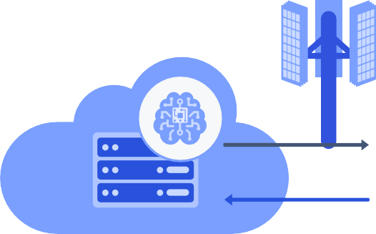





VISION FOR INTELLIGENT WIRELESS NETWORK
Base Station (BS)
Sub-6 GHz
mmWave
Central location to coherently train models
Trained models at the network edge
User Equipment (UE)
[https://www.qualcomm.com/media/documents/files/making-ai-ubiquitous.pdf]
Hybrid approach to unleash next-generation wireless “network intelligence”
BACKGROUND
Notes:
One of the visions

Slide 4
MOTIVATION: DEEP LEARNING IN COMMUNICATIONS
Absence of accurate mathematical formulations
data-driven approaches using ray-tracing datasets or field-measurements
[Zappone19]
Incremental changes in radio resource management (RRM) algorithms
industry standards still prefer “legacy” algorithms despite successive evolutions
[3gpp15] & [3gpp18]
Desire for fully autonomous self-organizing networks (SON)
operators are under constant pressure to reduce operational expenditure without impacting performance
[Zappone19]
Long training times and high implementation complexity pose significant challenges
BACKGROUND

Slide 5

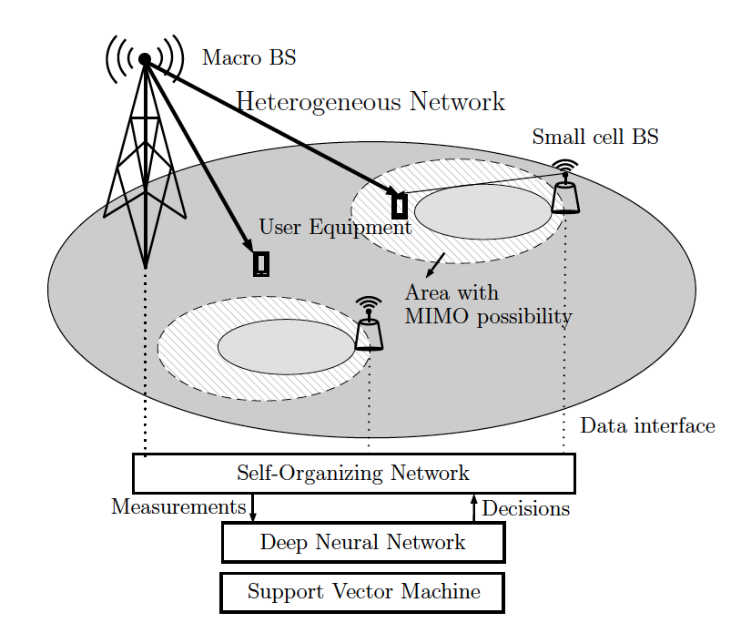
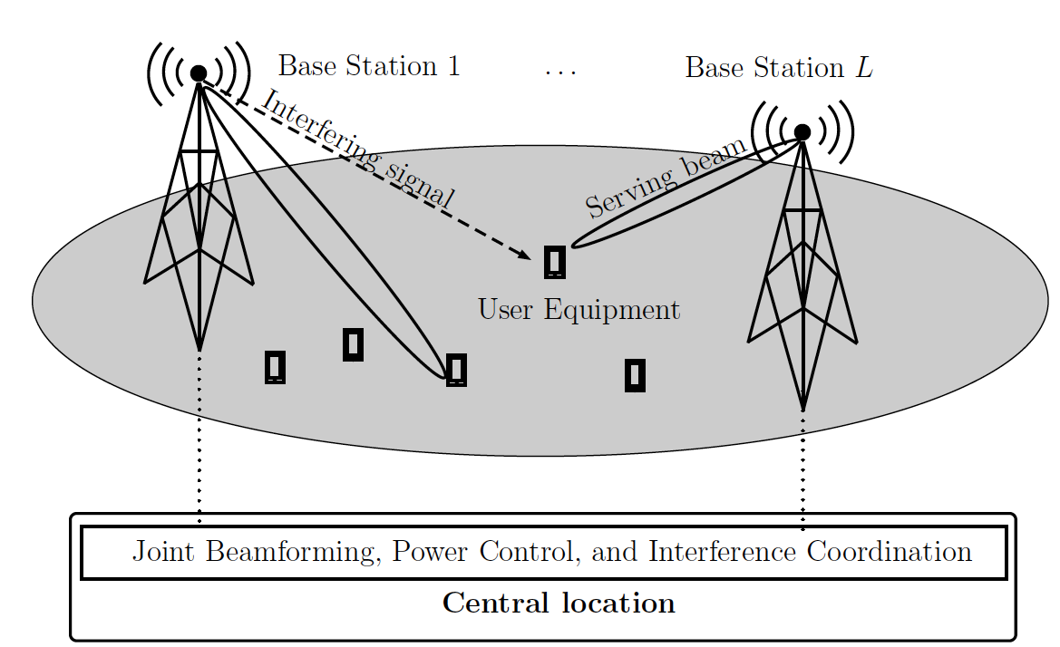
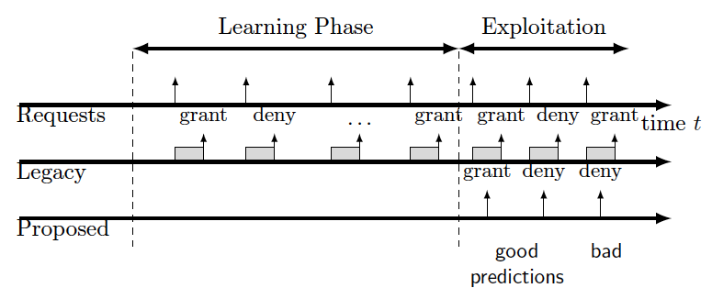
CONTRIBUTIONS
How to improve next-generation wireless networks system performance?
disrupt the legacy industry standards to boost reliability and eliminate performance bottlenecks
PHY perspective
RRM perspective
Beamforming, Power Control and Interference Coordination
Intelligent Coordinated Multipoint
Predictive Band Switching
Contribution 1
Contribution 2
Contribution 3
Improve user rates
Contributions are on the downlink (BS to UE)
RRM: radio resource management layer
PHY: physical layer
BS: Base station UE: user equipment.
CONTRIBUTIONS

Slide 6
JOINT BEAMFORMING, POWER CONTROL, AND INTERFERENCE COORDINATION
Contribution 1
Discussed in the PhD Qualifying Exam and Included in the PhD Dissertation
Related publications:
[1]. F. B. Mismar, B. L. Evans and A. Alkhateeb, “Deep Reinforcement Learning for 5G Networks: Joint Beamforming, Power Control, and Interference Coordination,” IEEE Transactions on Communications, submitted Jun. 28, 2019 and resubmitted Sep. 21, 2019 and Nov. 8, 2019.
[2]. F. B. Mismar and B. L. Evans, “Q-Learning Algorithm for VoLTE Closed-Loop Power Control in Indoor Small Cells,” Proceedings of the 52nd Annual Asilomar Conference on Signals, Systems, and Computers, Oct. 2018.

Slide 7
BACKGROUND
Problem
User served by a base station receives interference from neighboring base station
Base station serving the user causes interference to other users
Goal
Maximize the signal to interference plus noise ratio (SINR) from serving base station to user
Parameters
Beamforming (BF) to create a virtual sense of a user-specific channel for data
Power Control (PC) to control the transmit power of the serving BS towards a user
Interference Coordination (IC) to control the transmit power of the neighboring BSs
User spatial coordinates
Approach
Perform binary encoding of BF, PC, and IC actions to enable joint actions
If SINR of all users improve, then reward actions. This resolves the race condition
Compare proposed solution with optimal solution
CONTRIBUTION 1: JOINT BEAMFORMING AND POWER CONTROL
Notes:
Let’s start with the background of the first contribution.

Slide 8
SYSTEM MODEL
Multi-user downlink system
Signal model for the user served by the -th BS:
Multi-cell environment with single-antenna users
L total dual-band base stations
Uniform linear array (ULA) antennas (M)
Power control for all users
Codebook analog beamforming for mmWave data
More power control commands for sub-6 GHz voice
Inter-cellular interference
Gaussian noise
Narrow-band geometric channel model
channel path p gain
suitable for both sub-6 and mmWave propagation
smaller number of paths at mmWave (sparse)
Received SINR for the user served by the -th BS:
[Alkhateeb14]
path loss for user served by BS l in area of BS b
angle of departure
array response vector
Beamforming vector
CONTRIBUTION 1: JOINT BEAMFORMING AND POWER CONTROL

Slide 9
MOTIVATION AND PROBLEM FORMULATION
Improve SINR through joint power control, interference coordination, beam selection
Set of power (and interference coordination) commands
Set of beamforming vectors (where applicable)
beamforming vector of the j-th user
Target SINR value
received SINR of the j-th user
Baseline solution for voice is obtained from fixed power allocation with adaptive coding
Optimal solution (upper bound) for data is found through a brute force over all
beam patterns
power commands for the BSs
Run-time complexity of for M antennas and L base stations.
How can we reduce the complexity?
CONTRIBUTION 1: JOINT BEAMFORMING AND POWER CONTROL

Slide 10
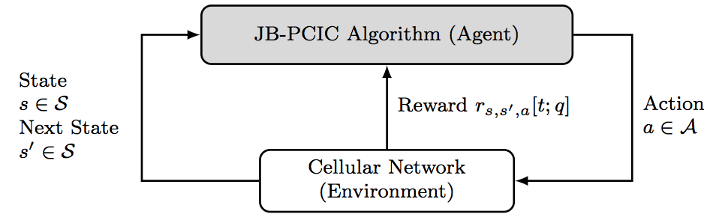
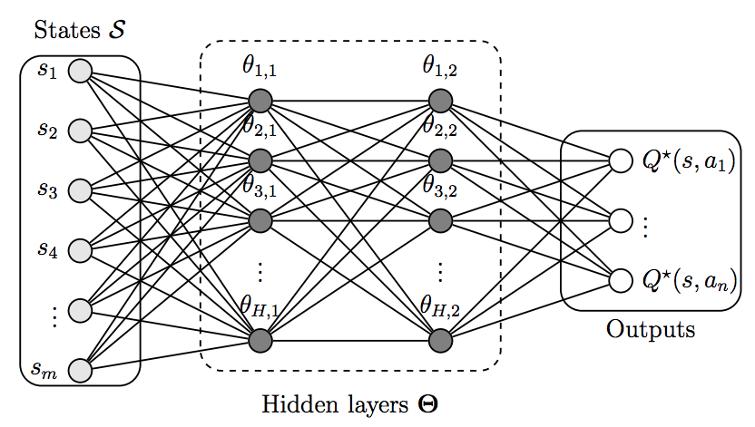
SOLUTION
Deep Reinforcement Learning
Create an environment from the system model
Create a joint reward
Reward the agent for every time the SINR improves.
Bearer selector
Use deep Q-network (DQN) as an estimator for state-action value function
Greedy policy
Train the DQN using minibatch samples to minimize the loss function:
DQN vectorized weights
state-action value function
estimated state-action value function
discount rate
reward
Can an 𝜺-greedy policy do better?
CONTRIBUTION 1: JOINT BEAMFORMING AND POWER CONTROL

Slide 11
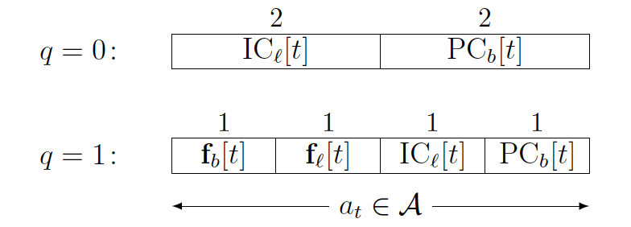
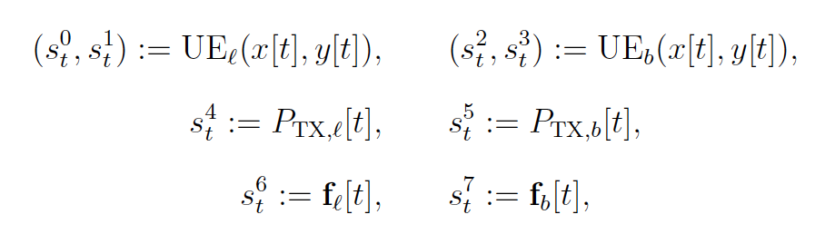
SOLUTION (L = 2)
Joint beamforming, power control, and interference coordination (JB-PCIC) encoding
Bearer selector
➔
3
0
enables up to 16 simultaneous actions for voice and 16 for data
Bitwise AND, masking, and shifting
string of bits in a register
0: step down beamforming codebook
1: step up beamforming codebook
Reward function
States
voice
bearer selector
data
A total of 8 states
if any constraint in problem formulation becomes inactive.
if the target SINR is achieved.
CONTRIBUTION 1: JOINT BEAMFORMING AND POWER CONTROL
Notes:
Here, I propose a compact way to jointly perform BF, PC, and IC, using a string of bits and binary logic.

Slide 12
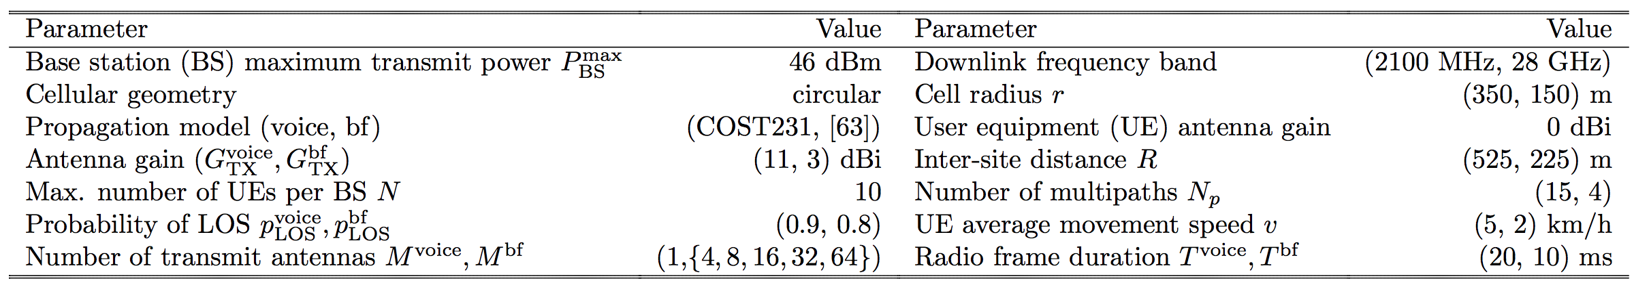
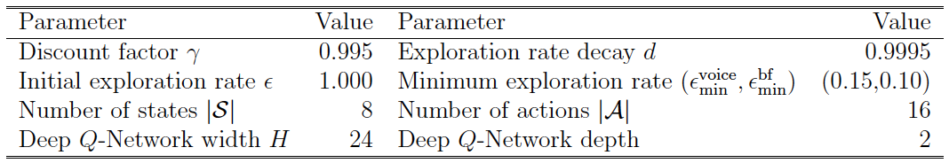
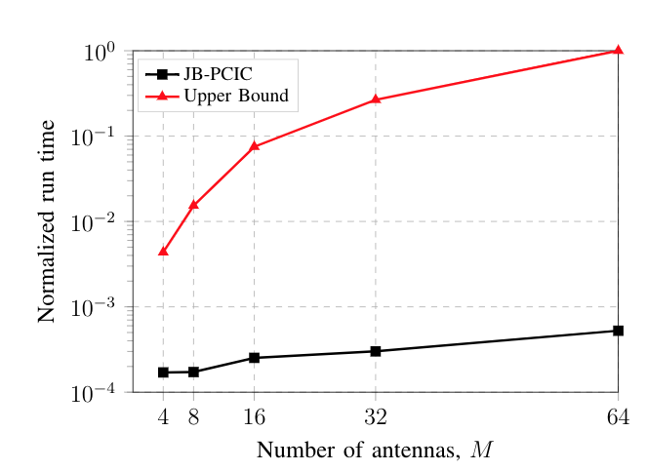
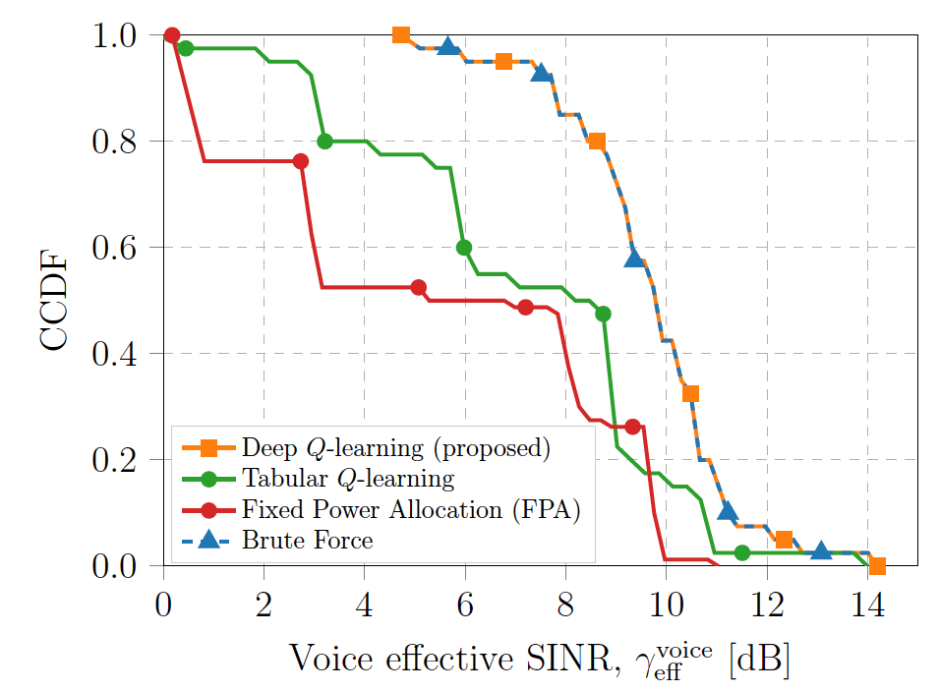
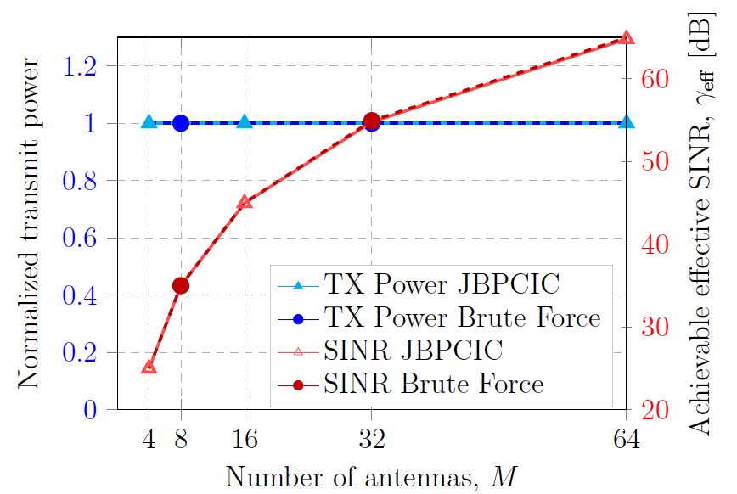
SIMULATION
Communication System Parameters
Deep Reinforcement Learning Hyperparameters
JB-PCIC algorithm achieves upper bound on performance but without exhaustive search in action space
CONTRIBUTION 1: JOINT BEAMFORMING AND POWER CONTROL
Notes:
Proposed RL algorithm outperforms industry standards. However, closer to cell center, algorithms perform similarly.
Tabular learning uses O(SA) = 16 * 8. Deep learning uses 16 * 24^2. Therefore, tabular achieves a speedup of 72x.
Tabular is guaranteed to converge. Qlearning is unstable or will diverge if nonlinear function approximator is used

Slide 13
SUMMARY
Optimize users’ received SINR
Optimal
Voice bearers
Exponential in number of base stations
Uses brute force
Perform power control for the serving cell
Coordinate transmit power for the other cells
Voice uses adaptive coding
Data bearers
Perform power control for the serving cell
Coordinate transmit power for the other cells
Proposed
Uses deep reinforcement learning
Encoding to facilitate joint actions
Avoids exhaustive search in the action space
CONTRIBUTION 1: JOINT BEAMFORMING AND POWER CONTROL

Slide 14
IMPROVED DOWNLINK COORDINATED MULTIPOINT PERFORMANCE
Contribution 2
Related publications:
[1]. F. B. Mismar and B. L. Evans, “Deep Learning in Downlink Coordinated Multipoint in New Radio Heterogeneous Network,” IEEE Wireless Communications Letters, vol. 8, no. 4, pp. 1040-1043, Aug. 2019.
[2]. F. B. Mismar and B. L. Evans, “Machine Learning in Downlink Coordinated Multi-point in Heterogeneous Networks,” Technical Report, Feb. 2019. [Online]. arXiv:1608.08306.

Slide 15
BACKGROUND
Problem
Industry implementations trigger coordinated multipoint (CoMP) based on user SINR
This yields low user throughput
Goal
Develop triggering function to improve the user throughput
Parameters
Block Error Rate (BLER) target for codeword reception error
Channel State Information (CSI) to help derive transmission rank
Approach
Train a classifier to learn the relationship between the reported measurements and the BLER
If a user is predicted to have a BLER lower than the target, configure rank-2 transmission
Compare with SINR-based trigger
CONTRIBUTION 2: IMPROVED DOWNLINK COORDINATED MULTIPOINT
Notes:
Base stations work independently to deliver data to the users. However, using low latency backhaul to small cells nearby, introducing a coordinated transmission can help further improve the user throughputs.
Explain why lower throughput: it is in the log(). Why SINR: it is standard-driven (based on CQI).

Slide 16
SYSTEM MODEL
Multi-user downlink system
The received power for the -th user at the -th antenna:
Multi-cell environment with multiple-antenna users
Small cells scattered in the service area
Macro cells and small cells can form a distributed MIMO channel with transmit antennas
Zero-Forcing (ZF) receiver at the user end
The received reference symbol power (RSRP) for the -th user:
Signal model for the -th user (narrowband):
number of resource blocks
number of subcarriers in a resource block
[Tse05]
UE received power measured at the first antenna
Gaussian noise
distributed MIMO channel (both large- and small-scale gain)
energy per symbol
The codeword block error rate (BLER) for the -th user:
The received SNR for the -th user at the -th antenna
BLER for the codeword transmitted to the j-th antenna
ZF receiver enhanced noise power
number of receive antennas
CONTRIBUTION 2: IMPROVED DOWNLINK COORDINATED MULTIPOINT
Notes:
Since energy is sampled every one second, it is equal to power. Hence P_BS = E_s.
BLER increases as the number of streams increase. BLER per stream also increases at low SNR.

Slide 17
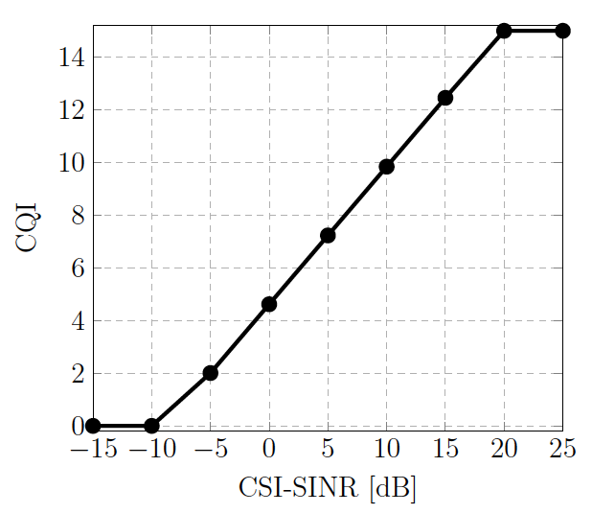
MOTIVATION AND PROBLEM FORMULATION
Industry approach is to use the users’ reported CSI to determine proper transmission rank
BLER increases as the transmission rank increases
Throughput decreases as BLER increases
Throughput increases as transmission rank increases, assuming decorrelated transmission streams
bandwidth
Users report a “quantized” SNR value known as the channel quality indicator (CQI)
effective rate of the i-th UE
How to optimize this group of conflicting variables?
Answer: main idea:
When the BLER is low, try to increase the transmission rank, if the second spatially decorrelated stream (i.e., rank-2) is possible.
Otherwise, default to a rank-1 transmission.
Can a dynamic data-driven approach help?
CSI: Channel State Information
BLER: Block Error Rate
CONTRIBUTION 2: IMPROVED DOWNLINK COORDINATED MULTIPOINT
Notes:
The pre-log terms have bigger gains

Slide 18
SOLUTION
Simplify the problem to rank-2 MIMO channel and build a binary classifier
For the binary classifier:
Labels are a function of the BLER meeting the standard threshold
Use standard-compliant CSI as learning features that help define the transmission rank
Invalidate the learned model after the channel coherence time passes.
Coordinated Multipoint (CoMP) trigger function:
found from either standards-compliant or proposed CoMP “votes”
CoMP trigger (MIMO), based on the majority of votes
a frequency function: percentage of y=0 and y=1 samples (i.e., an empirical probability):
Standards-Compliant
Proposed
uses SINR as a measure of decorrelation
CSI reported by the i-th user
a machine learning function
CONTRIBUTION 2: IMPROVED DOWNLINK COORDINATED MULTIPOINT

Slide 19
SOLUTION
Construct the surrogate function from:
fully connected deep neural network (DNN)
support vector machine (SVM)
Define the classification label based on the BLER being within target
Train classifiers to minimize loss objective
binary cross-entropy for DNN
The i-th support vector
hinge loss and regularization for SVM
hyperplane weights
 | Parameter | Type | Description
 | Bias term | Float | Equal to unity
 | CSI-RSRP | Float | Narrowband received power
 | CQI | Integer | Wideband received SNR on the first antenna (linear)
 | Rank | Integer | Number of received streams j
CONTRIBUTION 2: IMPROVED DOWNLINK COORDINATED MULTIPOINT
Notes:
Why not hinge loss? Hinge loss maximizes the decision boundary, cross-entropy maximizes the likelihood of the estimate.

Slide 20
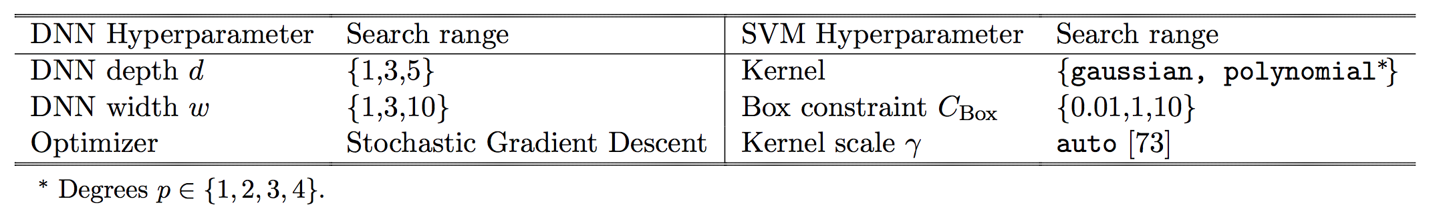
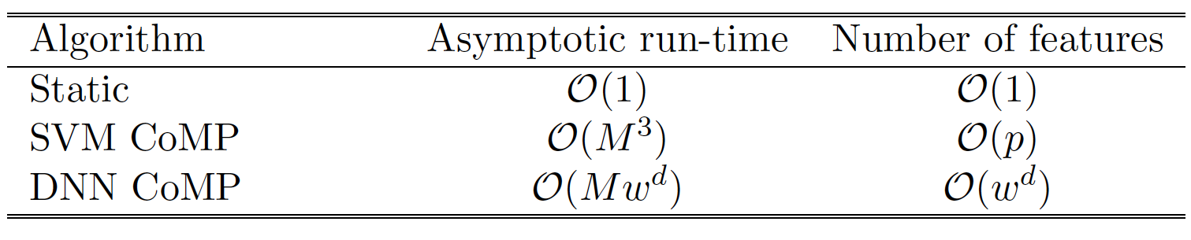
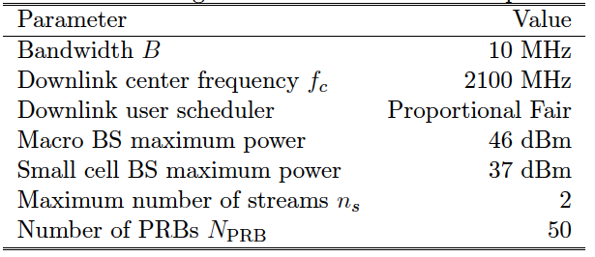
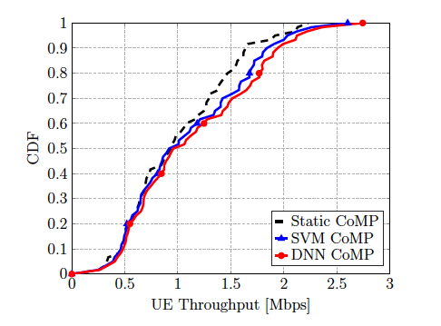
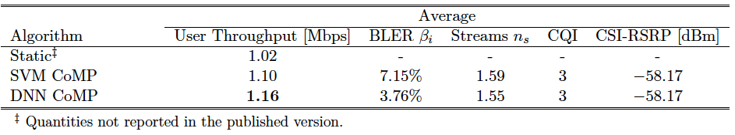
SIMULATION
Because CoMP decision is an “imbalanced” classification, DNN does better
CoMP: Coordinated Multipoint, DNN: Deep Neural Network, PRB: Physical Resource Block, SVM: Support Vector Machine.
CONTRIBUTION 2: IMPROVED DOWNLINK COORDINATED MULTIPOINT

Slide 21
SUMMARY
Optimize users’ achievable rate
Achievable rate depends on a group of features, some of which have opposing effects on the rate.
The use of a data-driven approach to find an improved achievable rate is possible.
Higher transmission rank does not always lead to better achievable rates.
Static
Dynamic
Triggers rank-2 based on reported SINR (absolute cutoff).
Triggers rank-2 based on a surrogate function based on deep learning.
The surrogate function is relearned every time the channel coherence time passes.
SVM
DNN
More features and more complicated models lead to better performance
CONTRIBUTION 2: IMPROVED DOWNLINK COORDINATED MULTIPOINT

Slide 22
DEEP LEARNING PREDICTIVE BAND SWITCHING IN WIRELESS NETWORKS
Contribution 3
Discussed in the PhD Qualifying Exam and Included in the PhD Dissertation
Related publications:
[1] F. B. Mismar, A. AlAmmouri, A. Alkhateeb, J. G. Andrews, and B. L. Evans, “Deep Learning Predictive Band Switching in Wireless Networks,” IEEE Transactions on Wireless Communications, submitted Oct. 2, 2019.
[2] F. B. Mismar and B. L. Evans, “Partially Blind Handovers for mmWave New Radio Aided by Sub-6 GHz LTE Signaling,” Proceedings of IEEE International Conference on Communications Workshops, May 2018.

Slide 23
BACKGROUND
Problem
Users want to switch to a different frequency band if they expect to get higher throughput
Switching between frequency bands requires a “measurement gap” which reduces user throughput
Goal
Improve user throughput by exploiting the spatial correlation to eliminate the measurement gap
Parameters
Band switch request threshold which defines the rate below which UE requests a band switch
Band switch grant threshold which defines the rate above which the UE request is granted
Percentage of users in sub-6 GHz or mmWave vs total users
User spatial coordinates
Approach
Employ a data-driven approach using a ray-tracing dataset
Use deep learning to rank the downlink channel quality based on the users’ coordinates
Grant a band switch if predicted to improve the user throughput (no need for the gap)
CONTRIBUTION 3: DEEP LEARNING PREDICTIVE BAND SWITCHING
Notes:
I shift now from PHY to RRM.
Explain what a measurement gap is

Slide 24
SYSTEM MODEL
Multi-user downlink system
The received instantaneous rate for the -th user at the -th frequency band:
Single-cell with multiple transmit antennas
Sub-6 GHz and mmWave bands (28 GHz)
Analog beamforming using DFT-based codebook
Signal model for the -th user at the -th frequency band:
bandwidth
received SINR
[Tse05]
The received effective achievable rate for the -th user at the -th frequency band:
Gaussian noise
beamforming precoder
channel vector
transmit power and large scale channel gain
The received SINR for the -th user at the -th frequency band
beam training time
band switching overhead
channel coherence time
Here, is the band switching algorithm.
noise power
SINR-optimal beamforming precoder
CONTRIBUTION 3: DEEP LEARNING PREDICTIVE BAND SWITCHING
Notes:
Since energy is sampled every one second, it is equal to power. Hence P_BS = E_s

Slide 25
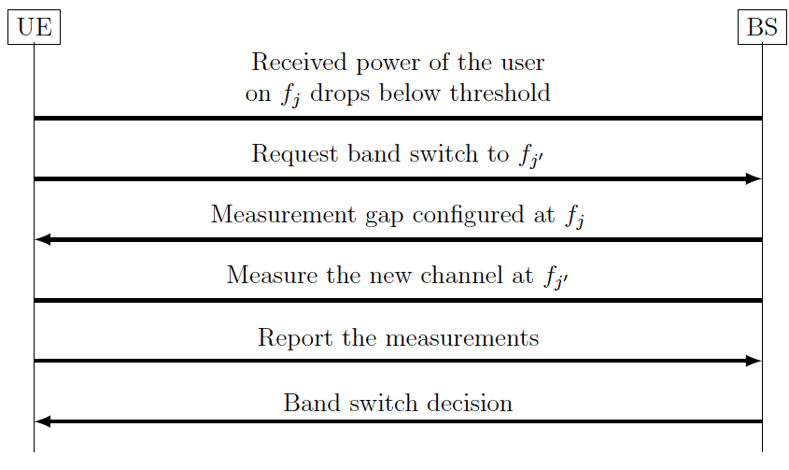
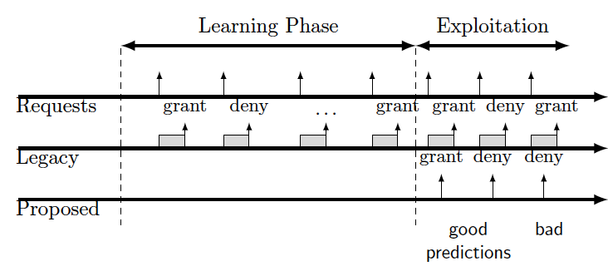
MOTIVATION AND PROBLEM FORMULATION
Next-generation wireless networks will use more frequency bands.
The band selection problem becomes more complicated:
How does user choose a band to improve their rate?
Problem:
Measurement gap reduces users’ effective achievable rates
Blindly switching user eliminates need for gap but risks rates
[3gpp18]
Legacy
Blind
Solution:
Main idea: rank bands based on their quality
Grant switch to band with the highest rank if requested.
Data-driven approach to eliminate the “measurement gap”
CONTRIBUTION 3: DEEP LEARNING PREDICTIVE BAND SWITCHING
Notes:
Is ranking quality mathematically intractable/. Why?

Slide 26
SOLUTION
Optimal solution (upper bound)
Use DeepMIMO ray-tracing dataset and engineer more features
[Alkhateeb19]
Proposed solution
Exploit the spatial correlation between frequency bands based on the location of the user
Define the band switch request and the band switch grant decision as follows:
Train a machine learning algorithm using the following features
band switching threshold
estimated instantaneous rate based on other users
 | Parameter | Type | Description
 | Bias term | Integer | Equal to unity
 | Effective rate at sub-6 | Float | Based on (2) with j = sub-6
 | Effective rate at mmWave | Float | Based on (2) with j = mmWave
 | Source technology | Boolean | (1 = for sub-6 and 0 for mmWave)
 | Coordinates | Float | The latitude, longitude, and height of the user (from the BS)
 | Band switch requested | Boolean | Did UE request band switch?
 | Band switch decision | Boolean | Was this requested switch granted?
CONTRIBUTION 3: DEEP LEARNING PREDICTIVE BAND SWITCHING

Slide 27
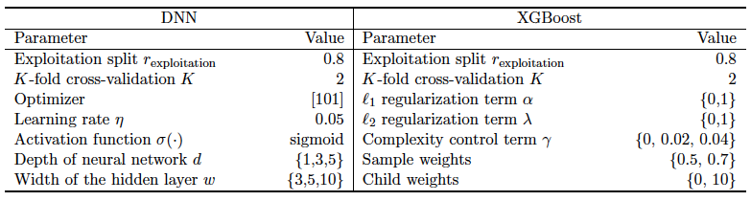
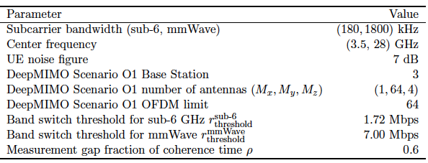
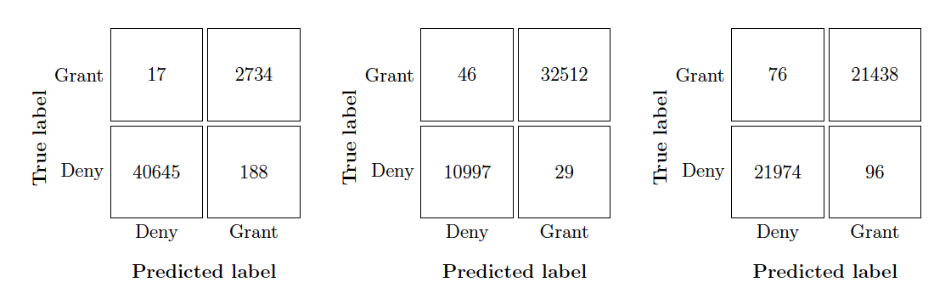
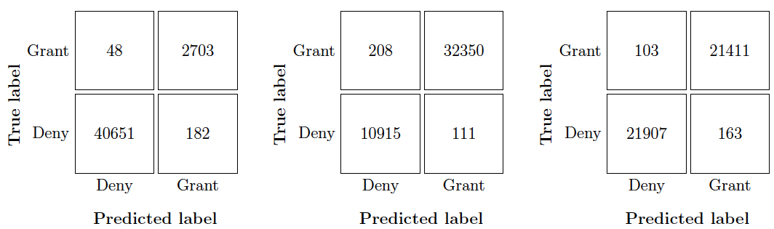
SIMULATION
Scenarios
Parameters (DNN: deep neural networks, XGBoost: Extreme Gradient Boosting)
Scenario | Users at Start
A | 100% sub-6 GHz
B | 100% mmWave
C | 70% sub-6 GHz and 30% mmWave
DNN requires a run-time of , while XGBoost requires a run-time of .
DNN depth
Number of rows in the feature matrix
DNN width
DNN outperforms XGBoost in receiver operator characteristic area and classification accuracy.
Confusion Matrix
DNN Confusion Matrix (Scenarios A, B, and C)
XGBoost Confusion Matrix (Scenarios A, B, and C)
CONTRIBUTION 3: DEEP LEARNING PREDICTIVE BAND SWITCHING

Slide 28
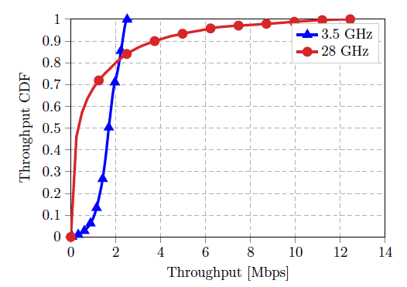
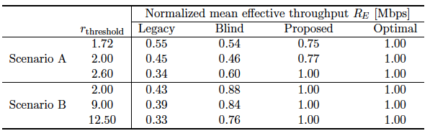
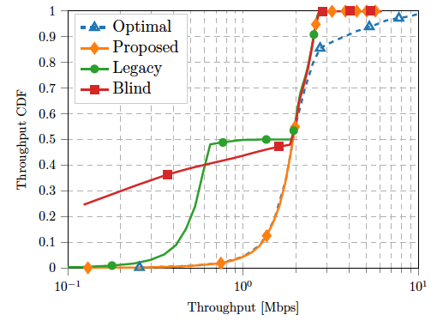
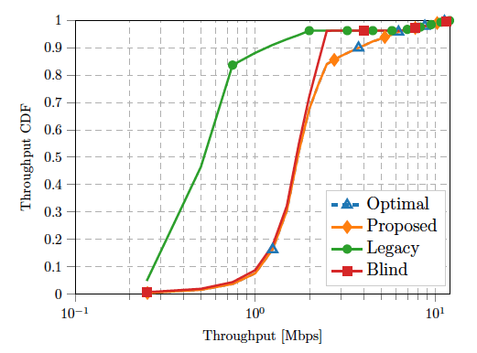
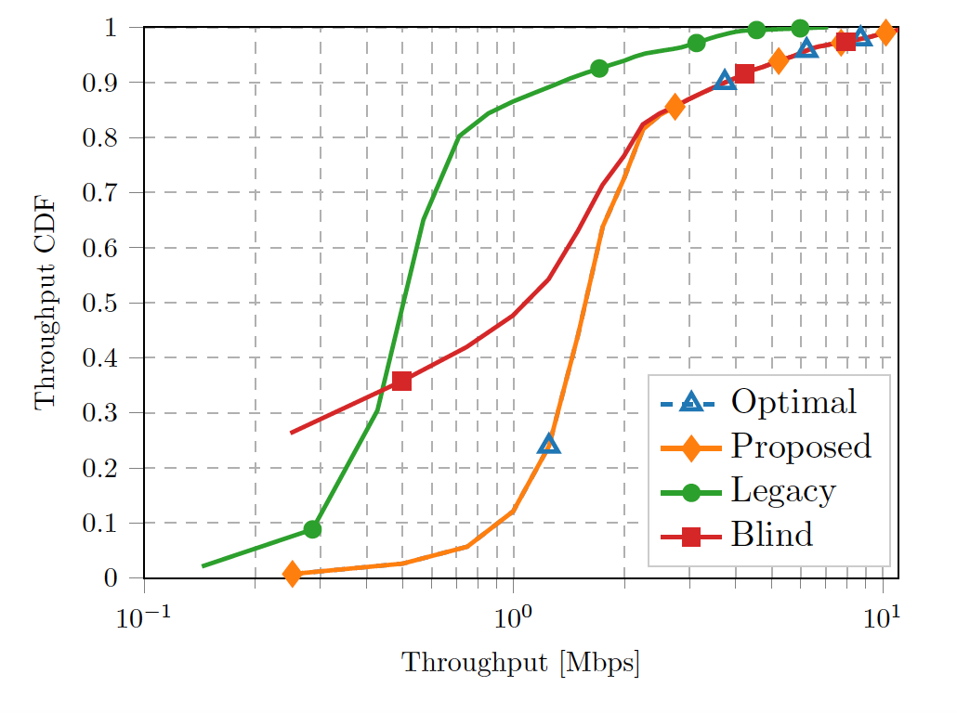
SIMULATION
Impact of the band switching threshold on the performance
Higher band switching thresholds cause the legacy approach performance to do worse.
Higher band switching thresholds enable my proposed algorithm to do even better
absence of measurement gap in optimal
… and near perfect DNN classification decisions
Scenario A: 100% users sub-6 GHz
Scenario B: 100% users mmWave
Scenario C: 30%-70% users
Legacy approach performs better than blind in low throughput regime.
CONTRIBUTION 3: DEEP LEARNING PREDICTIVE BAND SWITCHING

Slide 29
SUMMARY
Optimize users’ achievable rate
Band switching grows in importance with successive evolutions of wireless technology
The use of a data-driven approach to rank channels by their estimated quality is possible.
Using measurement gaps for the band switching procedure is a “performance overkill.”
Industry
Proposed
Use a gap to measure the candidate frequency band.
Does not require a measurement gap.
Exploits the spatial and spectral correlation of frequency bands at a given location.
Predicts the quality and ranks the bands.
Blindly switch to a different band.
Legacy
Blind
XGBoost
DNN
I disrupt the need to use a measurement gap in band switching
CONTRIBUTION 3: DEEP LEARNING PREDICTIVE BAND SWITCHING

Slide 30
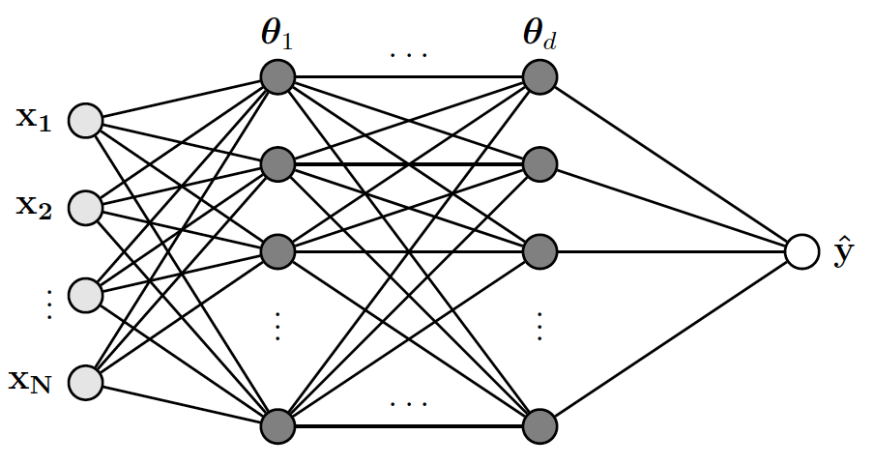
DISSERTATION SUMMARY AND CONCLUSION
Next-generation wireless networks will require intelligent predictive and prescriptive abilities
boost reliability and eliminate performance bottlenecks
disrupt reactive legacy standards
PHY Layer Perspective
Beamforming, Power Control and Interference Coordination
Intelligent Coordinated Multipoint
RRM Layer Perspective
Predictive Band Switching
CONCLUSION

Slide 31
FUTURE WORK IN DEEP LEARNING FOR COMMUNICATIONS
Optimal hybrid beamforming
I used simple DFT-based analog beamforming, but digital beamforming generates more patterns
at mmWave, a disjoint solution exists, but may not be optimal.
Exploit powers of two in the number of antennas
Improved Cell-Free Massive MIMO
Use coordinated BS capabilities with massive MIMO to improve joint-beamforming capabilities
Generalized multi-band predictive handoff
Introduce mobility over multiple base stations and build a multi-class classifier
FUTURE WORK
Notes:
Here, propose the following ideas for future work
This is the last slide.

Slide 32
PUBLICATIONS
Journal articles
Faris B. Mismar, Ahmad AlAmmouri, Ahmed Alkhateeb, Jeffrey G. Andrews, and Brian L. Evans, “Predictive Band Switching in Wireless Networks,” IEEE Transactions on Wireless Communications (submitted).
Faris B. Mismar, Brian L. Evans, and Ahmed Alkhateeb, “Deep Reinforcement Learning for 5G Networks: Joint Beamforming, Power Control, and Interference Coordination,” IEEE Transactions on Communications (submitted).
Faris B. Mismar, Jinseok Choi, and Brian L. Evans, “A Framework for Automated Cellular Network Tuning with Reinforcement Learning,” IEEE Transactions on Communications, vol. 67, no. 10, pp. 7152-7167, Oct. 2019.
Faris B. Mismar and Brian L. Evans, “Deep Learning in Downlink Coordinated Multipoint in New Radio Heterogeneous Networks,” IEEE Wireless Communications Letters, vol. 8, no. 4, pp. 1040-1043, Aug. 2019.
Conference papers
Faris B. Mismar and Brian L. Evans, “Deep Q-Learning for Self-Organizing Networks Fault Management and Radio Performance Improvement,” Proceedings of the 52nd Annual Asilomar Conference on Signals, Systems, and Computers, Oct. 2018.
Faris B. Mismar and Brian L. Evans, “Q-Learning Algorithm for VoLTE Closed-Loop Power Control in Indoor Small Cells,” Proceedings of the 52nd Annual Asilomar Conference on Signals, Systems, and Computers, Oct. 2018.
Faris B. Mismar and Brian L. Evans, “Partially Blind Handovers for mmWave New Radio Aided by Sub-6 GHz LTE Signaling,” Proceedings of IEEE International Conference on Communications Workshops, May 2018.
PUBLICATIONS
Notes:
Thank you!

Slide 33
SOFTWARE RELEASES
Available at https://github.com/farismismar
Faris B. Mismar and Brian L. Evans, “Band Switching with Deep Learning,” Python 3 code to accompany a paper entitled “Predictive Band Switching in Wireless Networks,” Version 1.0 (Sep. 28, 2019). [Online]. Available: https://github.com/farismismar/Bandswitch-DeepMIMO Builds on top of the 3.5 GHz and 28 GHz ray tracing dataset from ASU.
Faris B. Mismar and Brian L. Evans, “Deep Reinforcement Learning for 5G Networks: Joint Beamforming, Power Control, and Interference Coordination,” Python 3 code to accompany a paper entitled “Deep Reinforcement Learning for 5G Networks: Joint Beamforming, Power Control, and Interference Coordination,” Version 2.0 (Nov. 6, 2019). [Online]. Available: https://github.com/farismismar/Deep-Reinforcement-Learning-for-5G-Networks
Faris B. Mismar and Brian L. Evans, “Deep Q-Learning for SON Performance Improvement,” Python 3 and MATLAB codes to accompany a paper entitled “A Framework for Automated Cellular Network Tuning with Reinforcement Learning,” IEEE Transactions on Communications, 2019. Version 2.0 (Jun. 27, 2019). [Online]. Available: https://github.com/farismismar/Deep-Q-Learning-SON-Perf-Improvement Builds on top of Vienna University of Technology (TU Wien) Vienna LTE-A Downlink System Level Simulator v1.9.
Faris B. Mismar and Brian L. Evans, “Deep Learning in Downlink Coordinated Multipoint in New Radio Heterogeneous Networks,” Python 3 and MATLAB codes to accompany a paper entitled “Deep Learning in Downlink Coordinated Multipoint in New Radio Heterogeneous Networks,” IEEE Wireless Communications Letters, 2019. Version 2.0 (Jul. 30, 2019). [Online]. Available: https://github.com/farismismar/DL-CoMP-Machine-Learning Builds on top of Vienna University of Technology (TU Wien) Vienna LTE-A Downlink System Level Simulator v1.9.
SOFTWARE RELEASES

Slide 34
REFERENCES
[3gpp15] 3GPP, “LTE; Evolved Universal Terrestrial Radio Access (E-UTRA); Radio Resource Control (RRC); Protocol specification; Protocol specification” 3rd Generation Partnership Project, TS 36.331, Sep. 2015. [Online]. Available: http://www.3gpp.org/dynareport/36331.htm
[3gpp18] 3GPP, “LTE; Evolved Universal Terrestrial Radio Access (E-UTRA); Radio Resource Control (RRC); Protocol specification; Protocol specification” 3rd Generation Partnership Project, TS 36.331, Dec. 2018.
[Alkhateeb14] A. Alkhateeb, O. El Ayach, G. Leus, and R. W. Heath Jr., “Channel Estimation and Hybrid Precoding for Millimeter Wave Cellular Systems,” IEEE Journal of Selected Topics in Signal Processing, vol. 8, no. 5, pp. 831-846, Oct. 2014.
[Alkhateeb19] A. Alkhateeb, “DeepMIMO: A Generic Deep Learning Dataset for Millimeter Wave and Massive MIMO Applications,” Proceedings of Information Theory and Applications Workshop, Feb. 2019.
[Chen16] T. Chen and C. Guestrin, “XGBoost: A Scalable Tree Boosting System,” Proceedings of the ACM SIGKDD International Conference on Knowledge Discovery and Data Mining, Aug. 2016.
[Cortes95] C. Cortes and V. Vapnik, “Support-Vector Networks,” Machine Learning, vol. 20, no. 3, pp. 273-297, Sep. 1995.
[Goodfellow] I. Goodfellow, Y. Bengio, and A. Courville, Deep Learning, MIT Press, 2016.
[Paulraj] A. Paulraj, A. Rohit, R. Nabar, and D. Gore, Introduction to Space-Time Wireless Communications. New York, USA: Cambridge University Press, 2003.
[Silver] D. Silver, “Advanced Topics – Reinforcement Learning,” 2015. [Online]. Available: http://www0.cs.ucl.ac.uk/staff/d.silver/web/Teaching.html
[Sutton] R. Sutton and A. Barto, Reinforcement Learning. Massachusetts, USA: The MIT Press, 2002.
[Tse05] D. Tse and P. Vishwanath, Fundamentals of Wireless Communication. New York, USA: Cambridge University Press, 2005.
[Zadeh16] R. Zadeh, “The hard thing about Deep Learning,” KD Nuggets, Dec. 2016. [Online]. Available: https://www.kdnuggets.com/2016/12/hard-thing-about-deep-learning.html
[Zappone19] A. Zappone, M. Di Renzo and M. Debbah, “Wireless Networks Design in the Era of Deep Learning: Model-Based, AI-Based, or Both?,” IEEE Transactions on Communications, vol. 67, no. 10, pp. 7331-7376, Oct. 2019.
REFERENCES

Slide 35
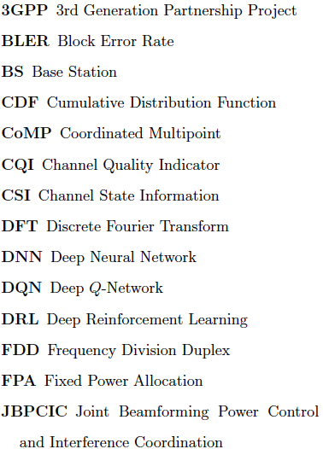
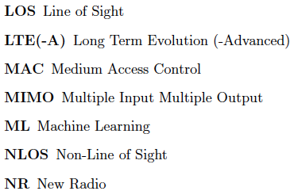
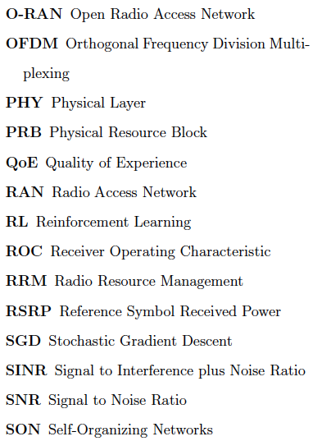
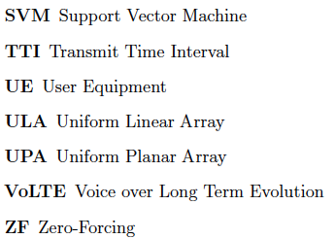
ACRONYMS AND ABBREVIATIONS

Slide 36
DISSERTATION CONTRIBUTIONS
 | 1. Joint BF, PC, IC | 2. Improved CoMP | 3. Band Switching
Dissertation Chapter | 2 | 3 | 4
Reference | [Mismar&Evans20a] | [Mismar&Evans19a] | [Mismar&Evans20b]
Frequency band | mmWave and sub-6 GHz | sub-6 GHz | mmWave and sub-6 GHz
Stack layer | PHY | PHY | RRM
Algorithm | DRL | DNN and SVM | DNN and XGBoost
Direction | Downlink
Users | Multi-User
BF: Beamforming, CoMP: Coordinated Multipoint, DNN: Deep Neural Network, DRL: Deep Reinforcement Learning, IC: Interference Coordination, PC: Power Control, PHY: Physical Layer, SON: Self-Organizing Network, XGBoost: Extreme Gradient Boosting.
DISSERTATION CONTRIBUTIONS

Slide 37
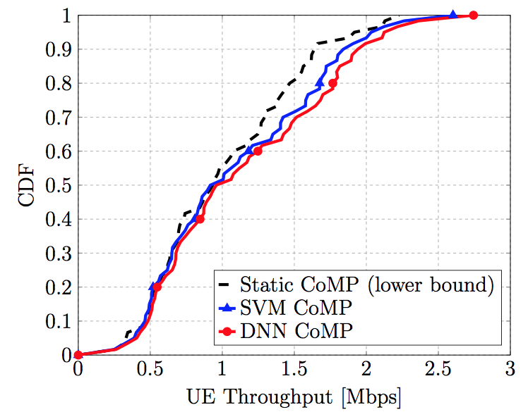
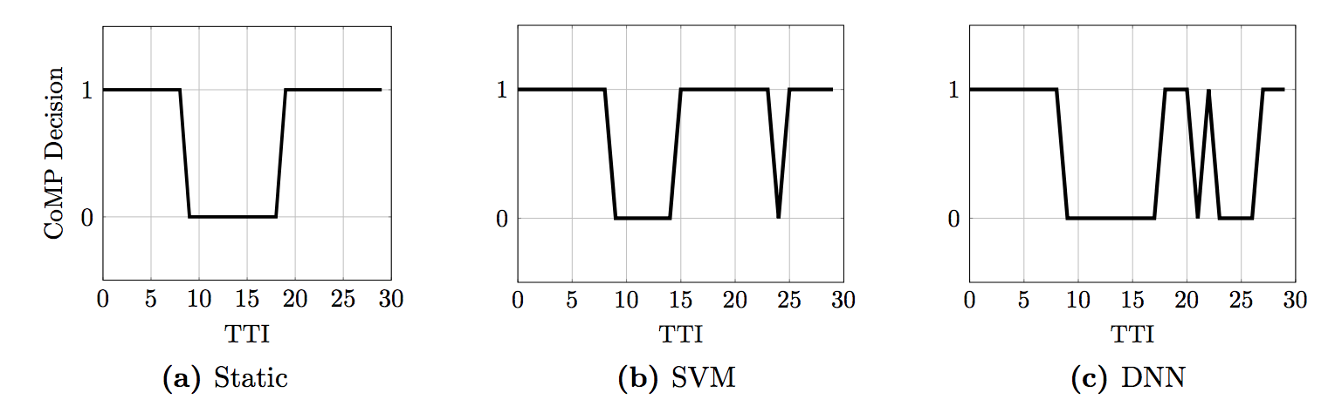
SIMULATION
CoMP: Coordinated Multipoint, DNN: Deep Neural Network, PRB: Physical Resource Block, SVM: Support Vector Machine.
CoMP decisions are “imbalanced” and DNN does better
CONTRIBUTION 2: IMPROVED DOWNLINK COORDINATED MULTIPOINT

Slide 38
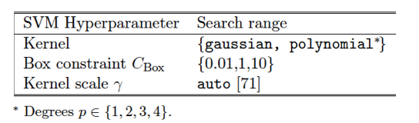
SOLUTION
Why DNN?
Support Vector Machines
m-th support vector
[Cortes95]
Kernel
“Box” constraint to control overfitting
Lagrangian multipliers
Can be faster than DNN, but suffers from bias towards majority class.
SVM will trigger more rank-2s than DNN, but at the wrong time!
Is CoMP triggered in a balanced fashion in a cell?
CONTRIBUTION 2: IMPROVED DOWNLINK COORDINATED MULTIPOINT
Notes:
Why is SVM biased towards the majority class? Hinge loss.

Slide 39
SIMULATION
AUC = 1.0
AUC ~ 1.0
Scenario A – DNN
Scenario A – XGBoost
DNN achieved ROC AUC = 1.0 with far less training samples than XGBoost

Slide 40
SUPPORT VECTOR MACHINES
Primal
hinge loss
Dual
kernel
[Cortes95]
Computationally more efficient, exploits strong duality, and enables the kernel “trick”
Notes:
Primal has wTx, which can be expensive for lengthy w. However, the kernel is sparse in nature, with few support vectors, leading to much less xTx computations.
Support vector are the points that are the nearest from the max separating hyperplane

Slide 41
XGBOOST
A tree-ensemble learning technique, which minimizes this objective function
regularization terms
number of leaves
convex loss function (e.g., logistic loss)
minimum loss reduction required to make a further partition (i.e., complexity control)
weight vector
Fast and accurate hence used in many data mining contests
Uses the sub-gradient (or derivative if differentiable) for the first (gradient) and second order (Hessian) of the objective function
Logistic loss function:
Using the gradient and Hessian, compute the “gain” for both the right and left subtrees. Choose the direction with the maximum gain.
[Chen16]

Slide 42
DEEP NEURAL NETWORKS
Perceptron
input feature vector
Non-linear activation function
bias term
perceptron weights
Deeper and wider neural networks
Feed-forward (no loops, adjusts weights )
Backpropagation (method of calculating the gradient with respect to the neural network weights)
Optimizers
Stochastic Gradient Descent
Adaptive moments “Adam”
learning rate
loss function
Uses the gradient and its second moment (i.e., gradient squared). Adapts the learning rate.
Slower execution time compared to SVM and XGBoost
[Goodfellow]

Slide 43
DEEP Q-LEARNING
Reinforcement learning
Learns through interaction with an environment
Seeks to maximize the expected future reward of an agent
Policy: defines a mapping from states to the actions taken
Stochastic
Deep Q-Network (DQN)
Experience
next state
current reward
Stored in a replay buffer
Universal approximation theorem
current state
Exploration vs exploitation
current action
Replay
Samples from prior experience (i.e., the replay buffer) to remove potential correlation and improve stability of DQN
Select a random action w.p.
Find action that maximizes w.p.
Bellman
discount rate
∊-greedy has linear “regret”
[Sutton]
[Silver]
future discounted reward

