Slide 1



Robust Transceivers to Combat Impulsive Noise in Powerline Communications
Jing Lin
Committee Members
Prof. Brian L. Evans (Supervisor)
Prof. Todd E. Humphreys
Prof. Alexis Kwasinski
Prof. Ahmed H. Tewfik
Prof. Haris Vikalo

Slide 2
Outline
Powerline Communications for Enabling Smart Grid Applications
Contributions
  Nonparametric mitigation of asynchronous impulsive noise
  Nonparametric mitigation of periodic impulsive noise
  Time-frequency modulation diversity to combat periodic impulsive noise
Conclusion
Notes:
I’ll start the presentation with an overview of the Smart Grid and powerline comm, with a focus on communication technologies. Then I’ll introduce powerline communications (or PLC), especially its promises and challenges in smart grid communications. The rest of the talk will be focused on dealing with impulsive noise, one of the primary challenges that limit the communication performance of PLC. In particular, I’ll describe the characteristics of two dominant noise components in PLC, namely asynchronous impulsive noise and periodic impulsive noise. After the introduction, I’ll go through the three contributions of the dissertation. In the first two contributions, I propose receiver methods to mitigate asynchronous impulsive noise and periodic impulsive noise, respectively. The last contribution is focused on a joint transmitter-receiver design to cope with periodic impulsive noise. I’ll conclude the dissertation at the end of the presentation.

Slide 3
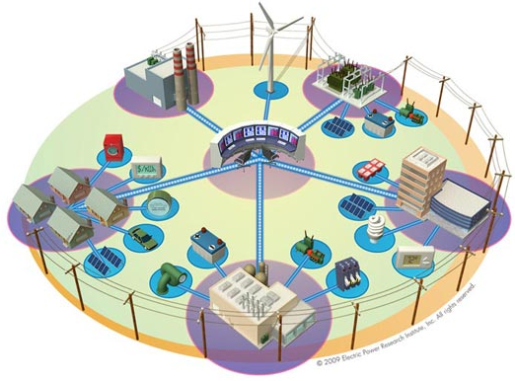
Smart Grid
Wind farm
Central power plant
HV-MV Transformer
Grid status monitoring
Utility control center
Smart metering
Integrating distributed energy resources
Homes
Offices
Device-specific billing
Building automation
Industrial sites
Notes:
The smart grid couples traditional power grids with communication networks, which enable information flow throughout the grid for better monitoring and controlling. For example, distributed energy resources, such as solar power, fuel power and other personally-owned energy storage, can be integrated to the grid to provide low-cost or standby energy during peak hours. Transducers deployed over the grids are used to collect measurement data for grid status estimation and outage detection. Smart meters can be used for time-dependent pricing, which motivates customers to scale back their energy usage during peak hours, and also device-specific billing, so that the house owner doesn’t have be pay electric bills for charging his friend’s electric vehicle. In addition, smart buildings and smart homes can be energy efficient with automated lights, air conditioners and other smart appliances.

Slide 4
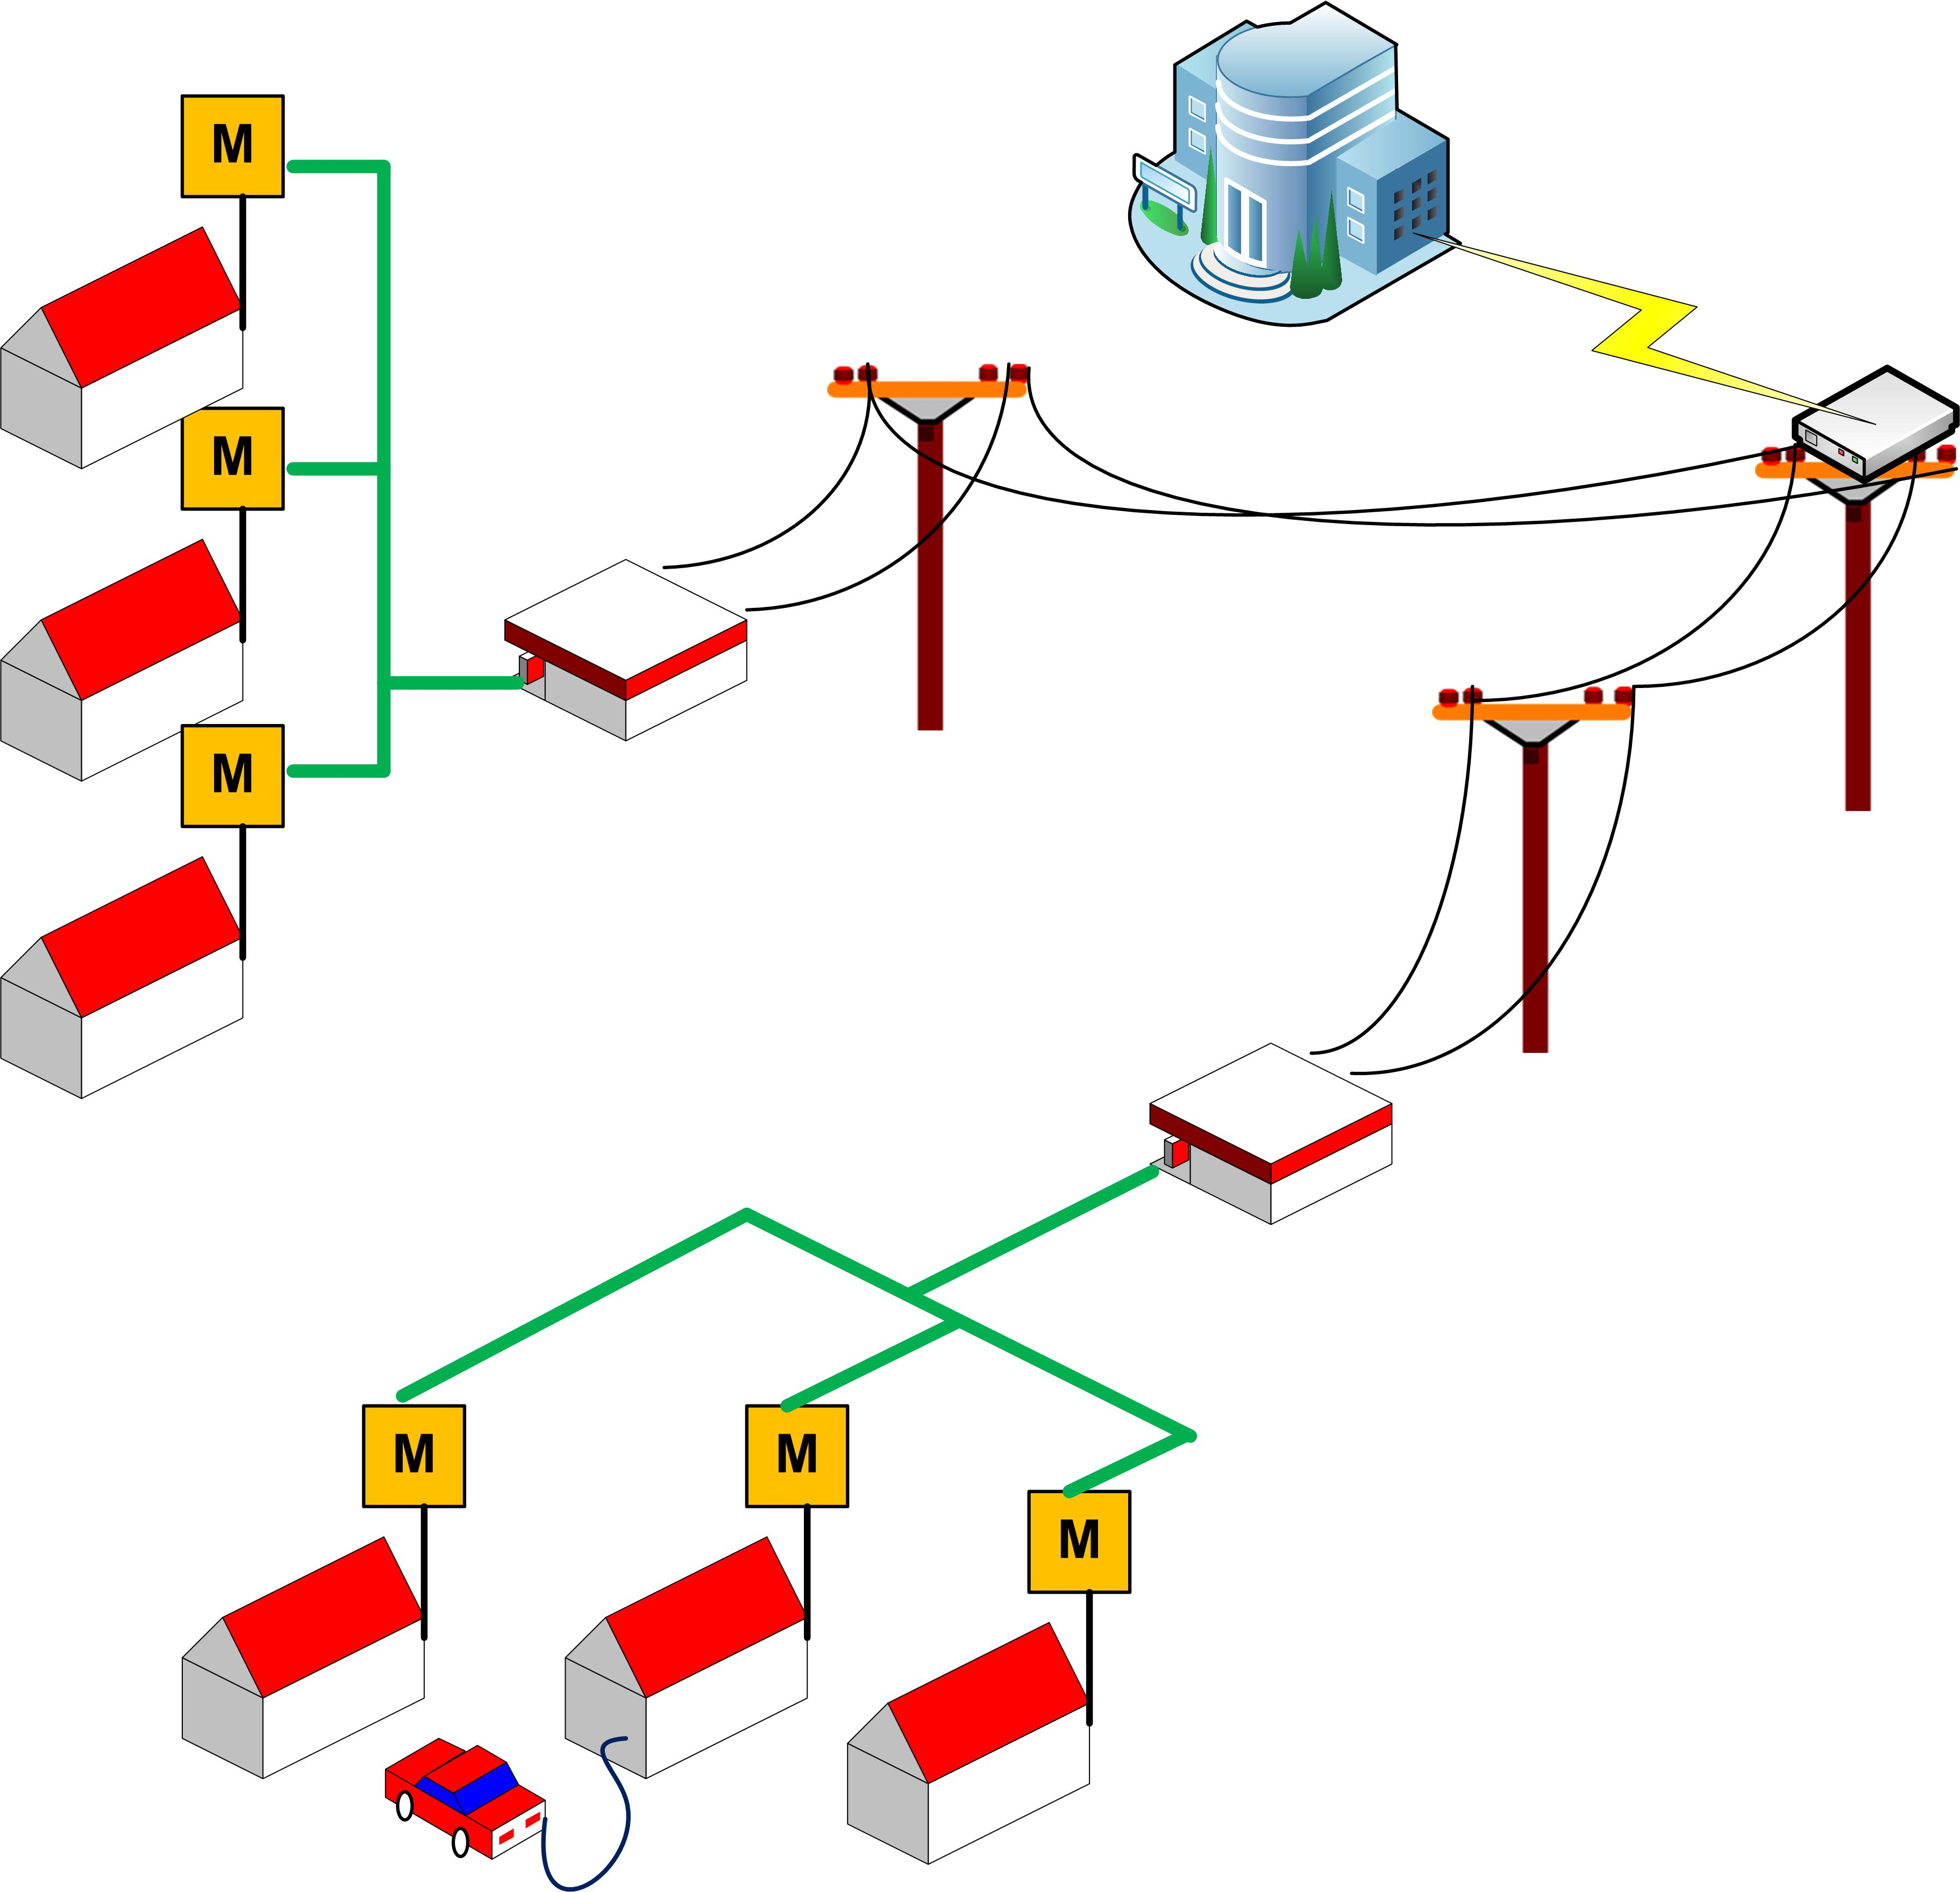
Smart Grid Communications
Local utility
Communication backhaul
Wireless / Optical
Data concentrator
Neighborhood Area Networks (NAN)
Wireless / Powerline
MV-LV Transformer
Smart meters
Home Area Networks (HAN)
Wireless / Powerline
Notes:
On the distribution side of the grids, the communications between a local utility control center and its customers plays an important role in local utility applications that I just mentioned. The local utility communicates with a number of data concentrators located at the medium-voltage lines in the US via communication backhaul. Each data concentrator is in charge of a few houses and can talk to them via the last mile communications to the smart meters. The smart meters serves as a gateway in the home area sensor networks that interconnect transducers on appliances and indoor power lines.

Slide 5
Powerline Communications (PLC)
Category | Primary Use | Band | Max Rate | Standards
Narrowband PLC | NAN | 3-500 kHz | 800 kbps | PRIME G3 ITU-T G.hnem IEEE P1901.2
Broadband PLC | HAN | 1.8-250 MHz | 200 Mbps | HomePlug ITU-T G.hn IEEE P1901
PLC systems use Orthogonal Frequency Multiplexing Division (OFDM)

Slide 6


Powerline Communications (PLC)
Low deployment cost
Static or periodically-varying channel response
Available in RF shielded environments (e.g. basements)
Significant attenuation across MV-LV transformers
Communication performance limited by impulsive noise

Slide 7
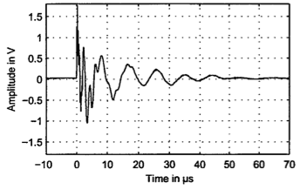
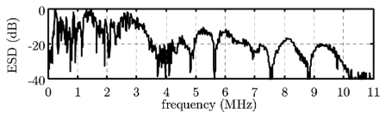
Impulsive Noise in PLC
Asynchronous impulsive noise
An impulse collected at an indoor power line
Caused by switching transients
Isolated impulses
Impulse duration | < 5 μs
Inter-arrival time | 10 μs - 100 ms
Normalized power spectral density of an impulse
Dominant in broadband PLC
Figures from [Zimmermann02, Cortes11]
Notes:
Recent field measurements have identified two dominant types of impulsive noise in PLC, one of which is called asynchronous impulsive noise. This type of noise is primarily caused by switching transients from devices or appliances connected to power lines. It takes the form of impulse trains that occur once every few ms or every few secs, depending on the disturbance environments. An impulse train consists of short duration impulses that arrive randomly with inter-arrival time ranging from10 to 30 us. An impulse raises the noise power over a wide frequency band from hundreds of kHz up to 10 MHz. In fact, asynchronous impulsive noise is the dominant noise component in broadband PLC.

Slide 8
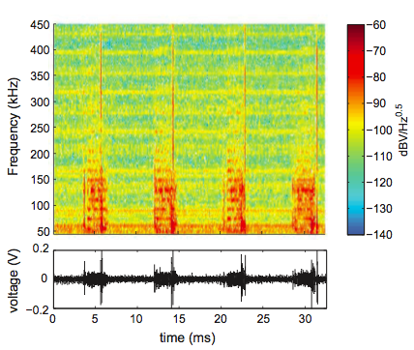
Impulsive Noise in PLC
Periodic impulsive noise
Noise collected from an outdoor LV power line
Caused by switching mode power supplies (e.g. inverters)
Synchronous to half the AC cycle
Dominant in narrowband PLC
Notes:
The other dominant noise component in PLC is periodic impulsive noise that consists of bursts and impulses that occur near the zero crossings of AC cycles. The impulsive noise power in this case can reach 30 – 50 dB higher above the background noise, over the tens to hundreds of kHz band. Therefore, periodic impulsive noise is the dominant in narrowband PLC.

Slide 9
Thesis Statement
Reliability of smart grid communications over power lines can be dramatically improved without sacrificing throughput
by exploiting sparsity and cyclostationarity of the impulsive noise
in both time and frequency domains.
Notes:
In this dissertation, I defend the statement that: …

Slide 10
Outline
Powerline Communications for Enabling Smart Grid Applications
Contributions
  Nonparametric mitigation of asynchronous impulsive noise
  Nonparametric mitigation of periodic impulsive noise
  Time-frequency modulation diversity to combat periodic impulsive noise
Conclusion
Notes:
In this talk, I’ll start with an overview of the big picture of the Smart Grid, including a variety of local utility applications and the underlying communication solutions for enabling these applications. Then I’ll introduce powerline communications (or PLC), especially its promises and challenges in smart grid communications. The rest of the talk will be focused on dealing with impulsive noise, one of the primary challenges that limit the communication performance of PLC. In particular, I’ll describe the characteristics of two dominant noise components in PLC, namely asynchronous impulsive noise and periodic impulsive noise. After the introduction, I’ll go through the three contributions of the dissertation. In the first two contributions, I propose receiver methods to mitigate asynchronous impulsive noise and periodic impulsive noise, respectively. The last contribution is focused on a joint transmitter-receiver design to cope with periodic impulsive noise. I’ll conclude the dissertation at the end of the presentation.

Slide 11
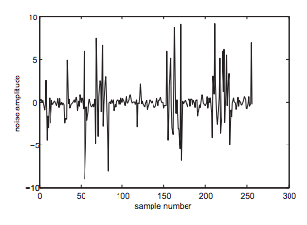
Asynchronous Impulsive Noise Modeling
 | Model | Distribution | Synthesized Noise
1st Order [Nassar11] | Gaussian Mixture
 | Middleton Class A
2nd Order [Zimmermann02] | Hidden Markov
z
- Mixing probability
samples
- Variance of Gaussian components
z
- Overlap index
- Mean intensity
samples
z
1
2
samples
Coherence time of noise statistics varies from millisecs to hours
Notes:
Two primary statistical models that capture the instantaneous amplitude of asynchronous impulsive noise are Gaussian mixture model and Middleton Class A model. A random variable is GM distributed if it’s drawn from one of K individual Gaussian distributions. The probability that it’s drawn from the k-th Gaussian distribution is pi of k. The variance of individual Gaussian distributions control the amplitude of impulses, while the mixing probabilities control how frequently the impulses occur. Middleton Class A model can be considered as an infinite term GMM, with a special form of pi k and gamma k. Similarly, the parameter A mainly controls the frequency of impulses, while omega controls the impulse amplitude.

Slide 12
Parametric vs. Nonparametric Receiver Design
Noise
Parameter Estimator
Parametric
Decoder
Decoded
bits
Received signal
 | Assume a noise model | Require training before transmission
Parametric | ✓ | ✓
Nonparametric | ✗ | ✗
Received signal
Impulsive Noise Estimator
-
Conventional Decoder
Decoded
bits
+

Slide 13
Problem Formulation
Estimate noise impulses from received signal
  Reconstruct the noise in time domain from partial observation of its spectrum
  A compressed sensing problem
Amplitude
Amplitude
Time
Frequency
Null
Data
Null
- DFT matrix; - Indices of null tones

Slide 14
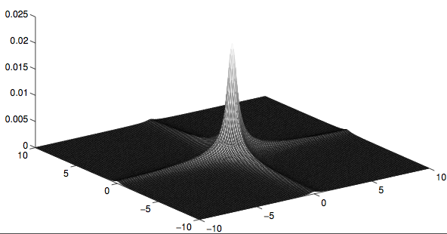
Sparse Bayesian Learning
Bayesian framework to solve compressed sensing problems [Tipping01]
Prior
Control sparsity
MAP Estimation
Expectation Maximization (EM)
Hyper-prior
IG - Inverse Gamma distribution
MAP - Maximum a posteriori

Slide 15
Proposed Impulsive Noise Estimators
Estimate noise impulses from
  Null tones
  Null tones + Data tones
  Null tones + Decision feedback
FFT
SBL
Conventional Decoder
+
-
+
-
Signal Reconstruction
-
+
SBL – Sparse Bayesian learning
FFT – Fast Fourier transform

Slide 16
Proposed vs. Prior Methods
Methods | Parametric | Nonparametric
 | MMSE [Haring03] | Basis Pursuit [Caire08] | Proposed
 |  |  | 1 | 2 | 3
SNR Gain * | 9 dB ** | 0 dB | 2 dB | 7 dB | 9 dB
BER Reduction * | >1000x | None | ~10x | ~1000x | >1000x
Throughput Reduction | ✔ | ✗ | ✗
Complexity | Low | Medium | High (Parallelizable [Nassar13])
* Measured in GM noise at 10⁻⁴ coded BER, compared with conventional OFDM receivers
** Assuming GM noise model and perfect knowledge of the model parameters

Slide 17
Outline
Powerline Communications for Enabling Smart Grid Applications
Contributions
  Nonparametric mitigation of asynchronous impulsive noise
  Nonparametric mitigation of periodic impulsive noise
  Time-frequency modulation diversity to combat periodic impulsive noise
Conclusion
Notes:
In this talk, I’ll start with an overview of the big picture of the Smart Grid, including a variety of local utility applications and the underlying communication solutions for enabling these applications. Then I’ll introduce powerline communications (or PLC), especially its promises and challenges in smart grid communications. The rest of the talk will be focused on dealing with impulsive noise, one of the primary challenges that limit the communication performance of PLC. In particular, I’ll describe the characteristics of two dominant noise components in PLC, namely asynchronous impulsive noise and periodic impulsive noise. After the introduction, I’ll go through the three contributions of the dissertation. In the first two contributions, I propose receiver methods to mitigate asynchronous impulsive noise and periodic impulsive noise, respectively. The last contribution is focused on a joint transmitter-receiver design to cope with periodic impulsive noise. I’ll conclude the dissertation at the end of the presentation.

Slide 18
Periodic Impulsive Noise Modeling
Linear periodically varying system model [Nassar12]
AWGN

Slide 19
Proposed Impulsive Noise Estimator
Time-domain interleaving spreads noise bursts into short impulses
Apply impulsive noise estimation and mitigation in Contribution I
Interleaving over half the AC cycle
Channel Equalizer
Π⁻¹
FFT
SBL
Conventional Receiver
-
+

Slide 20
Proposed vs. Prior Methods
Methods | Time-Domain Interleaving [Dweik10] | Proposed
 |  | 1 | 2 | 3
SNR Gain * | 0 dB | 0.8 dB | 4.8 dB | 6.8 dB
BER Reduction * | 1x | ~ 3x | ~ 50x | > 100x
Throughput Reduction | ✗ | ✗
Complexity | Medium | High (Parallelizable [Nassar13])
* Measured in synthesized noise at 10⁻⁴ coded BER,
compared with conventional OFDM receivers using frequency-domain interleaving

Slide 21
Outline
Powerline Communications for Enabling Smart Grid Applications
Contributions
  Nonparametric mitigation of asynchronous impulsive noise
  Nonparametric mitigation of periodic impulsive noise
  Time-frequency modulation diversity to combat periodic impulsive noise
Conclusion
Notes:
In this talk, I’ll start with an overview of the big picture of the Smart Grid, including a variety of local utility applications and the underlying communication solutions for enabling these applications. Then I’ll introduce powerline communications (or PLC), especially its promises and challenges in smart grid communications. The rest of the talk will be focused on dealing with impulsive noise, one of the primary challenges that limit the communication performance of PLC. In particular, I’ll describe the characteristics of two dominant noise components in PLC, namely asynchronous impulsive noise and periodic impulsive noise. After the introduction, I’ll go through the three contributions of the dissertation. In the first two contributions, I propose receiver methods to mitigate asynchronous impulsive noise and periodic impulsive noise, respectively. The last contribution is focused on a joint transmitter-receiver design to cope with periodic impulsive noise. I’ll conclude the dissertation at the end of the presentation.

Slide 22
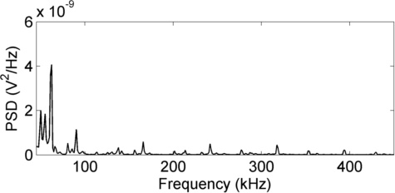
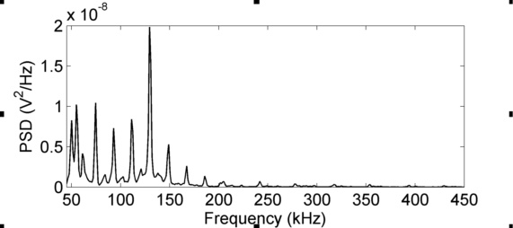
Periodically varying and spectrally shaped noise
Wideband impulses
Narrowband interferences
Sub-channel SNR is
highly frequency-selective
and time-varying
Notes:
As I’ve mentioned, periodic impulsive noise has a periodically varying and frequency selective power spectral density. In this particular example, one period of the noise consists of three stationary intervals. While one of the intervals is characterized by wideband impulses, in the other two intervals, the noise power is concentrated on a few frequency components. In other words, the noise is comprised of multiple narrowband interferences whose amplitudes and frequencies vary periodically. In an OFDM system, it indicates that the sub-channel SNR is highly frequency-selective as well as time-varying.

Slide 23
Previous vs. Proposed Transmitter Methods
 | Transmitter Methods | Throughput Reduction | Channel/Noise Info at Transmitter
Previous | Adaptive modulation [Nieman13] | ✗ | Full
 | Concatenated error correction coding (PLC standards) | ✔ | None
Proposed | Time-frequency modulation diversity | ✗ | Partial
Notes:
It was therefore proposed in a previous work to allocate the information bits non-uniformly over the time-frequency sub-channels, so that we use sub-channels with higher SNRs to convey more information, those with lower SNRs to carry less or no information. The adaptive modulation approach requires full knowledge of the channel and noise statistics at transmitter, which can be obtained from receiver feedback. In the other extreme, without any channel and noise information at transmitter, current PLC standards concatenate multiple types of error correction codes to enhance the transmission reliability. Heavy coding, however, reduces the data rates. In this contribution, I propose a time-frequency modulation diversity scheme, that exploits partial information about the channel and noise statistics to improve the reliability without reducing throughput.

Slide 24
Modulation Diversity
SNR
Sub-channels
s₁ | s₂ | s₃ | s₄ | s₅ | s₆ | s₇ | s₈ | s₉ | s₁₀ | s₁₁ | s₁₂ | s₁₃ | s₁₄ | s₁₅
X
Symbols
X
Bits
b₁ | b₂ | b₃ | b₄ | b₅ | b₆ | b₇ | b₈ | b₉ | b₁₀ | b₁₁ | b₁₂ | b₁₃ | b₁₄ | b₁₅
✔
Data rate = 1 bit / channel use
[Schober03]
Notes:
A modulation scheme maps a number of bits to symbols that are transmitted over individual sub-channels. Suppose that the target data rate is 1 bit / channel use. Conventional modulation maps each bit independently to a BPSK symbol. In this situation, a symbol that is transmitted on a low-SNR sub-channel is likely to be heavily corrupted and result in a bit error. Modulation diversity jointly maps N bits to N symbols, so that each of the symbols stores information about all the N bits. The data rate is maintained at 1 bit per channel use. More importantly, even if some of the symbols are severely corrupted, we can still recover all the related bits from the other symbols, with certain reliability.

Slide 25
Hochwald/Sweldens Code
Map N bits to a length-N codeword consisting of PSK symbols
  Special case: PSK repetition code
  Constellation mappings are optimized for channel statistics
011
100
011
110
010
010
110
110
010
111
000
111
000
111
000
101
001
001
101
101
001
100
011
100
Optimal length-3 code in Rayleigh fading channel
[Hochwald00]
Notes:
The mapping from N bits to N symbols is generally defined by a codebook. Since PSK is a mandatory modulation scheme in most narrowband PLC standards, the Hochwald/Sweldens code, which produces PSK symbols, would be a good choice. The code maps N bits to a length-N codeword consisting of PSK symbols. A special case of the code a PSK repetition code. More generally, the N symbols can be different from each other. As an example, a length-3 code optimized for Rayleigh fading or static flat channel is shown here

Slide 26
Proposed Time-Frequency Mapping
Allocate components of a codeword to time-frequency slots
Require partial noise information
  Narrowband interference width
  Burst duration
Subcarriers
…
Time-domain noise
…
…
…
OFDM symbols
Notes:
When allocating modulation diversity codewords to sub-channels, it is crucial to reduce the possibility for the entire codeword to be severely corrupted. In periodic impulsive noise, I propose a simple deterministic mapping scheme that allocates components of each codeword to designated time-frequency slots. Take a length-2 codeword for example. The 2 components in a codeword are allocated to two subcarriers that are separated apart in frequency domain. This separation is to ensure that a single narrowband interference or deep fade in channel does not affect all 2 symbols. In the time domain, the 2 components are separated by a number of OFDM symbols, so that a noise burst only corrupt one of them. The proposed mapping does not require full knowledge of the SNR profile. However, it does require information on, for example, the width of a narrowband interference, the separation between two adjacent NBIs, and burst duration of the impulsive noise.

Slide 27
Diversity Demodulation
Combine signals received from N sub-channels
Estimated sub-channel
Diversity Demodulator
Received signal
Log-likelihood ratio (LLR)
Estimated noise power
Notes:
More specifically, suppose that we map N bits to N symbols that are transmitted over N sub-channels. The diversity demodulator at receiver combines signals received from these sub-channels to produce soft decision on each bit. The soft decision is represented by a log-likelihood ratio, which indicates probability of a bit being 0 or 1. Given the channel and noise power estimation, the LLR expression can be easily derived. As it shows here, it is basically a linear combination of N decision metrics, one from each sub-channel, with the weights inversely proportional to the noise power on the sub-channel. From the expression, it is now more clear that as long as some of the N sub-channels have good SNR, we can decode the bits with considerable reliability.

Slide 28
Noise Power Estimation
Offline estimation
  Utilize silent intervals between transmissions
Semi-online estimation
  Between transmissions: Estimate start/end instances of all stationary intervals
  In transmissions: Estimate noise power spectrums
Transmission
Low
Offline
Time
Med
Semi-online
High
Workload at the noise power estimator
Notes:
To estimate the noise power spectrum in each stationary interval, a conventional approach is to measure the noise during the silent intervals between bursty transmissions. However, in a PLC network, a number of devices emit bursty transmissions in a time-division multiplexing manner, and hence the silent intervals between transmissions are typically much shorter than what’s needed for accurate estimation of the noise power spectrum. To overcome this disadvantage, I propose a semi-online algorithm that allows accurate estimation of noise power spectrums during data transmission, based on a coarse estimation between transmissions. More specifically, the coarse estimation only needs to find out the boundaries in time between different stationary intervals of the noise.

Slide 29
Proposed Semi-Online Estimation
Measure noise using cyclic prefix
Formulate a compressed sensing problem
  (where )
  Collect multiple measurements in the same stationary interval
Cyclic Prefix
OFDM symbol
Noise
-
NBI
AWGN
+
Notes:
In order to estimate the noise power spectrum during data transmission, the receiver takes a linear measurement of the noise using the cyclic prefix of an OFDM symbol. A cyclic prefix is a replica of the last few samples in the time-domain OFDM symbol. It is inserted for the purpose of reducing inter-symbol-interference and simplifying channel equalization. Suppose that the channel delay spread is L_h. After going through a linear time-invariant channel, the first L_h samples are contaminated by interference from the previous OFDM symbol, while the rest of the CP remains the same as the last few samples of the OFDM symbol. If we subtract these two segments of received signal from each other, the information bearing portion is cancelled out. The resulting signal y is the difference between two segments of noise in time domain. Furthermore, the noise can be decomposed in frequency domain into a narrowband interference component, and a low power background noise that is modeled by AWGN. Substituting the decomposition into this linear equation, we can formulate a compressed sensing problem for recovering the narrowband interference x from the measurement vector y, exploiting the sparsity of x. In addition, we can collect measurements from multiple OFDM symbols that are received in the same stationary interval, list them column by column, and formulate a multiple measurement vector model. Here X is a row sparse matrix, since each column represents a narrowband interference from the same stationary interval.

Slide 30
Proposed Semi-Online Estimation (Cont.)
Apply sparse Bayesian learning algorithm
Prior [Zhang11]
Row sparsity
Temporal correlation
EM Updates
Diversity Receiver
Hyper-prior
Slicing Error Estimation
IG - Inverse Gamma distribution; IW - Inverse Wishart distribution
EM - Expectation maximization
Notes:
I use an extended sparse Bayesian learning algorithm to solve the multiple measurement vector compressed sensing problem. To promote row sparsity in matrix X, the SBL algorithm imposes a parameterized prior on each row, using gamma_i to control the row sparsity, and a positive definite matrix B to capture temporal correlation between different columns. To allow the integration of more prior information, I propose to add a hyper-prior on the parameters gamma and B, respectively. In particular, I use the conjugate priors, inverse Gamma distribution, and inverse Wishart distribution, to ensure tractable computations. Using this hierarchical prior, and given the measurement matrix Y, we can again do a MAP estimation. Here we’re most interested in the parameters gamma and B, from which we can directly compute the noise power spectrum, and feed it into the diversity receiver. From the decoder output, we can obtain a second estimate of the noise, and use that to update the hyper-parameters in the hyper-prior.

Slide 31
Simulation Results
System parameters
Time-Frequency modulation diversity
Subcarriers
Parameters | Values
Sampling Frequency | 400 kHz
FFT Size | 256
CP Length | 30
# of Data Tones | 72
Convolutional Code | Rate 1/2, length 7
Interleaver Size | 72 bits
Packet Size | 256 Bytes
Subcarriers
…
…
…
…
…
…
…
…
…
OFDM symbols
OFDM symbols

Slide 32
Simulation Results
Length-2 code
>100x
Length-3 code
>2dB

Slide 33
Thesis Statement
Reliability of smart grid communications over power lines can be dramatically improved without sacrificing throughput
by exploiting sparsity and cyclostationarity of the impulsive noise
in both time and frequency domains.
Contribution |  | Impulsive Noise | Reliability Improvement | Throughput Reduction | Exploited Noise Properties
RX | I | Async. | 1000x | ✗ | Time-domain sparsity
 | II | Periodic | 100x | ✗ | Time-domain sparsity
TX-RX | III | Periodic | 100x | ✗ | Cyclostationarity & Frequency-domain sparsity

Slide 34
Publications
Journal Articles
J. Lin, T. Pande, I. H. Kim, A. Batra and B. L. Evans, “Time-frequency modulation diversity to combat periodic impulsive noise in narrowband powerline communications”, IEEE Trans. Comm., submitted.
J. Lin, M. Nassar, and B. L. Evans. “Impulsive noise mitigation in powerline communications using sparse Bayesian learning”, IEEE Journal on Selected Areas in Comm., vol. 31, no. 7, Jul. 2013, pp. 1172-1183.
M.Nassar, J. Lin, Y. Mortazavi, A. Dabak, I. H. Kim and B. L. Evans, “Local utility powerline communications in the 3-500 kHz band: channel impairments, noise, and standards”, IEEE Signal Processing Magazine, vol. 29, no. 5, pp. 116-127, Sep. 2012.
J. Lin, A. Gerstlauer and B. L. Evans, “Communication-aware heterogeneous multiprocessor mapping for real-time streaming systems”, Journal of Signal Proc. Systems, vol. 69, no. 3, May 19, 2012, pp. 279-291.
Conference Publications
J. Lin and B. L. Evans, “Non-parametric mitigation of periodic impulsive noise in narrowband powerline communications”, Proc. IEEE Int. Global Comm. Conf., 2013.
J. Lin and B. L. Evans, “Cyclostationary noise mitigation in narrowband powerline communications”, Proc. APSIPA Annual Summit and Conf., 2012.
J. Lin, M. Nassar, and B. L. Evans, “Non-parametric impulsive noise mitigation in OFDM systems using sparse Bayesian learning”, Proc. IEEE Int. Global Comm. Conf., 2011.
J. Lin, A. Srivatsa, A. Gerstlauer and B. L. Evans, “Heterogeneous multiprocessor mapping for real-time streaming systems”, Proc. IEEE Int. Conf. on Acoustics, Speech, and Signal Processing, 2011.

Slide 35
References
[Zimmermann02] M. Zimmermann and K. Dostert. Analysis and modeling of impulsive noise in broadband powerline communications. IEEE Trans. on Electromagn. Compat., 44(1):249–258, 2002
[Cortes10] J. A. Cortes, L. Diez, F. J. Canete, and J. J. Sanchez-Martinez. Analysis of the indoor broadband power-line noise scenario. IEEE Trans. on Electromagn. Compat., 52(4):849–858, 2010.
[Nassar11] M. Nassar, K. Gulati, Y. Mortazavi, and B. L. Evans. Statistical modeling of asynchronous impulsive noise in powerline communication networks. Proc. IEEE Global Comm. Conf., pages 1–6, 2011.
[Nassar13] M. Nassar, P. Schniter, and B. L. Evans. A factor graph approach to joint OFDM channel estimation and decoding in impulsive noise environments. IEEE Trans. on Signal Process., 2013
[Haring03] J. Haring and A. J. H. Vinck. Iterative decoding of codes over complex numbers for impulsive noise channels. IEEE Trans. on Information Theory, 49(5):1251–1260, 2003.
[Caire08] G. Caire, T.Y. Al-Naffouri, and A.K. Narayanan. Impulse noise cancellation in OFDM: an application of compressed sensing. In Proc. IEEE Int. Symp. Information Theory, pages 1293–1297, 2008.
[Tipping01] M.E. Tipping. Sparse Bayesian learning and the relevance vector machine. Journal of Machine Learning Research, 1:211–244, 2001.

Slide 36
References
[Nassar12] M. Nassar, A. Dabak, I.H. Kim, T. Pande, and B.L. Evans. Cyclostationary noise modeling in narrowband powerline communication for smart grid applications. Proc. IEEE Int. Conf. on Acoustics, Speech and Sig. Proc., pages 3089–3092, 2012.
[Dweik10] A. Al-Dweik, A. Hazmi, B. Sharif, and C. Tsimenidis. Efficient interleav- ing technique for OFDM system over impulsive noise channels. In Proc. IEEE Int. Symp. Personal Indoor and Mobile Radio Comm., 2010.
[Nieman13] K. F. Nieman, J. Lin, M. Nassar, K Waheed, and B. L. Evans. Cyclic spectral analysis of power line noise in the 3-200 kHz band. In Proc. IEEE Int. Symp. Power Line Comm. and Appl., 2013.
[Schober03] R. Schober, L. Lampe, W. H. Gerstacker, and S. Pasupathy. Modulation diversity for frequency-selective fading channels. IEEE Trans. on Info. Theory, 49(9):2268–2276, 2003.
[Hochwald00] B. M. Hochwald and T. L. Marzetta. Unitary space-time modulation for multiple-antenna communications in rayleigh flat fading. IEEE Trans. on Info. Theory, 46(2):543–564, 2000.
[Zhang11] Z. Zhang and B. D. Rao. Sparse signal recovery with temporally cor- related source vectors using sparse bayesian learning. IEEE Journal of Selected Topics in Signal Process., 5(5):912–926, 2011.

Slide 37

Thank you

