Slide 1


OPTIMIZING COMMUNICATION PERFORMANCE
OF LOW-RESOLUTION ADC SYSTEMS
WITH HYBRID BEAMFORMING
Jinseok Choi
September 10, 2019
Ph.D. Defense
The University of Texas at Austin
Embedded Signal Processing Laboratory
Wireless Networking & Communications Group
Notes:
Hi, thank you all for coming.
My name is Jinseok Choi, working with Prof. Evans mostly on wireless communications
Today, I am going to present my PhD research on ~

Slide 2



VISION FOR 5G COMMUNICATIONS
10 ms Latency
Latency < 1ms
7.2 Exabytes/Month Data Traffic
Data Traffic 50 Exabytes/Month (2021)
1 Gb/s Peak Data Rates
Peak Data Rates 20 Gb/s
4G 5G
10 Mb/s Sustainable Data Rate
Sustainable Data Rate 100 Mb/s
[2017 Qorvo Inc.]
+ Energy Efficiency
100k Connections/km² Connection Density
Connection Density 1M Connections/km²
[https://www.qorvo.com/design-hub/blog/getting-to-5g-comparing-4g-and-5g-system-requirements]
BACKGROUND
Notes:
Now, we are looking at 5G communications which requires much less latency and much larger data traffic.
It also requires higher peak data rates and about 10x sustainable data rates.
Data: 100x or 1000x increase
Latency: 15ms roundtrip -> 1ms (an order of magnitude)
Energy/cost efficiency: at least maintain on per-link basis.
MmWave
Vulnerable(susceptible) to blockage effect
Massive MIMO
Spectral efficiency [bps/Hz]
Channel smoothing - reduce randomness of small scale fading – due to law of large numbers
Quasi-orthogonal – simple tranceiver architecture

Slide 3












OVERVIEW
User devices
Millimeter wave channel
[Andrews14]
Base station (BS)
propagation paths
Multiple users
Single antenna
Low-resolution ADCs
[Pi&Khan11, Akdeniz&Rappaport14]
Many antennas (64+)
Hybrid analog/digital BF*
Low-resolution ADCs
High frequency: 30 – 300 GHz
Large bandwidth: 100MHz – 1GHz
Sparse in angular (beam) domain
Severe large scale fading (pathloss & shadowing)
User scheduling
Advanced BS design
*BF: beamforming
BACKGROUND
Notes:
Read Rappaport

Slide 4
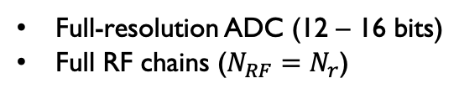
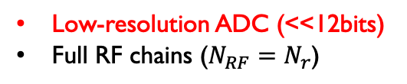
CHALLENGE IN MILLIMETER WAVE COMMUNICATION
Excessive power consumption
: caused by large number of antennas/RF components and high sampling rate of mmWave systems
Conventional Solution (A)
Conventional Solution (B)
Conventional MIMO receiver
Low-resolution ADC receiver
Hybrid beamforming receiver
Low resolution
RF chain
A
RF chain
ADC
A
ADC
RF chain
ADC
RF chain
RF chain
ADC
A
ADC
Analog
Combiner
A
A
Baseband
Combiner
Baseband
Combiner
Baseband
Combiner
. . .
RF chain
ADC
RF chain
ADC
RF chain
A
A
ADC
A
. . .
. . .
. . .
. . .
. . .
. . .
. . .
. . .
. . .
. . .
RF chain
ADC
A
RF chain
ADC
RF chain
A
ADC
A
Full-resolution ADC (12 – 16 bits)
Full RF chains ($N_{RF}=N_{r}$)
Low-resolution ADC (<<12bits)
Full RF chains ($N_{RF}=N_{r}$)
Full-resolution ADC (12 – 16 bits)
Fewer RF chains (NRF << Nr)
$$$$$
$$$
$$$
BACKGROUND
Notes:
5G Technologies
https://www.qorvo.com/design-hub/blog/getting-to-5g-comparing-4g-and-5g-system-requirements
Channel hardening
http://ma-mimo.ellintech.se/2017/01/25/channel-hardening-makes-fading-channels-behave-as-deterministic/
Millimeter wave antennas
https://www-03.ibm.com/press/us/en/photo/41229.wss
Massive MIMO antennas
http://www.ni.com/white-paper/52382/en/
Thank you,

Slide 5
LOW POWER RECEIVER ARCHITECTURE
Considered receiver (BS) architecture
Low-resolution ADC receiver
Low resolution
[Mo&Heath17]
Hybrid beamforming with low-resolution ADC receiver
RF chain
A
ADC
RF chain
ADC
Low Resolution
Sol A
A
Baseband
Combiner
RF chain
ADC
A
RF chain
ADC
. . .
. . .
. . .
A
. . .
Analog
Combiner
Baseband
Combiner
RF chain
ADC
RF chain
…
A
ADC
A
$$$
…
…
…
+
RF chain
ADC
A
Hybrid beamforming receiver
Reduced number of RF chains
+
Reduced number of ADC bits
RF chain
$$
Sol B
ADC
Analog
Combiner
A
. . .
RF chain
ADC
Baseband
Combiner
A
Problem
. . .
. . .
. . .
RF chain
Naïve combination of low-resolution ADCs and hybrid beamforming
: applying techniques for hybrid BF with perfect quantization does not work well
ADC
A
$$$
BACKGROUND
Notes:
Blindly applying

Slide 6


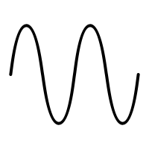





CONTRIBUTIONS
How to improve new system performance?
optimize architecture and/or technique to efficiently reduce quantization error
MAC perspective
PHY perspective
User scheduling
Resolution-adaptive ADCs
Antenna selection
Two-stage analog combiner
Contribution 1
Contribution 2
Contribution 3
Contribution 4
Analog combiner
ADC
Analog combiner
RF chain
ADC
. . .
RF chain
ADC
. . .
. . .
…
…
ADC
ADC
RF chain
Switch-based
Phase shifter-based
Optimize: set of users
Optimize: ADC bits
Optimize: analog beamformer
MAC: medium access control layer
PHY: physical layer
CONTRIBUTIONS
Notes:
To improve the performance of the new system, we need to optimize the architecture and relevant techniques to efficiently reduce quantization error.
In MAC layer, I investigated USER SCHEDULING.
In PHY layer, I developed different BS designs such as RESOLUTION-ADAPTIVE ADC RECEIVER, ANTENNA SELECTION ARCHITECTURE, AND TWO-STAGE ANALOG COMBINING RECEIVER.
The user scheduling work aimed to optimize a set of users.
The resolution-adaptive ADC work considered to optimize the number of ADC bits
and antenna selection and two-stage analog combining work considered to optimize the analog beamformer for switch-based analog networks and phase-shifter-based analog networks, respectively.
In today’s presentation, I will skip the contribution 1 and present the rest of contributions with more details. If time permits, I will also come back to contribution 1.

Slide 7
UPLINK USER SCHEDULING FOR HYBRID RECEIVERS WITH LOW-RESOLUTION ADCS
Contribution 1
Discussed in the PhD Qualifying Exam and Included in the PhD Dissertation
Related publications:
[1]. Jinseok Choi, Gilwon Lee, and Brian L. Evans, "Millimeter-Wave MIMO User Scheduling for Low-Resolution ADC Systems", IEEE Transactions on Wireless Communications, vol. 18, no. 4, pp. 2401-2414, Apr. 2019.
[2]. Jinseok Choi, and Brian L. Evans, "User Scheduling for Millimeter Wave MIMO Communications with Low-Resolution ADCs", IEEE International Conference on Communications, May 20-24, 2018, Kansas City, MO, USA.
Notes:
I can present in the closed door if committees would like to see

Slide 8
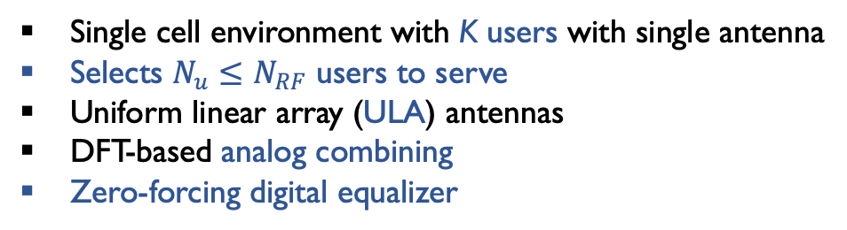

SYSTEM MODEL
Multi-user MIMO uplink system
DFT submatrix
Single cell environment with K users with single antenna
Selects $N_{u}≤N_{RF}$ users to serve
Uniform linear array (ULA) antennas
DFT-based analog combining
Zero-forcing digital equalizer
Low resolution
+
RF chain
ADC
A
RF chain
ADC
Baseband
Combiner
A
. . .
. . .
. . .
[Akdeniz&Rappaport14]
Millimeter wave channel model with limited scattering
RF chain
ADC
channel path gain
+
A
:
small Lk
sparse in beam domain
ULA
Considered receiver architecture
angle of arrival (AoA)
array response vector (ARV)
Beam domain projection by using ${ W}_{RF}$
path gains
DFT matrix
Beam domain projection:
Notations
Beam domain channel
CONTRIBUTION 1: USER SCHEDULING
Notes:
Sharif, Masoud, and Babak Hassibi. "On the capacity of MIMO broadcast channels with partial side information." IEEE Transactions on information Theory 51.2 (2005): 506-522.
Yoo, Taesang, and Andrea Goldsmith. "On the optimality of multiantenna broadcast scheduling using zero-forcing beamforming." IEEE Journal on selected areas in communications 24.3 (2006): 528-541.
Lee, Gilwon, Youngchul Sung, and Marios Kountouris. "On the performance of random beamforming in sparse millimeter wave channels." IEEE Journal of Selected Topics in Signal Processing 10.3 (2016): 560-575.

Slide 9
MOTIVATION & PROBLEM FORMULATION
Non-negligible quantization error
AWGN: minimized by previous criteria
Achievable rate of user k
(1)
(2)
AWGN
Quantization noise (QN)
QN: requires additional condition
(1), (2) cannot minimize quantization error
Maximum sum rate and fairness problems
Maximum sum rate user scheduling
set of scheduled users
beam domain channel of users in S
Proportional fairness (PF) scheduling
weight of user k at time t
indicator function
where
: first-order auto-regressive filter
regression rate parameter in (0, 1)
CONTRIBUTION 1: USER SCHEDULING
Notes:
Sharif, Masoud, and Babak Hassibi. "On the capacity of MIMO broadcast channels with partial side information." IEEE Transactions on information Theory 51.2 (2005): 506-522.
Yoo, Taesang, and Andrea Goldsmith. "On the optimality of multiantenna broadcast scheduling using zero-forcing beamforming." IEEE Journal on selected areas in communications 24.3 (2006): 528-541.
Lee, Gilwon, Youngchul Sung, and Marios Kountouris. "On the performance of random beamforming in sparse millimeter wave channels." IEEE Journal of Selected Topics in Signal Processing 10.3 (2016): 560-575.

Slide 10
NEW SCHEDUILNG CRITERIA & SIMULATIONS
Fig. 1: Rate vs. Tx power
New scheduling criteria
1. Unique *AoAs for channel paths:
index set of nonzero channel gains
2. Equal power spread within each channel:
number of nonzero channel gains for user S(k)
MS scheduling
total channel gain for user S(k)
Proposed user scheduling methods
Set Filtering
Selection
Update
Fig. 2: Rate vs. User index
Max
Sum
[Yoo&Goldsmith06]
Approximated SINR
:
Semi-orthogonality
Prop
Fair
[Lee&Sung16]
Approximated weighted rate
AR filter
:
Spatial orthogonality
PF scheduling
where
*AoA: angle of arrivals
CONTRIBUTION 1: USER SCHEDULING

Slide 11

SUMMARY
Takeaway Message
Channel structure-based scheduling
Semi-orthogonality
Maximum SINR scheduling
Channel structural scheduling criteria
Spatial orthogonality
Unique *AoAs for channel paths:
Full CSI
Chordal distance-based scheduling
Partial
Filtering
Equal power spread within each channel:
Selection
Sum rate analysis
CONTRIBUTION 1: USER SCHEDULING

Slide 12
BIT ALLOCATION FOR HYBRID BEAMFORMING RECEIVERS WITH RESOLUTION-ADAPTIVE ADCS
Contribution 2
Discussed in the PhD Qualifying Exam and Included in the PhD dissertation
Related publications:
[1]. Jinseok Choi, Brian L. Evans, and Alan Gatherer, "Resolution-Adaptive Hybrid MIMO Architectures for Millimeter Wave Communications", IEEE Transactions on Signal Processing, vol. 65, no. 23, pp. 6201-6216, Dec. 2017.
[2]. Jinseok Choi, Brian L. Evans, and Alan Gatherer, "ADC Bit Allocation under a Power Constraint for MmWave Massive MIMO Communication Receivers", Proc. IEEE Int. Conf. on Acoustics, Speech and Signal Processing, Mar. 5-9, 2017, New Orleans, LA, USA.
[3]. Jinseok Choi, Junmo Sung, Brian L. Evans, and Alan Gatherer, "ADC Bit Optimization for Spectrum- and Energy-Efficient Millimeter Wave Communications", IEEE Global Communications Conf., Dec. 4-8, 2017, Singapore.

Slide 13
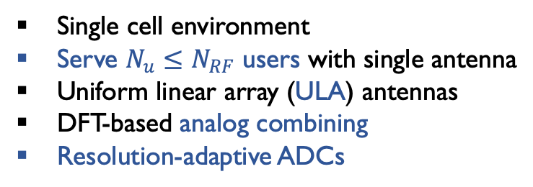

SYSTEM MODEL
Multi-user MIMO uplink system
DFT submatrix
Single cell environment
Serve $N_{u}≤N_{RF}$ users with single antenna
Uniform linear array (ULA) antennas
DFT-based analog combining
Resolution-adaptive ADCs
Resolution adaptive
+
RF chain
ADC
A
RF chain
ADC
Baseband
Combiner
A
. . .
. . .
. . .
[Akdeniz&Rappaport14]
Millimeter wave channel model with limited scattering
RF chain
ADC
large scale fading gain
channel path gain
+
A
:
small Lk
sparse in beam domain
ULA
Considered receiver architecture
angle of arrival (AoA)
array response vector (ARV)
Beam domain projection by using ${ W}_{RF}$
path gains
DFT matrix
Beam domain projection:
Notations
Beam domain channel
CONTRIBUTION 2: ADAPTIVE ADC
Notes:
Sharif, Masoud, and Babak Hassibi. "On the capacity of MIMO broadcast channels with partial side information." IEEE Transactions on information Theory 51.2 (2005): 506-522.
Yoo, Taesang, and Andrea Goldsmith. "On the optimality of multiantenna broadcast scheduling using zero-forcing beamforming." IEEE Journal on selected areas in communications 24.3 (2006): 528-541.
Lee, Gilwon, Youngchul Sung, and Marios Kountouris. "On the performance of random beamforming in sparse millimeter wave channels." IEEE Journal of Selected Topics in Signal Processing 10.3 (2016): 560-575.

Slide 14
MOTIVATION & PROBLEM FORMULATION
Selective bit allocation
Sparse beam domain mmWave channel
ex.
1 bit
2 bits
3 bits
more bits
fewer quantization bits
to smaller channel gain
ADC
less bits
ADC
More quantization bits
to larger channel gain
ADC
maintain similar quantization error over all ADCs
Minimizing quantization error
[Gersho&Gray12]
Mean squared quantization error (MSQE)
quantized desired signal
quantization bits
desired signal
Relaxed minimum MSQE problem in high SNR
Convex optimization
real number relaxation
: ADC total power constraint
CONTRIBUTION 2: ADAPTIVE ADC

Slide 15

BIT ALLOCATION SOLUTION & SIMULATIONS
Fig. 3: Rate vs. Constraint bits
Near optimal bit allocation (solution for $𝒫1$)
Minimizes total MSQE in high SNR
associated channel gain
: more bit to larger channel
channel gain for all RF chains
Minimizes generalized mutual information in low SNR
Worst case analysis
Approximated lower bound of achievable rate
Fig. 4: Energy efficiency vs. Constraint bits
where
System parameters
[Akdeniz&Rappaport14]
Cell radius | 200 m | Noise figure | 5 dB | # User | 8
Min. distance | 30 m | Equalizer | MRC | Tx power | 20 dBm
Carrier freq. | 28 GHz | # Antennas | 256
Bandwidth | 1 GHz | # RF chains | 128
CONTRIBUTION 2: ADAPTIVE ADC
Notes:
In this work, I focused on optimizing the ADC resolutions.
In the following two contributions, I focus on optimizing analog beamformer: one with switch-based, the other with phase-shifter based.
Show fig 3 first and show fig 4 later.

Slide 16
SUMMARY
Adaptive Bit Allocation
DFT submatrix
Resolution adaptive
Main assumption
+
RF chain
ADC
A
ADC changes its resolution depending on channel
RF chain
ADC
Baseband
Combiner
A
. . .
Main results
. . .
. . .
RF chain
ADC
Resolution-adaptive ADC with bit-allocation solution
ULA
+
A
path gains
High SNR: minimizes mean squared quantization error
Low SNR: maximizes generalized MI
Performance analysis: lower bound
ex.
1 bit
2 bits
3 bits
ADC
Takeaway Message
ADC
Selective bit allocation achieves high SE* and EE*
ADC
maintain similar quantization error over all ADCs
*SE: spectral efficiency
*EE: energy efficiency
CONTRIBUTION 2: ADAPTIVE ADC
Notes:
In this work, I focused on optimizing the ADC resolutions.
In the following two contributions, I focus on optimizing analog beamformer: one with switch-based, the other with phase-shifter based.
Show fig 3 first and show fig 4 later.

Slide 17
BASE STATION ANTENNA-SELECTION FOR LOW-RESOLUTION ADC SYSTEMS
Contribution 3
Partially Discussed in the PhD Qualifying Exam
Related publications:
[1] Jinseok Choi, Junmo Sung, Narayan Prasad, Xiao-Feng Qi, Brian L. Evans, and Alan Gatherer, "Base Station Antenna Selection for Low-Resolution ADC Systems", IEEE Transactions on Communications (submitted).
[2] Jinseok Choi, Brian L. Evans, and Alan Gatherer, "Antenna Selection for Large-Scale MIMO Systems with Low-Resolution ADCs", IEEE Int. Conf. on Acoustics, Speech, and Signal Processing, Apr. 15-20, 2018, Calgary, Alberta, Canada,

Slide 18
MOTIVATION & UPLINK SYSTEM MODEL
Switch-based analog beamforming
[Méndez-Rial16]
Lower implementation cost and complexity compared to phase shifters
Moderate performance in reducing the number of RF chains with small loss
[Gao15]
New design/analysis is necessary due to coarse quantization
Uplink system model
NMS users are equipped with single antenna
BS selects antenna subset with known CSI
BS employs low-resolution ADCs
Narrowband channel assumption
Switch-based
quantization error
Analog combiner
Mobile station 1
RF chain
ADC
RF chain
Baseband
Processor
. . .
RF chain
ADC
H
. . .
. . .
. . .
. . .
…
Mobile station NMS
RF chain
Baseband
Processor
RF chain
ADC
Considered uplink communication
CONTRIBUTION 3: ANTENNA SELECTION
Notes:
ADD ARROWS IN MS

Slide 19
PROBLEM FORMULATION
[Fletcher07]
Mutual information with selected antennas under additive quantization noise model (AQNM)
set of selected antennas
quantization noise covariance matrix
Uplink maximum mutual-information problem
Maximum mutual-information selection for narrowband system
Challenges
(1) Large number of antennas at BS*: Exhaustive search (X) vs. Greedy search (O)
(2) Greedy is suboptimal: performance bound is necessary
*BS: base station
CONTRIBUTION 3: ANTENNA SELECTION
Notes:
Sharif, Masoud, and Babak Hassibi. "On the capacity of MIMO broadcast channels with partial side information." IEEE Transactions on information Theory 51.2 (2005): 506-522.
Yoo, Taesang, and Andrea Goldsmith. "On the optimality of multiantenna broadcast scheduling using zero-forcing beamforming." IEEE Journal on selected areas in communications 24.3 (2006): 528-541.
Lee, Gilwon, Youngchul Sung, and Marios Kountouris. "On the performance of random beamforming in sparse millimeter wave channels." IEEE Journal of Selected Topics in Signal Processing 10.3 (2016): 560-575.

Slide 20


UPLINK BS ANTENNA SELECTION METHOD
Decomposition of mutual information
At $(n+1)$th antenna selection stage
# Generalized greedy selection criterion
gain
tradeoff
penalty
matrix determinant lemma
Computational complexity reduction
Matrix inversion in gain computation
# Simplified gain update
vector inner product
matrix inversion lemma
reuse previous gain
where
Quantization-aware fast antenna selection (QFAS)
scalar
CONTRIBUTION 3: ANTENNA SELECTION
where

Slide 21
PERFORMANCE ANALYSIS: LOWER BOUND
Submodular function
Definition
Function with diminishing return property :
Theorem
(Lower bound)
[Nemhauser78]
Normalized nonnegative and monotone submodular function f
: set obtained by selecting one at a time with largest marginal increase
: optimal set with same size as
# Lower bound of f with
Performance lower bound of proposed greedy selection
Corollary 1 (Lower bound of QFAS)
Mutual information achieved by proposed greedy-based antenna selection is lower bounded by
optimal antenna subset
Proof sketch
Define
Use submodularity of entropy function w.r.t. selected antennas
Show submodular, normalized, nonnegative, and monotone function
and
CONTRIBUTION 3: ANTENNA SELECTION
Notes:
e: Euler's number
G. L. Nemhauser, L. A. Wolsey, and M. L. Fisher, An analysis of approximations for maximizing submodular set functions

Slide 22
WIDEBAND UPLINK ANTENNA SELECTION
Uplink wideband OFDM* system
[Fletcher07]
Quantized signal for subcarrier n under AQNM*
Frequency domain channel
quantization gain < 1
thermal noise + quantization noise
Mutual-information for subcarrier n
Quantization noise variance
Greedy antenna selection and performance bound
Maximum mutual-information problem for OFDM system
all subcarriers share same antenna subset
Simplified greedy antenna selection method without matrix inversion
Corollary 2 (Lower bound of QFAS)
gain update w/o matrix inversion
Proof: submodularity is closed under addition
*OFDM: orthogonal frequency-division multiplexing
*AQNM: additive quantization noise model
CONTRIBUTION 3: ANTENNA SELECTION

Slide 23
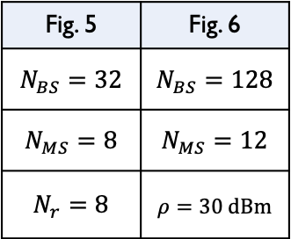
SIMULATION RESUTLS: UPLINK OFDM SYSTEM
Fig. 5: MI vs. Tx power
Simulated algorithms
QFAS: quantization-aware fast antenna selection (proposed)
FAS: fast antenna selection without quantization
NBS: norm-based selection
QMCMC-AS: quantization-aware adaptive-MCMC* based on MIS*
- Near numerical upper bound
- High complexity: iterations with multiple sampling (ex. 60, 120)
System parameters
[Akdeniz&Rappaport14]
Fig. 6: MI vs. # selected antennas
Cell radius | 200 m | Noise figure | 5 dB
Min. distance | 20 m | # channel paths | 3
Carrier freq. | 28 GHz | # channel delay taps | 4
Bandwidth | 100MHz | # subcarriers | 64
BS antenna gain | 15 dBi | # ADC bits | 3
Fig. 5 | Fig. 6
$$N_{BS}=32$$ | $$N_{BS}=128$$
$$N_{MS}=8$$ | $$N_{MS}=12$$
$$N_{r}=8$$ | $$ρ=30 dBm$$
Effective in low-resolution ADC system with high performance
*MCMC: Markov chain Monte Carlo
*MIS: metropolized independence sampler
CONTRIBUTION 3: ANTENNA SELECTION
Notes:
M. R. Akdeniz, Y. Liu, M. K. Samimi, S. Sun, S. Rangan, T. S. Rappaport, and E. Erkip, “Millimeter wave channel modeling and cellular capacity evaluation,” IEEE Journal Sel. Areas in Comm., vol. 32, no. 6, pp. 1164–1179, 2014.

Slide 24
DOWNLINK BS ANTENNA SELECTION
System model
Base station
Zero-forcing (ZF) precoder with CSI known at BS
Equal power allocation (EPA)
Users employ low-resolution ADCs
Achievable sum rate:
ZF Precoding
+
equal power allocation
Mobile station 1
RF chain
RF chain
Baseband
Processor
ADC
A
RF chain
. . .
. . .
Tx symbol power
. . .
. . .
. . .
Mobile station NMS
RF chain
RF chain
ADC
Baseband
Processor
A
Low resolution
set of selected antennas
Considered downlink communication
Antenna selection problem
Maximum rate antenna selection problem
total transmit power
: needs to be large and orthogonal
Equivalent to antenna selection in perfect quantization system
CONTRIBUTION 3: ANTENNA SELECTION

Slide 25


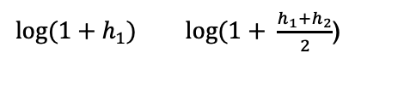
SUM RATE ANALYSIS
How many antennas?
More antennas do not always provide higher rate due to limited transmit power
# In perfect quantization system $b=∞$
[Lin&Tsai12]
: higher maximum rate with more antennas for ZF precoding with equal power allocation
# In coarse quantization system $b≠∞$
Corollary 3 (Monotonicity)
Theorem 1
Higher rate with more antennas for ZF-EPA*
Higher maximum rate with more antennas for ZF-EPA
Proof sketch
(a) Define where and
(b) Show by using matrix inversion lemma and [Lemma 2, Lin&Tsai12]
(c) Show where and
from (a), (b)
*ZF-EPA: zero-forcing precoding and equal power allocation
CONTRIBUTION 3: ANTENNA SELECTION
h1
Tx
h2
Rx
<
>
$log⁡(1+h_{1})$ $log⁡(1+ \frac{h_{1}+h_{2}}{2}$)
Notes:
Less number of antennas = fewer antennas

Slide 26

SUM RATE ANALYSIS
How much transmit power?
More power provides higher rate, but maybe less efficient
# In perfect quantization system $b=∞$
[Lin&Tsai12]
: rate loss increases with tx power and upper bounded by
matrix of channel eigenvalues
where
and
# In coarse quantization system $b≠∞$
Corollary 4 (Vanishing loss)
Corollary 5 (Maximum loss)
Rate loss converges to zero with tx power:
Maximum rate loss occurs at following tx power:
Tx power can compensate for rate loss due to using less antennas
can be good reference point
Similar analysis also holds for downlink OFDM systems
CONTRIBUTION 3: ANTENNA SELECTION
Notes:
.-H. Lin and S.-H. Tsai, Performance analysis and algorithm designs for transmit antenna selection in linearly precoded multiuser MIMO systems,
Why less efficient
Inter-cell-interference
Slower increase in rate
Tradeoff between tx power and # selected antennas need to be investigated (future work)

Slide 27
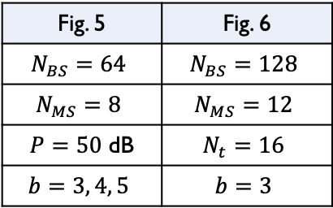
SIMULATION RESUTLS: DOWNLINK OFDM SYSTEM
System parameters
[Akdeniz&Rappaport14]
Fig. 7: Rate vs. # selected antennas
Fig. 8: Rate vs. Tx power
Cell radius | 200 m
Min. distance | 20 m
Carrier freq. | 28 GHz
Bandwidth | 100MHz
BS antenna gain | 15 dBi
Noise figure | 5 dB
# channel paths | 3
# channel delay taps | 4
# subcarriers | 64
higher rate
less gap
lower rate
less gap
Validations
Fig. 5 | Fig. 6
$$N_{BS}=64$$ | $$N_{BS}=128$$
$$N_{MS}=8$$ | $$N_{MS}=12$$
$P=50$ dB | $$N_{t}=16$$
$$b=3, 4, 5$$ | $$b=3$$
Non-decreasing property w.r.t number of selected antennas Nt
Presence of maximum rate loss and rate convergence
More antennas vs. more tx power
CONTRIBUTION 3: ANTENNA SELECTION

Slide 28
SUMMARY
Uplink BS antenna selection
Downlink BS antenna selection
Main assumption
Main assumption
BS selects rx antenna subset depending on channels
BS selects tx antenna subset depending on channels
Main results
Main results
Algorithm
Equivalent problem to perfect quantization
Performance lower bound
Monotonicity
Max loss
Extension to wideband OFDM system
Extension to wideband OFDM system
Takeaway Message
Takeaway Message
Quantization error needs to be considered
More antennas always provide higher rate
Greedy choice is suboptimal but efficient
Tx power can fully compensate reduced # antennas
CONTRIBUTION 3: ANTENNA SELECTION

Slide 29
TWO-STAGE ANALOG COMBINING IN HYBRID BEAMFORMING SYSTEMS WITH LOW-RESOLUTION ADCS
Contribution 4
Related publications:
[1]. Jinseok Choi, Gilwon Lee, and Brian L. Evans, "Two-Stage Analog Combining in Hybrid Beamforming Systems with Low-Resolution ADCs", IEEE Transactions on Signal Processing, vol. 67, no. 9, pp. 2410-2425, May 1, 2019
[2]. Jinseok Choi, Gilwon Lee, and Brian L. Evans, "A Hybrid Combining Receiver with Two-Stage Analog Combiner and Low-Resolution ADCs", IEEE Int. Conf. on Communications, 2019, pp. 1-6. doi: 10.1109/ICC.2019.8761780

Slide 30
MOTIVATION
Optimal analog combiner design
If feasible, is SVD* analog combiner optimal?
large gain
quantization error
# In perfect quantization system: Yes!
RF chain
ADC
SVD
combiner
A
: collects all of the channel gains onto reduced number of RF chains
RF chain
A
…
ADC
…
…
# In coarse quantization system: Maybe not..
RF chain
ADC
A
: too large signal power experiences large quantization error
Fig. 9: Signal power on each RF chain
large quantization error
Fig. 10: Mutual information vs. SNR
128 Rx antennas
16 RF chains
8 users
Proposed analog combining
proposed
Optimal analog combining
SVD analog combining
SVD upper bound
desired signals
large gap
SVD
small quantization error
noise components
*SVD: singular value decomposition
CONTRIBUTION 4: TWO-STAGE COMBINING
Notes:
SVD: No penalty in using reduced number of RF chains in perfect quantization system

Slide 31
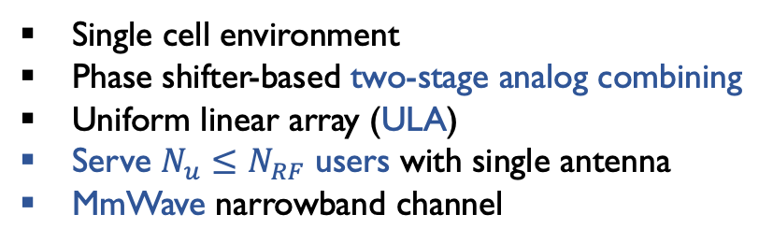
SYSTEM MODEL & PROBLEM FORMULATION
Proposed two-stage analog combining architecture
ULA
1st Analog Combiner
Single cell environment
Phase shifter-based two-stage analog combining
Uniform linear array (ULA)
Serve $N_{u}≤N_{RF}$ users with single antenna
MmWave narrowband channel
2nd Analog Combiner
+
RF chain
ADC
+
…
A
…
Baseband
Combiner
RF chain
ADC
…
…
…
…
A
[Akdeniz&Rappaport14]
…
…
…
…
channel path gain
…
…
RF chain
ADC
+
+
A
…
angle of arrival
Low Resolution
array response vector (ARV)
Maximizing mutual information
Covariance matrix of quantization noise
Mutual information
Analog combiner
: key role in changing quantization distribution
Relaxation: no constant modulus constraint on elements of analog combiner matrix
Relaxed maximum mutual-information problem
CONTRIBUTION 4: TWO-STAGE COMBINING

Slide 32
OPTIMAL SCALING LAW & TWO-STAGE SOLUTION
Optimal scaling law with respect to number of RF chains NRF
Theorem 2 (Optimal scaling law)
Optimal solution to achieves following scaling law w.r.t. number of RF chains:
Optimal scaling law can be also achieved by using following two-stage combiners:
: SVD combiner
: any NRF x NRF unitary matrix with constant modulus
Intuition
1. project on lower dimension
2. Spread evenly
signals
…
1
2
A
A
Moderate and even
quantization noise distribution
A
A
A
RF chains
ADCs
CONTRIBUTION 4: TWO-STAGE COMBINING
Notes:
PADC : Power [Watts] = energy/unit time (Joules / sec)
Gersho, Allen, and Robert M. Gray. Vector quantization and signal compression. Vol. 159. Springer Science & Business Media, 2012.

Slide 33
BOUNDED MI FOR CONVENTIONAL OPTIMAL SOLUTION
Mutual information achieved by SVD analog combining
Corollary 6 (Upper bound for SVD analog combining)
MI for conventional optimal solution for perfect quantization systems is bounded by
Proof
matrix of channel eigenvalues
:
collects all channel gains:
Nu eigenvalues
:
increases effective quantization noise:
large gains on a few ADCs
Quantization error term
Second analog combiner WRF2 in Theorem 2 addresses quantization noise enhancement
CONTRIBUTION 4: TWO-STAGE COMBINING
Notes:
Zhang, Wenyi. "A general framework for transmission with transceiver distortion and some applications." IEEE Transactions on Communications 60.2 (2012): 384-399.

Slide 34
MAXIMUM MUTUAL INFORMATION – SPECIAL CASE
Maximizing MI for special case: homogeneous channel singular values
Theorem 3 (Maximum Mutual Information)
Two-stage analog combining solution in Theorem 2, , is solution for:
and achieves maximum mutual information:
: achieves optimal scaling
Proof sketch
(a) Show is upper bounded by
(b) Then,
(c) Find upper bound of C(WRF) by using Jensen’s inequality with (b)
(d) Show upper bound of C(WRF) can be achieved with by replacing in Proof of Theorem 2
CONTRIBUTION 4: TWO-STAGE COMBINING

Slide 35
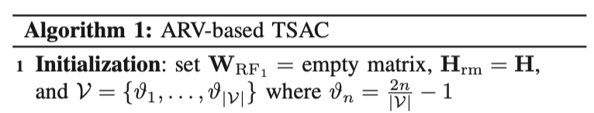
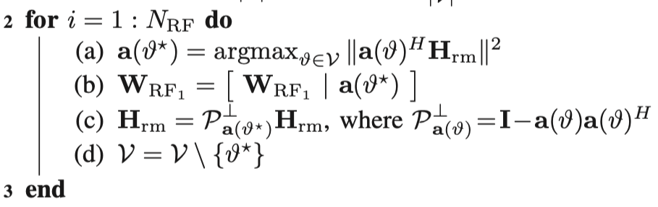

TWO-STAGE ANALOG COMBINING ALGORITHM
Implementation of two-stage analog combiner under practical constraints
Key constraints: (1) Constant modulus condition on elements of analog combining matrix
(2) Finite resolution of phase shifters
First analog combiner
Closely meets first condition in Theorem 2
: left eigenvectors (channel gain aggregation)
: AoA codebook
ARVs collect most sparse beam-domain channel gain
1st analog combiner
Second analog combiner
: capture max channel gain
Perfectly meets second condition in Theorem 2
: unitary with constant modulus (spreading)
: null space projection (for orthogonality)
DFT matrix or Hadamard matrix can be used
2nd analog combiner
Low cost; negligible power consumption once configured
: independent to channel condition
implemented with fixed phase shifters
Two-stage analog combining architecture provides favorable structure for implementation
*ARV: array response vector
*TSAC: two-stage analog combiner
CONTRIBUTION 4: TWO-STAGE COMBINING
Notes:
Zhang, Wenyi. "A general framework for transmission with transceiver distortion and some applications." IEEE Transactions on Communications 60.2 (2012): 384-399.

Slide 36
PERFORMANCE ANALYSIS
Ergodic rate of ARV-TSAC method with maximum ratio combining (MRC)
Two-stage analog combining
Theorem 4 (Ergodic rate of two-stage combining)
For MRC digital combining, ergodic rate of ARV-TSAC is approximated as
where
: achieves optimal scaling
One-stage analog combining
Corollary 7 (Ergodic rate of one-stage combining)
For MRC digital combining, ergodic rate of one-stage analog combining is approximated as
where
: cannot achieve optimal scaling
Two-stage analog combining achieves optimal scaling law with linear receiver
CONTRIBUTION 4: TWO-STAGE COMBINING
Notes:
Zhang, Wenyi. "A general framework for transmission with transceiver distortion and some applications." IEEE Transactions on Communications 60.2 (2012): 384-399.

Slide 37
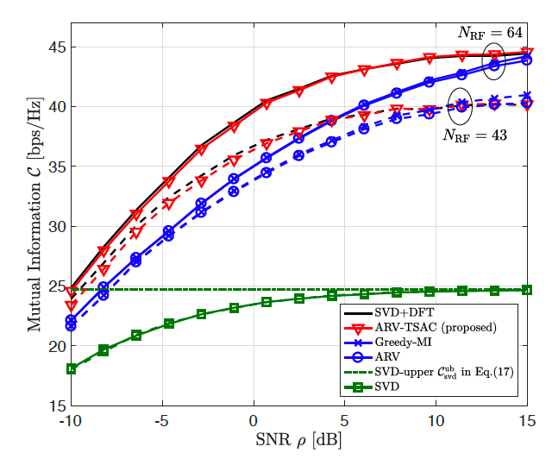
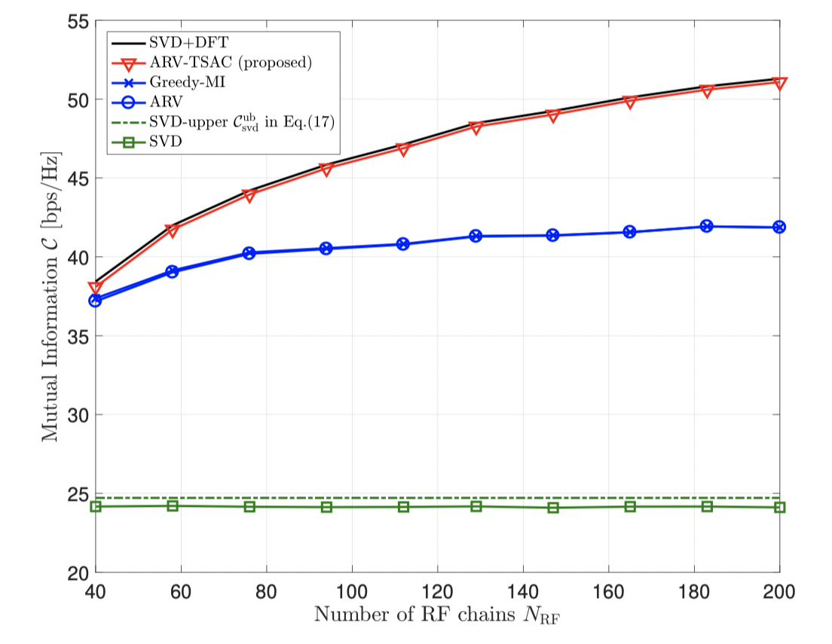
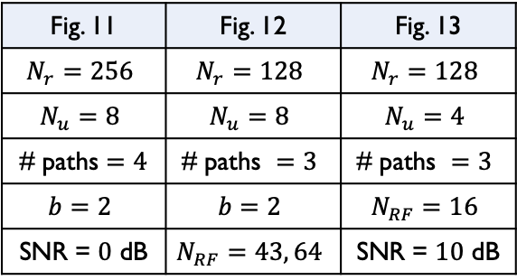
SIMULATION RESULTS 1
Simulated algorithms
Fig. 11 | Fig. 12 | Fig. 13
$$N_{r}=256$$ | $$N_{r}=128$$ | $$N_{r}=128$$
$$N_{u}=8$$ | $$N_{u}=8$$ | $$N_{u}=4$$
# paths $=4$ | $$\text{\# }\text{paths} =3$$ | $$\text{\# }\text{paths} =3$$
$$b=2$$ | $$b=2$$ | $$N_{RF}=16$$
SNR = $0$ dB | $$N_{RF}=43, 64$$ | SNR = $10$ dB
Two-
stage
ARV-TSAC: proposed two-stage analog combining
SVD+DFT:
ARV: designed from ARV-TSAC
Greedy-MI: greedy maximization based on ARVs
SVD:
Infeasible
and (Theorem 2)
One-
stage
Infeasible
Fig. 11: Mutual information vs. # RF chains
Fig. 12: Mutual information vs. SNR
Fig. 13: Signal power on each RF chain
3 ~ 6 dB gain
CONTRIBUTION 4: TWO-STAGE COMBINING

Slide 38
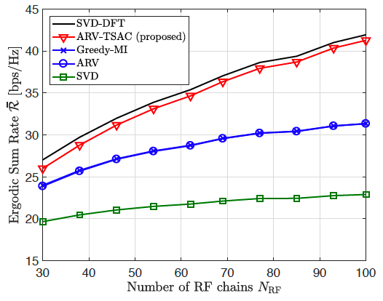
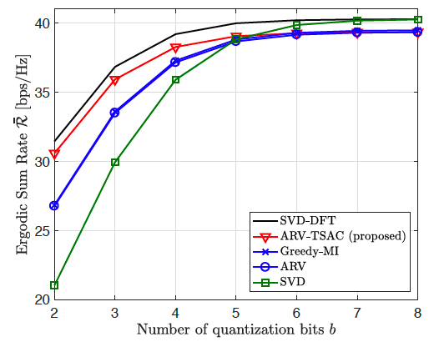
SIMULATION RESULTS 2
Linear digital equalizer: maximum ratio combiner
(Figure 14) NRF/Nr = 1/3, Nu = 8, b = 2, # paths = 3, and SNR = 0 dB
(Figure 15) Nr = 128, NRF = 43, Nu = 8, b = 2, # paths = 3
Fig. 14: Rate vs. # RF chains
Fig. 15: Rate vs. Quantization bits
: due to increasing Nr
Low resolution regime
Two-stage analog combining is effective in low-resolution ADC regime
CONTRIBUTION 4: TWO-STAGE COMBINING

Slide 39
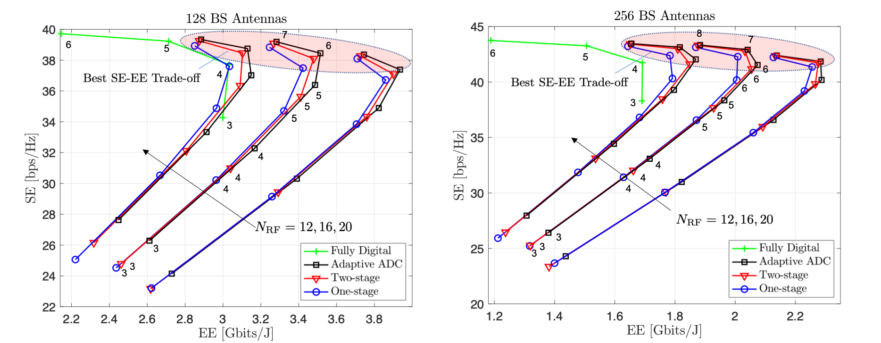
SPECTRAL VS ENERGY EFFICIENCY TRADE-OFF
Simulated algorithms in low-resolution ADC system
System parameters
Two-stage analog combining receiver (contribution 4)
Resolution-adaptive ADC receiver (contribution 2)
Conventional one-stage analog combining receiver
Fully digital receiver
Bandwidth | 1 GHz | # users | 4
SNR | 10 dB | # channel paths | 2
*SE: spectral efficiency
*EE: energy efficiency
CONTRIBUTION 4: TWO-STAGE COMBINING

Slide 40
SUMMARY
Proposed two-stage analog combining receiver
1st Analog Combiner
2nd Analog Combiner
Low Resolution
+
RF chain
ADC
…
+
…
A
RF chain
ADC
Baseband
Combiner
…
A
…
…
…
…
…
…
…
…
…
RF chain
ADC
…
+
+
A
Optimality
Algorithm
Two-stage combining solution
Sparse channel assumption
: unitary
ARV-TSAC algorithm
Optimal scaling law
Maximum mutual information
Ergodic rate analysis with MRC receiver
Second analog combiner is essential in reducing effective quantization error
CONTRIBUTION 4: TWO-STAGE COMBINING

Slide 41




SUMMARY AND CONCLUSION
Considered system: hybrid beamforming with low-resolution ADC system for high energy efficiency
Optimizations for mitigating quantization error
MAC Layer Perspective
User scheduling
optimize set of users
PHY Layer Perspective
Adaptive ADC
Antenna selection
Two-stage combining
- switch based -
- phase shifter based -
optimize ADC resolution
optimize analog combiner
Advanced architectures and techniques at different parts of wireless systems can significantly increase spectral and energy efficiency
CONCLUSION
Notes:
Dahrouj, Hayssam, and Wei Yu. "Coordinated beamforming for the multicell multi-antenna wireless system." IEEE transactions on wireless communications 9.5 (2010).
Sanderovich, Amichai, Oren Somekh, and Shlomo Shamai. "Uplink macro diversity with limited backhaul capacity." Information Theory, 2007. ISIT 2007. IEEE International Symposium on. IEEE, 2007.
Ng, Boon Loong, et al. "Distributed downlink beamforming with cooperative base stations." IEEE Transactions on Information Theory 54.12 (2008): 5491-5499.

Slide 42
FUTURE WORK
Channel estimation in two-stage analog combining system
Use estimation techniques for hybrid system after multiplying inverse matrix of second combiner
: Less performance degradation thanks to even distribution of quantization error (QE)
Develop new estimation technique by estimating quantization noise level
: Maybe easier to estimate quantization error thanks to even distribution of QE under same total QE
Extension of receiver design work into wideband communications
Base station antenna selection: similar results both in narrowband and wideband OFDM
: It is not proved for two-stage analog combining system and resolution-adaptive ADC system
Cooperation of multiple base stations under limited total power consumption
Optimization of ADC resolution over multiple BSs in multiple cells
: It can be jointly optimized with user transmit power
FUTURE WORK
Notes:
Dahrouj, Hayssam, and Wei Yu. "Coordinated beamforming for the multicell multi-antenna wireless system." IEEE transactions on wireless communications 9.5 (2010).
Sanderovich, Amichai, Oren Somekh, and Shlomo Shamai. "Uplink macro diversity with limited backhaul capacity." Information Theory, 2007. ISIT 2007. IEEE International Symposium on. IEEE, 2007.
Ng, Boon Loong, et al. "Distributed downlink beamforming with cooperative base stations." IEEE Transactions on Information Theory 54.12 (2008): 5491-5499.

Slide 43
PUBLICATIONS – JOURNAL ARTICLES
Jinseok Choi, Junmo Sung, Narayan Prasad, Xiao-Feng Qi, Brian L. Evans, and Alan Gatherer, "Base Station Antenna Selection for Low-Resolution ADC Systems", IEEE Transactions on Communications (under revision).
Faris B. Mismar, Jinseok Choi, and Brian L. Evans, "A Framework for Automated Cellular Network Tuning with Reinforcement Learning", IEEE Transactions on Communications accepted for publication.
Jinseok Choi, Gilwon Lee, and Brian L. Evans, "User Scheduling for Millimeter Wave Hybrid Beamforming Systems with Low-Resolution ADCs", IEEE Transactions on Wireless Communications, vol. 18, no. 4, pp. 2401-2414, Apr. 2019.
Jinseok Choi, Gilwon Lee, and Brian L. Evans, "Two-Stage Analog Combining in Hybrid Beamforming Systems with Low-Resolution ADCs", IEEE Transactions on Signal Processing, vol. 67, no. 9, pp. 2410-2425, May 1, 2019.
Jinseok Choi and Brian L. Evans, "Analysis of Ergodic Rate for Transmit Antenna Selection in Low-Resolution ADC Systems", IEEE Transactions on Vehicular Technology, vol. 68, no. 1, pp. 952-956, Jan. 2019.
Jinseok Choi, Brian L. Evans, and Alan Gatherer, "Resolution-Adaptive Hybrid MIMO Architectures for Millimeter Wave Communications", IEEE Transactions on Signal Processing, vol. 65, no. 23, pp. 6201-6216, Dec. 2017.
Jinseok Choi, Jeonghun Park, and Brian L. Evans, "Spectral Efficiency Bounds for Interference-Limited SVD-MIMO Cellular Communication Systems", IEEE Wireless Communications Letters, vol. 6, no. 1, pp. 46-49, Feb. 2017.
PUBLICATIONS

Slide 44
PUBLICATIONS – CONFERENCE PAPERS
Jinseok Choi, Yunseong Cho, Brian L. Evans, and Alan Gatherer, "Robust Learning-Base ML Detection for Massive MIMO Systems with One-Bit Quantized Signals", IEEE Global Communications Conf. Dec. 9-13, 2019, Waikoloa, HI, USA.
Jinseok Choi, Gilwon Lee, and Brian L. Evans, "A Hybrid Beamforming Receiver with Two-Stage Analog Combiner and Low-Resolution ADCs", IEEE Int. Conf. on Communications, 2019, May 2019, Shanghai, China.
Jinseok Choi, Brian L. Evans, and Alan Gatherer, "Antenna Selection for Large-Scale MIMO Systems with Low-Resolution ADCs", Proc. IEEE Int. Conf. on Acoustics, Speech, and Signal Processing, Apr. 15-20, 2018, Calgary, Alberta, Canada, accepted.
Junmo Sung, Jinseok Choi, and Brian L. Evans, "Narrowband Channel Estimation for Hybrid Beamforming Millimeter Wave Communication Systems with One-bit Quantization", Proc. IEEE Int. Conf. on Acoustics, Speech, and Signal Processing, Apr. 15-20, 2018.
Jinseok Choi, and Brian L. Evans, "User Scheduling for Millimeter Wave MIMO Communications with Low-Resolution ADCs", Proc. IEEE Int. Conf. on Communications, May 20-24, 2018, Kansas City, MO, USA.
Jinseok Choi, Junmo Sung, Brian L. Evans, and Alan Gatherer, "ADC Bit Optimization for Spectrum- and Energy-Efficient Millimeter Wave Communications”, Proc. IEEE Global Communications Conf., Dec. 4-8, 2017, Singapore.
Jinseok Choi, Brian L. Evans, and Alan Gatherer, "ADC Bit Allocation under a Power Constraint for MmWave Massive MIMO Communication Receivers", Proc. IEEE Int. Conf. on Acoustics, Speech and Signal Processing, Mar. 5-9, 2017, New Orleans, LA, USA.
Jinseok Choi, Brian L. Evans, and Alan Gatherer, "Space-­Time Fronthaul Compression of Complex Baseband Uplink LTE Signals'', Proc. IEEE Int. Conf. on Communications, May 23-27, 2016, Kuala Lumpur, Malaysia.
PUBLICATIONS

Slide 45
SOFTWARE RELEASES
Available at http://users.ece.utexas.edu/~bevans/projects/mimo/software.html
Jinseok Choi and Brian L. Evans, "Two-Stage Analog Beamforming", MATLAB code to accompany a paper entitled "Two-Stage Analog Combining in Hybrid Beamforming Systems with Low-Resolution ADCs" in the IEEE Transactions on Signal Processing, vol. 67, no. 9, May 1, 2019, pp. 2410-2425, DOI 10.1109/TSP.2019.2904931. Version 1.0 (July 27, 2019)
Jinseok Choi and Brian L. Evans, "Antenna Selection for Large-Scale MIMO Systems with Low-Resolution ADCs", MATLAB code to accompany a paper of the same title in the 2018 IEEE International Conference on Acoustics, Speech and Signal Processing. Version 1.0 (October 27, 2017).
Jinseok Choi and Brian L. Evans, "User Scheduling Algorithms for Millimeter Wave MIMO Systems", MATLAB code to accompany a paper of the same title in the 2018 IEEE International Conference on Communications. Version 1.0 (October 13, 2017).
Jinseok Choi and Brian L. Evans, "Resolution-Adaptive Hybrid MIMO Architectures for Millimeter Wave Communications", MATLAB code to accompany a paper of the same title in the IEEE Transactions on Signal Processing, vol. 65, no. 23, pp. 6201-6216, Dec. 2017, DOI 10.1109/TSP.2017.2745440. Software release is version 1.0 (Nov. 15, 2018).
Jinseok Choi and Brian L. Evans, "Space-Time Baseband LTE Compression Software", copyright © 2016 by The University of Texas. This MATLAB release implements algorithms to compress uplink baseband cellular LTE signals received by an antenna array. Software release accompanies the paper "Space-Time Fronthaul Compression of Complex Baseband Uplink LTE Signals" in the 2016 IEEE International Conference on Communications. Version 1.0 (April 4, 2016).
SOFTWARE RELEASE

Slide 46
REFERENCES
[Akdeniz&Rappaport14] M. R. Akdeniz, Y. Liu, M. K. Samimi. S. Sun, S. Rangan, T. S. Rappaport, E. Erkip, "Millimeter wave channel modeling and cellular capacity evaluation." IEEE Journal on Sel. Areas in Comm. 32.6 (2014): 1164-1179.
[Andrews14] J. G. Andrews, S. Buzzi, W. Choi, S. V. Hanly, A. Lozano, A. C. K. Soong, J. C. Zhang, "What will 5G be?." IEEE Journal on Sel. Areas in Comm. 32.6 (2014): 1065-1082.
[Fletcher ] A. K. Fletcher, S. Rangan, V. K. Goyal, and K. Ramchandran, “Robust predictive quantization: Analysis and design via convex optimization,” IEEE Journal of Sel. Topics in Signal Process., vol. 1, no. 4, pp. 618–632, Dec. 2007.
[Gersho&Gray12] Gersho, Allen, and Robert M. Gray. ”Vector quantization and signal compression”. Vol. 159. Springer Science & Business Media, 2012.
[Lee&Sung16] Gilwon Lee, Youngchul Sung, and Marios Kountouris. "On the performance of random beamforming in sparse millimeter wave channels." IEEE Journal of Sel. Topics in Signal Processing 10.3 (2016): 560-575.
[Lin&Tsai] Lin, Pu-Hsuan, and Shang-Ho Tsai. "Performance analysis and algorithm designs for transmit antenna selection in linearly precoded multiuser MIMO systems." IEEE Trans. on Veh. Tech. 61.4 (2012): 1698-1708.
[Méndez-Rial16], R. Méndez-Rial, C. Rusu, N. González-Prelcic, A. Alkhateeb, and R. W. Heath, “Hybrid MIMO architectures for millimeter wave Communications: Phase shifters or switches?” IEEE Access, vol. 4, pp. 247–267, Jan. 2016.
[Mo&Heath17] J. Mo, A. Alkhateeb, S. Abu-Surra and R. W. Heath, "Hybrid Architectures With Few-Bit ADC Receivers: Achievable Rates and Energy-Rate Tradeoffs," in IEEE Transactions on Wireless Communications, vol. 16, no. 4, pp. 2274-2287, April 2017
[Nemhauser78] G. L. Nemhauser, L. A. Wolsey, and M. L. Fisher, “An analysis of approximations for maximizing submodular set functions–I,” Math. Programming, vol. 14, no. 1, pp. 265–294, 1978
[Pi&Khan11] Pi, Zhouyue, and Farooq Khan. "An introduction to millimeter-wave mobile broadband systems." IEEE Comm. Mag. 49.6 (2011).
[Yoo&Goldsmith06] Yoo, Taesang, and Andrea Goldsmith. "On the optimality of multiantenna broadcast scheduling using zero-forcing beamforming." IEEE Journal on Sel. Areas in Comm. 24.3 (2006): 528-541.
REFERENCES

Slide 47
OUTLINE
Background
Millimeter wave communications with a large number of antennas
Motivation of my PhD dissertation
Contributions
1 | User scheduling in low-resolution ADC systems
2 | Resolution-adaptive ADC receiver architecture
3 | Base station antenna selection in low-resolution ADC systems
4 | Two-stage analog combining receiver architecture in low-resolution ADC systems
Conclusion & Future work
Future work
Summary
OUTLINE

Slide 48
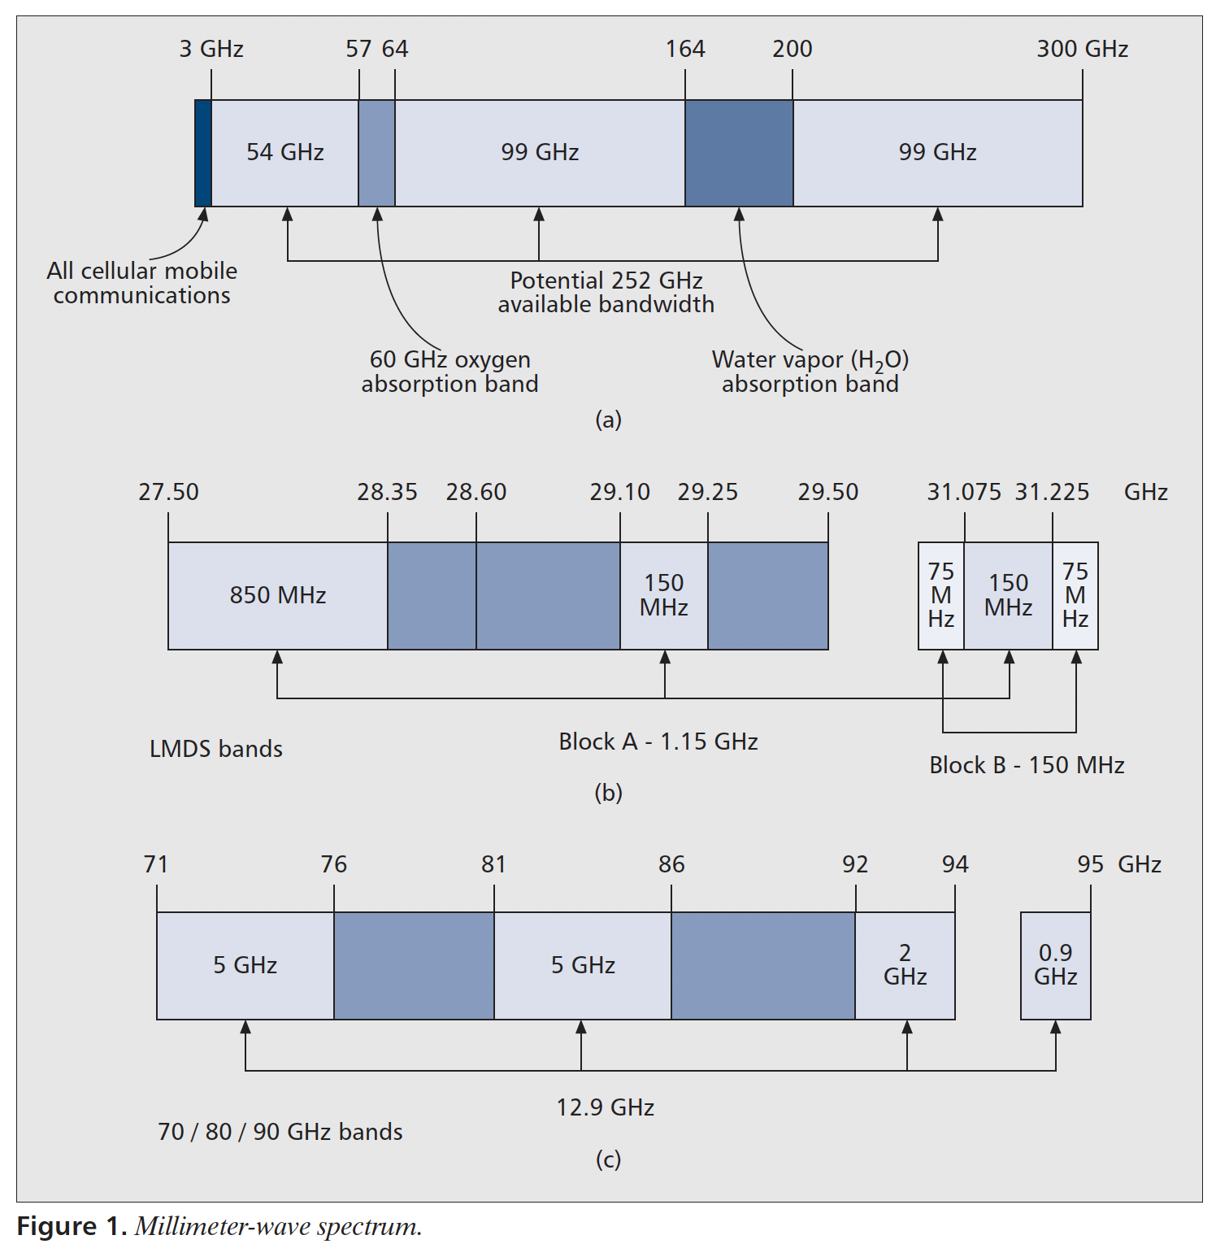
MILLIMETER WAVE SPECTRUM
[Pi&Khan11] Pi, Zhouyue, and Farooq Khan. "An introduction to millimeter-wave mobile broadband systems." IEEE Comm. Mag. 49.6 (2011).

Slide 49
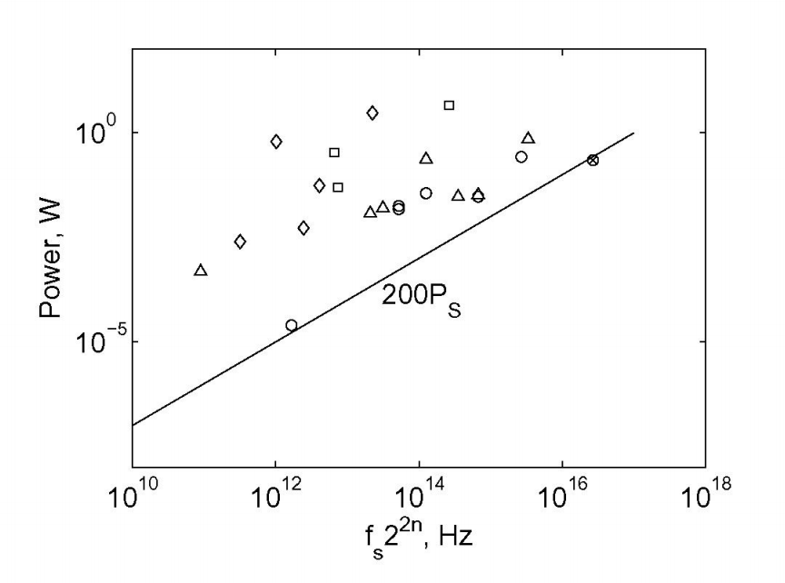
ADC POWER CONSUMPTION
n: quantization bits
fs: sampling rate
Svensson, Christer, Stefan Andersson, and Peter Bogner. "On the power consumption of analog to digital converters." 2006 NORCHIP. IEEE, 2006.

Slide 50
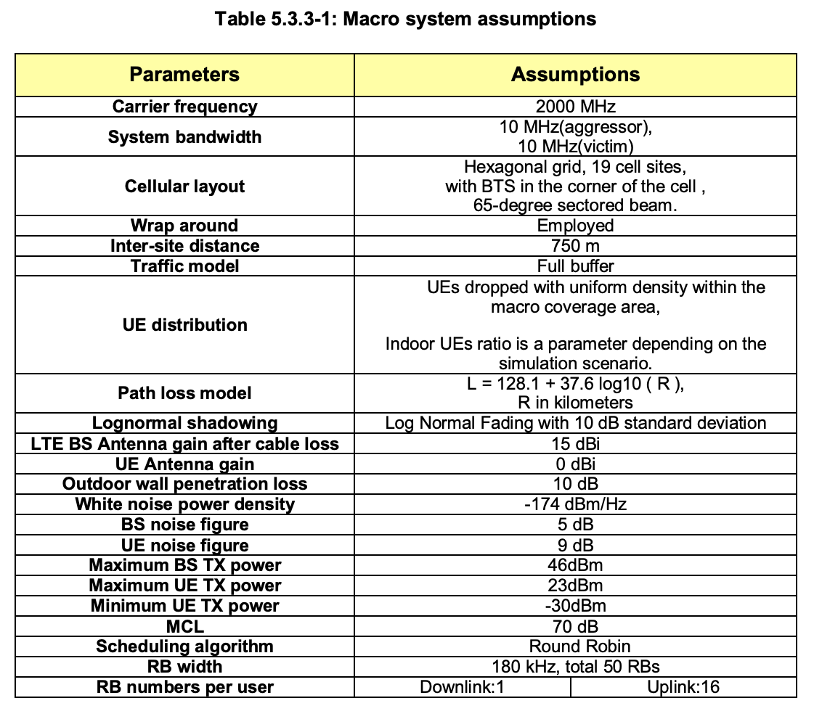
SYSTEM ASSUMPTIONS
3GPP TR 36.931 V12.0.0 (2014-09)

Slide 51
CONTRIBUTION 1
USER SCHEDULING
APPENDIX

Slide 52

NEW USER SCHEDULING CRITERIA
Solution of $𝒫2$: structural scheduling criteria
For total # of channel paths $≤N_{RF}$
Theorem A-1
Unique *AoAs at receiver for channel paths of each scheduled user:
Equal power spread across beamspace complex gains within each channel:
*Angle of arrivals
Channel Hb
Aggregated channel gain at ADC
RF chain
ADC
minimize error here
+
A
Unique AoAs
Equal power spread
RF chain
ADC
A
Baseband
Combiner
RF chain
ADC
+
A
CONTRIBUTION 1

Slide 53

PROOF OF THEOREM A-1
Case: total # of channel paths $≤$NRF
Two-stage maximization approach
1. Minimize
II. Maximize under orthogonal condition
: channels have to be orthogonal
Non-overlap of channel gains
KKT condition: equal power spread
(a-c): sufficient conditions for maximizing sum rate
: max rate for single user case
CONTRIBUTION 1

Slide 54
PARTIAL CSI-BASED USER SCHEDULING
Alternative to instantaneous full CSI
*Angles of arrival (AoA): slowly-varying channel characteristics
  : reduces burden of estimating instantaneous full CSI at every channel coherence time
Chordal distance-based user scheduling
measure separation between channel subspaces
Key idea
Channel
Vector
Chordal
Distance
Steps
1. RF chain angle filtering
2. Chordal distance filtering
3. Max # of AoAs (+ max. chordal distance)
Filter users:
no AoAs in reduced range of angles of RF chains
Filter users:
Select user with max. # of AoAs.
If many:
CONTRIBUTION 1

Slide 55

PERFORMANCE ANALYSIS – PARTIAL CSI
Ergodic sum rate analysis for single path
Exact AoA alignment
Proposition 1
Ergodic rate without quantization
rate loss due to quantization error
Arbitrary AoA
Proposition 2
Remark
As $b→∞,$ both converge to
CONTRIBUTION 1

Slide 56
SIMULATION – PERFORMANCE VALIDATION
Greedy: schedules user who provides maximum sum rate (sub-optimal performance with prohibitively high complexity)
Sum Rate vs. Transmit power
Sum Rate vs. # of RF chains
Figure 1
(40 RF chains)
Figure 2
(6 dB Tx power)
Sub-optimality
Sub-optimality
More beneficial
when SNR is high
Marginal gain
NRF
Quantization error dominates thermal noise
: CSS is effective under coarse quantization
As NRF increases, channels become more orthogonal
: quantization error becomes major bottleneck
Why?
Why?
Settings
128 antennas, 200 candidate users, 12 scheduled users, 3 ADC bits, 3 average channel paths
CONTRIBUTION 1

Slide 57
SIMULATION – ANALYSIS VALIDATION
Sum Rate vs. Transmit power
Sum Rate vs. # of ADC bits
Figure 3
Figure 4
Converges to
Sum rate gap
Channel leakage reduces quantization error
: equal power spread in Theorem 1
Why?
Settings
128 antennas, 128 RF chains, 200 candidate users, 12 scheduled users, single channel path
CONTRIBUTION 1

Slide 58
CONTRIBUTION 2
ADAPTIVE ADC
APPENDIX

Slide 59
EXTENSION TO RECEIVER POWER CONSTRAINT
Joint binary search algorithm
: solves total power constrained MMSQE bit allocation problem
Total receiver power constraint
Challenges in total receiver power
# of active RF chains
: function of ADC bits (0-bit: inactive)
Resolution-switching power consumption
: function of previous bits and current bits
Steps
Joint binary search for Nact & b
*Channel gains are sorted in descending order
1. Offline PSW estimation
2. BA solution for fixed Nact
3. Total MSQE computation & comparison
Training and modeling
avg. PSW as function of power constraint
Case:
(Nact - 1)
(Nact )
(Nact + 1)
MSQE:
vs
vs
Go to smaller half
CONTRIBUTION 2

Slide 60
SUMMARY
Proposed resolution-adaptive ADC receiver
Resolution adaptive
+
RF chain
ADC
A
RF chain
ADC
Baseband
Combiner
A
. . .
. . .
. . .
. . .
RF chain
ADC
ULA
+
A
Near optimal bit-allocation
Worst case analysis
High SNR: minimizes mean squared quantization error
Lower bound of Ergodic rate for proposed receiver architecture
Low SNR: maximizes generalized mutual information
Selective bit allocation works for sparse channel with limited power consumption
CONTRIBUTION 2

Slide 61
SYMBOL ERROR RATE (SER)
Proposed Method
Achieves SER comparable to infinite-resolution case at around Ptot = 120 W
30 % total receiver power saving from 4~5-bit ADC system
80 % total receiver power saving from *infinite-bit (b = 12) ADC system
*Power consumption of infinite-bit ADC system = 689 W
CONTRIBUTION 2

Slide 62
CONTRIBUTION 3
ANTENNA SELECTION
APPENDIX

Slide 63
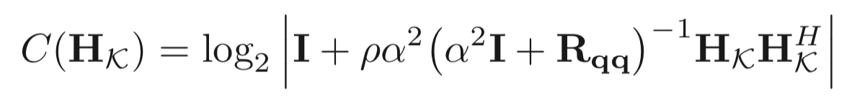


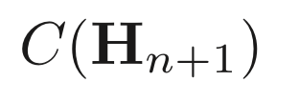
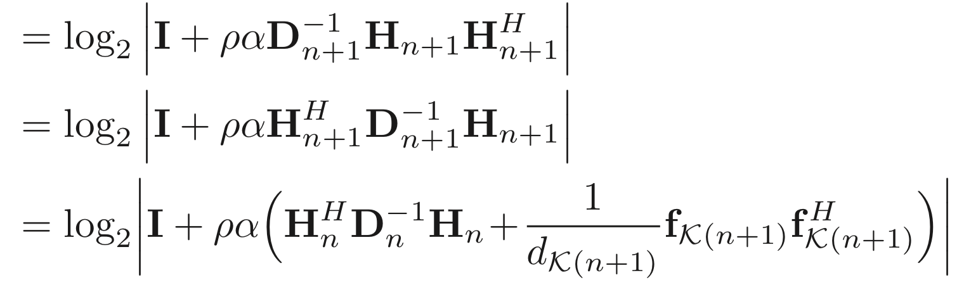
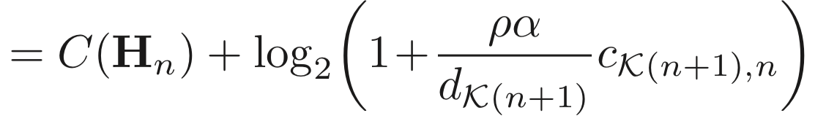
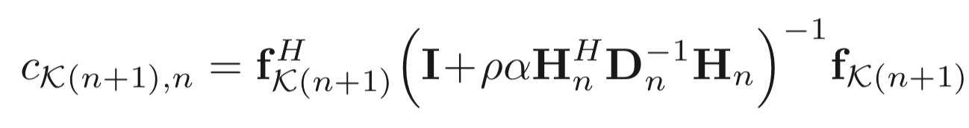
GREEDY MI-MAXIMIZING ANTENNA SELECTION
Decomposition of mutual information
quantization noise covariance
Mutual information
where
At (n+1)th selection stage
(n+1) th row of Hn+1
(a)
Diagonal entry of D corresponding to fK(n+1)
where
Here, (a) comes from matrix determinant lemma
CONTRIBUTION 3

Slide 64
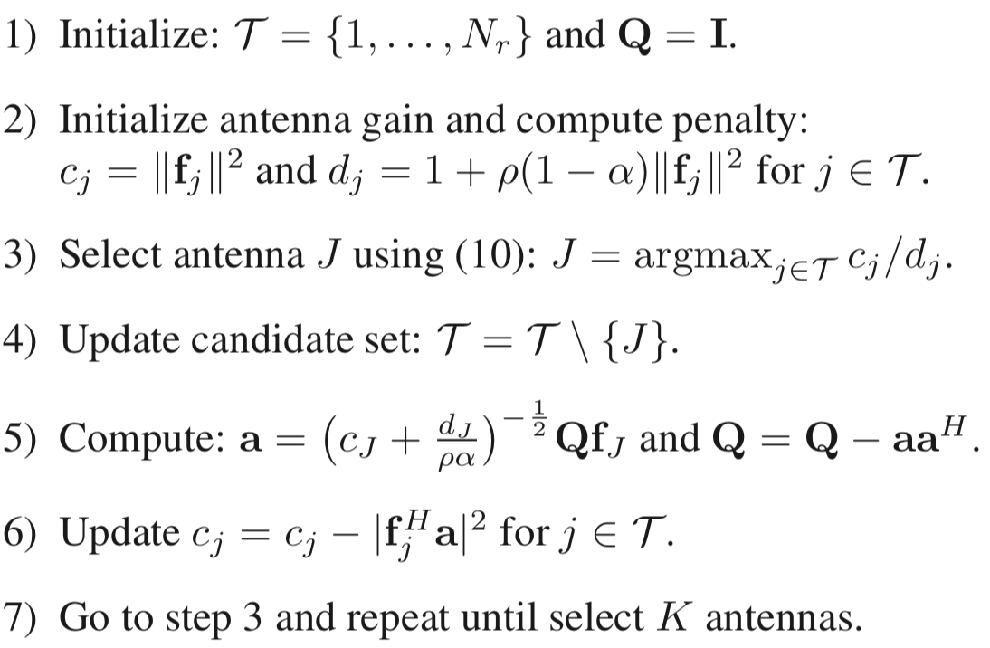

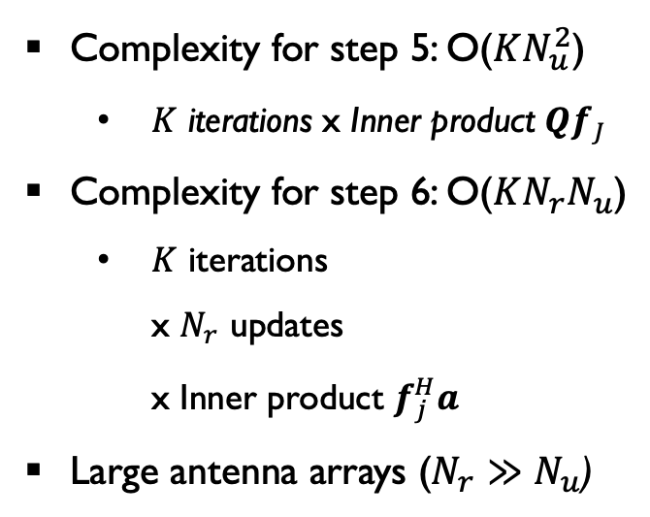
COMPLEXITY OF QFAS ALGORITHM
Complexity analysis
Proposed algorithm
Complexity for step 5: O($KN_{u}^{2}$)
  $K$ iterations x Inner product $Qf_{J}$
Complexity for step 6: O($KN_{r}N_{u}$)
  $K$ iterations
  x $N_{r}$ updates
  x Inner product $f_{j}^{H}a$
Large antenna arrays ($N_{r}≫N_{u}$)
Quantization-Aware Fast Antenna Selection (QAFAS)
  Overall complexity becomes O(K Nr Nu)
Complexity
O(K Nr Nu)
same as FAS
[Gharavi-Alkhansari04]
CONTRIBUTION 3

Slide 65
CONTRIBUTION 4
TWO-STAGE
ANALOG COMBINING
APPENDIX

Slide 66

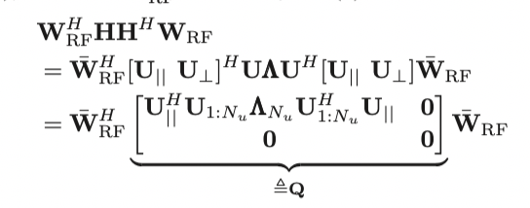


PROOF OF THEOREM 2 - SCALING LAW
Rewrite mutual information
Define and rewrite mutual information
Jensen’s inequality
CONTRIBUTION 4
Notes:
PADC : Power [Watts] = energy/unit time (Joules / sec)
Gersho, Allen, and Robert M. Gray. Vector quantization and signal compression. Vol. 159. Springer Science & Business Media, 2012.

Slide 67
PROOF OF THEOREM 2 – TWO-STAGE SOLUTION
With two-stage solution in Theorem 2:
: NRF x NRF unitary matrix with constant modulus
Condition (i) and (ii)
Recall channel model:
As , we have:
and
CONTRIBUTION 4
Notes:
PADC : Power [Watts] = energy/unit time (Joules / sec)
Gersho, Allen, and Robert M. Gray. Vector quantization and signal compression. Vol. 159. Springer Science & Business Media, 2012.

Slide 68
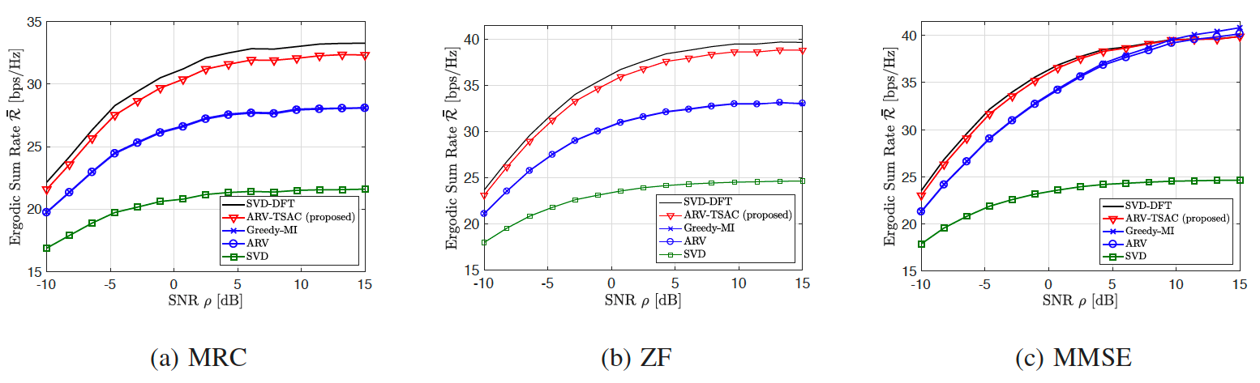
SIMULATION RESULTS 3
Linear digital equalizers
Nr = 128, NRF = 43, Nu = 8, b = 2, and # paths = 3
Fig. 14: Rate vs. SNR
Proposed algorithm provides higher rates than one-stage algorithms
Proposed algorithm achieves MMSE performance with ZF whereas one-stage algorithms cannot achieve it
– one-stage algorithms suffer from large quantization errors
Simple equalizer can achieve high rate with two-stage analog combining
CONTRIBUTION 4

Slide 69
ANALOG BEAMFORMING IN OFDM WITH LOW-RESOLUTION ADCS
Mutual Information for subcarrier n
Quantization noise covariance matrix
Quantization noise covariance matrix
Maximize gain by capturing frequency domain channel gain
VS
Minimize quantization error by manipulating time domain delay channels

