Slide 1
Radio Frequency Interference Modeling and Mitigation in Wireless Receivers
Kapil Gulati
Committee Members:
Prof. Jeffrey G. Andrews
Prof. Brian L. Evans (supervisor)
Prof. Elmira Popova
Prof. Haris Vikalo
Prof. Sriram Vishwanath
PhD Defense

Slide 2
Outline
Introduction
Background
System Model
Statistical Modeling of Radio Frequency Interference
Communication Performance Analysis of Wireless Networks
Receiver Design to Mitigate Radio Frequency Interference
Conclusion

Slide 3




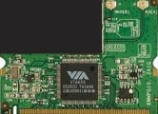

Introduction
Wireless transceivers
antenna
Wireless Communication
Sources
Closely located sources
Coexisting protocols
Non-Communication
Sources
Electromagnetic radiations
baseband processor
Computational Platform
Clocks, busses, processors
Co-located transceivers

Slide 4
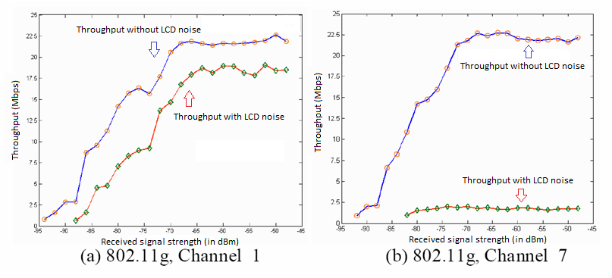
Introduction (cont…)
RFI may severely degrade communication performance
Impact of LCD noise on throughput for an IEEE 802.11g embedded wireless receiver [Shi, Bettner, Chinn, Slattery & Dong, 2006]
Notes:
Questions:
1. For (b), the throughput will rise eventually ?

Slide 5


Problem Statement
Designing wireless transceivers to mitigate residual RFI
Channel 11
Residual RFI
Co-channel
Adjacent channel
Out-of-platform
In-platform
(a)
(a)
Channel 11
Duration
(c)
(b)
(d)
Guard zone
Channel 9
Example: Dense Wi-Fi Networks

Slide 6


Problem Statement
Designing wireless transceivers to mitigate residual RFI
Physical (PHY) Layer
Improves: Link communication performance
Channel 11
Thermal
noise
RFI
Transmit
signal
Pre-Filter
Conventional Receiver
Channel 11
Duration
Medium Access Control (MAC) Layer
Optimize channel access protocols, e.g., Improves: Network communication performance
Distribution of Duration
Guard zone
Channel 9
Example: Dense Wi-Fi Networks

Slide 7
Approach
Statistical Modeling of Residual RFI
RFI Mitigation in MAC Layer
RFI Mitigation in PHY Layer
Thesis Statement:
For interference-limited wireless networks, deriving closed-form non-Gaussian statistics to model tail probabilities of RFI unlocks analysis of network throughput, delay, and reliability tradeoffs and designs of physical layer receivers to increase link spectral efficiency by several bits/s/Hz, without requiring knowledge of the number, locations, or types of interference sources.

Slide 8
Contributions
Contribution #1
Statistical Modeling of RFI
Instantaneous statistics of RFI
Applicability to ad hoc, cellular, local area & femtocell networks
Contribution #2
Communication Performance Analysis of Wireless Networks
Decentralized wireless networks with temporal correlation
Throughput, delay, and reliability
Motivates: RFI Mitigation at MAC Layer
Contribution #3
RFI Mitigation at PHY Layer
Pre-filtering methods mitigate RFI

Slide 9

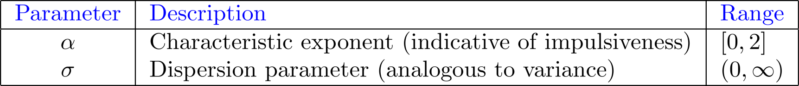
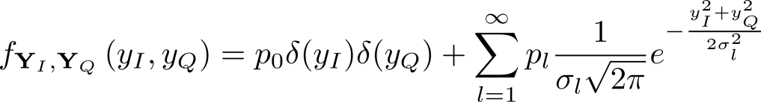
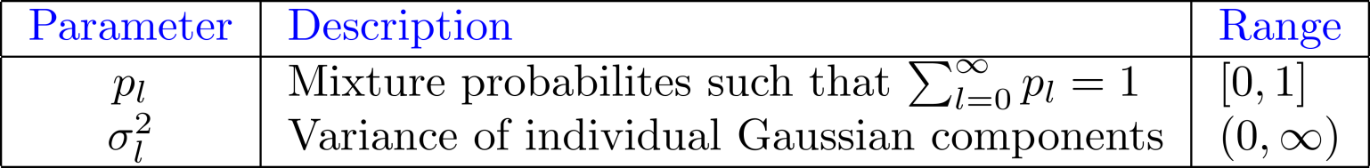
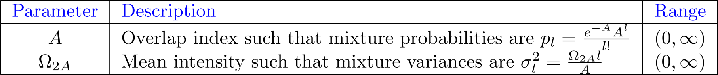
Statistical Models
Symmetric Alpha Stable (isotropic, zero-centered)
  Characteristic function
Gaussian Mixture Model (isotropic, zero-centered)
  Amplitude distribution
Middleton Class A (without the additive Gaussian component)

Slide 10
Background
 |  | SAS | MCA | GMM
Statistical Modeling | Statistical-Physical Derivation | [Sousa92] [IlowHatzinakos98] [YangPetropulu03] | [Middleton77] [Middleton99] | No
 | Interferer Distribution | Poisson | Poisson | -
 | Interferer Region | Entire plane | Finite area | -
 | Bounded Pathloss | No | Yes | -
Network Perf. | Used for Analysis | [SousaSilvester90] [WeberAndrJin05] [PintoWin10] | No | No
 | Temporal Dependence | Limited | No | No
Receiver Design | Example Prior Work | [AmbikeIlowHatz94] [GonzalesArce98] | [SpauldingMidd77] [HaringVinck02] | [EldarYeredor01] [KotechaDjuric03]
 | Include Thermal Noise ? | No | Yes | Yes
 | Optimal Pre-Filter | Myriad | not known | not known
 | Opt. Distance Measure | Log deviations | not known | not known
Others RFI Models: Laplacian, Generalized Gaussian, Weibull, Lognormal, … (many more)
Derive RFI statistics for wider range of interference scenarios
Use RFI statistics to analyze performance of networks
Use a distance measure robust to impulsive statistics of RFI

Slide 11
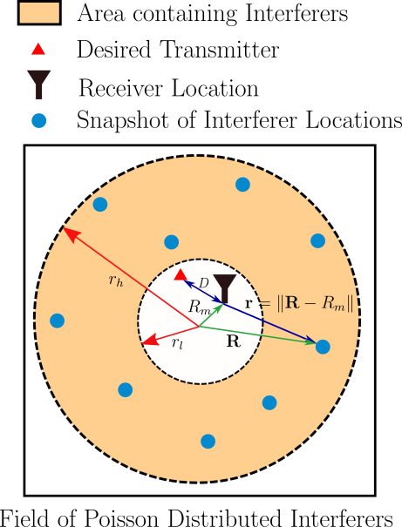

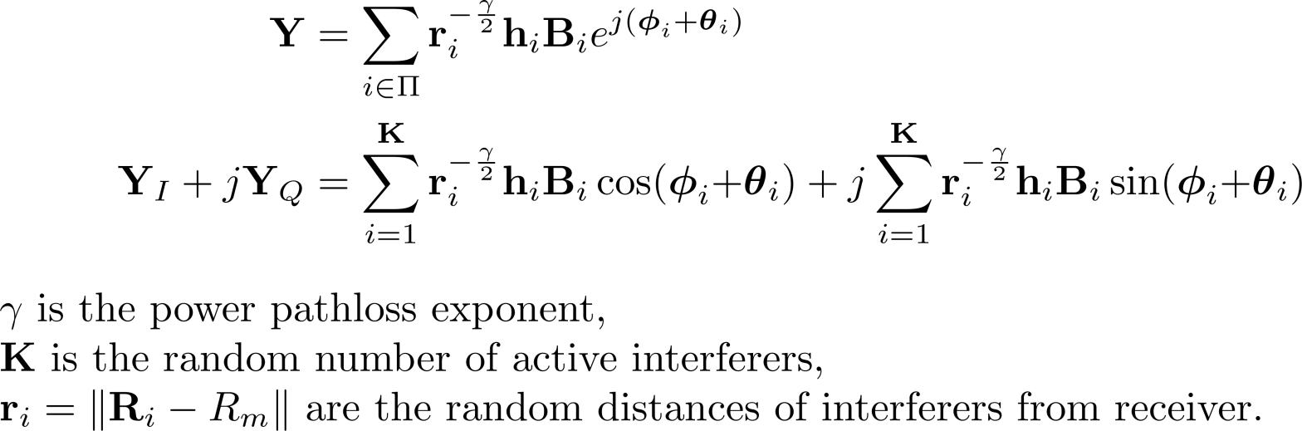
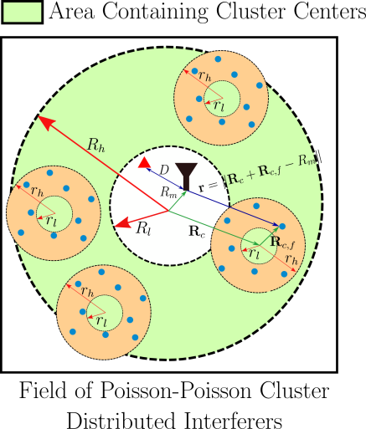
Initial System Model
Interferer locations follow a spatial point process
Intended transmitter-receiver pair is
  Distance apart
Sum Interference at receiver
Pathloss
Narrowband Interferer emissions
Fading

Slide 12
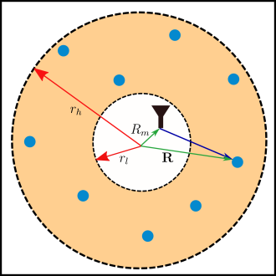
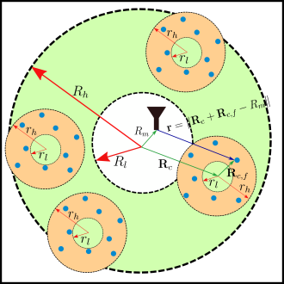
Contribution #1
Instantaneous Statistics of Radio Frequency Interference
Field of Poisson interferers distributed over Case I: Entire plane Case II: Finite-area annular region Case III: Infinite-area region with guard zone around receiver
Field of Poisson-Poisson clusters of interferers distributed over Case I: Entire plane Case II: Finite-area annular region Case III: Infinite-area region with guard zone around receiver
Model computational platform noise measurements Robust to deviations from system model assumptions

Slide 13


Instantaneous Statistics of RFI
Poisson Field of Interferers
  Interferers
Poisson-Poisson Cluster Field of Interferers
  Cluster Centers
  Interferers
Closed-form statistics accurately modeling tail probability

Slide 14
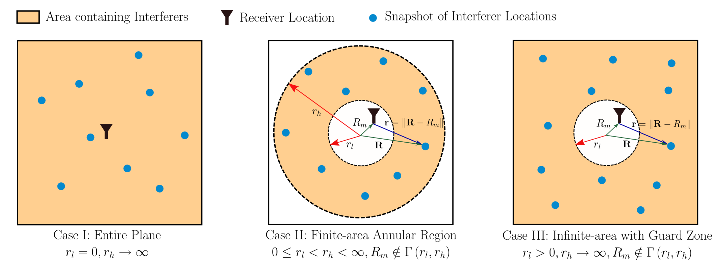
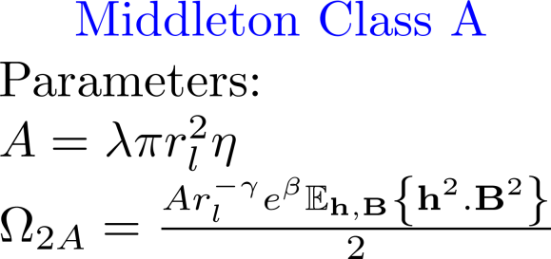
Poisson Field of Interferers
Symmetric Alpha Stable
Middleton Class A (form of Gaussian Mixture)
Sensor networks
Ad hoc networks
Cellular networks
Hotspots (e.g. café)
Dense Wi-Fi networks
Networks with contention based medium access

Slide 15
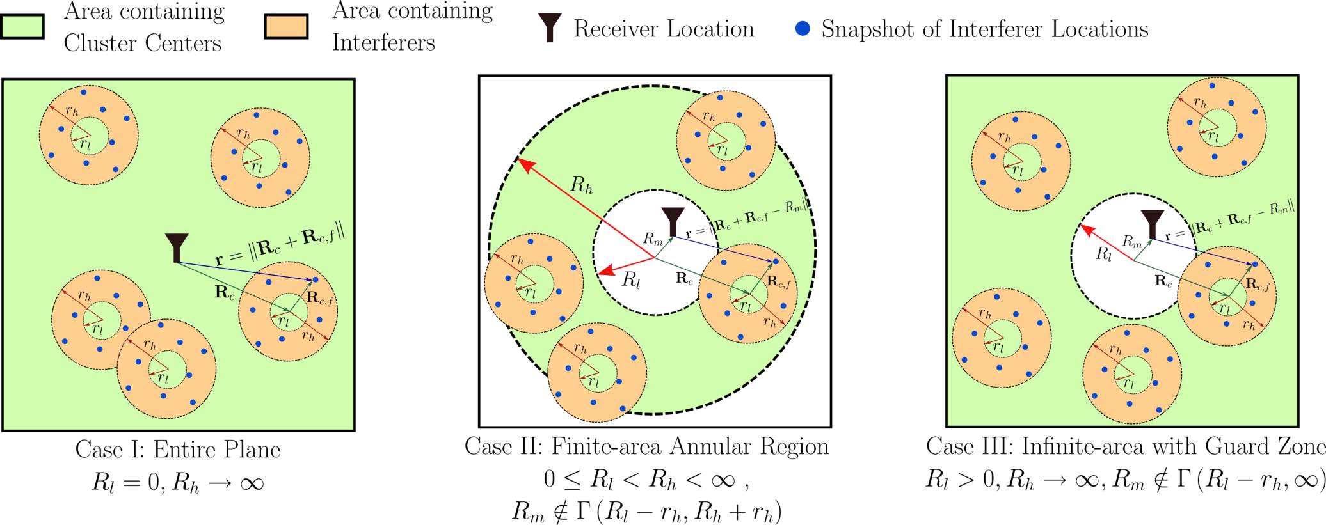
Poisson-Poisson Cluster Field of Interferers
Symmetric Alpha Stable
Gaussian Mixture Model
In-cell and out-of-cell femtocell users in femtocell networks
Out-of-cell femtocell users in femtocell networks
Cluster of hotspots
(e.g. marketplace)

Slide 16
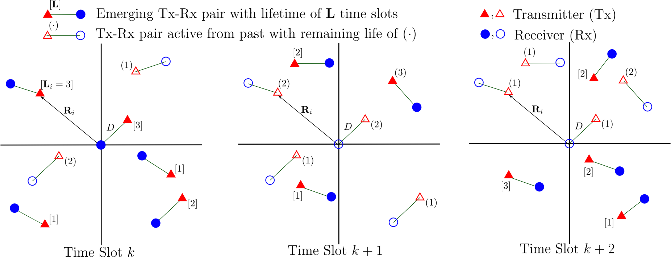
Contribution #2
Decentralized Wireless Network with Temporal Correlation
Joint temporal statistics of interference Poisson field with temporal correlation Entire plane Unbounded pathloss function
Closed-form measures of single-hop communication performance Local delay Throughput outage probability Average network throughput
Extend definition and analysis of transmission capacity Quantify throughput-delay-reliability tradeoffs

Slide 17
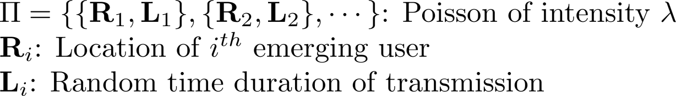
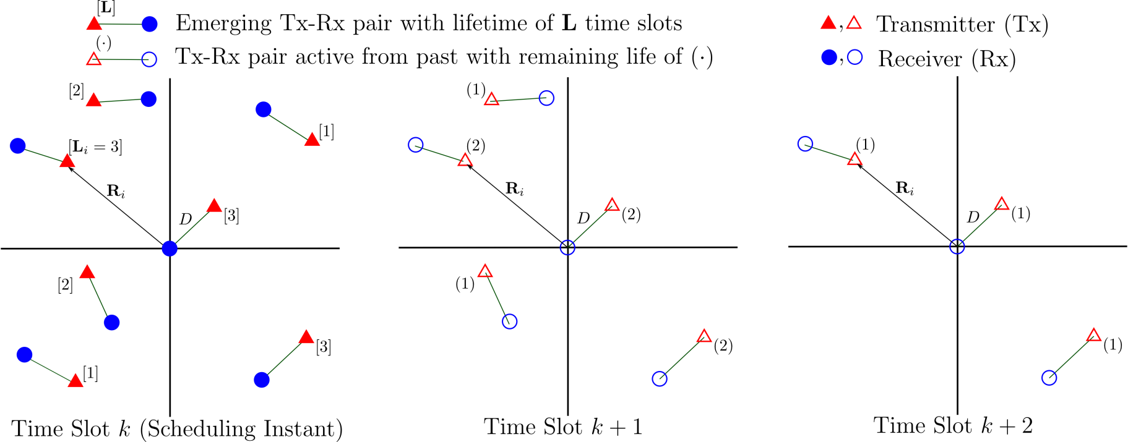
System Model (Temporal Extension)
Network Model I (Synchronous)
  User emerge at time slot k and transmit for random duration

Slide 18
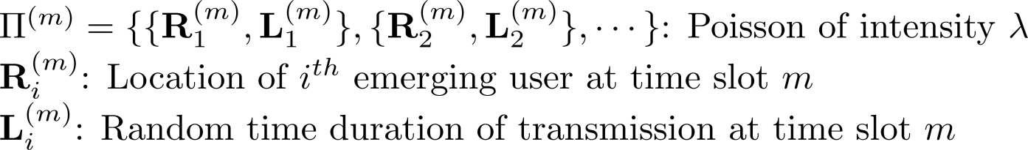
System Model (Temporal Extension)
Network Model II (Asynchronous)
  Users can emerge at any time slot m

Slide 19
Performance of Decentralized Networks
Single-hop communication performance measures
Deriving exact closed-form expressions with temporal dependence is an open problem
Performance Measure | Key Prior Work | Temporal Dependence
Outage Probability | [Weber, Andrews & Jindal, 2007] | Independent
Transmission Capacity | [Weber et al., 2005] | Independent
Local Delay | [Haenggi, 2010] [Baccelli & Blaszczyszyn, 2010] | Independent Complete correlation

Slide 20
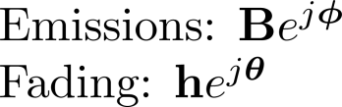

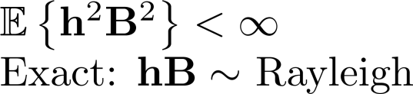



Deriving Closed-form Performance Measures
Key Prior Work
My Approach
Problem Formulation
Power
Amplitude and Phase
Required assumptions
Approximate tails if closed-form not possible
Characteristic Function
Performance Measures
Laplace Transform
Tail Probability
Advantage: Closed-form expressions derived relatively easily
Disadvantage: Asymptotically exact for low outage regimes
(simulations also match in high outage regimes)

Slide 21
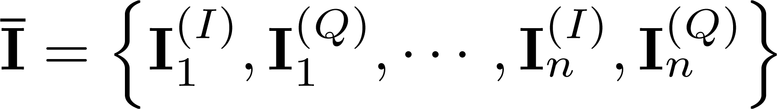

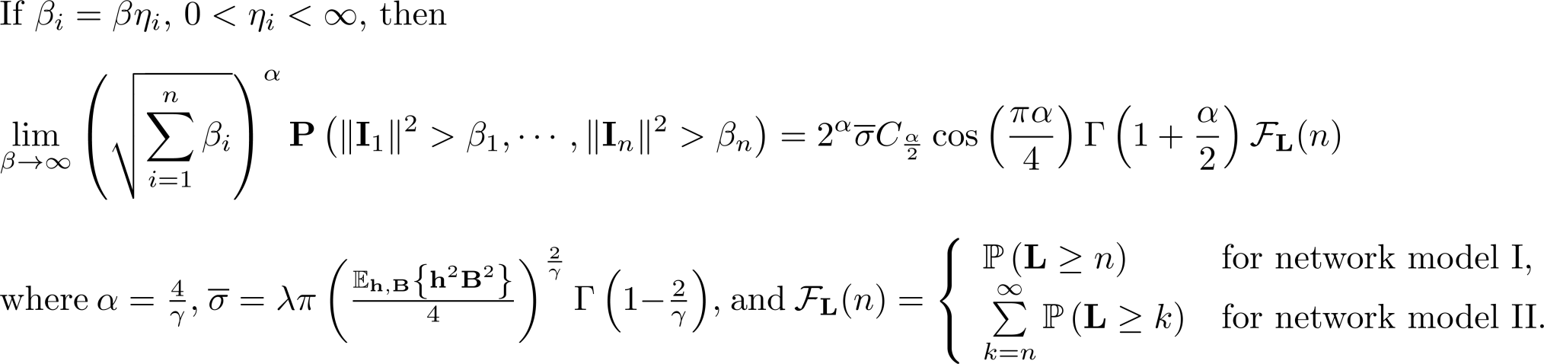
Joint Temporal Statistics of Interference
Interference vector
Follows a 2n-dimensional symmetric alpha stable
  Exact when [Ilow & Hatzinakos, 1998]
Dissertation provides theorems to show
  Joint amplitude tail probabilities dominated by isotropic component (i.e., due to users active in time slots 1 through n)
Depends on fading and emissions
Depends on L

Slide 22






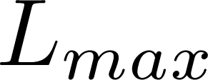
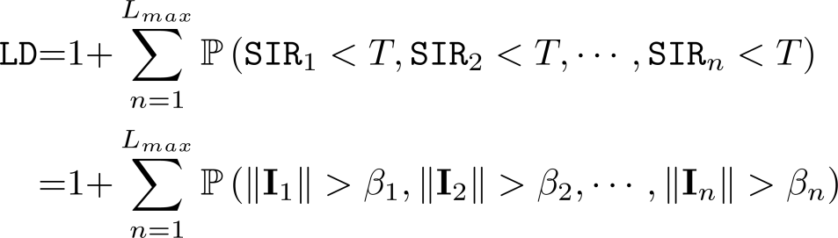
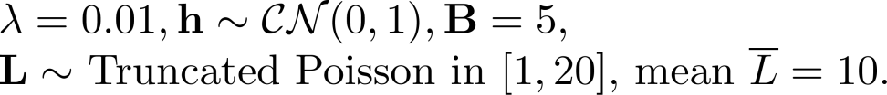
Local Delay
Average time slots to have one successful transmission
Dissertation also derives
  Throughput outage probability
  Average network throughput
Network Model II

Slide 23
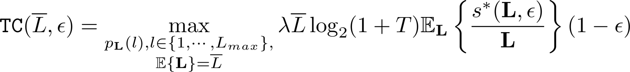
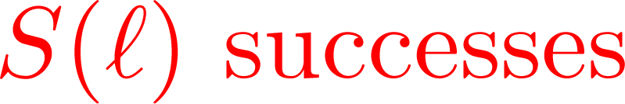


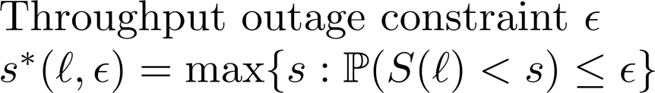





Transmission Capacity (TC)
Defined assuming temporal independence [Weber et al., 2005]
Extension:
Goodput: ~1.8x
Motivates designing MAC protocols that achieve optimum lifetime distribution
Improved Reliability
Network Model II

Slide 24
Contribution #3
Pre-filter Design to Mitigate RFI
Joint temporal statistics of interference Poisson field with temporal correlation Entire plane Bounded pathloss function
Distance measure robust to impulsive statistics of interference Scale Correntropy Induced Metric space using zero-order statistics
Pre-filter structures Modify selection filter (S filter) Modify combination filter (Ll filter)

Slide 25

Network Model I and II
Multivariate GMM RFI under bounded pathloss
  Inphase/quadrature samples dependent but uncorrelated
  Individually temporally dependent but uncorrelated
Sliding window pre-filters for single-carrier uncoded systems
Prior work on mitigating GMM noise
Thermal
Noise
RFI
Map to QAM Constellation
Transmit Pulse Shape Filter
Pre-Filter
Matched
Filter
Demapping
Received
Bits
Bits
Pre-Filter | Prior Work | Distance | Temp. Dep.
Bank of Wiener filters | [Eldar & Yeredor, 2001] | L₂ Norm | No
Bank of Gaussian Particle filters | [Kotecha & Djuric, 2003] | L₂ Norm | No
Order Statistic filters | Not based on RFI statistics |  | (Some)

Slide 26






Choosing a Distance Measure for GMM
Correntropy Induced Metric (CIM) [Liu & Principe, 2007]
Prior work did not adapt parameter based on RFI statistics
L₀
L₁
L₀
L₁
L₂
L₂

Slide 27
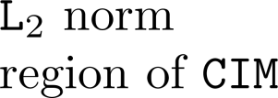




Zero-Order Statistics of RFI to Scale CIM
Zero-order statistics (ZOS) [Gonzalez et al., 2006]
  Use as approximate Gaussian power
Approximate lower bound on error
Window of
received samples
Scale CIM Space

Slide 28
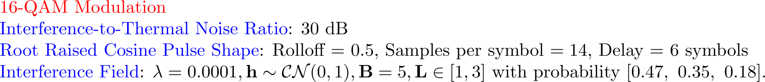
Simulation Results
>20 dB gain
5dB

Slide 29
Conclusions
Contribution #1
Statistical Modeling of RFI
Instantaneous statistics of RFI
Applicability to ad hoc, cellular, local area & femtocell networks
Contribution #2
Communication Performance Analysis of Wireless Networks
Decentralized wireless networks with temporal correlation
Unveiled 2x “potential” improvement in network throughput
Contribution #3
RFI Mitigation at PHY Layer
Pre-filtering methods mitigate RFI
Improve link efficiency up to 20 dB

Slide 30
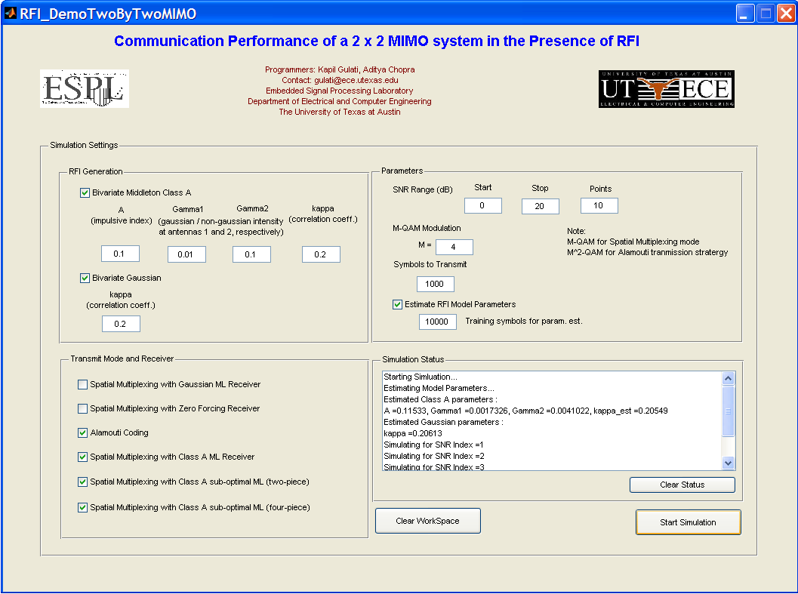
Software Release
K. Gulati, M. Nassar, A. Chopra, B. Okafor, M. R. DeYoung, N. Aghasadeghi, A. Sujeeth, and B. L. Evans, "Radio Frequency Interference Modeling and Mitigation Toolbox in MATLAB", copyright © 2006-2011 by The University of Texas at Austin.
Latest Toolbox Release: Version 1.6, April 2011
Website: http://users.ece.utexas.edu/~bevans/projects/rfi/software
Snapshot of a demo

Slide 31
Future Work
Statistical Modeling
  Non-Poisson based interferer locations
Communication Performance Analysis of Wireless Networks
  Multi-hop communications
Receiver Design to Mitigate RFI
  MAC: Decentralized protocol to control temporal dependence
  PHY: Use of ZOS scaled CIM as distance measure
Extensions to
  Single-carrier MIMO
  Single-antenna OFDM
  MIMO-OFDM

Slide 32
Related Publications
Journal Publications
K. Gulati, B. L. Evans, and S. Srikanteshwara, “Interference Modeling and Mitigation in Decentralized Wireless Networks with Temporal Correlation”, in preparation.
K. Gulati, R. K. Ganti, J. G. Andrews, B. L. Evans, and S. Srikanteshwara, “Throughput, Delay, and Reliability of Decentralized Wireless Networks with Temporal Correlation”, IEEE Transactions on Wireless Communications, to be submitted.
K. Gulati, B. L. Evans, J. G. Andrews, and K. R. Tinsley, “Statistics of Co-Channel Interference in a Field of Poisson and Poisson-Poisson Clustered Interferers”, IEEE Transactions on Signal Processing, Vol. 58, No. 19, Dec 2010.
M. Nassar, K. Gulati, M. R. DeYoung, B. L. Evans and K. R. Tinsley, “Mitigating Near-Field Interference in Laptop Embedded Wireless Transceivers”, Journal of Signal Processing Systems, Mar. 2009, invited paper.
Conference Publications
M. Nassar, K. Gulati, Y. Mortazavi, and B. L. Evans, “Statistical Modeling of Asynchronous Impulsive Noise in Powerline Communication Networks”, Proc. IEEE Global Communications Conf., Dec. 5-9, 2011, Houston, Texas, USA, submitted.

Slide 33
Related Publications
Conference Publications (cont…)
K. Gulati, B. L. Evans, and K. R. Tinsley, “Statistical Modeling of Co-Channel Interference in a Field of Poisson Distributed Interferers”, Proc. IEEE Int. Conf. on Acoustics, Speech, and Signal Proc., Mar. 14-19, 2010, Dallas, Texas USA.
K. Gulati, A. Chopra, B. L. Evans, and K. R. Tinsley, “Statistical Modeling of Co-Channel Interference”, Proc. IEEE Int. Global Communications Conf., Nov. 30-Dec. 4, 2009, Honolulu, Hawaii.
A. Chopra, K. Gulati, B. L. Evans, K. R. Tinsley, and C. Sreerama, “Performance Bounds of MIMO Receivers in the Presence of Radio Frequency Interference”, Proc. IEEE Int. Conf. on Acoustics, Speech, and Signal Proc., Apr. 19-24, 2009, Taipei, Taiwan.
K. Gulati, A. Chopra, R. W. Heath, Jr., B. L. Evans, K. R. Tinsley, and X. E. Lin, “MIMO Receiver Design in the Presence of Radio Frequency Interference”, Proc. IEEE Int. Global Communications Conf., Nov. 30-Dec. 4th, 2008, New Orleans, LA USA.
M. Nassar, K. Gulati, A. K. Sujeeth, N. Aghasadeghi, B. L. Evans and K. R. Tinsley, “Mitigating Near-Field Interference in Laptop Embedded Wireless Transceivers”, Proc. IEEE Int. Conf. on Acoustics, Speech, and Signal Proc., Mar. 30-Apr. 4, 2008, Las Vegas, NV USA.

Slide 34
Thanks !

Slide 35
Selected References
RFI Modeling
D. Middleton, “Non-Gaussian noise models in signal processing for telecommunications: New methods and results for Class A and Class B noise models”, IEEE Trans. Info. Theory, vol. 45, no. 4, pp. 1129-1149, May 1999.
K. Furutsu and T. Ishida, “On the theory of amplitude distributions of impulsive random noise,” J. Applied Physics, vol. 32, no. 7, pp. 1206–1221, 1961.
J. Ilow and D . Hatzinakos, “Analytic alpha-stable noise modeling in a Poisson field of interferers or scatterers”, IEEE Trans. on Signal Proc., vol. 46, no. 6, pp. 1601-1611, Jun. 1998.
E. S. Sousa, “Performance of a spread spectrum packet radio network link in a Poisson field of interferers,” IEEE Trans. on Info. Theory, vol. 38, no. 6, pp. 1743–1754, Nov. 1992.
X. Yang and A. Petropulu, “Co-channel interference modeling and analysis in a Poisson field of interferers in wireless communications,” IEEE Trans. on Signal Proc., vol. 51, no. 1, pp. 64–76, Jan. 2003.
E. Salbaroli and A. Zanella, “Interference analysis in a Poisson field of nodes of finite area,” IEEE Trans. on Vehicular Tech., vol. 58, no. 4, pp. 1776–1783, May 2009.
M. Z. Win, P. C. Pinto, and L. A. Shepp, “A mathematical theory of network interference and its applications,” Proc. of the IEEE, vol. 97, no. 2, pp. 205–230, Feb. 2009.

Slide 36
Selected References
Parameter Estimation
S. M. Zabin and H. V. Poor, “Efficient estimation of Class A noise parameters via the EM [Expectation-Maximization] algorithms”, IEEE Trans. Info. Theory, vol. 37, no. 1, pp. 60-72, Jan. 1991 .
G. A. Tsihrintzis and C. L. Nikias, "Fast estimation of the parameters of alpha-stable impulsive interference", IEEE Trans. Signal Proc., vol. 44, Issue 6, pp. 1492-1503, Jun. 1996.
Communication Performance of Wireless Networks
M. Haenggi and R. K. Ganti, “Interference in large wireless networks,” in Foundations and Trends in Networking. Now Publishers Inc., Dec. 2008, vol. 3, no. 2, pp. 127-248.
F. Baccelli and B. Blaszczyszyn, “Stochastic geometry and wireless networks, volume 1 – theory”, in Foundations and Trends in Networking. Now Publishers Inc., Mar. 2009, vol. 3, no. 3-4, pp. 249-449.
F. Baccelli and B. Blaszczyszyn, “Stochastic geometry and wireless networks, volume 2 – applications”, in Foundations and Trends in Networking. Now Publishers Inc., Mar. 2009, vol. 4, no. 1-2, pp. 1-312.
R. Ganti and M. Haenggi, “Interference and outage in clustered wireless ad hoc networks,” IEEE Trans. on Info. Theory, vol. 55, no. 9, pp. 4067–4086, Sep. 2009.
A. Hasan and J. G. Andrews, “The guard zone in wireless ad hoc networks,” IEEE Trans. on Wireless Comm., vol. 4, no. 3, pp. 897–906, Mar. 2007.

Slide 37
Selected References
Communication Performance of Wireless Networks (cont…)
X. Yang and G. de Veciana, “Inducing multiscale spatial clustering using multistage MAC contention in spread spectrum ad hoc networks,” IEEE/ACM Trans. on Networking, vol. 15, no. 6, pp. 1387–1400, Dec. 2007.
S. Weber, X. Yang, J. G. Andrews, and G. de Veciana, “Transmission capacity of wireless ad hoc networks with outage constraints,” IEEE Trans. on Info. Theory, vol. 51, no. 12, pp. 4091-4102, Dec. 2005.
S. Weber, J. G. Andrews, and N. Jindal, “The effect of fading, channel inversion, and threshold scheduling on ad hoc networks,” IEEE Trans. on Info. Theory, vol. 53, no. 11, pp. 4127-4149, Nov. 2007.
J. G. Andrews, S. Weber, M. Kountouris, and M. Haenggi, “Random access transport capacity,” IEEE Trans. On Wireless Comm., vol. 9, no. 6, pp. 2101-2111, Jun. 2010.
M. Haenggi, “Local delay in static and highly mobile Poisson networks with ALOHA," in Proc. IEEE Int. Conf. on Comm., Cape Town, South Africa, May 2010.
F. Baccelli and B. Blaszczyszyn, “A New Phase Transitions for Local Delays in MANETs,” in Proc. of IEEE Int. Conf. on Computer Comm., San Diego, CA, Mar. 14-19 2010, pp. 1-6.
R. K. Ganti and M. Haenggi, “Spatial and Temporal correlation of the interference in ALOHA ad hoc networks,” IEEE Comm. Letters, vol. 13, no. 9, pp. 631-633, Sep. 2009.
H. Inaltekin, S. B. Wicker, M. Chiang, and H. V. Poor, "On unbounded path-loss models: effects of singularity on wireless network performance," IEEE Journal on Selected Areas in Comm., vol. 27, no. 7, pp. 1078-1092, Sep. 2009.

Slide 38
Selected References
Receiver Design to Mitigate RFI
A. Spaulding and D. Middleton, “Optimum Reception in an Impulsive Interference Environment-Part I: Coherent Detection”, IEEE Trans. Comm., vol. 25, no. 9, Sep. 1977
J.G. Gonzalez and G.R. Arce, “Optimality of the Myriad Filter in Practical Impulsive-Noise Environments”, IEEE Trans. on Signal Proc., vol. 49, no. 2, Feb 2001
S. Ambike, J. Ilow, and D. Hatzinakos, “Detection for binary transmission in a mixture of Gaussian noise and impulsive noise modelled as an alpha-stable process,” IEEE Signal Proc. Letters, vol. 1, pp. 55–57, Mar. 1994.
G. R. Arce, Nonlinear Signal Processing: A Statistical Approach, John Wiley & Sons, 2005.
Y. Eldar and A. Yeredor, “Finite-memory denoising in impulsive noise using Gaussian mixture models,” IEEE Trans. on Circuits and Systems II: Analog and Digital Signal Proc., vol. 48, no. 11, pp. 1069-1077, Nov. 2001.
J. H. Kotecha and P. M. Djuric, “Gaussian sum particle filtering,” IEEE Trans. on Signal Proc., vol. 51, no. 10, pp. 2602-2612, Oct. 2003.
J. G. Gonzalez, J. L. Paredes, and G. R. Arce, "Zero-order statistics: A mathematical framework for the processing and characterization of very impulsive signals," IEEE Trans. on Signal Proc., vol. 54, no. 10, pp. 3839-3851, Oct. 2006.

Slide 39
Selected References
Receiver Design to Mitigate RFI
J. G. Gonzalez, J. L. Paredes, and G. R. Arce, "Zero-order statistics: A mathematical framework for the processing and characterization of very impulsive signals," IEEE Trans. on Signal Proc., vol. 54, no. 10, pp. 3839-3851, Oct. 2006.
W. Liu, P. P. Pokharel, and J. C. Principe, "Correntropy: Properties and applications in non-Gaussian signal processing," IEEE Trans. on Signal Proc., vol. 55, no. 11, pp. 5286-5298, 2007.
W. Liu, P. P. Pokharel, and J. C. Principe, "Error entropy, correntropy and M-estimation," in Proc. IEEE Workshop on Machine Learning for Signal Proc., Arlington, VA, Sep. 6-8 2006, pp. 179-184.
J. Haring and A. J. H. Vinck, "Iterative decoding of codes over complex numbers for impulsive noise channels," IEEE Trans. on Info. Theory, vol. 49, no. 5, pp. 1251-1260, May 2003.

Slide 40
Backup Slides
Introduction
  Summary of interference mitigation methods
  Interference avoidance, alignment, and cancellation methods
  Femtocell networks
Statistical Modeling of RFI
  Impact of RFI
  Computational platform noise modeling results
  Transients in digital FIR filters
  Spatial Poisson Point Process
  Poisson field of interferers
  Poisson-Poisson cluster field of interferers
Backup
Backup
Backup
Backup
Backup
Backup
Backup
Backup
Backup

Slide 41
Backup Slides (cont…)
Communication Performance of Wireless Networks
  Performance Analysis of Wireless Networks
  Ad hoc networks with guard zones
  Local Delay
  Decentralized networks with temporal correlation
    Local Delay
    Throughput Outage Probability
    Transmission Capacity
Parameter Estimation
  Expectation maximization overview
  Extreme order statistics based estimator for Alpha Stable
Backup
Backup
Backup
Backup
Backup
Backup
Backup
Backup

Slide 42
Backup Slides (cont…)
Receiver Design to Mitigate RFI
  Gaussian mixture vs. Alpha Stable
  Mitigating RFI in SISO systems
  Mitigating RFI in 2x2 MIMO systems
  Pre-filtering methods to mitigate RFI
Pre-filtering methods to mitigate GMM distributed RFI
  Joint temporal statistics
  Distance Measure
  Correntropy Induced Metric
  Zero-order Statistics
Backup
Backup
Backup
Backup
Backup
Backup
Backup
Backup

Slide 43
Backup Slides (cont…)
Pre-filtering methods to mitigate GMM RFI (cont…)
  Pre-filters
  Computational complexity
  Applications of ZOS scaled CIM space
    OFDM
    Turbo Decoders
Backup
Backup
Backup
Backup

Slide 44
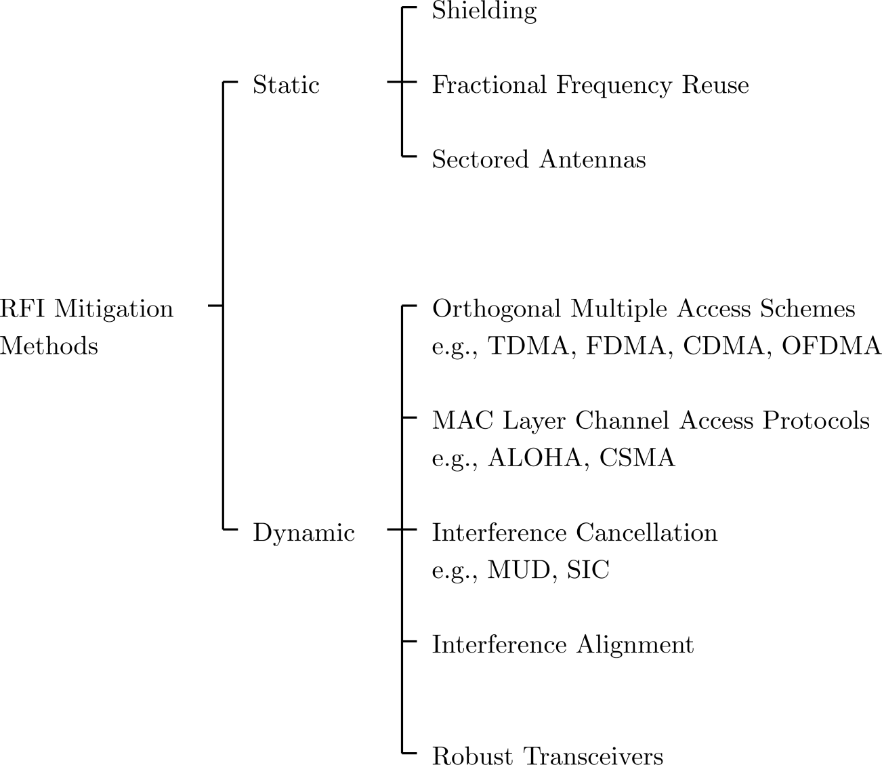
Interference Mitigation Techniques
Return

Slide 45
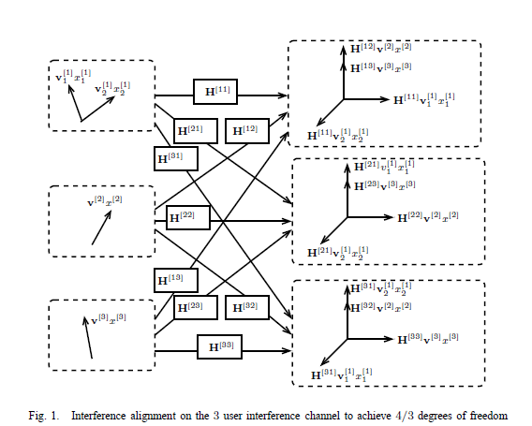
Interference Mitigation Techniques (cont…)
Interference avoidance
  CSMA / CA
Interference alignment
  Example:
  [Cadambe & Jafar, 2007]
Return

Slide 46
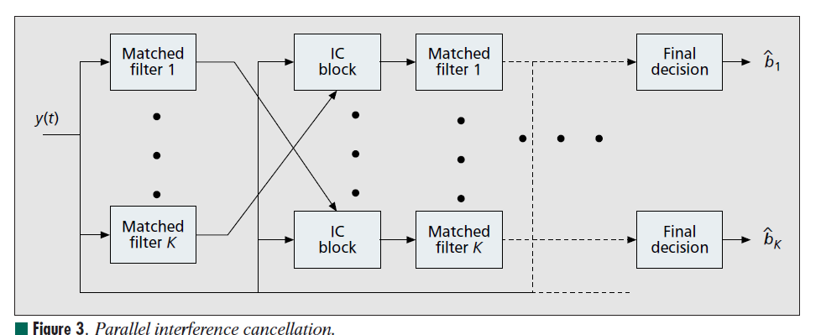
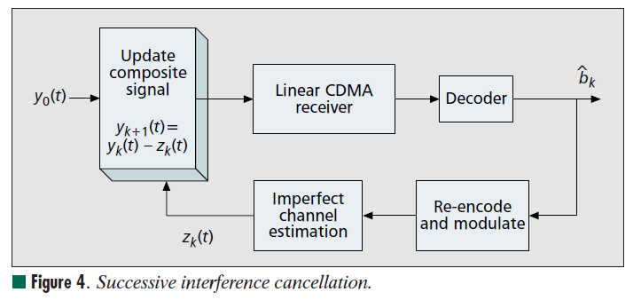
Interference Mitigation Techniques (cont…)
Interference cancellation
Ref: J. G. Andrews, ”Interference Cancellation for Cellular Systems: A Contemporary Overview”, IEEE Wireless Communications Magazine, Vol. 12, No. 2, pp. 19-29, April 2005
Return

Slide 47
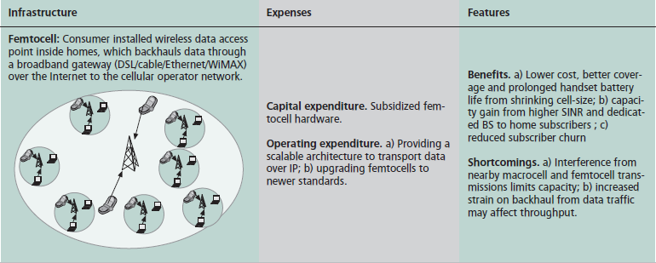
Femtocell Networks
Reference:
V. Chandrasekhar, J. G. Andrews and A. Gatherer, "Femtocell Networks: a Survey", IEEE Communications Magazine, Vol. 46, No. 9, pp. 59-67, September 2008
Return

Slide 48
Common Spectral Occupancy
48
Return
Standard | Carrier (GHz) | Wireless Networking | Interfering Clocks and Busses
Bluetooth | 2.4 | Personal Area Network | Gigabit Ethernet, PCI Express Bus, LCD clock harmonics
IEEE 802. 11 b/g/n | 2.4 | Wireless LAN (Wi-Fi) | Gigabit Ethernet, PCI Express Bus, LCD clock harmonics
IEEE 802.16e | 2.5–2.69 3.3–3.8 5.725–5.85 | Mobile Broadband (Wi-Max) | PCI Express Bus, LCD clock harmonics
IEEE 802.11a | 5.2 | Wireless LAN (Wi-Fi) | PCI Express Bus, LCD clock harmonics

Slide 49
Impact of RFI
49
Calculated in terms of desensitization (“desense”)
  Interference raises noise floor
  Receiver sensitivity will degrade to maintain SNR
  Desensitization levels can exceed 10 dB for 802.11a/b/g due to computational platform noise
  [J. Shi et al., 2006]
    Case Sudy: 802.11b, Channel 2, desense of 11dB
    More than 50% loss in range
    Throughput loss up to ~3.5 Mbps for very low receive signal strengths
    (~ -80 dbm)
Return

Slide 50
Impact of LCD clock on 802.11g
50
Pixel clock 65 MHz
LCD Interferers and 802.11g center frequencies
Return
LCD Interferers | 802.11g Channel | Center Frequency | Difference of Interference from Center Frequencies | Impact
2.410 GHz | Channel 1 | 2.412 GHz | ~2 MHz | Significant
2.442 GHz | Channel 7 | 2.442 GHz | ~0 MHz | Severe
2.475 GHz | Channel 11 | 2.462 GHz | ~13 MHz | Just outside Ch. 11. Impact minor

Slide 51
Results on Measured RFI Data
25 radiated computer platform RFI data sets from Intel
50,000 samples taken at 100 MSPS
Return
Wireless Networking and Communications Group

Slide 52
Results on Measured RFI Data
For measurement set #23
Return

Slide 53

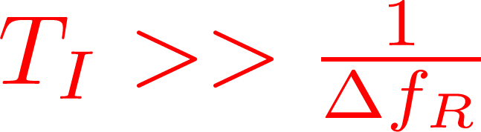
Transients in Digital FIR Filters
Input
25-Tap FIR Filter
Low pass
Stopband freq. 0.22 (normalized)
Output
Return
Freq = 0.16
Interference duration = 10 * 1/0.22
Interference duration = 100 x 1/0.22
Transients
Transients Significant w.r.t. Steady State
Transients Ignorable w.r.t. Steady State

Slide 54
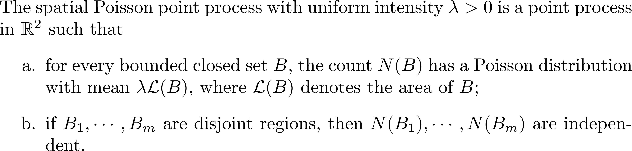
Homogeneous Spatial Poisson Point Process
Return

Slide 55
Poisson Field of Interferers
Applied to wireless ad hoc networks, cellular networks
Return
Closed Form Amplitude Distribution
Model | Interference | Region | Key Prior Work
Symmetric Alpha Stable | Spatial | Entire plane | [Sousa, 1992] [Ilow & Hatzinakos, 1998] [Yang & Petropulu, 2003]
Middleton Class A | Spatio-temporal | Finite area | [Middleton, 1977, 1999]
Other Interference Statistics – closed form amplitude distribution not derived
Statistics | Interference | Region | Key Prior Work
Moments | Spatial | Finite area | [Salbaroli & Zanella, 2009]
Characteristic Function | Spatial | Finite area | [Win, Pinto & Shepp,2009]
Notes:
Actions:
Should mention Shot-Noise related work.
Questions:

Slide 56
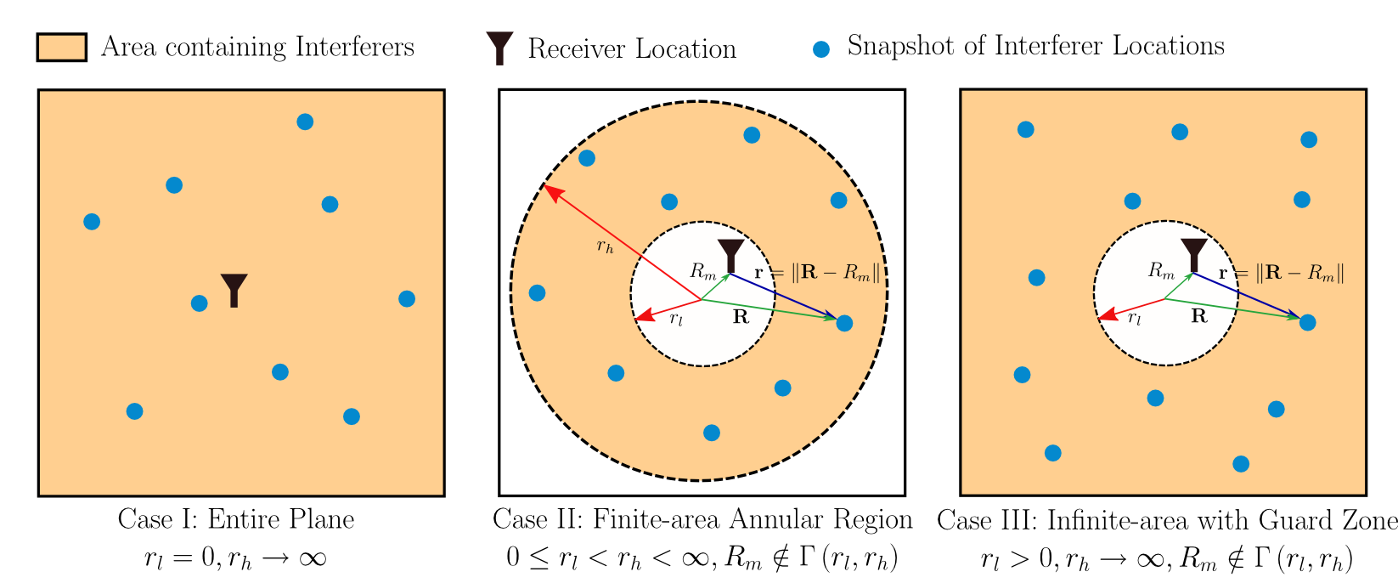
Poisson Field of Interferers
Interferers distributed over parametric annular space
Log-characteristic function
Return

Slide 57
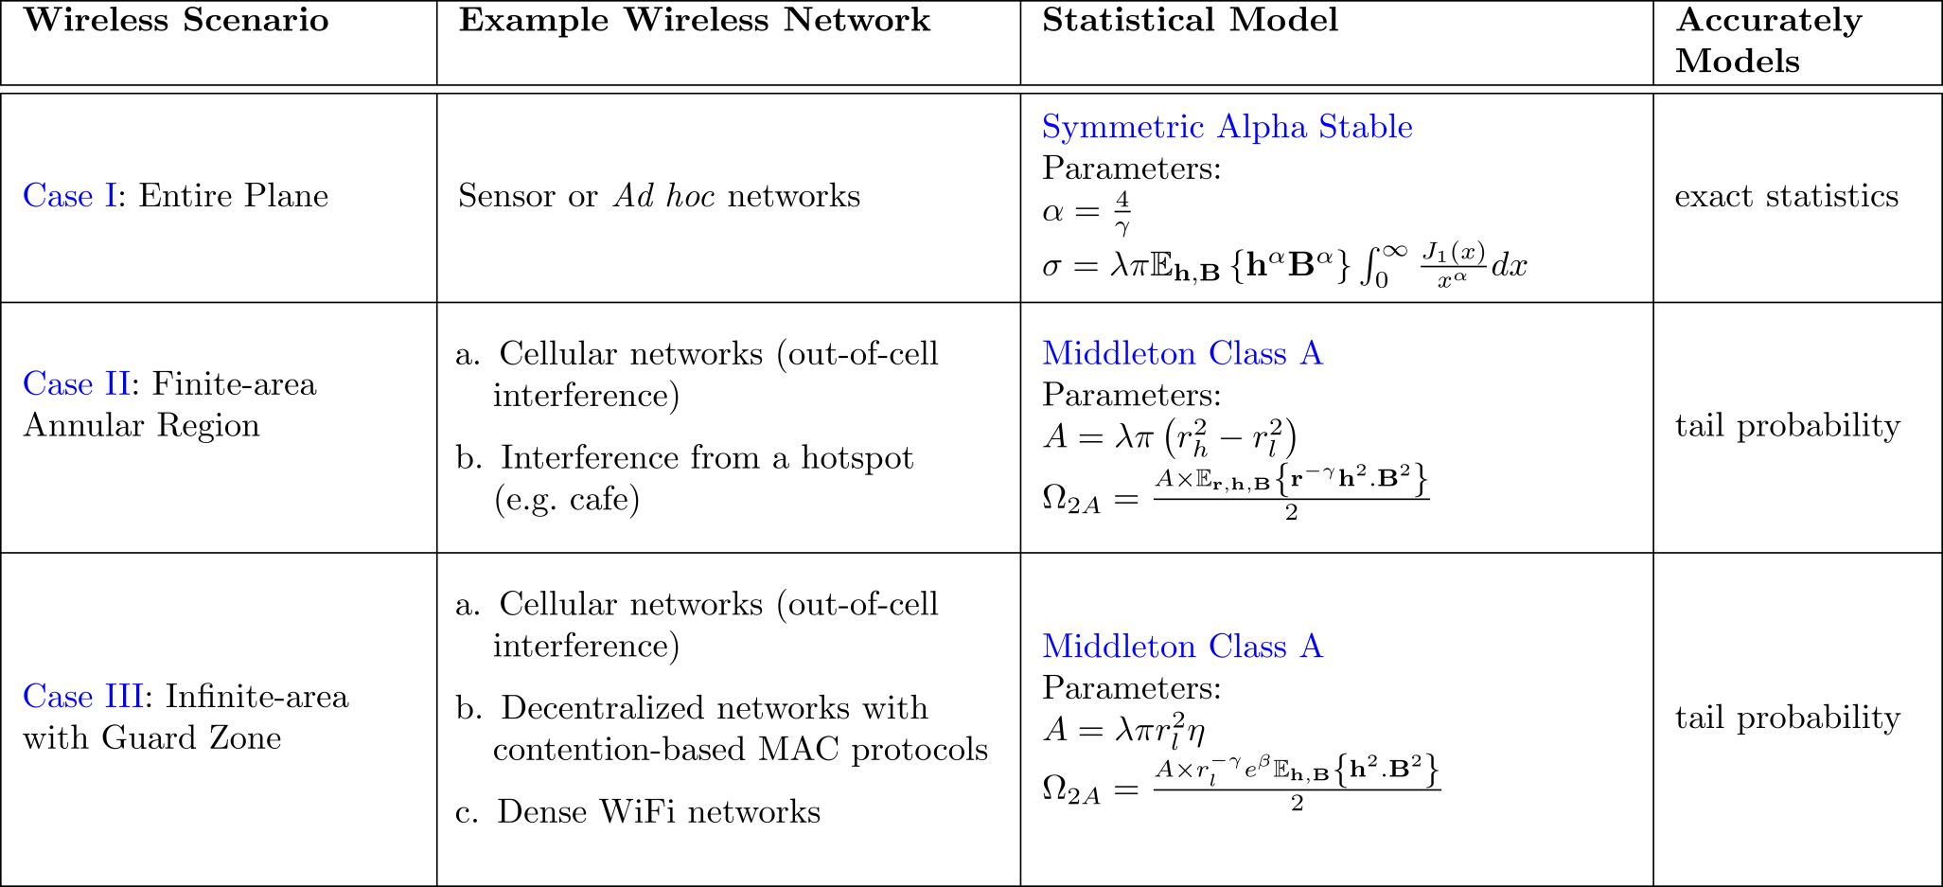
Poisson Field of Interferers
Return

Slide 58
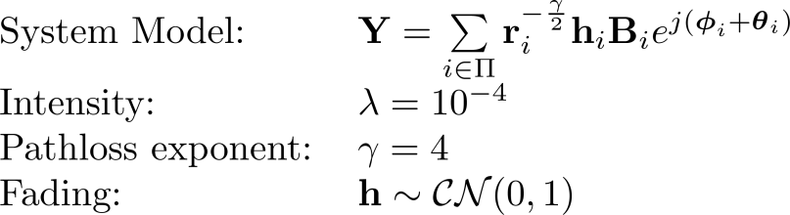
Poisson Field of Interferers
Return
Simulation Results
(tail probability)
Case I: Entire Plane
Case III: Infinite-area with guard zone
Gaussian and Middleton Class A models are not applicable since mean intensity is infinite

Slide 59
Poisson Field of Interferers
Simulation Results (tail probability)
Return
Case II: Finite area annular region
Notes:
Question:
1. Middleton Class A kinda underestimates the impulsiveness of noise. P(mca > a) < P (Y > a). This might be an issue.

Slide 60
Poisson-Poisson Cluster Field of Interferers
Applied to femtocell networks, cellular and ad hoc networks with user clustering
Clustering due to
  Geographical factors (femtocell networks)
  Medium Access Control (MAC) layer protocols
  [Yang & de Veciana, 2007]
Prior Work
  Closed form amplitude distribution not derived
Return
Statistics | Interference | Region | Key Prior Work
Outage Probability | Spatial | Entire Plane | [Ganti & Haenggi, 2009]
Characteristic Function | Temporal | - | [Furutsu & Ishida, 1961]
Notes:
Questions:
1. MAC clustering example ?

Slide 61
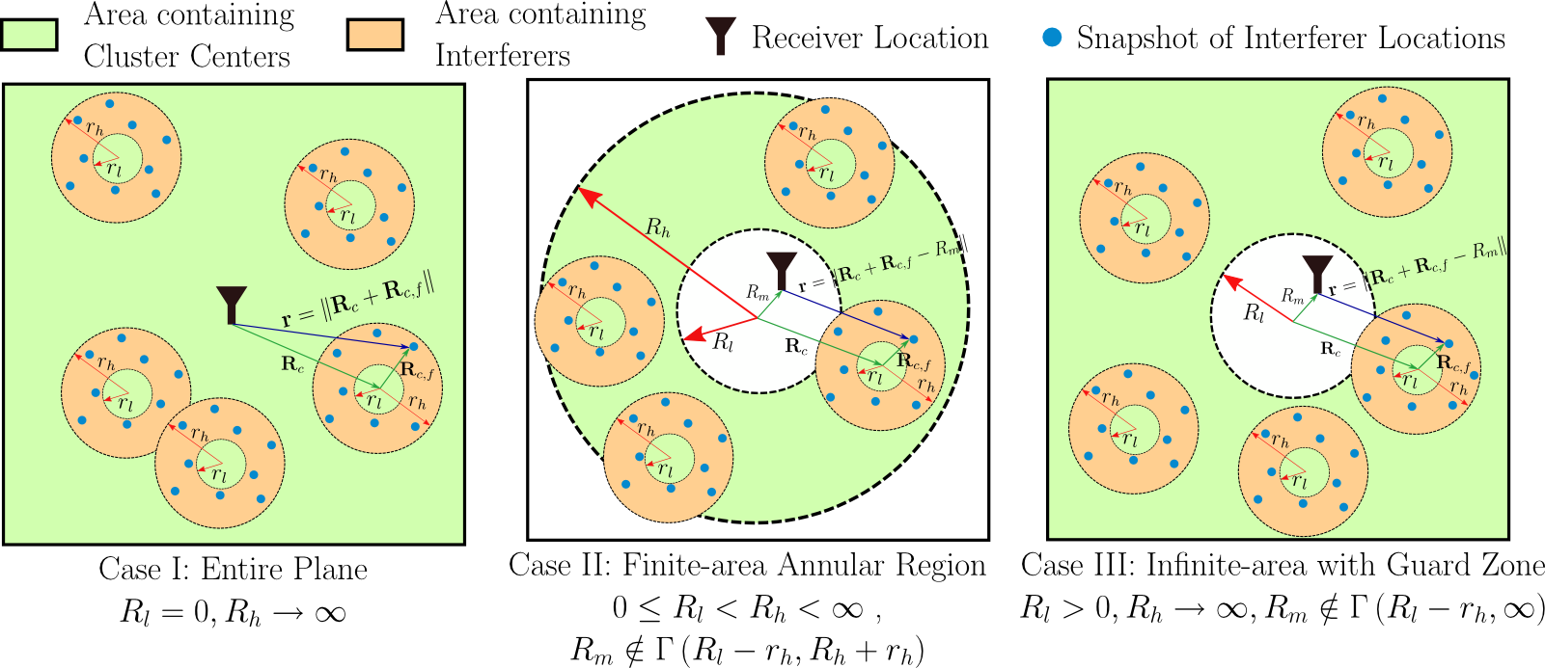
Poisson-Poisson Cluster Field of Interferers
Cluster centers distributed as spatial Poisson process over
Interferers distributed as spatial Poisson process
Return

Slide 62
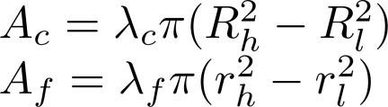
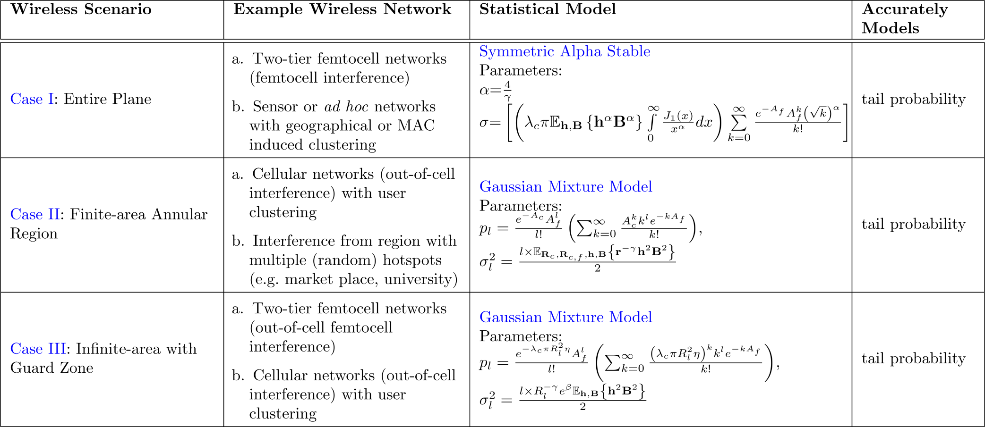
Poisson-Poisson Cluster Field of Interferers
Log-Characteristic function
Return

Slide 63
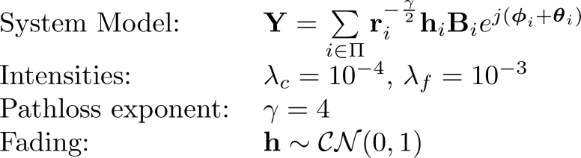
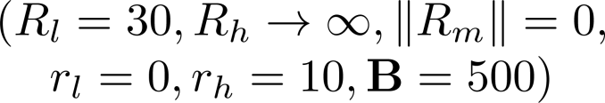
Poisson-Poisson Cluster Field of Interferers
Return
Simulation Results
(tail probability)
Case I: Entire Plane
Case III: Infinite-area with guard zone
Gaussian and Gaussian mixture models are not applicable since mean intensity is infinite

Slide 64
Poisson-Poisson Cluster Field of Interferers
Simulation Results (tail probability)
Return
Case II: Finite area annular region

Slide 65
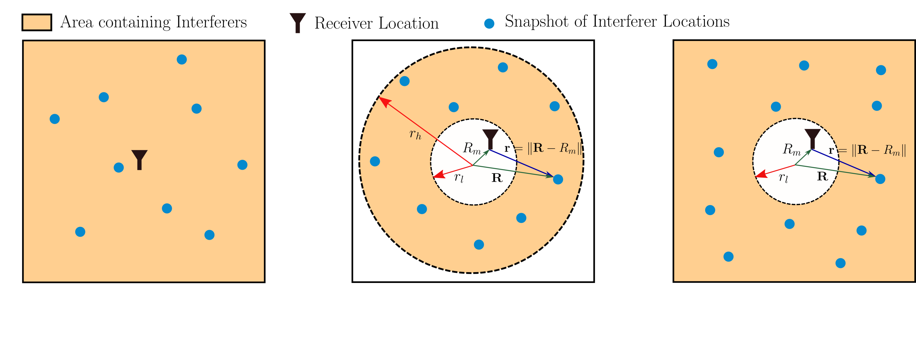
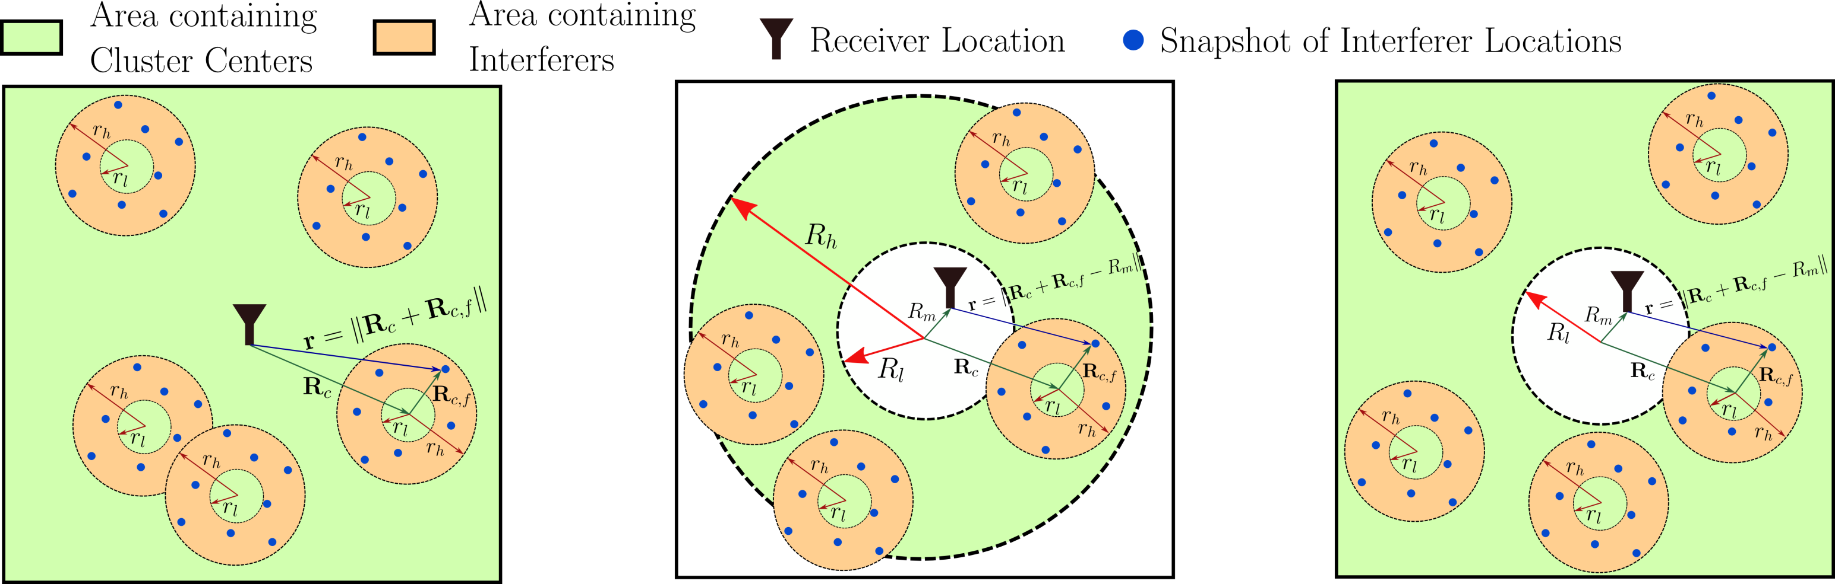
Summary of Contribution #1
Return
Symmetric Alpha Stable
Gaussian Mixture Model
Poisson field of interferers
Ad hoc networks
Cellular networks
Sensor networks
Ad hoc networks
Cellular networks
Hotspots (e.g. café)
Dense Wi-Fi networks
Poisson-Poisson Cluster field of interferers
Femtocell networks
In-cell and out-of-cell femtocell users
Cluster of hotspots
(e.g. marketplace)
Out-of-cell femtocell users

Slide 66
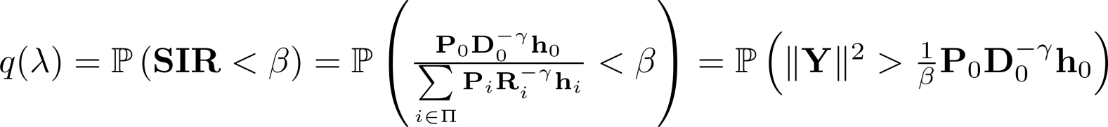
Performance Analysis of Wireless Networks
Interference statistics useful for
  Communication performance analysis of wireless networks
  Deriving network strategies to improve performance
    Both Physical (PHY) and Medium Access Control (MAC) Layer
Communication performance measures
Return
Outage Probability
Key Prior Work Derives bounds in Poisson field of interferers [Weber, Andrews & Jindal, 2007] Proposed Work Improve analysis based on tail probabilities of statistical models

Slide 67
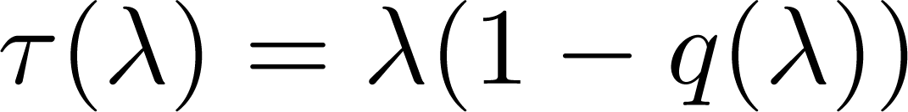
Performance Analysis of Wireless Networks (cont…)
Return
Proposed Contribution #2 [future work]
Spatial Throughput [Weber, Andrews & Jindal, 2007]
Expected spatial density of successful transmissions Limitation: Quality-of-service constraints not included
Transmission Capacity [Weber, Yang, Andrews & de Veciana, 2005]
Enables quantitative design tradeoffs for both PHY and MAC layer techniques Limitation: Only simultaneous single hop transmissions captured
Random Access Transport Capacity [Andrews, Weber, Kountouris & Haenggi, 2010]
Includes multihop transmissions Bridges gap between asymptotic throughput scaling and transmission capacity
Local Delay [Haenggi, 2010][Baccelli & Blaszczyszyn, 2010]
Expected number of retransmissions for successful reception of packet

Slide 68

Ad hoc Networks with Guard Zones (GZs)
System Model
Return

Slide 69

Point Processes for Networks with GZs
Modified Matern hardcore [Baccelli, 2009]
  Neighbor set (received power based) [Baccelli, 2009]
  Neighbor set (distance based) [Hasan & Andrews, 2007]
  Limitation: Underestimates intensity
Simple Sequential Inhibition [Busson, Chelius & Gorce, 2009]
  Even intensity expression not known
Return
1
2
3

Slide 70

Ad hoc networks with GZ: Prior Work
Transmission Capacity, Optimum GZ size
[Hasan & Andrews, 2007]
  AS1: Poisson distributed
  AS2: Sum interference is Gaussian
  AS3: Distance based GZ creation
  Limitation: Gaussian assumption may not be valid
  Plan of Work: Use Middleton Class A statistics
Return

Slide 71

Ad hoc networks with GZ: Prior Work
Outage Probability [Baccelli, 2009]
  AS1: Poisson distributed
  AS2: Received power based GZ creation
  Limitation: Closed form for Rayleigh fading only
Return

Slide 72


Probability of Successful Transmission
Return

Slide 73



Local Delay: Definition
Expected time slots till packet is successfully received
Probability of success
Conditional Local Delay – Geometric with mean
Local Delay
Return

Slide 74


Local Delay: Prior Work
Prior Work [Haenggi, 2010][Baccelli, 2010]
Phase transition for static Poisson networks
  Due to SINR model for connectivity
  Avoided by using adaptive coding [Baccelli, 2010]
Return
Poisson Networks with ALOHA
Static | Highly Mobile
Finite for transmit probability (for ALOHA) below a threshold | Finite local delay
Minimum Local Delay:

Slide 75


Local Delay
Return

Slide 76
Local Delay (cont…)
Return
Network Model I
Network Model II

Slide 77

Throughput Outage Probability
Return
Derived closed-form expressions using joint tail probability
Network Model II

Slide 78
Throughput Outage Probability (cont…)
Return
Network Model I

Slide 79
Average Network Throughput
Return
Network Model II

Slide 80

Transmission Capacity
Defined assuming temporal independence [Weber et al., 2005]
Extension:
Return
Goodput: ~1.8x
Motivates designing MAC protocols that achieve optimum lifetime distribution
Network Model II
Improved Reliability

Slide 81

Transmission Capacity (cont…)
Optimal Lifetime distribution (via numerical optimization)
Return
Using fmincon function in MATLAB
Active set algorithm
Network Model II

Slide 82






Expectation Maximization Overview
82
Return

Slide 83

Extreme Order Statistics
83
Return

Slide 84

Parameter Estimators for Alpha Stable
84
Return
0 < p < α

Slide 85

Particle Filtering
Ref: P. Djuric et. al., “Particle Filtering,” IEEE Signal Processing Magazine, vol. 20, no. 5, September 2003, pp: 19-38.
Return

Slide 86
Gaussian Mixture vs. Alpha Stable
Gaussian Mixture vs. Symmetric Alpha Stable
Return
 | Gaussian Mixture | Symmetric Alpha Stable
Modeling | Interferers distributed with Guard zone around receiver (actual or virtual due to PL) | Interferers distributed over entire plane
Pathloss Function | With GZ: singular / non-singular Entire plane: non-singular | Singular form
Thermal Noise | Easily extended (sum is Gaussian mixture) | Not easily extended (sum is Middleton Class B)
Outliers | Easily extended to include outliers | Difficult to include outliers

Slide 87
RFI Mitigation in SISO Systems
87
Return
Mitigation of computational platform noise in single carrier, single antenna systems [Nassar, Gulati, DeYoung, Evans & Tinsley, ICASSP 2008, JSPS 2009]
Computer Platform Noise Modelling | Evaluate fit of measured RFI data to noise models Middleton Class A model Symmetric Alpha Stable
Parameter Estimation | Evaluate estimation accuracy vs complexity tradeoffs
Filtering / Detection | Evaluate communication performance vs complexity tradeoffs Middleton Class A: Correlation receiver, Wiener filtering, and Bayesian detector Symmetric Alpha Stable: Myriad filtering, hole punching, and Bayesian detector

Slide 88
Filtering and Detection
  Assumption
  Multiple samples of the received signal are available
  N Path Diversity [Miller, 1972]
  Oversampling by N [Middleton, 1977]
88
Impulsive Noise
Pulse
Shaping
Pre-Filtering
Matched Filter
Detection Rule
Return
Middleton Class A noise
Symmetric Alpha Stable noise
Filtering
Wiener Filtering (Linear)
Detection
Correlation Receiver (Linear)
Bayesian Detector
[Spaulding & Middleton, 1977]
Small Signal Approximation to Bayesian detector
[Spaulding & Middleton, 1977]
Filtering
Myriad Filtering
  Optimal Myriad
  [Gonzalez & Arce, 2001]
  Selection Myriad
Hole Punching
[Ambike et al., 1994]
Detection
Correlation Receiver (Linear)
MAP approximation
[Kuruoglu, 1998]

Slide 89
Results: Class A Detection
89
Communication Performance
Return
Binary Phase Shift Keying
Pulse shape Raised cosine 10 samples per symbol 10 symbols per pulse | Channel A = 0.35 Γ = 0.5 × 10⁻³ Memoryless
Method | Comp. Complexity | Detection Perform.
Correl. | Low | Low
Wiener | Medium | Low
Bayesian S.S. Approx. | Medium | High
Bayesian | High | High

Slide 90
Results: Alpha Stable Detection
90
Communication Performance
Return
Same transmitter settings as previous slide
Method | Comp. Complexity | Detection Perform.
Hole Punching | Low | Medium
Selection Myriad | Low | Medium
MAP Approx. | Medium | High
Optimal Myriad | High | Medium
Use dispersion parameter γ in place of noise variance to generalize SNR

Slide 91
RFI Mitigation in 2x2 MIMO Systems
91
2 x 2 MIMO receiver design in the presence of RFI
[Gulati, Chopra, Heath, Evans, Tinsley & Lin, Globecom 2008]
Return
RFI Modeling | Evaluated fit of measured RFI data to the bivariate Middleton Class A model [McDonald & Blum, 1997] Includes noise correlation between two antennas
Parameter Estimation | Derived parameter estimation algorithm based on the method of moments (sixth order moments)
Performance Analysis | Demonstrated communication performance degradation of conventional receivers in presence of RFI Bounds on communication performance [Chopra , Gulati, Evans, Tinsley, and Sreerama, ICASSP 2009]
Receiver Design | Derived Maximum Likelihood (ML) receiver Derived two sub-optimal ML receivers with reduced complexity

Slide 92







Bivariate Middleton Class A Model
Joint spatial distribution
Return
Parameter | Description | Typical Range
 | Overlap Index. Product of average number of emissions per second and mean duration of typical emission
 | Ratio of Gaussian to non-Gaussian component intensity at each of the two antennas
 | Correlation coefficient between antenna observations

Slide 93
Results on Measured RFI Data
Return
50,000 baseband noise samples represent broadband interference
Estimated Parameters
Bivariate Middleton Class A
Overlap Index (A) | 0.313 | 2D- KL Divergence 1.004
Gaussian Factor (Γ₁) | 0.105
Gaussian Factor (Γ₂) | 0.101
Correlation (κ) | -0.085
Bivariate Gaussian
Mean (µ) | 0 | 2D- KL Divergence 1.6682
Variance (σ₁) | 1
Variance (σ₂) | 1
Correlation (κ) | -0.085
Marginal PDFs of measured data compared with estimated model densities

Slide 94




System Model
Return
2 x 2 MIMO System
Maximum Likelihood (ML) receiver
Log-likelihood function
Sub-optimal ML Receivers
approximate

Slide 95





Sub-Optimal ML Receivers
95
Two-piece linear approximation
Four-piece linear approximation
Return
Approximation of
chosen to minimize

Slide 96
Results: Performance Degradation
Performance degradation in receivers designed assuming additive Gaussian noise in the presence of RFI
Return
Simulation Parameters
4-QAM for Spatial Multiplexing (SM) transmission mode
16-QAM for Alamouti transmission strategy
Noise Parameters:
A = 0.1, Γ₁= 0.01, Γ₂= 0.1, κ = 0.4
Severe degradation in communication performance in high-SNR regimes

Slide 97
Results: RFI Mitigation in 2 x 2 MIMO
97
Return
Improvement in communication performance over conventional Gaussian ML receiver at symbol error rate of 10⁻²
A | Noise Characteristic | Improve-ment
0.01 | Highly Impulsive | ~15 dB
0.1 | Moderately Impulsive | ~8 dB
1 | Nearly Gaussian | ~0.5 dB
Communication Performance
(A = 0.1, Γ₁= 0.01, Γ₂= 0.1, κ = 0.4)

Slide 98



Results: RFI Mitigation in 2 x 2 MIMO
98
Return
Complexity Analysis for decoding M-level QAM modulated signal
Receiver | Quadratic Forms | Exponential | Comparisons
Gaussian ML | M² | 0 | 0
Optimal ML | 2M² | 2M² | 0
Sub-optimal ML (Four-Piece) | 2M² | 0 | 2M²
Sub-optimal ML (Two-Piece) | 2M² | 0 | M²
Complexity Analysis
Communication Performance
(A = 0.1, Γ₁= 0.01, Γ₂= 0.1, κ = 0.4)

Slide 99

Pre-filtering Methods to Mitigate RFI
Pre-filtering based on statistical models
Gaussian Mixture Filtering (MMSE objective function)
  Non-linear combination of banks of Weiner filter
  Non-linear combination of banks of Gaussian Particle Filters
Return

Slide 100
Pre-filtering for Gaussian mixture noise
Closed form objective function or filter structure for BER optimality not known
Finite-memory minimum mean squared error (MMSE) filter [Eldar & Yeredor, 2001]
  Filtering Gaussian signal in Gaussian mixture noise
  Non-linear combination of bank of Wiener filters
  Good for highly impulsive noise
Gaussian sum particle filters [Kotecha & Djuric, 2003]
  Bank of Gaussian particle filters
Order-statistic filtering
  Linear combination of ordered data
Return

Slide 101

Order Statistic Filtering
Linear combination of order statistics
Return

Slide 102

Joint Temporal Statistics
Bounded Pathloss Function
Return
Network Model II

Slide 103

Distance Measure
Example: Constant signal in noise
Optimal distance measure depends on noise statistics
  Not known for GMM noise
Return
Nearly Gaussian Noise
Impulsive Noise

Slide 104

Correntropy Induced Metric (CIM)
Sample estimator of Correntropy [Liu and Principe, 2007]
Return

Slide 105

Zero-Order Statistics
Return

Slide 106
Zero-Order Statistics (cont…)
“Gaussian part” of non-Gaussian random process
Return

Slide 107




Pre-filters
Return
Selection Pre-filter
Modified Ll Pre-filter
Sliding window
Selection Pre-filter
Ll Pre-filter
J(x) | Optimal for
L₂ Norm | Gaussian
L₁ Norm | Laplacian
CIM | N/A
Adaptive Update with J(error)
Training data

Slide 108
Simulation Results
Return

Slide 109
Simulation Results (cont…)
Return

Slide 110
Simulation Results (cont…)
Gaussian distributed interference
Return

Slide 111





Computational Complexity
Return

Slide 112
Computational Complexity (cont…)
Zero-order statistics from N received samples
  N-1 multiplications
  1 table lookup to evaluate N^{th} root
Correntropy Induced Metric (additional over L2 norm)
  1 multiplication
  1 exponential evaluation (table lookup)
  1 subtraction
  1 square root evaluation (table lookup)
Return
Not required if max/min operation on distance is being performed

Slide 113

Pre-filtering in OFDM Systems
OFDM transmissions with nyquist sampling at receiver
Return

Slide 114
Pre-filtering in OFDM Systems (cont…)
OFDM transmissions with 7x oversampling at receiver
Return

Slide 115




Turbo Decoder
Parity 1
Decoder 1
-
Return
Systematic Data
-
Decoder 2
-
Parity 2
-
Extrinsic Information
A-priori
Information
Independent of channel statistics
Depends on channel statistics
Independent of channel statistics

Slide 116



Turbo Decoder (cont…)
Gaussian noise
Non-Gaussian noise (requires knowledge of noise statistics)
Proposed: Based on ZOS scaled CIM space
Return
S-CIM instead of L₂ norm

Slide 117

Turbo Decoder (Preliminary Results)
Return

Slide 118
ESPL Research in RFI Modeling and Mitigation
ESPL Research in RFI Modeling and Mitigation
RFI Modeling
Student | Methods | Antennas | Carrier | Multipath | Time Samples | Measured Fitting
Kapil | Statistical Physical | Single | Single | No | Dependent | Computational Platform Noise
Aditya | Statistical Physical | Multiple | Single | Yes | Independent
Marcel | Statistical Physical | Single | Multiple | No | Dependent | Computational Platform Noise
Receiver Design in the Presence of RFI
Student | Antennas | Carrier | Coding | Multipath | Focus
Kapil | Single / Multiple | Single | No | No | Filtering methods
Aditya | Single / Multiple | Single | No | Yes | Detection methods
Marcel | Single / Multiple | Single / Mulitple | Yes | No | Filtering and decoding
Multipath indicates if multiple paths from interferer to receiver.
Measured Fitting indicates the pure simulation-based measured fitting results, but
does not include possible results from measured data from the underlying model assumed:
(a) co-channel / adjacent channel (Kapil)
(b) multi-antenna (Aditya)
(c) correlated fitting (Marcel)).
Return

