Slide 1



Towards Power-Efficient and Intelligent Wireless Communication Systems
Yunseong Cho (yscho@utexas.edu)
PhD Committee
Prof. Jeffrey G. Andrews
Prof. Brian L. Evans (Supervisor)
Prof. Grani Hanasusanto
Prof. Hyeji Kim
Prof. Aryan Mokhtari
June. 7, 2023

Slide 2
Outline
Motivation
Review of Contribution #1: Coordinated Beamforming and Power Control for Low-Resolution Systems: Total Power Minimization
Contribution #2: Coordinated Per-Antenna Maximum Power Minimization for Low-Resolution Systems
Contribution #3: Learning-Based Maximum Likelihood Detection with One-Bit ADCs
Contribution #4: Joint Hybrid Beamforming and Power Control Using Deep Reinforcement Learning
Conclusion and Future Works

Slide 3
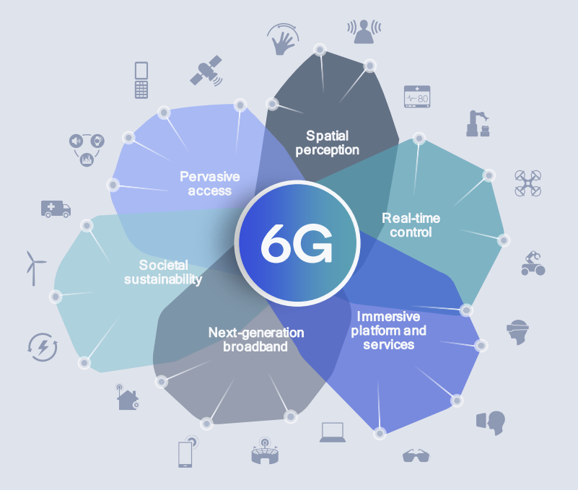
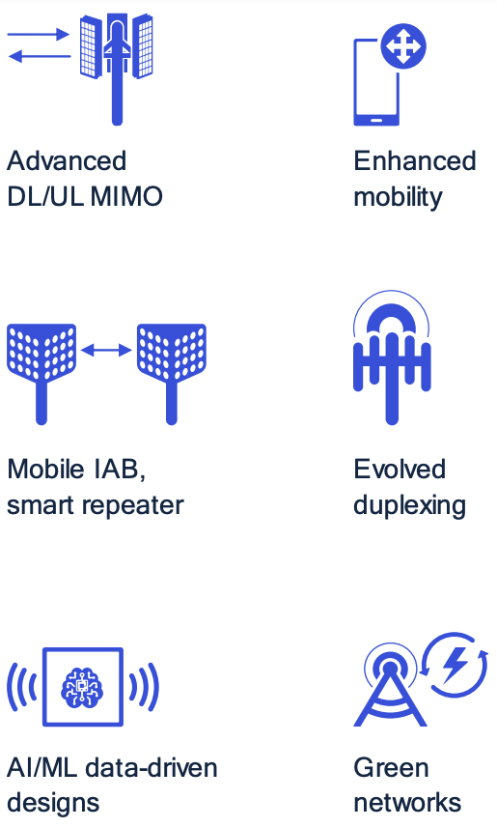
VISION FOR 6G COMMUNICATIONS
*MIMO: Multiple-Input Multiple-Output
4G 5G
3GPP Release 18
Latency
Data Traffic
Peak Data Rate
Sustainable Data Rate
Connectivity
10 ms
7.2 EB/mo
1 Gb/s
10 Mb/s
100k/km²
<1 ms
50 EB/mo
20 Gb/s
100 Mb/s
1M/km²
Beamforming, power control, data detection
for low-power *MIMO systems
[1] https://www.qorvo.com/design-hub/blog/getting-to-5g-comparing-4g-and-5g-system-requirements
[2] Qualcomm, “It’s 2022 — why and what do you need to know about 6G?”
Notes:
[45s] From 4G to 5G, we have achieved many key performance indicators such as latency and data rates.
Now, we are looking at 6G communications to unlock a variety of application spaces.
In the meantime, 3GPP specifies possible research directions that can help us deploy 5G advanced or 6G in practice.
Out of the six items, I will contribute to these three topics by developing beamforming, power control, and data detection mechanism for low-power MIMO systems

Slide 4
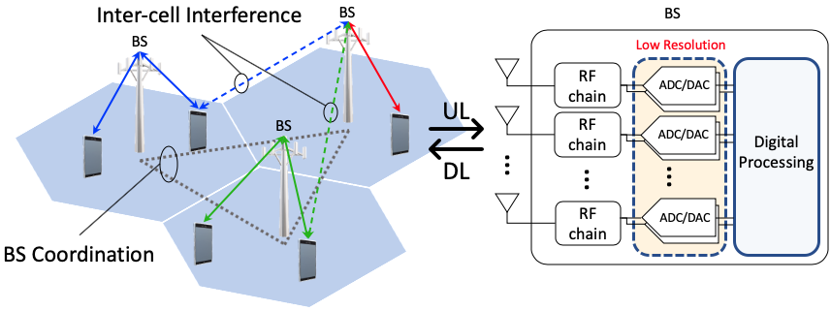

Motivation: Increased Power Consumption of Massive MIMO Systems
#1: Low-resolution data converters
Replace high-res data converters with low-res data converters
Power consumption is exponential in the number of quantization bits ($∝2^{b}$).
Non-trivial quantization error
#2: Hybrid beamforming architecture
Use analog beamformer to project high-dim. input onto low-dim. output.
Directly scale down # of RF chains
Non-convex unit-modulus constraint of analog beamformers
Notes:
The main motivation of my PhD research is the increased power consumption of massive MIMO systems.
To accomplish significant gain in data rates and compensate propagation loss by using beamforming, modern and future communication systems are coupled with Massive MIMO systems.
As we increase the number of antennas, we end up with the increased number of power hungry RF chains.
Therefore, we can come up with two possible low-power architectures.

Slide 5
Contributions
*DRL: Deep Reinforcement Learning
#1: Low-resolution data converters
#2: Hybrid beamforming architecture
2-4 bits
1-bit
Coordinated Beamforming & Power Control
*DRL-based Hybrid Beamforming
#4
Total Power
Minimization
Peak Power
Minimization
Learning-based
Data Detection
#1
#2
#3

Slide 6
Coordinated Beamforming and Power Control for Low-Resolution Systems: Total Power Minimization
Review of Contribution #1
[1] Yunseong Cho, Jinseok Choi, and Brian L. Evans, “Coordinated Multicell Beamforming and Power Allocation for Massive MIMO with low-resolution ADC/DAC”, IEEE International Conference on Communications (ICC), Jun. 2021
[2] Jinseok Choi, Yunseong Cho, and Brian L. Evans, “Quantized Massive MIMO Systems with Multicell Coordinated Beamforming and Power Control”, IEEE Transactions on Communications, vol. 69, no. 2, pp. 946-961, Nov. 2020
Contribution #1: Coordinated Beamforming and Power Control for Low-Resolution Systems: Total Power Minimization

Slide 7
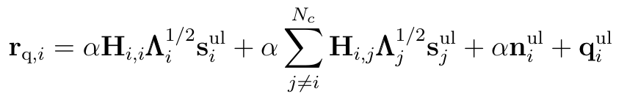
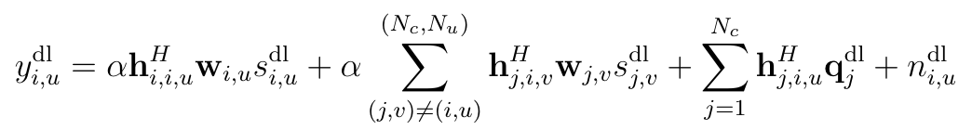


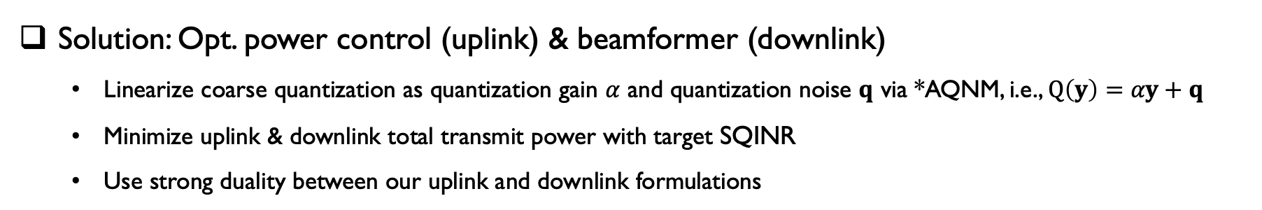



Background
*SQINR: Signal-to-quantization-plus-interference-plus-noise ratio
*AQNM: Additive Quantization Noise Model
Problem: Minimize total transmit power with target *SQINR
Quantization noise from low-resolution (low-power) ADCs and DACs
Thermal noise as well as intra-cell, and inter-cell interference
Solution: Opt. power control (uplink) & beamformer (downlink)
Linearize coarse quantization as quantization gain $α$ and quantization noise $q$ via *AQNM, i.e., $Q\left(y\right)=αy+q$
Minimize uplink & downlink total transmit power with target SQINR
Use strong duality between our uplink and downlink formulations
Quantized received signal in uplink
Quantized received signal in downlink
quantization noise
inter-cell interference
quantization gain $≪$ 1
inter-cell interference
+ inter-user interference
when ${\text{BS}}_{i}$ transmits
Design uplink power control $λ_{i,u}$
Design downlink beamformer $w_{i,u}$
Contribution #1: Coordinated Beamforming and Power Control for Low-Resolution Systems: Total Power Minimization

Slide 8
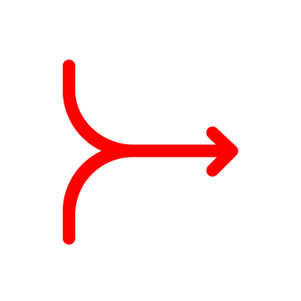
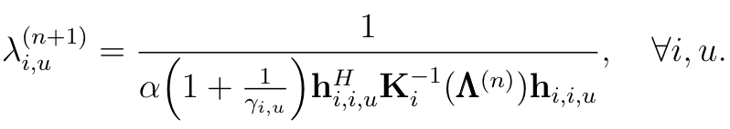

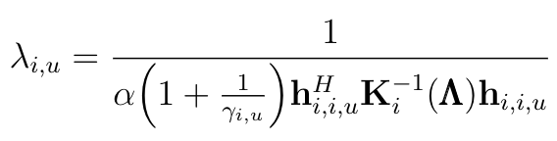
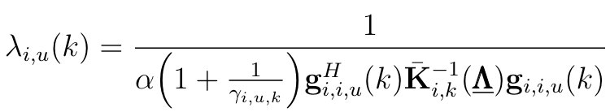


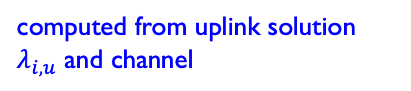



Derived Results and Proposed Algorithm
Proposed Algorithm (NB)
Uplink Total Transmit Power Minimization Problem
Downlink Total Transmit Power Minimization Problem
1) Initialize $λ_{i,u}^{(0)}, ∀i, u$
2) Iteratively update $λ_{i,u}^{(n+1)}$ until converges
3) Find uplink MMSE equalizer $f_{i,u}$ using $λ_{i,u}, ∀i, u.$
4) Compute downlink beamformer $w_{i,u}, ∀i,u$
separate
problems
Theorem 1: Duality
Corollary 1: Strong Duality
Optimal Uplink Solution
Proposed Algorithm (WB)
1) Initialize $λ_{i,u}^{\left(0\right)}\left(k\right), ∀i, u,k$
2) Iteratively update $λ_{i,u}^{(n+1)}$ until converges
3) Find uplink MMSE equalizer $f_{i,u}\left(k\right)$ using $λ_{i,u}\left(k\right), ∀i, u,k.$
4) Compute downlink beamformer $w_{i,u}\left(k\right), ∀i,u,k$
: proved the same results in wideband case
covariance matrix of received signal
locally estimated w/o explicit inter-cell channels!!
$→$ distributed manner
Optimal Downlink Solution
computed from uplink solution $λ_{i,u}$ and channel
computed from $f_{i,u}$ and $h_{i,u}$
convergence is also proved!!
Contribution #1: Coordinated Beamforming and Power Control for Low-Resolution Systems: Total Power Minimization

Slide 9
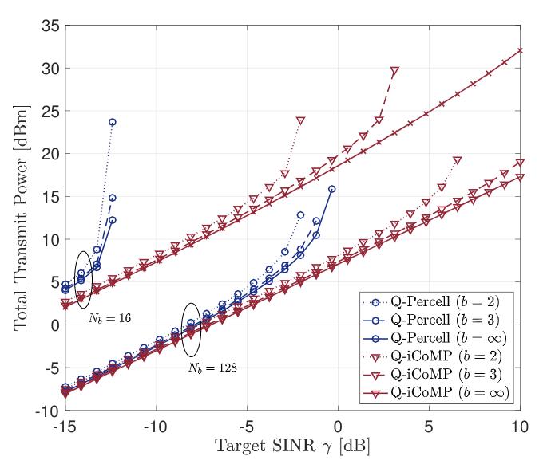
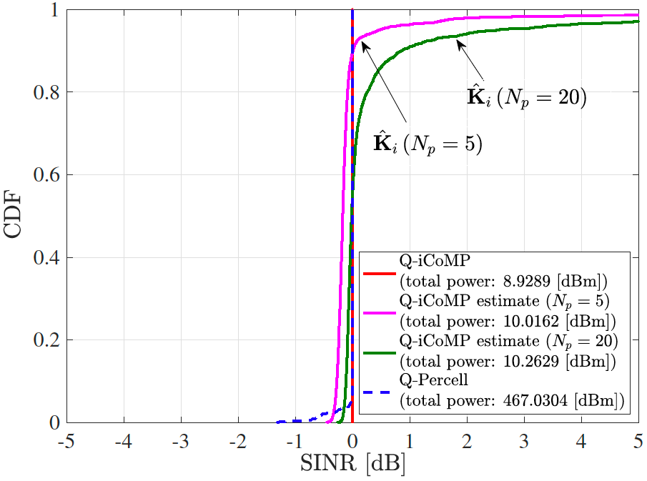
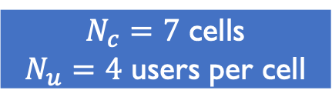
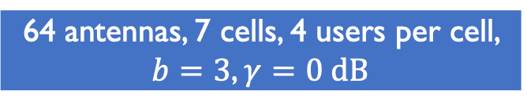
Simulation Results for the Proposed Iterative Coordinated Multipoint (iCoMP)
Target SINR vs. Total Transmit Power ($b:$ quantization bits)
Distributed algorithms
gain over per-cell method
CDF of achieved SINR
$N_{c}=7$ cells
$N_{u}=4$ users per cell
64 antennas, 7 cells, 4 users per cell, $b=3$, $γ=0 dB$
Contribution #1: Coordinated Beamforming and Power Control for Low-Resolution Systems: Total Power Minimization
Notes:
Let’s move onto the simulation results.
we plot target SINR versus total transmit power, and b means the number of quantization bits
We compare our algorithm against a per-cell approach. Red line are our algorithm and blue line are the per-cell approach.
With 16 antennas, the per-cell approach easily diverges in low-SINR target, however our method diverges in medium SINR.
With 128 antennas which is considered as massive MIMO, our method shows divergence only with 2 bits case.
This figure validates the strong duality between UL and DL. We first plot the uplink cases with red lines, and we placed the downlink results with blue markers. Since they are matching together, we can observe the strong duality from this figure,
For the wideband case, we have 16 antennas, 2 cells, 2 users per cell, and 64 subcarriers. We observed the same trend as narrowband case. The total transmit power increases as resolution decreases, but not very much.

Slide 10
Coordinated Per-Antenna Maximum Power Minimization for Low-Resolution Systems
Contribution #2
[1] Yunseong Cho, Jinseok Choi, and Brian L. Evans, “Coordinated Per-Antenna Power Minimization for Multicell Massive MIMO Systems with Low-Resolution Data Converters”, submitted to IEEE Transactions on Communications.
[2] Yunseong Cho, Jinseok Choi, and Brian L. Evans, “Coordinated Beamforming in Quantized Massive MIMO Systems with Per-Antenna Constraints”, IEEE Wireless Communications and Networking Conference (WCNC), Apr. 2022
Contribution #2: Coordinated Per-Antenna Maximum Power Minimization for Low-Resolution Systems

Slide 11
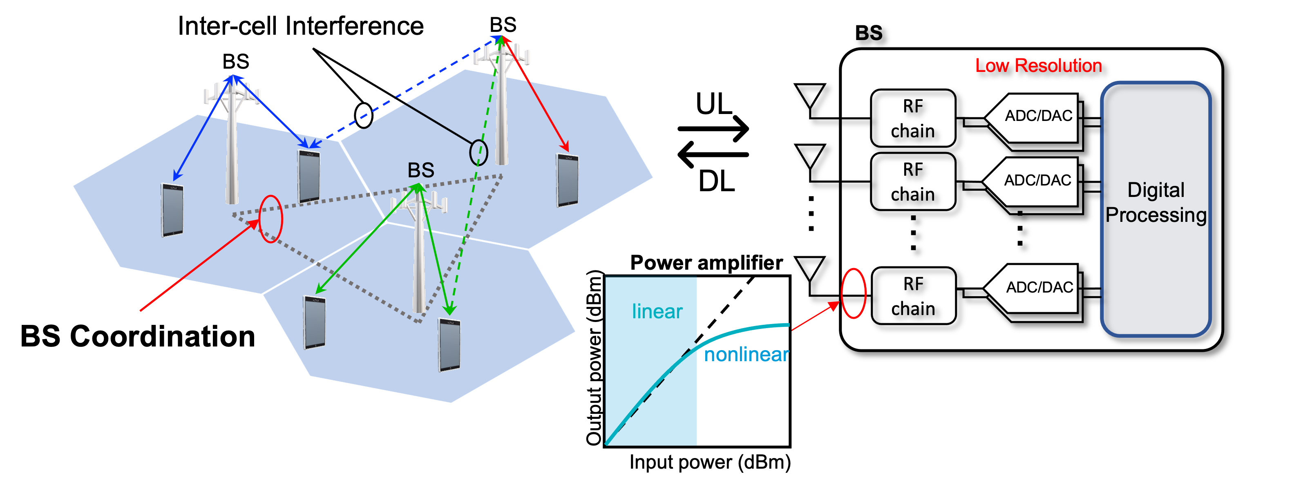
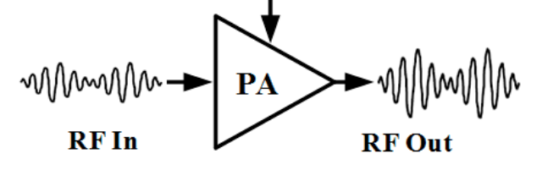
Motivation: Maximum Power Minimization
Per-Antenna Level Power Constraints
Limit antenna powers to achieve energy efficiency and realistic deployment
Avoid nonlinear and inefficient power amplification
Place less burden on power amplifiers and electronics
[1] A. Vasjanov and V. Barzdenas, “A Review of Advanced CMOS RF Power Amplifier Architecture Trends for Low Power 5g Wireless Networks”, Electronics, vol. 7, no. 11, 2018
Contribution #2: Coordinated Per-Antenna Maximum Power Minimization for Low-Resolution Systems
Notes:
Generally speaking, massive MIMO or large-scale antenna systems are one of the key technologies that enable modern and future communication systems because of its significant gain in spectral efficiency and capacity.
However, since each antenna is usually equipped with an RF chain with two 16-bit data converters, overall power consumption eventually goes up dramatically.
As one of the low-power solutions, we can choose to deploy low-resolution ADCs and DACs with typically 2 to 4 bits since power increases exponentially with the number of quantization bits.
On top of that, there is a need to limit the power of base stations to achieve more power-efficient deployment. In this way, we can place less burden on power amplifiers and electronic components.

Slide 12
Background
Problem: Minimize maximum transmit power with target SQINR
Quantization noise from low-resolution (low-power) ADCs and DACs
Thermal noise as well as intra-cell, and inter-cell interference
Per-antenna level power constraints
Solution: Opt. power control (uplink) & beamformer (downlink)
Minimize peak transmit power with target SQINR
Use strong duality between our uplink and downlink formulations
Iterative optimization between uplink and downlink solutions
Contribution #2: Coordinated Per-Antenna Maximum Power Minimization for Low-Resolution Systems

Slide 13
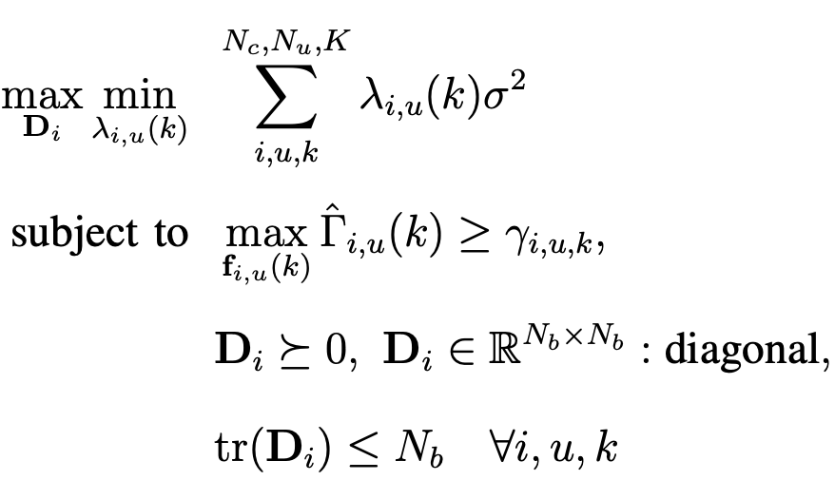
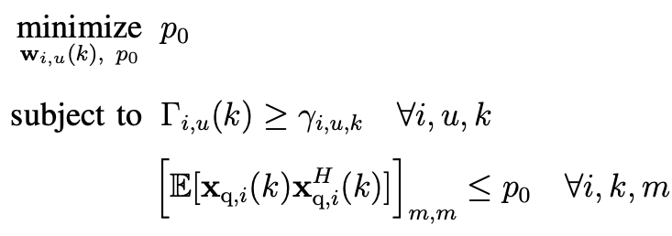
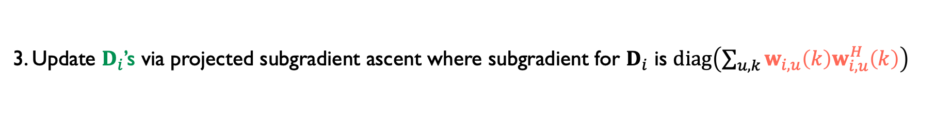
Problem Formulation
Maximum Transmit Power Minimization
Uplink (Dual)
Maximum Transmit Power Minimization
Downlink (Primal)
Limit antenna powers for efficiency
Place less burden on electronics
1. Find the inner problem solution $λ_{i,u}\left(k\right)$ for fixed $D_{i}$’s
2. Compute downlink beamformer $w_{i,u}\left(k\right)$ as a function of UL solution $λ_{i,u}\left(k\right)$
3. Update $D_{i}$’s via projected subgradient ascent where subgradient for $D_{i}$ is $diag\left(\sum_{u,k}{w_{i,u}\left(k\right)w_{i,u}^{H}\left(k\right)}\right)$
Convergence is shown both theoretically and numerically
Contribution #2: Coordinated Per-Antenna Maximum Power Minimization for Low-Resolution Systems
Notes:
We first formulate the maximum transmit power minimization problem for downlink which is our primal problem. Here, we need to satisfy a target SQINR (signal to quantization and interference plus noise ratio). This expression gives the transmit power of m-th BS antenna. Each power is upper bounded by p0, and our final target is to minimize p0 by desinging beamformer w. As you can see here, the SINR expressions are coupled with quantization error.
Here on the righthand side, we have a virtual uplink problem. It looks complicated, but it consists of the inner part and outer part. The inner part is the minimization of the total transmit power for a given target SINR. The outer part is maximization over D_i which is the noise covariance matrix at BS_i.
At this point, they are two separate problems.

Slide 14
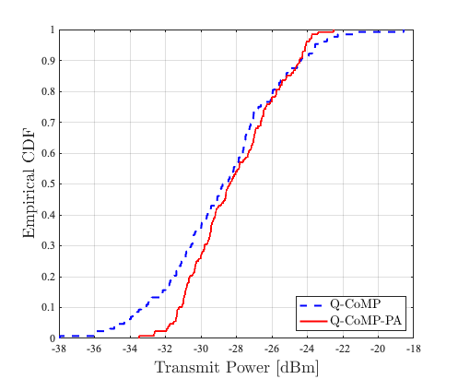
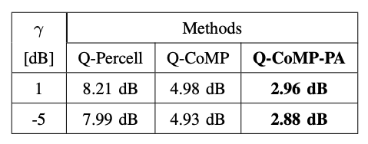
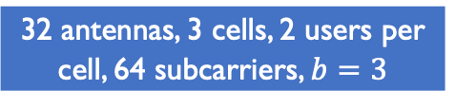
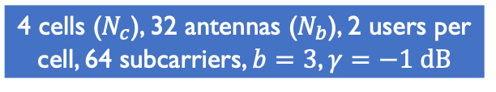

Simulation Results of the Proposed Q-CoMP and Q-CoMP-PA
Saturation points [Vasjanov et al.]
Peak power
Dynamic range
~2 dB reduction over Q-CoMP
~5 dB reduction over Q-Percell
Peak power vs. target SQINR
CDF of $N_{b}N_{c}\left(=128\right)$ antenna powers
Peak-to-average power ratio
16 antennas, 4 cells, 2 users per cell, 32 subcarriers
4 cells ($N_{c}$), 32 antennas ($N_{b}$), 2 users per cell, 64 subcarriers, $b=3$, $γ=−1 dB$
32 antennas, 3 cells, 2 users per
cell, 64 subcarriers, $b=3$
[1] A. Vasjanov and V. Barzdenas, “A Review of Advanced CMOS RF Power Amplifier Architecture Trends for Low Power 5g Wireless Networks”, Electronics, vol. 7, no. 11, 2018
Contribution #2: Coordinated Per-Antenna Maximum Power Minimization for Low-Resolution Systems
Notes:
Let’s move onto the simulation results.
we plot target SINR versus total transmit power, and b means the number of quantization bits
We compare our algorithm against a per-cell approach. Red line are our algorithm and blue line are the per-cell approach.
With 16 antennas, the per-cell approach easily diverges in low-SINR target, however our method diverges in medium SINR.
With 128 antennas which is considered as massive MIMO, our method shows divergence only with 2 bits case.
This figure validates the strong duality between UL and DL. We first plot the uplink cases with red lines, and we placed the downlink results with blue markers. Since they are matching together, we can observe the strong duality from this figure,
For the wideband case, we have 16 antennas, 2 cells, 2 users per cell, and 64 subcarriers. We observed the same trend as narrowband case. The total transmit power increases as resolution decreases, but not very much.

Slide 15
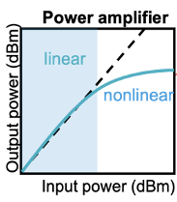


Summary
Minimize maximum transmit power with target SINR
Impairments: Thermal noise; intra-cell, and inter-cell interference
Quantization noise from low-res ADCs and DACs in base stations
Add per-antenna power constraint to place less burden on power amplifiers and electronics
Low-Res
ADC/DAC
A
Objective
Approach
Coordinate multiple base stations
Design precoding and power control for downlink/uplink
Use strong duality
Iterative algorithms based on dual space
Update covariance matrix via downlink solution using projected subgradient ascend
Contribution #2: Coordinated Per-Antenna Maximum Power Minimization for Low-Resolution Systems
Notes:
PADC : Power [Watts] = energy/unit time (Joules / sec)
Gersho, Allen, and Robert M. Gray. Vector quantization and signal compression. Vol. 159. Springer Science & Business Media, 2012.

Slide 16
Learning-Based ML Detection for Massive MIMO Systems with One-bit ADCs
Contribution #3
[1] Yunseong Cho, Jinseok Choi, and Brian L. Evans, “Adaptive Learning-Based Maximum Likelihood and Channel-Coded Detection for Massive MIMO Systems with One-Bit ADCs”, submitted to IEEE Transactions on Vehicular Technologies 2023
[2] Jinseok Choi, Yunseong Cho, and Brian L. Evans, “Robust Learning-Based ML Detection for Massive MIMO Systems with One-Bit Quantized Signals”, IEEE Global Communications, Dec. 2019.
Contribution #3: Learning-Based ML Detection for Massive MIMO Systems with One-bit ADCs

Slide 17
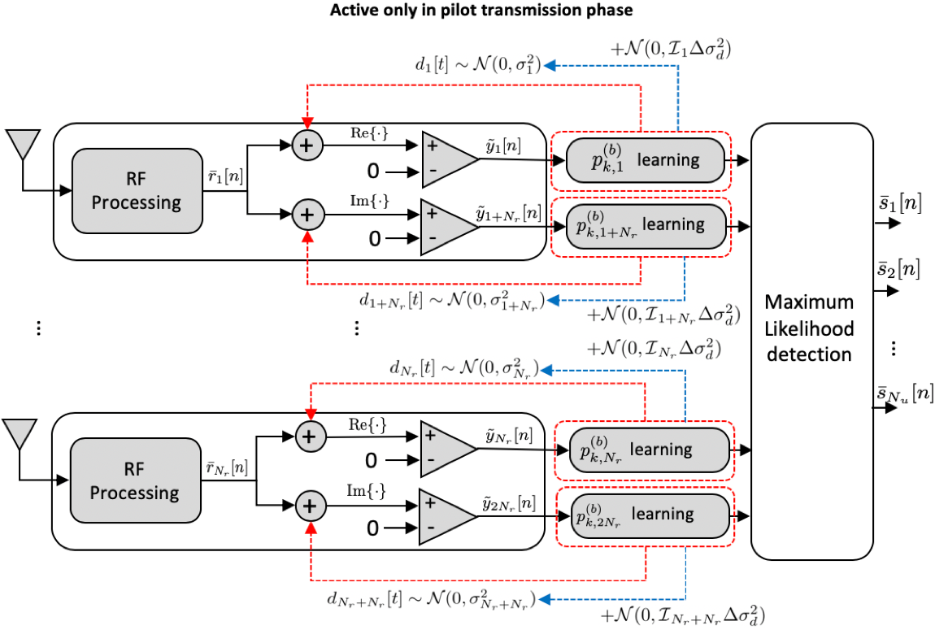



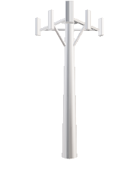

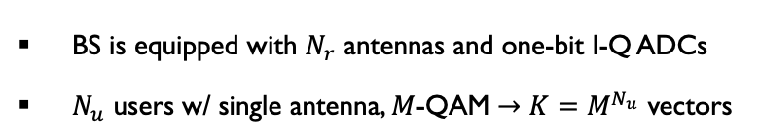
Background
*CSI: Channel State Information
Problem: Maximum likelihood (ML) detection
Reduce power consumption by using one-bit I-Q ADCs
True likelihood function requires *CSI
Inaccurate channel estimation with one-bit observations
Likelihood probability estimation without CSI
Count number of received +1 and –1 occurrences
With high SNR, likelihood function is biased to 0 or 1
Zero probability wipes out all other likelihood functions
Base Station (BS) Solution
Add artificial dithering noise with known variance
Adapt dithering power and estimate SNR for de-noising
BS is equipped with $N_{r}$ antennas and one-bit I-Q ADCs
$N_{u}$ users w/ single antenna, $M$-QAM $→K=M^{N_{u}}$ vectors
Proposed receiver architecture
Contribution #3: Learning-Based ML Detection for Massive MIMO Systems with One-bit ADCs
Notes:
PADC : Power [Watts] = energy/unit time (Joules / sec)
Gersho, Allen, and Robert M. Gray. Vector quantization and signal compression. Vol. 159. Springer Science & Business Media, 2012.

Slide 18
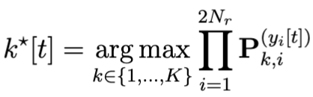

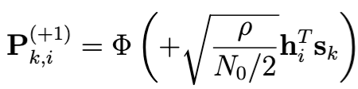
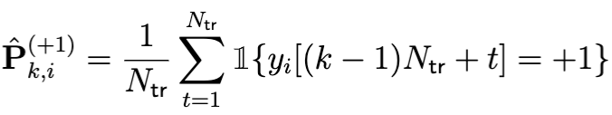
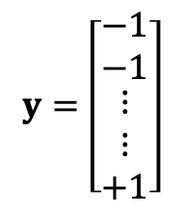


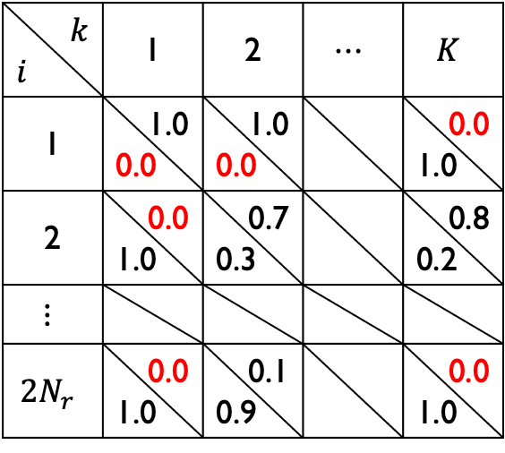




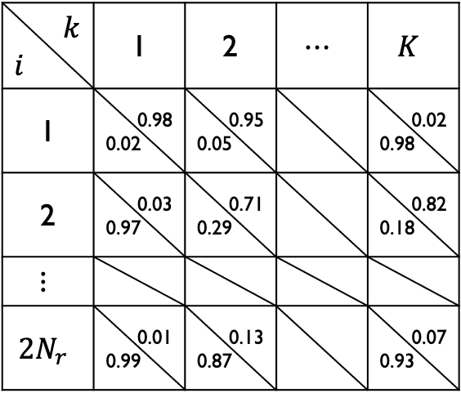


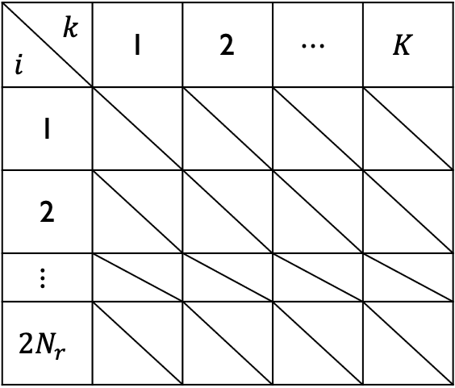

One-bit ML detection
One-bit maximum likelihood detection
Full CSI
Learning-based
$$P_{2,1}^{\left(−1\right)}$$
$$P_{2,1}^{\left(+1\right)}$$
$$N_{tr}=10$$
$$k$$ $$i$$ | 1 | 2 | $$⋯$$ | $$K$$
1
2
$$⋮$$
$$2N_{r}$$
$$k$$ $$i$$ | 1 | 2 | $$⋯$$ | $$K$$
1 | 1.0 0.0 | 1.0 0.0 |  | 0.0 1.0
2 | 0.0 1.0 | 0.7 0.3 |  | 0.8 0.2
$$⋮$$
$$2N_{r}$$ | 0.0 1.0 | 0.1 0.9 |  | 0.0 1.0
$$k$$ $$i$$ | 1 | 2 | $$⋯$$ | $$K$$
1 | 0.98 0.02 | 0.95 0.05 |  | 0.02 0.98
2 | 0.03 0.97 | 0.71 0.29 |  | 0.82 0.18
$$⋮$$
$$2N_{r}$$ | 0.01 0.99 | 0.13 0.87 |  | 0.07 0.93
$$y=\left[\begin{matrix}−1 \\ −1 \\ \begin{matrix}⋮ \\ ⋮ \\ +1\end{matrix}\end{matrix}\right]$$
$$ℙ\left(y|H,s_{1}\right)$$
$$ℙ\left(y|H,s_{2}\right)$$
$$ℙ\left(y|H,s_{K}\right)$$
$$ℙ\left(y|H,s_{1}\right)$$
$$ℙ\left(y|H,s_{2}\right)$$
$$ℙ\left(y|H,s_{K}\right)$$
Contribution #3: Learning-Based ML Detection for Massive MIMO Systems with One-bit ADCs
Notes:
PADC : Power [Watts] = energy/unit time (Joules / sec)
Gersho, Allen, and Robert M. Gray. Vector quantization and signal compression. Vol. 159. Springer Science & Business Media, 2012.

Slide 19
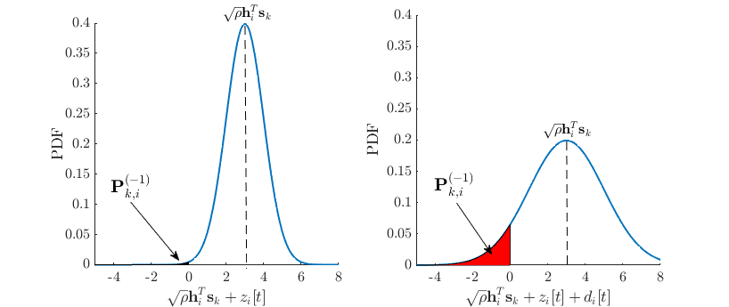
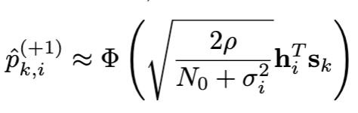
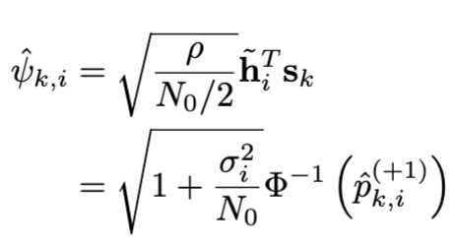
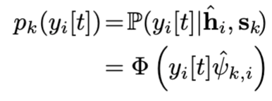

Dither-and-Learn
Dithered and quantized signal
known to BS
Much less likely to have zero probabilities
$σ_{i}^{2}:$ dithering power at $i$th antenna
Learning stage (training)
Count # of +1 and -1 based on dithered signals
Estimate the likelihood probabilities
De-noising stage
Use SNR estimates and dithering noise
Update the likelihood probabilities
Contribution #3: Learning-Based ML Detection for Massive MIMO Systems with One-bit ADCs
Notes:
PADC : Power [Watts] = energy/unit time (Joules / sec)
Gersho, Allen, and Robert M. Gray. Vector quantization and signal compression. Vol. 159. Springer Science & Business Media, 2012.

Slide 20
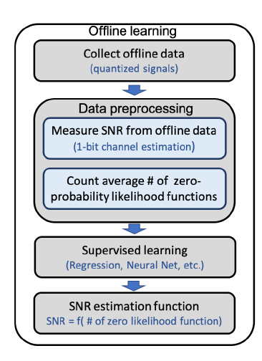
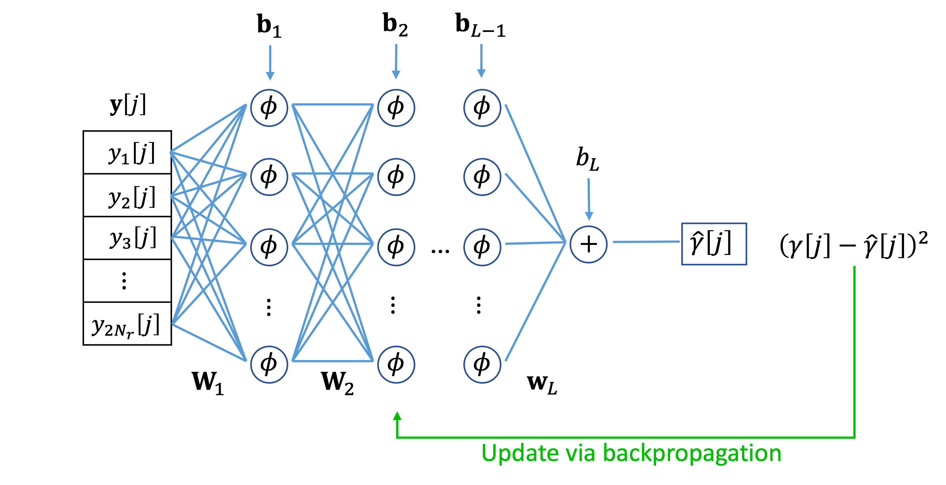
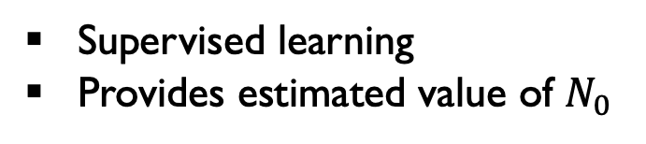
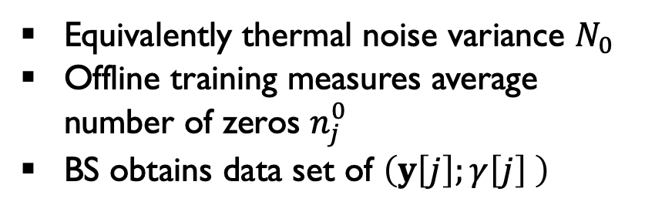
SNR Learning
Data collection
SNR learning
Equivalently thermal noise variance $N_{0}$
Offline training measures average number of zeros $n_{j}^{0}$
BS obtains data set of $\left(y\left[j\right];γ\left[j\right] \right)$
Mapping
Supervised learning
Provides estimated value of $N_{0}$
Contribution #3: Learning-Based ML Detection for Massive MIMO Systems with One-bit ADCs
Notes:
PADC : Power [Watts] = energy/unit time (Joules / sec)
Gersho, Allen, and Robert M. Gray. Vector quantization and signal compression. Vol. 159. Springer Science & Business Media, 2012.

Slide 21
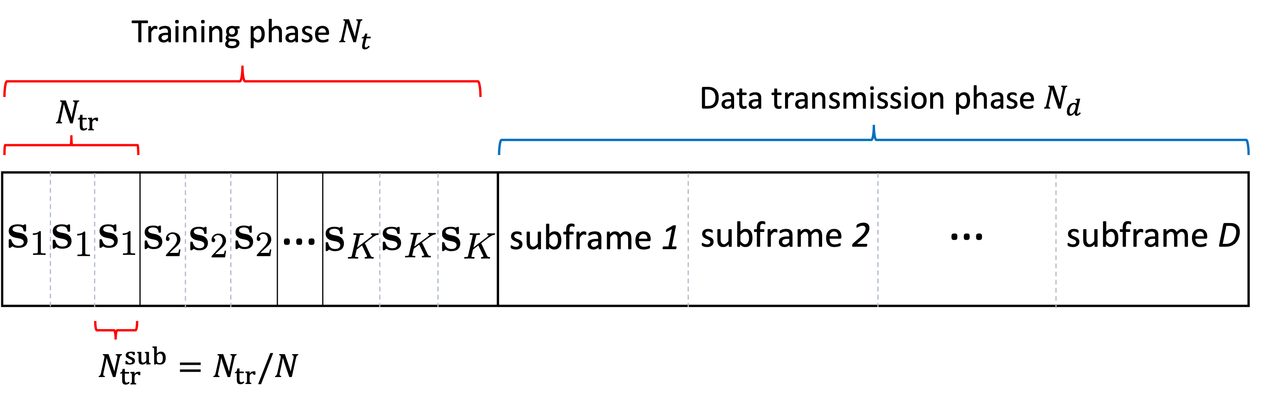
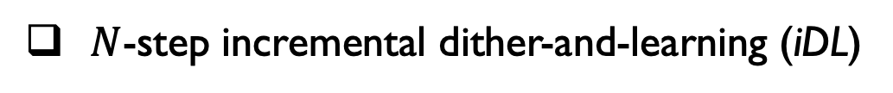
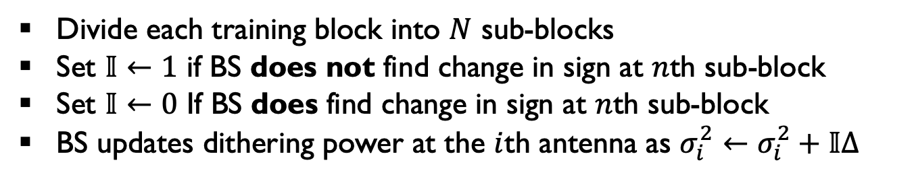
Dither Power Update
Dithering power is hyperparameter
The BS has to find suitable dithering power based on the behavior of observations
$N$-step incremental dither-and-learning (iDL)
Divide each training block into $N$ sub-blocks
Set $𝕀←1$ if BS does not find change in sign at $n$th sub-block
Set $𝕀←0$ If BS does find change in sign at $n$th sub-block
BS updates dithering power at the $i$th antenna as $σ_{i}^{2}←σ_{i}^{2}+𝕀∆$
Contribution #3: Learning-Based ML Detection for Massive MIMO Systems with One-bit ADCs
Notes:
Low dithering power still triggers lots of zero-valued likelihood probabilities
High dithering power makes noise dominant

Slide 22
Simulation Results
Symbol Error Rate vs. Transmit Power
32 antennas, 4 users per cell, 45 pilots 4-QAM
64 antennas, 3 users per cell, 45 pilots 16-QAM
Contribution #3: Learning-Based ML Detection for Massive MIMO Systems with One-bit ADCs
Notes:
inf resolution

Slide 23
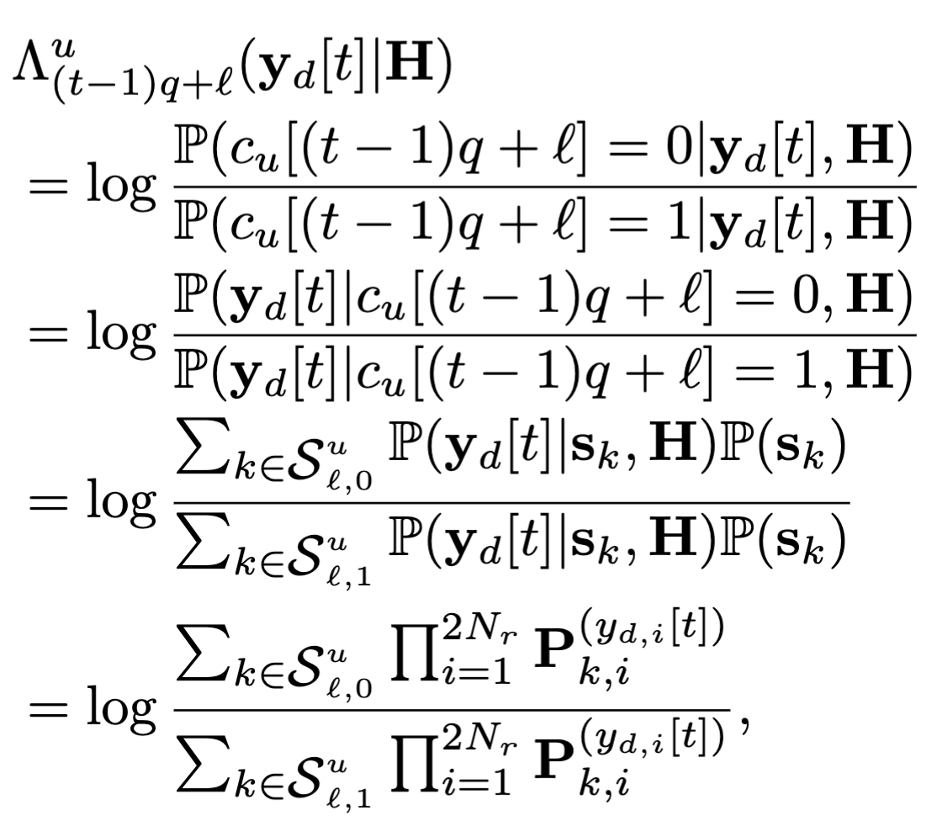




Soft-Metric for Coded Systems
Log-Likelihood Ratio $Λ$
So far, $ℙ$ was used for joint detection of the collection of symbols from users
However, $Λ$ is defined for each single binary bit of user to enable coded systems
Frame Error Rate vs. Transmit Power
Subgroup of symbol vectors
whose $ℓ$th bit of $u$th user is 0
32 BS antennas, 4 users, 4-QAM, $N_{tr}=30$, Rayleigh fading
(Channel Coding) Rate-1/2 Polar code $\left(κ,η\right)=\left(64,128\right)$
Subgroup of symbol vectors
whose $ℓ$th bit of $u$th user is 1
Contribution #3: Learning-Based ML Detection for Massive MIMO Systems with One-bit ADCs
Notes:
Focusing on a single binary bit of one particular user, this is the collection of symbol vector whose corresponding binary information is 0. The other subgroup is defined for binary bit 1

Slide 24





Summary
Learning-based Data Detection with One-bit ADCs
${\hat{s}}_{1}$ ${\hat{s}}_{2}$ ${\hat{s}}_{3}$
$${\left\{−1,+1\right\}}^{2N_{r}}$$
In high SNR, one-bit observations produce same output
Inaccurate channel estimation with one-bit observations
Adaptive dithering noise
$$s_{3}$$
$$s_{1}$$
$$s_{2}$$
Objective
Approach
Add artificial randomness (dithering) to capture sign changes
Remove added dithering noise via de-noising stage
Use deep neural network to estimate SNR
Avoid zero-valued likelihood probability
Acceptable amount of training
Contribution #3: Learning-Based ML Detection for Massive MIMO Systems with One-bit ADCs
Notes:
PADC : Power [Watts] = energy/unit time (Joules / sec)
Gersho, Allen, and Robert M. Gray. Vector quantization and signal compression. Vol. 159. Springer Science & Business Media, 2012.

Slide 25
Joint Hybrid Beamforming and Power Control Using Deep Reinforcement Learning
Contribution #4
[1] Yunseong Cho, C. Dick, and Brian L. Evans, “Fully Autonomous Hybrid Beamforming for mmWave Massive MIMO Systems Using Deep Reinforcement Learning”, to be submitted to IEEE Access
Contribution #4: Joint Hybrid Beamforming and Power Control Using Deep Reinforcement Learning

Slide 26


Background
Problem
Deployment of hybrid analog-digital beamforming architecture to scale down # of RF chains.
Analog components introduce non-convexity and non-linearity
Objective
Joint optimization of digital and analog components
High-dimensional analog beamformer: Manipulation of directional propagation
Low-dimensional digital beamformer: Baseband processing
Power control
Approach
Uses reinforcement learning, a goal-oriented approach
Interaction b/w agent and environment updates neural net parameters
Take an action $a_{t}$ at given state $s_{t}$ and receive instantaneous reward
Critic $Q$: Approximate the sum of discounted rewards through $Q\left(s_{t},a_{t}\right)$using rewards from training
Actor $π$: Find the best policy that can maximize $Q\left(s_{t},a_{t}\right)$
Contribution #4: Joint Hybrid Beamforming and Power Control Using Deep Reinforcement Learning
Notes:
PADC : Power [Watts] = energy/unit time (Joules / sec)
Gersho, Allen, and Robert M. Gray. Vector quantization and signal compression. Vol. 159. Springer Science & Business Media, 2012.

Slide 27








Problem Formulation
System Model: Multicell Multiuser uplink MIMO system
$$ℙ=\left\{e^{j2πφ/M}|φ∈\left\{0,1,…,M−1\right\}\right\}$$
$W_{BB}$ is continuous yet complex matrix
$W_{RF}$ satisfies unit-modulus and discreteness constraints
$p$ has max. and min. range
$N_{c}$: # of Base stations
$N_{r}$: # of receive antennas
$M$: # of possible phase angles
$N_{u}$: # of UEs per cell
$N_{RF}$: # of RF chains
Not a convex problem
because of unit-modular constraints of $W_{RF}$
Contribution #4: Joint Hybrid Beamforming and Power Control Using Deep Reinforcement Learning
Notes:
collection of N elements equally spaced along a straight line

Slide 28






































RL Setup & Deep Deterministic Policy Gradient (DDPG)
$$T$$
${\tilde{a}}_{t}=vec\left(\left[{\tilde{w}}_{BB}^{}, X,\tilde{p}\right]\right)$ where $x_{i,j,c}∈ℝ^{M}$
1
9
$$⋮$$
0.1
0
1
$$⋮$$
$$M−1$$
0
1
$$⋮$$
0
$ψ\left(x,β\right)=\sum_{m=0}^{M−1}{m}\frac{e^{βx_{m}}}{1_{M}^{T}e^{βx}}→m^{∗}$ : soft argmax
$$σ\left(x\right)=\left(p_{max}−p_{min}\right)sigmoid\left(x\right)+p_{min}$$
$$→$$
$$∗$$
$$≈m^{∗}$$
Action $a_{t}$: agent’s decision
$$a_{t}=f\left({\tilde{a}}_{t}\right)$$ $=vec\left(\left[normalize\left({\tilde{w}}_{BB}\right), ψ\left({\tilde{w}}_{RF},β\right), σ\left(\tilde{p}\right)\right]\right)$
$$x$$
$e^{βx}/$ $1_{M}^{T}e^{βx}$
State $s_{t}$: current situation
Reward $R_{t}$: feedback from environment
$$s_{t}={\left[a_{t−1}^{T},{\left(γ_{1,1},…,γ_{N_{u},N_{c}}\right)}^{T}\right]}^{T}$$
$$R_{t}$$
All SINRs satisfy target
At least one SINR satisfies target
All SINRs improve
Power penalty
Environment
$${\tilde{w}}_{BB}$$
$$X$$
$$\tilde{p}$$
Normalize
$$w_{BB}$$
$$w_{RF}$$
$$p$$
$$R_{t}$$
1. Update $θ^{Q}$ to minimize
${\left[Q\left(s_{t},a_{t}\right)−\left(R_{t}+γ\overline{Q}\left(s_{t+1},{\overline{a}}_{t+1}\right)\right)\right]}^{2}$
2. Update $θ^{μ}$ to maximize $Q\left(s_{t},a_{t}\right)$
$$W_{BB,1},…,W_{BB,N_{c}}$$
Vector-wise
Soft-argmax $ψ\left(⋅\right)$
$$a_{t}$$
$$W_{RF,1},…,W_{RF,N_{c}}$$
SINR
$$\left(γ_{1,1},…,γ_{N_{u},N_{c}}\right)$$
Target Actor $θ^{\overline{μ}}$
$$s_{t}$$
3. Update $\left(θ^{\overline{μ}},θ^{\overline{Q}}\right)←\left(1−τ\right)\left(θ^{\overline{μ}},θ^{\overline{Q}}\right)+τ\left(θ^{μ},θ^{Q}\right)$
$$p_{1},…,p_{N_{C}}$$
$$s_{t+1}$$
$$σ\left(⋅\right)$$
Slice & Assembly
$${\overline{a}}_{t+1}=$$
$$f\left(\overline{μ}\left(s_{t+1};θ^{\overline{μ}}\right)\right)$$
$$f\left(⋅\right)$$
$${\tilde{a}}_{t}=μ\left(s_{t};θ^{μ}\right)$$
Actor $θ^{μ}$
Target Critic $θ^{\overline{Q}}$
DRL Agent: Actor + Critic
Critic $θ^{Q}$
$$\overline{Q}\left(s_{t+1},{\overline{a}}_{t+1};θ^{\overline{Q}}\right)$$
$$Q\left(s_{t},a_{t};θ^{Q}\right)$$
Contribution #4: Joint Hybrid Beamforming and Power Control Using Deep Reinforcement Learning

Slide 29

Simulation Results
Result for target SINR
Target SINR
2 dB target SINR for all UEs
After 700+ iterations, all UEs stably satisfy the target SINR
MindtPy solver for mixed-integer nonlinear programs did not produce a meaningful result.
Settings
32 BS antennas, 3 RF chains, 2 cells, 2 users per cell, 2 propagation path
Contribution #4: Joint Hybrid Beamforming and Power Control Using Deep Reinforcement Learning
Notes:
N

Slide 30





Summary
Multi-cell & multi-user hybrid analog-digital architecture
DRL
Non-convex constraints and high-dimensional decision variables
Analog beamformers introduce non-convexity and non-linearity
Inter-cell interference needs to be considered in problem formulation
&
&
$$⋰$$
$$⋰$$
$$⋱$$
$$⋱$$
Objective
Approach
High-dimensional analog beamformer on each base station
Low-dimensional digital beamformer on each base station
Transmit power for each user
Actor-critic DRL (DDPG)
Take neural output and apply piece-wise activation function
Contribution #4: Joint Hybrid Beamforming and Power Control Using Deep Reinforcement Learning
Notes:
PADC : Power [Watts] = energy/unit time (Joules / sec)
Gersho, Allen, and Robert M. Gray. Vector quantization and signal compression. Vol. 159. Springer Science & Business Media, 2012.

Slide 31






Dissertation Summary
Power-Efficient and Intelligent Wireless Communication Systems
Contribution #1
Contribution #3
${\hat{s}}_{1}$ ${\hat{s}}_{2}$ ${\hat{s}}_{3}$
$${\left\{−1,+1\right\}}^{2N_{r}}$$
Low-Res
ADC/DAC
Adaptive dithering noise
A
$$s_{3}$$
$$s_{1}$$
$$s_{2}$$
Contribution #2
Contribution #4
DRL
&
&
$$⋰$$
$$⋰$$
$$⋱$$
Low-Res
ADC/DAC
$$⋱$$
A
Notes:
PADC : Power [Watts] = energy/unit time (Joules / sec)
Gersho, Allen, and Robert M. Gray. Vector quantization and signal compression. Vol. 159. Springer Science & Business Media, 2012.

Slide 32
Future Work
Multicell coordination taking channel estimation error into account
Adaptively changing the decision threshold of one-bit ADCs
Spectral efficiency maximization via DRL-based reconfigurable intelligent surfaces
Notes:
PADC : Power [Watts] = energy/unit time (Joules / sec)
Gersho, Allen, and Robert M. Gray. Vector quantization and signal compression. Vol. 159. Springer Science & Business Media, 2012.

Slide 33
Thank you!
Q&A

