Slide 1
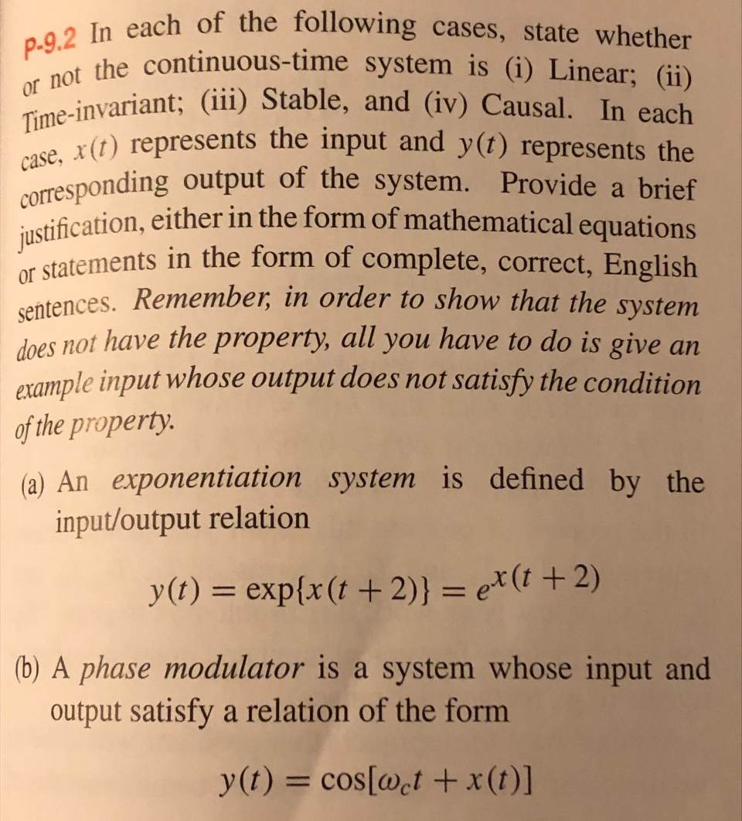
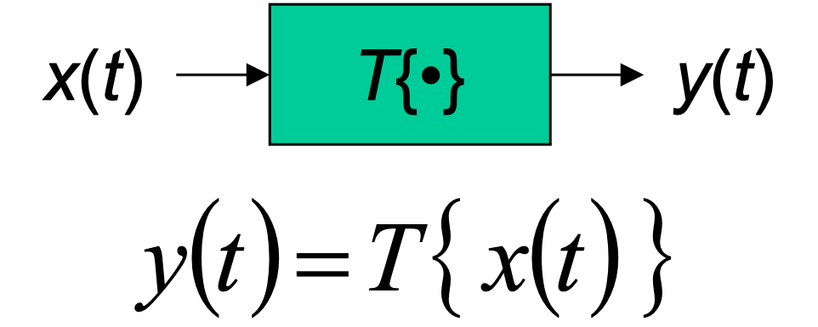
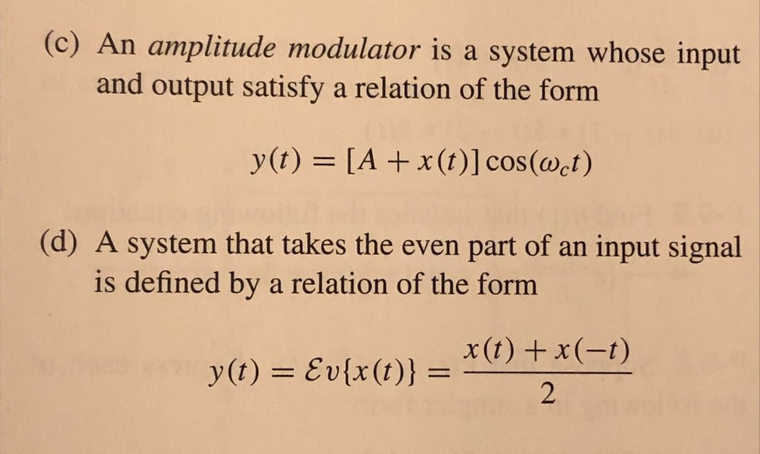
Homework 7.3
From J. H. McClellan, R. W. Schafer, and M. A. Yoder, Signal Processing First, page 279.

Slide 2
System Properties
Let x(t), x₁(t), and x₂(t) be inputs to a continuous-time linear system and let y(t), y₁(t), and y₂(t) be their corresponding outputs
A linear system satisfies
  Additivity: x₁(t) + x₂(t) ⇒ y₁(t) + y₂(t)
  Homogeneity: a x(t) ⇒ a y(t) for any real/complex constant a
Quick test to identify some nonlinear systems?
For time-invariant system, shift of input signal by any real-valued τ causes same shift in output signal, i.e. x(t - τ) ⇒ y(t - τ), for all τ
A stable system will always produce a bounded amplitude output signal when given a bounded amplitude input signal
A causal system depends only on current and previous input values and/or previous output values to compute an output value

