Slide 1


Task 1836.063, Brian L. Evans, The University of Texas at Austin
Powerline Communications For Enabling Smart Grid Applications
Task Description: Improve powerline communication (PLC) bit rates for monitoring/controlling applications for residential and commercial energy uses
Anticipated Results: (1) Characterization and modeling of noise in PLC;
(2) Communication techniques to improve efficiency and robustness of PLC;
(3) Testbeds for field measurements and performance vs. complexity tradeoffs
Current Students (with expected graduation dates):
Ms. Jing Lin Ph.D. (May 2014) Summer 2013 intern at TI
Mr. Marcel Nassar Ph.D. (Aug. 2013) Accepted position at Samsung R&D
Mr. Karl Nieman Ph.D. (Dec. 2014) Summer 2013 intern at Freescale
Funding for Three Years: $300,000 (1 August 2010 to 31 July 2013)
Industrial Liaisons: Dr. Anuj Batra (TI), Dr. Anand Dabak (TI), Mr. Leo Dehner (Freescale), Mr. Michael Dow (Freescale), Dr. Il Han Kim (TI), Mr. Frank Liu (IBM), Dr. Tarkesh Pande (TI) and Dr. Khurram Waheed (Freescale)

Slide 2
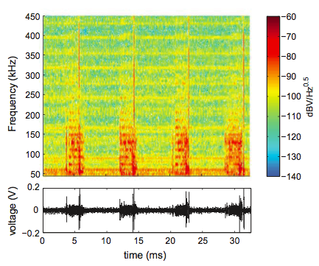
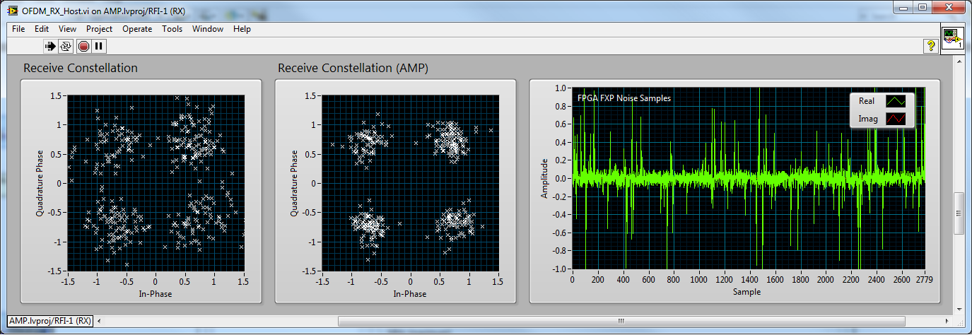
Task 1836.063, Brian L. Evans, The University of Texas at Austin
Powerline Communications For Enabling Smart Grid Applications
Accomplishments
Characterization and modeling of powerline noise
Development of robust communication techniques
Proof-of-concept testbeds
Publications
[1] Lin et al, "Impulsive Noise Mitigation in Powerline Communications Using Sparse Bayesian Learning", IEEE JSAC, 2013.
[2] Nassar et al, "Local Utility Powerline Communications in the 3-500 kHz Band: Channel Impairments, Noise, and Standards”, IEEE Signal Processing Magazine, 2012.
[3] Nieman et al, "FPGA Implementation of a Message-Passing OFDM Receiver for Impulsive Noise Channels”, Asilomar 2013.
Cyclostationary noise in narrowband PLC
Real-time testbed demonstrating receiver techniques to mitigate non-Gaussian noise

Slide 3
Task 1836.063, Brian L. Evans, The University of Texas at Austin
Powerline Communications For Enabling Smart Grid Applications
State of Art: Non-Gaussian noise limits communication performance of PLC systems.
Objectives: Improve efficiency and robustness of PLC in non-Gaussian noise
Novelty: Modeling of powerline noise; communication techniques to combat non-Gaussian noise.
Measurements (left) and modeling (right) of cyclostationary noise in narrowband PLC in the 3-500 kHz band.
Accomplishments:
Accomplishment #1. Characterization and modeling of cyclostationary noise in PLC.
Accomplishment #2. Transmitter and receiver methods to combat non-Gaussian noise in PLC.
Important Publications/Patents:
[1] Lin et al, IEEE JSAC 2013.
[2] Nassar et al, IEEE SP Magazine 2012.
[3] Nieman et al, Asilomar 2013.
Receiver methods to mitigate non-Gaussian noise implemented in real-time communication testbeds.

