Slide 1


ECE 382N ADV EMBEDDED MICROCONTROLLER SYSTEM
ACCELERATING Convolution FOR IMAGE CLASSIFICATION
DHRUV ANJARIA, KRISHNAJA KODALI

Slide 2
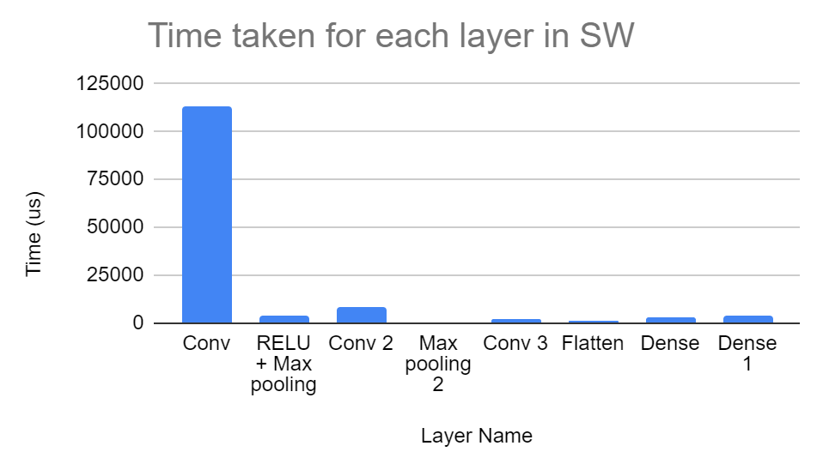
PROBLEM STATEMENT
Image Classification using CNN
Convolution
Max Pooling
Max-Pooling-2
Convolution-2
Convolution-3
Flatten
Dense
Dense1
32x32 input image
30x30 output
The first convolution layer needs to be accelerated

Slide 3
OVERALL DESIGN
OCM
Representation: 16-bit fixed point (12-bit precision)
Verilog
AXI BURST MASTER to transfer data from ocm to dfsm
dfsm manages the flow of data to convolver unit
Convolution for one Kernel (weights hardcoded)
Input to the convolver is 16-bit data
Application module:
Input image is read and written to OCM
Output Index is varied in the application code
Output is written back to an output file
Set PL Frequency to 50MHz
Convolution end interrupt is detected, and timer value is stored
Register to select the index of output to display
128 bits
Burst Master
128 bits
dfsm
16 bits
Convolver
16*30 bits
Slave Registers
Slave

Slide 4
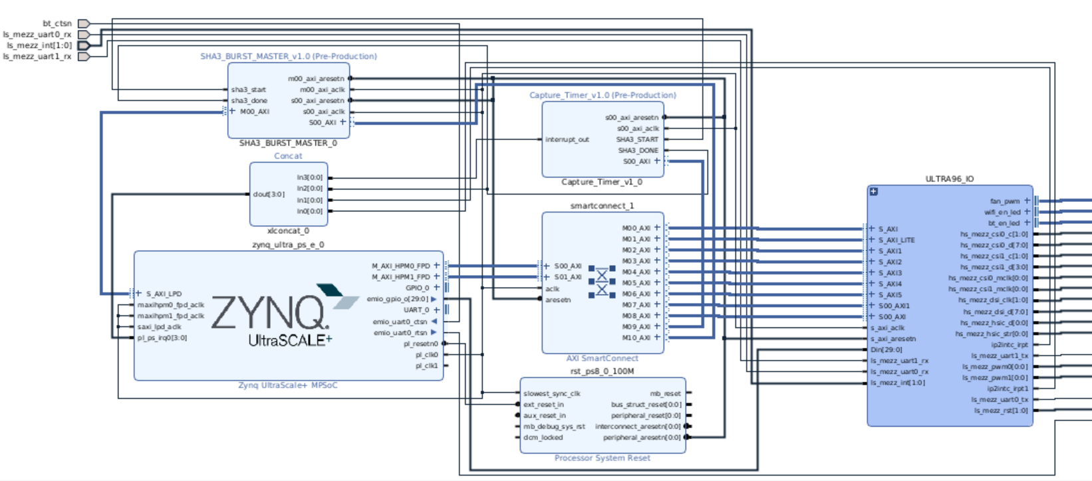
BLOCK DIAGRAM

Slide 5
CONVOLVER
Output store register
Valid
Input [15:0]
Matmul w0
Matmul w3
Matmul w6
End
Matmul w1
Matmul1 w4
Matmul w7
Output [30*16-1:0]
Matmul w2
Matmul w5
Matmul w8
conv [15:0]
….
Shift register

Slide 6

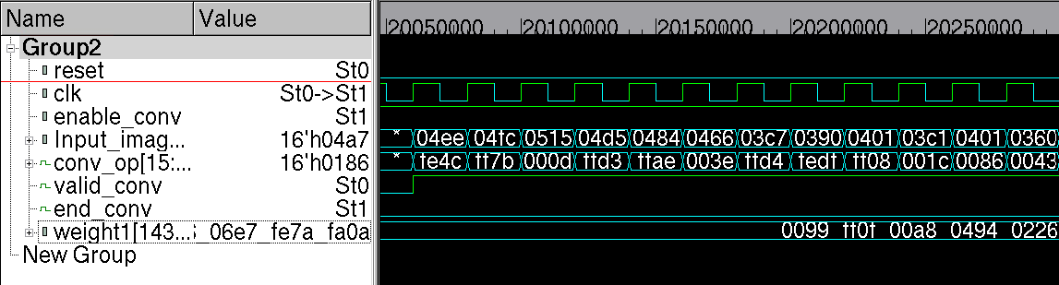
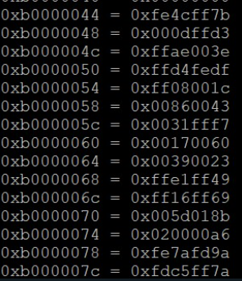
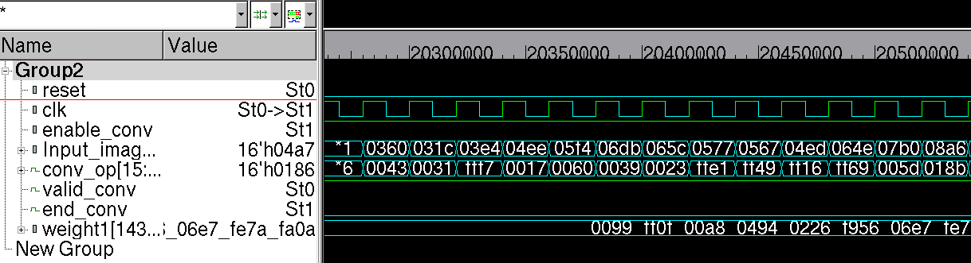
RESULTS - WAVEFORMS
FPGA Registers
Design Vision Simulation

Slide 7
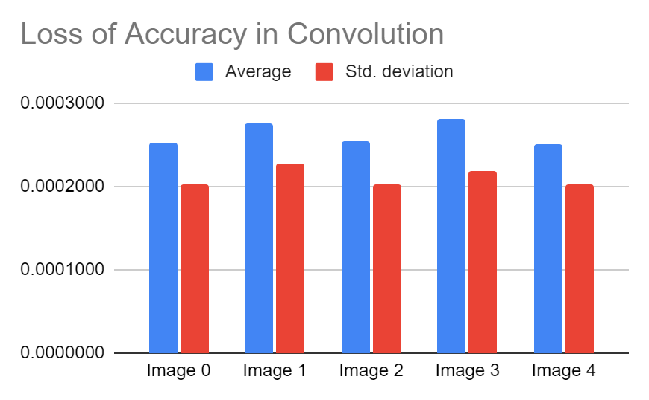
RESULTS - ACCURACY
We compared the expected output from SW to our outputs
Below results are for Fixed point representation (4,12)
The average loss in accuracy is 1.77 * 1/(2^12) = 0.0026

Slide 8
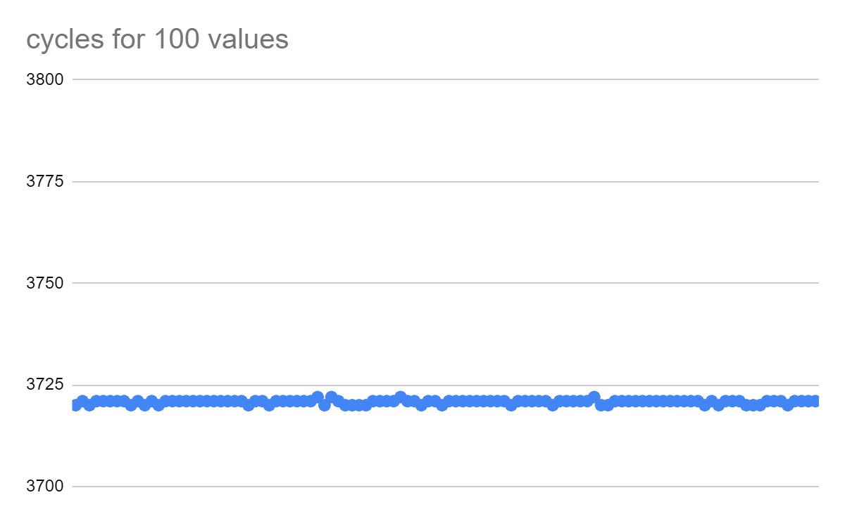
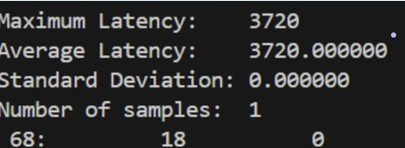
SPEED UP
Hardware
Acceleration
No of cycles = 3720
PL Frequency = 50MHz
Convolution time:
=3720*(1/50)us
=74.4us
Speedup:
= 112923/74.4
= 1517
% decrease in
Latency = 99.93%
Software
Time = 112923

Slide 9
REGRETS ☺
Debugging Efficiency spent debugging Verilog, when PL clock frequency was the issue.
Flexibility Enhancement: Could have provisioned for different weights, stride and fixed-point representations
Streamlined Model Selection: Wasted Time in model selection.
Optimized Input Size: should have started with smaller inputs to optimize resource allocation and free up space for logic

Slide 10

THANK YOU
QUESTIONS?

