Slide 1


MAY 2024
Edge Detection using Sobel Filters on Zynq Ultra-96
EE382N-4 Advanced Embedded Systems Final Project
Ishan Bansal (ib5897) , Kenrick Pinto (kxp58) , Yojan Chitkara (yc29254)
Graduate Students, The University of Texas at Austin

Slide 2
Agenda
Motivation
Implementation Details
Results
Future Work

Slide 3
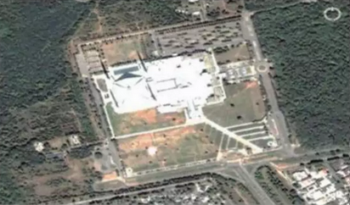
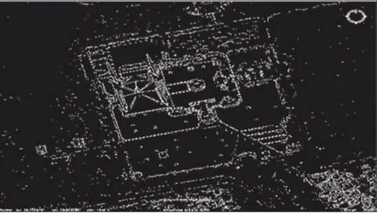
Motivation
Edge detection involves convolution operations to detect edges.
Expensive in software.
We built an efficient hardware implementation to accelerate this application which is flexible enough to run on multiple image sizes without generating new bitstream.
https://www.slideshare.net/NareshBiloniya/application-of-edge-detection-96942725

Slide 4

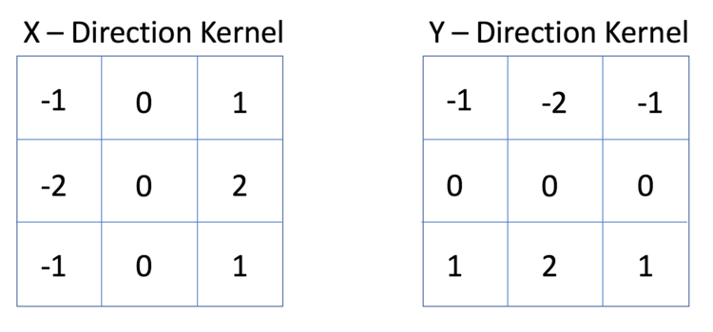

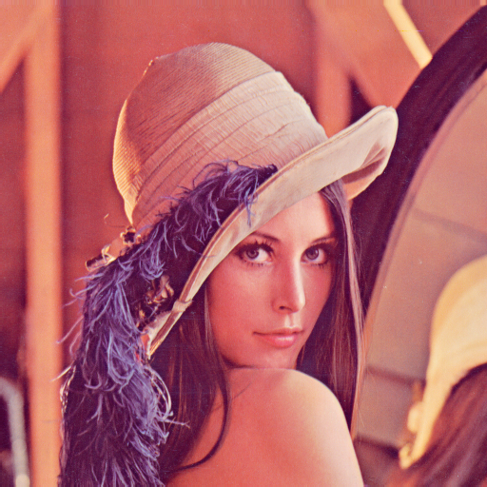
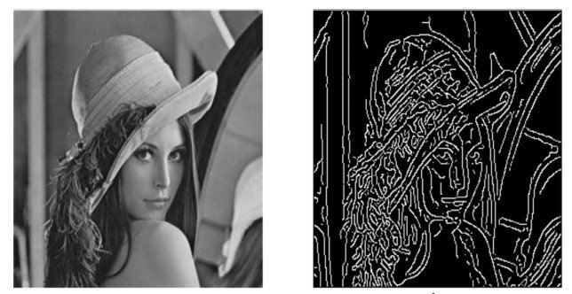
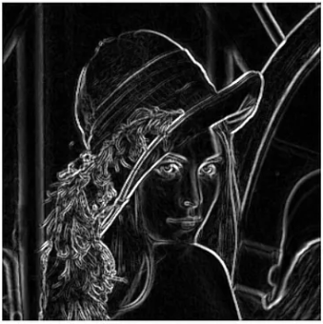
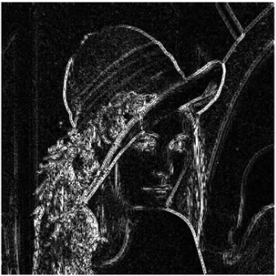
Methodology

Slide 5
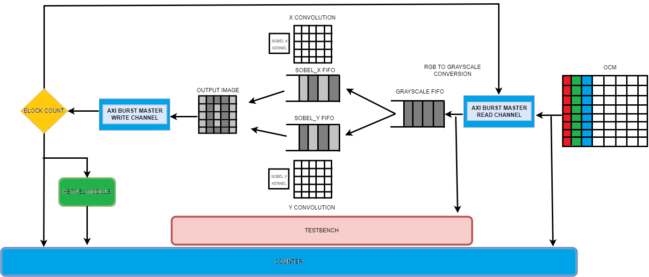
Hardware Implementation Overview

Slide 6
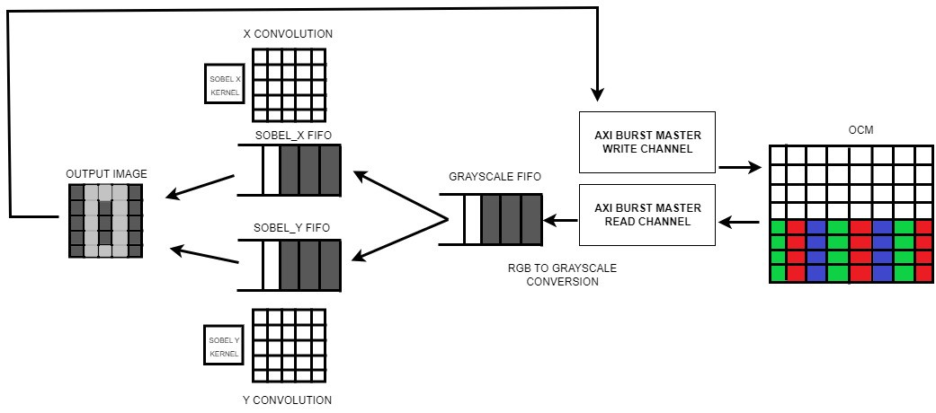
AXI Burst Read/Write in the parallel

Slide 7
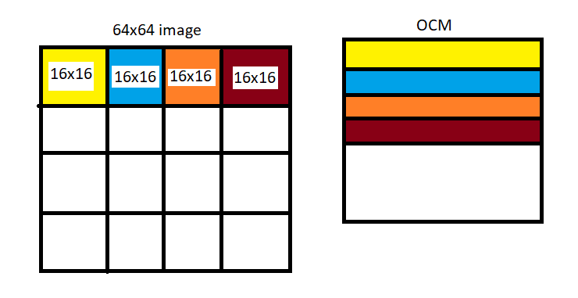
Design Optimisations
NxN image divided into 16x16 blocks
Perform convolution operations on smaller blocks at at time. Reduce LUT load by using smaller fifo depths, lesser logic to store and manipulate pixels
Taking advantage of locality in OCM by storing image in 16x16 Blocks instead of row-major/column major.

Slide 8
LUT Savings using mathematical optimisations
Multiplication to Shift
Square Root
LUT with SQRT - 77519
LUT available - 70560
Square Root approximated from √(x² + y²) to abs(x) +abs(y).
Use of AXI burst master to read and write data from OCM memory.
Burst length - 64
Parallelising Independent operations.
Per pixel RGB to grayscale calculation
Convolution on Sobel X and Sobel Y filters

Slide 9

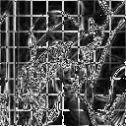
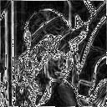
Results
Hardware generated
Software generated

Slide 10
Software Implementation (Optimizations)
Function | Percentage of Total Time Spent
 | O0 | O1 | O2 | O3 | O4
RGB to Gray | 7.46% | 12.65% | 13.11% | 13.95% | 14.63%
Sobel X | 41.88% | 41.77% | 40.98% | 41.86% | 41.46%
Sobel Y | 41.23% | 39.24% | 37.70% | 32.55% | 34.14%
Contour | 9.415% | 6.329% | 8.196% | 11.62% | 9.756%
Total Time (us) | 462 | 250 | 226 | 202 | 225

Slide 11
Hardware vs Software Comparison
Image Size | Execution Time in Hardware (us) |  |  | Software (us) | Speedup
 | Burst Size 64 | Burst Size 1 | Parallel Read/Write
128 x 128 | 151.7 | 999.5 | 124.47 | 2170 | 17.44
64 x 64 | 37.93 | 249.85 | 31.37 | 679 | 21.64
32 x 32 | 9.5 | 62.48 | 8.18 | 281 | 34.35
16 x 16 | 2.37 | 15.62 | 2.36 | 202 | 85.59
Software run with O3 optimization level

Slide 12
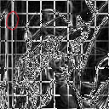
Future Work
Read 18x18 matrices from the OCM to improve the quality of the resulting image
Streamline the design and improve resource utilization
Setting up simulation environment to offset validation time is not difficult

Slide 13
THANK YOU

