Slide 1


SPRING 2024
Accelerating Modular Exponentiation with Montgomery Multiplier for Cryptosystems
ECE 382N – Advanced Embedded Microcontroller Systems
Madumitha Chinnadurai, Avinash Bellana
The University of Texas at Austin

Slide 2

SPRING 2024
Problem

Slide 3

SPRING 2024
Public-key cryptosystems like RSA demand extensive computational resources for modular exponentiation.
Given the time-consuming nature of modular exponentiation in software applications, our objective is to accelerate this process by developing a dedicated hardware architecture.
We aim to address this challenge by implementing the Montgomery multiplication algorithm to enhance the efficiency of cryptographic systems.
Encryption Mathematical operation:
Plaintext block P is encrypted to a cipher text block C by
$$C=P^{e} mod N$$
where e is the public key and N is the modulus
Problem

Slide 4
SPRING 2024
APPROACH

Slide 5
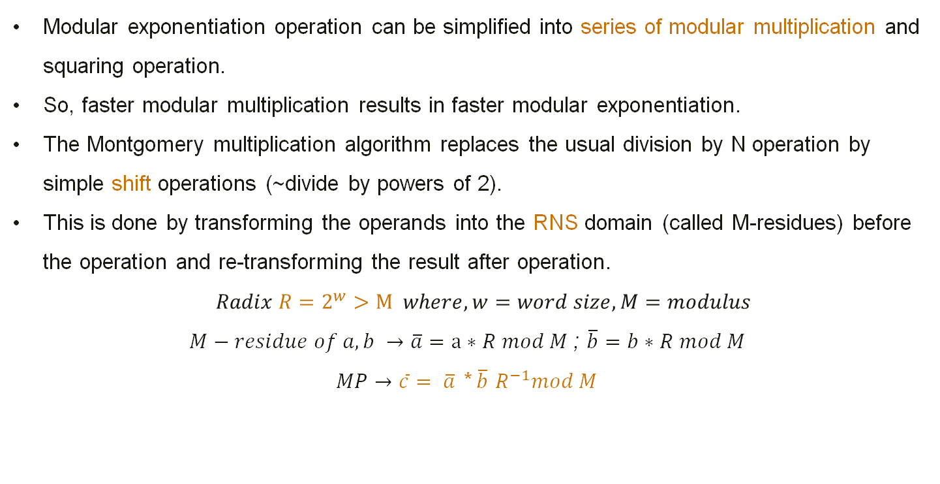
Modular exponentiation operation can be simplified into series of modular multiplication and squaring operation.
So, faster modular multiplication results in faster modular exponentiation.
The Montgomery multiplication algorithm replaces the usual division by N operation by simple shift operations (~divide by powers of 2).
This is done by transforming the operands into the RNS domain (called M-residues) before the operation and re-transforming the result after operation.
$$Radix R=2^{w}>M where, w=word size, M=modulus$$
$M−residue of a,b →\overline{a}=a∗R mod M$ ; $\overline{b}=b∗R mod M$
$MP→\overline{c}$ $= \overline{a}$ * $\overline{b}$ $R^{−1}mod M$

Slide 6
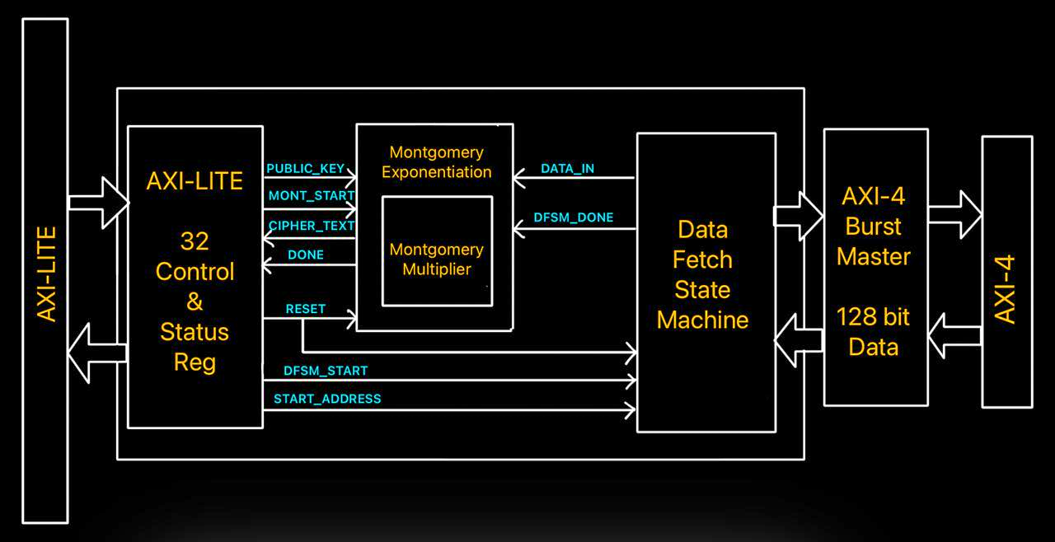
Architecture
Montgomery Exponentiation (Public Key Encryption Module): – Contains Montgomery multiplication module to perform Modular Exponentiation.
DFSM: Facilitates data transfer between OCM and encryption module through AXI Burst Master.
AXI Control and Status Registers: Provide parameters and initiate encryption process.

Slide 7
Hardware Implementation
The Montgomery multiplier and exponentiator modules are coded in Verilog and instantiated in the AXI-Slave module (S00).
Flow:
  The AXI control registers designate the start address and asserts "dfsm_start" to start the DFSM.
  Upon receiving start signal, DFSM reads 192-bits of data from OCM through two reads. ( 1 read = 128 bits)
  DFSM sends the data (plain text) to the Encryption module and asserts "dfsm_done" to signal that the data is ready.
  The Encryption module waits for the "mont_start" signal from the AXI control register. It then proceeds to encrypts the received plain text.
  The encrypted cipher text is written into the AXI registers and "done" interrupt is generated.
An application code was written to imitate the above flow and run multiple times to obtain average time taken for the hardware accelerated encryption.

Slide 8
Software Implementation
A python code that implements Modular Exponentiation using Montgomery algorithm was sourced from an open-source project.
An application program was coded which runs the python executable while also recording the start and end timestamp.
The Hardware accelerator showed a considerably huge speed up from that of the Software application for the same plain texts (Success!).
What could have caused such a high speed up?
  The major time-consuming portions of the Montgomery Algorithm are the preprocessing steps that converts the regular operands to the RNS domain. These independent steps can be executed parallelly in hardware while the software implementation executes them sequentially.

Slide 9
SPRING 2024
RESULTS

Slide 10
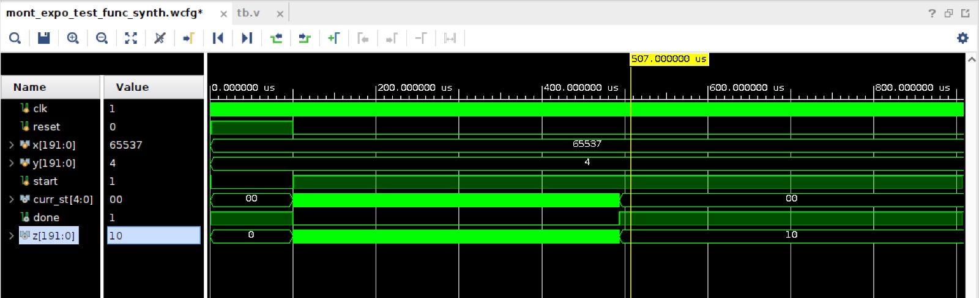
Simulation Results:
done=1
Result z=10
Fig.1 Simulation with y=4, x=65537 and Modulus=13
Result z = 10

Slide 11
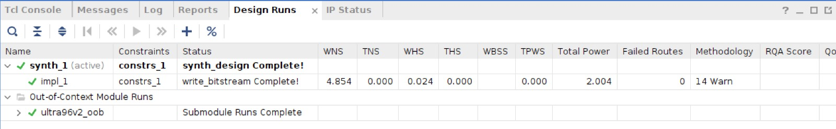
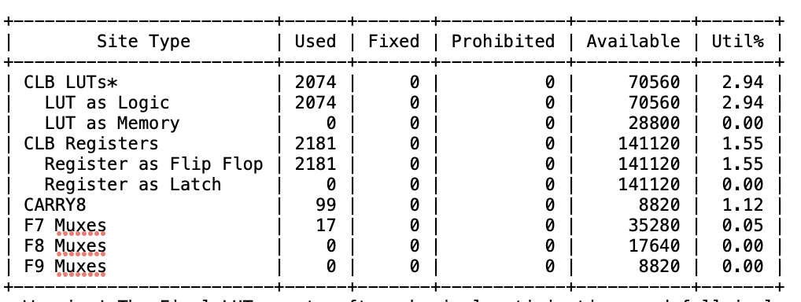
Reports:
Fig.2 Synthesis complete without timing violations
Fig.3 Resource Utilization (FPGA)

Slide 12
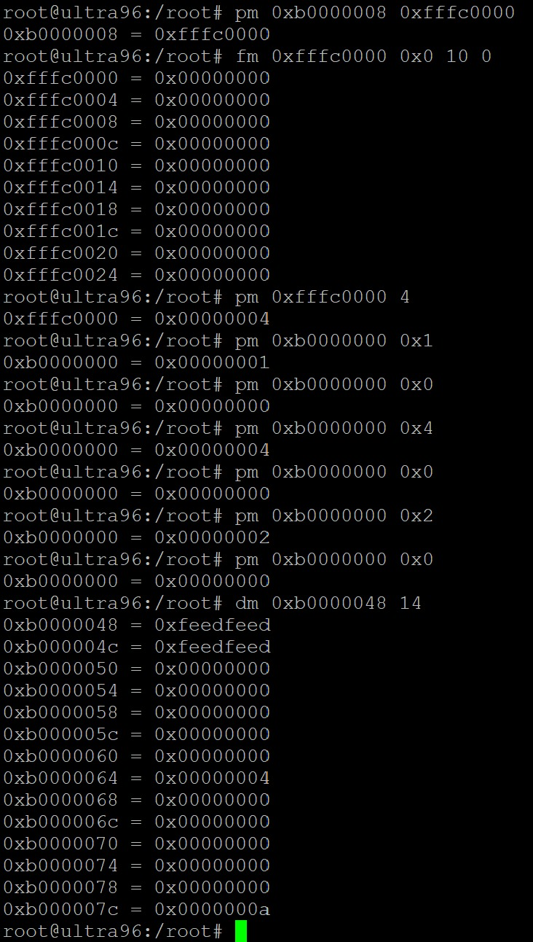
Testing on board :
pm 0xfffc0000 0x4
{base value - y}
Input y = 0x4 {0xb0000050 – 0xb0000064}
Result z = 0xa
{0xb0000068 – 0xb000007c}

Slide 13
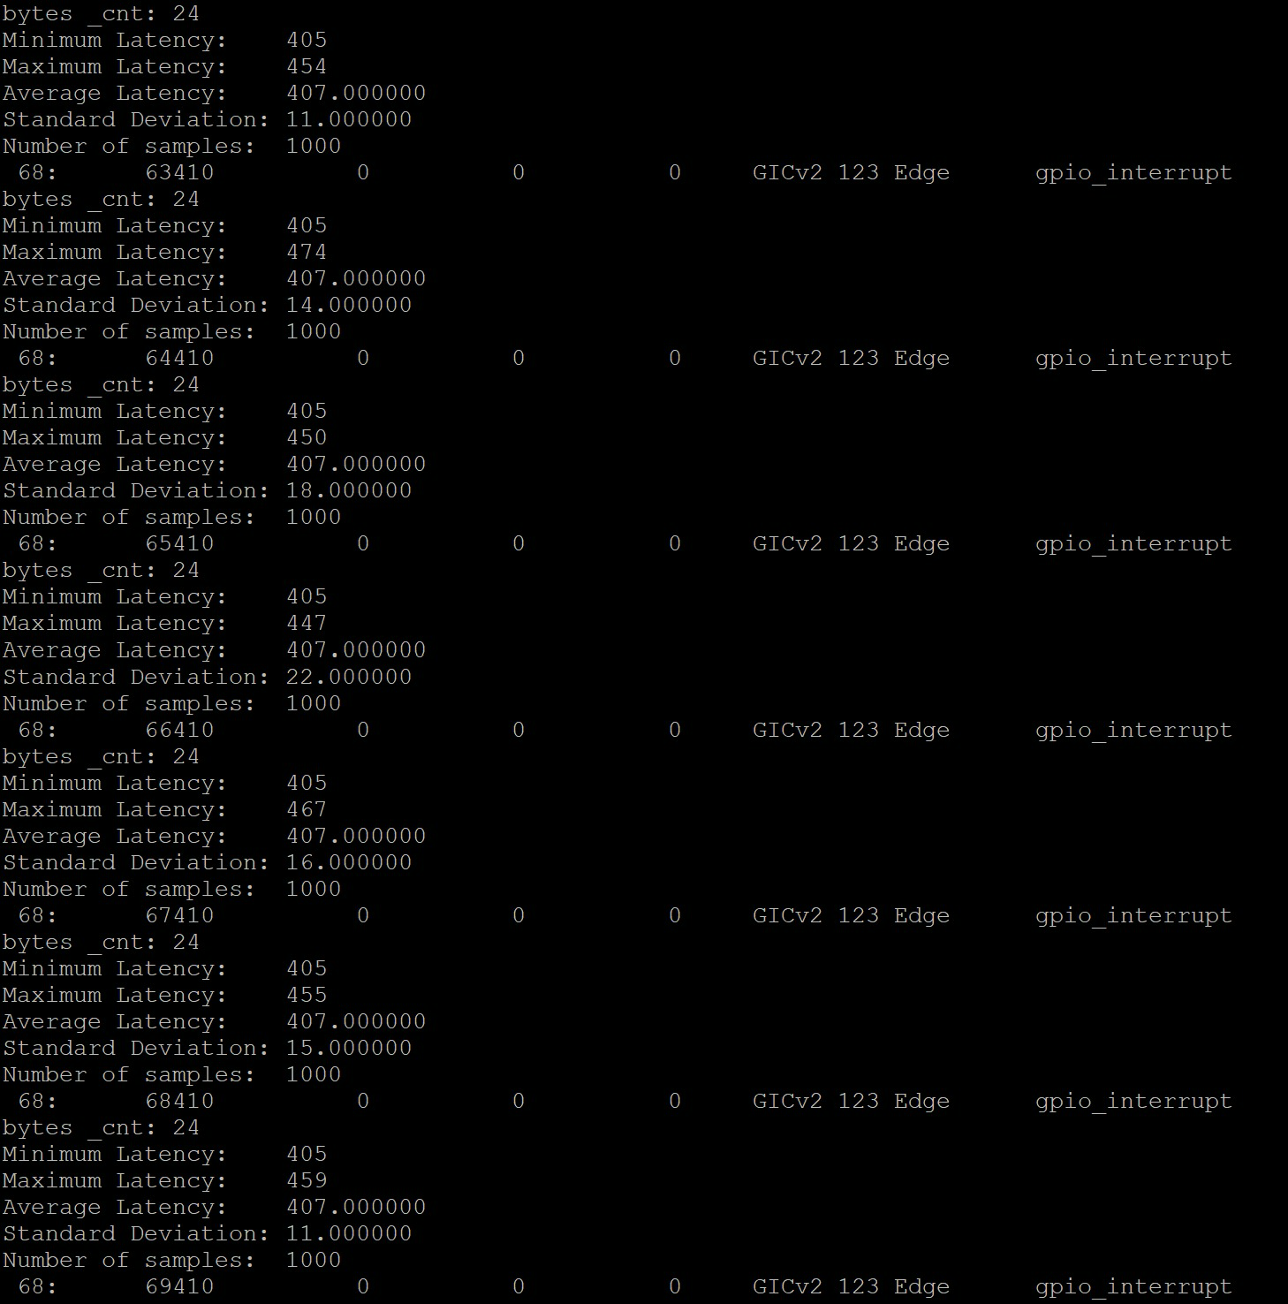
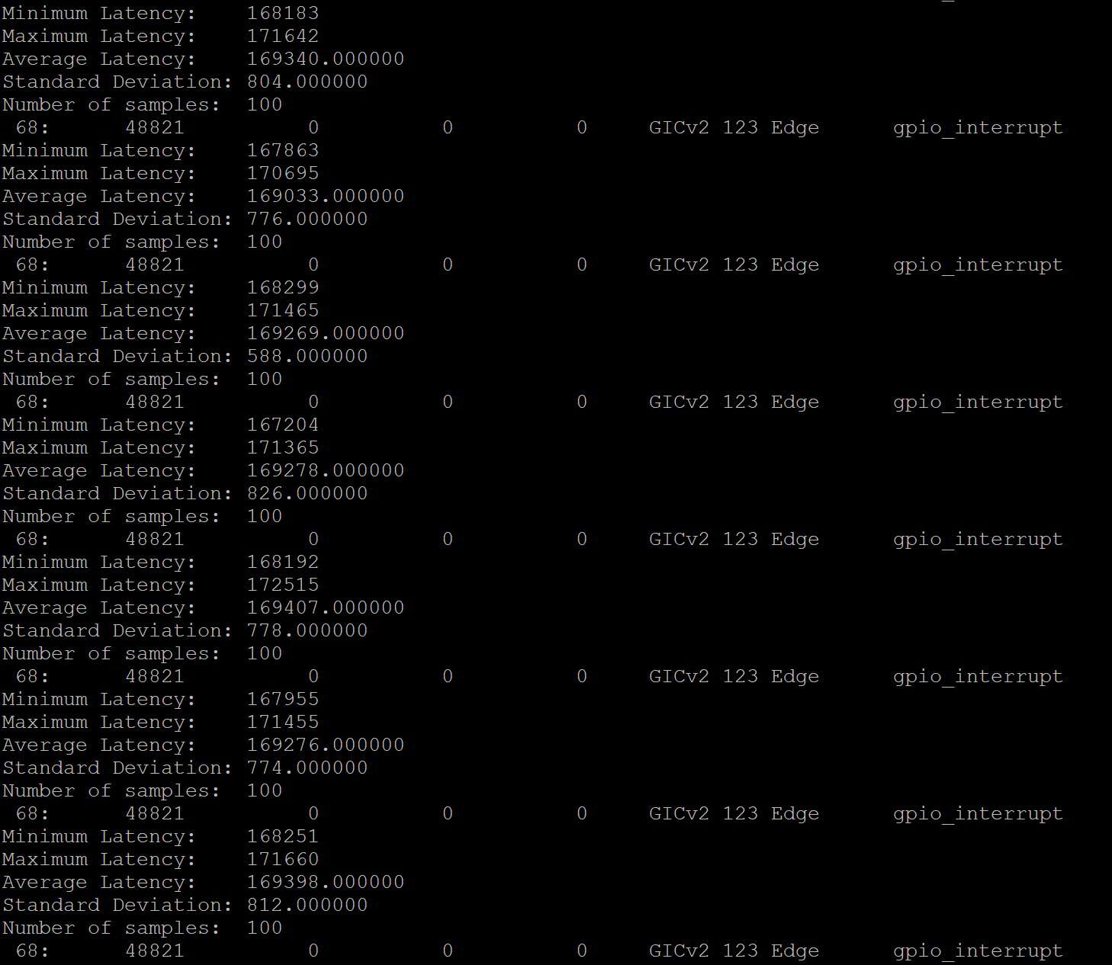
Hardware time
Average time = 407.0
Speedup ~ 416
Software time
Average time = 169398.0

Slide 14
SPRING 2024
DEMO

Slide 15
What we could have done different?
The current design only accommodates a base value of 192 bits, but it can be modified to support larger base values through parameterization.
The implemented Verilog code could be optimized or coded more efficiently.
The software implementation could also be optimized to maximize effectiveness for a fair comparison between the two implementations.

Slide 16
Lessons learnt
Having a functional simulation doesn't guarantee hardware functionality.
Debugging is frustratingly amusing! Toss in as many internal signals as possible for debug.
Blocking statements in Verilog – Handle with caution!

Slide 17
SPRING 2024
Thank you

