Slide 1
Bitcoin Miner
Alex, Ben, Raymond

Slide 2
Presentation Overview
What is the blockchain? What does it mean to “mine” Bitcoin?
Baseline Benchmarking
Design Process & Prior Work
Results
Lessons

Slide 3
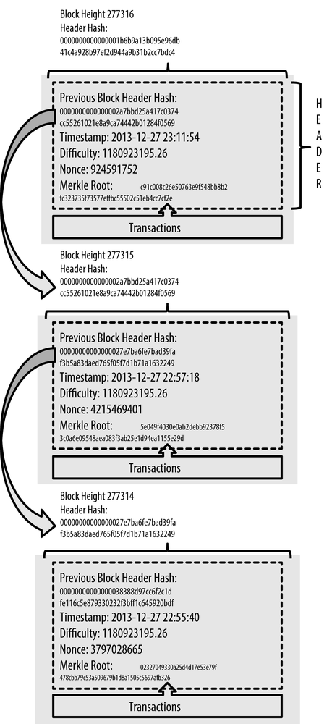
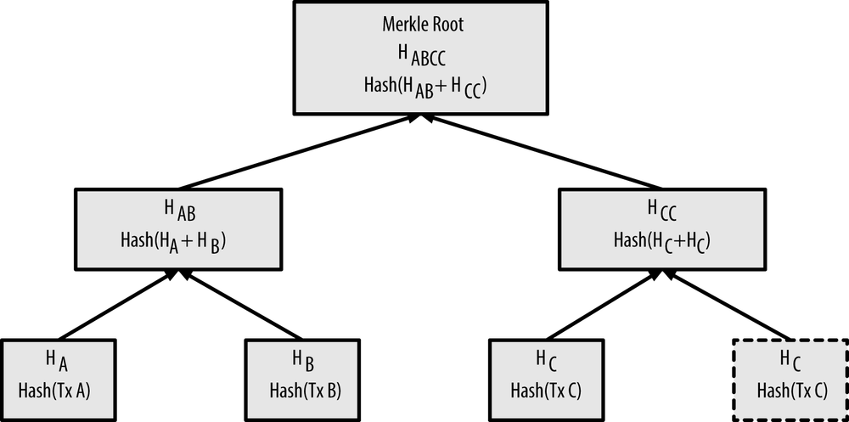
The Bitcoin Blockchain
The blockchain is comprised of block headers and transactions
Each block contains a hash of the previous blocks header, to verify its place in the blockchain
Merkle Roots distill transaction information into a hash result

Slide 4
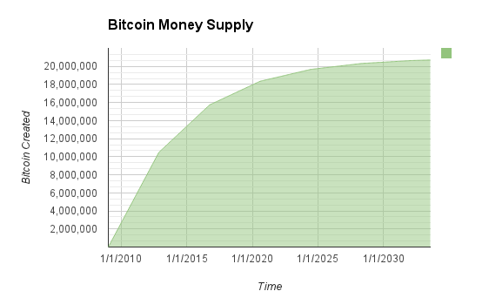
Mining New Blocks
New transactions are constantly submitted to the transaction pool
Every miner will put together a set of transactions and begin “mining” them
If a block is successfully “mined”, it is added to the blockchain
Newly minted bitcoin is given as a reward, along with transaction fees, to the successful miner

Slide 5
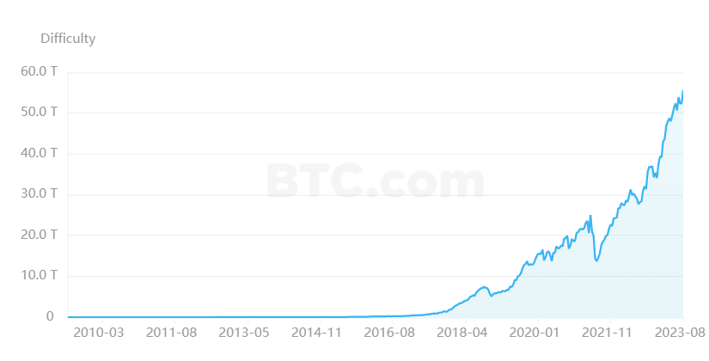
Mining Difficulty
Size | Field
4 bytes | Version
32 bytes | Previous Block Hash
32 bytes | Merkle Root
4 bytes | Timestamp
4 bytes | Difficulty Target
4 bytes | Nonce
Bitcoin has set a standard that a block must be successfully mined on average every 10 minutes
It achieves this with the difficulty target, which is adjusted based on the collective hash rate of all participating miners
Miners create a header for the transactions, and test hash results for different Nonces
Once a miner finds a Nonce which results in a hash below the Hash Target, the block is added to the blockchain and the reward is given
 | Hash Target | Difficulty
Genesis | 0x00000000FFFF0000000000000000000000000000000000000000000000000000 | 1
Current | 0x0000000000000000000331DB0000000000000000000000000000000000000000 | 88 Trillion

Slide 6
What Makes a Good Miner
Hashrate: How many hashes per second can be performed and checked?
Hashrate per Watt: Profit is dependent on cost in vs cost out, or Bitcoin reward vs energy used

Slide 7
FPGA Fabric Design (multiple slides)
Describe the design of the mining accelerator,

Slide 8
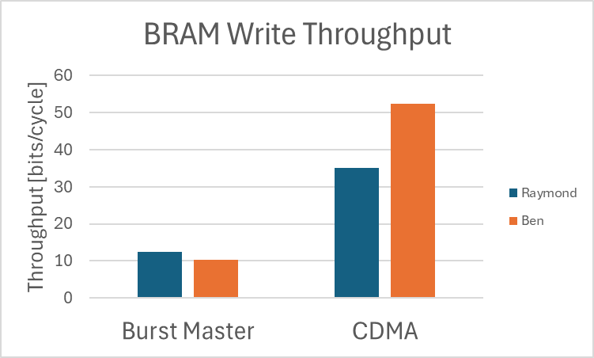
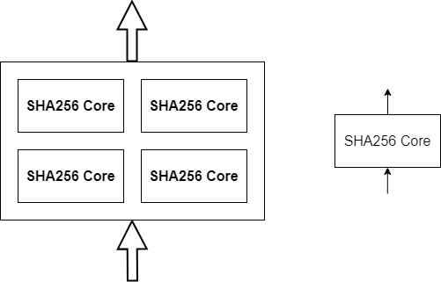
Knowledge (Tips) from Prior Works
Use multiple, parallel SHA256 cores
CDMA vs Burst Master (Lab 1 vs Lab 2)

Slide 9
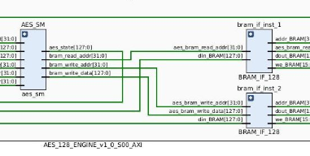
Knowledge (Tips) from Prior Works
Use multiple, parallel SHA256 cores
Pipelining data w/ AXI stream interface
Parallel streams or BRAMs
CDMA vs Burst Master (Lab 1 vs Lab 2)
Optimize scheduling
Roh, H., "AES-128 Accelerator," Class presentation for Advanced Micro-Controller Systems, University of Texas at Austin,

Slide 10
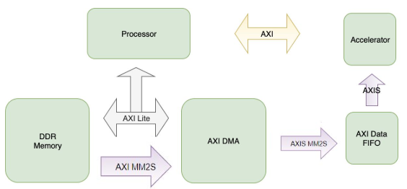
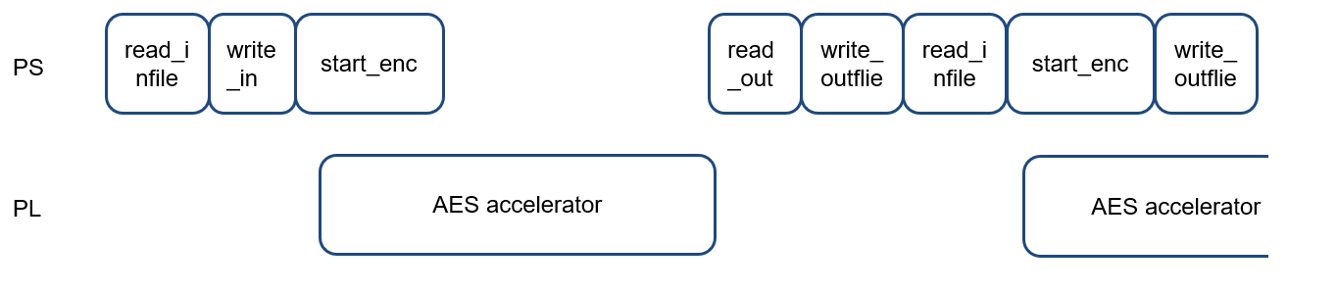
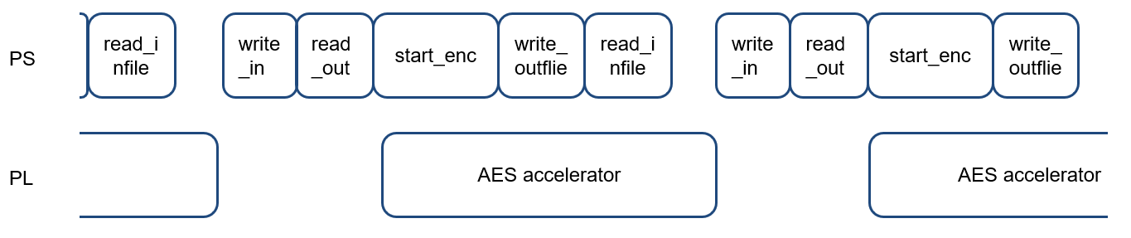
Knowledge (Tips) from Prior Works
Pipelining data w/ AXI stream interface
Parallel streams or BRAMs
Optimize scheduling
Zheng, Y. et al., "The Spinning SHA3," Class presentation for Advanced Embedded Micro-Controller Systems, University of Texas at Austin, Fall 2019.
Bhat et al., "AES128 Encryption and Decryption using Hardware Accelerators," Class presentation for Advanced Micro-Controller Systems, University of Texas at Austin, May 2018.
Roh, H., "AES-128 Accelerator," Class presentation for Advanced Micro-Controller Systems, University of Texas at Austin,

Slide 11
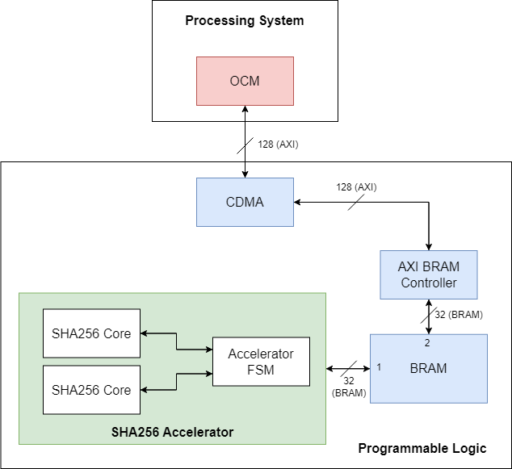
Initial FPGA Design
Nothing fancy yet…
Identify bottlenecks
Open-Source (FREE) SHA256 Core: https://github.com/secworks/sha256

Slide 12
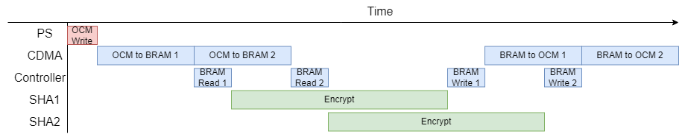
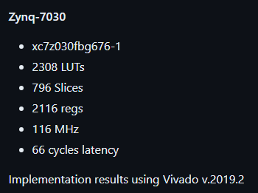
Initial FPGA Scheduling & Scaling
*Not to scale
71k total LUTS / 2308 LUTs/Core
= ~30 cores

Slide 13
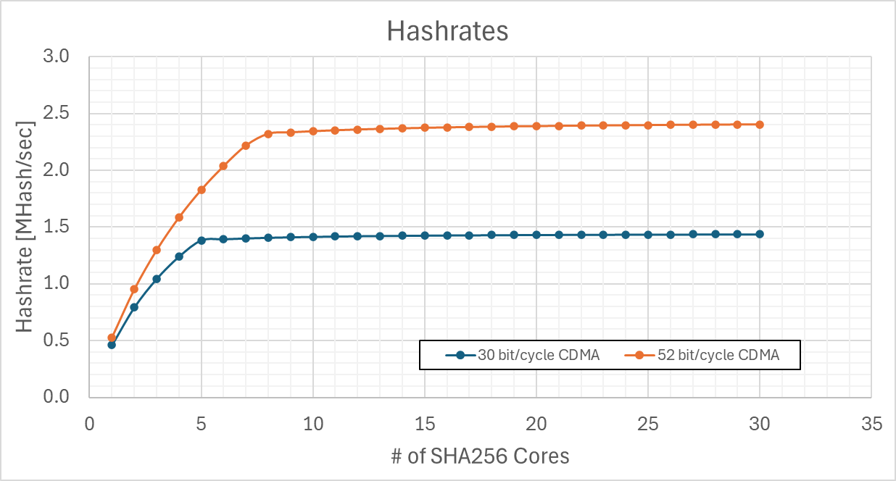
Initial FPGA Scheduling & Scaling

Slide 14
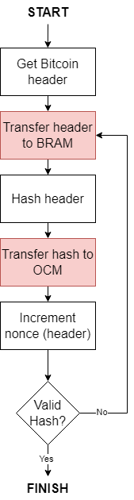
Bottleneck: PS-PL Data Transfer
Bottlenecks

Slide 15
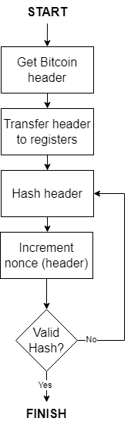
Bottleneck: PS-PL Data Transfer
Bottlenecks

Slide 16
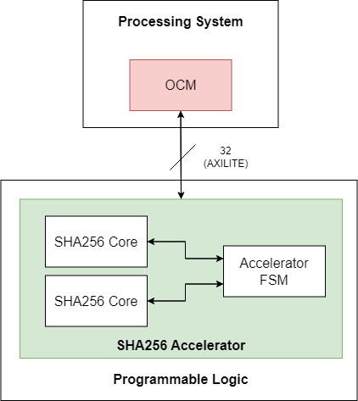
Hashrate != Data Throughput
SHA256 input stays mostly the same between hashes!
Let FSM increment the nonce

Slide 17
Design Flow
Test & verify modules from ground up (nested modules first)
Test SHA256 Core
Write Controller
Test Controller
Write Checker
Test Checker
Test Core Unit
Write Core Unit
Test Accelerator
(parallel core units)

Slide 18
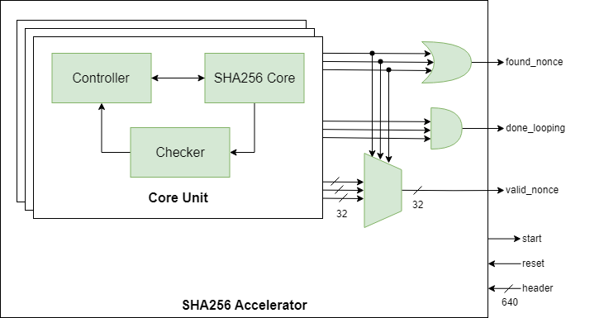
Final Design Architecture
AXI Registers
PS

Slide 19
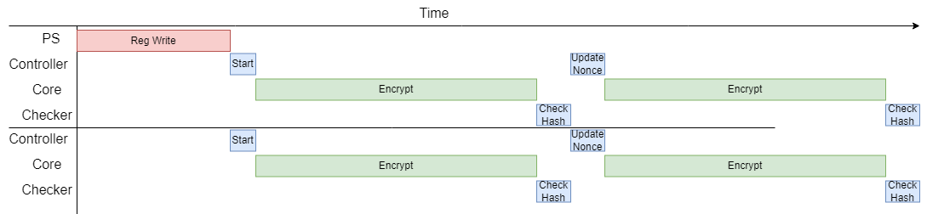
Final Design Architecture
AXI Registers
PS

Slide 20
Final Design Architecture
Expensive one-hot mux (not trivial)
AXI Registers
PS

Slide 21
Final Design
Show block diagram of modules and flowchart (or flow of data through modules)

Slide 22
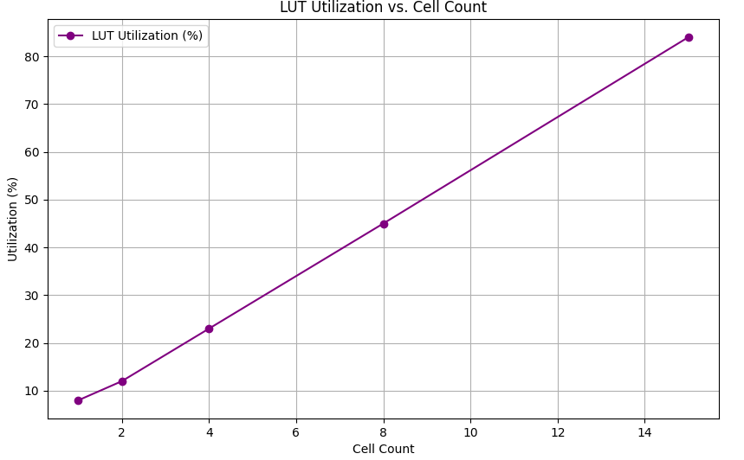
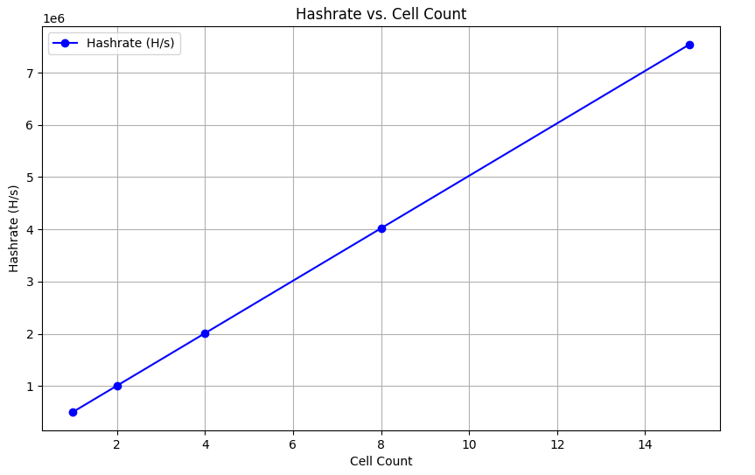
FPGA Utilization and Hashrate

Slide 23
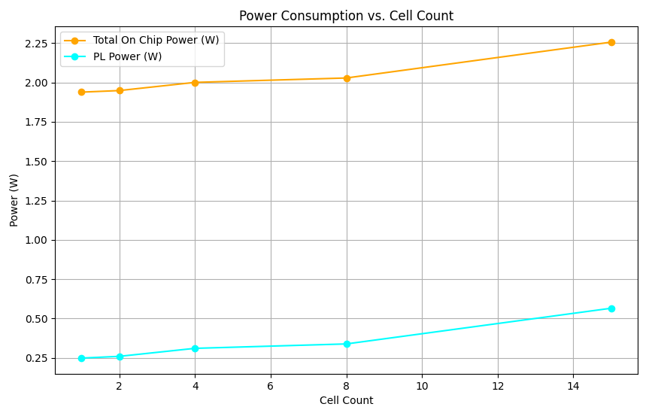
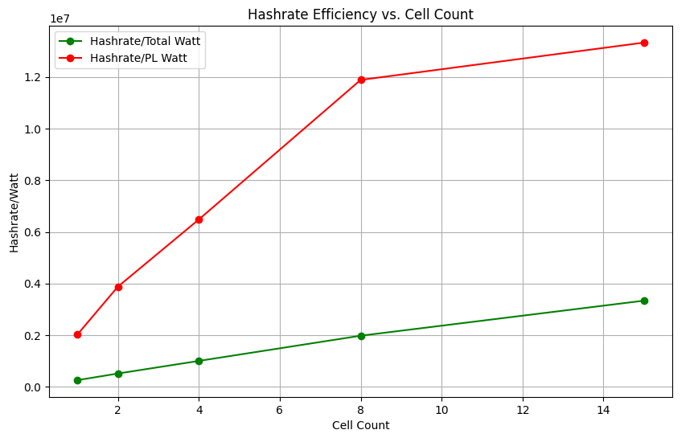
FPGA Fabric Performance vs Cores

Slide 24
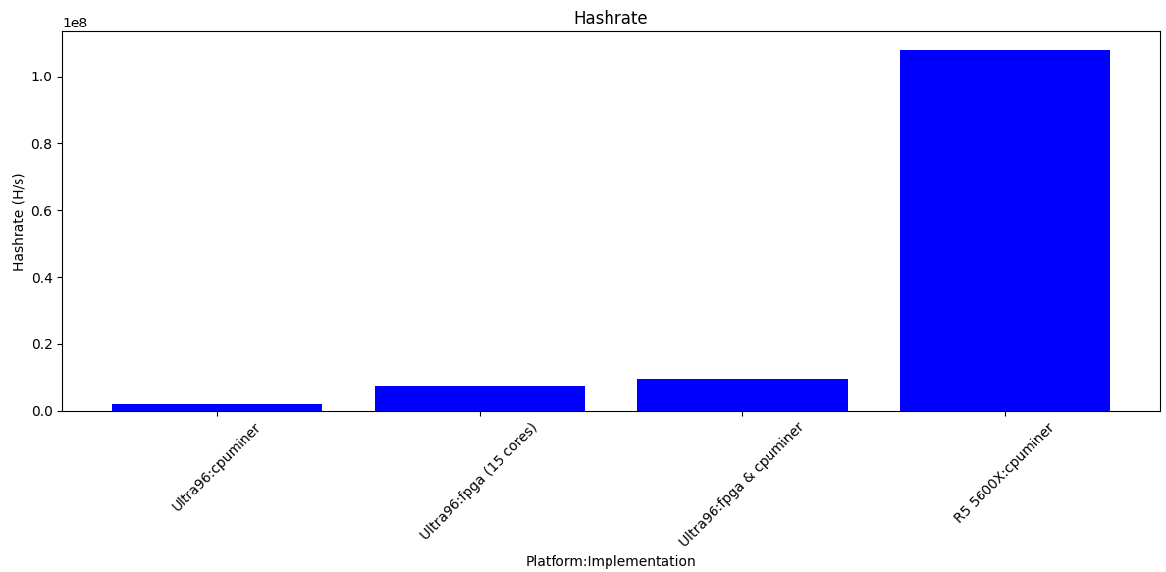
Comparison to CPU: Hash Rate
~100M
~7.5M
~9.5M
~2M

Slide 25
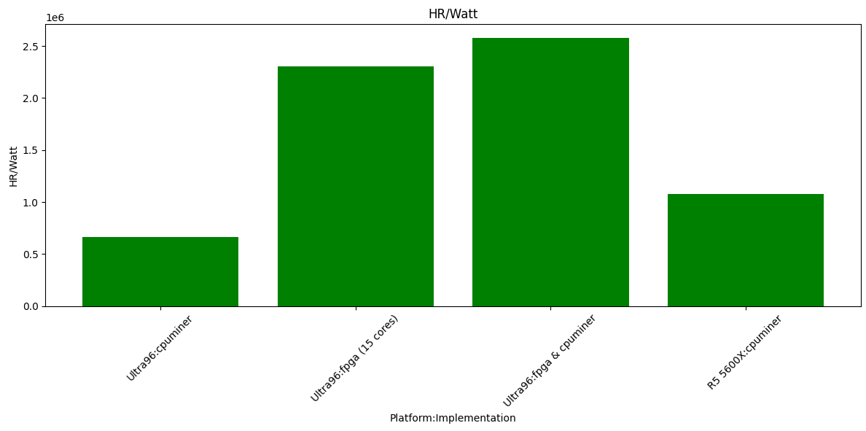
Comparison to CPU: Hash Rate per Watt
~2.55M
~2.25M
~1M
~0.7M

Slide 26
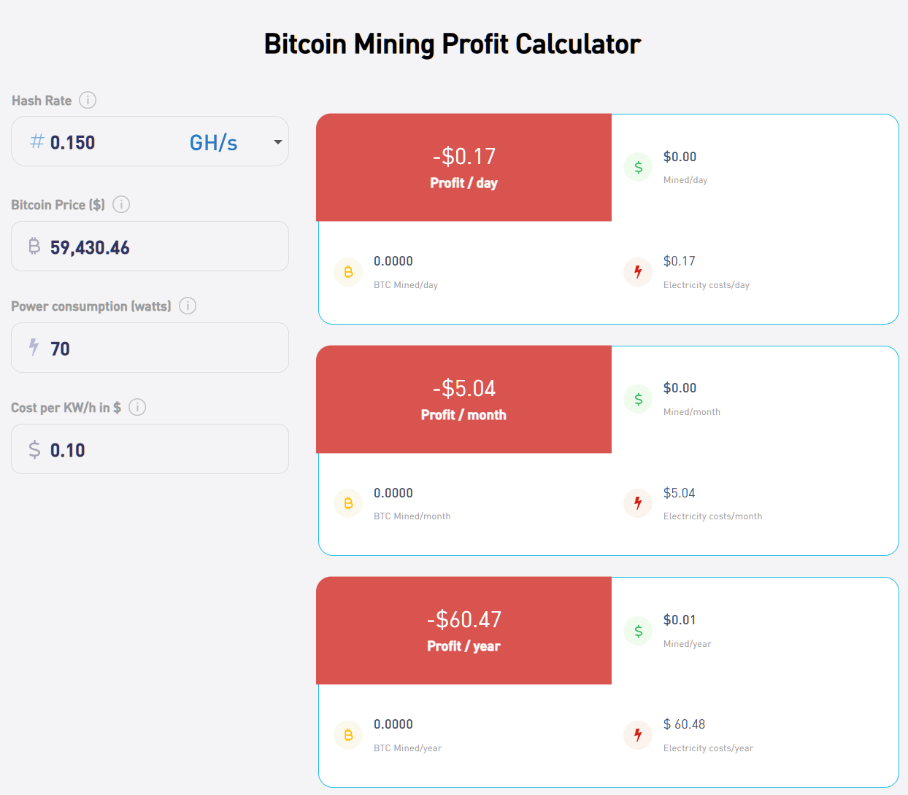
Connecting to a Mining Pool
Mining is effectively a lottery, thus to provide more reliable income, many miners work together in mining pools and share the profits (Law of Large Numbers).
Each miner connects to the pool using the Stratum protocol. The pool provides each miner with a unique header template to work on. Every miner uses the template to create a header and attempts to find a nonce that satisfies the difficulty target (SHA256d(header) <= Target).

Slide 27
Conclusions & Ways to Further Improve
Bitcoin mining on CPUs and FPGAs not profitable today
20 Ultra96 boards running for 1 year would earn ~1 cent and cost $60 in electricity
Would have been amazing 15 years ago
Clock in header (large wire count, each w/ large fanout)
Poorly synthesized one-hot mux (not trivial)
Reduce utilization to fit more cores
Clock gating
Minimize power consumption
AXI Registers
PS

Slide 28

Demo

Slide 29
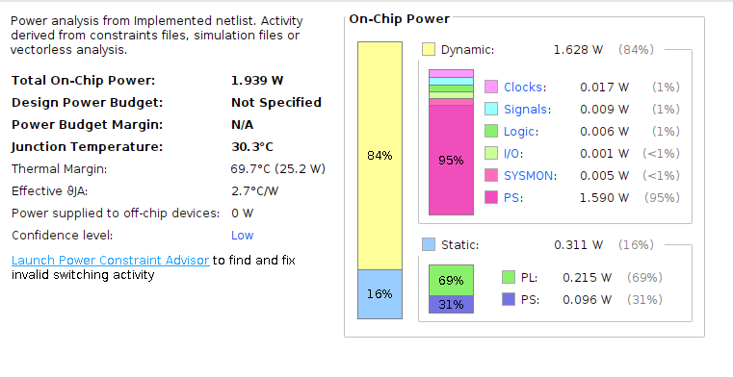
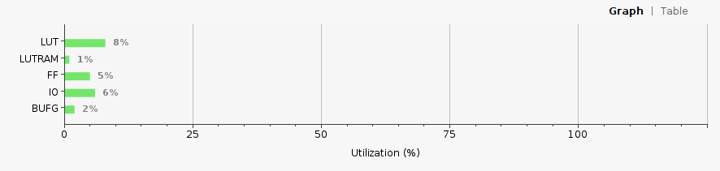
1 Cell Data
Exhausted possible nonce values - Time taken: 8547.40 seconds

Slide 30
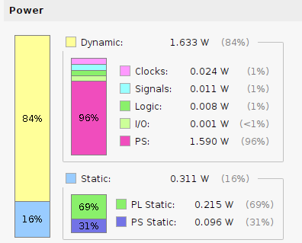
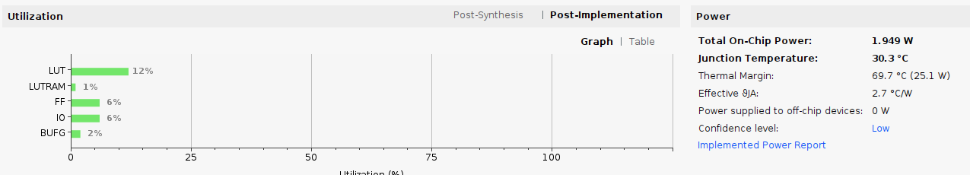
2 Cell Data
Exhausted possible nonce values - Time taken: 4273.72 seconds

Slide 31
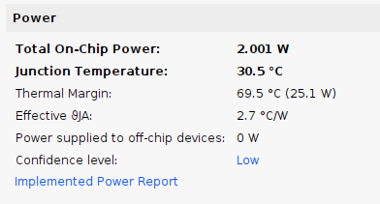
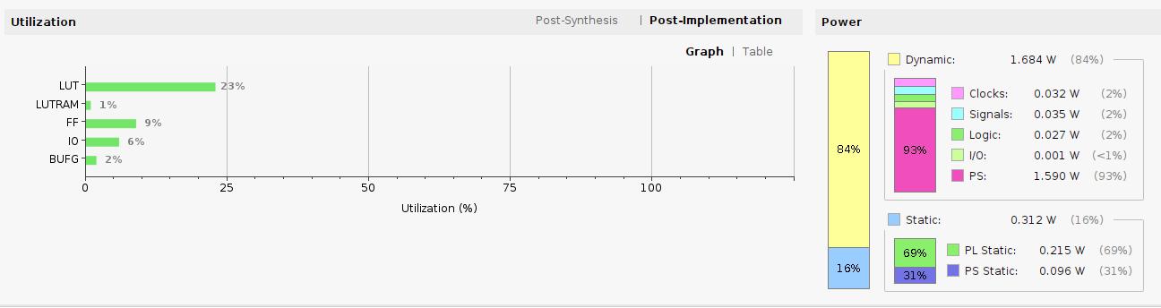
4 Cell Data
Exhausted possible nonce values - Time taken: 2136.91 seconds

Slide 32
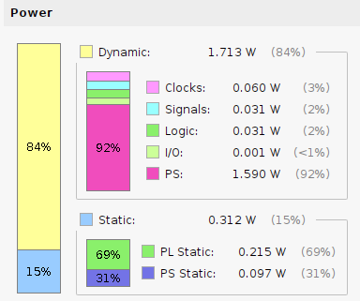
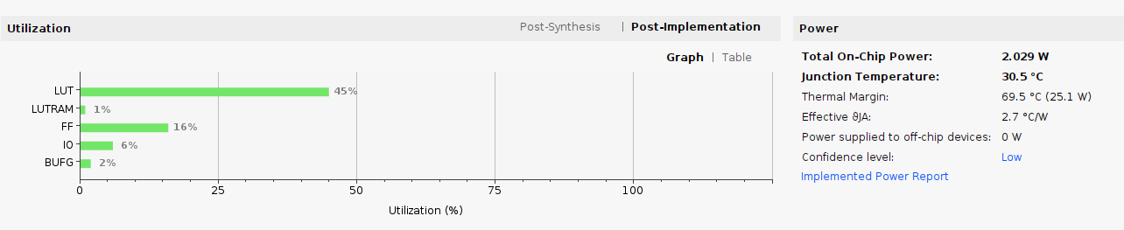
8 Cell Data
Exhausted possible nonce values - Time taken: 1068.47 seconds

Slide 33
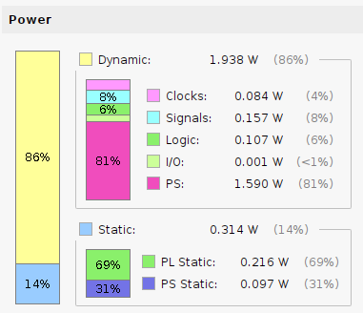
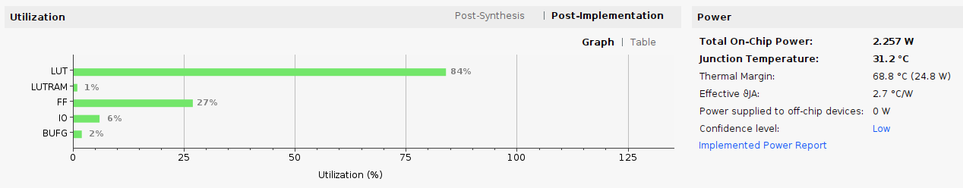
15 Cell Data
Exhausted possible nonce values - Time taken: 569.92 seconds

