Slide 1

LOW POWER DESIGN OF AMBER25 SoC
EE382M – VLSI2
Project Review
  TEAM 4: Instructor:
  Anisa Qazi Prof. Mark McDermott
  Gayatri Sivaraman
  Neena Hulkoti
  Sharukh Shaikh
  Sruthi Somarouthu

Slide 2
Outline
Design flow
Amber25 architecture
Synthesis Results
Physical Design flow
ECO & Timing Analysis
Power Analysis
Formality results
Challenges faced
What will we do differently?
Key Learnings

Slide 3
Work distribution
TASK | Owner
Synthesis | Sharukh, Sruthi
Floorplan | Anisa, Sruthi
Powerplan | Neena, Gayatri
PNR, ECO, PT | Sharukh, Neena
PTPX, Formality | Anisa, Gayatri

Slide 4
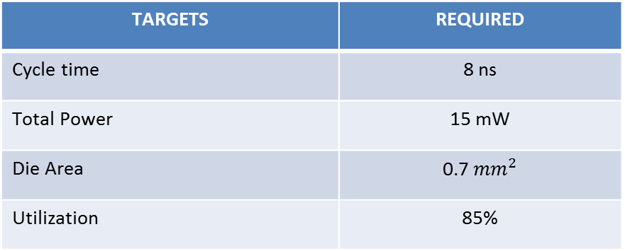
Design Targets
TARGETS | REQUIRED
Cycle time | 8 ns
Total Power | 15 mW
Die Area | 0.7 ${mm}^{2}$
Utilization | 85%

Slide 5
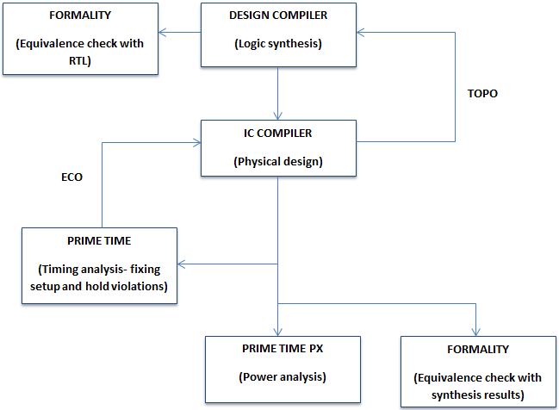
Design Flow chart

Slide 6
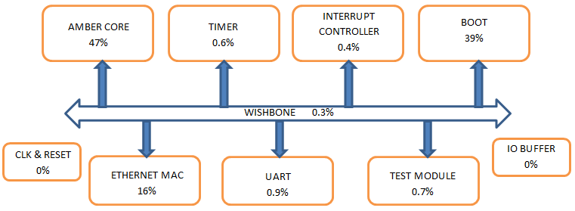
SoC Architecture

Slide 7
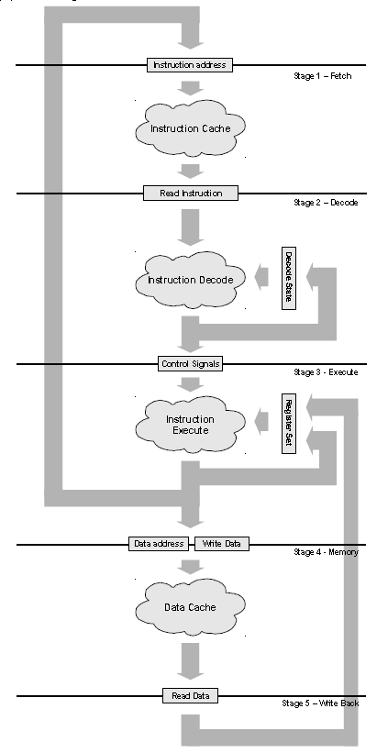
Amber25 Architecture
Amber25 is 5 stage pipeline
  Fetch
  Decode
  Execute
  Memory
  Writeback
Separate Data cache and Instruction cache and a register bank with 27 register
32 bit Wishbone bus interface
ALU, Barrel Shifter, Multiplier
Peripherals used: UART, timer and Ethernet MAC

Slide 8
Synthesis Switches
Topographical mode: Uses feedback from ICC (pin placement and other information) to provide more margin in timing.
‘set DO_TOPO true’
Avoid usage of LVT/RVT cells:
‘set_dont_use [get_lib_cells *LVT*]’
Leakage power optimization:
‘set DO_LEAKAGE_OPT true’
Clock gating:
‘set DO_CLOCK_GATING false’

Slide 9
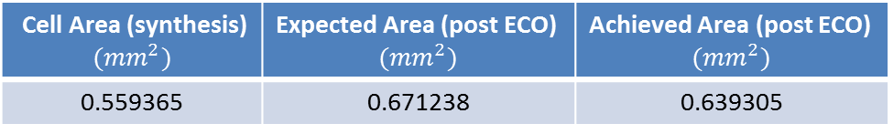
Synthesis Results
Area analysis: After obtaining the area from synthesis, overhead has to be added to account for Routing, Power plan and ECO fixes. Hence, typically a margin of 20% is used.
Cell Area (synthesis) $${(mm}^{2})$$ | Expected Area (post ECO) $${(mm}^{2})$$ | Achieved Area (post ECO) $${(mm}^{2})$$
0.559365 | 0.671238 | 0.639305

Slide 10
Synthesis Results
Vth Group split:
Critical path Slack:
Zero Setup/Hold Violations
Vth Group Name | Synthesis | Post ECO
HVT | 99.93 % | 99.69 %
RVT | 0.07 % | 0.18 %
LVT | 0 % | 0.13 %
# Total cells | 28400 | 29068
Clock | Period (ns) | Critical path slack (ns)
sys_clk | 8 | 0.0029
sys_slow_clk | 32 | 2.34
mrx_clk | 40 | 4.16
mtx_clk | 40 | 2.94

Slide 11
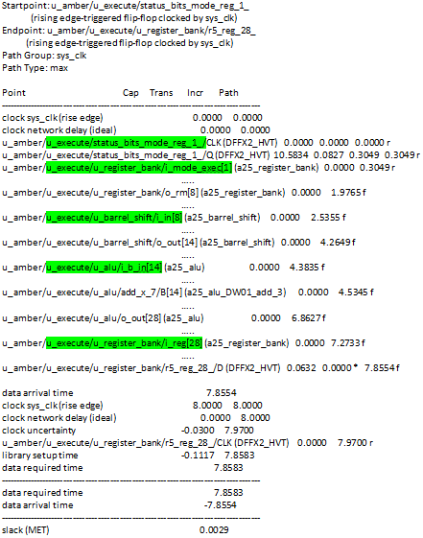
Critical Path in Synthesis

Slide 12
Effect of Clock Gating switch in Synthesis
Power comparison:
Synthesis was performed with and without the switch ‘DO_CLOCK_GATING’
After first round of ICC, the total power increased for the synth db with ‘DO_CLK_GATING’ set as true.
DO_CLOCK_GATING | Total power mW)
FALSE | 5.93
TRUE | 5.999

Slide 13
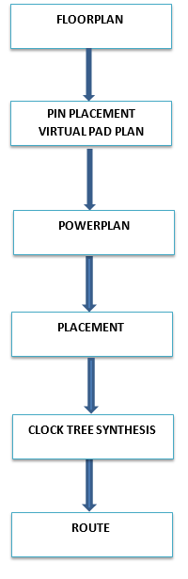
Physical Design Flow

Slide 14
Hard Macros
SRAM MACRO | # BLOCKS
Instruction Cache | 4
Data Cache | 4
Boot Memory | 8
Ethernet | 1
Instruction and data cache are part of the Amber core
Ethernet SRAM block is a part of the Ethernet MAC
Boot Memory is accessed by Amber25 core via the wishbone.
Metal Layers used: M1-M5

Slide 15
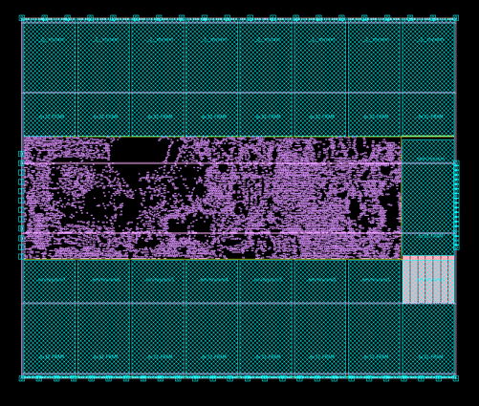
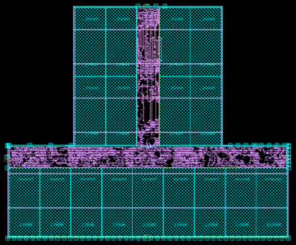
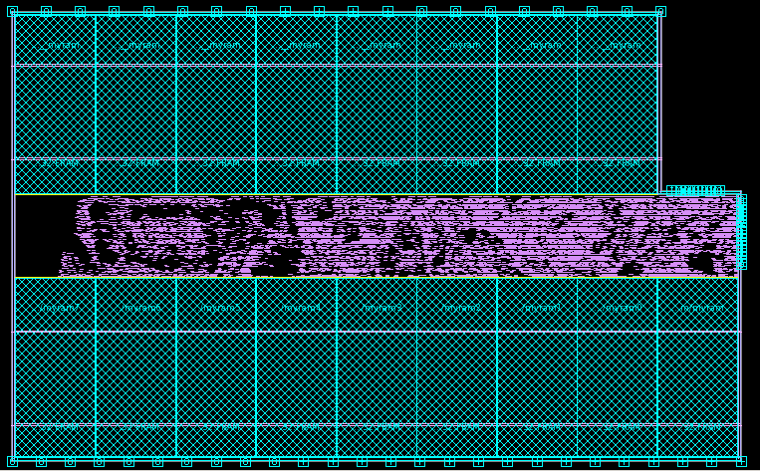
Floorplans
Floorplan rectangular
Floorplan T
Floorplan L
- Fixed x and y
- No flexibility in area reduction
- Low Utilization
- Difficulties with power planning
- Area met
- Utilization target almost met
- Routing congestion
- Less flexibility in area reduction
- Least area
- Maximum utilization
- Less routing congestion
- Better power planning

Slide 16
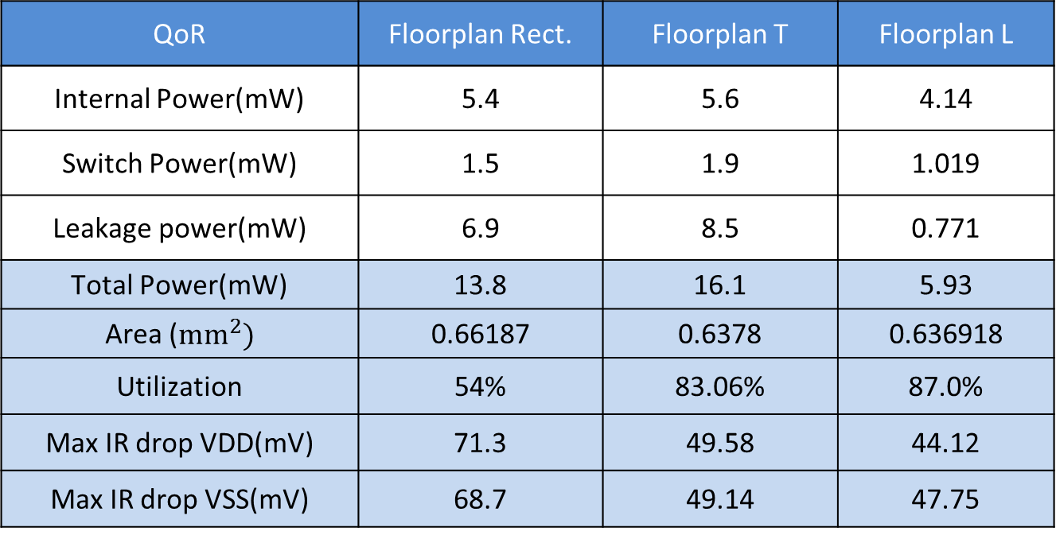
Comparison of all Floorplans
(before ECO)
QoR | Floorplan Rect. | Floorplan T | Floorplan L
Internal Power(mW) | 5.4 | 5.6 | 4.14
Switch Power(mW) | 1.5 | 1.9 | 1.019
Leakage power(mW) | 6.9 | 8.5 | 0.771
Total Power(mW) | 13.8 | 16.1 | 5.93
Area (${mm}^{2})$ | 0.66187 | 0.6378 | 0.636918
Utilization | 54% | 83.06% | 87.0%
Max IR drop VDD(mV) | 71.3 | 49.58 | 44.12
Max IR drop VSS(mV) | 68.7 | 49.14 | 47.75

Slide 17
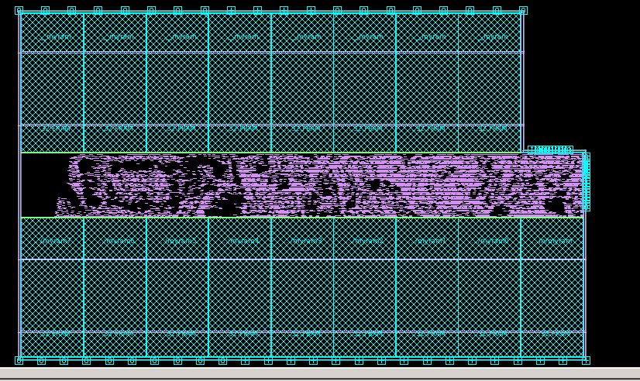
FLOORPLAN L
Data Cache
Instruction Cache
Boot memory
Ethernet
Notes:
Why hard blockage?

Slide 18
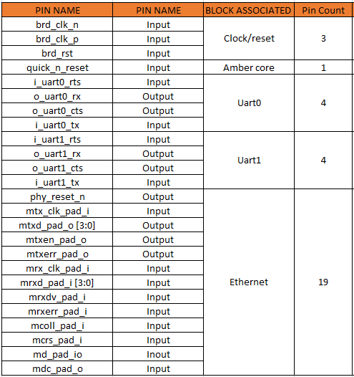
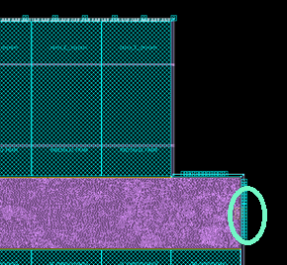
Pin Distribution
Ethernet

Slide 19
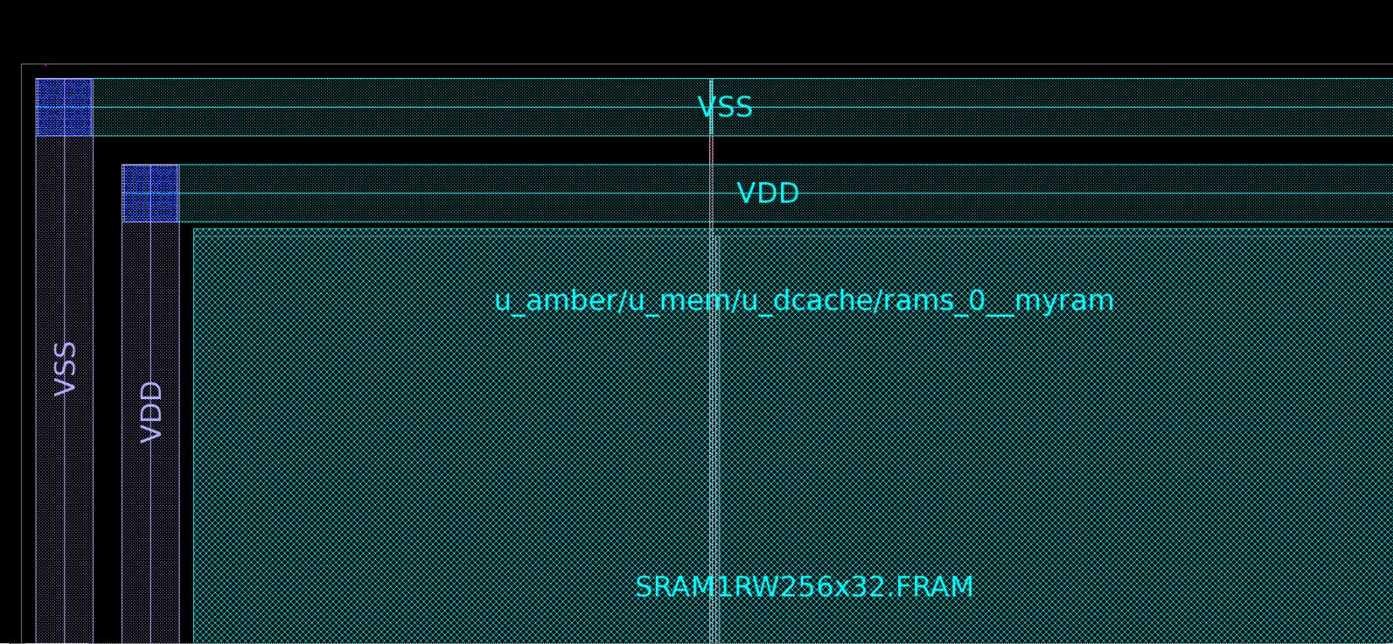
Power Rings
M8
Width: 2um
Spacing: 1um
M7
Width: 2um
Spacing: 1um
Notes:
Explain we used M1-M5, route power in M6

Slide 20
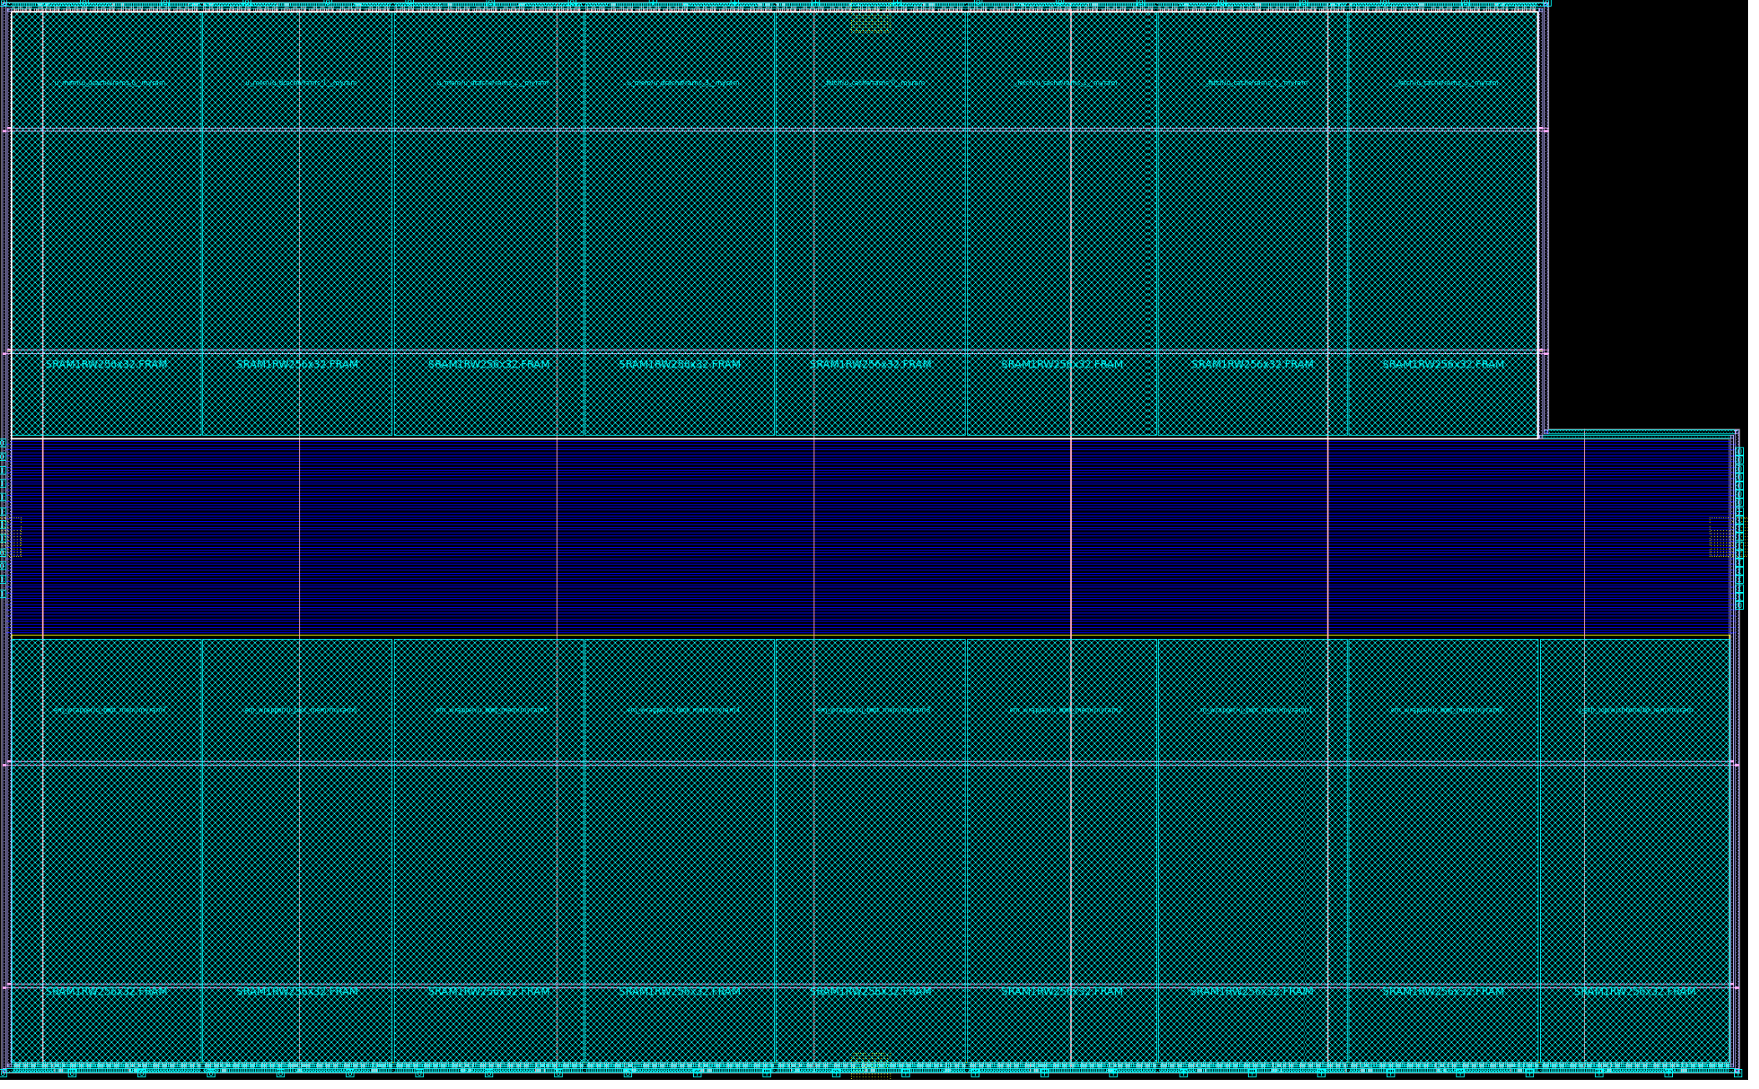
Power Grid
M9
Width: 1u
Step : 130um
M1
Width: 0.12u
Step: 2*1.672
M6
Width: 0.112u
Step: 130um
**(M1 pitch = height of standard cell)

Slide 21
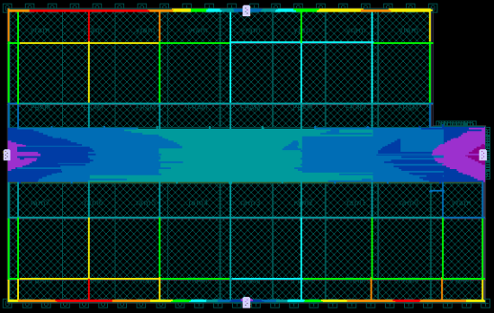
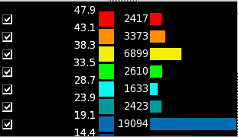
Virtual Pad Placement & IR Drop
4 pairs of {VDD VSS} virtual pads.
Distribute VDD and VSS virtual pads uniformly for lesser IR drop.
IR drop: 44.11 mV (VDD)
47.74 mV (VSS)

Slide 22
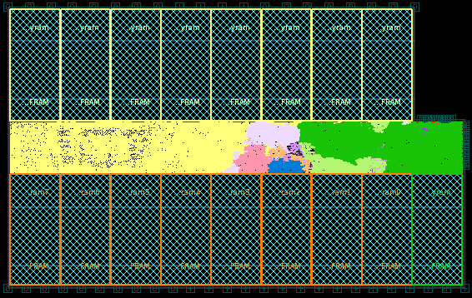
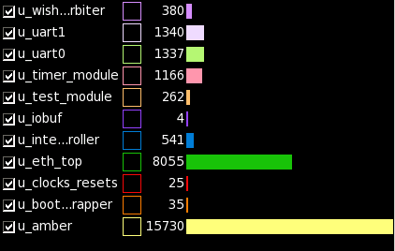
Placement (Hierarchy)
SoC

Slide 23
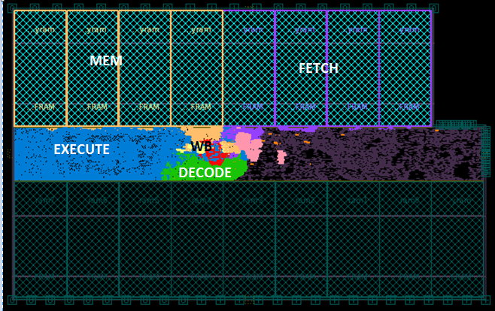
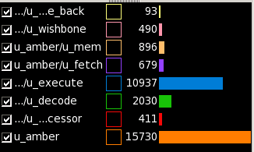
Amber Core

Slide 24
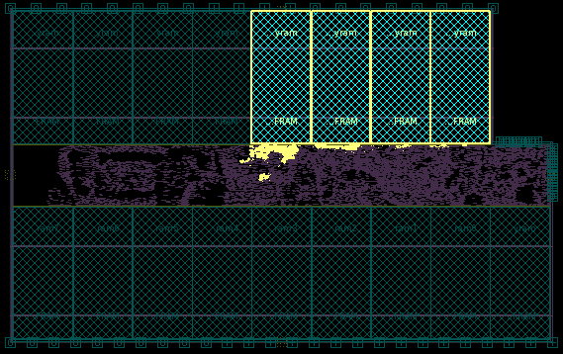
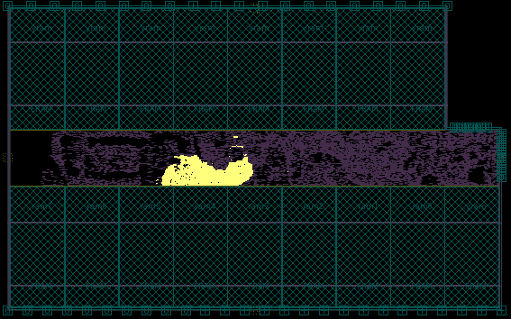
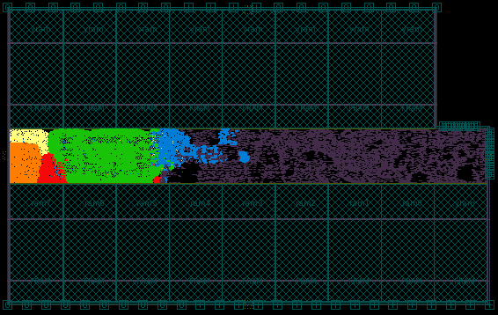
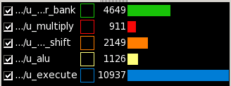
Amber Core Hierarchy
Fetch
Decode
Execute

Slide 25
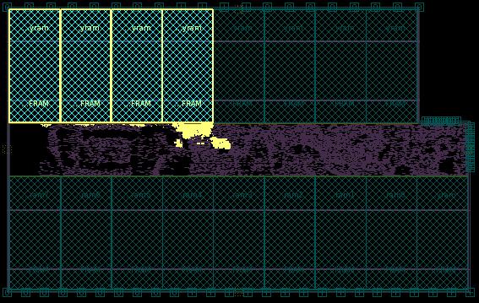
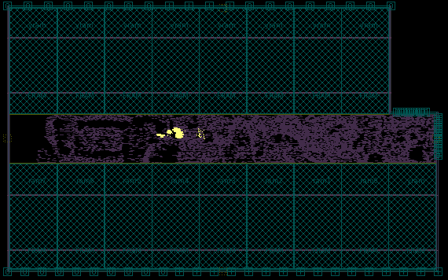
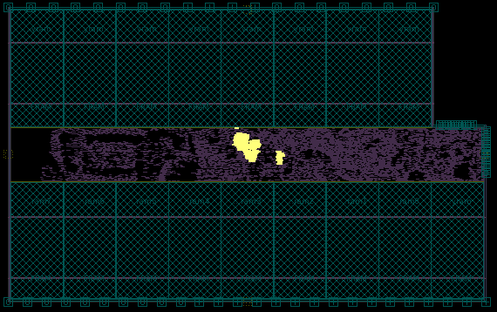
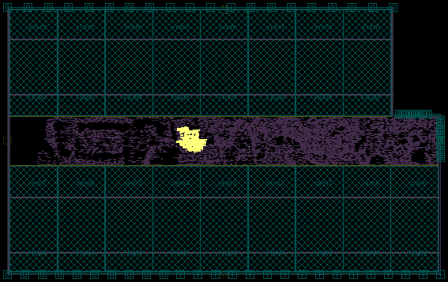
Mem
Writeback
Wishbone
Co-processor
Notes:
Co-processor is instantiated in amber core and it has 15 registers and control signals. There are dedicated instructions of type coretrans (mrc and mcr) to move the register data from co-processor to amber register bank.
Mrc- co-processor to amber register bank
Mcr- amber register bank to co-processor

Slide 26
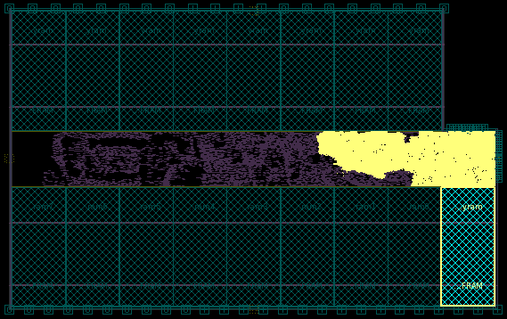
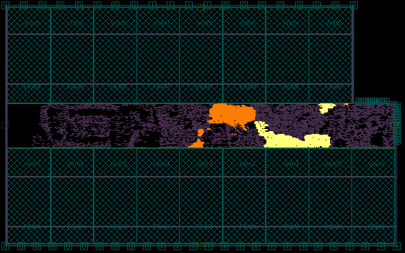
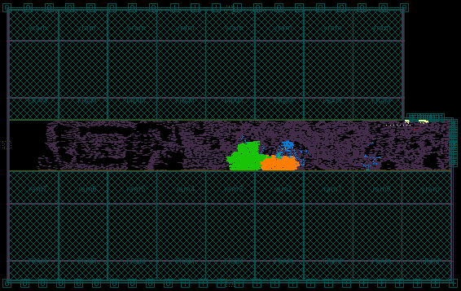
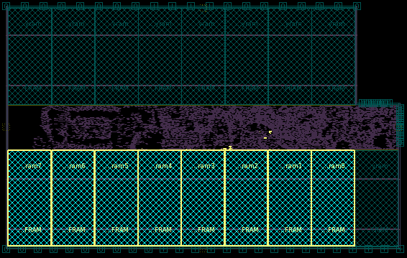
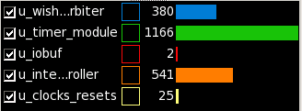
Ethernet
Uart0, Uart1
Misc. Blocks
Boot Memory

Slide 27
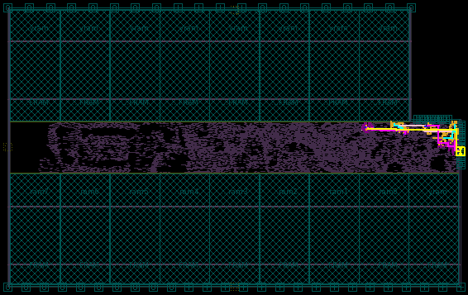
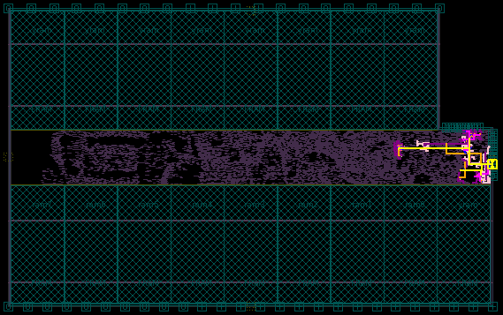
Clock Trees
mtx
mrx

Slide 28
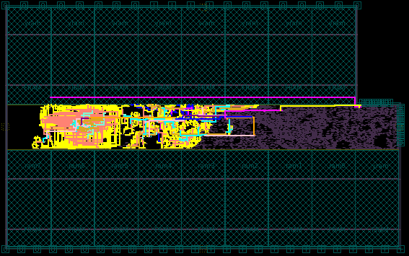
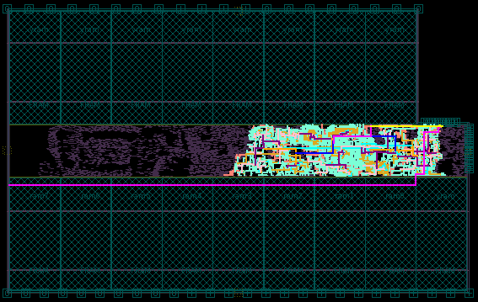
Clock Trees
sys_clk
sys_clk_slow

Slide 29
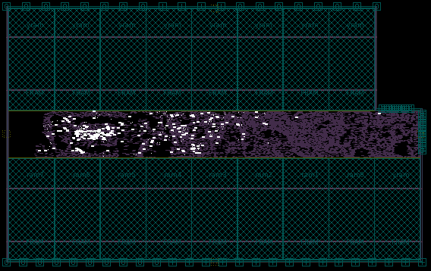
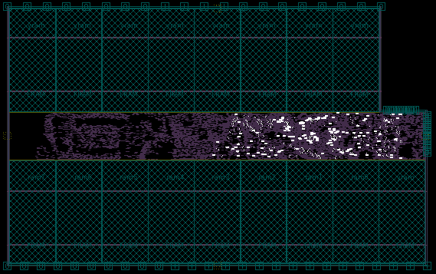
Clock Buffers
sys_clk
sys_clk_slow

Slide 30
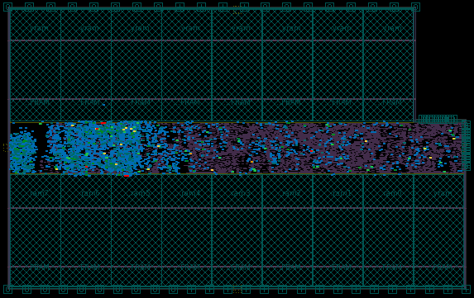
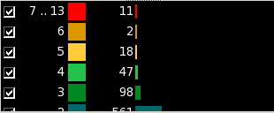
Routing Congestion
Notes:
Routing Congestion is ratio of

Slide 31
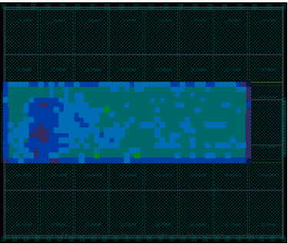
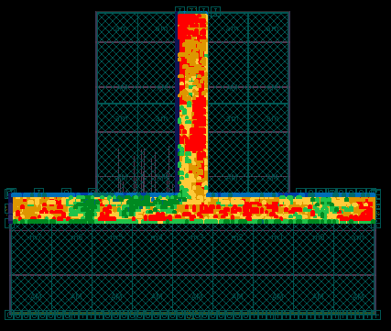
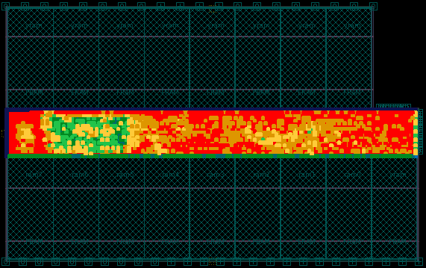
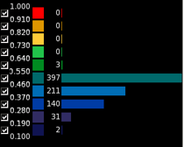
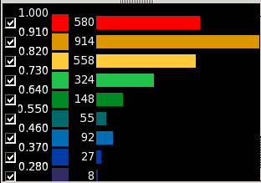
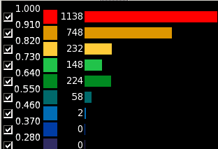
Cell density Comparison
Utilization: 54%
Utilization: 83.06%
Utilization: 87%

Slide 32
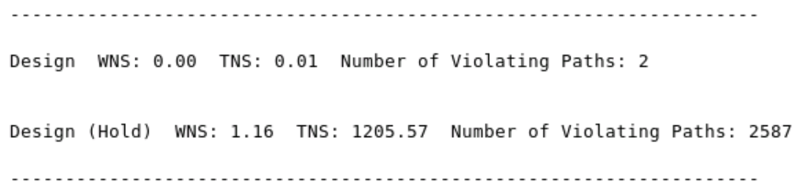

Results: Before ECO
Specification | Floorplan L (before eco)
Total Power(mW) | 5.93
Area(${mm}^{2}$) | 0.636918
Utilization | 87.0%
Max IR drop VDD(mV) | 44.12
Max IR drop VSS(mV) | 47.75
# Setup Violations | 2
# Hold Violations | 2587

Slide 33

ECO FLOW

Slide 34

PT Multi-corner Timing Analysis

Slide 35
Multi-Corner Timing Analysis
Corner | Setup Slack (ns) | Hold Slack (ns)
ss0p95n40c | 0.07 | 0.04
tt1p05v25c | 3.373 | 0.013
ff1p16v125c | 5.39 | 0.001

Slide 36

Critical paths (post ECO)
Decode Register -> Register Bank -> Barrel Shifter -> ALU -> Status Bit Update

Slide 37


Decode Register -> Register Bank -> Barrel Shifter -> ALU -> Status Bit Update

Slide 38

MULTICYCLE PATH

Slide 39


Amber Wishbone -> Wishbone Arbiter -> Amber Wishbone -> Mem D-Cache -> Amber Wishbone -> Execute Register Bank Clock Gate EN

Slide 40



Post ECO Reports

Slide 41

Results: Before and After ECO
Specification | Floorplan L (before eco) | Floorplan L (after eco)
Internal Power(mW) | 4.14 | 4.14
Switch Power(mW) | 1.019 | 1.013
Leakage power(mW) | 0.771 | 1.057
Total Power(mW) | 5.93 | 6.210
Area(${mm}^{2}$) | 0.636918 | 0.639305
Utilization | 87.0% | 89.07%
Max IR drop VDD(mV) | 44.12 | 44.20
Max IR drop VSS(mV) | 47.75 | 47.87

Slide 42
PTPX Power Analysis flows
Leakage power estimation gives fairly accurate results
There exists 3 different methodologies for estimating active power
Static activity factor (AF) propagation:
Obtain approximate AF for each block. Propagate the same inside the block
Estimate power based on this
Key points:
  Inaccurate
Full GLS:
Run gate level simulation of average use case to get a VCD dump
Convert VCD to SAIF
Use this SAIF to estimate power
Key points:
  Need a working timing GLS simulation framework – tedious, runs take time
  Accurate AFs for all nodes
Forced gate GLS:
Run RTL simulation and obtain values of key nodes
Run GLS by forcing the values on those mapped(RTL->Gate level) nodes and obtain VCD dump
Convert VCD to SAIF
Use this SAIF to estimate power
Key points:
  Faster compared to Full GLS
  Accurate AFs for all nodes
*GLS: Gate level simulation
*VCD: Value change dump
*SAIF: Switching activity interface format
Reference: SNUG Boston 2010 (Measuring active power using PTPX: A User perspective)
Notes:
Simple summations of the total device width or the total device width attached to power and ground supplies can be used to calculate reasonable leakage approximations. Leakage power is not nearly as pattern dependent as active power.
We referred to the paper from SNUG mentioned below to understand the flow for power estimation
Leakage power is not dependent on the block activities, thus most of the devices gives almost accurate results.
But, active power depends on activity factors and our power estimates depend on the accuracy of these. According to this paper, there are 3 methodologies that are usually followed.

Slide 43
Steps to obtain activity factor
Run GLS and obtain VCD
Convert VCD to SAIF: “vcd2saif –input gls_dump.vcd –o gls_dump.saif”
Read SAIF in ptpx: “read_saif –input gls_dump.saif –strip_path tb/dut/u1”
Can report the activity factors: “report_switching_activity”

Slide 44




Power report
(Static AF propagation)

Slide 45


Formality Flow

Slide 46




Formality check: RTL vs DC Netlist
No failing points
No abort points
1 Unmatched point in REF design due to logic removal in optimization
285 unmatched points in IMP design due to clock gating latch insertion during synthesis
Test Passed!

Slide 47




Formality check: DC vs ICC post ECO Netlist
No failing points
No abort points
No unmatched points
Test passed!

Slide 48

Final Results: Post ECO
QoR | Specification | Results | Margin
Cycle time (ns) | 8 | 8 | 0
Total power (mW) | 15 | 6.210 | 58.6 %
Area ${(mm}^{2})$ | 0.7 | 0.639305 | 8.67 %
Utilization (%) | 85 | 89.07 | 4.07 %
Max. IR Drop VDD (mV) | <50 | 44.20 | 5.8 mV
Max. IR Drop VSS (mV) | <50 | 47.87 | 2.13 mV
Verify LVS | CLEAN | CLEAN | -
Verify DRC | CLEAN | CLEAN | -
Formality | CLEAN | CLEAN | -

Slide 49


Slide 50


Challenges faced
Power Planning
Routing congestion leading to shorts during ECO iterations
Reason: M9 Power strap placed at centre standard cell area

Slide 51


Challenges faced
Clock Tree
Unnecessary long routing of sys_clk_slow
Reason: UART blocks were placed far apart

Slide 52


Challenges faced
Setup Slack (post ECO, ss corner)
Initial DC & ICC use: HVT + RVT
Initial DC & ICC use: Only HVT
** ECO in both cases uses: HVT, RVT & LVT

Slide 53
Challenges faced
Routing Congestion
In ECO iterations, verify_lvs reported several shorts
Reason: Utilization was around 91%, routing congestion was high
Solution: Went back and increased the standard cell region area of floorplan

Slide 54

Challenges faced
Hold Time Fixing
ECO was unable to fix a hold violation even with multiple iterations
Reason: Hold violations on ‘brd_rst’
‘brd_rst’ is an asynchronous reset
**Hierarchy: system -> clocks_resets -> eth_top
**‘brd_rst’ signal is passed as ‘wb_rst_i’ to ‘eth_top’
Set as false path in constraints
set_false_path –from [get_ports brd_rst]

Slide 55

What would we do differently?
Adapt a better power estimation technique by extracting activity factors from GLS VCD.
Reference: VLSI2 – Lecture notes
(Early Design Planning – Front End)

Slide 56

What would we do differently?
Follow CPF/UPF based flow and implement voltage domains for blocks based on their specifications.

Slide 57
Key Learnings
Clock Gating can decrease dynamic power, but may increase leakage power which might lead to increase in total power
Utilization can be increased by reducing area or increasing blockage
Power straps should be spaced optimally considering IR drop and routing congestion
Increase width of power straps for reducing IR drop.
Virtual pads must be equidistant to have uniform IR drop
Extra area has to be accounted for in order to fix violations during ECO iterations
Proper database management and good communication between team members helps complete the project smoothly

Slide 58
Questions?

Slide 59
Backup

Slide 60


IR Drop comparison
IR drop: 49.86 mV (VDD)
48.96 mV (VSS)
IR drop: 44.11 mV (VDD)
47.74 mV (VSS)

Slide 61

DC area report

Slide 62

DC timing report

Slide 63

ICC area report: Post ECO

Slide 64

ICC Utilization report: Post ECO

Slide 65

PTPX results

