Slide 1
Computer Architecture: Fundamentals, Tradeoffs, Challenges Chapter 2: The ISA
Yale Patt
The University of Texas at Austin
Austin, Texas
Spring, 2025

Slide 2
Outline
The ISA -- What is it?
The interface between hardware and software
A specification
NOT microarchitecture
NOT just the instruction set
The Instruction
The atomic unit of processing
Changes the state of the machine
Characteristics of an ISA (using LC-3b as an example)
The LC-3b instruction set
Other ISAs
X86
RISCV
ISA Tradeoffs (with examples)

Slide 3
What is the ISA?
A specification
The interface between hardware and software
A contract
What the software demands
What the hardware agrees to deliver

Slide 4
NOT Microarchitecture
Architecture
Software Visible
Address Space, Addressability
Opcodes, Data Types, Addressing Modes
Privilege, Priority
Support for Multiprocessors (e.g., TSET)
Support for Multiprogramming (e.g., LDCTX)
Microarchitecture
Not Software Visible
Caches (although this has changed, …sort of)
Branch Prediction
The instruction cycle
Pipelining
DIGRESSION (nugget): You have a brilliant idea, and
It requires a change to the ISA or to the uarchitecture.

Slide 5
Another DIGRESSION (nugget)
The pure distinction between ISA vs uarchitecture
ISA is visible to the software
Microarchitecture is “underneath the hood”
BUT some have noticed that…
If you let the compiler know how the ISA is implemented,
i.e., if you break the walls between the transformation levels,
You can produce better code for that implementation
…at the expense of compatibility
Today, with the impending demise of Moore’s Law,
Computer Architecture is looking for ways to still be relevant
I have been preaching: Break the layers!
MIT recent white paper: “There is plenty of room at the top!”

Slide 6
Characteristics of an ISA (e.g., the LC-3b)
Processor State (memory, registers)
Memory addressability: byte
Memory address space: 2^16
Registers: 8 GPR, Condition Codes N, Z, P
Word length: 16 bits
Program Counter (Actually, Instruction pointer)
Process Status Register (contains Privilege, Priority, CC)
Privilege: 2 levels, supervisor, user
Priority: 8 levels
Instruction format: fixed length, uniform decode. 16 bits
Flynn’s observation: Two or three lengths better than all the same
Endian-ness: little endian
Instructions (opcode, addressing mode, data type)
Opcode (14 opcodes, including XOR, SHF, LDB)
Addressing modes (PC-relative, Register + offset)
Data types (2’s complement 16 bit integers, bit vector)
Three-address machine (Load/Store ISA)

Slide 7
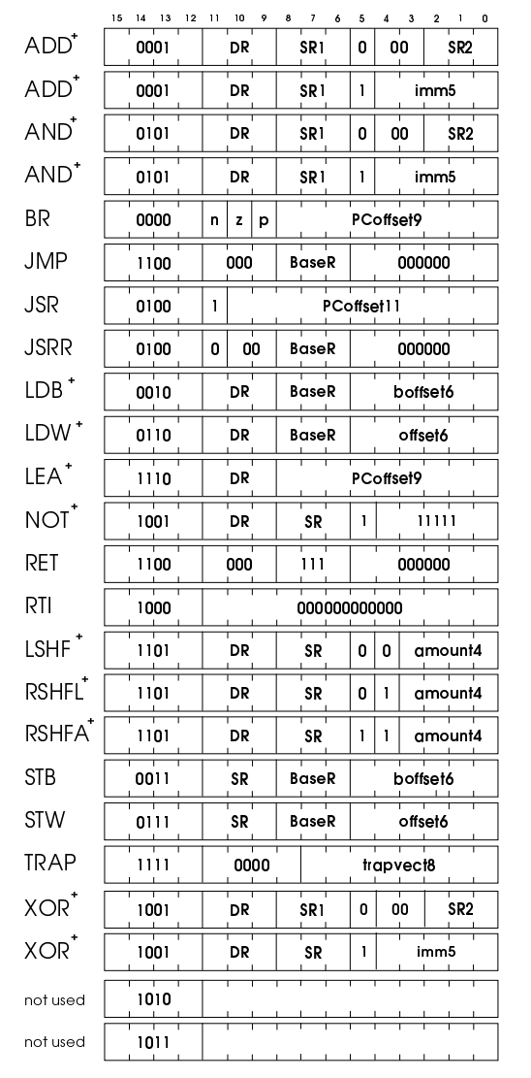
The LC-3b Instruction Set

Slide 8
Pragmas (aka Pseudo-ops)
Not part of the instruction set
Not executed by the computer
Messages from the programmer to the translater
Necessary for the translater to produce object code
Opportunity for programmer to affect performance (e.g., hints)

Slide 9
Characteristics of an ISA (continued)
Vector architecture (instructions, operands)
Not part of the LC-3b
Virtual memory specification: not yet part of LC-3b!
Address space
Translation mechanism
Protection
Page size
System architecture
State to deal with: trap vector table, interrupt vector table
Interrupt, exception handling
Instructions for the O/S to use (RTI)
NOT the instruction cycle (that is part of the uarch)

Slide 10
x86
Variable length instruction (one byte to 16 bytes)
Characteristics
Rich set of addressing modes
Two-address machine
SSE extension (originally, MMX)
Not load/store
Three page sizes (4KB, 2MB, 1GB)
Register sizes: 8b, 16b, 32b, 64b, 128b, …
Example: AH, Ax, EAX, …
Memory: Byte addressable, 64 bit address space

Slide 11
RISCV
The 5th chip from Professor David Patterson’s group
UC Berkeley
Nothing (really) in common with their other four risc chips
Mostly handled by Professor Krste Asonovic
Major selling point: Open Source
Overall structure
Multiple subset ISAs (Integer, Float, MUL/DIV, Atomic, etc.)
Designers build their own system, picking and choosing
MUST contain one of the Integer subsets (32-bit or 64-bit)
The rest (extensions) are up to the designer

Slide 12
RISCV (characteristics)
The subsets
Integer: 32-bit (RV32I), 64-bit (RV64I), 128-bit (RV128I)
Float extension: 32-bit (RV32F), 64-bit (RV64D), 128-bit (RV128Q)
M extension: Integer MUL/DIV
A extension: Atomic instructions
L extension: Decimal float
C extension: Compressed
B extension: Bit manipulation
J extension: Dynamically translated
T extension: Transactional memory
P extension: Packed SIMD
V extension: Vector operations
E extension: Embedded Controller (RV32E)
G extension: A system, really (IMAFD)

Slide 13
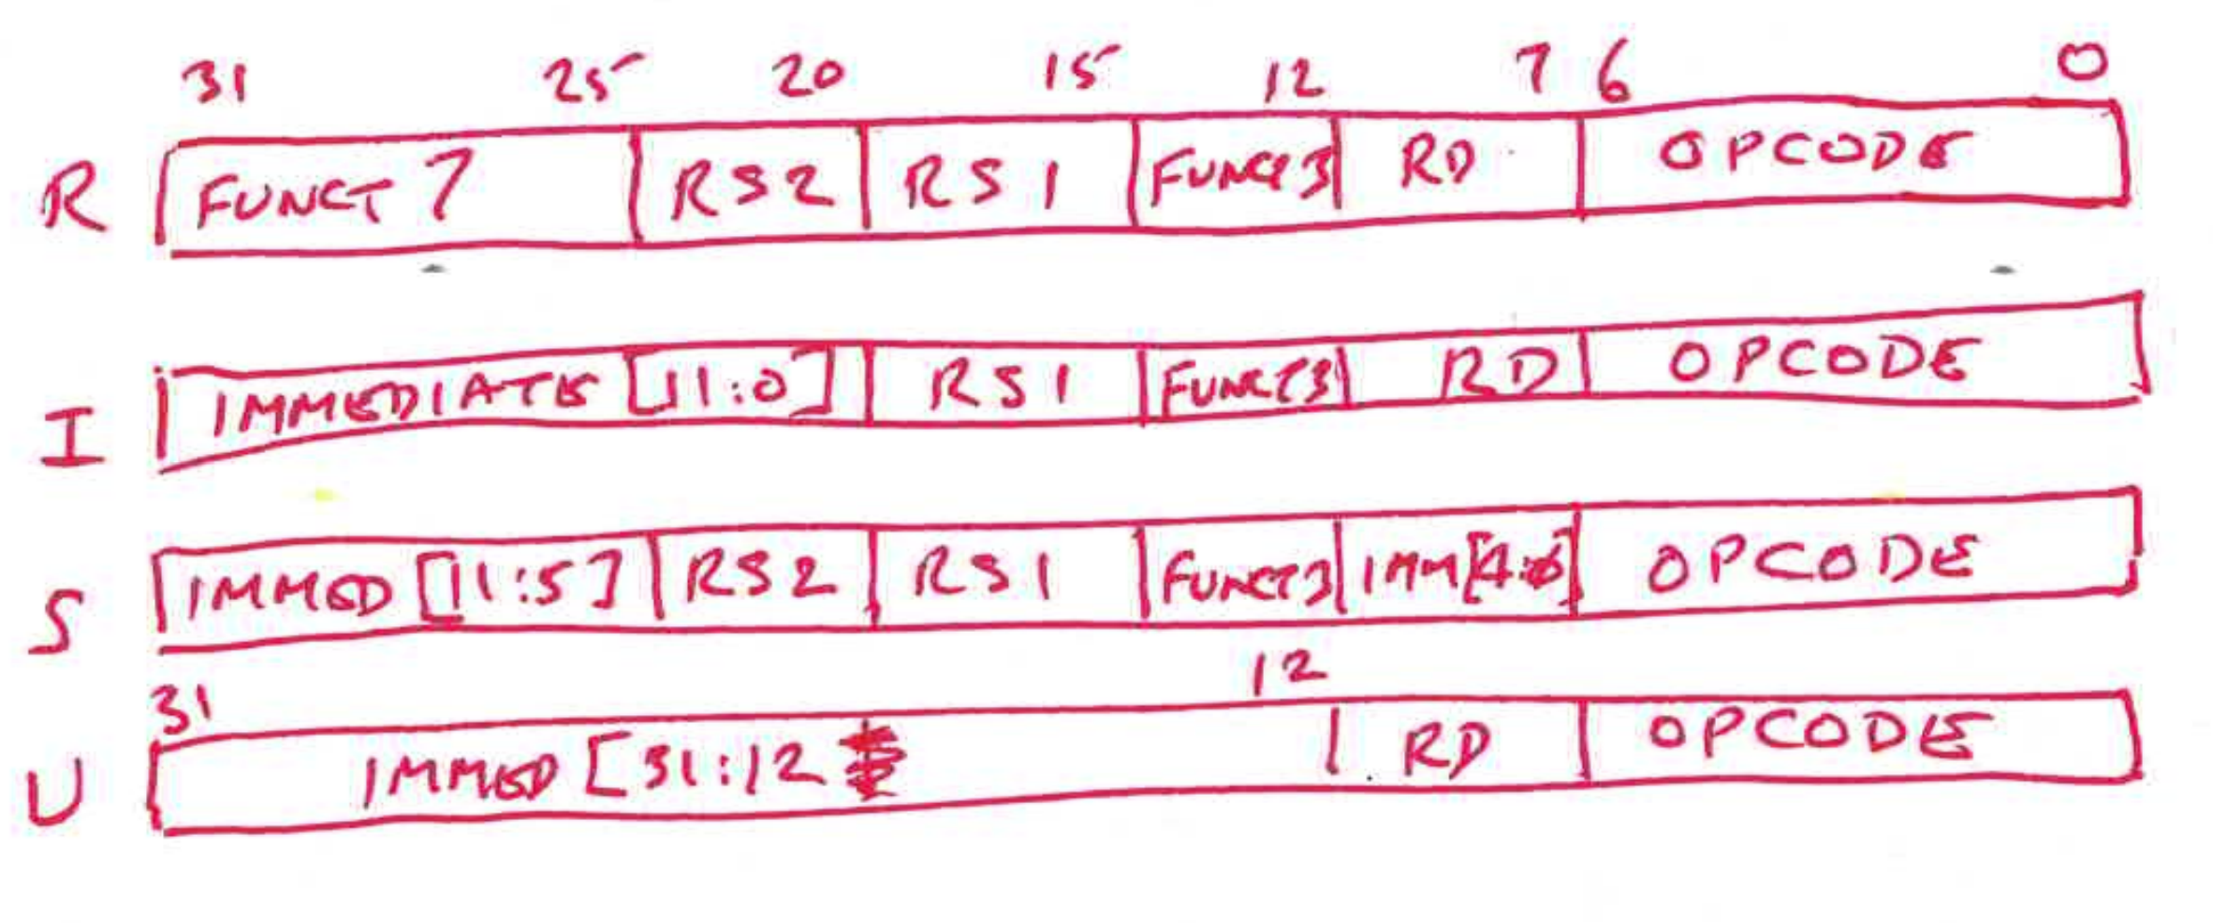
RISCV Characteristics (continued)
RV32I (32 bit Integer data type)
47 distinct opcodes (
loads, stores, shifts, arith, logic, compare, branch, jump, synch, count
32 GPRs (x0 to x31, x0=0, x1 used for call return linkage)
Also contains a PC
32 bit instructions
Can be extended by a multiple of n bits
Mixture allows for unaligned access
Also allows for 16 bit instructions, but then restricted to 8 registers
4 basic instruction formats
Other
Little endian
Load/Store
No predication
Conditional branches use GPRs, not condition codes

Slide 14
ISA Tradeoffs (examples)
Dynamic-Static Interface (The Semantic Gap)
ISA closer to the HLL
ISA closer to the control signals
ISA-level CAPABILITY (aka “Security”)
instructions included privilege needed
Intel 432, IBM System 38, Data General Fountainhead
All failed! Why? Performance was very slow
PREDICATION
x86 CMOV, ARM inst[31:28], THUMB IT block
Support for multiple ISAs on the same chip
ARM T bit, VAX Compatibility mode bit
Both in the PSR, making it part of the ISA.

Slide 15
ISA Tradeoffs (continued)
REGISTER SET -- how many reg, how many bits each
Many machines: 32 32-bit registers
More registers save spills to memory, but longer context switch
x86 now has 512-bit registers
Itanium has 1-bit predicate registers
Register window (SPARC ISA) vs set of gprs
Condition codes vs gprs. (MIPS, CDC6600 used gprs)
Serialization of code vs getting something done for nothing
John Cocke RS6000 -- 8 sets of 4 condition codes each
RICH INSTRUCTION SET vs. LEAN INSTRUCTION SET
Hewlett-Packard: HPPA RISC had 140 opcodes
So much for RISC being a small set of instructions!

Slide 16
ISA Tradeoffs (continued)
Do we include complex instructions (faster, but more gates)
EDITPC -- for COBOL
INDEX -- for Fortran
AOBLEQ -- For loop
LDCTX/SAVCTX -- to swap in/out context needed for next quantum
Test and Set (an Atomic operation) – for multiprocessing
CALL -- formal procedure call
more work, but cleaner interface to libraries
In addition to JSR (quick and simple)
FF -- find first
INSQUE/REMQUE -- doubly linked list data type
TRIADS – example: MAC (multiply accumulate)
CHMD -- to change privilege mode
Notes:
Had to remove PROBE since it didn’t fit. Can add it back sorry.

Slide 17
ISA Tradeoffs (continued)
INST SET Orthogonal vs Tailoring to each opcode
LOAD/STORE vs NOT Load/Store
Load/Store: Can’t access storage and operate in same instruction
LC-3b is load/store, x86 is not
Load/Store had more importance before o-o-o processing
MEMORY ADDRESS SPACE -- keeps getting larger
MEMORY ADDRESSABILITY -- depends on needs
Most memories: byte addressable (for data processing)
Scientific machines -- 64 bits
Burroughs 1700 -- one bit (needed for virtual machines)

Slide 18
ISA Tradeoffs (continued)
VLIW (compile time) vs. Superscalar (do it at runtime)
Compile time in ISA, runtime is uarchitecture (Superscalar)
VLIW: Hard to find enough instructions to fill the long word,
VLIW is fast because there are no dependencies at runtime.
Examples Multiflow, cydra five
Itanium 3 in one VLIW, but allows for dependencies
0,1,2,3 address machines. 3 addresses are needed.
How many have to be explicit?
0. stack machine: pop, pop, compute, push
1. one accumulator when reg were expensive AC ← AC + Memory
2. two. X86 (Rd ← Rd op Rx)
3. LD/ST all three are explicit Rd ← Rs1 op Rs2 (LC-3b)
VAX ISA had both 2-address and 3-address

Slide 19
ISA Tradeoffs (continued)
Word length (max size processed as a unit)
VAX 32 bits, x86 initially 16 bits, then 32, today 64;
CRAY-1 64bits
DEC System 20, an AI Machine. LISP’s car, cdr needed 36 bits
Help for the programmer or help for the microarchitect
Aligned vs. unaligned accesses easier – who gets the easy job?
PDP11 NO, VAX YES, ALPHA NO
Data types; int, float, bitvector, char string, doubly linked list
Addressing modes; indirect, index, autoinc/autodec/ SIB byte

Slide 20
ISA Tradeoffs (continued)
PAGE SIZE
(4KB vs more than one size
Intel has 3three: 4KBm 2MB, 1GB)
Faruk has all sizes 2^n for n greater or equal to 12
Efficient use of TLB, vs. Wasted space
Better use of TLB (fewer PTEs) vs. wasted space
Too many PTEs vs longer access time
I/O architecture
Today most use memory mapped I/O with LD,ST
OLD days, special I/O instructions
x86 still has both
Compile time vs run time
MIPS use of NOPS rather than hardware interlocks

Slide 21
ISA Tradeoffs (continued)
Synch vs Asynch
Instruction format:
Most: fixed length, uniform decode (easier multiple decode)
X86: variable length more work done per instruction)
Intel 432: different sizes for different opcodes (Nightmare!)
SPEED DEMONS vs. BRAINIACS
Alpha: Speed demon, 200 MHz;
Pentium: Brainiac, 66MHz

Slide 22
Obrigado!!

