Slide 1
Branch Prediction
Feb. 2026
EE382N.19

Slide 2
Branch Prediction is Still Important
Branch prediction is still a bottleneck for performance/energy efficiency
Need to provide the processor with correct path instructions
Misprediction penalties are large and waste energy

Slide 3
Motivating Example (from Prof. Mutlu)
20 stage pipeline, 5 wide fetch
1 in every 5 instruction is a branch
Each 5 instruction block end with a branch
How long does it take to fetch 500 instructions?
  100% prediction accuracy
  99% prediction accuracy (1 misprediction)
  95% prediction accuracy (5 mispredictions)
500/5 = 100 cycles
500/5 + 20 = 120 cycles
500/5 + 100 = 200 cycles

Slide 4
(Brief)History of Branch Predictors
Static Predictions
  Always Taken, Always Not Taken, BTFN
  Compiler/User Hints
Dynamic Predictions
  2 bit counter(global/per PC)
  History based predictors, 2-level, gshare, …

Slide 5
Global Branch Correlations
Integer A, and B are random variables
If(A) { //Branch 1
}
If(B){ //Branch 2
}
If(A XOR B){ //Branch 3
}

Slide 6
Key Insight
Branch 3’s direction is deterministic given the direction of branch 1 and branch 2
We can build a large table to track the direction of the branch for each control flow

Slide 7
What’s the problem with gshare?
Long history
Aliasing
Predicting branches that needs a short history

Slide 8
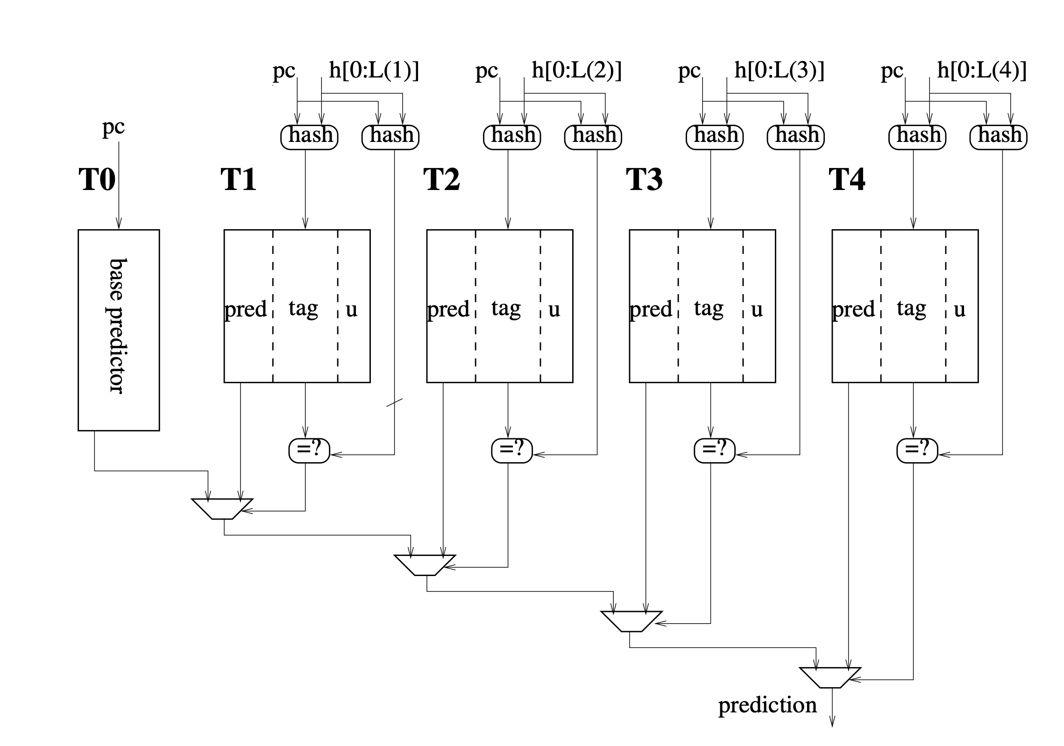
TAgged GEometric History Length Predictor (TAGE)

Slide 9
Branch Prediction
Part 2
Feb. 2026
EE382N.19

Slide 10
TAGE on a High Level
Captures the stable direction for that control flow
  Input: Control flow
  Output: Direction
Each tagged table works just like a cache
  Look up the table with a hash of (PC and history)
  Break up the hash into index and tag
  A hit indicates we have “likely” found an entry intended for this control flow
The prediction out of the bimodal(tagless) table is used when there is no tag match

Slide 11
Update—Step 1:Usefulness bit
If the prediction from the longest matching entry and the prediction from the second longest matching entry are the same
  Do not update the usefulness bit
If the prediction from the longest matching entry is correct
  Set the usefulness bit of the longest matching entry
If the prediction from the longest matching entry is incorrect
  Clear the usefulness bit of the longest matching entry

Slide 12
Update—Step 2:Counter
Update the counter from the provider entry

Slide 13
Update—Step 3:New Allocation
If prediction is incorrect, and the longest matching entry does not come from the last table
Say the longest matching entry is from table x, and the last table is N
For each table from x+1 to N
  If the entry pointed by the index is not useful
    Select as victim
    Put in new tag, initialize counter to be weakly T/NT
    End of update
  Else
    Go to the next table and try again

Slide 14
Pipeline Integration
History Update
Counter Update
  What needs to be checkpointed per branch for the update?
What happens on a flush?

Slide 15
Predictor Latency
Predictors today uses large look up tables and complex logic to generate a prediction
TAGE requires a hashing function, large table look-ups, and complex selection function for prediction
This leads to a multi-cycle prediction look up latency
As we continue to improve predictor accuracy, the latency will only increase in the future.

Slide 16
Prior Work: Multiple Predictors
Products today uses a multiple predictors at different latency
  A simple single-cycle predictor so that it can keep predicting on the next cycle
  A high accuracy predictor that has a 3-cycle latency
  Each disagreement effectively stalls the prediction pipeline for 2 cycles
Cycle 0 | Cycle 1 | Cycle 2 | Cycle 3
History and PC of Br N
Single-Cycle Predictor
Pred for Br N
Multi-Cycle Predictor
Pred for Br N
Single-Cycle Predictor
Multi-Cycle Predictor

Slide 17
Prior Work: Multiple Predictors
Products today uses a multiple predictors
  A simple single-cycle predictor so that it can keep predicting on the next cycle
  A high accuracy predictor that has a 3-cycle latency
  Each disagreement effectively stalls the prediction pipeline for 2 cycles
Cycle 0 | Cycle 1 | Cycle 2 | Cycle 3
History and PC of Br N
Single-Cycle Predictor
Pred for Br N
Multi-Cycle Predictor
Pred for Br N
Single-Cycle Predictor
Multi-Cycle Predictor

Slide 18
Performance vs. Predictor Latency
Single-cycle predictor:
  1k-entry PC tagged 2-bit counter
Multi-cycle:
  TAGE from CBP5

Slide 19
When Prediction is needed
History and PC of Br N
Multiple Predictors
Ahead Prediction
Cycle -2 | Cycle -1 | Cycle 0 | Cycle 1 | Cycle 2
Single-Cycle Predictor
Pred for Br N
Multi-Cycle Predictor
Pred for Br N
History and PC of Br 0
Cycle -2 | Cycle -1 | Cycle 0 | Cycle 1 | Cycle 2
Ahead Predictor
Pred for Br N
Notes:
Starts with an imcomplete information
Then uses the missing things at the end to select a final prediction when the time comes
Compare both of them at the end, with timing lines

Slide 20
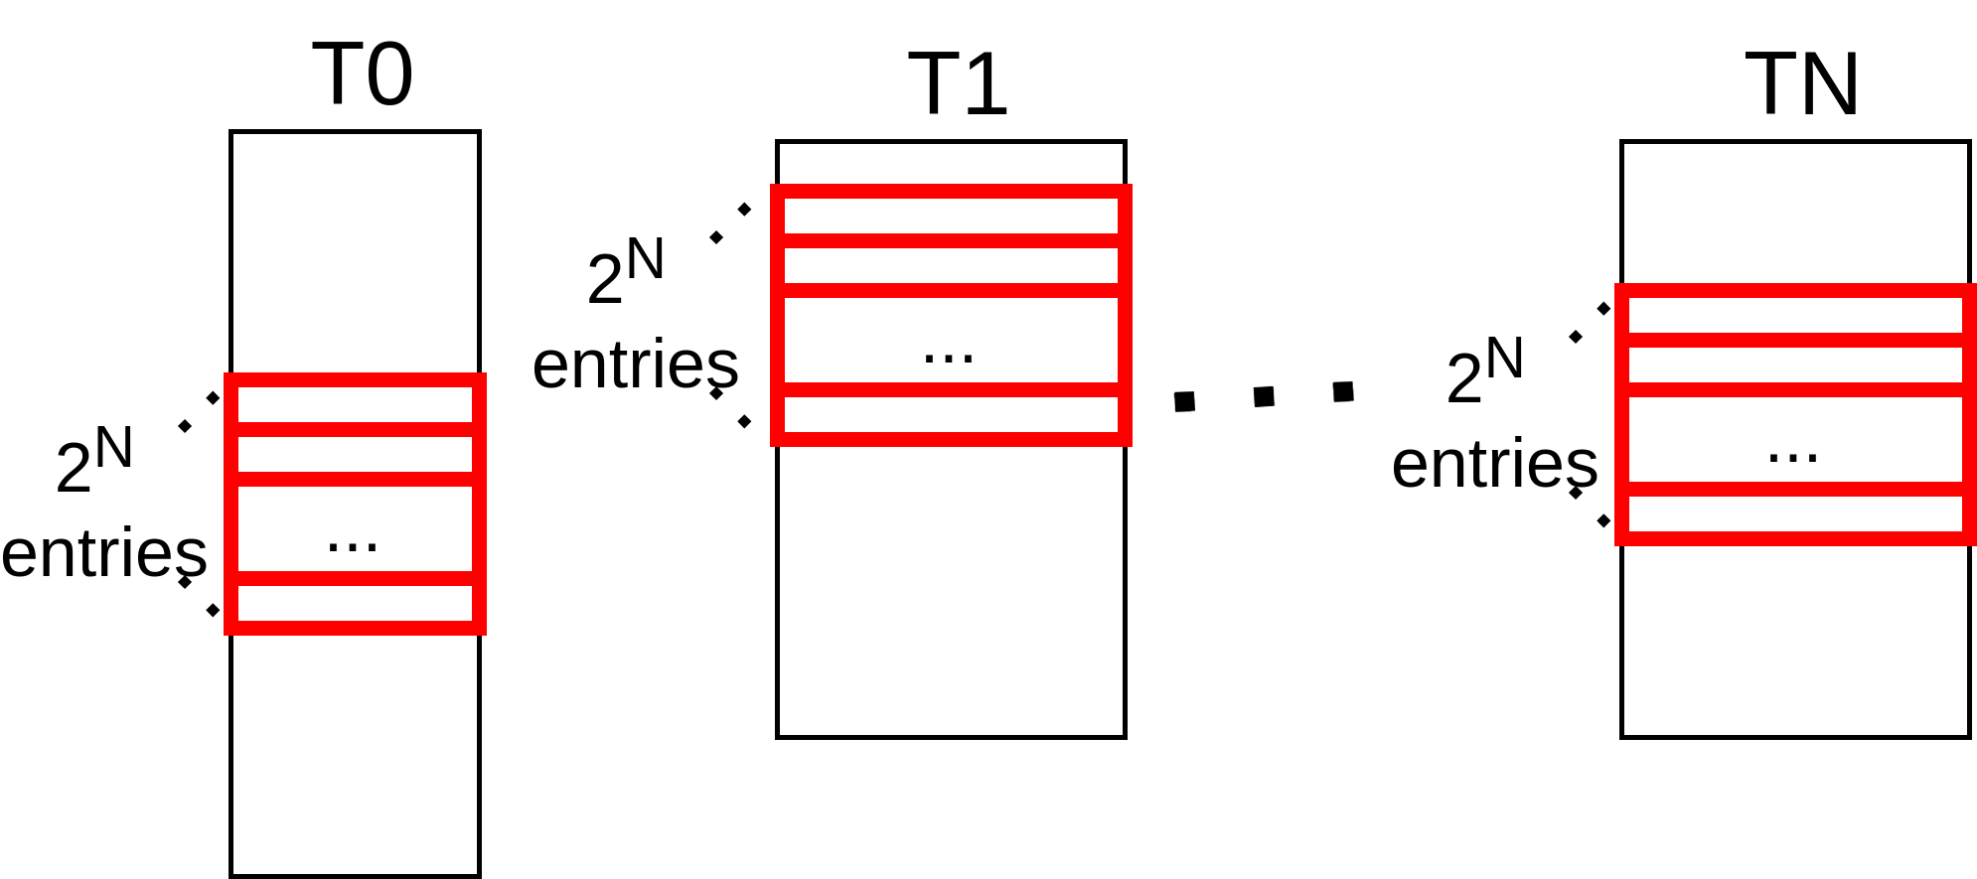
Ahead Prediction
Prior work[Seznec’07] reads out multiple entries per table, each corresponding to one of the possible missing history patterns
When the prediction is needed, all intermediate branches have been predicted. We use the direction of the intermediate branches to generate a final prediction
Cacti shows that per prediction energy for ahead distance of 5 is 14x compared to baseline TAGE.

Slide 21
Drawbacks of Prior Works
Using multiple predictors provides a high prediction accuracy, but still suffers from the latency of the overriding predictor when they do not agree
Ahead Prediction can hide the prediction latency, but suffers from high per-prediction energy

Slide 22
How many missing history patterns are there?
For every instance of a branch, I collect its PC + history, and the sequence of the next 5 branches.
  PC + History: Ahead history that is used to start the prediction
  Sequence of the next 5 branches: Missing history pattern
At the end, I count the number of patterns observed for each control flow.
This experiment is performed with no history, and with 64 bits of history
Notes:
Why 5?

Slide 23
No History
Used:
64-bit
History
Used:

Slide 24
No History
Used:
64-bit
History
Used:

Slide 25
No History
Used:
64-bit
History
Used:

Slide 26
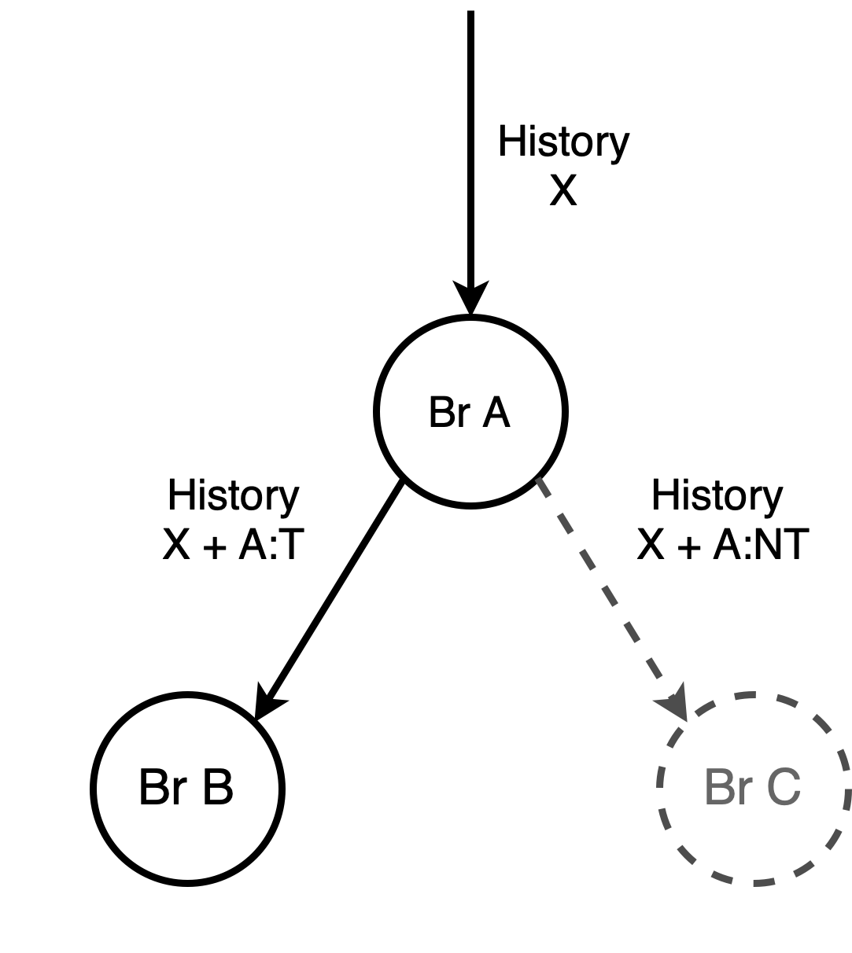
Predictable Branch
Suppose Br A is a predictable branch
Under history X, Br A is always taken
Br A can be not taken under other control flows
Only observe one path after a predictable branch
Insight:
A predictable branch does not introduce a new path
Notes:
Color is bad

Slide 27
Why are # of missing history patterns much fewer than 2^N?
BR A
BR B
A predictable branch does not introduce a new path
After BR A and B, there is still only 1 path
But since BR C is unpredictable, both path after BR C can occur, and must be accounted for during ahead prediction
Since there are more predictable branches than unpredictable branches, we observe only a few patterns overall
BR C
BR D1
BR D2
BR E1
BR E2
Predictable Branch
Unpredictable Branch
Notes:
History register example

Slide 28
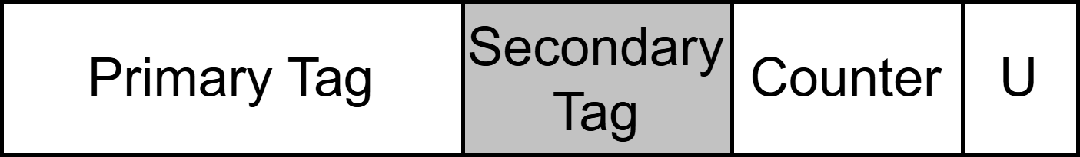
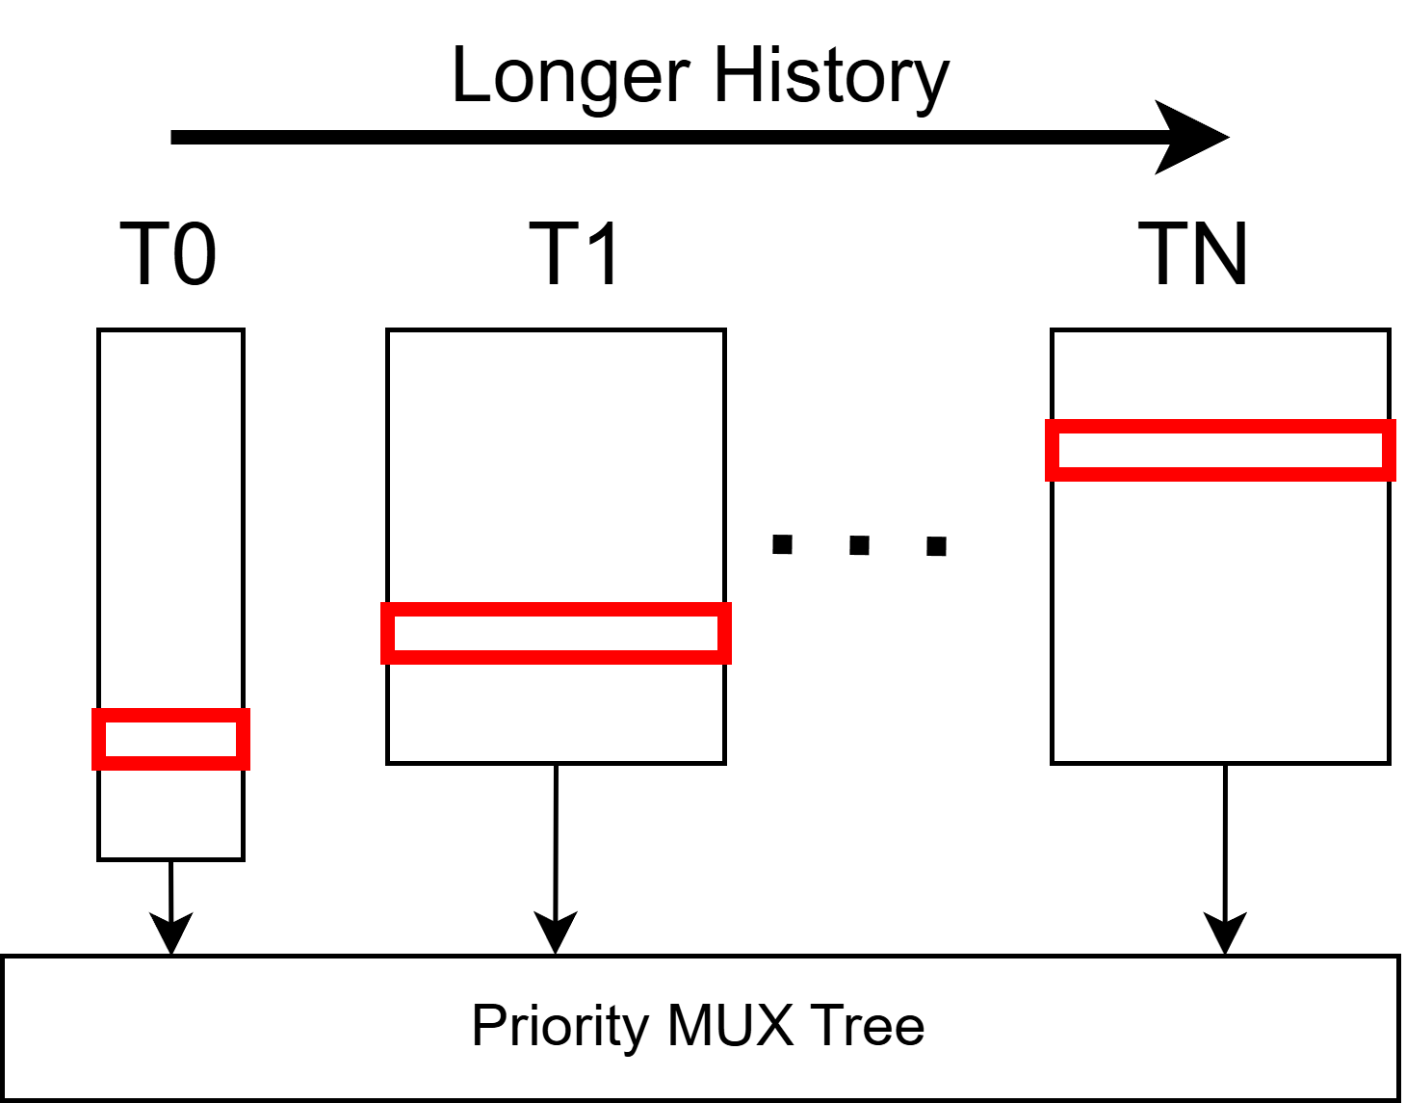
Baseline TAGE Implementation
Tagged Entry:
TAGE assigns a counter per control flow to capture the majority direction of the branch under that control flow
  This is done by tagging each counter with a hash of the control flow leading up to the branch
  A tag match indicates the entry is intended for the current branch
Start predicting each branch with no history, and then progressively use longer history if TAGE can’t find a stable direction at the current history length
  This is done by allocating an entry for the branch at a higher table that uses longer history

Slide 29
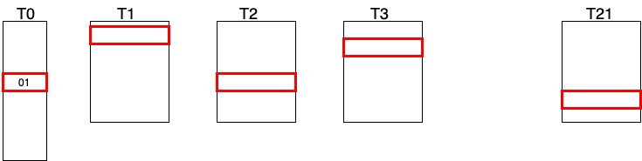
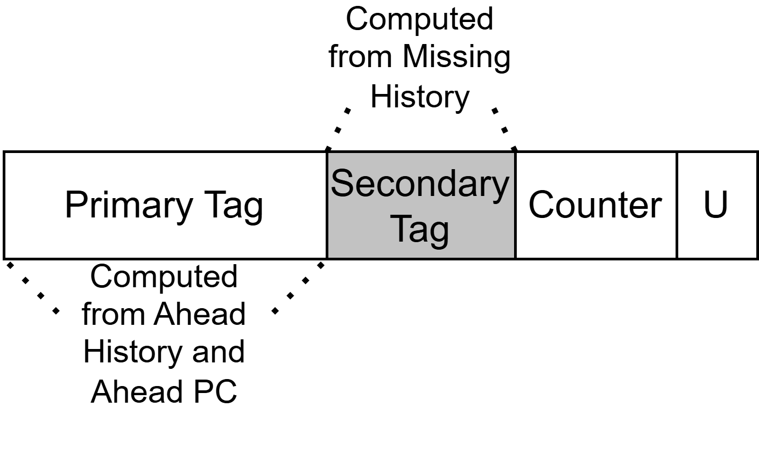
My Ahead Prediction Scheme Overview
I force the entries corresponding to the same ahead history to be in different tables.
This allows me to read out all the entries from the same ahead history without reading multiple entries per table.
I explicitly tag each entry with the missing history pattern that leads to the entry.

Slide 30
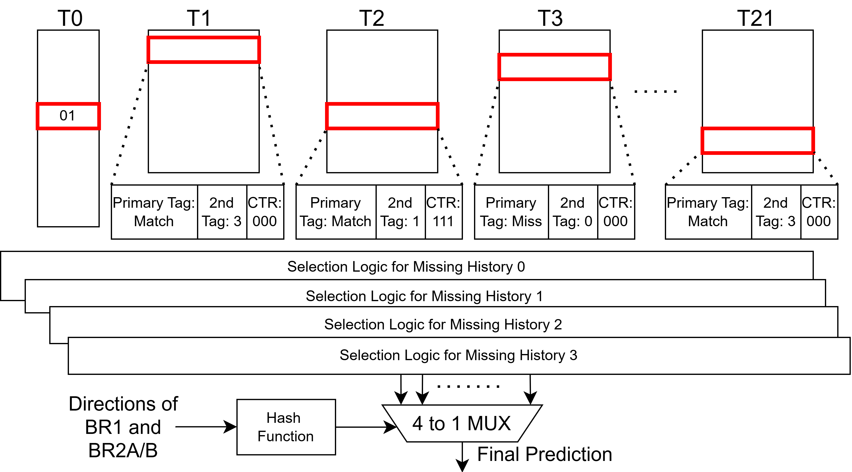
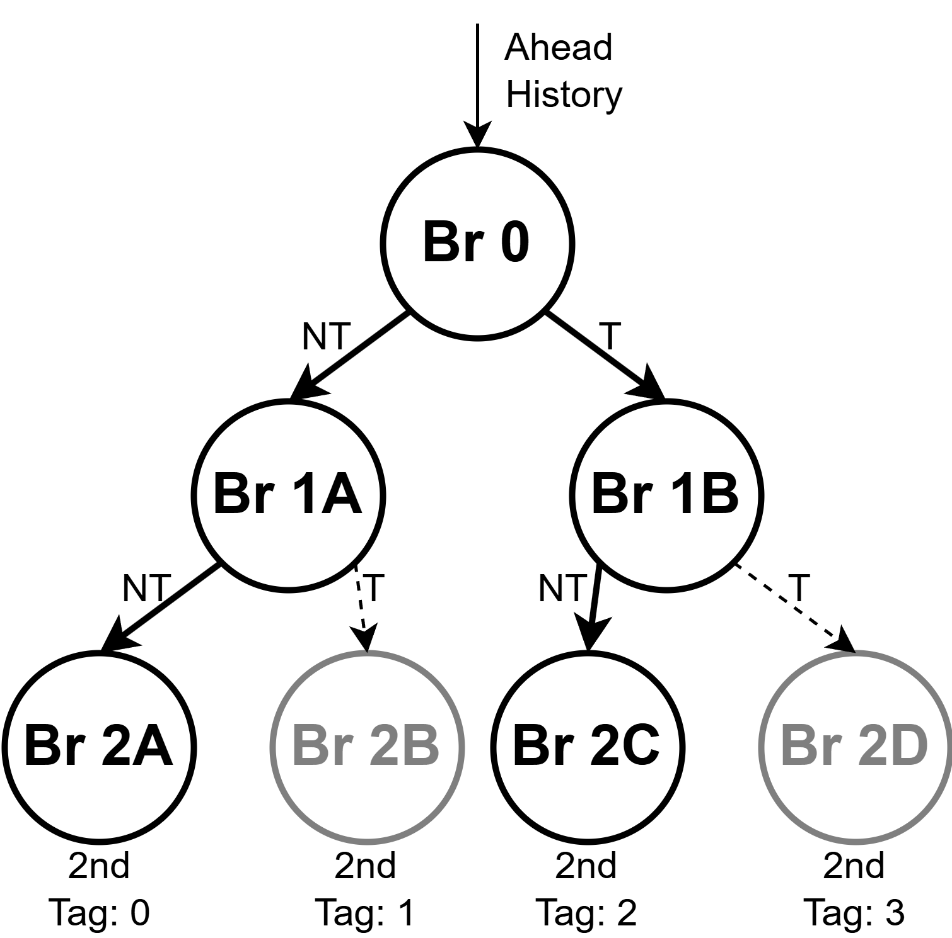
Example of Predicting 2 Ahead
Use history and PC of BR0 (ahead history) to predict BR2
Use a 2-bit secondary tag to represent the possible branches that are 2 ahead
  BR2A:0
  BR2B:1
  BR2C:2
  BR2D:3
Under this particular ahead history, only observed Br2A and Br2C
Notes:
Break up the final selection logic, maybe a new slide

Slide 31
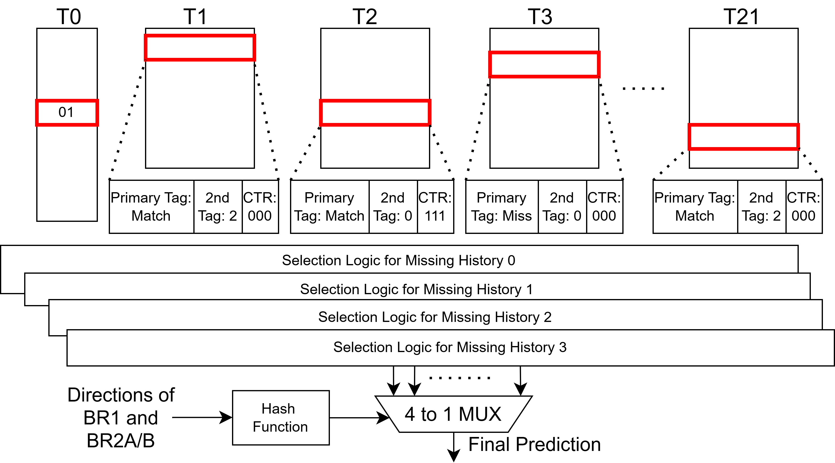
Example of Predicting 2 Ahead
Notes:
Break up the final selection logic, maybe a new slide

Slide 32
Example of Predicting 2 Ahead
Notes:
Break up the final selection logic, maybe a new slide

Slide 33
Example of Predicting 2 Ahead
Notes:
Break up the final selection logic, maybe a new slide

Slide 34
Example of Predicting 2 Ahead
Notes:
Break up the final selection logic, maybe a new slide

Slide 35
Example of Predicting 2 Ahead
Notes:
Break up the final selection logic, maybe a new slide

Slide 36

Example of Predicting 2 Ahead

Slide 37
Backup

Slide 38
Support for multiple history?
A biased(always taken or always not taken) branch only needs 1 entry in the bimodal table to predict branch
A gshare predictor with 4 bit history potentially needs 2^4 entries to predict the branch
Multiple tables, each trained with a different history length

Slide 39
History Folding
In 2-level/gshare, the length of the history register directly affects the size of the pattern history table(PHT)
  The size of the PHT is 2^(history length)
XOR the top half and the bottom half of the history together
Keep doing so until the size of the history results in an acceptable size of the PHT

Slide 40
Why is it important to have a few patterns?
TAGE internally reads out 21 tagged entries per prediction
All the entries under the same ahead history are forced to be in different tables, but they are share the same index for each table
As the number of patterns increase, their corresponding entries are less likely to be allocated in the ideal history length
# of Missing History Pattern | Misprediction Rate Increase
1-3 | 0.065%
4-6 | 0.15%
7 and above | 0.16%
Overall(All branches) | 0.067%

Slide 41
Results(IPC and MPKI)
IPC and MPKI

Slide 42
IPC/Energy over Secondary Tag Size

Slide 43
Prediction
Using the PC and History to generate a index and a tag for each table
If the prediction from the longest tag match is weak and useful bit is not set
  then use the second longest prediction
Otherwise
  The prediction from the longest tag match is used

