Slide 1
Dynamic Memory – A Review
Adapted from Dr. Mary Eberlein, UT Austin

Slide 2
Dynamic Memory
We can allocate memory on the heap during program execution
Often used for strings, arrays, structs, linked lists, trees
<stdlib.h> declares 3 memory allocation functions:
malloc: allocates an uninitialized block of memory
calloc: allocates a block of memory and initializes to zero
  Takes time to zero out memory – don't use unless needed
realloc: resizes allocated block of memory
All three return type void * (a void pointer)
Return null pointer if block of requested size isn't found
NULL represents null pointer

Slide 3
Allocating Memory
prototype: void *malloc(size_t size);
malloc allocates contiguous size bytes and returns pointer to it
size_t: unsigned integer type (defined in <stdlib.h>)
void free(void *ptr); // free memory when done with it
Example: array of n ints
int * a = malloc(n * sizeof(int));// a holds address of first elt
if(a != NULL) { // better: if(a)
for(int i = 0; i < n; i++)
a[i] = i; // Or: *(a+i) = i;
}
Later - free memory: free(a);

Slide 4
Deallocation & Common Mistakes
free(a); // releases allocated block on heap
Free memory which has been dynamically allocated
Calling free() does not change value of pointer variable – reset it to NULL
Common mistakes:
  dangling pointer: a pointer that contains the address of dynamic memory which has been freed
    Can happen when there are multiple pointers to dynamically allocated memory
  memory leak: memory is allocated and not freed up again
    system will eventually run out of memory
    can occur if memory is malloc'ed in a loop
    check return value of malloc/calloc/realloc to ensure it isn't NULL
    use valgrind to detect (more on valgrind in recitation)
  double deallocation: attempting to deallocate memory pointed to by dangling pointer
  uninitialized pointer: an uninitialized pointer contains garbage – trying to access random memory location can cause unpredictable behavior

Slide 5
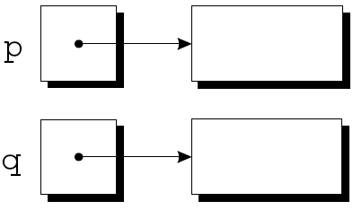
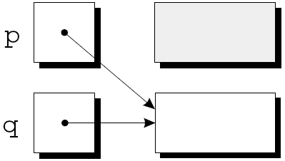
Memory Leak
p = malloc(...);
q = malloc(...);
p = q;
no pointer to 1st block (garbage)
Block cannot be freed
This sort of code leads to memory leaks

Slide 6
Dangling Pointer
char *ptr1 = malloc(10*sizeof(char)); // new string
char *ptr2 = ptr1;
...
free(ptr2);
...
strcpy(ptr1, "hello");
Two dangling pointers – point to same deallocated memory

Slide 7
String Functions
char *myConcat(const char *s1, const char *s2) {
char *result = malloc(strlen(s1) + strlen(s2) + 1);
if(result == NULL) {
printf("Error: malloc failed\n");
exit(EXIT_FAILURE);
}
strcpy(result, s1);
strcat(result, s2);
return result;
}
Function call:
char *p = myConcat("hello ", "world");
process termination: flushes output streams, closes open streams
Type man 3 exit at command prompt for more info
Notes:
version of strcat: takes pointers to two strings, allocates enough memory for both + the null character, allocates memory for concatenated string and copies both strings in

Slide 8
calloc
Prototype: void *calloc(size_t nmemb, size_t size);
Allocates space for nmemb elements, each of size bytes
Initializes memory to 0
Notes:
Performance hit for initialization – don't use unless you really need initialization to 0

Slide 9
Dynamically Allocated Arrays
Particularly useful before C99 standard allowed non-constant array sizes
int numVals = -1;
double *data = NULL;
do {
printf("How many data values do you want to store? ");
scanf("%d", &numVals);
} while (numVals < 1);
data = malloc(numVals * sizeof(double)); // uninitialized
// data = calloc(numValues, sizeof(double)); // cleared to zeros
if(!data) printf("Error – malloc failed\n");

Slide 10
realloc
Resize a dynamically allocated array
Prototype: void *realloc(void *ptr, size_t size);
ptr points to previously allocated memory block
  if ptr is NULL, new block allocated and pointer to block returned
size = new size of block in bytes (can be larger or smaller than original size)
  if size is 0 and ptr points to existing block, block is deallocated and NULL is returned
Returns pointer to new block or NULL on failure
Attempts to use original block of memory, shrinking or expanding it in place
Notes:
int *temp = realloc(ptr, 1000 * sizeof(int));
if(temp) ptr = temp;
Check for success of realloc call before resetting pointer to data

