Slide 1
Linked Lists
Adapted from Dr. Mary Eberlein, UT Austin

Slide 2
Linked List
chain of structs (nodes) in which each node contains a pointer to next node
last node contains null pointer
Need pointer to head of list (1st element)
Advantages over array:
easy to increase size of list
easy to insert or delete element at any location
Disadvantages:
Slow access to i^{th} element of list

Slide 3
Define List Node
Nodes contain data and pointer to next node in list
struct node {
int value;
struct node *next;
};
node must be tag, not typedef alias, to allow declaration of type of next pointer

Slide 4
Create Empty List
Sets list pointer to null, creating empty list
struct node *first = NULL;

Slide 5
Exercise
Add first node to list – value for node is 10
allocate memory for new node
initialize node's fields
update list pointer

Slide 6
Exercise
Write code that adds a new element to the beginning of a list. Assume first is a pointer to the beginning of the list, and add 15 to the list.

Slide 7
Create List Node
List nodes are typically allocated dynamically and added to list
Allocate memory for node
Store data in node
Insert node into list
Allocating memory:
struct node *new_node = malloc(sizeof(struct node));
Store data in node:
new_node → value = 10;
OR: (*new_node).value = 10;
OR: scanf("%d", &new_node → value);

Slide 8
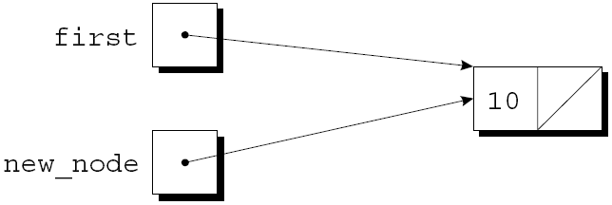
Insert Node at Beginning of List
new_node points to node we are inserting
first always points to first node in list
here list was initially empty
new_node → next = first;
first = new_node;

Slide 9
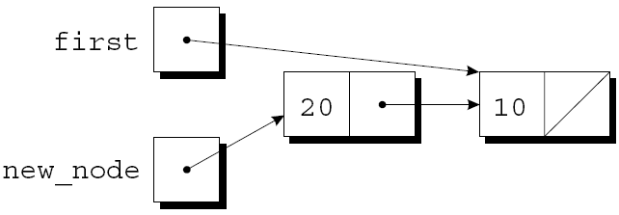
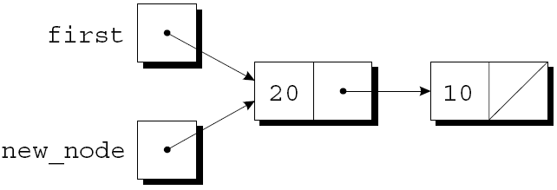
Insert Node at Beginning of List
new_node points to node we are inserting
first points to first node in list
new_node = malloc(sizeof(struct node));
new_node → value = 20;
new_node → next = first;
first = new_node;

Slide 10
Function: Insert Node at Beginning of List
struct node *addToList(struct node *list, int n) {
struct node *newNode = malloc(sizeof(struct node));
if(newNode == NULL) {
printf("Error: malloc failed\n");
exit(EXIT_FAILURE);
}
newNode → value = n;
newNode → next = list;
return newNode;
}
Store return value in first:
first = addToList(first, 10);
first = addToList(first, 20);

Slide 11
Exercise
Write a function that finds integer n in list, and returns a pointer to the node that contains n. The function returns NULL if n is not in the list.
struct node *searchList(struct node *list, int n) {

Slide 12
Search Linked List
Look for node containing value n
struct node *searchList(struct node *list, int n) {
struct node *p;
for(p = list; p != NULL; p = p → next)
if(p → value == n)
return p;
return NULL;
}
Notes:
Could also just use list to iterate, since it's a copy of the original list pointer (we can't change it).
for(; list != NULL; list = list → next) {if(list →value == n) return list; ...

Slide 13
Search Linked List
struct node *searchList(struct node *list, int n) {
for(; list!= NULL && list→value != n; list = list→next) ;
return list;
}
loop body is empty
list is NULL if we reach end of list, so NULL is returned if n not found
more natural to use while loop:
while(list != NULL && list→value != n) list = list→next;
return list;

Slide 14
Deleting Node From Linked List
Easy to delete node from linked list
3 steps:
Locate the node
Maintain pointer to previous node (prev) and pointer to current node (cur)
Initially prev is NULL, cur is first (list pointer)
Update previous node's next pointer to bypass deleted node
Free the deleted node

Slide 15
Deleting Node From List
Assume list is as follows, n is 20
cur = list; prev = NULL;
while(cur != NULL && cur→value !=n)
prev = cur; cur = cur → next;

Slide 16
Deleting Node From List
while(cur != NULL && cur→value !=n)
prev = cur; cur = cur → next;
loop terminates since cur→value != n is false

Slide 17
Deleting Node: Steps 2 & 3 Bypass Deleted Node and Free It
prev → next = cur → next;
free(cur);

Slide 18
Deleting Node From Linked List
struct node *deleteNode(struct node *list, int n) {
struct node *cur, *prev;
for(cur = list, prev = NULL; cur != NULL && cur → value != n;
prev = cur, cur = cur → next) ;
if(cur == NULL) return list; // n not found
if(prev == NULL) list = list → next; // n in first node
else prev → next = cur →next; // n in some other node
free(cur);
return list;
}
Notes:
Return list pointer.
Function returns FIRST node containing n.
Deleting 1st node is a special case that requires updating the list pointer.

Slide 19
Exercise
Write a function that returns the length of a linked list:
int linkedLength(struct node *list) {
// Your code here
}

Slide 20
Ordered List
Nodes are maintained in order – decreasing or increasing
Inserting is more difficult than inserting always at the beginning of the list
Exercise: Rewrite addToList assuming that the list of nodes is in increasing order.

Slide 21
Pointers to Pointers
If we want a function to modify a pointer, we must pass a pointer to that pointer
The function addToList adds a new element to beginning of a list, and updates the list pointer, rather than returning the list pointer
void addToList(struct node **listRef, int n) {
struct node *newNode = malloc(sizeof(struct node));
if(newNode == NULL) {
printf("Error: malloc failed\n");
exit(EXIT_FAILURE);
}
// What goes here??
}

Slide 22
Pointers to Pointers: Add to Beginning of List
void add_to_list(struct node **listRef, int n)
{
struct node *new_node;
new_node = malloc(sizeof(struct node));
if (new_node == NULL) {
printf("Error: malloc failed in add_to_list\n");
exit(EXIT_FAILURE);
}
new_node->value = n;
new_node->next = *listRef;
*listRef = new_node;
}
Call: addToList(&first, 10);

Slide 23
Exercise
Write C code that adds a new node (containing your favorite integer) to the end of a linked list. Assume list points at the first element of the list.
struct node *list = ... ;

Slide 24
Exercise
Write a function that moves the last node in a list to the front of the linked list. headRef is a pointer to the list pointer.
void moveLastToFirst(struct node **headRef) { ...

Slide 25
Exercise
Write a function that reverses a linked list. headRef is a pointer to the list pointer.
void reverse(struct node **headRef) {...

